Slide 1

CS 224: ALGORITHMS FOR DATA SCIENCE LECTURE 11 (10/16)
Tensor decomposition
Sum-of-squares
Robustness
Supervised learning
Computational complexity
Statistical physics
Generative modeling
CLASSIFICATION UNDER MASSART NOISE

Slide 2
ANNOUNCEMENTS
Thanks for filling out mid-semester course feedback!
Takeaways:
Blackboard > iPad
Content a little overwhelming - give more high-level overviews of proof strategies, zoom in on proof details more selectively
Scribing requirement: please write out the proof details in the handwritten notes, including ones that are not explicitly covered in class
List-decodable mean estimation IOUs: I’ve typed up some supplemental notes on the course page that take a deeper dive into the proof details
Psets difficult, but amazing TF support!

Slide 3
PAC learning halfspaces – problem setup
Random classification noise / agnostic learning
Massart noise
Two-player game and analysis
Experiment – robustness + fairness?
Recap of robustness unit

Slide 4

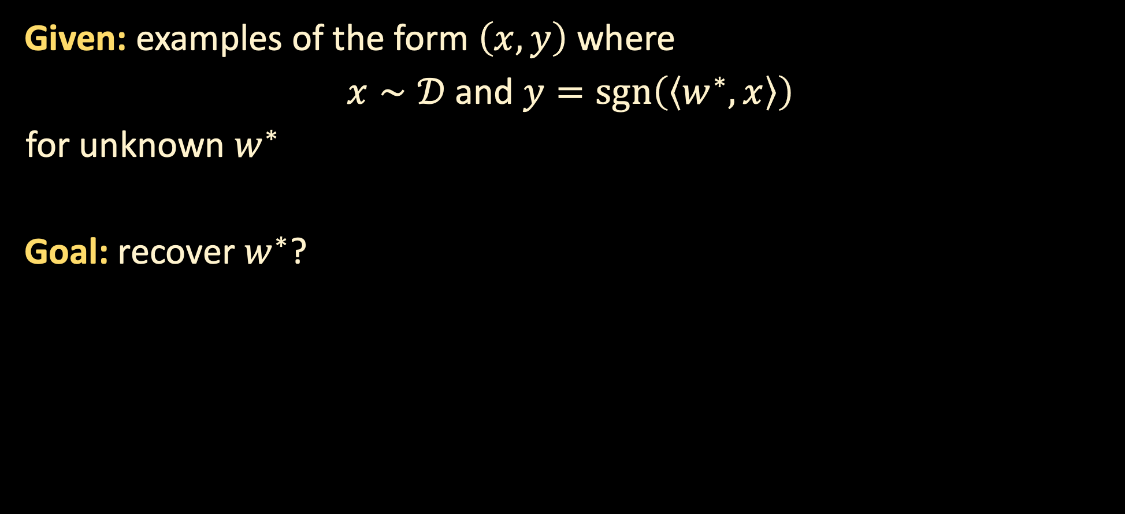
PAC LEARNING HALFSPACES
Given: examples of the form $\left(x,y\right)$ where
$x∼𝒟$ and $y=\operatorname{sgn}\left(\left\langle w^{∗},x\right\rangle \right)$
for unknown $w^{∗}$
Goal: recover $w^{∗}$?
$$w^{∗}$$

Slide 5

PAC LEARNING HALFSPACES
Given: examples of the form $\left(x,y\right)$ where
$x∼𝒟$ and $y=\operatorname{sgn}\left(\left\langle w^{∗},x\right\rangle \right)$
for unknown $w^{∗}$
Goal: recover $w^{∗}$?
$$w^{∗}$$

Slide 6

PAC LEARNING HALFSPACES
Given: examples of the form $\left(x,y\right)$ where
$x∼𝒟$ and $y=\operatorname{sgn}\left(\left\langle w^{∗},x\right\rangle \right)$
for unknown $w^{∗}$
Goal: recover $w^{∗}$?
$$w^{∗}$$

Slide 7
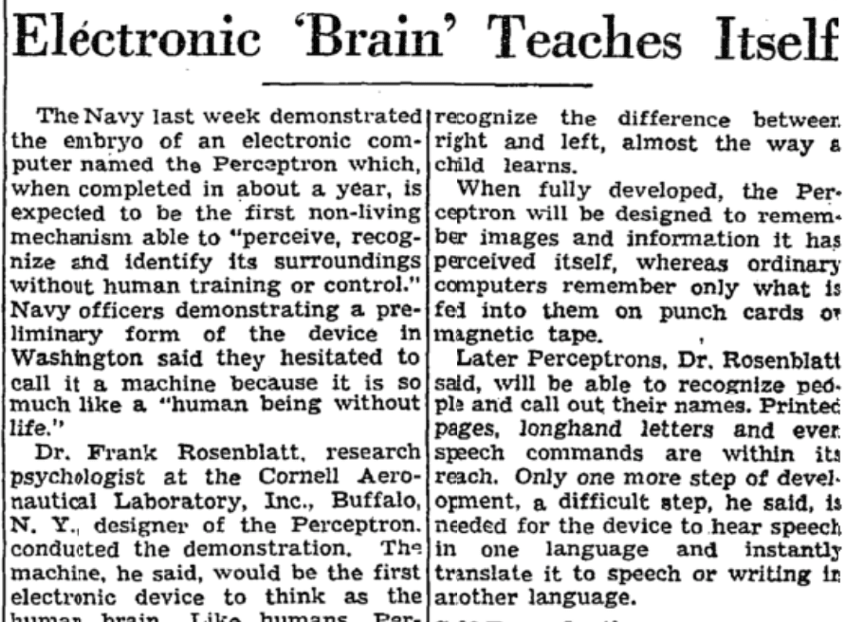

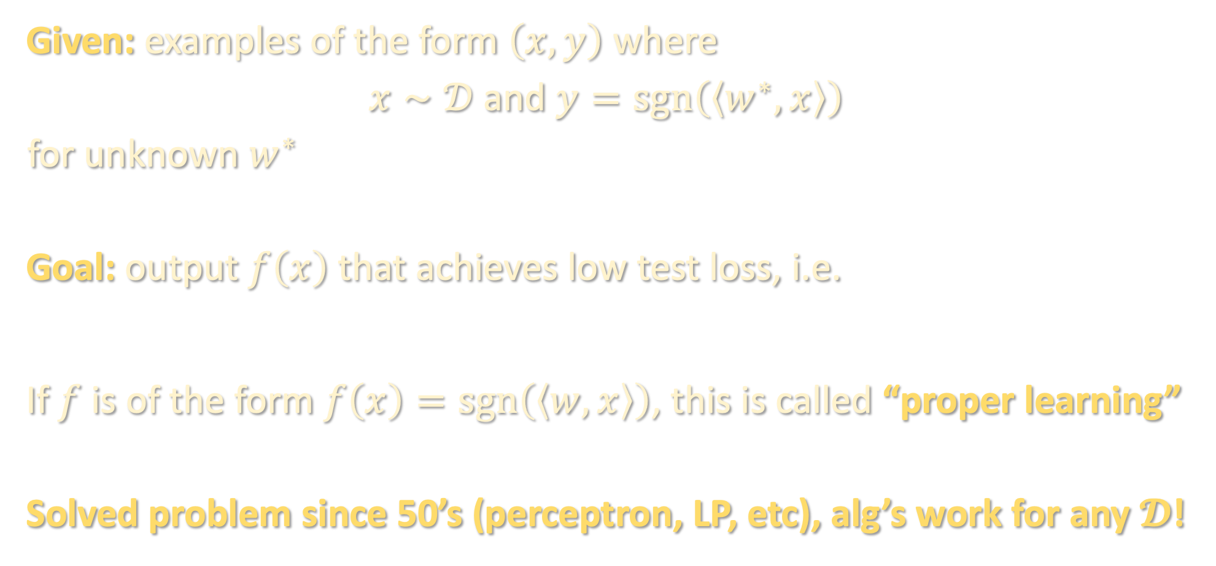
PAC LEARNING HALFSPACES
Given: examples of the form $\left(x,y\right)$ where
$x∼𝒟$ and $y=\operatorname{sgn}\left(\left\langle w^{∗},x\right\rangle \right)$
for unknown $w^{∗}$
Goal: output $f\left(x\right)$ that achieves low test loss, i.e.
If $f$ is of the form $f\left(x\right)=\operatorname{sgn}\left(\left\langle w,x\right\rangle \right)$, this is called “proper learning”
Solved problem since 50’s (perceptron, LP, etc), alg’s work for any $𝓓$!
$$\operatorname{Pr}\left[f\left(x\right)≠\operatorname{sgn}\left(\left\langle w^{∗},x\right\rangle \right)\right]≤ε$$

Slide 8
PAC learning halfspaces – problem setup
Random classification noise / agnostic learning
Massart noise
Two-player game and analysis
Experiment – robustness + fairness?
Recap of robustness unit

Slide 9

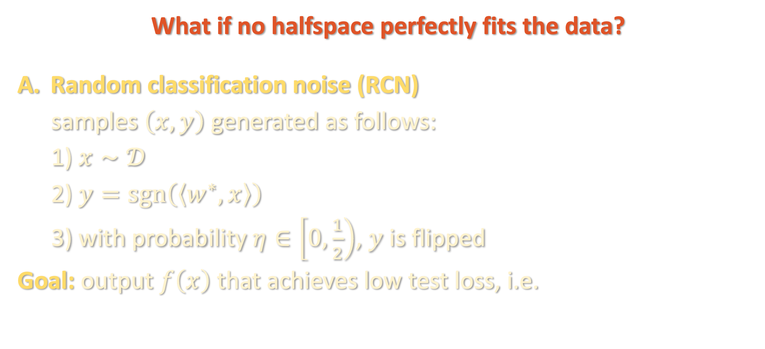
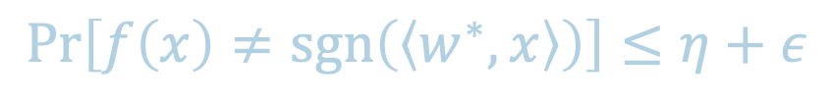
PAC LEARNING (NOISY) HALFSPACES
What if no halfspace perfectly fits the data?
Random classification noise (RCN)
samples $\left(x,y\right)$ generated as follows:
1) $x∼𝒟$
2) $y=\operatorname{sgn}\left(\left\langle w^{∗},x\right\rangle \right)$
3) with probability $η∈\left[0,\frac{1}{2}\right)$, $y$ is flipped
Goal: output $f\left(x\right)$ that achieves low test loss, i.e.
$$w^{∗}$$
$$\operatorname{Pr}\left[f\left(x\right)≠\operatorname{sgn}\left(\left\langle w^{∗},x\right\rangle \right)\right]≤η+ε$$

Slide 10

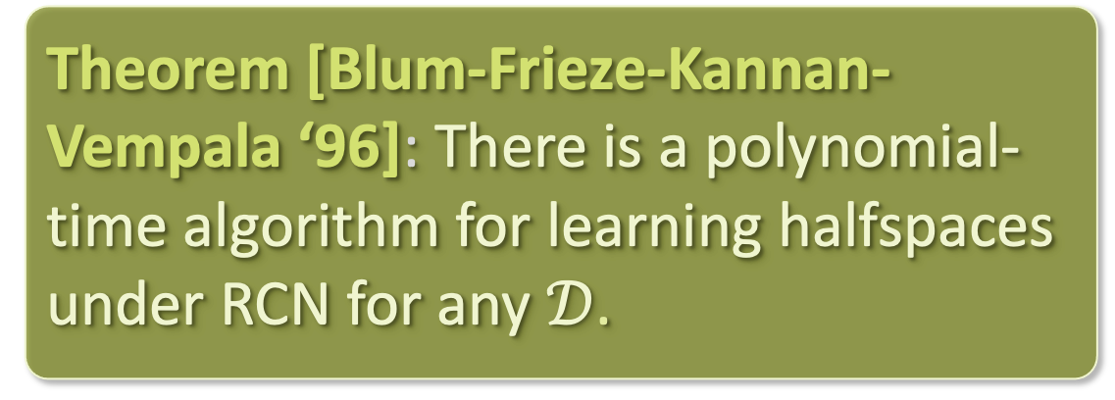

PAC LEARNING (NOISY) HALFSPACES
The margin is the largest $τ$ for which $\left|\left\langle w^{∗}, x\right\rangle \right|≥τ$ almost surely over $x∼𝒟$
What if no halfspace perfectly fits the data?
Random classification noise (RCN)
In large-margin case, SGD on a convex loss already works!
Theorem [Blum-Frieze-Kannan-Vempala ‘96]: There is a polynomial-time algorithm for learning halfspaces under RCN for any $𝒟$.
$$w^{∗}$$
$$τ$$

Slide 11

MINIMIZING CONVEX LOSSES
Our goal is to find a halfspace with low 0-1 loss:
$$err\left(w\right)≝\operatorname{Pr}\left[\operatorname{sgn}\left(\left\langle w,x\right\rangle \right)≠y\right]$$

Slide 12

MINIMIZING CONVEX LOSSES
Our goal is to find a halfspace with low 0-1 loss:
$$err\left(w\right)≝𝔼\left[𝕀\left[−y⋅\left\langle w,x\right\rangle >0\right]\right]$$
Issue: loss function is nonconvex

Slide 13

MINIMIZING CONVEX LOSSES
Standard fix: replace 0-1 loss with a convex surrogate
$$err\left(w\right)≝𝔼\left[𝕀\left[−y⋅\left\langle w,x\right\rangle >0\right]\right]$$
Issue: loss function is nonconvex

Slide 14
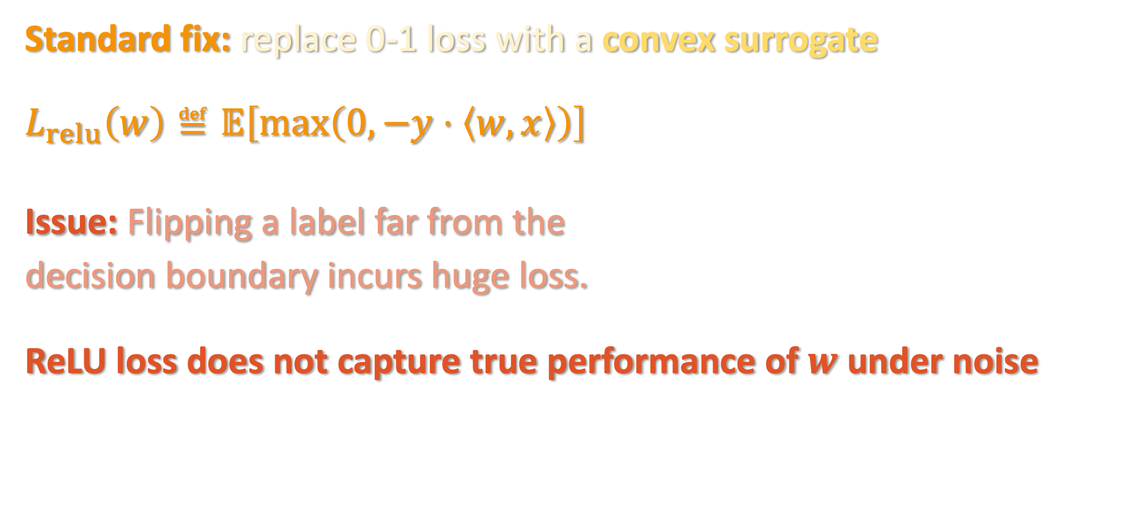
MINIMIZING CONVEX LOSSES
Standard fix: replace 0-1 loss with a convex surrogate
$$L_{relu}\left(w\right)≝𝔼\left[\max\left(0,−y⋅\left\langle w,x\right\rangle \right)\right]$$
Issue: Flipping a label far from the
decision boundary incurs huge loss.
ReLU loss does not capture true performance of $w$ under noise

Slide 15
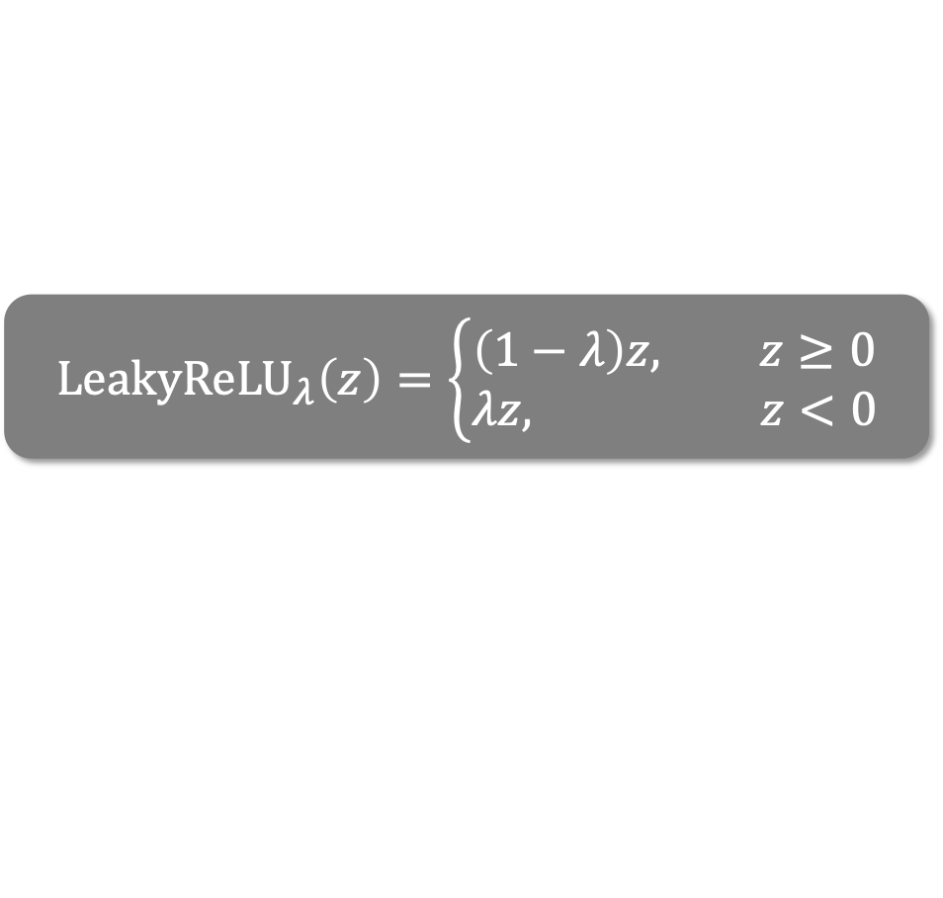

MINIMIZING CONVEX LOSSES
Standard fix: replace 0-1 loss with a convex surrogate
$$ℓ_{LR}\left(w\right)≝𝔼\left[{LeakyReLU}_{λ}\left(−y⋅\left\langle w,x\right\rangle \right)\right]$$
Theorem [implicit in Bylander ‘94]: Gradient descent with respect to LeakyReLU loss learns large-margin halfspaces under RCN.
$${LeakyReLU}_{λ}\left(z\right)=\left\{\begin{aligned}\left(1−λ\right)z, z≥0 \\ λz, z<0\end{aligned}\right.$$

Slide 16
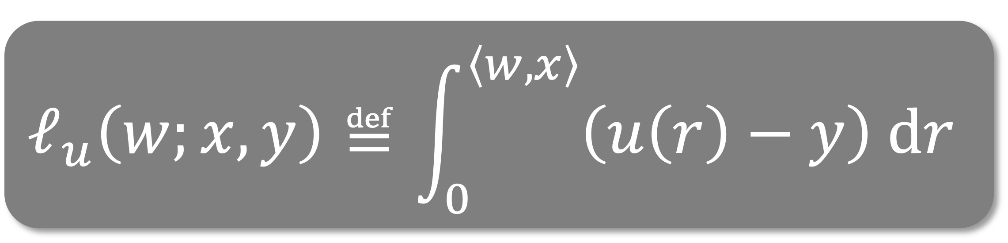
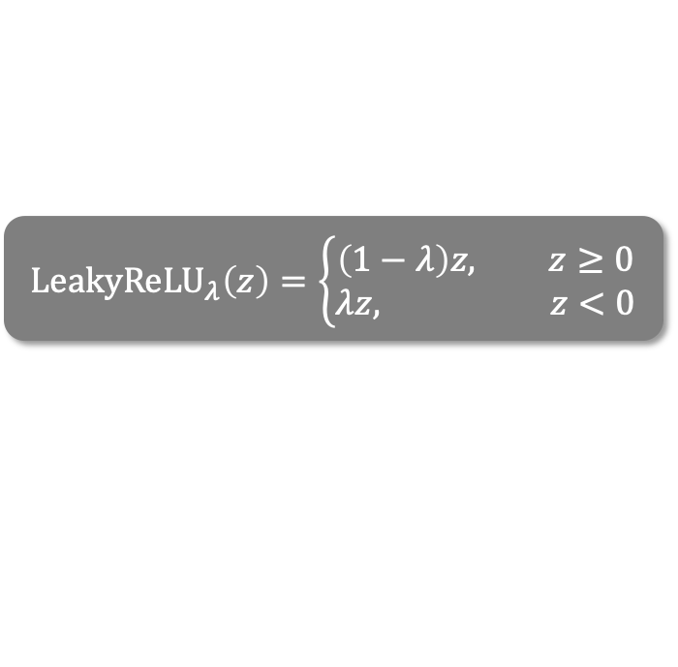
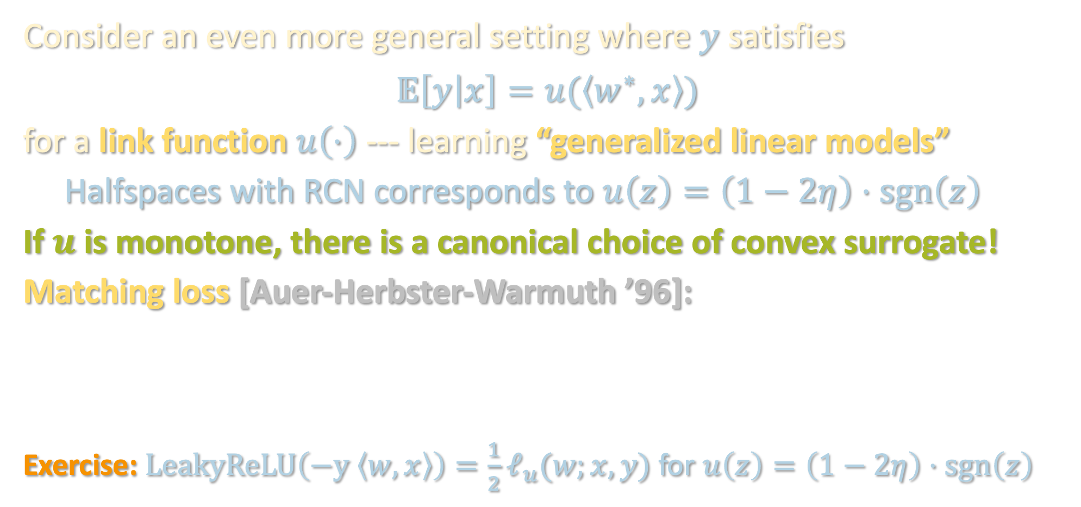
LEAKYRELU SUFFICES FOR RCN
$${LeakyReLU}_{λ}\left(z\right)=\left\{\begin{aligned}\left(1−λ\right)z, z≥0 \\ λz, z<0\end{aligned}\right.$$
Consider an even more general setting where $y$ satisfies
$$𝔼\left[y | x\right]=u(\left\langle w^{∗},x\right\rangle )$$
for a link function $u\left(⋅\right)$ --- learning “generalized linear models”
Halfspaces with RCN corresponds to $u\left(z\right)=\left(1−2η\right)⋅sgn\left(z\right)$
If $u$ is monotone, there is a canonical choice of convex surrogate!
Matching loss [Auer-Herbster-Warmuth ’96]:
Exercise: $LeakyReLU\left(−y \left\langle w,x\right\rangle \right)=\frac{1}{2}ℓ_{u}(w;x,y)$ for $u\left(z\right)=\left(1−2η\right)⋅sgn\left(z\right)$

Slide 17

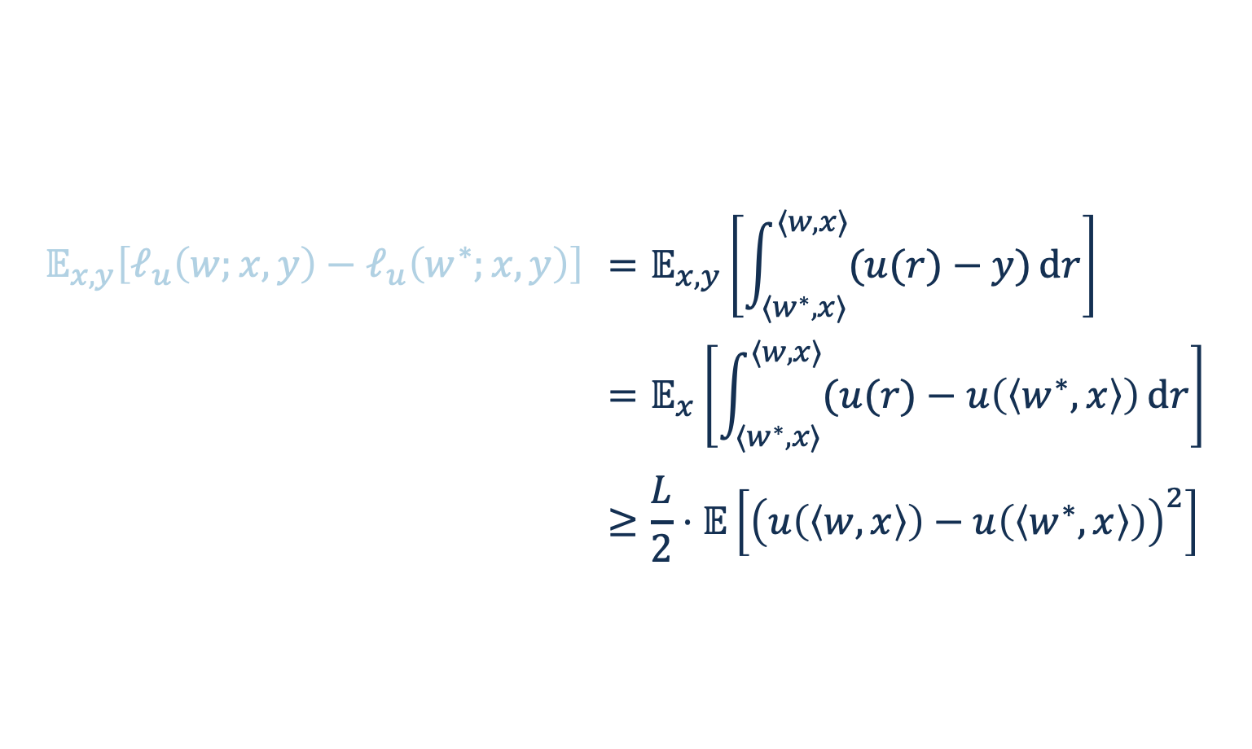
LEAKYRELU SUFFICES FOR RCN
Claim 1: The matching loss is convex
Claim 2: If $\left|u\left(a\right)−u\left(b\right)\right|≤L |a−b|$ for all $a,b$, then
$$𝔼_{x,y}\left[ℓ_{u}\left(w;x,y\right)−ℓ_{u}\left(w^{∗};x,y\right)\right]≥\frac{1}{2L}⋅𝔼\left[{\left(u\left(\left\langle w,x\right\rangle \right)−u\left(\left\langle w^{∗},x\right\rangle \right)\right)}^{2}\right]$$
i.e. if $w$ achieves large test loss, it achieves large matching loss
Proof:
$$𝔼_{x,y}\left[ℓ_{u}\left(w;x,y\right)−ℓ_{u}\left(w^{∗};x,y\right)\right]$$ | $$=𝔼_{x,y}\left[\int_{⟨w^{∗},x⟩}^{⟨w,x⟩}{(u(r)−y)}dr\right]$$
 | $$=𝔼_{x}\left[\int_{⟨w^{∗},x⟩}^{⟨w,x⟩}{(u(r)−u\left(\left\langle w^{∗},x\right\rangle \right)}dr\right]$$
 | $$≥\frac{L}{2}⋅𝔼\left[{\left(u\left(\left\langle w,x\right\rangle \right)−u\left(\left\langle w^{∗},x\right\rangle \right)\right)}^{2}\right]$$

Slide 18

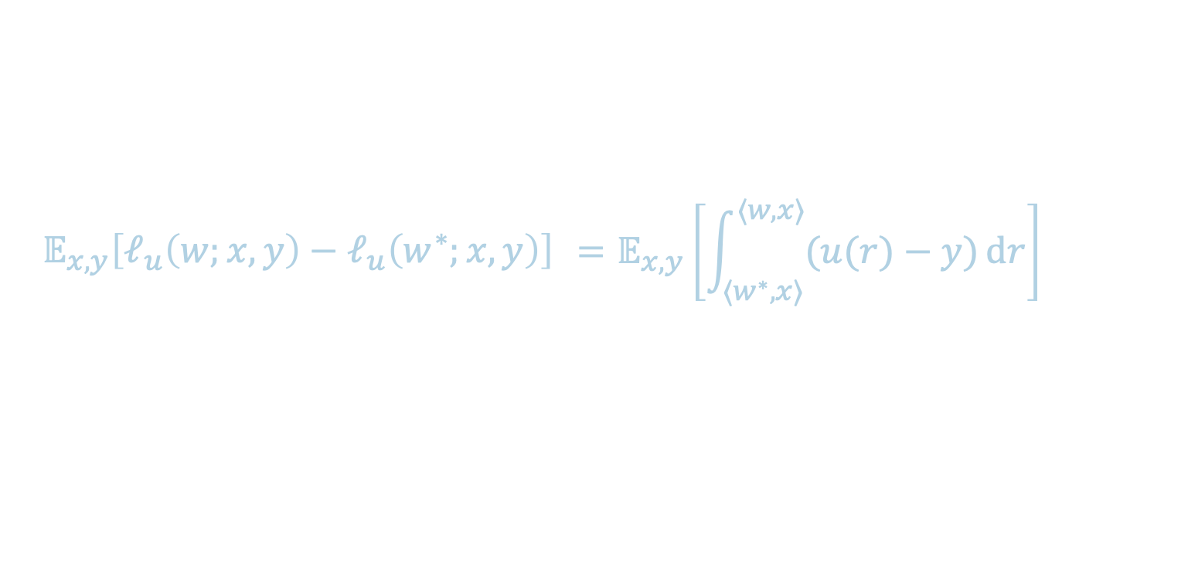
LEAKYRELU SUFFICES FOR RCN
Claim 1: The matching loss is convex
Claim 2: If $\left|u\left(a\right)−u\left(b\right)\right|≤L |a−b|$ for all $a$, then
$$𝔼_{x,y}\left[ℓ_{u}\left(w;x,y\right)−ℓ_{u}\left(w^{∗};x,y\right)\right]≥\frac{1}{2L}⋅𝔼\left[{\left(u\left(\left\langle w,x\right\rangle \right)−u\left(\left\langle w^{∗},x\right\rangle \right)\right)}^{2}\right]$$
i.e. if $w$ achieves large test loss, it achieves large matching loss
Proof:
$$𝔼_{x,y}\left[ℓ_{u}\left(w;x,y\right)−ℓ_{u}\left(w^{∗};x,y\right)\right]$$ | $$=𝔼_{x,y}\left[\int_{⟨w^{∗},x⟩}^{⟨w,x⟩}{(u(r)−y)}dr\right]$$

Slide 19



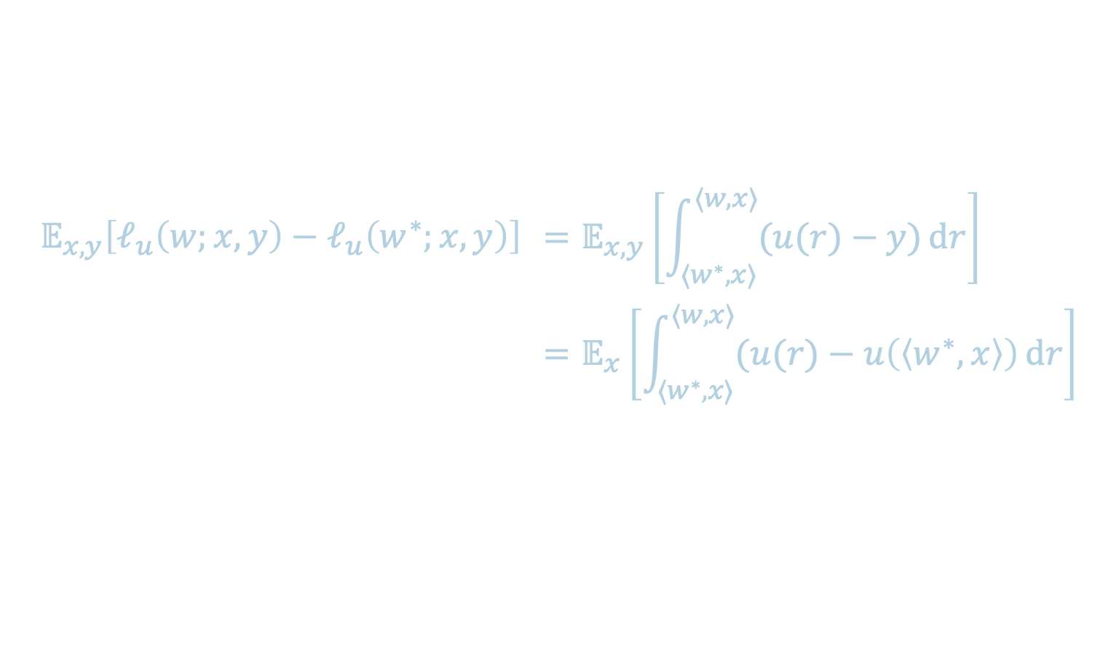
LEAKYRELU SUFFICES FOR RCN
Claim 1: The matching loss is convex
Claim 2: If $\left|u\left(a\right)−u\left(b\right)\right|≤L |a−b|$ for all $a$, then
$$𝔼_{x,y}\left[ℓ_{u}\left(w;x,y\right)−ℓ_{u}\left(w^{∗};x,y\right)\right]≥\frac{1}{2L}⋅𝔼\left[{\left(u\left(\left\langle w,x\right\rangle \right)−u\left(\left\langle w^{∗},x\right\rangle \right)\right)}^{2}\right]$$
i.e. if $w$ achieves large test loss, it achieves large matching loss
Proof:
$$𝔼_{x,y}\left[ℓ_{u}\left(w;x,y\right)−ℓ_{u}\left(w^{∗};x,y\right)\right]$$ | $$=𝔼_{x,y}\left[\int_{⟨w^{∗},x⟩}^{⟨w,x⟩}{(u(r)−y)}dr\right]$$
 | $$=𝔼_{x}\left[\int_{⟨w^{∗},x⟩}^{⟨w,x⟩}{(u(r)−u\left(\left\langle w^{∗},x\right\rangle \right)}dr\right]$$
$$u(\left\langle r\right)−u\left(\left\langle w^{∗},x\right\rangle \right)$$
$$⟨w^{∗},x⟩$$
$$⟨w,x⟩$$

Slide 20



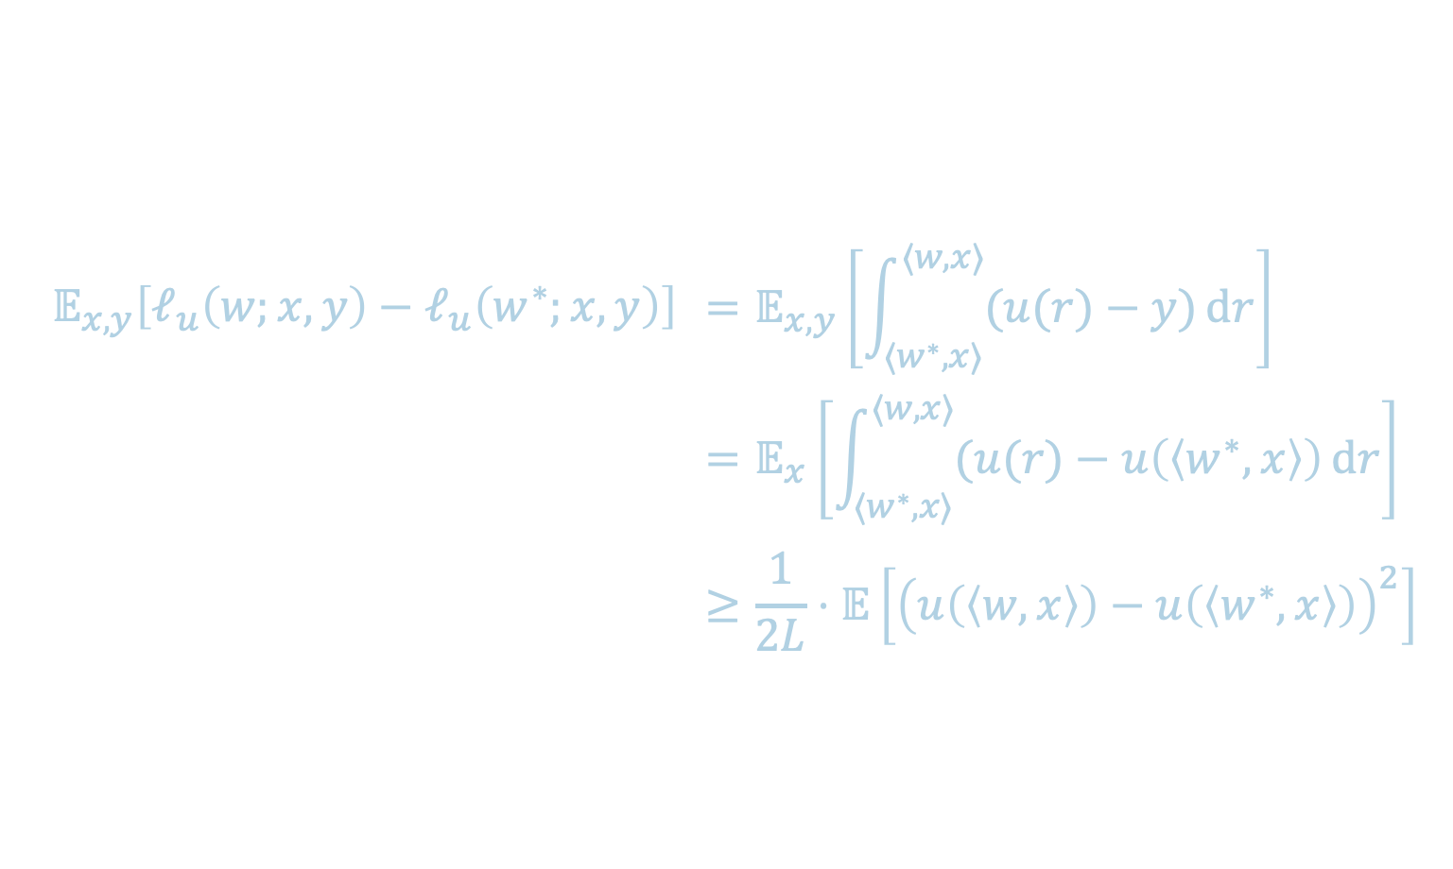
LEAKYRELU SUFFICES FOR RCN
Claim 1: The matching loss is convex
Claim 2: If $\left|u\left(a\right)−u\left(b\right)\right|≤L |a−b|$ for all $a$, then
$$𝔼_{x,y}\left[ℓ_{u}\left(w;x,y\right)−ℓ_{u}\left(w^{∗};x,y\right)\right]≥\frac{1}{2L}⋅𝔼\left[{\left(u\left(\left\langle w,x\right\rangle \right)−u\left(\left\langle w^{∗},x\right\rangle \right)\right)}^{2}\right]$$
i.e. if $w$ achieves large test loss, it achieves large matching loss
Proof:
$$𝔼_{x,y}\left[ℓ_{u}\left(w;x,y\right)−ℓ_{u}\left(w^{∗};x,y\right)\right]$$ | $$=𝔼_{x,y}\left[\int_{⟨w^{∗},x⟩}^{⟨w,x⟩}{(u(r)−y)}dr\right]$$
 | $$=𝔼_{x}\left[\int_{⟨w^{∗},x⟩}^{⟨w,x⟩}{(u(r)−u\left(\left\langle w^{∗},x\right\rangle \right)}dr\right]$$
 | $$≥\frac{1}{2L}⋅𝔼\left[{\left(u\left(\left\langle w,x\right\rangle \right)−u\left(\left\langle w^{∗},x\right\rangle \right)\right)}^{2}\right]$$
$$u(\left\langle r\right)−u\left(\left\langle w^{∗},x\right\rangle \right)$$
(by change of variable)
$$u\left(\left\langle w^{∗},x\right\rangle \right)$$
$$u\left(\left\langle w,x\right\rangle \right)$$

Slide 21
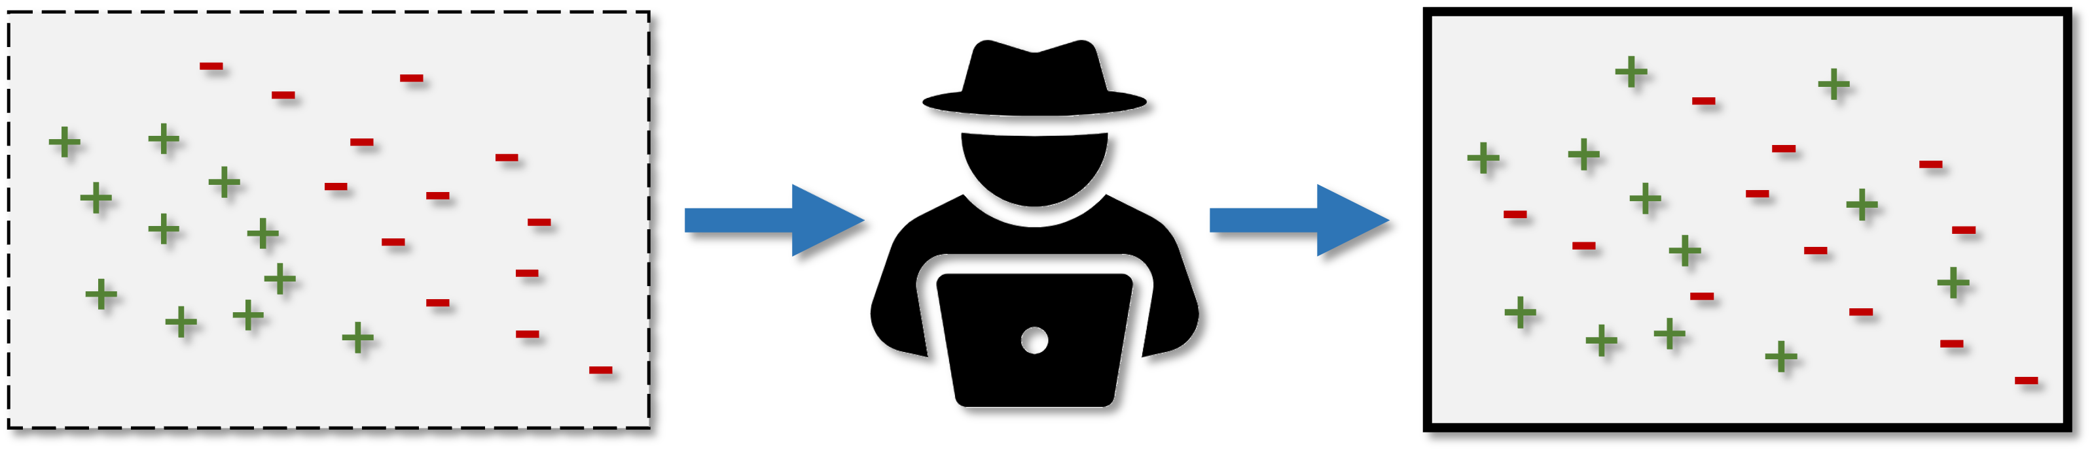

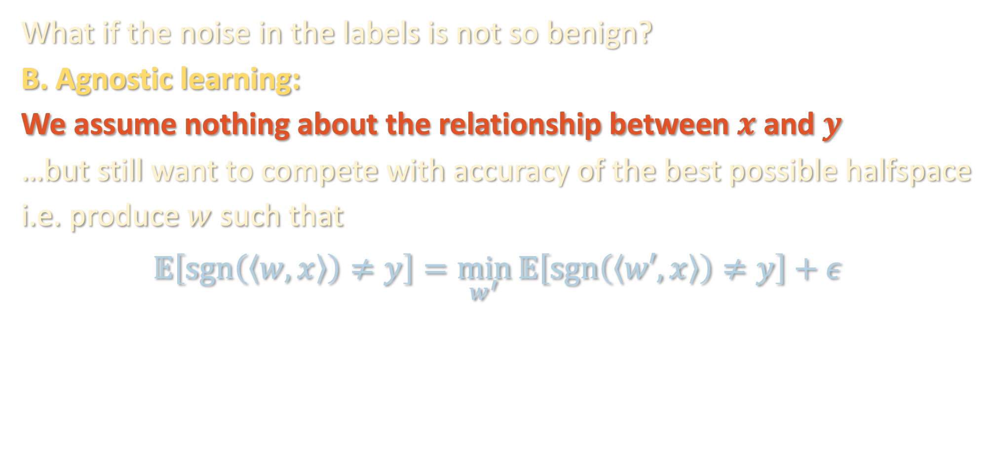
IS THIS A REALISTIC NOISE MODEL?
What if the noise in the labels is not so benign?
B. Agnostic learning:
We assume nothing about the relationship between $x$ and $y$
…but still want to compete with accuracy of the best possible halfspace
i.e. produce $w$ such that
$$𝔼\left[\operatorname{sgn}\left(\left\langle w,x\right\rangle \right)≠y\right]=\min_{w^{′}}{𝔼\left[\operatorname{sgn}\left(\left\langle w′,x\right\rangle \right)≠y\right]}+ε$$
OPT

Slide 22
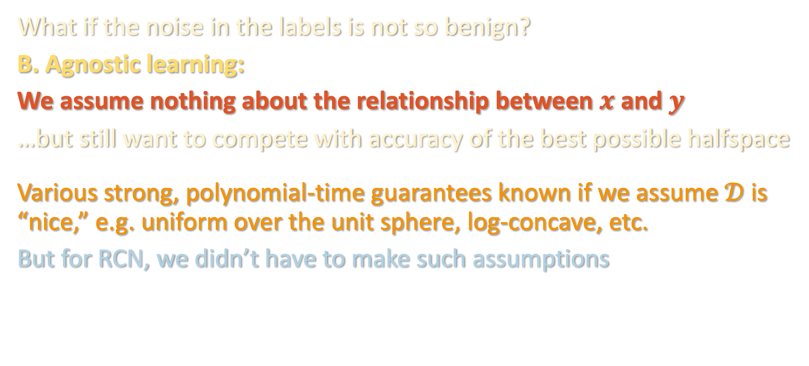
IS THIS A REALISTIC NOISE MODEL?
What if the noise in the labels is not so benign?
B. Agnostic learning:
We assume nothing about the relationship between $x$ and $y$
…but still want to compete with accuracy of the best possible halfspace
Various strong, polynomial-time guarantees known if we assume $𝒟$ is “nice,” e.g. uniform over the unit sphere, log-concave, etc.
But for RCN, we didn’t have to make such assumptions

Slide 23
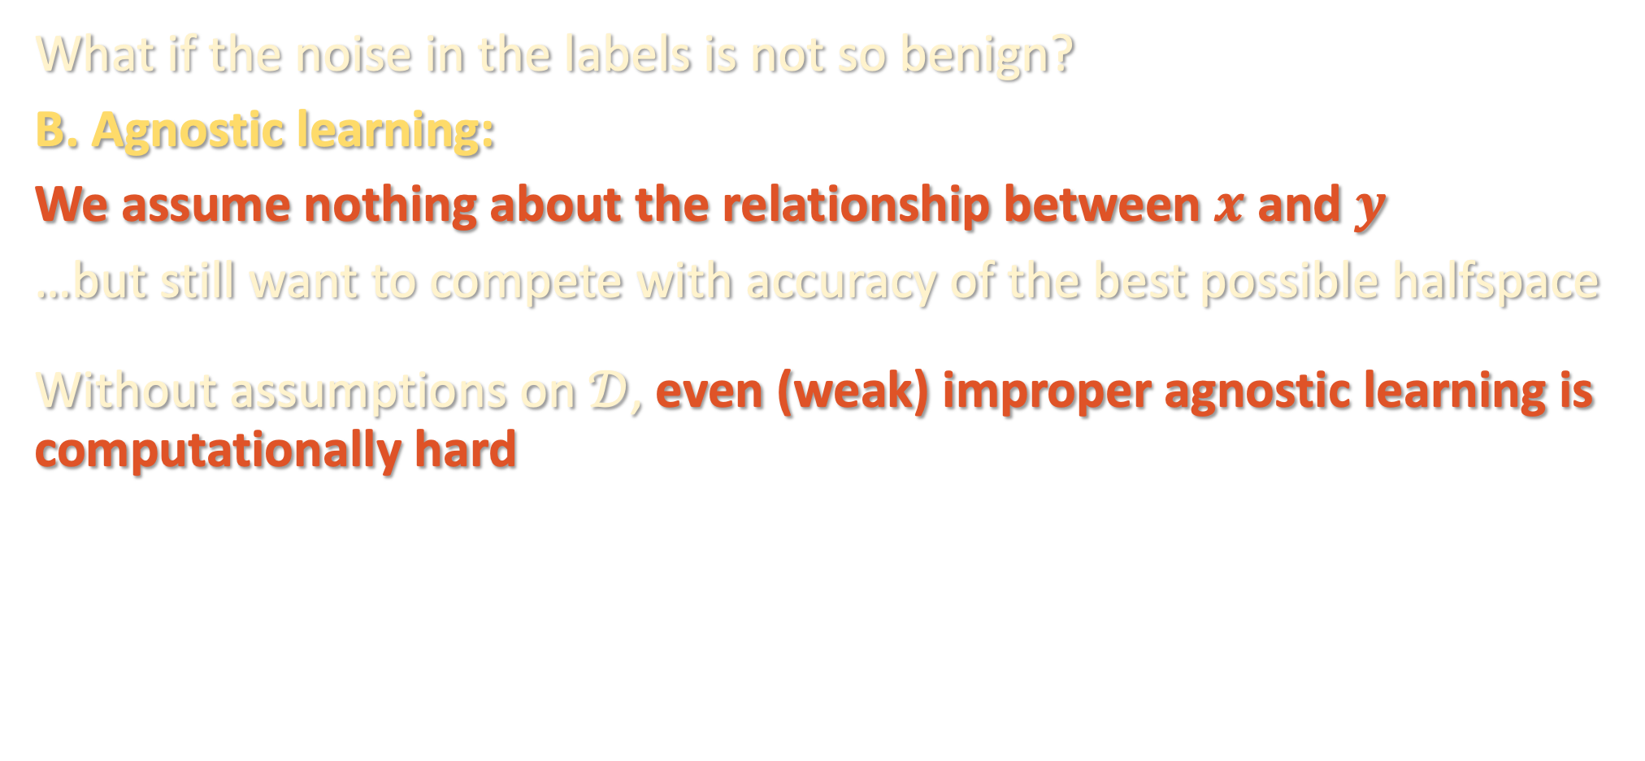
IS THIS A REALISTIC NOISE MODEL?
* Feige’s random 3SAT hypothesis or hardness of lattice problems
What if the noise in the labels is not so benign?
B. Agnostic learning:
We assume nothing about the relationship between $x$ and $y$
…but still want to compete with accuracy of the best possible halfspace
Without assumptions on $𝒟$, even (weak) improper agnostic learning is computationally hard
Theorem [Daniely ‘15], [Tiegel ‘22]: Under standard complexity assumptions*, there are instances where, even if a halfspace with 1% test loss exists, hard to find any classifier achieving even 49% (!)

Slide 24
LANDSCAPE OF NOISE MODELS
Computational
Hardness
Noiseless
RCN
Massart
Agnostic
Clean but less realistic
General but intractable
Are there rich intermediate noise models under which we can design efficient algorithms that work for general input distributions?

Slide 25
PAC learning halfspaces – problem setup
Random classification noise / agnostic learning
Massart noise
Two-player game and analysis
Experiment – robustness + fairness?
Recap of robustness unit

Slide 26
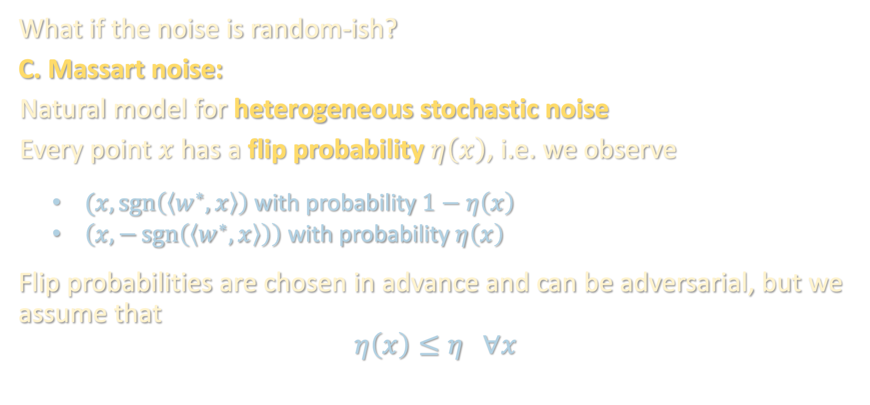
SEMIRANDOM NOISE
What if the noise is random-ish?
C. Massart noise:
Natural model for heterogeneous stochastic noise
Every point $x$ has a flip probability $η\left(x\right)$, i.e. we observe
$(x,\operatorname{sgn}\left(\left\langle w^{∗},x\right\rangle \right)$ with probability $1−η\left(x\right)$
$\left(x,−\operatorname{sgn}\left(\left\langle w^{∗},x\right\rangle \right)\right)$ with probability $η\left(x\right)$
Flip probabilities are chosen in advance and can be adversarial, but we assume that
$$η\left(x\right)≤η ∀x$$

Slide 27
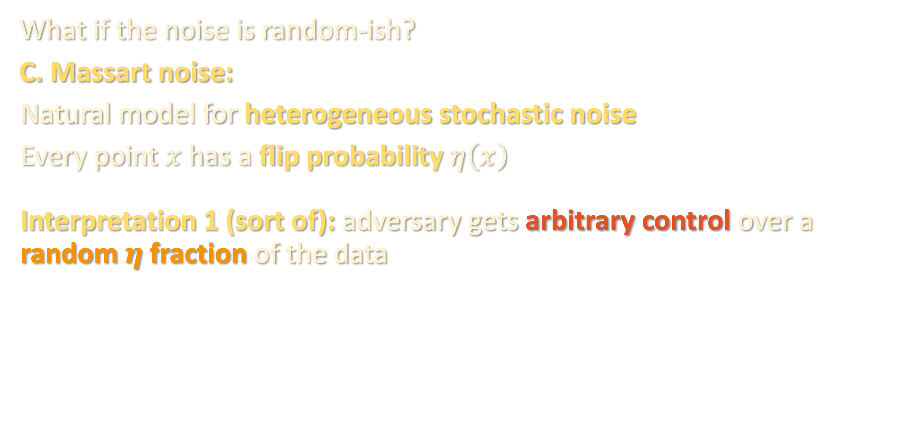
SEMIRANDOM NOISE
What if the noise is random-ish?
C. Massart noise:
Natural model for heterogeneous stochastic noise
Every point $x$ has a flip probability $η\left(x\right)$
Interpretation 1 (sort of): adversary gets arbitrary control over a random $η$ fraction of the data

Slide 28
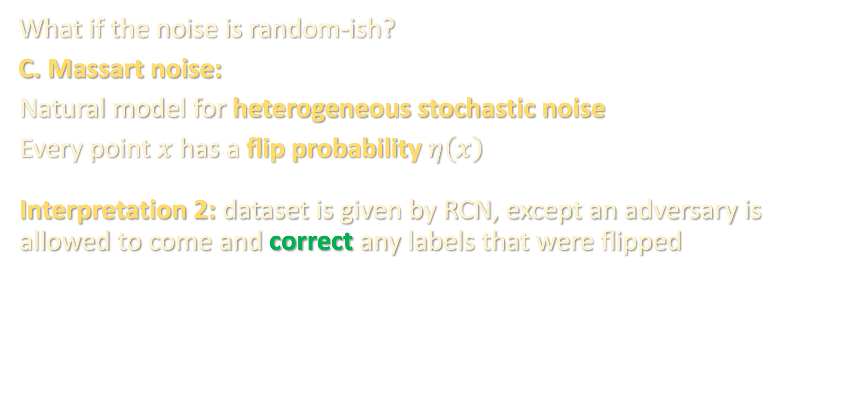
SEMIRANDOM NOISE
What if the noise is random-ish?
C. Massart noise:
Natural model for heterogeneous stochastic noise
Every point $x$ has a flip probability $η\left(x\right)$
Interpretation 2: dataset is given by RCN, except an adversary is allowed to come and correct any labels that were flipped
RCN

Slide 29

SEMIRANDOM NOISE
What if the noise is random-ish?
C. Massart noise:
Natural model for heterogeneous stochastic noise
Every point $x$ has a flip probability $η\left(x\right)$
Interpretation 2: dataset is given by RCN, except an adversary is allowed to come and correct any labels that were flipped
RCN

Slide 30
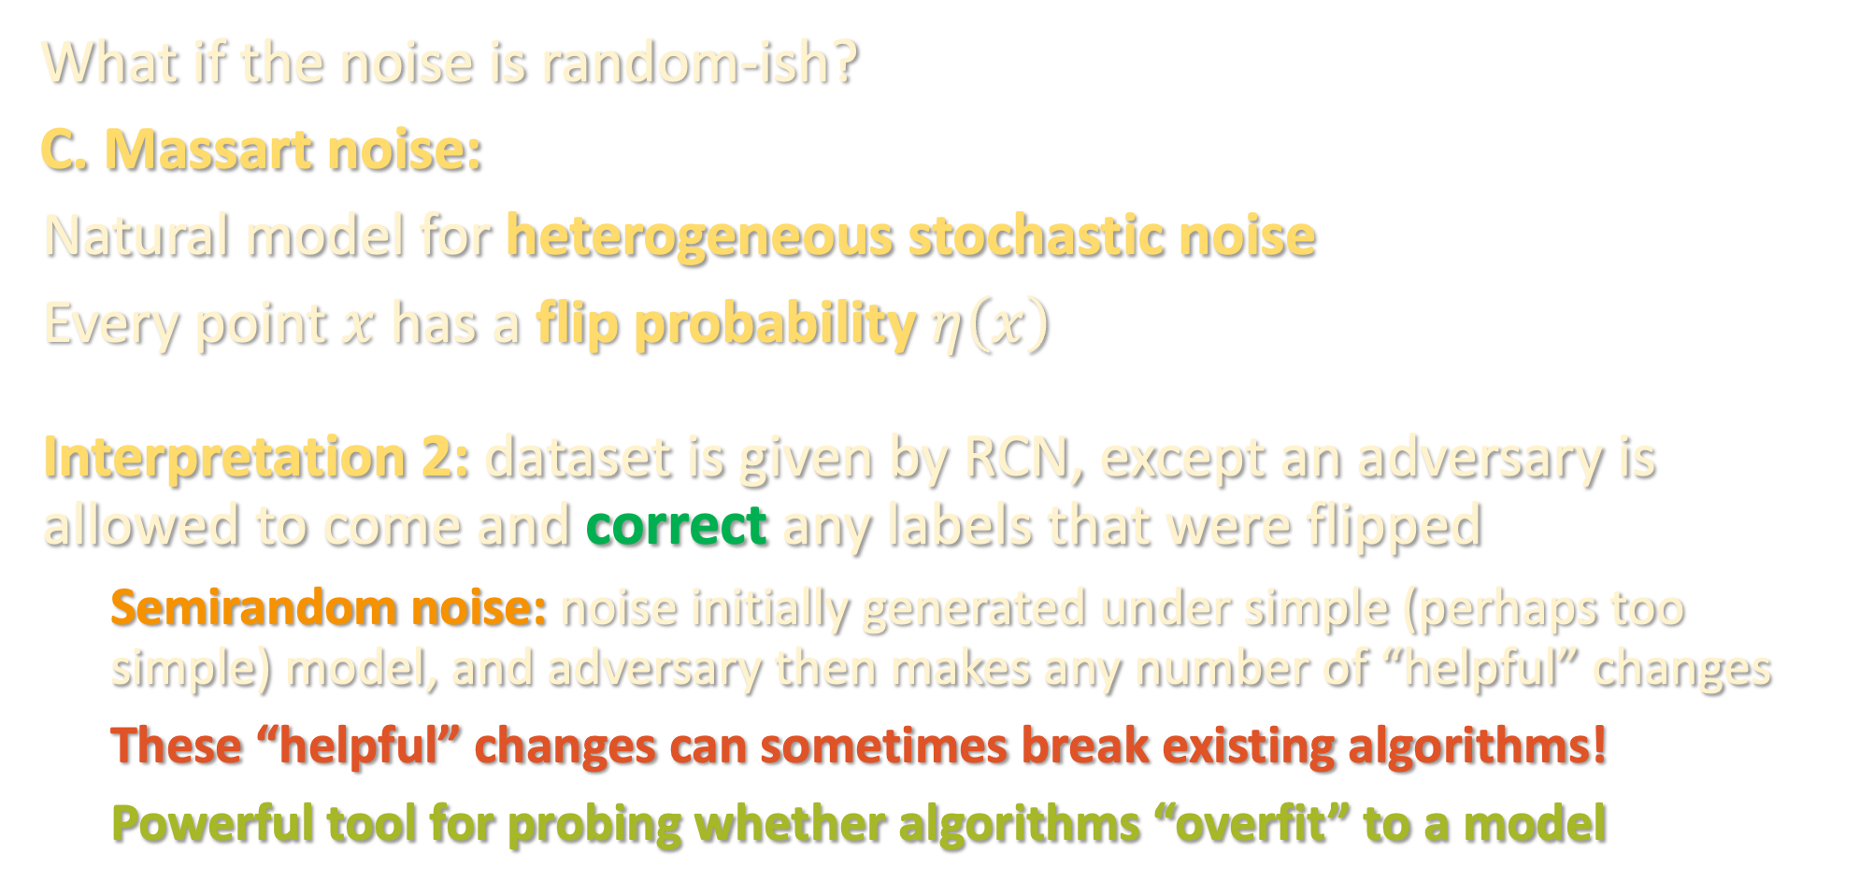
SEMIRANDOM NOISE
What if the noise is random-ish?
C. Massart noise:
Natural model for heterogeneous stochastic noise
Every point $x$ has a flip probability $η\left(x\right)$
Interpretation 2: dataset is given by RCN, except an adversary is allowed to come and correct any labels that were flipped
Semirandom noise: noise initially generated under simple (perhaps too simple) model, and adversary then makes any number of “helpful” changes
These “helpful” changes can sometimes break existing algorithms!
Powerful tool for probing whether algorithms “overfit” to a model

Slide 31
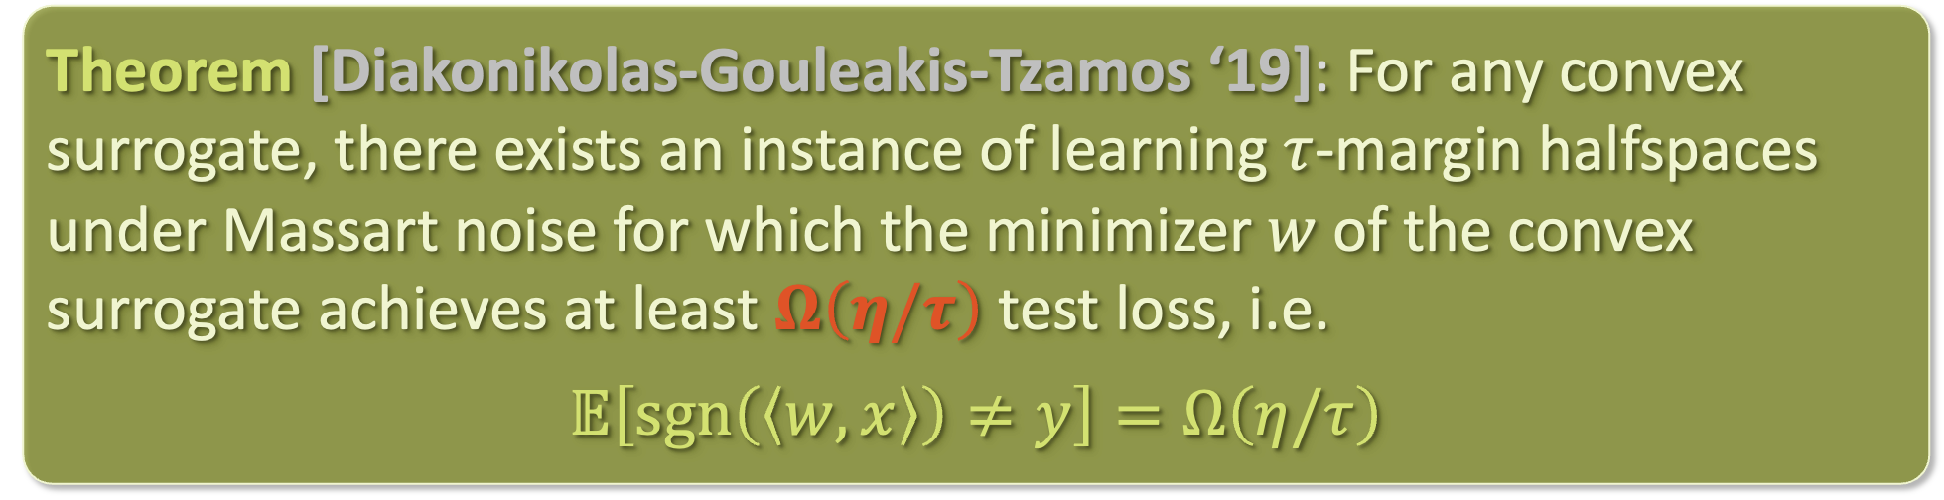
CONVEX SURROGATES FAIL FOR MASSART NOISE
Theorem [Diakonikolas-Gouleakis-Tzamos ‘19]: For any convex surrogate, there exists an instance of learning $τ$-margin halfspaces under Massart noise for which the minimizer $w$ of the convex surrogate achieves at least $Ω\left(η/τ\right)$ test loss, i.e.
$$𝔼\left[\operatorname{sgn}\left(\left\langle w,x\right\rangle \right)≠y\right]=Ω\left(η/τ\right)$$
[Sloan ‘88], [Cohen ‘97]: Are there polynomial-time algorithms for learning halfspaces under Massart noise?

Slide 32
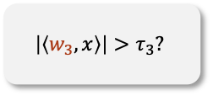
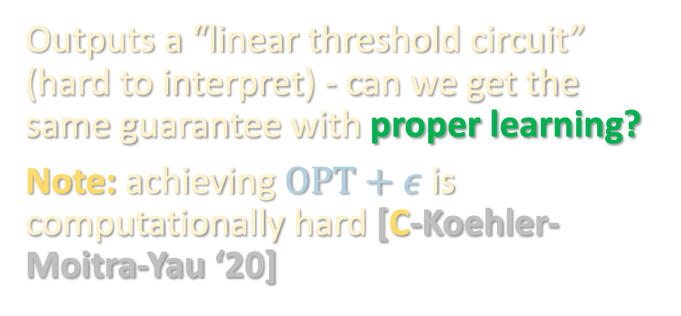
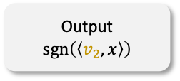
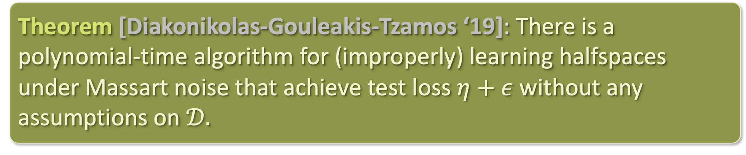

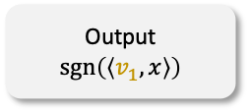
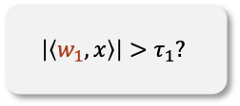

AN IMPROPER LEARNING ALGORITHM
Theorem [Diakonikolas-Gouleakis-Tzamos ‘19]: There is a polynomial-time algorithm for (improperly) learning halfspaces under Massart noise that achieve test loss $η+ε$ without any assumptions on $𝒟.$
Outputs a “linear threshold circuit” (hard to interpret) - can we get the same guarantee with proper learning?
Note: achieving $OPT+ε$ is computationally hard [C-Koehler-Moitra-Yau ‘20]
$$\left|\left\langle w_{1},x\right\rangle \right|>τ_{1}?$$
Output $\operatorname{sgn}\left(\left\langle v_{1},x\right\rangle \right)$
$$\left|\left\langle w_{2},x\right\rangle \right|>τ_{2}?$$
Output $\operatorname{sgn}\left(\left\langle v_{2},x\right\rangle \right)$
$$\left|\left\langle w_{3},x\right\rangle \right|>τ_{3}?$$
…
Output $\operatorname{sgn}\left(\left\langle v_{3},x\right\rangle \right)$

Slide 33
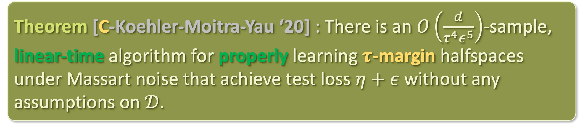
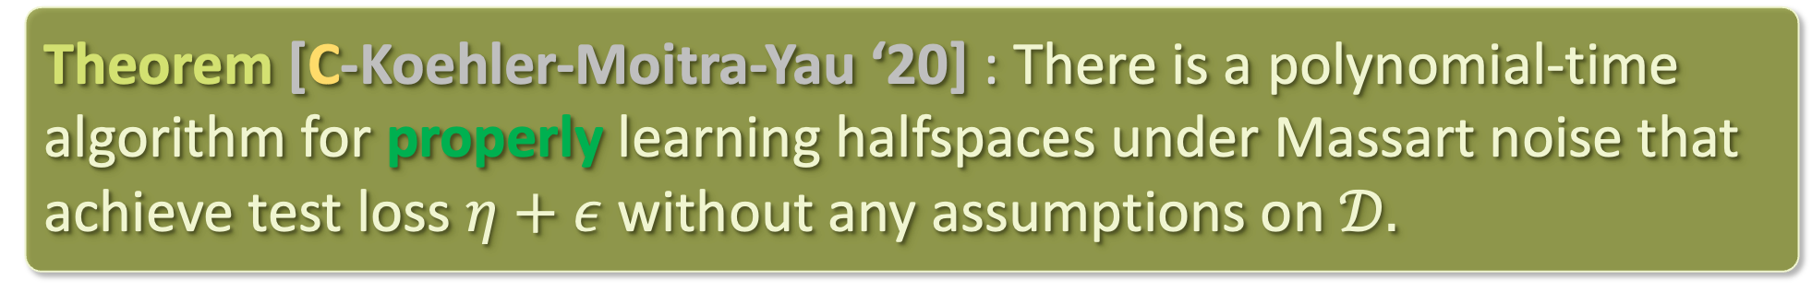
A PROPER LEARNING ALGORITHM
Theorem [C-Koehler-Moitra-Yau ‘20] : There is a polynomial-time algorithm for properly learning halfspaces under Massart noise that achieve test loss $η+ε$ without any assumptions on $𝒟.$
Theorem [C-Koehler-Moitra-Yau ‘20] : There is an $O\left(\frac{d}{τ^{4}ε^{5}}\right)$-sample, linear-time algorithm for properly learning $τ$-margin halfspaces under Massart noise that achieve test loss $η+ε$ without any assumptions on $𝒟.$

Slide 34
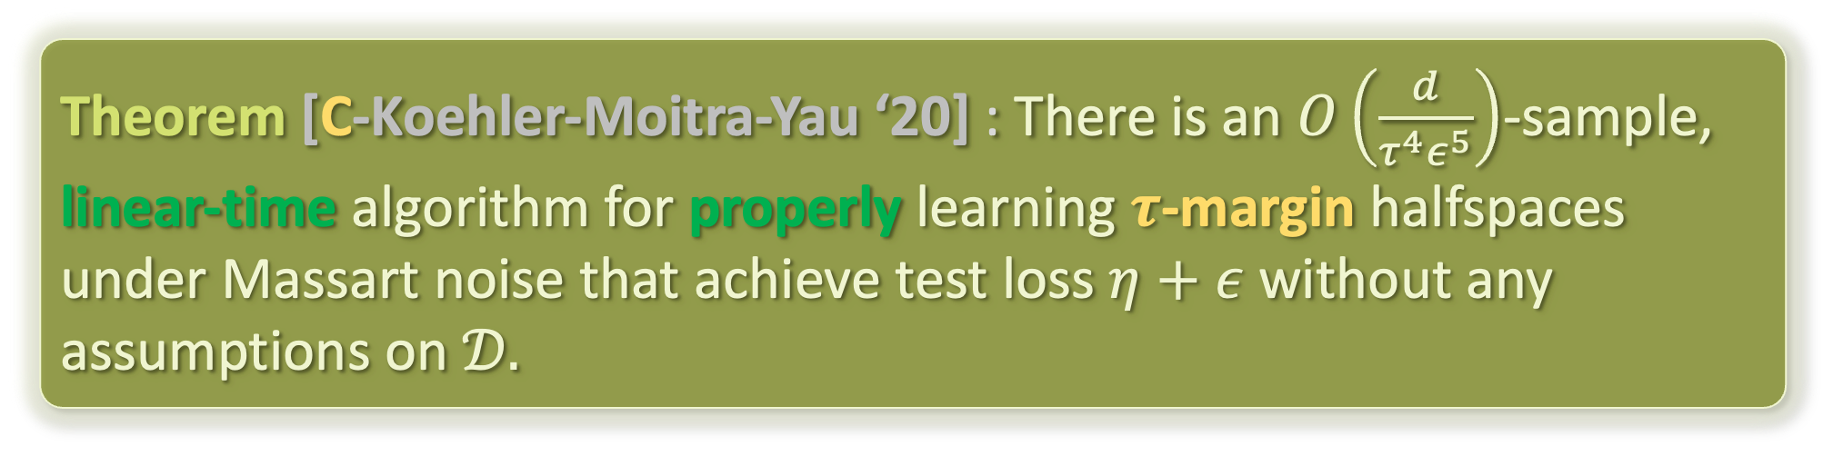
A PROPER LEARNING ALGORITHM
Theorem [C-Koehler-Moitra-Yau ‘20] : There is a polynomial-time algorithm for properly learning halfspaces under Massart noise that achieve test loss $η+ε$ without any assumptions on $𝒟.$
Theorem [C-Koehler-Moitra-Yau ‘20] : There is an $O\left(\frac{d}{τ^{4}ε^{5}}\right)$-sample, linear-time algorithm for properly learning $τ$-margin halfspaces under Massart noise that achieve test loss $η+ε$ without any assumptions on $𝒟.$

Slide 35
PAC learning halfspaces – problem setup
Random classification noise / agnostic learning
Massart noise
Two-player game and analysis
Experiment – robustness + fairness?
Recap of robustness unit

Slide 36


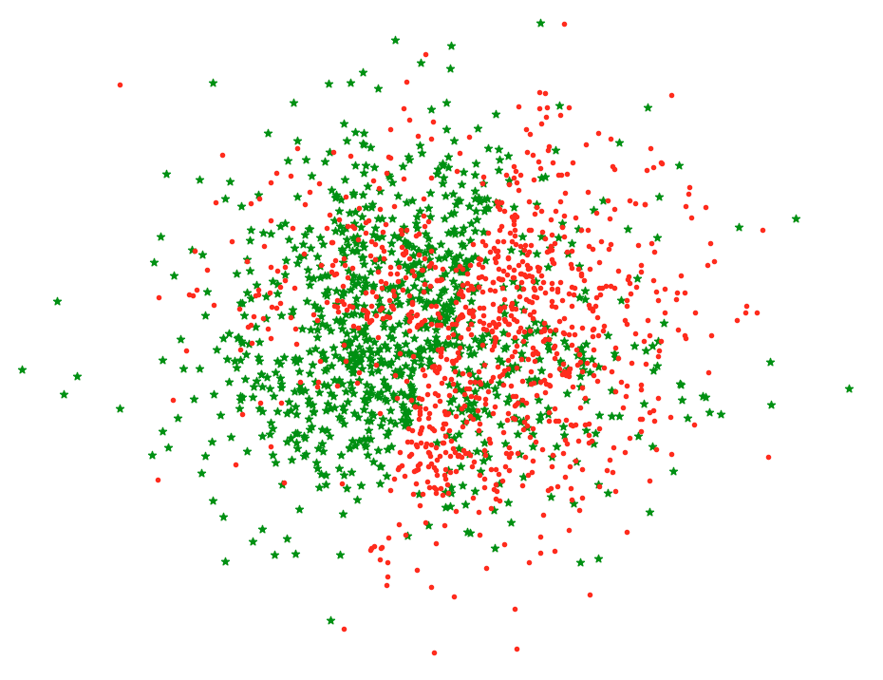
TWO-PLAYER GAME
$$\min_{\left\|w\right\|=1 }{\max_{φ}{𝔼\left[{LeakyReLU}_{λ}\left(−y⋅\left\langle w,x\right\rangle \right)⋅φ\left(x\right)\right]}}$$

Slide 37
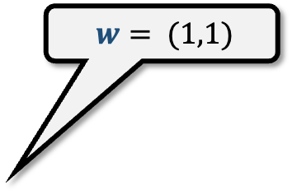
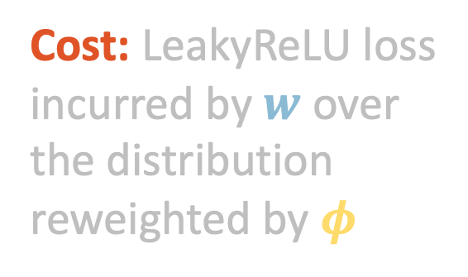
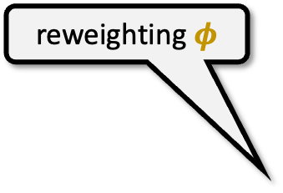
TWO-PLAYER GAME
$$\min_{\left\|w\right\|=1 }{\max_{φ}{𝔼\left[{LeakyReLU}_{λ}\left(−y⋅\left\langle w,x\right\rangle \right)⋅φ\left(x\right)\right]}}$$
$$w= (1,1)$$
reweighting $φ$
Cost: LeakyReLU loss incurred by $w$ over the distribution reweighted by $φ$

Slide 38


TWO-PLAYER GAME
$$\min_{\left\|w\right\|=1 }{\max_{φ}{𝔼\left[{LeakyReLU}_{λ}\left(−y⋅\left\langle w,x\right\rangle \right)⋅φ\left(x\right)\right]}}$$
$$w^{′}= (−3,2)$$
reweighting $φ′$
Cost: LeakyReLU loss incurred by $w$ over the distribution reweighted by $φ$

Slide 39


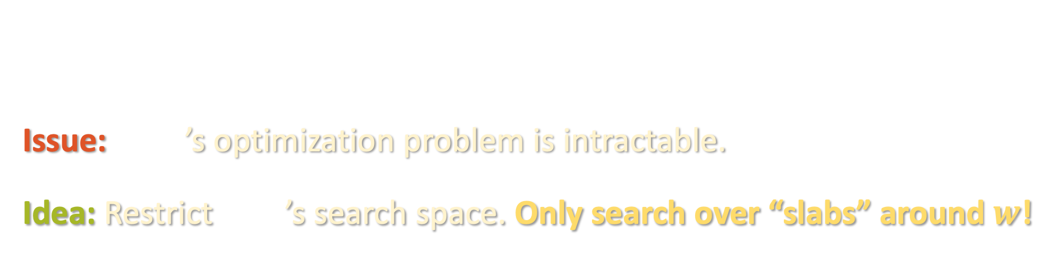
TWO-PLAYER GAME
$$\min_{\left\|w\right\|=1 }{\max_{φ}{𝔼\left[{LeakyReLU}_{λ}\left(−y⋅\left\langle w,x\right\rangle \right)⋅φ\left(x\right)\right]}}$$
Turns out Alice’s optimal strategy is to play $w^{∗}$, in fact minimizing this objective is equivalent to achieving optimal test loss
Issue: ’s optimization problem is intractable.
Idea: Restrict ’s search space. Only search over “slabs” around $w$!

Slide 40

TWO-PLAYER GAME
$$\min_{\left\|w\right\|=1 }{\max_{φ}{𝔼\left[{LeakyReLU}_{λ}\left(−y⋅\left\langle w,x\right\rangle \right)⋅φ\left(x\right)\right]}}$$
$$w= (1,1)$$
reweighting $φ$
Cost: LeakyReLU loss incurred by $w$ over the distribution reweighted by $φ$
$$γ$$

Slide 41
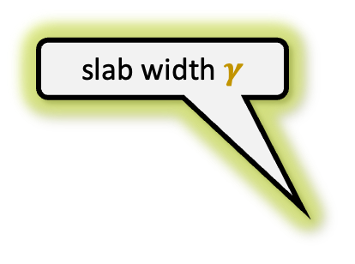
TWO-PLAYER GAME
$$\min_{\left\|w\right\|=1 }{\max_{φ}{𝔼\left[{LeakyReLU}_{λ}\left(−y⋅\left\langle w,x\right\rangle \right)⋅φ\left(x\right)\right]}}$$
$$w= (1,1)$$
slab width $γ$
Cost: LeakyReLU loss incurred by $w$ over the distribution reweighted by $φ$
$$γ$$

Slide 42

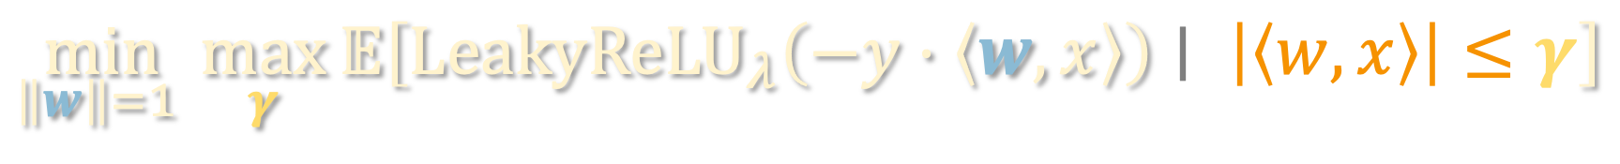
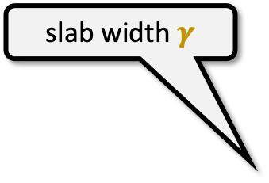
TWO-PLAYER GAME
$$\min_{\left\|w\right\|=1 }{\max_{γ}{𝔼\left[{LeakyReLU}_{λ}\left(−y⋅\left\langle w,x\right\rangle \right)∣ \left|\left\langle w,x\right\rangle \right|≤γ\right]}}$$
$$w= (1,1)$$
slab width $γ$
Cost: LeakyReLU loss incurred by $w$ over the distribution reweighted by $φ$
$$γ$$

Slide 43
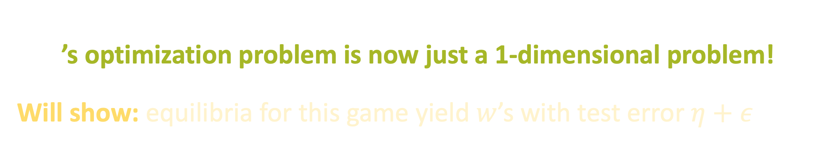

TWO-PLAYER GAME
$$\min_{\left\|w\right\|=1 }{\max_{γ}{𝔼\left[{LeakyReLU}_{λ}\left(−y⋅\left\langle w,x\right\rangle \right)∣ \left|\left\langle w,x\right\rangle \right|≤γ\right]}}$$
’s optimization problem is now just a 1-dimensional problem!
Will show: equilibria for this game yield $w$’s with test error $η+ε$

Slide 44
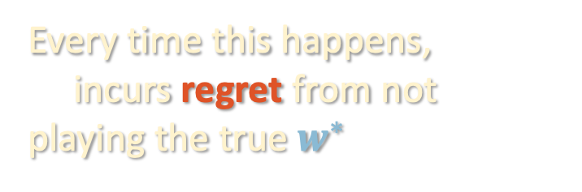


ALGORITHM PSEUDOCODE
$$L^{γ}\left(w\right)$$
$$\min_{\left\|w\right\|=1 }{\max_{γ}{𝔼\left[{LeakyReLU}_{λ}\left(−y⋅\left\langle w,x\right\rangle \right)∣ \left|\left\langle w,x\right\rangle \right|≤γ\right]}}$$
FILTERTRON
Every time this happens,
incurs regret from not playing the true $w^{∗}$
initializes $w$ to arbitrary unit vector
Repeat:
plays slab $γ$ maximizing $L^{γ}\left(w\right)$
If $L_{0−1}\left(w\right)≤η+ε$, return $w$
Else, updates $w←Π\left(w−η⋅∇L^{γ}\left(w\right)\right)$
Guarantee for projected gradient descent: can’t keep having large regret

Slide 45

IOU’S IN THE ANALYSIS
$$L^{γ}\left(w\right)$$
$$\min_{\left\|w\right\|=1 }{\max_{γ}{𝔼\left[{LeakyReLU}_{λ}\left(−y⋅\left\langle w,x\right\rangle \right)∣ \left|\left\langle w,x\right\rangle \right|≤γ\right]}}$$
True halfspace $w^{∗}$ achieves small $L^{γ}\left(w\right)$ regardless of $γ$
For any $w$ with high 0-1 loss, there is a good strategy $γ$ for ,
i.e. one that achieves large $L^{γ}\left(w\right)$
(See board)

Slide 46
PAC learning halfspaces – problem setup
Random classification noise / agnostic learning
Massart noise
Two-player game and analysis
Experiment – robustness + fairness?
Recap of robustness unit

Slide 47

CAN NON-ROBUSTNESS LEAD TO UNFAIR OUTCOMES?
An experiment comparing Filtertron to non-robust baselines:
UCI Adult dataset: 48K individuals, 14 attributes (gender, race, etc)
Task: given demographic info, predict whether income >$50K

Slide 48


CAN NON-ROBUSTNESS LEAD TO UNFAIR OUTCOMES?
An experiment comparing Filtertron to non-robust baselines:
UCI Adult dataset: 48K individuals, 14 attributes (gender, race, etc)
Task: given demographic info, predict whether income >$50K
if in <marginalized group>:
keep label the same
else: flip label w.p. $η$
the attack

Slide 49
CAN NON-ROBUSTNESS LEAD TO UNFAIR OUTCOMES?
random forest
our algorithm
logistic regression
convex surrogate

Slide 50
CAN NON-ROBUSTNESS LEAD TO UNFAIR OUTCOMES?
Trained on noisy data, measured accuracy on
Entire population
random forest
our algorithm
logistic regression
convex surrogate
African-Americans
females
immigrants

Slide 51

CAN NON-ROBUSTNESS LEAD TO UNFAIR OUTCOMES?
Trained on noisy data, measured accuracy on
Entire population
{target group} $∩$ {income >$50K}
random forest
our algorithm
logistic regression
convex surrogate
African-Americans
females
immigrants

Slide 52
PAC learning halfspaces – problem setup
Random classification noise / agnostic learning
Massart noise
Two-player game and analysis
Experiment – robustness + fairness?
Recap of robustness unit

Slide 53

ROBUSTNESS RECAP
In the last three lectures and pset, we saw different ways in which robust estimation tasks can be reduced to a min-max optimization over an “estimate” and a “discriminator”
Robust mean estimation:
$$\min_{w}{\max_{u}{u^{⊤}Σ_{w}u}}$$
List-decodable mean estimation:
$$\min_{w}{\max_{u⊥\left\{u_{1},…,u_{k}\right\}}{u^{⊤}Σ_{w}u}}$$
Halfspaces with Massart noise:
$$\min_{w}{\max_{γ}{ L^{γ}\left(w\right)}}$$

Slide 54
ROBUSTNESS RECAP
In the last three lectures and pset, we saw different ways in which robust estimation tasks can be reduced to a min-max optimization over an “estimate” and a “discriminator”
Algorithms are practical, based on simple iterative updates, make minimal distributional assumptions
Sometimes must be careful with choice of model, especially when making minimal assumptions on the input distribution:
Regression: does adversary control random or arbitrary fraction? is it only the labels that get corrupted?
List-decodable learning: learn true parameter, or just list of candidates?
Today: are label corruptions stochastic / adversarial / somewhere in between?

Slide 55
ROBUSTNESS RECAP
In the last three lectures and pset, we saw different ways in which robust estimation tasks can be reduced to a min-max optimization over an “estimate” and a “discriminator”
Algorithms are practical, based on simple iterative updates, make minimal distributional assumptions
Sometimes must be careful with choice of model, especially when making minimal assumptions on the input distribution
Consequences “upstream” and “downstream”
Upstream: stress-test existing models to prevent “assumption overfitting”
Downstream: robustness (and lack thereof) can have unintended consequences even in settings where there is no real adversary (e.g. fairness)

Slide 56
ROBUSTNESS RECAP
In the last three lectures and pset, we saw different ways in which robust estimation tasks can be reduced to a min-max optimization over an “estimate” and a “discriminator”
Algorithms are practical, based on simple iterative updates, make minimal distributional assumptions
Sometimes must be careful with choice of model, especially when making minimal assumptions on the input distribution
Consequences “upstream” and “downstream”
Algorithms we have explored suggest general frameworks that are useful even beyond “self-contained” realm in which they were developed

Slide 57

UESS OF ITERATIVE FILTERING
Exploratory data analysis? [Diakonikolas-Kamath-Kane-Li-Moitra-Stewart ‘17]

Slide 58



UESS OF ITERATIVE FILTERING
Defenses against data poisoning attacks [Tran-Li-Madry ‘18]

Slide 59

LOOKING AHEAD
sum-of-squares
optimization
robust statistics
tensors
supervised
learning

