Slide 1

CS 224: ALGORITHMS FOR DATA SCIENCE LECTURE 17 (11/6)
Tensor decomposition
Sum-of-squares
Robustness
Supervised learning
Computational complexity
Statistical physics
Generative modeling
HARDNESS BASICS, SQ LOWER BOUNDS (PARITY, MLPs, PARALLEL PANCAKES)

Slide 2
ANNOUNCEMENTS
My office hours this week (Thursday 4-5) will be held virtually, please email me for the Zoom link if you plan on attending
Spring ‘24 course announcement (Prof. Mark Sellke):
STAT 291: Random High-Dimensional Optimization: Landscapes and Algorithmic Barriers (Tu/Th 10:30am-11:45am)
This course will focus on paradigmatic optimization problems with random objective functions. We will develop the tools needed to understand the geometric behavior of complex random landscapes, the different phase transitions that can occur, and how these transitions are linked to the success and failure of efficient algorithms. Likely topics will include:
• Random constraint satisfaction problems, spin glasses, and tensor PCA
• Landscape complexity via critical point counting
• The overlap gap property as a geometric barrier to optimization
• Implications for Markov chain sampling
• Combining these ideas to prove the spherical Parisi formula

Slide 3
Wrapping up mean field, supervised learning unit
Computational lower bounds: overview
Statistical query lower bounds for supervised problems

Slide 4
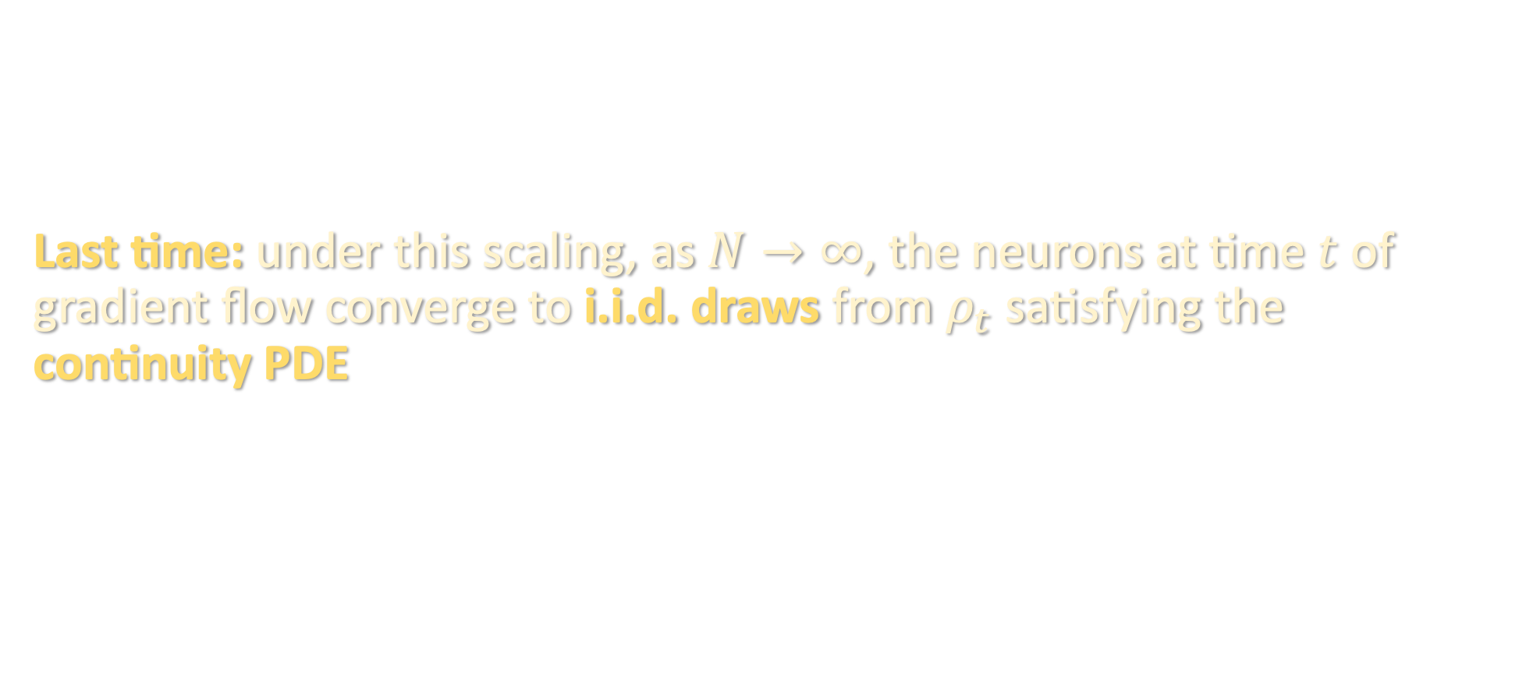
MEAN FIELD LIMIT
Last time: under this scaling, as $N→∞$, the neurons at time $t$ of gradient flow converge to i.i.d. draws from $ρ_{t}$ satisfying the continuity PDE

Slide 5
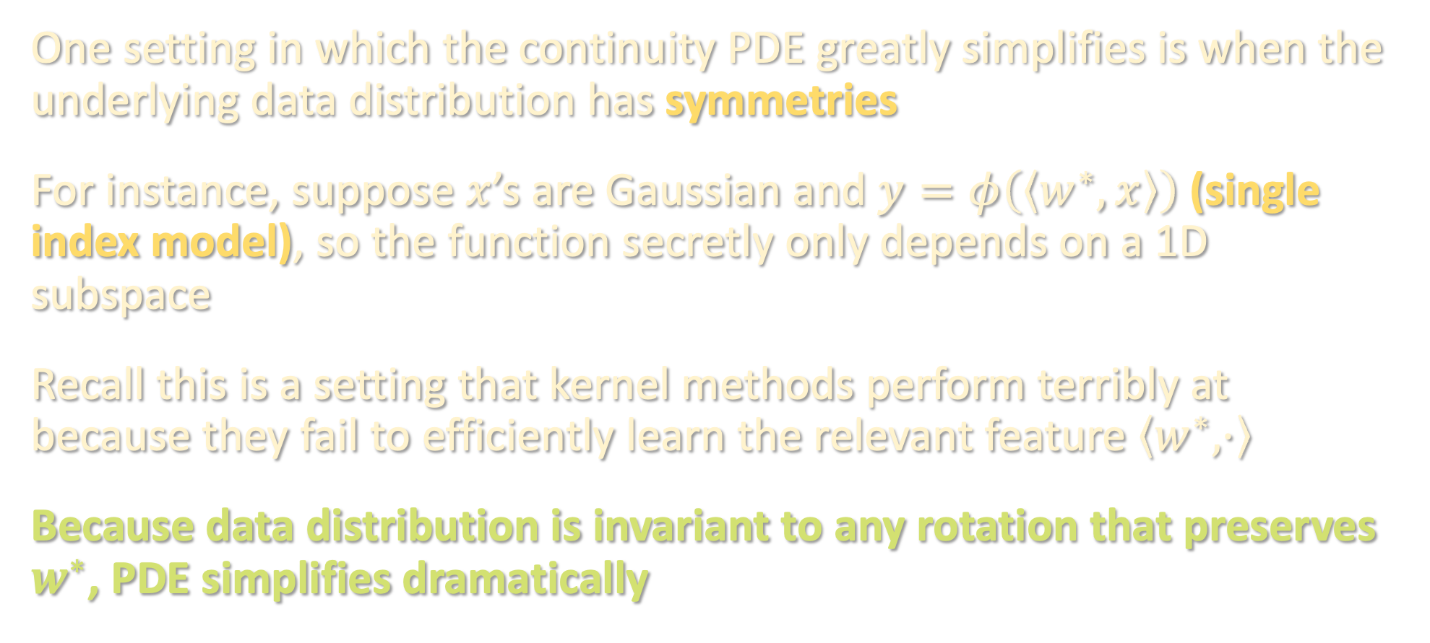
TOY MODELS
One setting in which the continuity PDE greatly simplifies is when the underlying data distribution has symmetries
For instance, suppose $x$’s are Gaussian and $y=φ\left(\left\langle w^{∗},x\right\rangle \right)$ (single index model), so the function secretly only depends on a 1D subspace
Recall this is a setting that kernel methods perform terribly at because they fail to efficiently learn the relevant feature $\left\langle w^{∗},⋅\right\rangle$
Because data distribution is invariant to any rotation that preserves $w^{∗}$, PDE simplifies dramatically

Slide 6
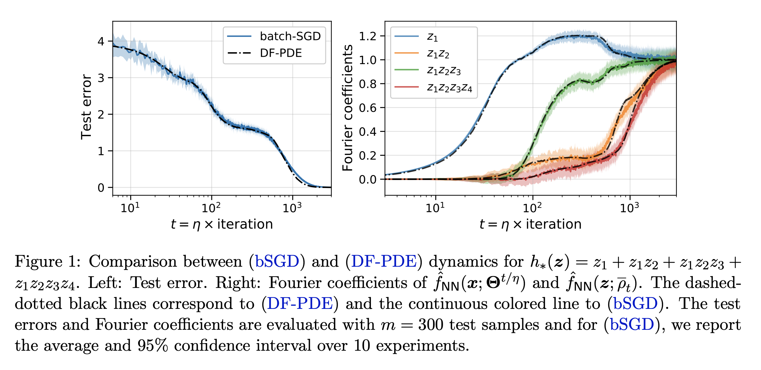
TOY MODELS
In such settings where symmetries drastically reduce the dimension of the PDE, we can numerically solve it and obtain sharp predictions
Although a finite-dimensional problem, to get rigorous guarantees they still need to modify the training algorithm (e.g. do layerwise training) to get end-to-end provable guarantees
from [Abbe-Boix-Adsera-Misiakiewicz ‘22]

Slide 7
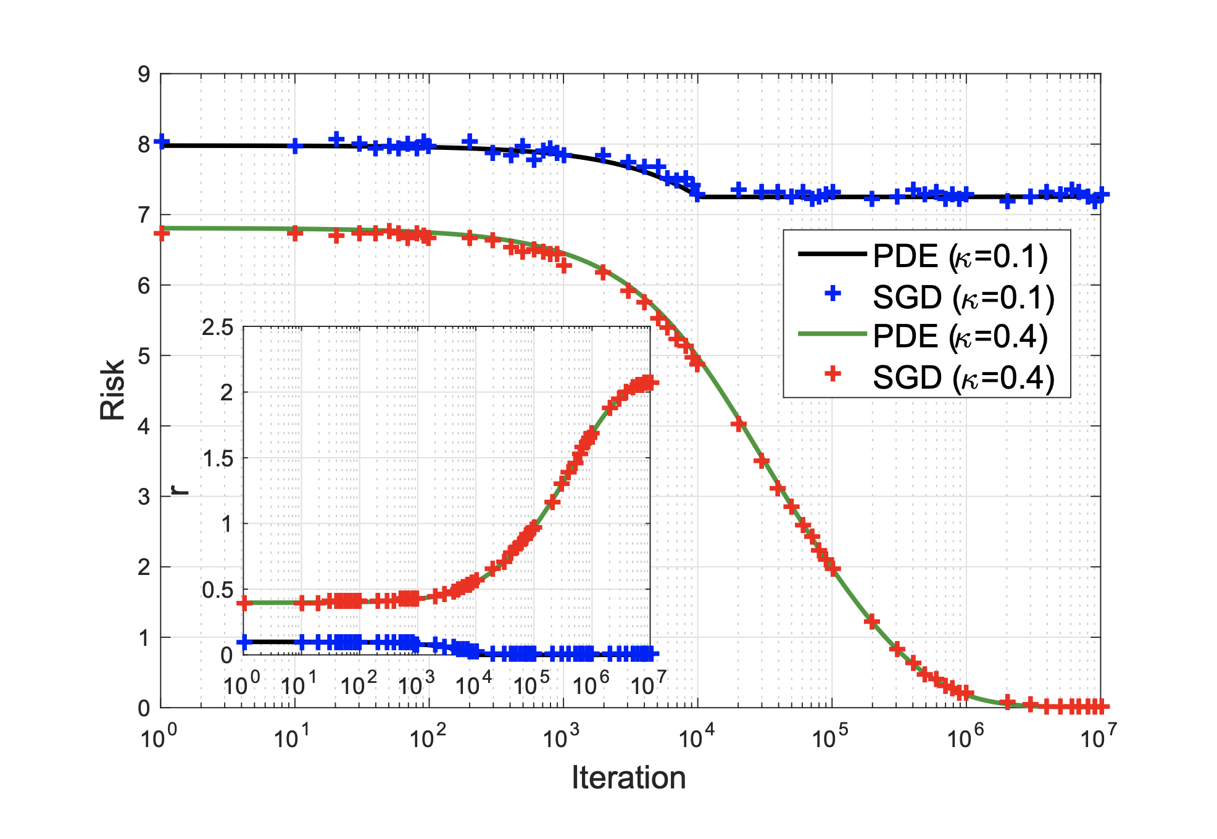

TOY MODELS
In such settings where symmetries drastically reduce the dimension of the PDE, we can numerically solve it and obtain sharp predictions
Classifying isotropic Gaussians:
Data is a mixture of
$x∼N\left(0,{\left(1+Δ\right)}^{2}⋅Id_{d}\right)$, $y=1$
$x∼N\left(0,{\left(1−Δ\right)}^{2}⋅Id_{d}\right)$, $y=−1$
Reduced PDE is 1-dimensional (only need to track distribution of ${\left\|θ\right\|}_{2}$)
They obtain rigorous end-to-end guarantees for this problem
from [Mei-Montanari-Nguyen ‘18]

Slide 8
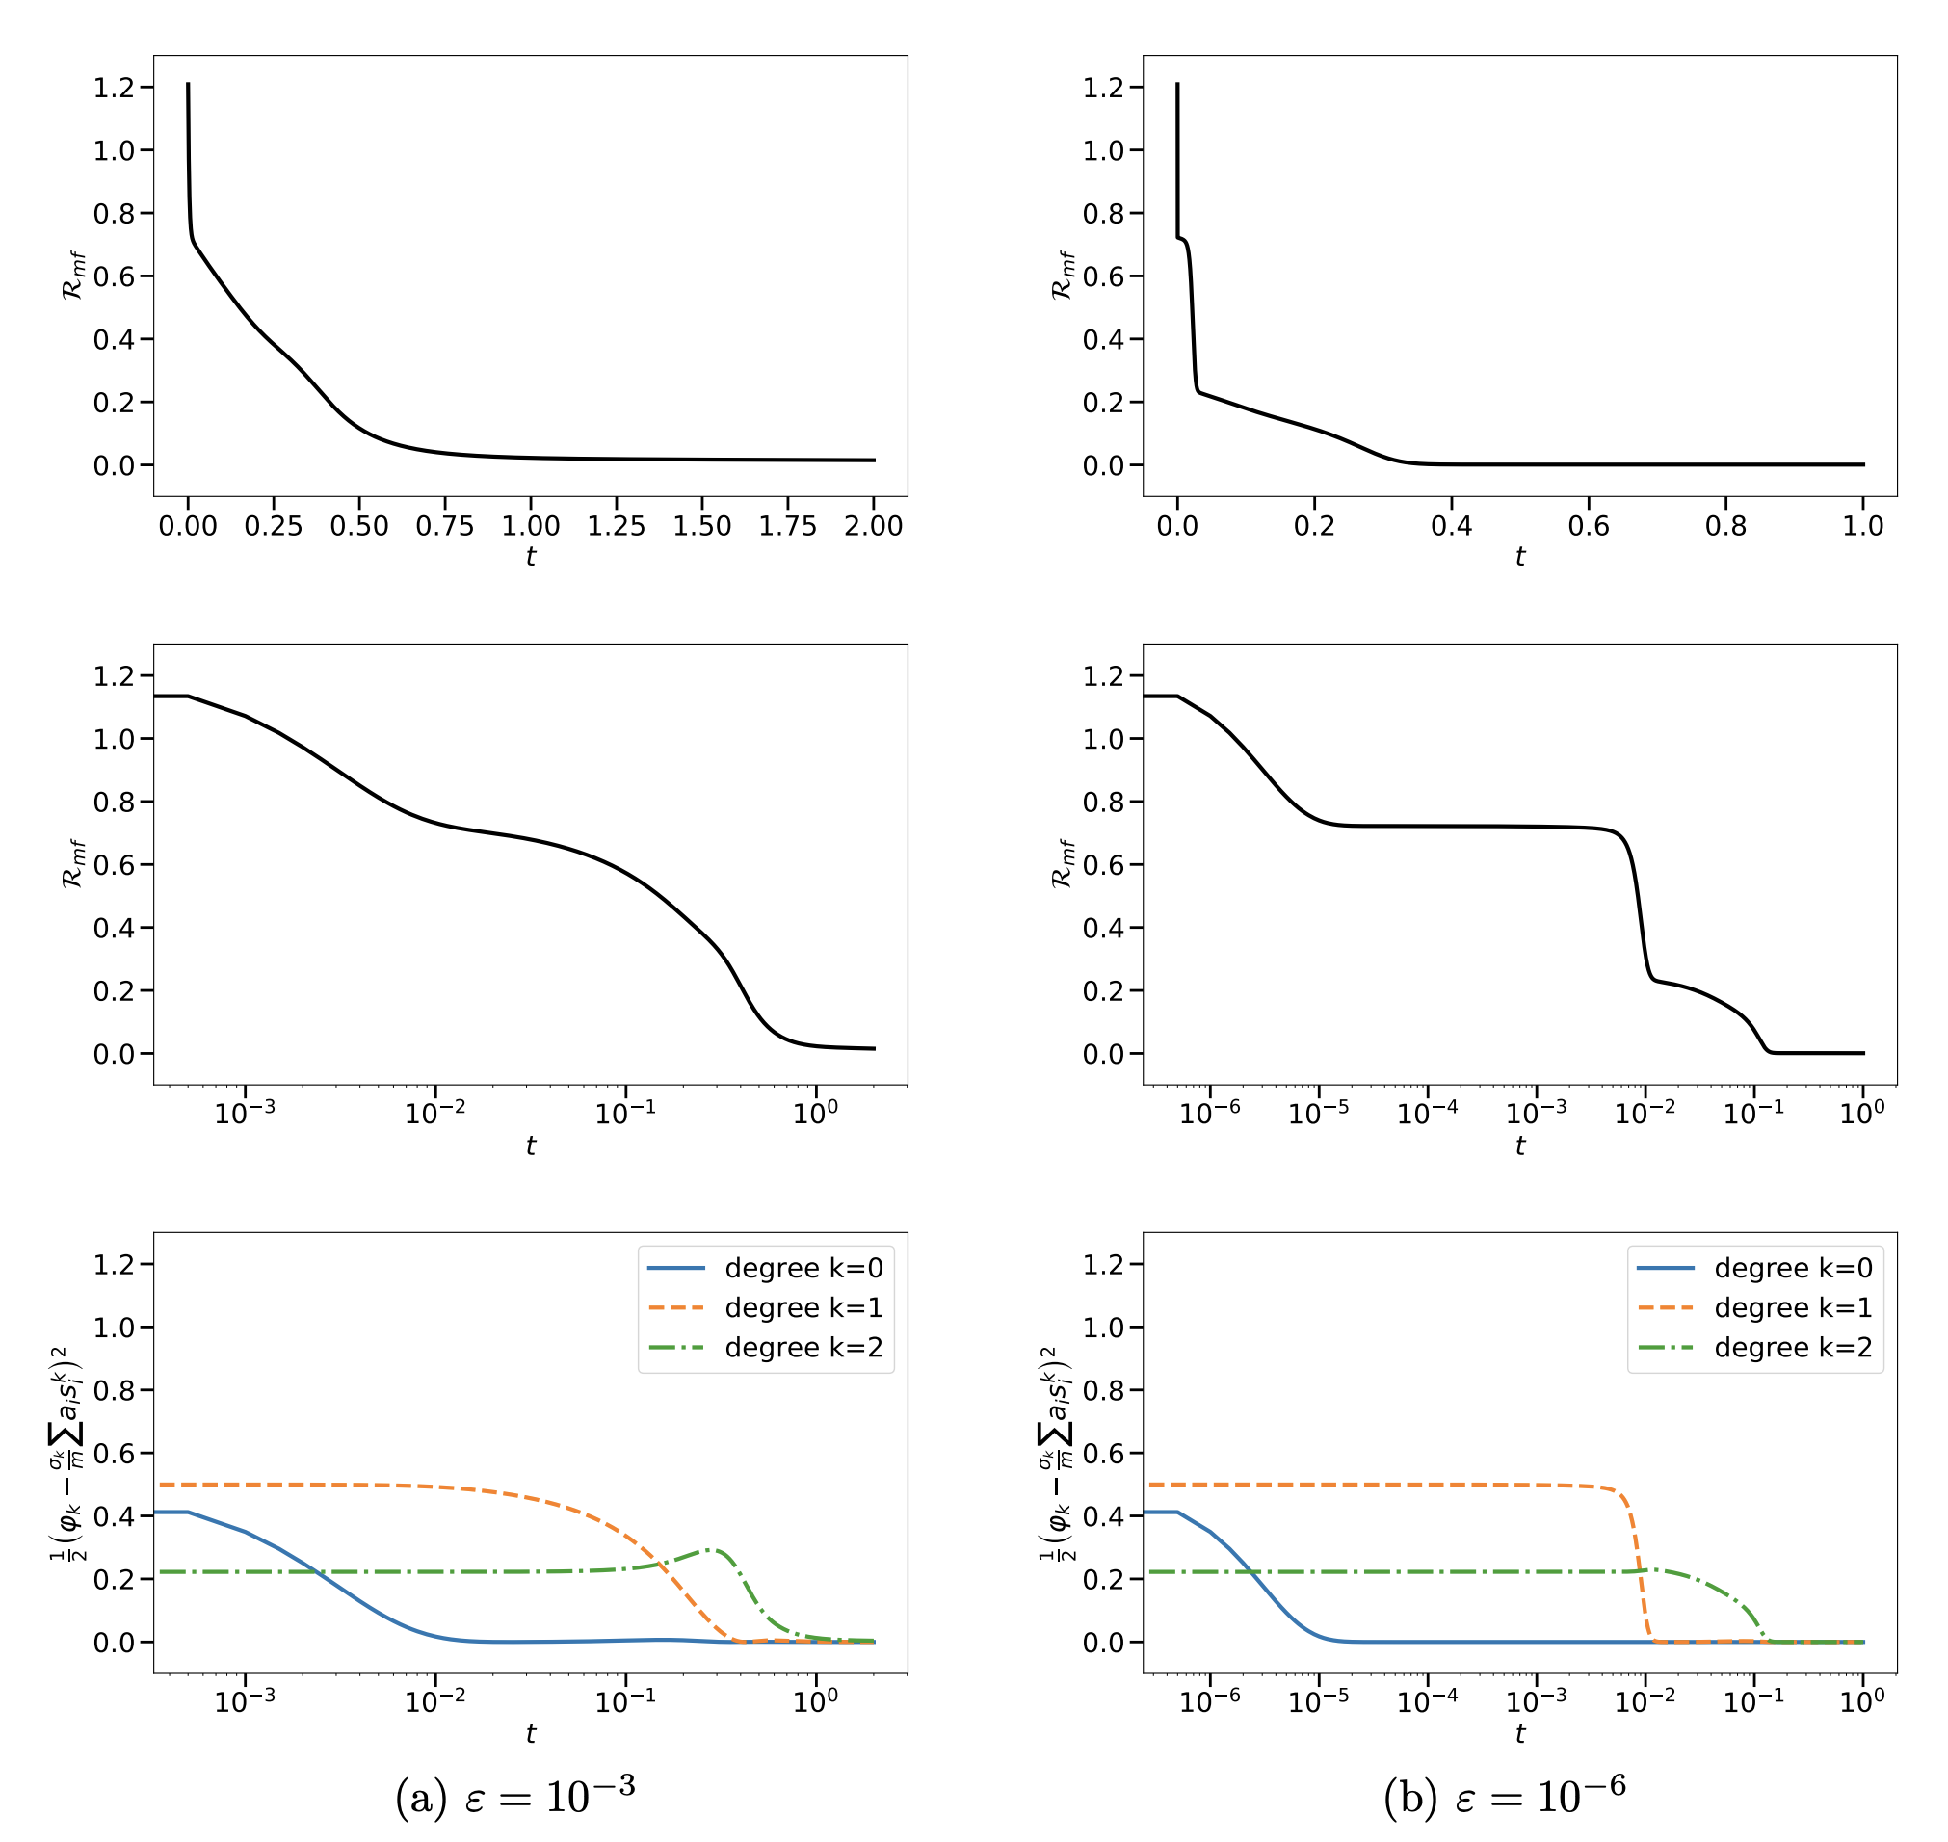

TOY MODELS
In such settings where symmetries drastically reduce the dimension of the PDE, we can numerically solve it and obtain sharp predictions
Continuity PDE for learning $f\left(x\right)=φ\left(\left\langle w^{∗},x\right\rangle \right)$ for
$$φ\left(z\right)=He_{0}\left(z\right)−He_{1}\left(z\right)+\frac{2}{3}He_{2}\left(z\right)$$
using a one-hidden-layer ReLU network over Gaussian examples
Demonstrates two empirically observed phenomena:
Plateaus in the loss curve, interspersed with sharp drops
Longer and longer time scales
Key (partially rigorous) finding: mean field gradient flow incrementally learns low-degree Hermite components of single index models
from [Berthier-Montanari-Zhou ‘23]

Slide 9
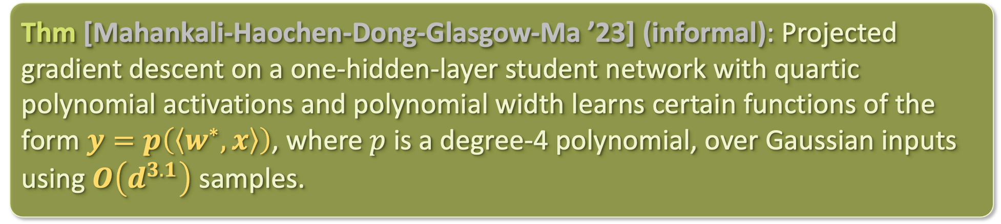
TOY MODELS
Currently, the only “end-to-end” non-asymptotic, global convergence result for learning single-index models with ”standard” gradient descent (no layerwise training, no weird learning rate schedules, no sharp gradient clipping, etc.):
Thm [Mahankali-Haochen-Dong-Glasgow-Ma ’23] (informal): Projected gradient descent on a one-hidden-layer student network with quartic polynomial activations and polynomial width learns certain functions of the form $y=p\left(\left\langle w^{∗},x\right\rangle \right)$, where $p$ is a degree-4 polynomial, over Gaussian inputs using $O\left(d^{3.1}\right)$ samples.

Slide 10
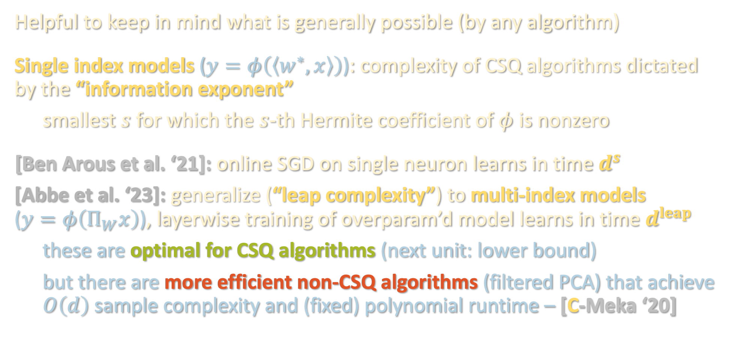
CSQ REVISITED
Helpful to keep in mind what is generally possible (by any algorithm)
Single index models ($y=φ\left(\left\langle w^{∗},x\right\rangle \right)$): complexity of CSQ algorithms dictated by the “information exponent”
smallest $s$ for which the $s$-th Hermite coefficient of $φ$ is nonzero
[Ben Arous et al. ‘21]: online SGD on single neuron learns in time $d^{s}$
[Abbe et al. ‘23]: generalize (“leap complexity”) to multi-index models ($y=φ\left(Π_{W}x\right)$), layerwise training of overparam’d model learns in time $d^{leap}$
these are optimal for CSQ algorithms (next unit: lower bound)
but there are more efficient non-CSQ algorithms (filtered PCA) that achieve $O\left(d\right)$ sample complexity and (fixed) polynomial runtime – [C-Meka ‘20]

Slide 11
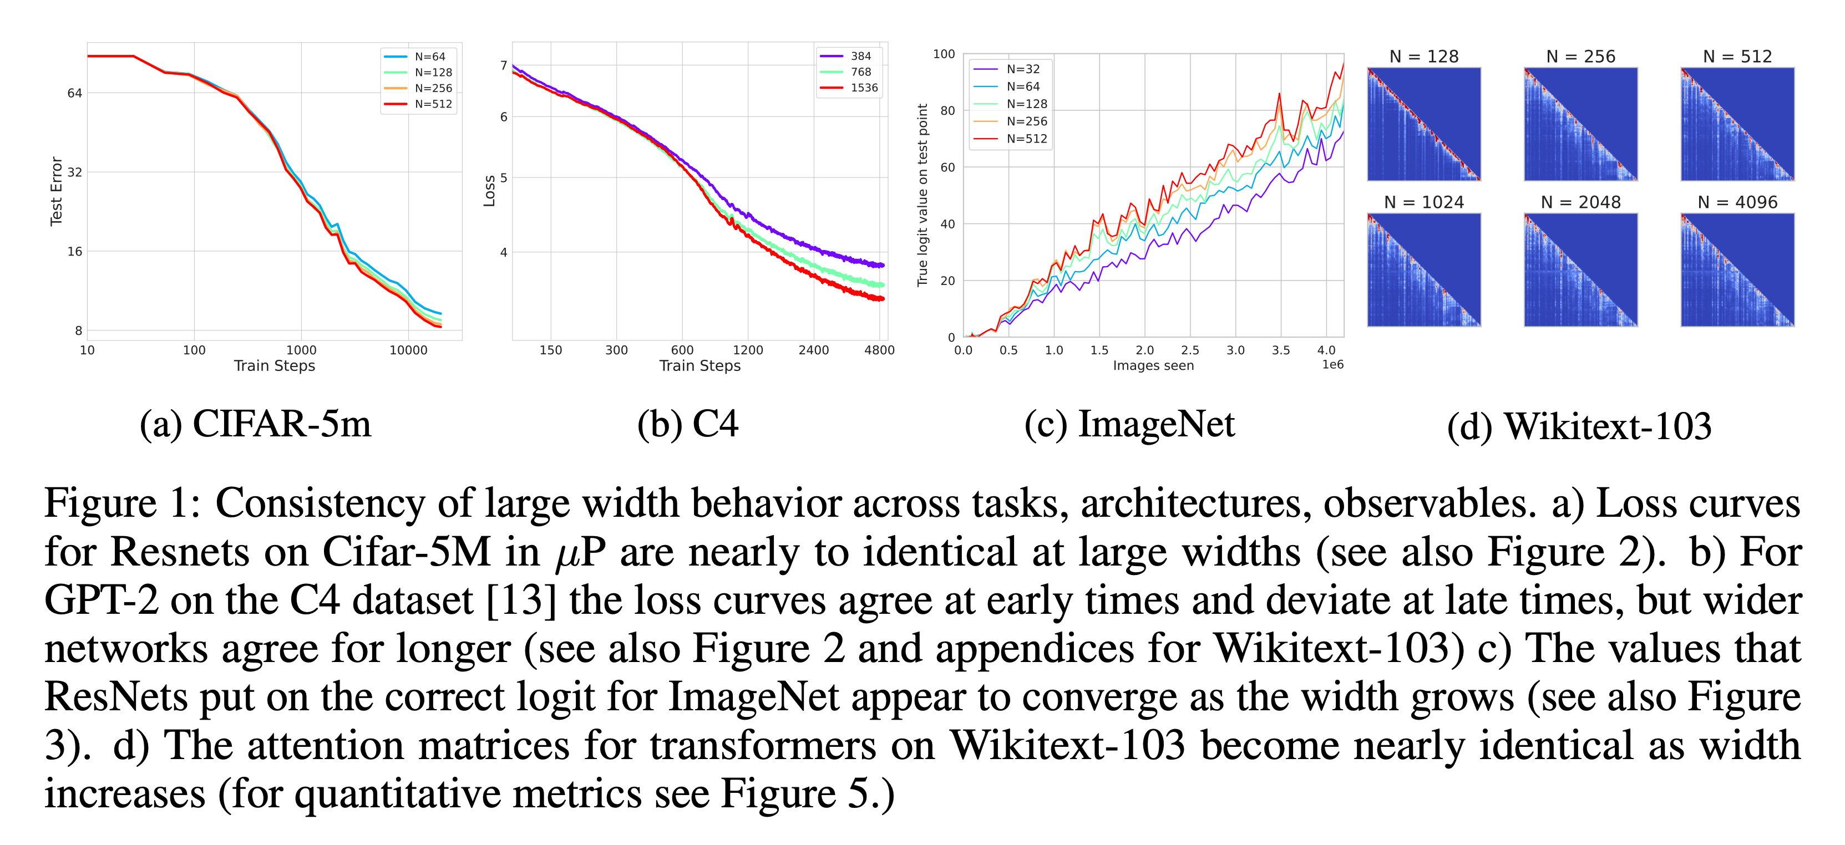
PRACTICAL IMPLICATIONS BEYOND TOY SETTINGS
How predictive is the mean field limit of practically observed phenomena?
from [Vyas-Atanasov-Bordelon-Morwani-Sainathan-Pehlevan ‘23]

Slide 12
SUPERVISED LEARNING RECAP- ALGORITHMS
30 years after [Linial-Mansour-Nisan ‘93]’s low-degree algorithm, (almost) everything in PAC is still about low-degree polynomials
But there are two distinct flavors:
⚠️
⚠️
 | What is the smallest degree for which there is a polynomial that approximates the ground truth? | What is the smallest degree at which the ground truth has a nonzero polynomial component?

Slide 13
SUPERVISED LEARNING RECAP- ALGORITHMS
30 years after [Linial-Mansour-Nisan ‘93]’s low-degree algorithm, (almost) everything in PAC is still about low-degree polynomials
But there are two distinct flavors:
⚠️
⚠️
 | What is the smallest degree for which there is a polynomial that approximates the ground truth? | What is the smallest degree at which the ground truth has a nonzero polynomial component?
Structure being exploited | Fourier/Hermite concentration | information exponent / leap

Slide 14
SUPERVISED LEARNING RECAP- ALGORITHMS
30 years after [Linial-Mansour-Nisan ‘93]’s low-degree algorithm, (almost) everything in PAC is still about low-degree polynomials
But there are two distinct flavors:
⚠️
⚠️
 | What is the smallest degree for which there is a polynomial that approximates the ground truth? | What is the smallest degree at which the ground truth has a nonzero polynomial component?
Structure being exploited | Fourier/Hermite concentration | information exponent / leap
Algorithms | low-degree algorithm, polynomial regression, kernel methods | tensor methods, feature learning / GD beyond NTK

Slide 15
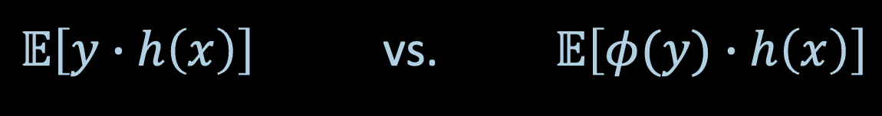
SUPERVISED LEARNING RECAP- ALGORITHMS
30 years after [Linial-Mansour-Nisan ‘93]’s low-degree algorithm, (almost) everything in PAC is still about low-degree polynomials
Algorithms in practice largely captured by the CSQ model, but the theory suggests that even slight deviations from this model can lead to improvements in time/data efficiency (e.g. filtered PCA)
$𝔼\left[y∙h\left(x\right)\right]$ vs. $𝔼\left[φ(y)∙h\left(x\right)\right]$

Slide 16
SUPERVISED LEARNING RECAP- ALGORITHMS
30 years after [Linial-Mansour-Nisan ‘93]’s low-degree algorithm, (almost) everything in PAC is still about low-degree polynomials
Algorithms in practice largely captured by the CSQ model, but the theory suggests that even slight deviations from this model can lead to improvements in time/data efficiency (e.g. filtered PCA)
Last two lectures: to understand why training overparametrized models helps, pass to a limiting object:
If not careful about scaling, “easy” to prove convergence / generalization because dynamics are linear
With critical scaling, limiting object quite predictive, but remains hard to analyze except in toy settings

Slide 17

SUPERVISED LEARNING RECAP- MODELING
Still in the early stages of navigating tradeoff between distributional assumptions and algorithmic guarantees:
Distribution-free with Massart noise
Known
Truth?
generality of
distributional
assumption
Gaussian/
uniform over ${\left\{±1\right\}}^{n}$
Halfspaces
Neural networks
expressivity of function class

Slide 18
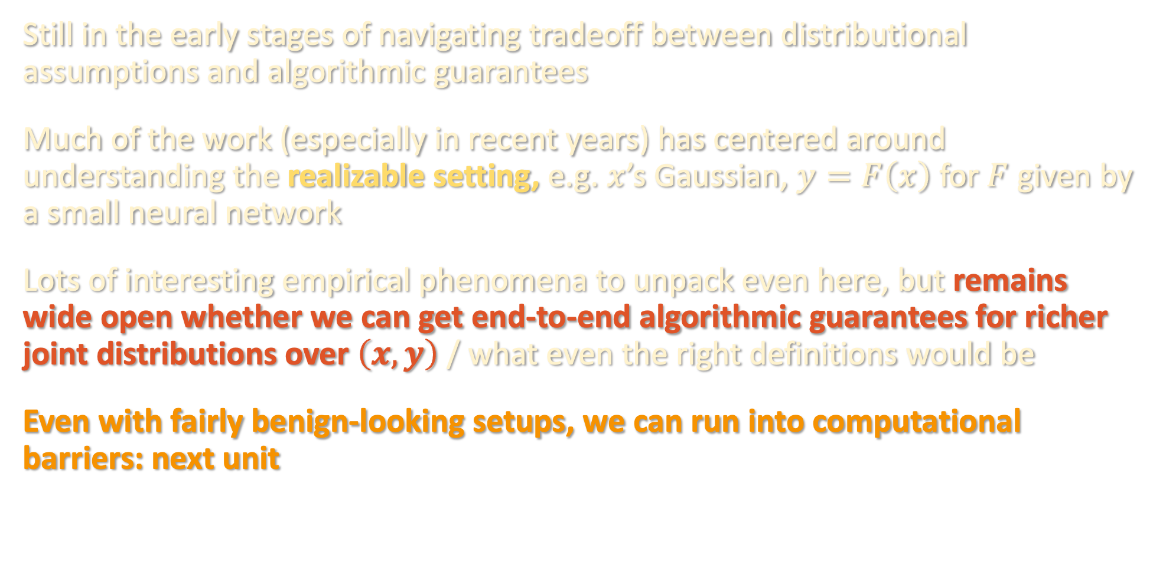
SUPERVISED LEARNING RECAP- MODELING
Still in the early stages of navigating tradeoff between distributional assumptions and algorithmic guarantees
Much of the work (especially in recent years) has centered around understanding the realizable setting, e.g. $x$’s Gaussian, $y=F\left(x\right)$ for $F$ given by a small neural network
Lots of interesting empirical phenomena to unpack even here, but remains wide open whether we can get end-to-end algorithmic guarantees for richer joint distributions over $\left(x,y\right)$ / what even the right definitions would be
Even with fairly benign-looking setups, we can run into computational barriers: next unit

Slide 19

UP NEXT
sum-of-squares
optimization
robust statistics
tensors
supervised
learning
computational complexity

Slide 20
Wrapping up mean field, supervised learning unit
Computational lower bounds: overview
Statistical query lower bounds for supervised problems

Slide 21
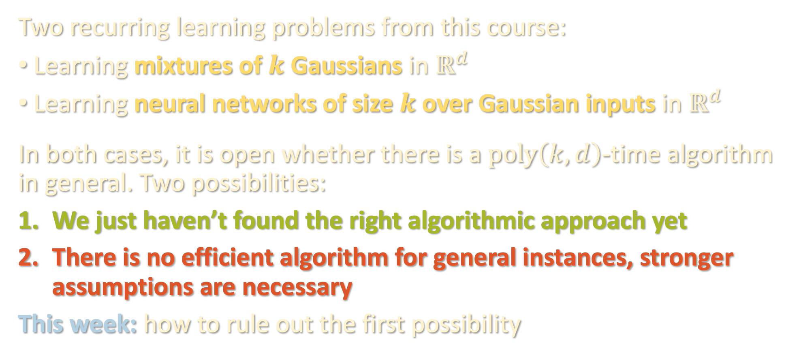
GUIDING EXAMPLES
Two recurring learning problems from this course:
Learning mixtures of $k$ Gaussians in $ℝ^{d}$
Learning neural networks of size $k$ over Gaussian inputs in $ℝ^{d}$
In both cases, it is open whether there is a $poly\left(k,d\right)$-time algorithm in general. Two possibilities:
We just haven’t found the right algorithmic approach yet
There is no efficient algorithm for general instances, stronger assumptions are necessary
This week: how to rule out the first possibility

Slide 22
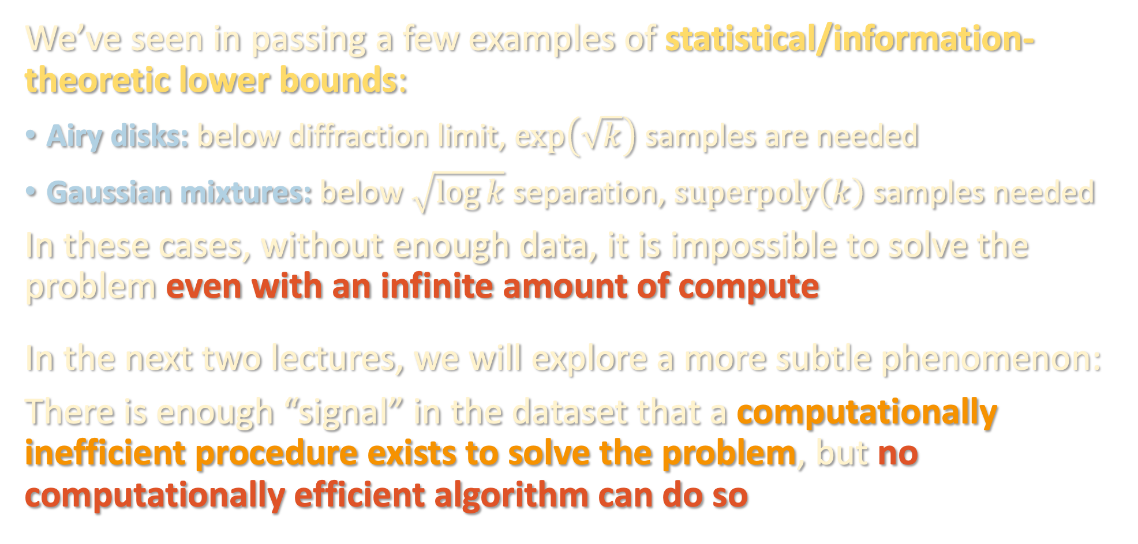
COMPUTATIONAL LOWER BOUNDS
We’ve seen in passing a few examples of statistical/information-theoretic lower bounds:
Airy disks: below diffraction limit, $\exp\left(\sqrt{k}\right)$ samples are needed
Gaussian mixtures: below $\sqrt{\log{k}}$ separation, $superpoly\left(k\right)$ samples needed
In these cases, without enough data, it is impossible to solve the problem even with an infinite amount of compute
In the next two lectures, we will explore a more subtle phenomenon:
There is enough “signal” in the dataset that a computationally inefficient procedure exists to solve the problem, but no computationally efficient algorithm can do so

Slide 23
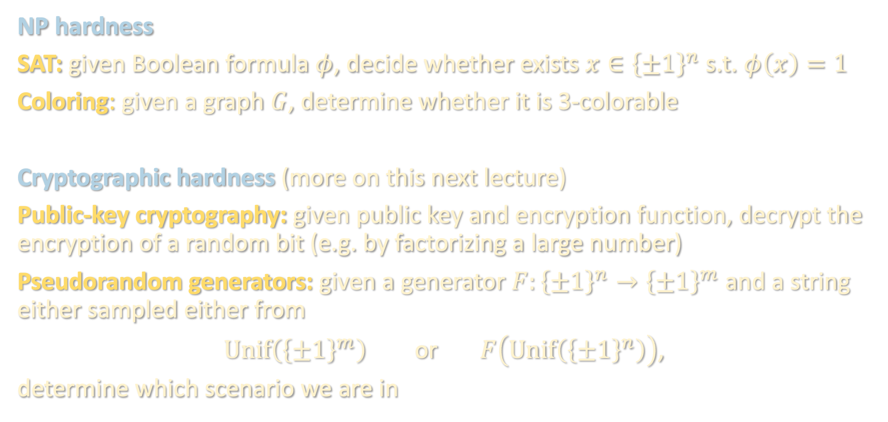
CLASSIC EXAMPLES
NP hardness
SAT: given Boolean formula $φ$, decide whether exists $x∈{\left\{±1\right\}}^{n}$ s.t. $φ\left(x\right)=1$
Coloring: given a graph $G$, determine whether it is 3-colorable
Cryptographic hardness (more on this next lecture)
Public-key cryptography: given public key and encryption function, decrypt the encryption of a random bit (e.g. by factorizing a large number)
Pseudorandom generators: given a generator $F:{\left\{±1\right\}}^{n}→{\left\{±1\right\}}^{m}$ and a string either sampled either from
$Unif\left({\left\{±1\right\}}^{m}\right)$ or $F\left(Unif\left({\left\{±1\right\}}^{n}\right)\right)$,
determine which scenario we are in

Slide 24
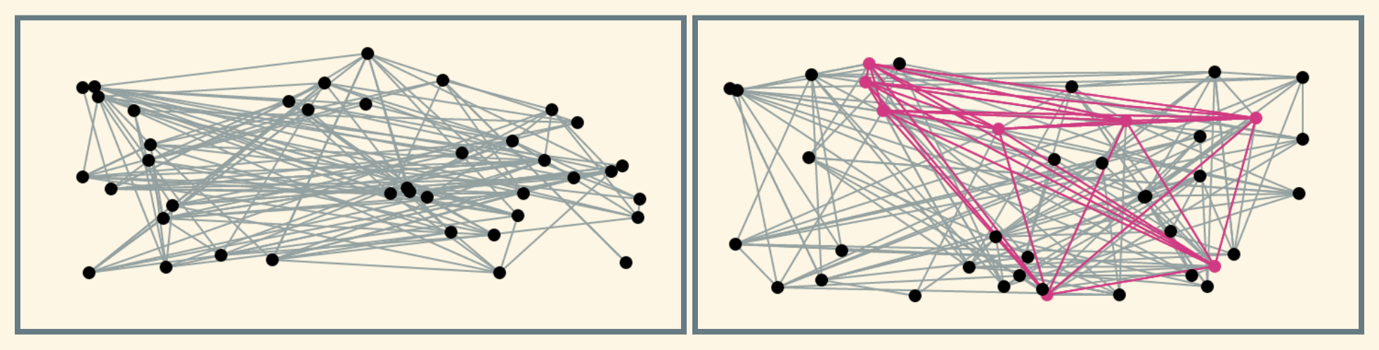

CLASSIC EXAMPLES
Average case hardness
Planted clique: given the adjacency matrix of a graph sampled either from
Erdos-Renyi $G(n,1/2)$: every edge independently included w.p. $1/2$
Taken from [Hopkins, FOCS ‘16]

Slide 25

CLASSIC EXAMPLES
Average case hardness
Planted clique: given the adjacency matrix of a graph sampled either from
Erdos-Renyi $G(n,1/2)$: every edge independently included w.p. $1/2$
Planted: graph is $G\left(n,1/2\right)$ + a random clique of size $N$
Task: determine which case we are in w.h.p. over randomness of the instance
Taken from [Hopkins, FOCS ‘16]

Slide 26
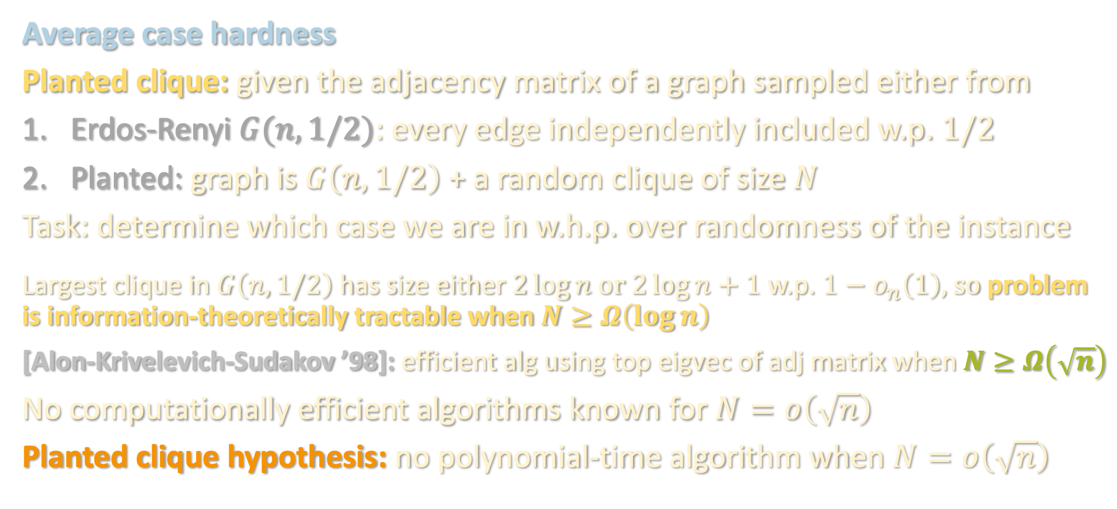
CLASSIC EXAMPLES
Average case hardness
Planted clique: given the adjacency matrix of a graph sampled either from
Erdos-Renyi $G(n,1/2)$: every edge independently included w.p. $1/2$
Planted: graph is $G\left(n,1/2\right)$ + a random clique of size $N$
Task: determine which case we are in w.h.p. over randomness of the instance
Largest clique in $G\left(n,1/2\right)$ has size either $2\log{n}$ or $2\log{n}+1$ w.p. $1−o_{n}\left(1\right)$, so problem is information-theoretically tractable when $N≥Ω\left(\log{n}\right)$
[Alon-Krivelevich-Sudakov ’98]: efficient alg using top eigvec of adj matrix when $N≥Ω\left(\sqrt{n}\right)$
No computationally efficient algorithms known for $N=o\left(\sqrt{n}\right)$
Planted clique hypothesis: no polynomial-time algorithm when $N=o\left(\sqrt{n}\right)$

Slide 27
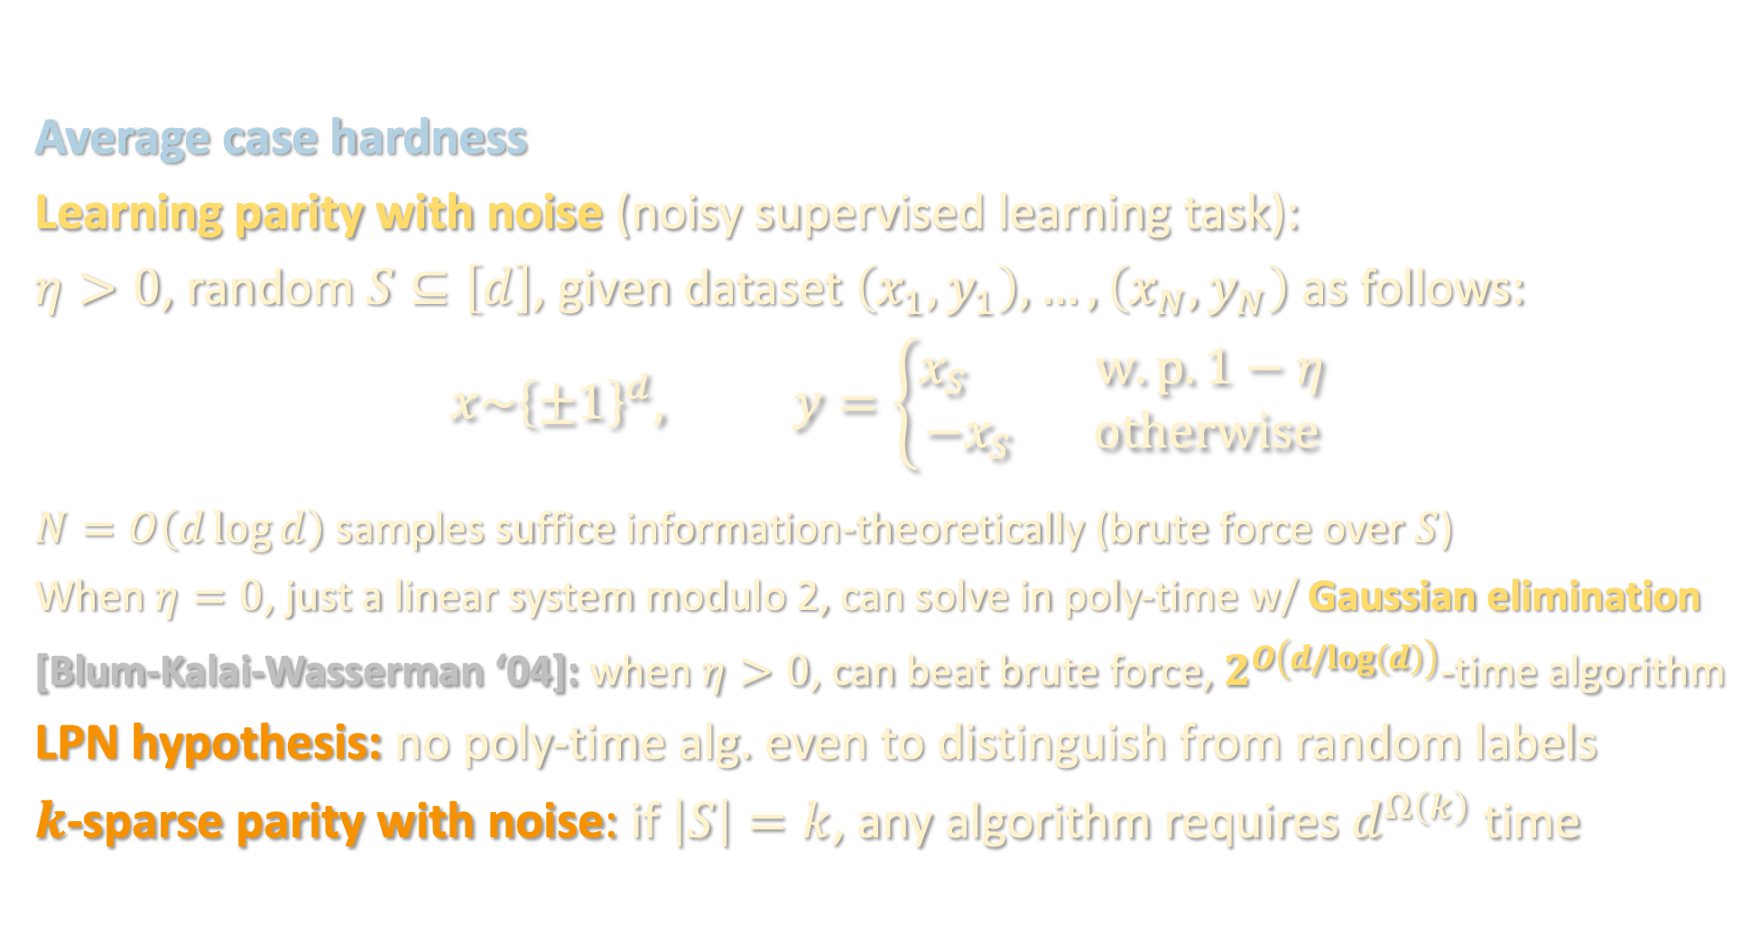
CLASSIC EXAMPLES
Average case hardness
Learning parity with noise (noisy supervised learning task):
$η>0$, random $S⊆\left[d\right]$, given dataset $\left(x_{1},y_{1}\right),…,\left(x_{N},y_{N}\right)$ as follows:
$$x\sim {\left\{±1\right\}}^{d}, y=\left\{\begin{aligned}x_{S} w.p. 1−η \\ −x_{S} otherwise\end{aligned}\right.$$
$N=O\left(d\log{d}\right)$ samples suffice information-theoretically (brute force over $S$)
When $η=0$, just a linear system modulo 2, can solve in poly-time w/ Gaussian elimination
[Blum-Kalai-Wasserman ‘04]: when $η>0$, can beat brute force, $2^{O\left(d/log\left(d\right)\right)}$-time algorithm
LPN hypothesis: no poly-time alg. even to distinguish from random labels
$k$-sparse parity with noise: if $\left|S\right|=k$, any algorithm requires $d^{Ω\left(k\right)}$ time

Slide 28
TRADITIONAL APPROACH TO HARDNESS
Reduction:
Assume problem X is hard (e.g. SAT, LPN, breaking crypto)
To prove problem Y is hard, (efficiently) reduce any instance of X to an instance of Y
If Y had an efficient algorithm, would imply efficient algorithm for X
Works great for worst-case hardness, e.g. SAT instances can be transformed into (highly pathological) instances of other combinatorial problems
But machine learning problems are not worst case!

Slide 29
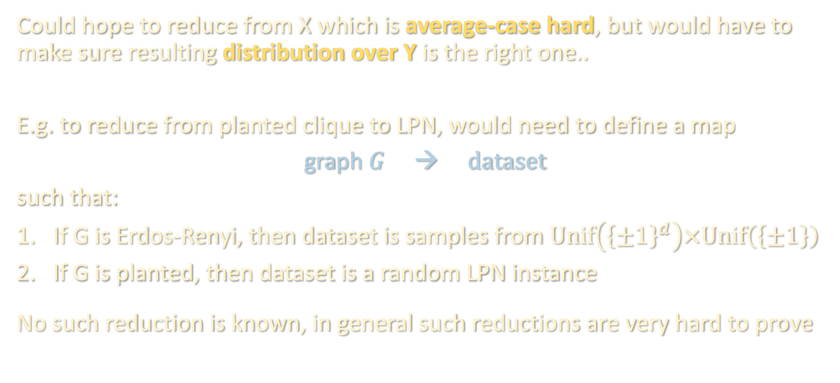
TRADITIONAL APPROACH TO HARDNESS
Could hope to reduce from X which is average-case hard, but would have to make sure resulting distribution over Y is the right one..
E.g. to reduce from planted clique to LPN, would need to define a map
graph $G$ → $dataset$
such that:
If G is Erdos-Renyi, then dataset is samples from $Unif\left({\left\{±1\right\}}^{d}\right)×Unif\left(\left\{±1\right\}\right)$
If G is planted, then dataset is a random LPN instance
No such reduction is known, in general such reductions are very hard to prove

Slide 30
Wrapping up mean field, supervised learning unit
Computational lower bounds: overview
Statistical query lower bounds for supervised problems

Slide 31
LOWER BOUNDS IN RESTRICTED MODELS
Alternative approach:
Formally define a restricted model of computation that captures all known algorithms for the problem in question
Prove (unconditional) lower bound against algorithms in restricted model
Statistical query: only makes use of noisy estimates of population-level statistics (e.g. moments) of the data distribution
Lipschitz algorithms: if instance perturbed, alg. output does not change much
Low-degree algorithms: only uses low-degree poly’s evaluated on the data
Sum-of-squares algorithms: there is a “canonical” sum-of-squares relaxation of the problem, and we want to prove high degree SoS is necessary
Pros: “easier” to show, there are general recipes for proving lower bounds
Cons: less convincing than reduction-based lower bound

Slide 32

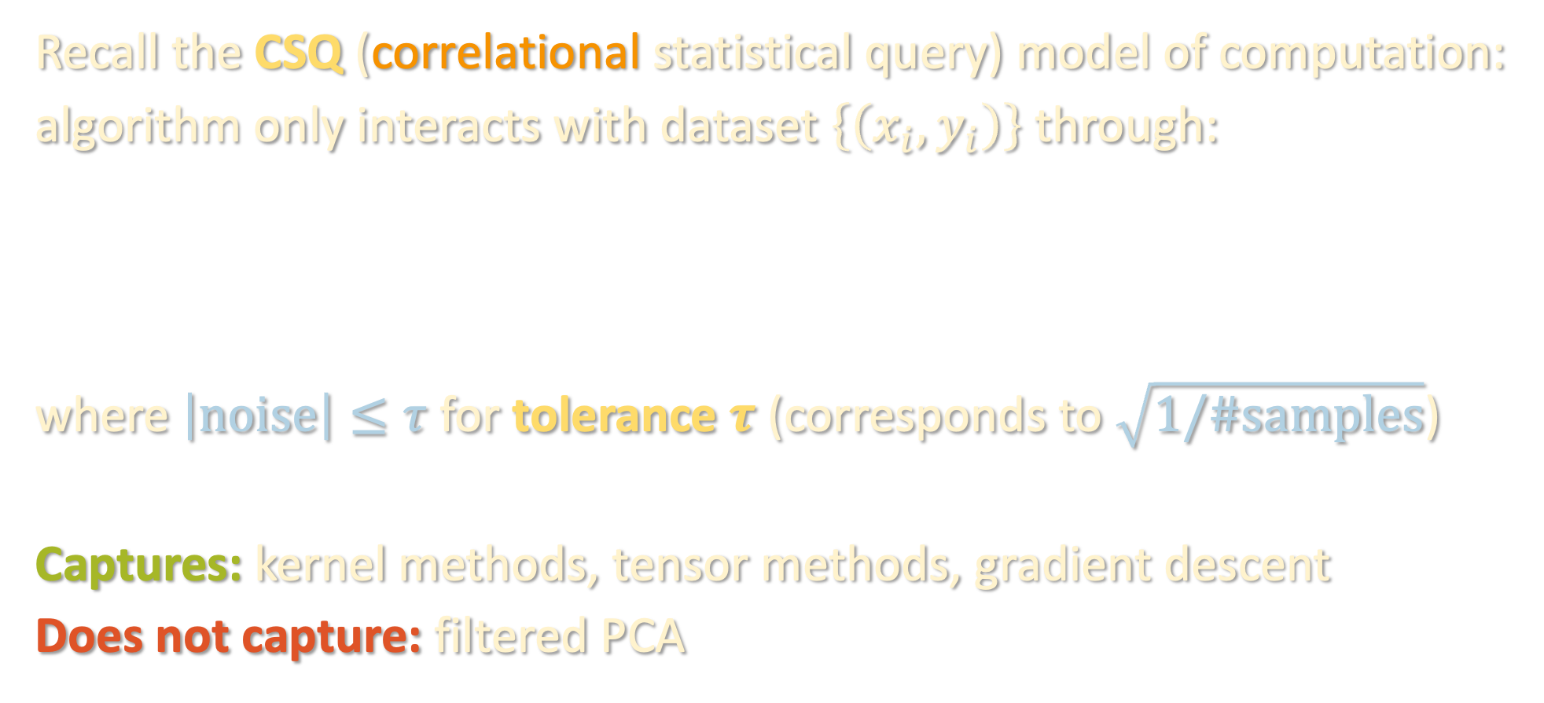
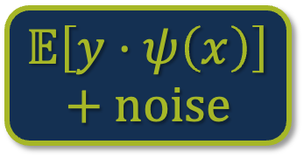

TODAY: STATISTICAL QUERY
Recall the CSQ (correlational statistical query) model of computation:
algorithm only interacts with dataset $\left\{\left(x_{i},y_{i}\right)\right\}$ through:
where $\left|noise\right|≤τ$ for tolerance $τ$ (corresponds to $\sqrt{1/\#samples}$)
Captures: kernel methods, tensor methods, gradient descent
Does not capture: filtered PCA
$$𝔼\left[y⋅ψ\left(x\right)\right]+noise$$
$$ψ:ℝ^{d}→ℝ$$

Slide 33
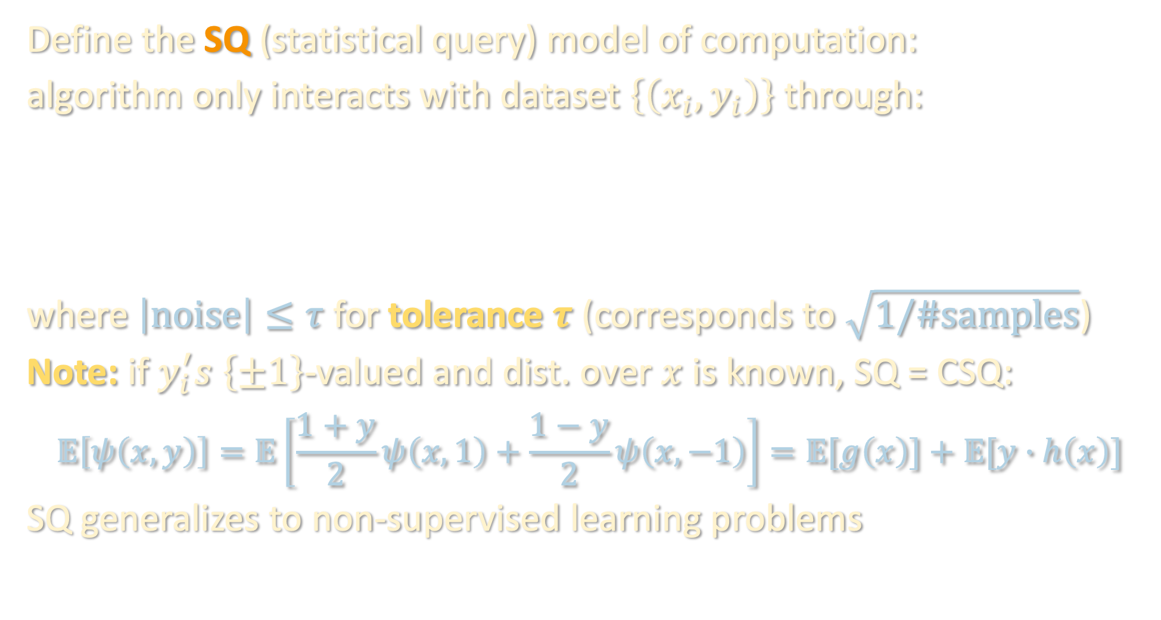
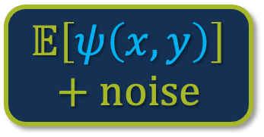

TODAY: STATISTICAL QUERY
Define the SQ (statistical query) model of computation:
algorithm only interacts with dataset $\left\{\left(x_{i},y_{i}\right)\right\}$ through:
where $\left|noise\right|≤τ$ for tolerance $τ$ (corresponds to $\sqrt{1/\#samples}$)
Note: if $y_{i}^{′}s$ $\left\{±1\right\}$-valued and dist. over $x$ is known, SQ = CSQ:
$$𝔼\left[ψ\left(x,y\right)\right]=𝔼\left[\frac{1+y}{2}ψ\left(x,1\right)+\frac{1−y}{2}ψ\left(x,−1\right)\right]=𝔼[g\left(x\right)]+𝔼[y∙h\left(x\right)]$$
SQ generalizes to non-supervised learning problems
$$𝔼\left[ψ\left(x,y\right)\right]+noise$$
$$ψ:ℝ^{d}×ℝ→ℝ$$

Slide 34
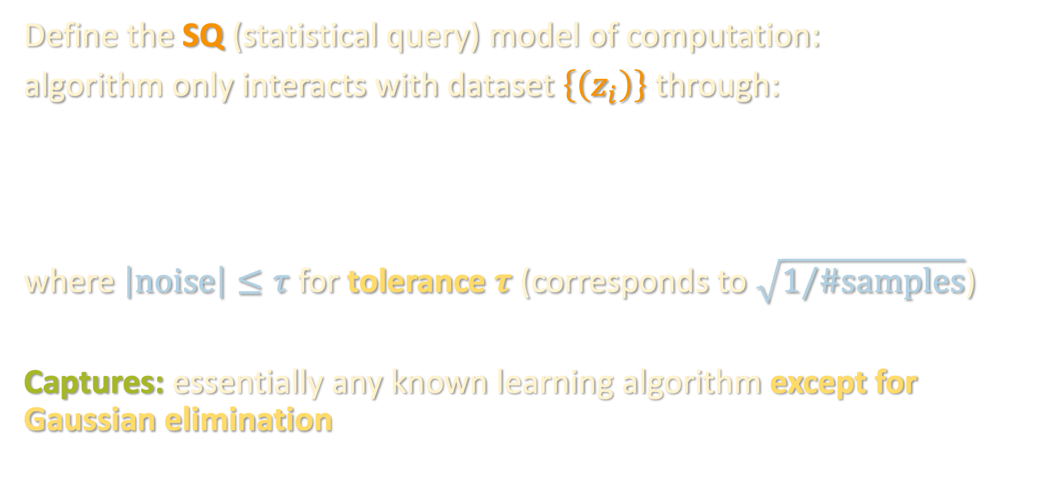
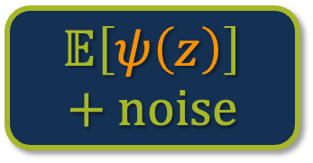

TODAY: STATISTICAL QUERY
Define the SQ (statistical query) model of computation:
algorithm only interacts with dataset $\left\{\left(z_{i}\right)\right\}$ through:
where $\left|noise\right|≤τ$ for tolerance $τ$ (corresponds to $\sqrt{1/\#samples}$)
Captures: essentially any known learning algorithm except for Gaussian elimination
$$𝔼\left[ψ\left(z\right)\right]+noise$$
$$ψ:ℝ^{m}→ℝ$$

Slide 35
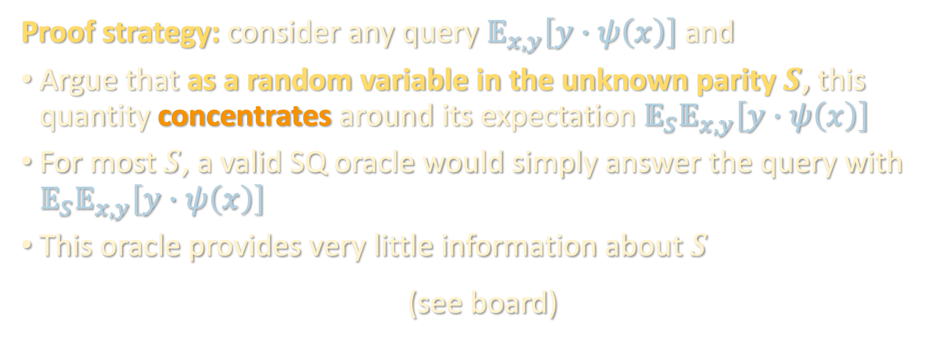
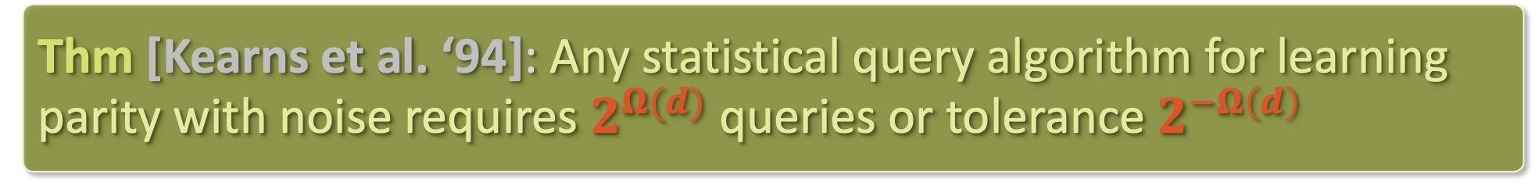
SQ LOWER BOUND FOR NOISY PARITY
Thm [Kearns et al. ‘94]: Any statistical query algorithm for learning parity with noise requires $2^{Ω(d)}$ queries or tolerance $2^{−Ω\left(d\right)}$
Proof strategy: consider any query $𝔼_{x,y}\left[y∙ψ\left(x\right)\right]$ and
Argue that as a random variable in the unknown parity $S$, this quantity concentrates around its expectation $𝔼_{S}𝔼_{x,y}\left[y∙ψ\left(x\right)\right]$
For most $S$, a valid SQ oracle would simply answer the query with $𝔼_{S}𝔼_{x,y}\left[y∙ψ\left(x\right)\right]$
This oracle provides very little information about $S$
(see board)

