Slide 1

CS 224: ALGORITHMS FOR DATA SCIENCE
LECTURE 21 (11/20)
Tensor decomposition
Sum-of-squares
Robustness
Supervised learning
Computational complexity
Statistical physics
Generative modeling
BELIEF PROPAGATION, BETHE FREE ENERGY

Slide 2

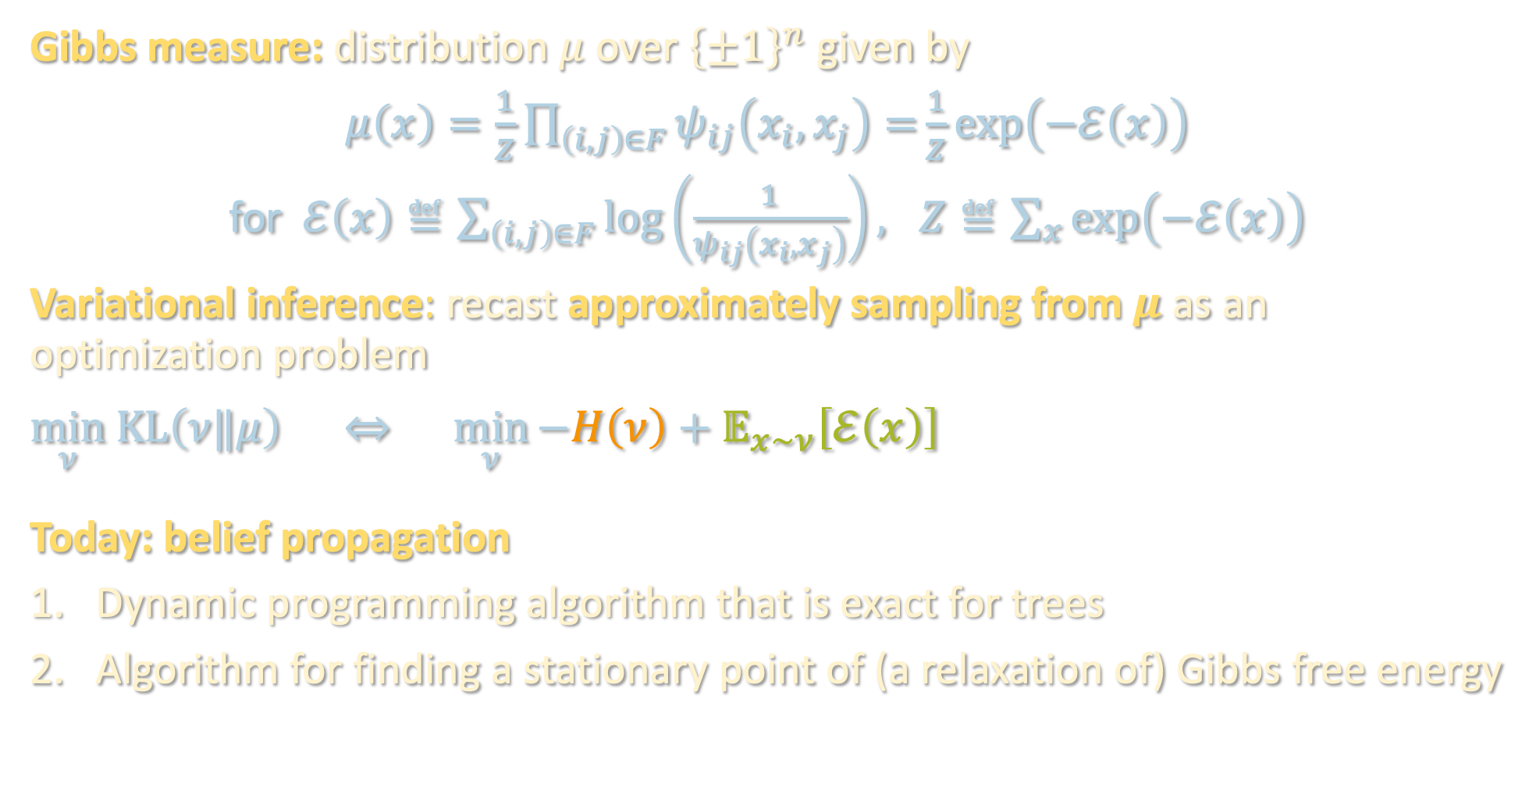
GRAPHICAL MODELS RECAP
Gibbs measure: distribution $μ$ over ${\left\{±1\right\}}^{n}$ given by
$μ\left(x\right)=\frac{1}{Z}\prod_{\left(i,j\right)∈F}{ψ_{ij}\left(x_{i},x_{j}\right)=}\frac{1}{Z}\exp\left(−ℰ\left(x\right)\right)$
for $ℰ\left(x\right)≝\sum_{\left(i,j\right)∈F}{\log\left(\frac{1}{ψ_{ij}\left(x_{i},x_{j}\right)}\right)}, Z≝\sum_{x}{\exp\left(−ℰ\left(x\right)\right)}$
Variational inference: recast approximately sampling from $μ$ as an optimization problem
$$\min_{ν} KL\left(ν‖μ\right) ⇔ \min_{ν}{−H\left(ν\right)+𝔼_{x∼ν}\left[ℰ\left(x\right)\right]}$$
Today: belief propagation
Dynamic programming algorithm that is exact for trees
Algorithm for finding a stationary point of (a relaxation of) Gibbs free energy
Gibbs free energy
(for $ν$ that we optimize over, this is easy to evaluate)
entropy
average energy

Slide 3
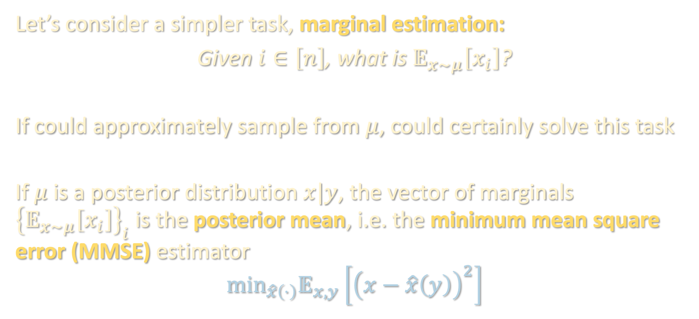
MARGINAL ESTIMATION
Let’s consider a simpler task, marginal estimation:
Given $i∈\left[n\right]$, what is $𝔼_{x∼μ}\left[x_{i}\right]$?
If could approximately sample from $μ$, could certainly solve this task
If $μ$ is a posterior distribution $x|y$, the vector of marginals ${\left\{𝔼_{x∼μ}\left[x_{i}\right]\right\}}_{i}$ is the posterior mean, i.e. the minimum mean square error (MMSE) estimator
$$min_{\hat{x}\left(⋅\right)}𝔼_{x,y}\left[{\left(x−\hat{x}\left(y\right)\right)}^{2}\right]$$

Slide 4
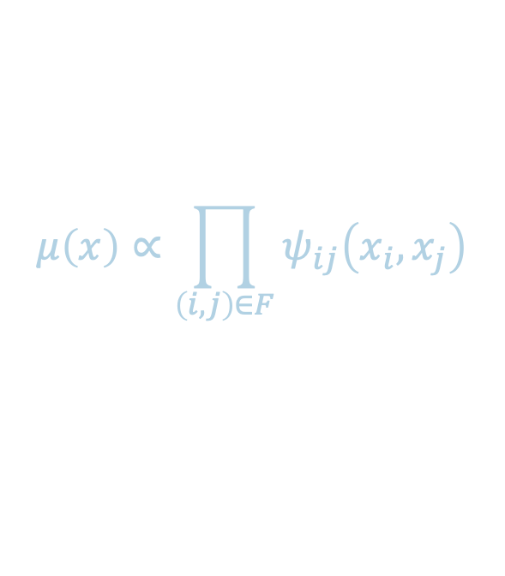

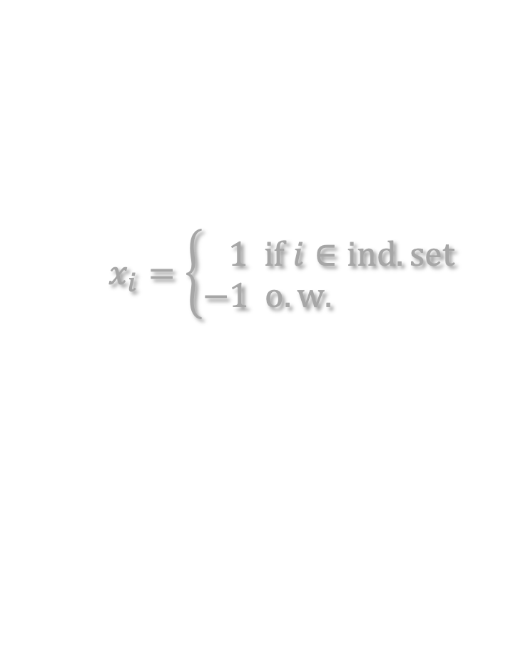
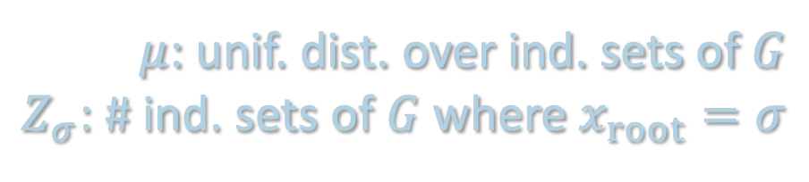
BELIEF PROPAGATION WARMUP
$$μ\left(x\right)∝\prod_{\left(i,j\right)∈F}{ψ_{ij}\left(x_{i},x_{j}\right)}$$
Suppose we want to estimate marginals of the uniform distribution over independent sets of a graph $G$
i.e. $F=\left\{\left(i,j\right)∈G\right\}$, $ψ_{ij}\left(x_{i},x_{j}\right)=1\left[\left(x_{i},x_{j}\right)≠\left(1,1\right)\right]$
#P-complete (i.e. very hard) in general, but suppose $G$ is a tree
$$x_{i}=\left\{\begin{aligned}1 if i∈ind. set \\ −1 o.w. \end{aligned}\right.$$
$μ$: unif. dist. over ind. sets of $G$
$Z_{σ}$: # ind. sets of $G$ where $x_{root}=σ$

Slide 5

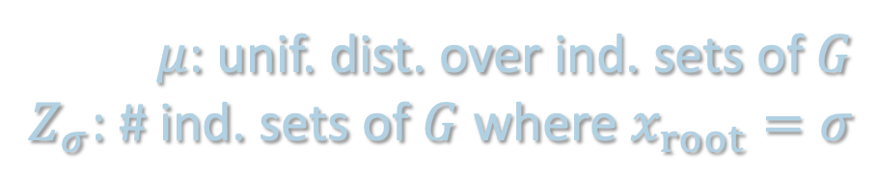
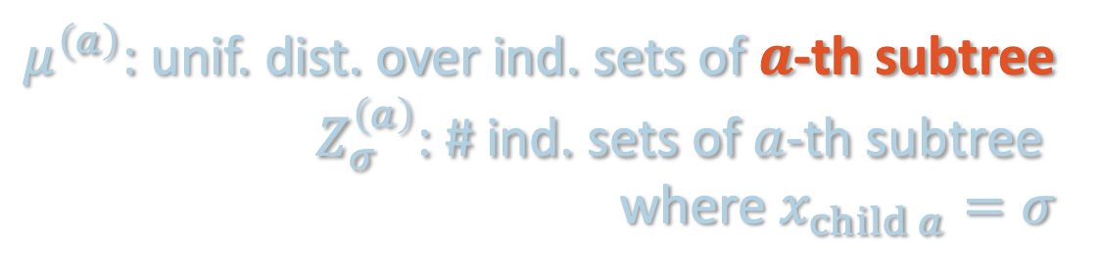
BELIEF PROPAGATION WARMUP
$$μ\left(x\right)∝\prod_{\left(i,j\right)∈F}{ψ_{ij}\left(x_{i},x_{j}\right)}$$
Suppose we want to estimate marginals of the uniform distribution over independent sets of a graph $G$
i.e. $F=\left\{\left(i,j\right)∈G\right\}$, $ψ_{ij}\left(x_{i},x_{j}\right)=1\left[\left(x_{i},x_{j}\right)≠\left(1,1\right)\right]$
#P-complete (i.e. very hard) in general, but suppose $G$ is a tree
$$x_{i}=\left\{\begin{aligned}1 if i∈ind. set \\ −1 o.w. \end{aligned}\right.$$
$μ$: unif. dist. over ind. sets of $G$
$Z_{σ}$: # ind. sets of $G$ where $x_{root}=σ$
$μ^{\left(a\right)}$: unif. dist. over ind. sets of $a$-th subtree
$Z_{σ}^{\left(a\right)}$: # ind. sets of $a$-th subtree
where $x_{child a}=σ$

Slide 6

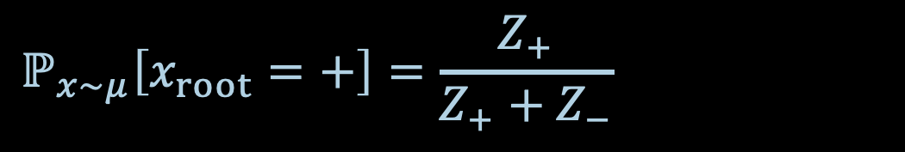
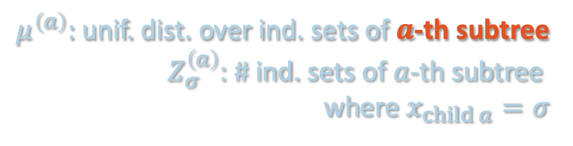
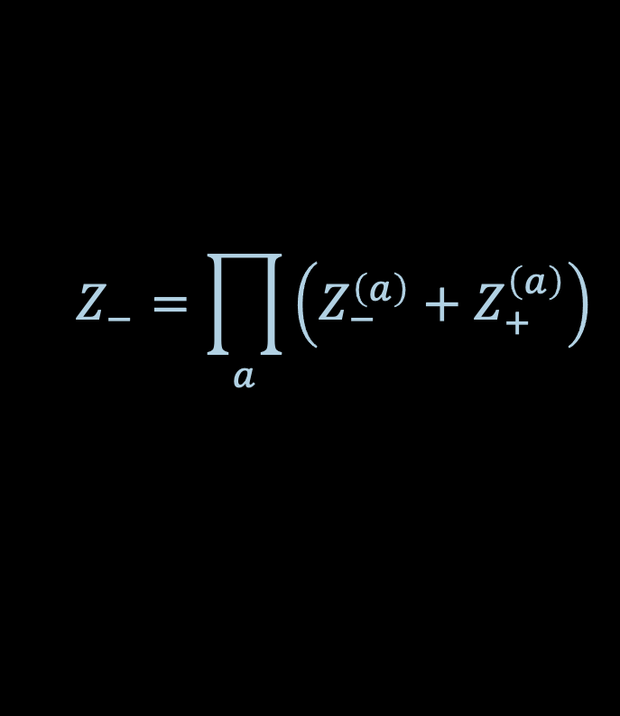
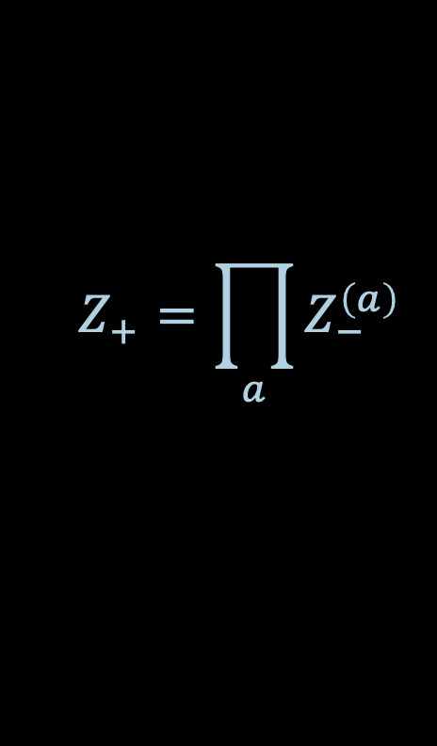

BELIEF PROPAGATION WARMUP
$$x_{i}=\left\{\begin{aligned}1 if i∈ind. set \\ −1 o.w. \end{aligned}\right.$$
$μ$: unif. dist. over ind. sets of $G$
$Z_{σ}$: # ind. sets of $G$ where $x_{root}=σ$
$$Z_{+}=\prod_{a}{Z_{−}^{\left(a\right)}}$$
$μ^{\left(a\right)}$: unif. dist. over ind. sets of $a$-th subtree
$Z_{σ}^{\left(a\right)}$: # ind. sets of $a$-th subtree
where $x_{child a}=σ$
$$Z_{−}=\prod_{a}{\left(Z_{−}^{\left(a\right)}+Z_{+}^{\left(a\right)}\right)}$$
$$ℙ_{x∼μ}\left[x_{root}=+\right]=\frac{Z_{+}}{Z_{+}+Z_{−}}$$

Slide 7

BELIEF PROPAGATION WARMUP
$$x_{i}=\left\{\begin{aligned}1 if i∈ind. set \\ −1 o.w. \end{aligned}\right.$$
$μ$: unif. dist. over ind. sets of $G$
$Z_{σ}$: # ind. sets of $G$ where $x_{root}=σ$
$$Z_{+}=\prod_{a}{Z_{−}^{\left(a\right)}}$$
$μ^{\left(a\right)}$: unif. dist. over ind. sets of $a$-th subtree
$Z_{σ}^{\left(a\right)}$: # ind. sets of $a$-th subtree
where $x_{child a}=σ$
$$Z_{−}=\prod_{a}{\left(Z_{−}^{\left(a\right)}+Z_{+}^{\left(a\right)}\right)}$$
$$ℙ_{x∼μ}\left[x_{root}=+\right]∝Z_{+}$$
Issue: this is not “agnostic” to the tree structure, so not clear how to extend it to general graphs

Slide 8

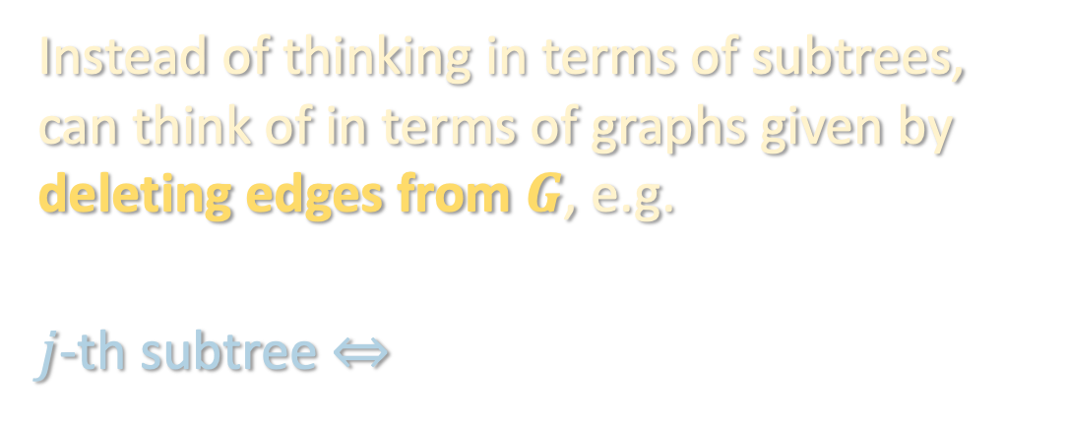


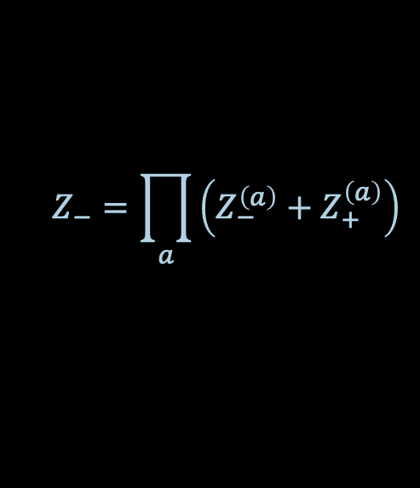

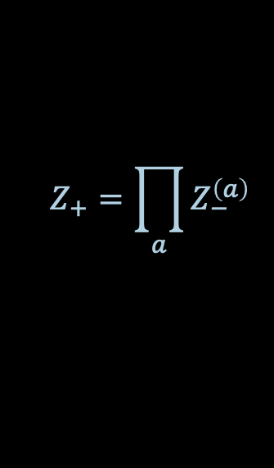

BELIEF PROPAGATION DERIVATION
$$x_{i}=\left\{\begin{aligned}1 if i∈ind. set \\ −1 o.w. \end{aligned}\right.$$
$μ$: unif. dist. over ind. sets of $G$
$Z_{σ}$: # ind. sets of $G$ where $x_{root}=σ$
Instead of thinking in terms of subtrees, can think of in terms of graphs given by deleting edges from $G$, e.g.
$j$-th subtree $⇔$
$μ^{\left(a\right)}$: unif. dist. over ind. sets of $a$-th subtree
$Z_{σ}^{\left(a\right)}$: # ind. sets of $a$-th subtree
where $x_{child a}=σ$
subgraph $V^{j→i}$ given by deleting $\left(i,j\right)$ from $G$ and keeping the side containing $j$
$$i$$
Expresses marginals for entire tree in terms of marginals for$V^{j→i}$ for all $j∈∂i$
$$j$$
$$Z_{+}=\prod_{a}{Z_{−}^{\left(a\right)}}$$
$$Z_{−}=\prod_{a}{\left(Z_{−}^{\left(a\right)}+Z_{+}^{\left(a\right)}\right)}$$
$$ℙ_{x∼μ}\left[x_{root}=+\right]∝Z_{+}$$

Slide 9


BELIEF PROPAGATION DERIVATION
$$x_{i}=\left\{\begin{aligned}1 if i∈ind. set \\ −1 o.w. \end{aligned}\right.$$
$μ$: unif. dist. over ind. sets of $G$
$Z_{σ}$: # ind. sets of $G$ where $x_{root}=σ$
Instead of thinking in terms of subtrees, can think of in terms of graphs given by deleting edges from $G$, e.g.
$i$-th subtree $⇔$
$μ^{\left(a\right)}$: unif. dist. over ind. sets of $a$-th subtree
$Z_{σ}^{\left(a\right)}$: # ind. sets of $a$-th subtree
where $x_{child a}=σ$
subgraph $V^{j→i}$ given by deleting $\left(i,j\right)$ from $G$ and keeping the side containing $j$
$$i$$
We want a self-similar expression of marginals for $V^{j^{′}→i^{′}}$ in terms of marginals for $V^{j→i}$’s
$$j$$
$$Z_{+}=\prod_{a}{Z_{−}^{\left(a\right)}}$$
$$Z_{−}=\prod_{a}{\left(Z_{−}^{\left(a\right)}+Z_{+}^{\left(a\right)}\right)}$$
$$ℙ_{x∼μ}\left[x_{root}=+\right]∝Z_{+}$$

Slide 10


BELIEF PROPAGATION DERIVATION
We want a self-similar expression of marginals for $V^{j^{′}→i^{′}}$ in terms of marginals for $V^{j→i}$’s
Let $m_{σ}^{j →i}$ denote the probability that $x_{j}=σ$ in $V^{j→i}$
“message” that node $j$ passes to node $i$
$$i$$
$$j$$
$$Z_{+}=\prod_{a}{Z_{−}^{\left(a\right)}}$$
$$Z_{−}=\prod_{a}{\left(Z_{−}^{\left(a\right)}+Z_{+}^{\left(a\right)}\right)}$$
$$ℙ_{x∼μ}\left[x_{root}=+\right]∝Z_{+}$$

Slide 11

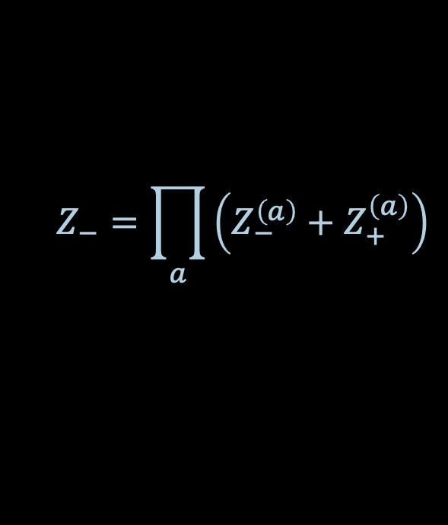

BELIEF PROPAGATION DERIVATION
We want a self-similar expression of marginals for $V^{j^{′}→i^{′}}$ in terms of marginals for $V^{j→i}$’s
Let $m_{σ}^{j →i}$ denote the probability that $x_{j}=σ$ in $V^{j→i}$
$$Z_{+}=\prod_{a}{Z_{−}^{\left(a\right)}}$$
$$Z_{−}=\prod_{a}{\left(Z_{−}^{\left(a\right)}+Z_{+}^{\left(a\right)}\right)}$$
$$i$$
$$ℙ_{x∼μ}\left[x_{root}=+\right]∝Z_{+}$$
$$j$$

Slide 12

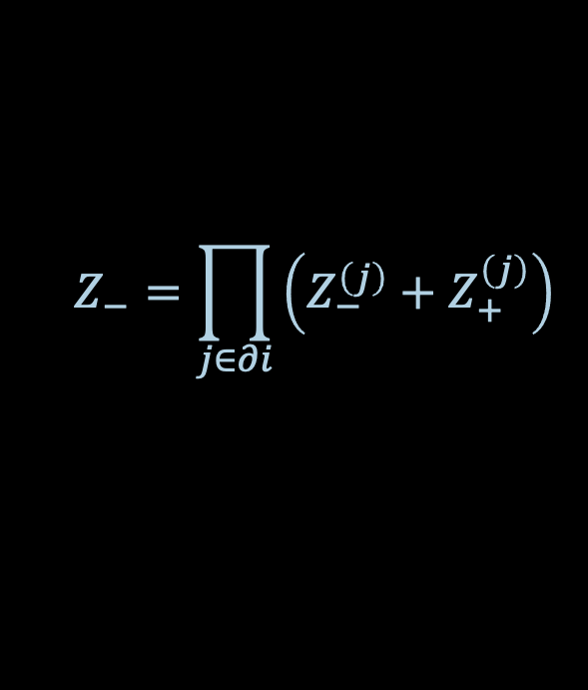
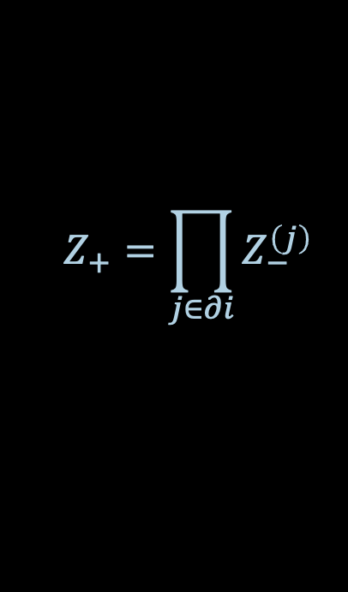
BELIEF PROPAGATION DERIVATION
We want a self-similar expression of marginals for $V^{j^{′}→i^{′}}$ in terms of marginals for $V^{j→i}$’s
Let $m_{σ}^{j →i}$ denote the probability that $x_{j}=σ$ in $V^{j→i}$
$$Z_{+}=\prod_{j∈∂i}{Z_{−}^{\left(j\right)}}$$
$$Z_{−}=\prod_{j∈∂i}{\left(Z_{−}^{\left(j\right)}+Z_{+}^{\left(j\right)}\right)}$$
$$i$$
$$ℙ_{x∼μ}\left[x_{i}=+\right]∝Z_{+}$$
$$j$$

Slide 13
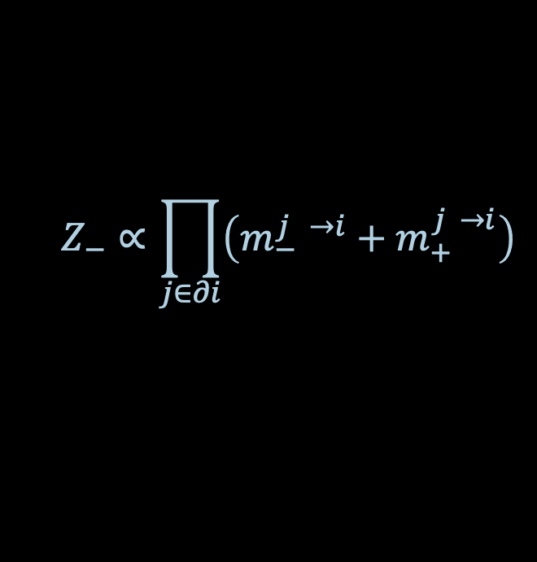
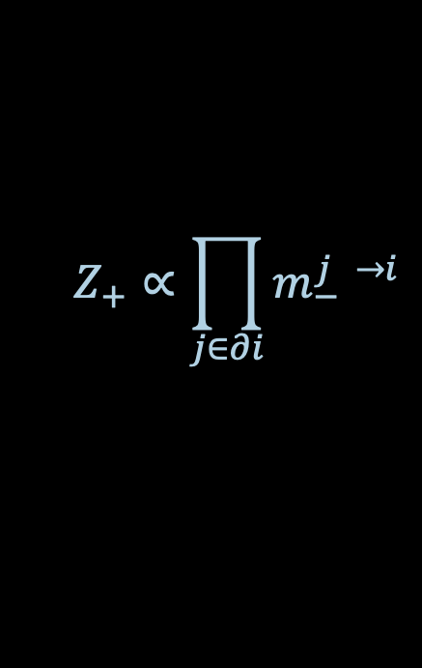
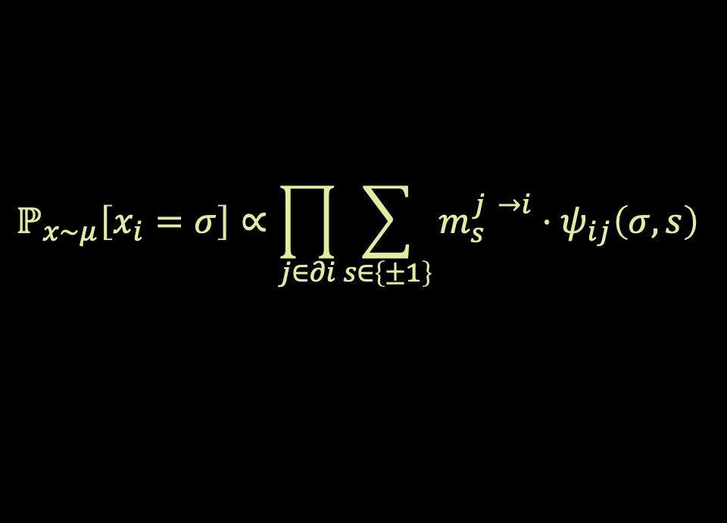
BELIEF PROPAGATION DERIVATION
We want a self-similar expression of marginals for $V^{j^{′}→i^{′}}$ in terms of marginals for $V^{j→i}$’s
Let $m_{σ}^{j →i}$ denote the probability that $x_{j}=σ$ in $V^{j→i}$
$$Z_{+}∝\prod_{j∈∂i}{m_{−}^{j →i}}$$
$$Z_{−}∝\prod_{j∈∂i}{\left(m_{−}^{j →i}+m_{+}^{j →i}\right)}$$
$$i$$
$$ℙ_{x∼μ}\left[x_{i}=+\right]∝Z_{+}$$
$$j$$
$$ℙ_{x∼μ}\left[x_{i}=σ\right]∝\prod_{j∈∂i}{\sum_{s∈\left\{±1\right\}}{m_{s}^{j →i}⋅ψ_{ij}\left(σ,s\right)}}$$

Slide 14
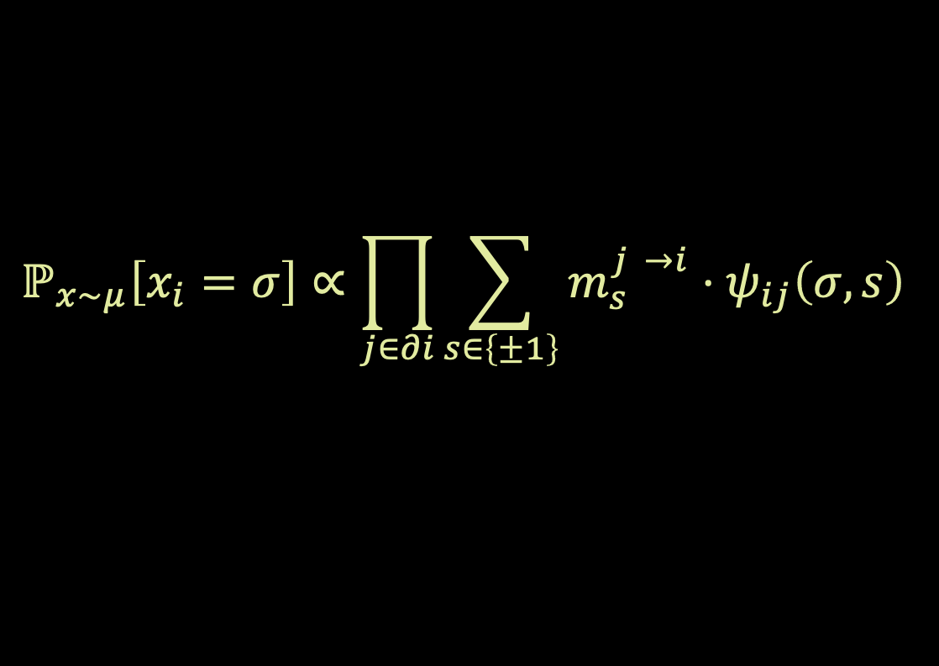
BELIEF PROPAGATION DERIVATION
We want a self-similar expression of marginals for $V^{j^{′}→i^{′}}$ in terms of marginals for $V^{j→i}$’s
Let $m_{σ}^{j →i}$ denote the probability that $x_{j}=σ$ in $V^{j→i}$
$$ℙ_{x∼μ}\left[x_{i}=σ\right]∝\prod_{j∈∂i}{\sum_{s∈\left\{±1\right\}}{m_{s}^{j →i}⋅ψ_{ij}\left(σ,s\right)}}$$
$$i$$
$$j$$

Slide 15



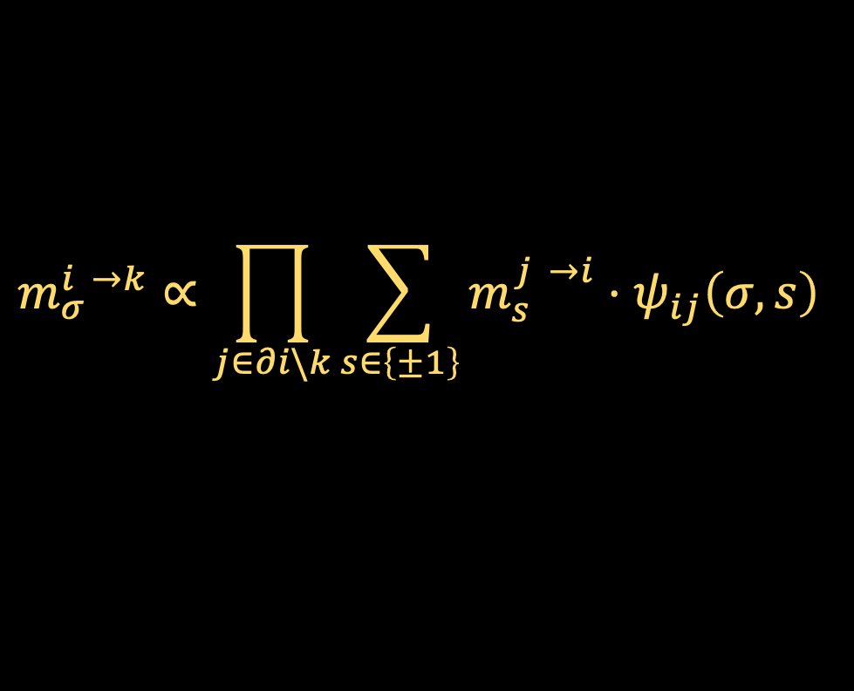
BELIEF PROPAGATION DERIVATION
We want a self-similar expression of marginals for $V^{j^{′}→i^{′}}$ in terms of marginals for $V^{j→i}$’s
Let $m_{σ}^{j →i}$ denote the probability that $x_{j}=σ$ in $V^{j→i}$
$$ℙ_{x∼μ}\left[x_{i}=σ\right]∝\prod_{j∈∂i}{\sum_{s∈\left\{±1\right\}}{m_{s}^{j →i}⋅ψ_{ij}\left(σ,s\right)}}$$
$$V^{i→k}$$
$$i$$
$$k$$
$$m_{σ}^{i →k}∝\prod_{j∈∂i\backslash k}{\sum_{s∈\left\{±1\right\}}{m_{s}^{j →i}⋅ψ_{ij}\left(σ,s\right)}}$$
$$j$$

Slide 16


BELIEF PROPAGATION DERIVATION
We want a self-similar expression of marginals for $V^{j^{′}→i^{′}}$ in terms of marginals for $V^{j→i}$’s
Let $m_{σ}^{j →i}$ denote the probability that $x_{j}=σ$ in $V^{j→i}$
Let ${\overline{m}}_{σ}^{j → i}$ denote the probability that $x_{i}=σ$ in ${\overline{V}}^{j→i}$
$$ℙ_{x∼μ}\left[x_{i}=σ\right]∝\prod_{j∈∂i}{\sum_{s∈\left\{±1\right\}}{m_{s}^{j →i}⋅ψ_{ij}\left(σ,s\right)}}$$
${\overline{V}}^{j→i}$
$$i$$
$∝$ marginal for ${\overline{V}}^{j→i}$
$$m_{σ}^{i →k}∝\prod_{j∈∂i\backslash k}{\sum_{s∈\left\{±1\right\}}{m_{s}^{j →i}⋅ψ_{ij}\left(σ,s\right)}}$$
$$j$$

Slide 17
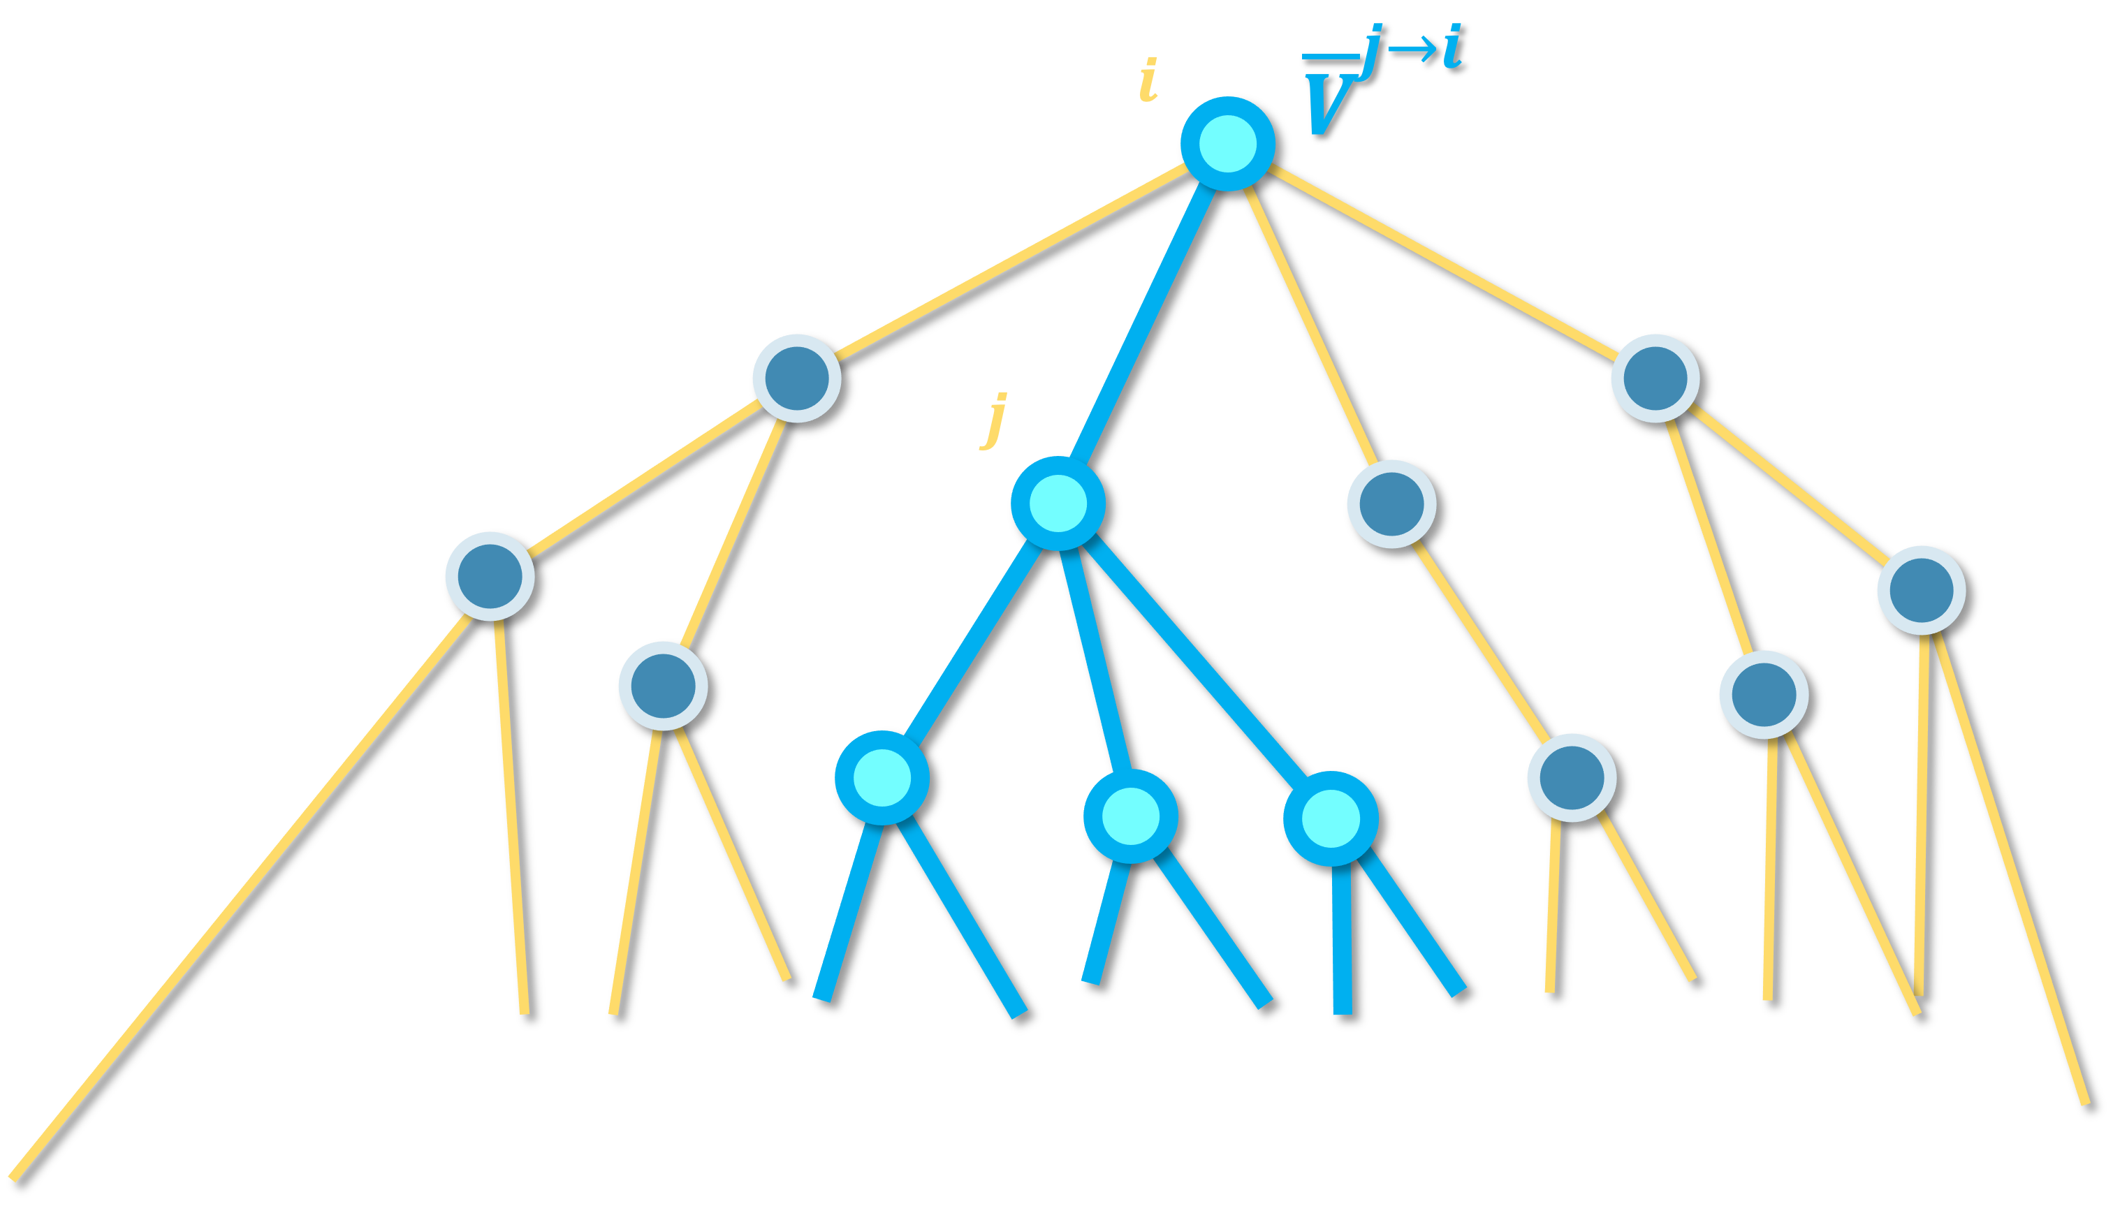
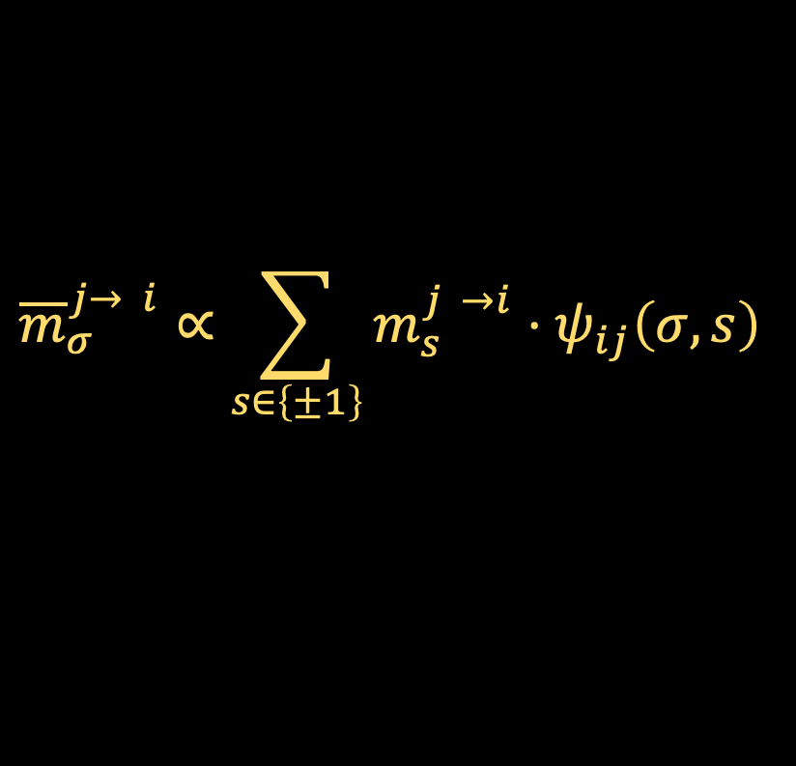
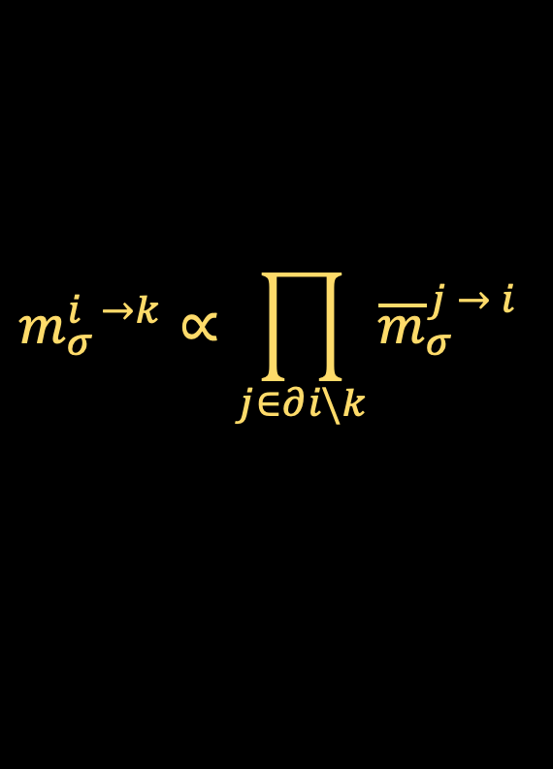
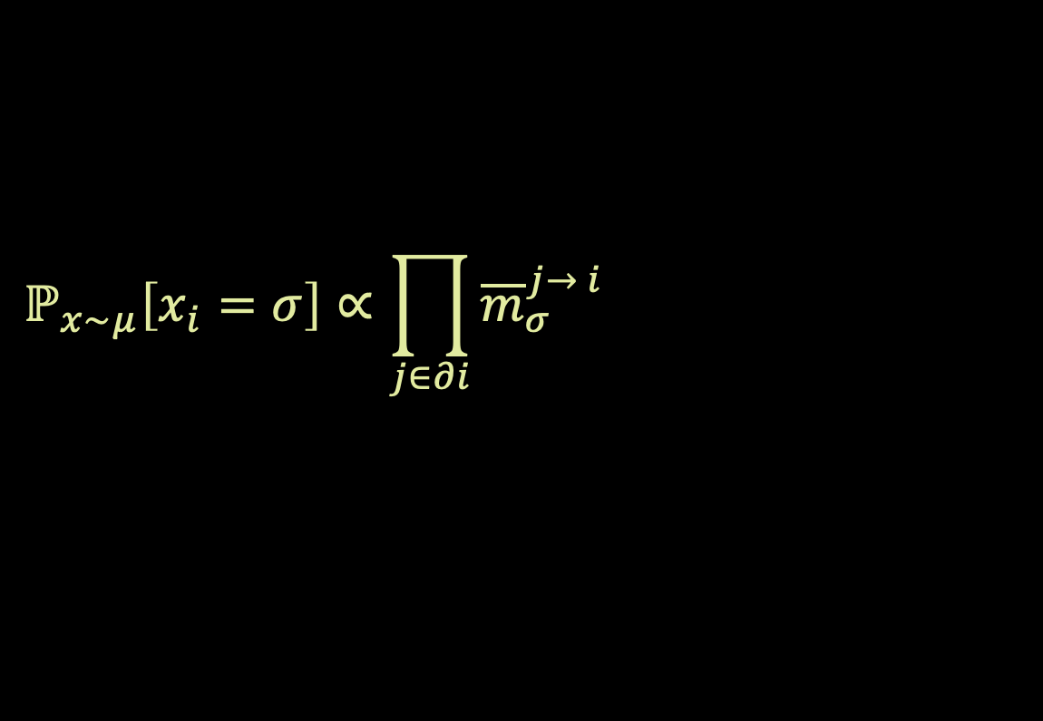
BELIEF PROPAGATION DERIVATION
We want a self-similar expression of marginals for $V^{j^{′}→i^{′}}$ in terms of marginals for $V^{j→i}$’s
Let $m_{σ}^{j →i}$ denote the probability that $x_{j}=σ$ in $V^{j→i}$
Let ${\overline{m}}_{σ}^{j → i}$ denote the probability that $x_{i}=σ$ in ${\overline{V}}^{j→i}$
$$ℙ_{x∼μ}\left[x_{i}=σ\right]∝\prod_{j∈∂i}{\sum_{s∈\left\{±1\right\}}{m_{s}^{j →i}⋅ψ_{ij}\left(σ,s\right)}}$$
$$m_{σ}^{i →k}∝\prod_{j∈∂i\backslash k}{{\overline{m}}_{σ}^{j → i}}$$
$${\overline{m}}_{σ}^{j→ i}∝\sum_{s∈\left\{±1\right\}}{m_{s}^{j →i}⋅ψ_{ij}\left(σ,s\right)}$$
$$ℙ_{x∼μ}\left[x_{i}=σ\right]∝\prod_{j∈∂i}{{\overline{m}}_{σ}^{j→ i}}∝m_{σ}^{i →k}⋅{\overline{m}}_{σ}^{k→ i}$$

Slide 18
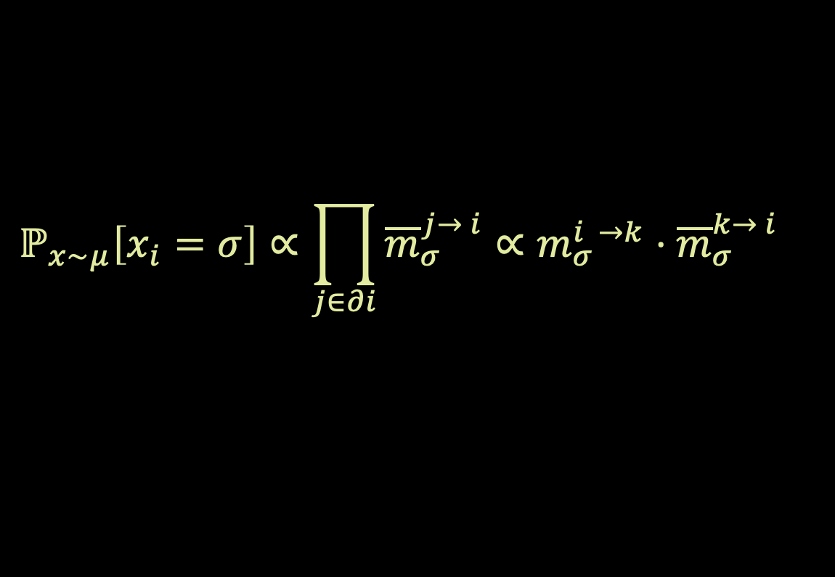
BELIEF PROPAGATION DERIVATION
We want a self-similar expression of marginals for $V^{j^{′}→i^{′}}$ in terms of marginals for $V^{j→i}$’s
Let $m_{σ}^{j →i}$ denote the probability that $x_{j}=σ$ in $V^{j→i}$
Let ${\overline{m}}_{σ}^{j → i}$ denote the probability that $x_{i}=σ$ in ${\overline{V}}^{j→i}$
$$ℙ_{x∼μ}\left[x_{i}=σ\right]∝\prod_{j∈∂i}{\sum_{s∈\left\{±1\right\}}{m_{s}^{j →i}⋅ψ_{ij}\left(σ,s\right)}}$$
$$m_{σ}^{i →k}∝\prod_{j∈∂i\backslash k}{{\overline{m}}_{σ}^{j → i}}$$
$${\overline{m}}_{σ}^{j→ i}∝\sum_{s∈\left\{±1\right\}}{m_{s}^{j →i}⋅ψ_{ij}\left(σ,s\right)}$$
$$ℙ_{x∼μ}\left[x_{i}=σ\right]∝\prod_{j∈∂i}{{\overline{m}}_{σ}^{j→ i}}∝m_{σ}^{i →k}⋅{\overline{m}}_{σ}^{k→ i}$$

Slide 19
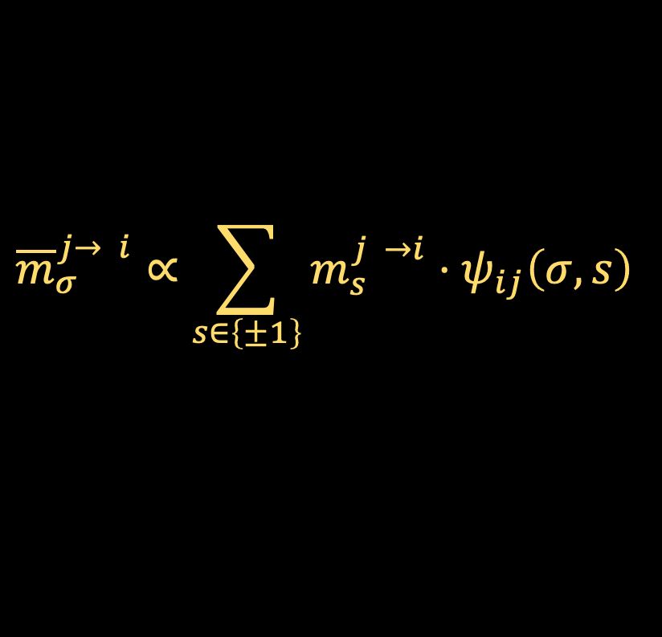




BELIEF PROPAGATION DERIVATION
We want a self-similar expression of marginals for $V^{j^{′}→i^{′}}$ in terms of marginals for $V^{j→i}$’s
Belief propagation (BP): repeatedly update msgs ${\left\{m_{σ}^{i→j},{\overline{m}}_{σ}^{j→i}\right\}}_{\left(i,j\right)∈G, σ∈\left\{±1\right\}}$in parallel using (*), then use (**) to estimate marginals
$$m_{σ}^{i →k}∝\prod_{j∈∂i\backslash k}{{\overline{m}}_{σ}^{j → i}}$$
$${\overline{m}}_{σ}^{j→ i}∝\sum_{s∈\left\{±1\right\}}{m_{s}^{j →i}⋅ψ_{ij}\left(σ,s\right)}$$
(*)
$$ℙ_{x∼μ}\left[x_{i}=σ\right]∝\prod_{j∈∂i}{{\overline{m}}_{σ}^{j→ i}}∝m_{σ}^{i →k}⋅{\overline{m}}_{σ}^{k→ i}$$
(**)
Proposition (“BP is exact on trees”): If $G$ is a tree, belief propagation exactly recovers the marginals of the Gibbs measure

Slide 20

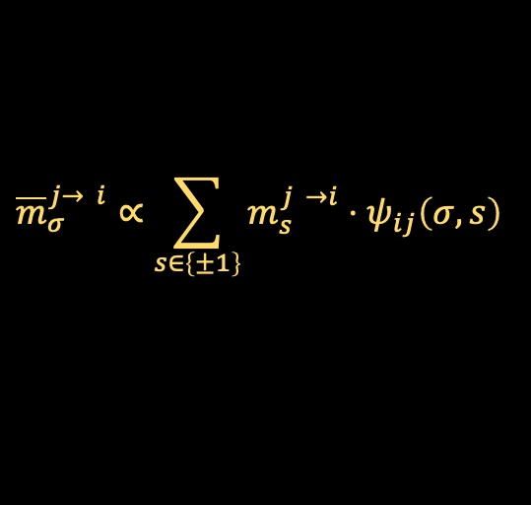

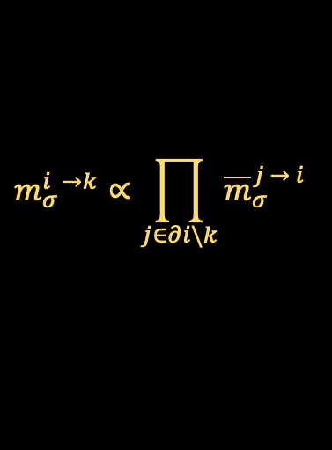

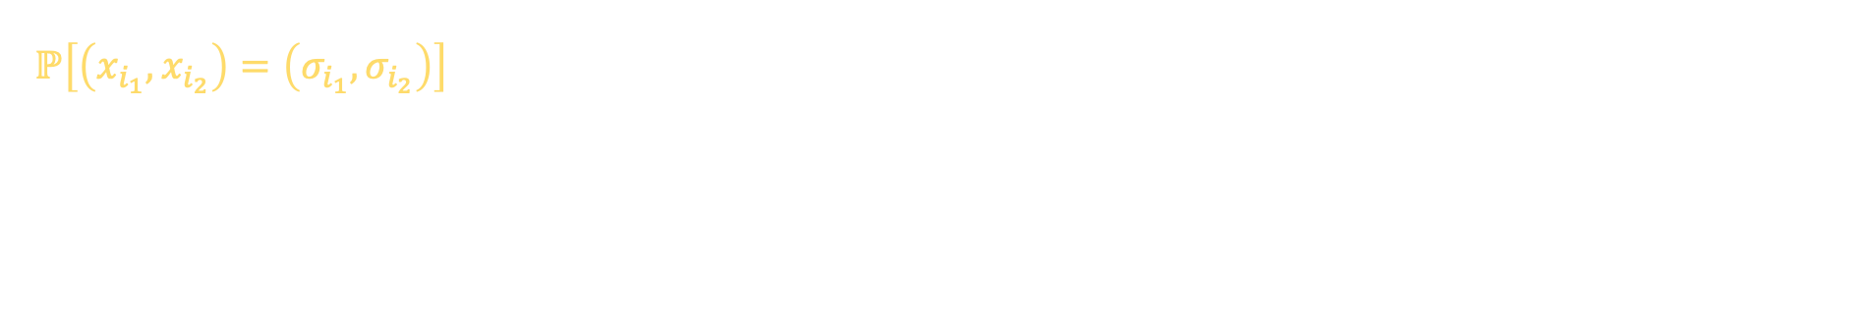
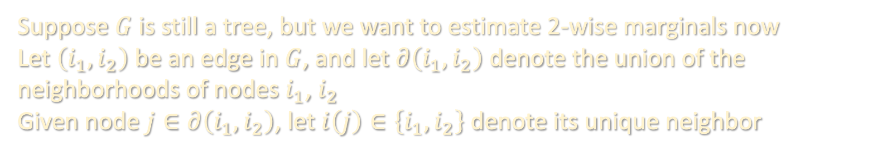

HIGHER-ORDER MARGINALS
$$m_{σ}^{i →k}∝\prod_{j∈∂i\backslash k}{{\overline{m}}_{σ}^{j → i}}$$
$${\overline{m}}_{σ}^{j→ i}∝\sum_{s∈\left\{±1\right\}}{m_{s}^{j →i}⋅ψ_{ij}\left(σ,s\right)}$$
Suppose $G$ is still a tree, but we want to estimate 2-wise marginals now
Let $\left(i_{1},i_{2}\right)$ be an edge in $G$, and let $∂\left(i_{1},i_{2}\right)$ denote the union of the neighborhoods of nodes $i_{1}$, $i_{2}$
Given node $j∈∂\left(i_{1},i_{2}\right)$, let $i\left(j\right)∈\left\{i_{1},i_{2}\right\}$ denote its unique neighbor
$$ℙ\left[\left(x_{i_{1}},x_{i_{2}}\right)=\left(σ_{i_{1}},σ_{i_{2}}\right)\right]$$
$$i\left(j\right)$$
$$i_{1}$$
$$i_{2}$$
$$j$$

Slide 21
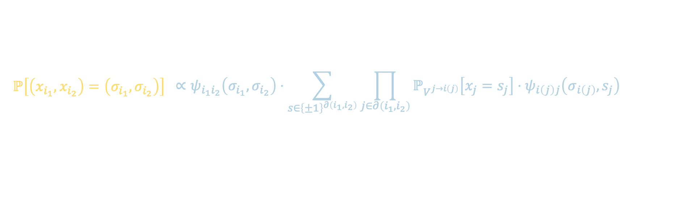
HIGHER-ORDER MARGINALS
$$m_{σ}^{i →k}∝\prod_{j∈∂i\backslash k}{{\overline{m}}_{σ}^{j → i}}$$
$${\overline{m}}_{σ}^{j→ i}∝\sum_{s∈\left\{±1\right\}}{m_{s}^{j →i}⋅ψ_{ij}\left(σ,s\right)}$$
Suppose $G$ is still a tree, but we want to estimate 2-wise marginals now
Let $\left(i_{1},i_{2}\right)$ be an edge in $G$, and let $∂\left(i_{1},i_{2}\right)$ denote the union of the neighborhoods of nodes $i_{1}$, $i_{2}$
Given node $j∈∂\left(i_{1},i_{2}\right)$, let $i\left(j\right)∈\left\{i_{1},i_{2}\right\}$ denote its unique neighbor
$$ℙ\left[\left(x_{i_{1}},x_{i_{2}}\right)=\left(σ_{i_{1}},σ_{i_{2}}\right)\right]$$ | $$∝ψ_{i_{1}i_{2}}\left(σ_{i_{1}},σ_{i_{2}}\right)⋅\sum_{s∈{\left\{±1\right\}}^{∂\left(i_{1},i_{2}\right)}}{\prod_{j∈∂\left(i_{1},i_{2}\right)}{ℙ_{V^{j→i\left(j\right)}}\left[x_{j}=s_{j}\right]⋅ψ_{i\left(j\right)j}\left(σ_{i\left(j\right)},s_{j}\right)}}$$
$$i\left(j\right)$$
$$i_{1}$$
$$i_{2}$$
$$j$$

Slide 22
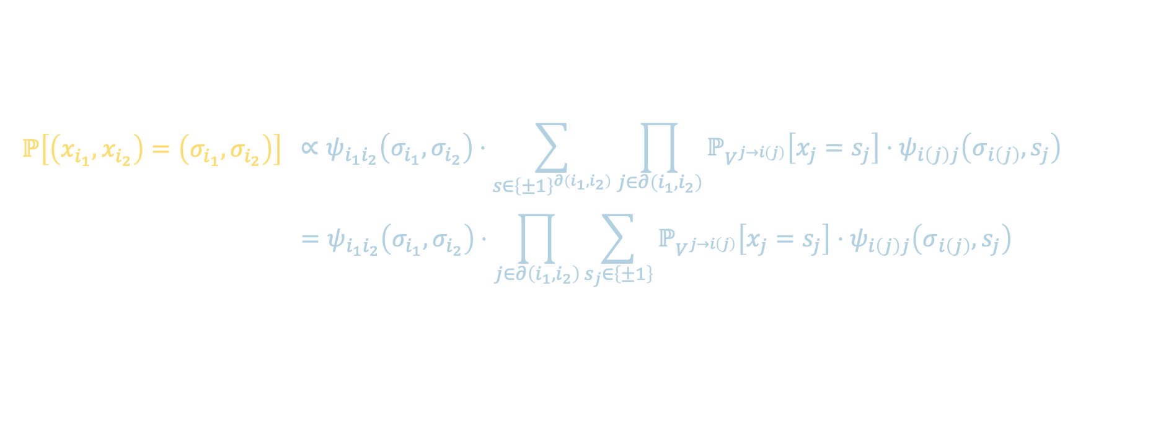
HIGHER-ORDER MARGINALS
$$m_{σ}^{i →k}∝\prod_{j∈∂i\backslash k}{{\overline{m}}_{σ}^{j → i}}$$
$${\overline{m}}_{σ}^{j→ i}∝\sum_{s∈\left\{±1\right\}}{m_{s}^{j →i}⋅ψ_{ij}\left(σ,s\right)}$$
Suppose $G$ is still a tree, but we want to estimate 2-wise marginals now
Let $\left(i_{1},i_{2}\right)$ be an edge in $G$, and let $∂\left(i_{1},i_{2}\right)$ denote the union of the neighborhoods of nodes $i_{1}$, $i_{2}$
Given node $j∈∂\left(i_{1},i_{2}\right)$, let $i\left(j\right)∈\left\{i_{1},i_{2}\right\}$ denote its unique neighbor
$$ℙ\left[\left(x_{i_{1}},x_{i_{2}}\right)=\left(σ_{i_{1}},σ_{i_{2}}\right)\right]$$ | $$∝ψ_{i_{1}i_{2}}\left(σ_{i_{1}},σ_{i_{2}}\right)⋅\sum_{s∈{\left\{±1\right\}}^{∂\left(i_{1},i_{2}\right)}}{\prod_{j∈∂\left(i_{1},i_{2}\right)}{ℙ_{V^{j→i\left(j\right)}}\left[x_{j}=s_{j}\right]⋅ψ_{i\left(j\right)j}\left(σ_{i\left(j\right)},s_{j}\right)}}$$
 | $$=ψ_{i_{1}i_{2}}\left(σ_{i_{1}},σ_{i_{2}}\right)⋅\prod_{j∈∂\left(i_{1},i_{2}\right)}{\sum_{s_{j}∈\left\{±1\right\}}{ℙ_{V^{j→i\left(j\right)}}\left[x_{j}=s_{j}\right]⋅ψ_{i\left(j\right)j}\left(σ_{i\left(j\right)},s_{j}\right) }}$$
$$i\left(j\right)$$
$$i_{1}$$
$$i_{2}$$
$$j$$

Slide 23
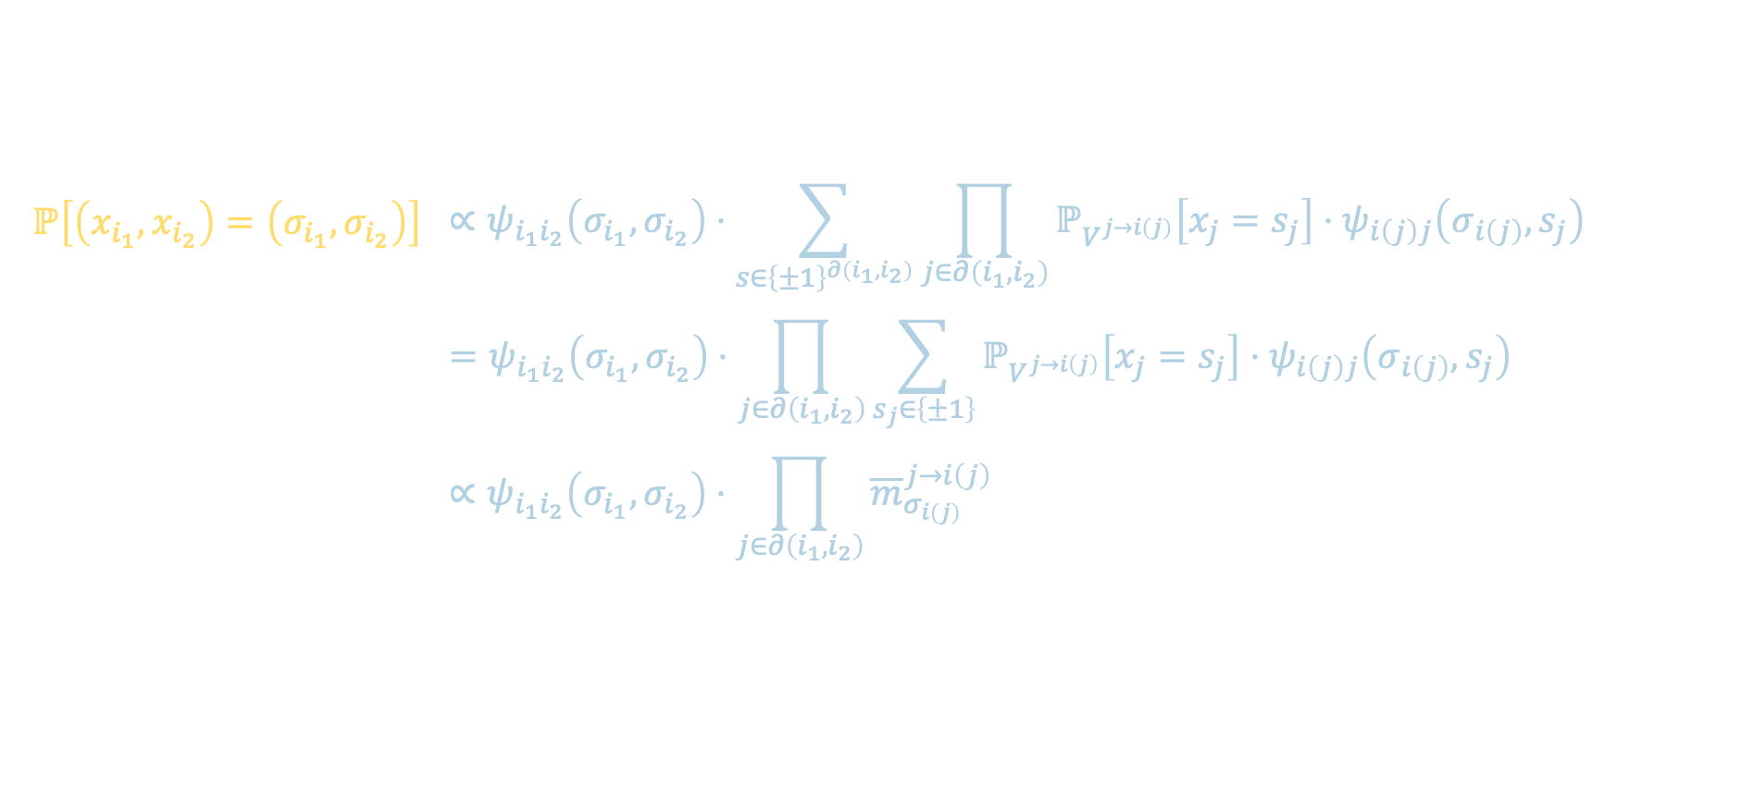
HIGHER-ORDER MARGINALS
$$m_{σ}^{i →k}∝\prod_{j∈∂i\backslash k}{{\overline{m}}_{σ}^{j → i}}$$
$${\overline{m}}_{σ}^{j→ i}∝\sum_{s∈\left\{±1\right\}}{m_{s}^{j →i}⋅ψ_{ij}\left(σ,s\right)}$$
Suppose $G$ is still a tree, but we want to estimate 2-wise marginals now
Let $\left(i_{1},i_{2}\right)$ be an edge in $G$, and let $∂\left(i_{1},i_{2}\right)$ denote the union of the neighborhoods of nodes $i_{1}$, $i_{2}$
Given node $j∈∂\left(i_{1},i_{2}\right)$, let $i\left(j\right)∈\left\{i_{1},i_{2}\right\}$ denote its unique neighbor
$$ℙ\left[\left(x_{i_{1}},x_{i_{2}}\right)=\left(σ_{i_{1}},σ_{i_{2}}\right)\right]$$ | $$∝ψ_{i_{1}i_{2}}\left(σ_{i_{1}},σ_{i_{2}}\right)⋅\sum_{s∈{\left\{±1\right\}}^{∂\left(i_{1},i_{2}\right)}}{\prod_{j∈∂\left(i_{1},i_{2}\right)}{ℙ_{V^{j→i\left(j\right)}}\left[x_{j}=s_{j}\right]⋅ψ_{i\left(j\right)j}\left(σ_{i\left(j\right)},s_{j}\right)}}$$
 | $$=ψ_{i_{1}i_{2}}\left(σ_{i_{1}},σ_{i_{2}}\right)⋅\prod_{j∈∂\left(i_{1},i_{2}\right)}{\sum_{s_{j}∈\left\{±1\right\}}{ℙ_{V^{j→i\left(j\right)}}\left[x_{j}=s_{j}\right]⋅ψ_{i\left(j\right)j}\left(σ_{i\left(j\right)},s_{j}\right) }}$$
 | $$∝ψ_{i_{1}i_{2}}\left(σ_{i_{1}},σ_{i_{2}}\right)⋅\prod_{j∈∂\left(i_{1},i_{2}\right)}{{\overline{m}}_{σ_{i\left(j\right)}}^{j→i\left(j\right)}}$$
$$i\left(j\right)$$
$$i_{1}$$
$$i_{2}$$
$$j$$

Slide 24
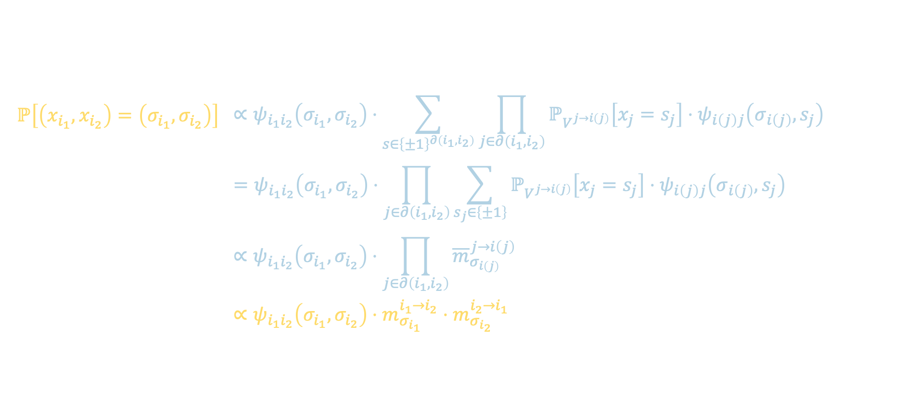
HIGHER-ORDER MARGINALS
$$m_{σ}^{i →k}∝\prod_{j∈∂i\backslash k}{{\overline{m}}_{σ}^{j → i}}$$
$${\overline{m}}_{σ}^{j→ i}∝\sum_{s∈\left\{±1\right\}}{m_{s}^{j →i}⋅ψ_{ij}\left(σ,s\right)}$$
Suppose $G$ is still a tree, but we want to estimate 2-wise marginals now
Let $\left(i_{1},i_{2}\right)$ be an edge in $G$, and let $∂\left(i_{1},i_{2}\right)$ denote the union of the neighborhoods of nodes $i_{1}$, $i_{2}$
Given node $j∈∂\left(i_{1},i_{2}\right)$, let $i\left(j\right)∈\left\{i_{1},i_{2}\right\}$ denote its unique neighbor
$$ℙ\left[\left(x_{i_{1}},x_{i_{2}}\right)=\left(σ_{i_{1}},σ_{i_{2}}\right)\right]$$ | $$∝ψ_{i_{1}i_{2}}\left(σ_{i_{1}},σ_{i_{2}}\right)⋅\sum_{s∈{\left\{±1\right\}}^{∂\left(i_{1},i_{2}\right)}}{\prod_{j∈∂\left(i_{1},i_{2}\right)}{ℙ_{V^{j→i\left(j\right)}}\left[x_{j}=s_{j}\right]⋅ψ_{i\left(j\right)j}\left(σ_{i\left(j\right)},s_{j}\right)}}$$
 | $$=ψ_{i_{1}i_{2}}\left(σ_{i_{1}},σ_{i_{2}}\right)⋅\prod_{j∈∂\left(i_{1},i_{2}\right)}{\sum_{s_{j}∈\left\{±1\right\}}{ℙ_{V^{j→i\left(j\right)}}\left[x_{j}=s_{j}\right]⋅ψ_{i\left(j\right)j}\left(σ_{i\left(j\right)},s_{j}\right) }}$$
 | $$∝ψ_{i_{1}i_{2}}\left(σ_{i_{1}},σ_{i_{2}}\right)⋅\prod_{j∈∂\left(i_{1},i_{2}\right)}{{\overline{m}}_{σ_{i\left(j\right)}}^{j→i\left(j\right)}}$$
 | $$∝ψ_{i_{1}i_{2}}\left(σ_{i_{1}},σ_{i_{2}}\right)⋅m_{σ_{i_{1}}}^{i_{1}→i_{2}}⋅m_{σ_{i_{2}}}^{i_{2}→i_{1}}$$
$$i\left(j\right)$$
$$i_{1}$$
$$i_{2}$$
$$j$$

Slide 25
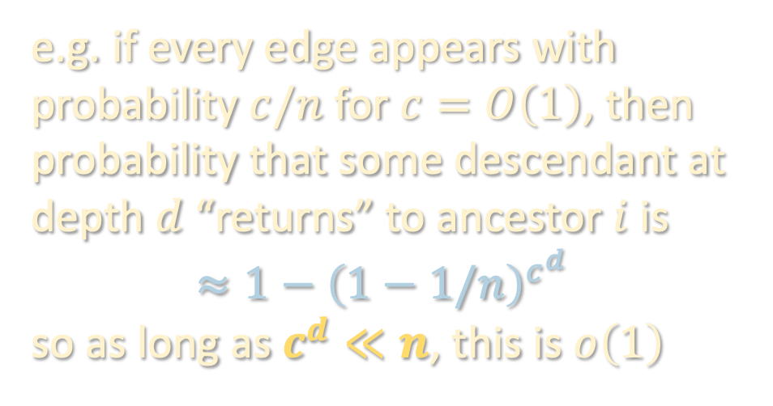
GENERAL GRAPHS
While one can run BP on general, not-necessarily-acyclic graphs, it is notoriously hard to analyze rigorously
Intuition for why it should work: in certain target applications, e.g. if the graph is random and sparse, the graph “locally” looks like a tree
e.g. if every edge appears with probability $c/n$ for $c=O\left(1\right)$, then probability that some descendant at depth $d$ “returns” to ancestor $i$ is
$$≈1−{\left(1−1/n\right)}^{c^{d}}$$
so as long as $c^{d}≪n$, this is $o\left(1\right)$
………
………
………
………

Slide 26
BP AS NONCONVEX OPTIMIZATION
BP can also be interpreted as a local update rule that tries to minimize a certain relaxation of the Gibbs free energy called the Bethe free energy
Can thus view BP not only as a dynamic programming-inspired heuristic for marginal estimation, but as a recipe for variational inference
Key ideas:
Free energy of any Gibbs measure over a tree can be expressed purely in terms of 1-wise and 2-wise marginals
Marginals given by fixed point of BP are “locally consistent” with marginals of an actual distribution (“pseudo-distributions,” but not in SoS sense)
Can thus define Bethe energy to be a functional over the space of pseudo-distributions, and stationarity equivalent to BP fixed point!
(see board)

Slide 27
NEXT TWO LECTURES
Belief propagation offers a powerful heuristic for variational inference which is conjectured in various non-acyclic settings to be “exact”, but there aren’t many known settings where we have an “end-to-end” analysis
Instead, we will look at two “BP-inspired” algorithms with provable guarantees:
Linearization – spectral method in which one considers the top eigenvector of a certain ”nonbacktracking” matrix whose construction comes from linearizing the BP update rule
Dense approximation – approximate message passing

