Slide 1

CS 224: ALGORITHMS FOR DATA SCIENCE
LECTURE 5 (9/20)
Tensor decomposition
Sum-of-squares
Robustness
Supervised learning
Computational complexity
Statistical physics
Generative modeling
LEARNING MIXTURES OF GAUSSIANS WITH SoS

Slide 2
ANNOUNCEMENTS
Pset 2 will be released tonight, due Monday Oct 9
2 questions + 1 ungraded question

Slide 3
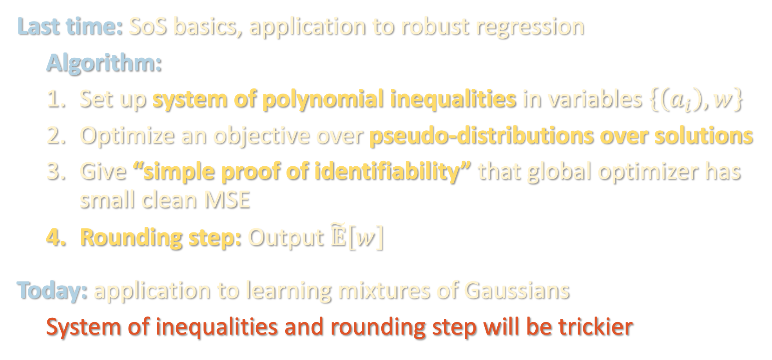
PLAN
Last time: SoS basics, application to robust regression
Algorithm:
Set up system of polynomial inequalities in variables $\left\{\left(a_{i}\right),w\right\}$
Optimize an objective over pseudo-distributions over solutions
Give “simple proof of identifiability” that global optimizer has small clean MSE
Rounding step: Output $\tilde{𝔼}\left[w\right]$
Today: application to learning mixtures of Gaussians
System of inequalities and rounding step will be trickier

Slide 4
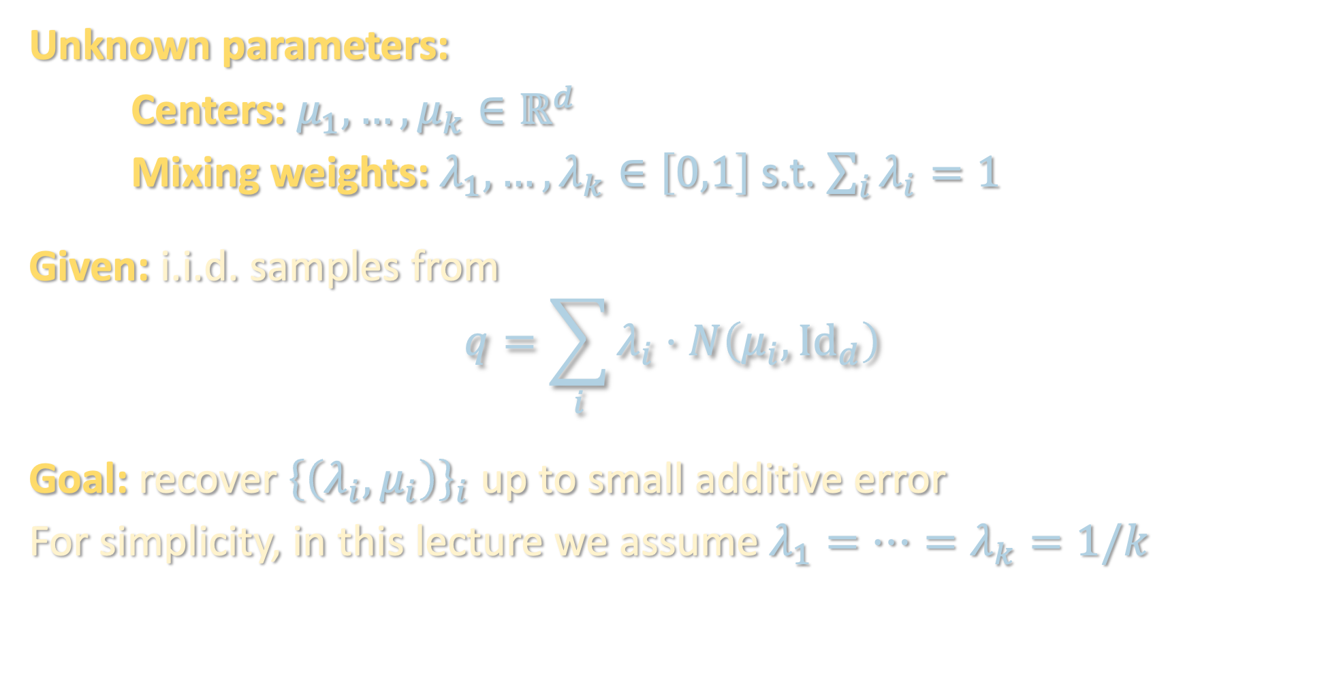
MIXTURES OF GAUSSIANS
Unknown parameters:
Centers: $μ_{1},…,μ_{k}∈ℝ^{d}$
Mixing weights: $λ_{1},…,λ_{k}∈\left[0,1\right]$ s.t. $\sum_{i}{λ_{i}}=1$
Given: i.i.d. samples from
$$q=\sum_{i}{λ_{i}}⋅N\left(μ_{i},{Id}_{d}\right)$$
Goal: recover ${\left\{\left(λ_{i},μ_{i}\right)\right\}}_{i}$ up to small additive error
For simplicity, in this lecture we assume $λ_{1}=⋯=λ_{k}=1/k$

Slide 5
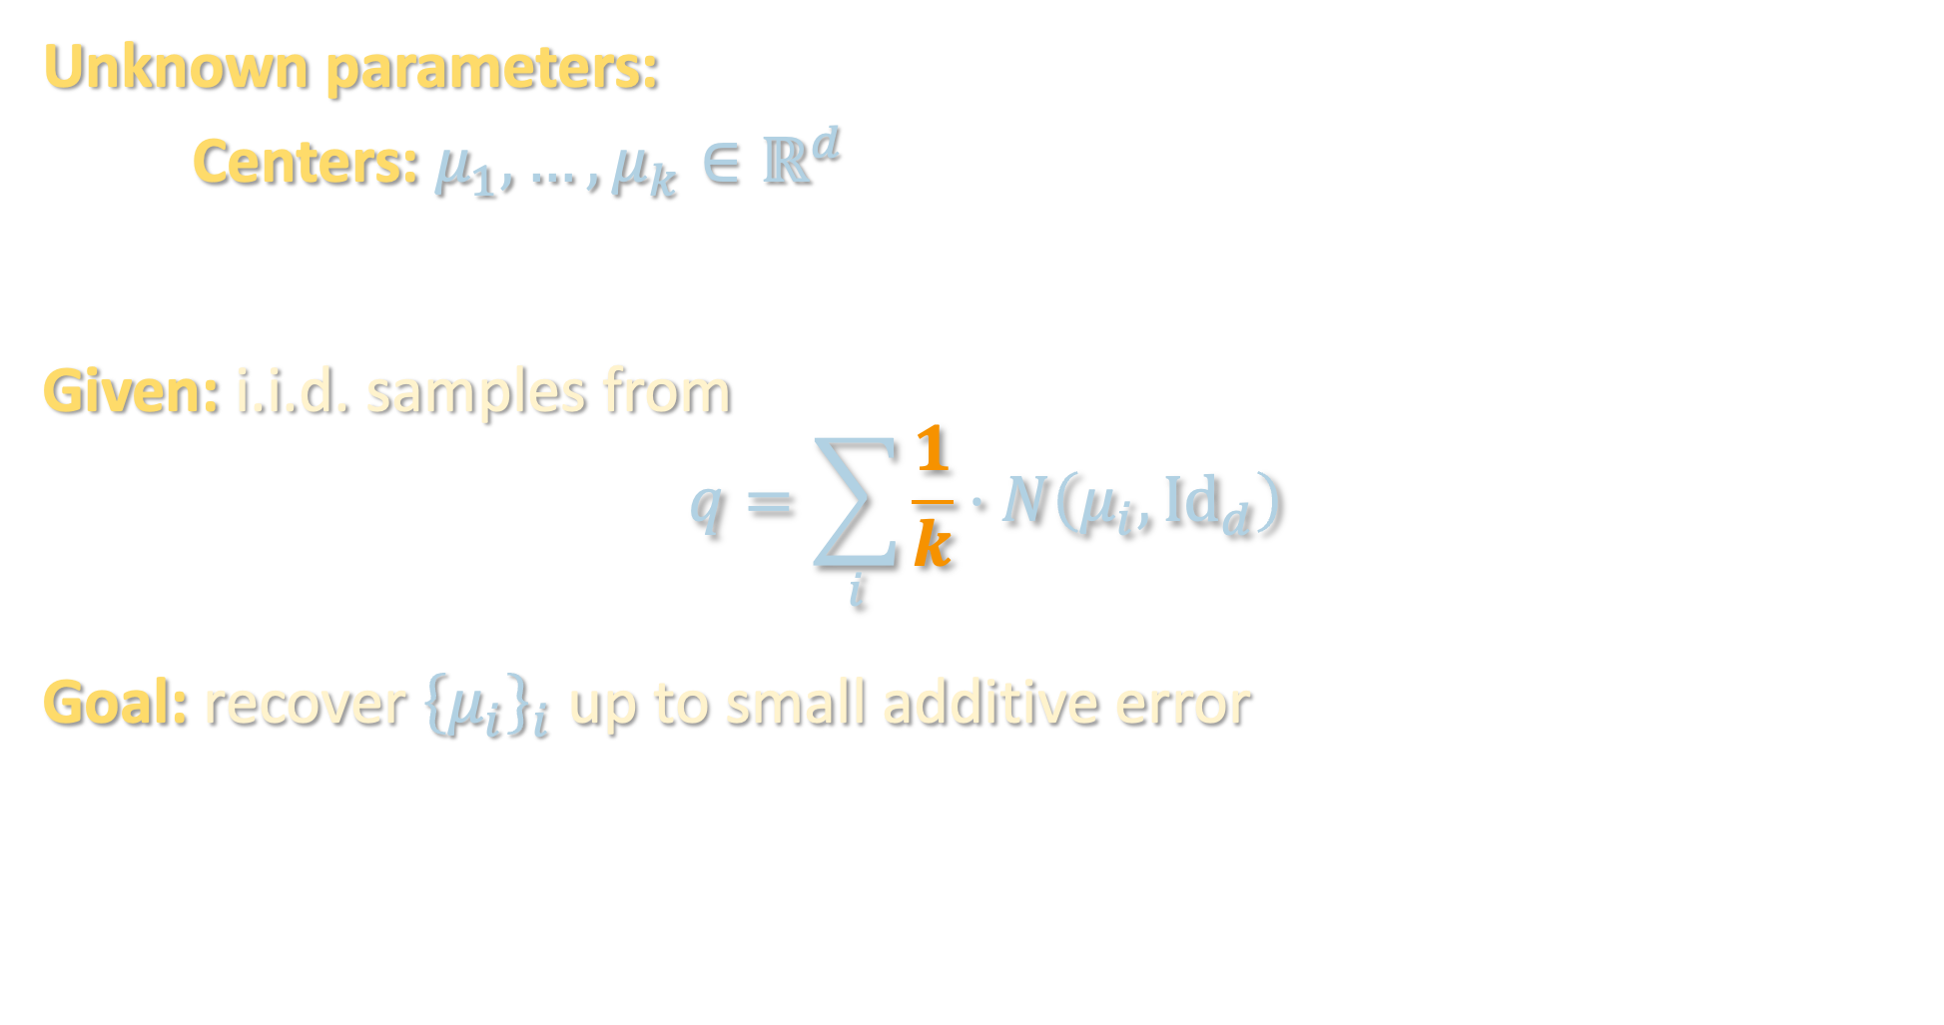
MIXTURES OF GAUSSIANS
Unknown parameters:
Centers: $μ_{1},…,μ_{k}∈ℝ^{d}$
Given: i.i.d. samples from
$$q=\sum_{i}{\frac{1}{k}}⋅N\left(μ_{i},{Id}_{d}\right)$$
Goal: recover ${\left\{μ_{i}\right\}}_{i}$ up to small additive error

Slide 6
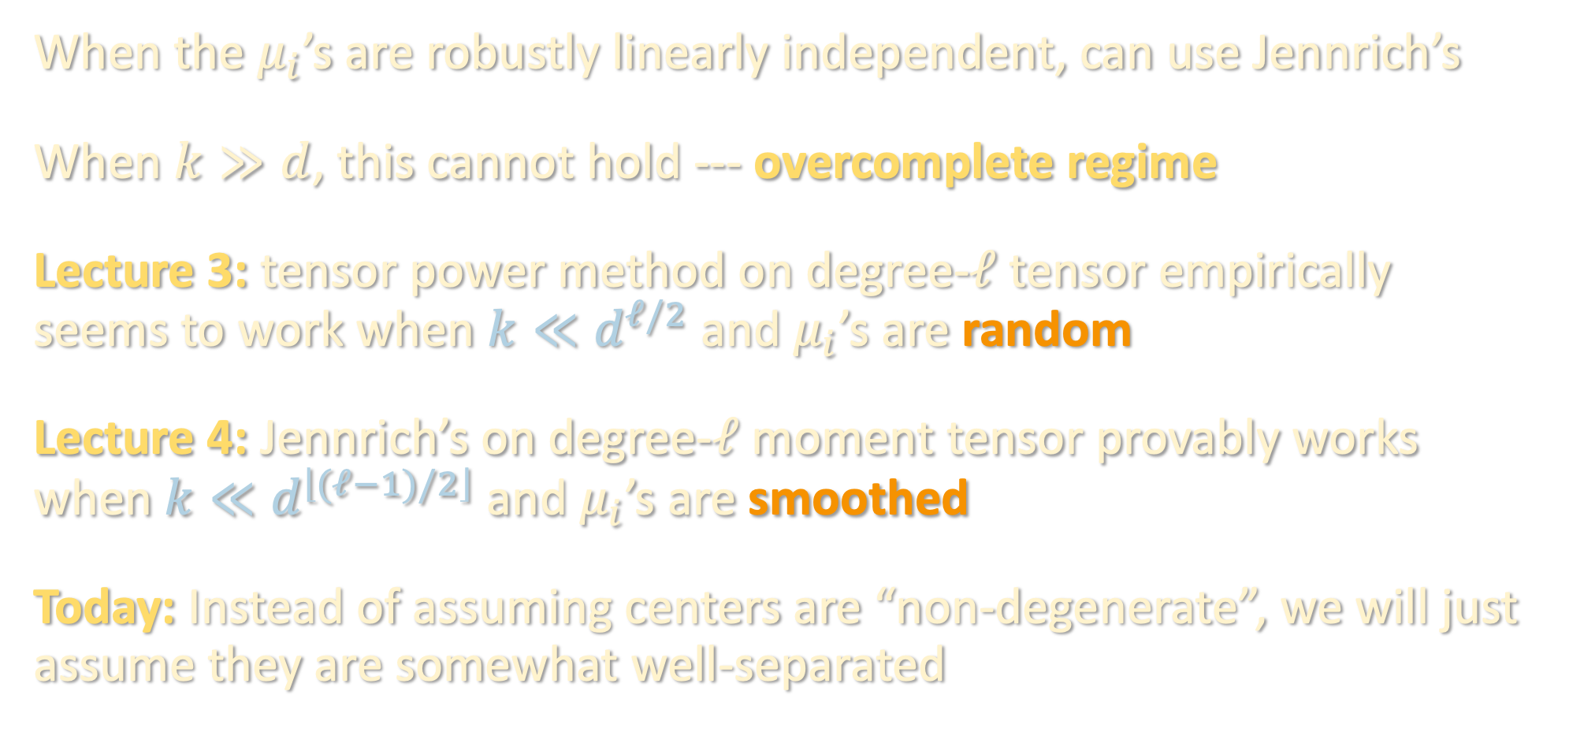
REMINDER: TENSOR DECOMPOSITION
When the $μ_{i}$’s are robustly linearly independent, can use Jennrich’s
When $k≫d$, this cannot hold --- overcomplete regime
Lecture 3: tensor power method on degree-$ℓ$ tensor empirically seems to work when $k≪d^{ℓ/2}$ and $μ_{i}$’s are random
Lecture 4: Jennrich’s on degree-$ℓ$ moment tensor provably works when $k≪d^{\left\lfloor (ℓ−1)/2\right\rfloor }$ and $μ_{i}$’s are smoothed
Today: Instead of assuming centers are “non-degenerate”, we will just assume they are somewhat well-separated

Slide 7
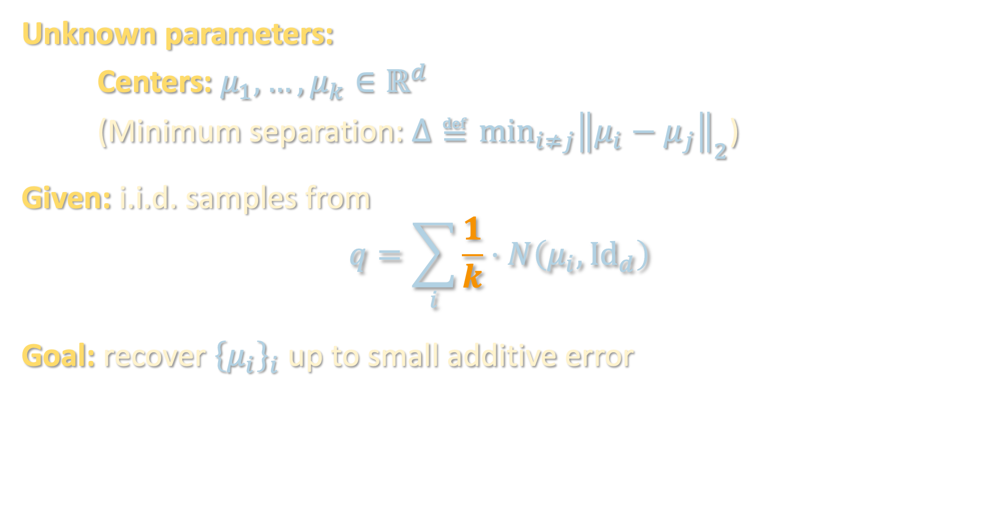
MIXTURES OF GAUSSIANS
Unknown parameters:
Centers: $μ_{1},…,μ_{k}∈ℝ^{d}$
(Minimum separation: $Δ≝\min_{i≠j}{{\left\|μ_{i}−μ_{j}\right\|}_{2}}$)
Given: i.i.d. samples from
$$q=\sum_{i}{\frac{1}{k}}⋅N\left(μ_{i},{Id}_{d}\right)$$
Goal: recover ${\left\{μ_{i}\right\}}_{i}$ up to small additive error

Slide 8

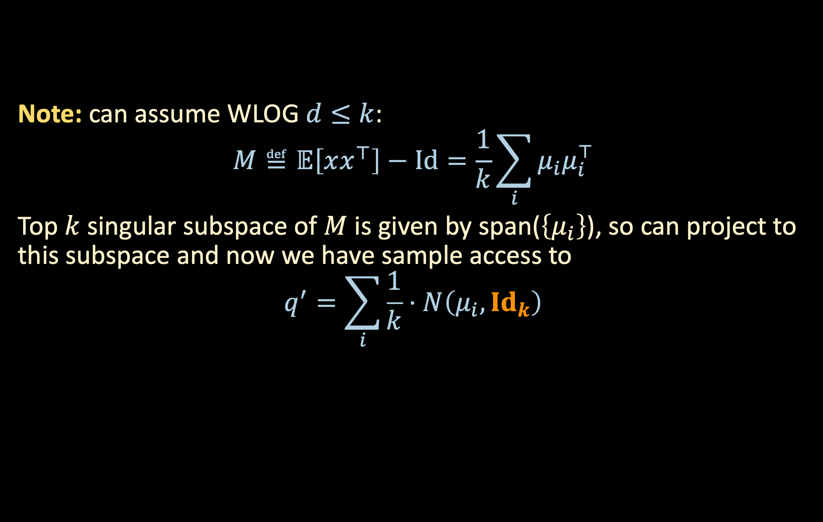
MIXTURES OF GAUSSIANS – THRESHOLD FOR $Δ$
Note: can assume WLOG $d≤k$:
$$M≝𝔼\left[xx^{⊤}\right]−Id=\frac{1}{k}\sum_{i}{μ_{i}μ_{i}^{⊤}}$$
Top $k$ singular subspace of $M$ is given by span($\left\{μ_{i}\right\}$), so can project to this subspace and now we have sample access to
$$q^{′}=\sum_{i}{\frac{1}{k}⋅N\left(μ_{i},{Id}_{k}\right)}$$

Slide 9

MIXTURES OF GAUSSIANS – THRESHOLD FOR $Δ$
$Δ≥Ω\left(d^{1/2}\right)$ [Dasgupta ‘99]
$$ℙ_{x∼N\left(μ,Id\right)}\left[\left\|x−μ\right\|>\sqrt{d}+t\right]≤\exp\left(−Ω\left(t^{2}\right)\right),$$
so components are nearly disjoint and a trivial clustering algorithm will work

Slide 10




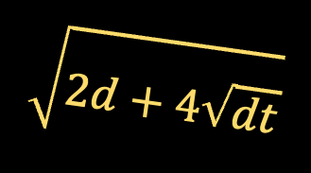




MIXTURES OF GAUSSIANS – THRESHOLD FOR $Δ$
$Δ≥Ω\left(d^{1/2}\right)$ [Dasgupta ‘99]
$Δ≥Ω\left(d^{1/4}\right)$ [Arora-Kannan ‘05]:
Even though components now overlap, every pair of vertices from the same component will be closer than every pair of vertices from different components
$$\sqrt{2d+4\sqrt{dt}+Δ^{2}}$$
$$\sqrt{2d+4\sqrt{dt}}$$
In high dimensions, random vectors approximately orthogonal
$$t=Θ\left(\log{d}\right)$$
$$\sqrt{d}+\sqrt{t}$$
$$\sqrt{d}+\sqrt{t}$$
$$\sqrt{d}+\sqrt{t}$$
$$\sqrt{d}+\sqrt{t}$$
$$Δ$$

Slide 11

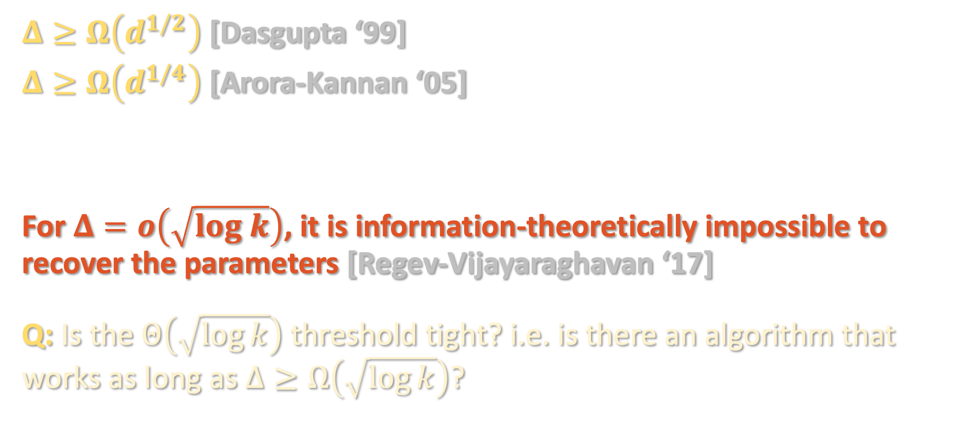
MIXTURES OF GAUSSIANS – THRESHOLD FOR $Δ$
$Δ≥Ω\left(d^{1/2}\right)$ [Dasgupta ‘99]
$Δ≥Ω\left(d^{1/4}\right)$ [Arora-Kannan ‘05]
For $Δ=o\left(\sqrt{log k}\right)$, it is information-theoretically impossible to recover the parameters [Regev-Vijayaraghavan ‘17]
Q: Is the $Θ\left(\sqrt{\log{k}}\right)$ threshold tight? i.e. is there an algorithm that works as long as $Δ≥Ω\left(\sqrt{\log{k}}\right)$?
$$⋮$$

Slide 12
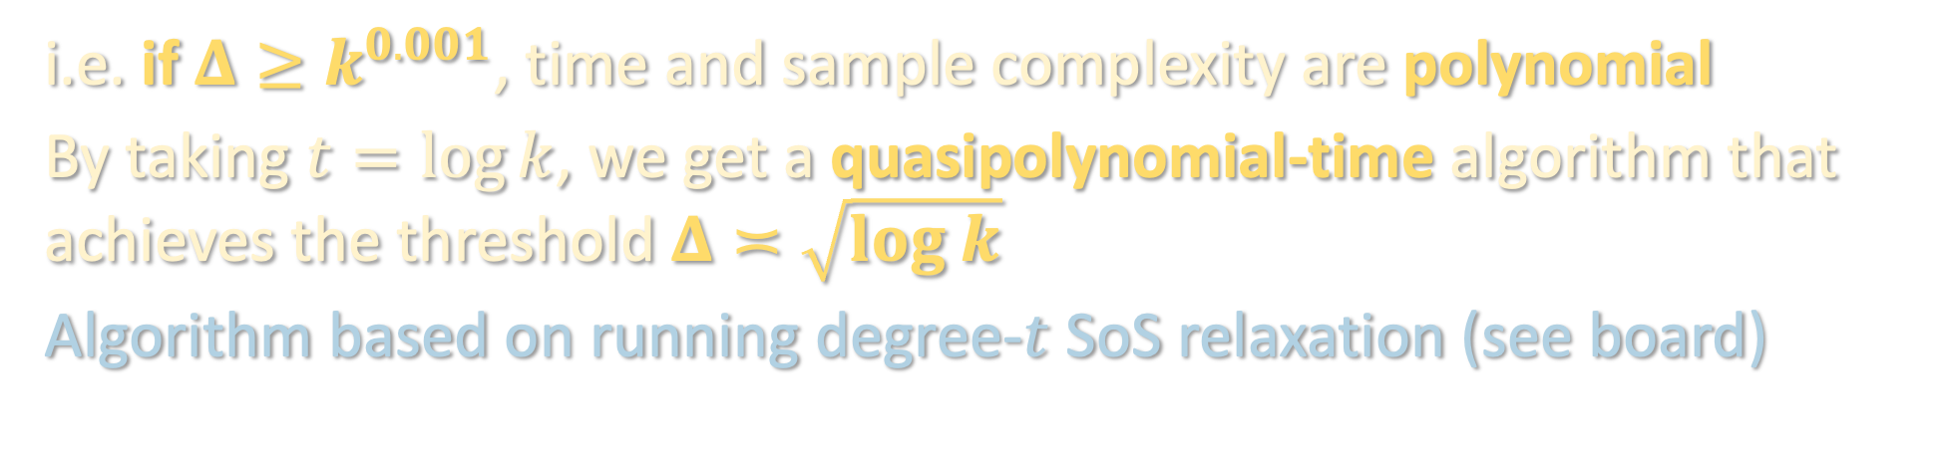
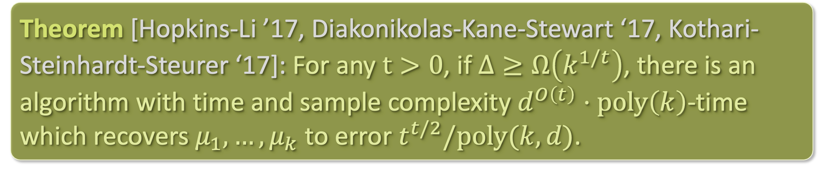
MIXTURES OF GAUSSIANS – THRESHOLD FOR $Δ$
Theorem [Hopkins-Li ’17, Diakonikolas-Kane-Stewart ‘17, Kothari-Steinhardt-Steurer ‘17]: For any $t>0$, if $Δ≥Ω\left(k^{1/t}\right)$, there is an algorithm with time and sample complexity $d^{O\left(t\right)}⋅poly\left(k\right)$-time which recovers $μ_{1},…,μ_{k}$ to error $t^{t/2}/poly(k,d)$.
i.e. if $Δ≥k^{0.001}$, time and sample complexity are polynomial
By taking $t=\log{k}$, we get a quasipolynomial-time algorithm that achieves the threshold $Δ≍\sqrt{log k}$
Algorithm based on running degree-$t$ SoS relaxation (see board)

Slide 13
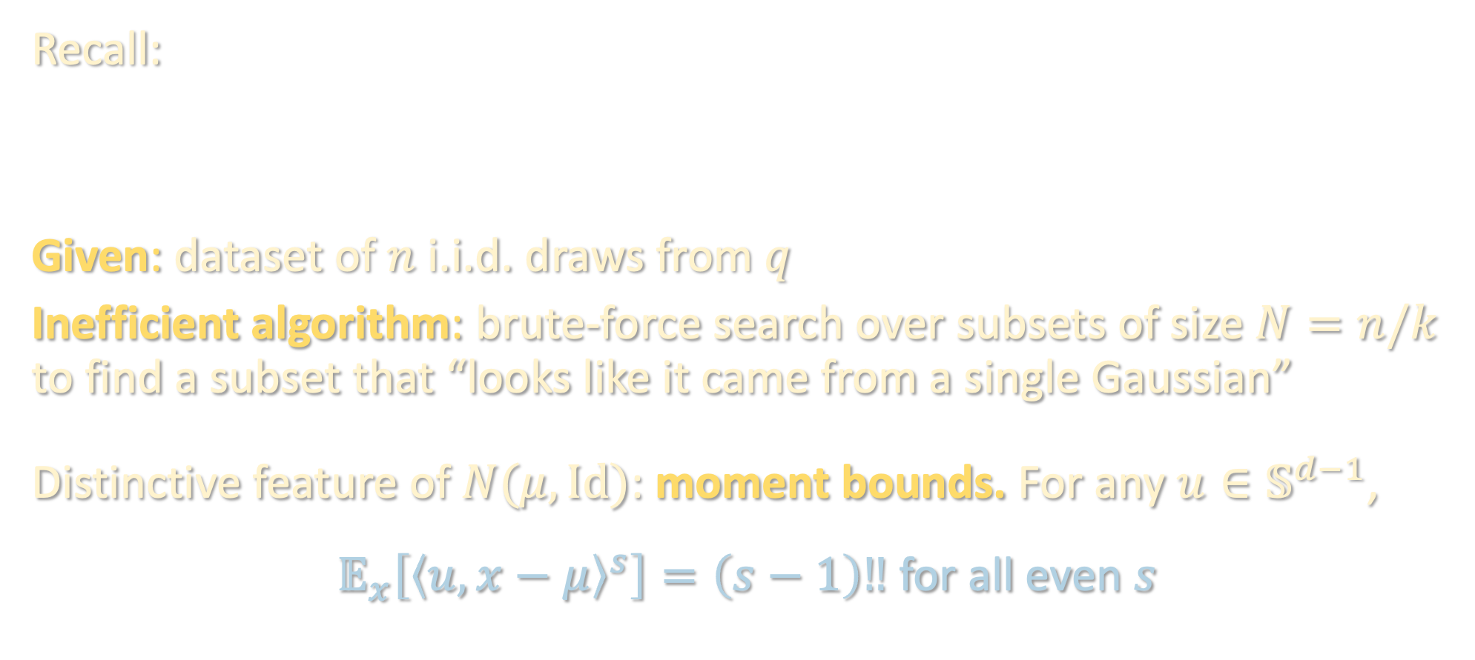
LOW-DEGREE IDENTIFIABILITY
Recall:
Given: dataset of $n$ i.i.d. draws from $q$
Inefficient algorithm: brute-force search over subsets of size $N=n/k$ to find a subset that “looks like it came from a single Gaussian”
Distinctive feature of $N(μ, Id)$: moment bounds. For any $u∈𝕊^{d−1}$,
$𝔼_{x}\left[{\left\langle u,x−μ\right\rangle }^{s}\right]=\left(s−1\right)‼$ for all even $s$
Inefficient algorithm with a “simple” proof of correctness
Efficient algorithm with the same guarantees

Slide 14
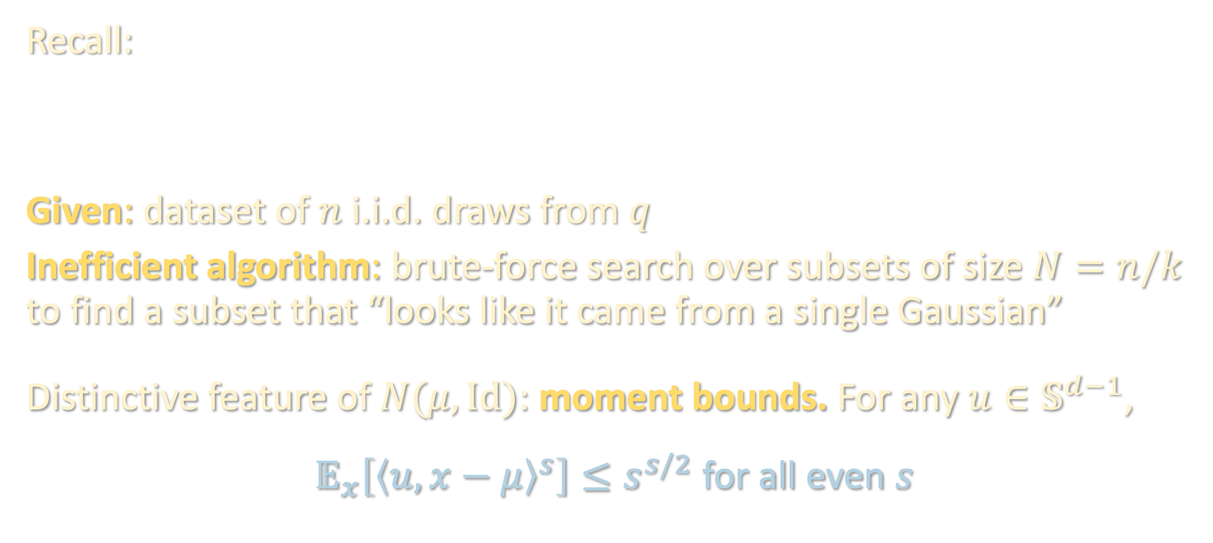
LOW-DEGREE IDENTIFIABILITY
Recall:
Given: dataset of $n$ i.i.d. draws from $q$
Inefficient algorithm: brute-force search over subsets of size $N=n/k$ to find a subset that “looks like it came from a single Gaussian”
Distinctive feature of $N(μ, Id)$: moment bounds. For any $u∈𝕊^{d−1}$,
$𝔼_{x}\left[{\left\langle u,x−μ\right\rangle }^{s}\right]≤s^{s/2}$ for all even $s$
Inefficient algorithm with a “simple” proof of correctness
Efficient algorithm with the same guarantees

Slide 15
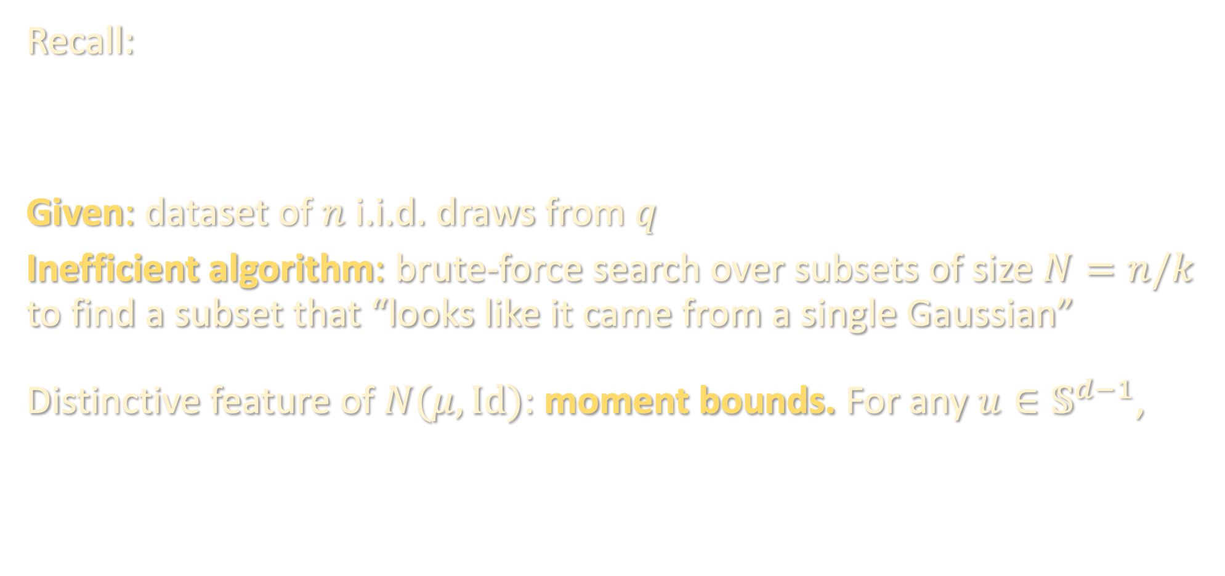
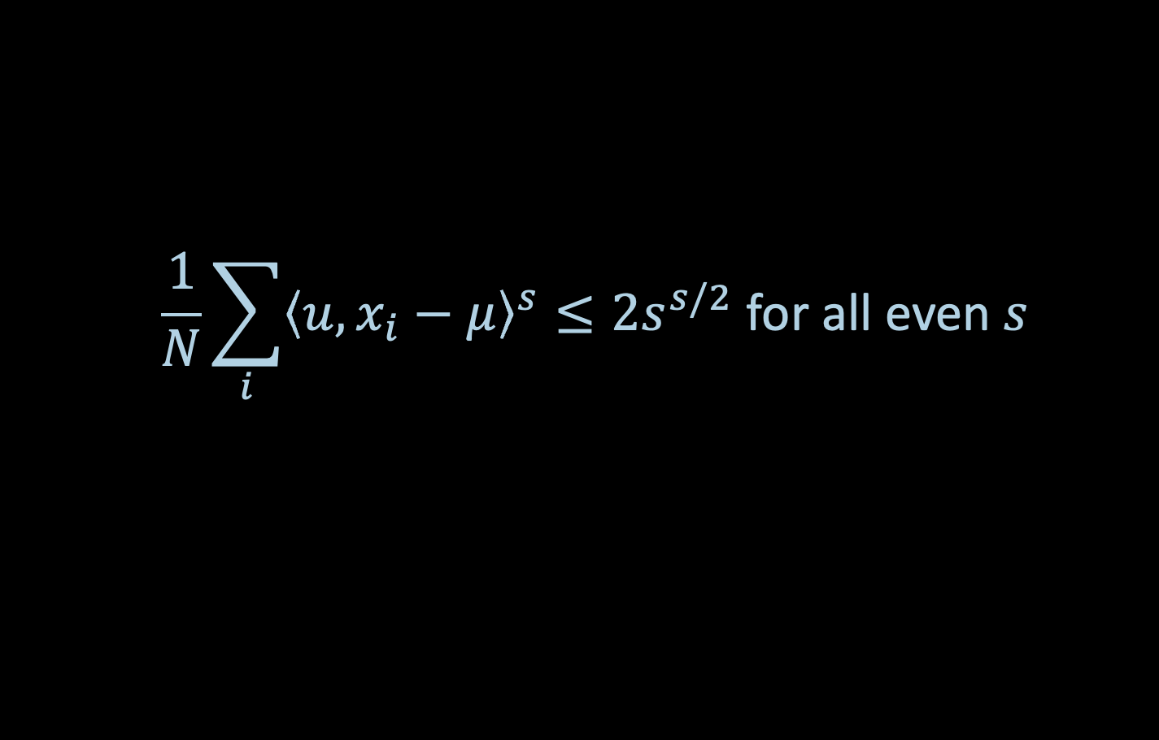
LOW-DEGREE IDENTIFIABILITY
Recall:
Given: dataset of $n$ i.i.d. draws from $q$
Inefficient algorithm: brute-force search over subsets of size $N=n/k$ to find a subset that “looks like it came from a single Gaussian”
Distinctive feature of $N(μ, Id)$: moment bounds. For any $u∈𝕊^{d−1}$,
Inefficient algorithm with a “simple” proof of correctness
Efficient algorithm with the same guarantees
$$\frac{1}{N}\sum_{i}{{\left\langle u,x_{i}−μ\right\rangle }^{s}}≤2s^{s/2} \text{for} \text{all} \text{even} s$$

Slide 16
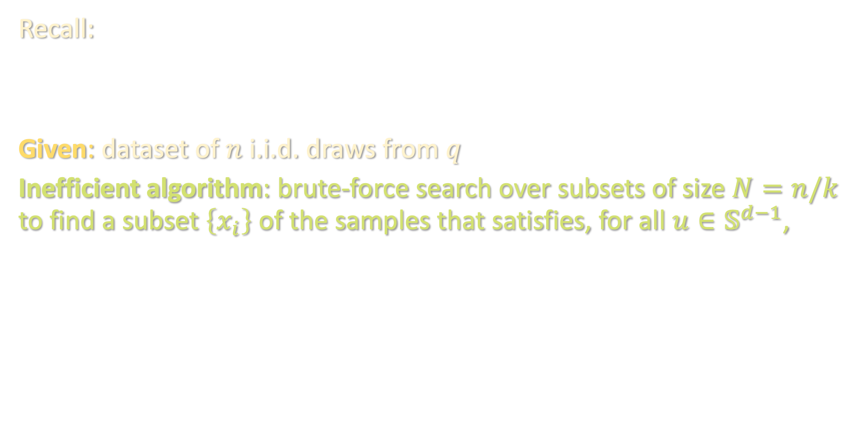

LOW-DEGREE IDENTIFIABILITY
Recall:
Given: dataset of $n$ i.i.d. draws from $q$
Inefficient algorithm: brute-force search over subsets of size $N=n/k$ to find a subset $\left\{x_{i}\right\}$ of the samples that satisfies, for all $u∈𝕊^{d−1}$,
Inefficient algorithm with a “simple” proof of correctness
Efficient algorithm with the same guarantees
$$\frac{1}{N}\sum_{i}{{\left\langle u,x_{i}−μ\right\rangle }^{s}}≤2s^{s/2} \text{for} \text{all} \text{even} s$$

Slide 17
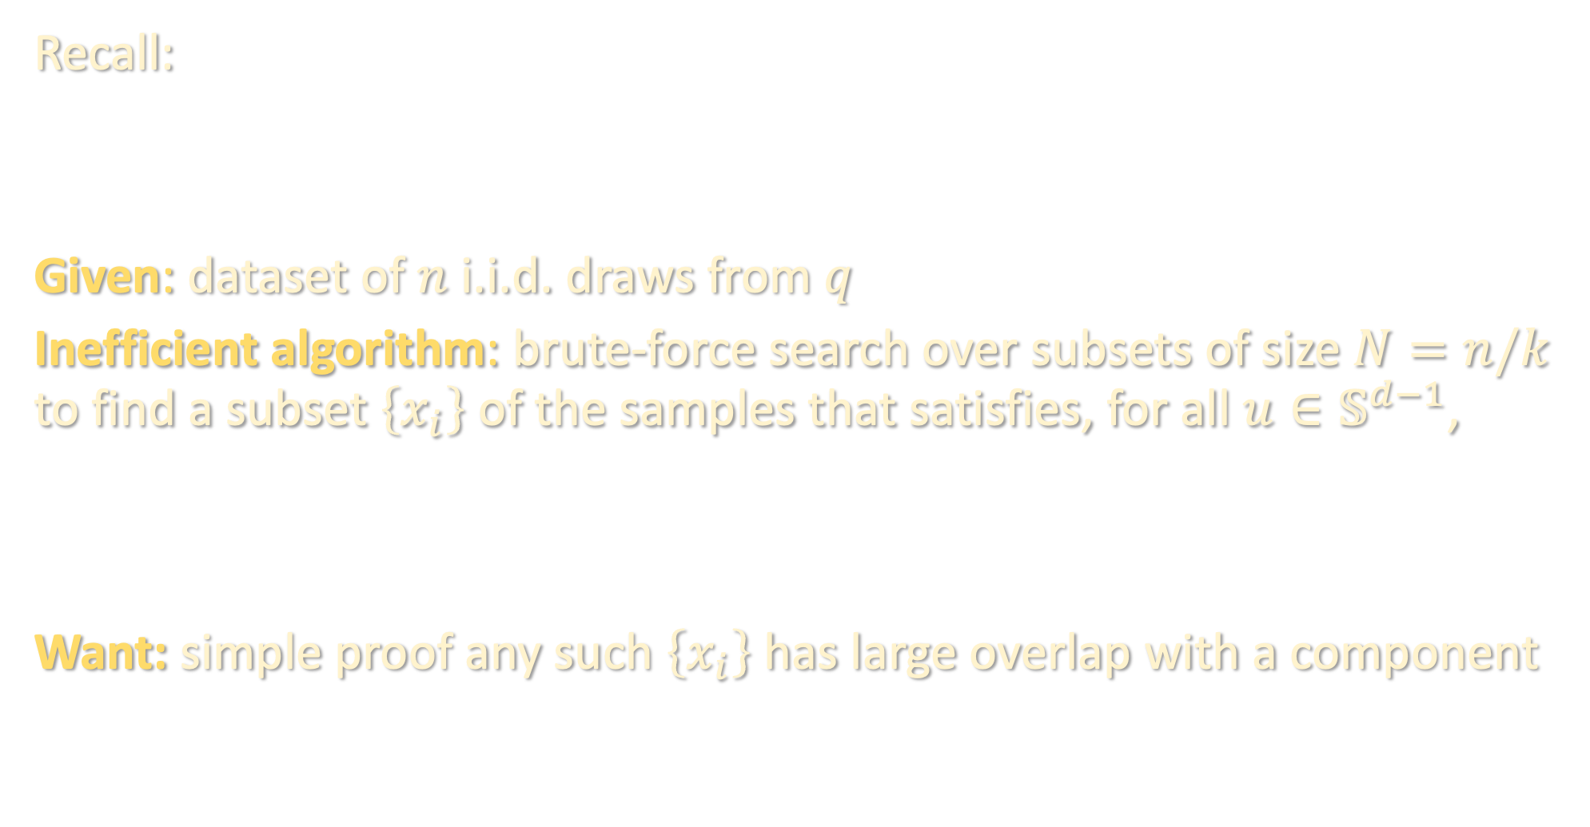
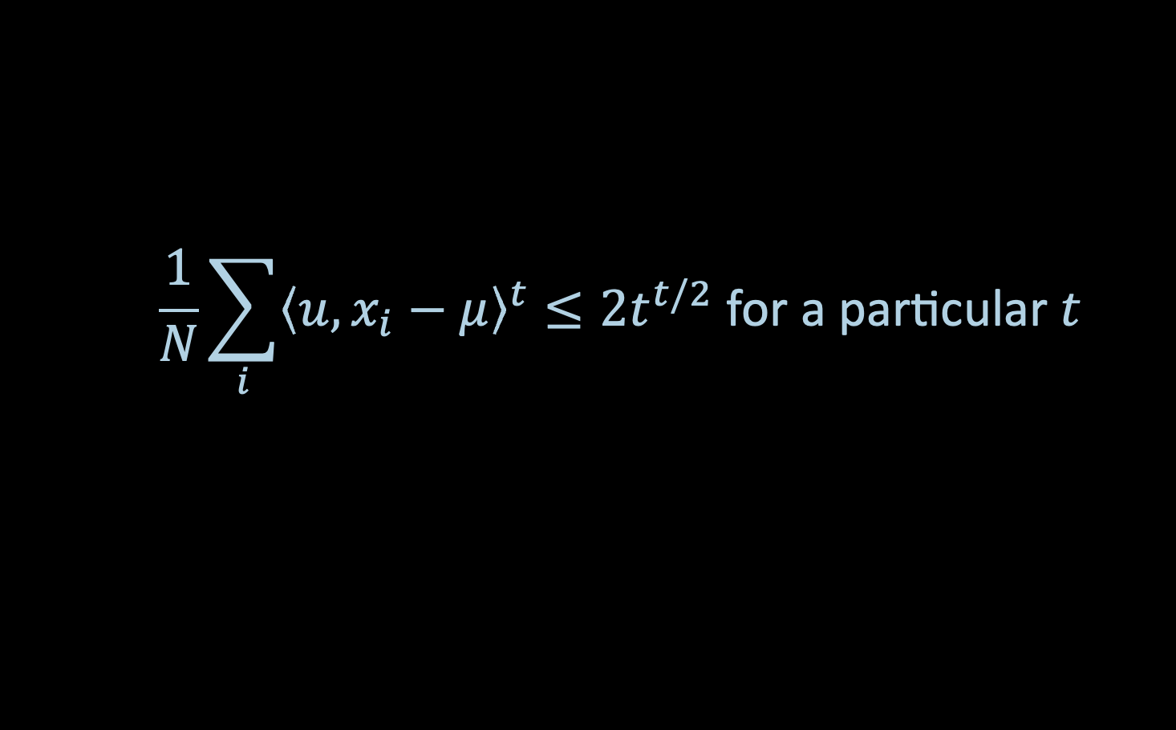
LOW-DEGREE IDENTIFIABILITY
Recall:
Given: dataset of $n$ i.i.d. draws from $q$
Inefficient algorithm: brute-force search over subsets of size $N=n/k$ to find a subset $\left\{x_{i}\right\}$ of the samples that satisfies, for all $u∈𝕊^{d−1}$,
Want: simple proof any such $\left\{x_{i}\right\}$ has large overlap with a component
Inefficient algorithm with a “simple” proof of correctness
Efficient algorithm with the same guarantees
$$\frac{1}{N}\sum_{i}{{\left\langle u,x_{i}−μ\right\rangle }^{t}}≤2t^{t/2} \text{for} \text{a} \text{particular} t$$

Slide 18

LOW-DEGREE IDENTIFIABILITY
Recall:
Given: dataset of $n$ i.i.d. draws from $q$
Inefficient algorithm: brute-force search over subsets of size $N=n/k$ to find a subset $\left\{x_{i}\right\}$ of the samples that satisfies, for all $u∈𝕊^{d−1}$,
Want: simple proof any such $\left\{x_{i}\right\}$ has large overlap with a component
Inefficient algorithm with a “simple” proof of correctness
Efficient algorithm with the same guarantees
$$\frac{1}{N}\sum_{i}{{\left\langle u,x_{i}−μ\right\rangle }^{t}}≤2t^{t/2} \text{for} \text{a} \text{particular} t$$

Slide 19
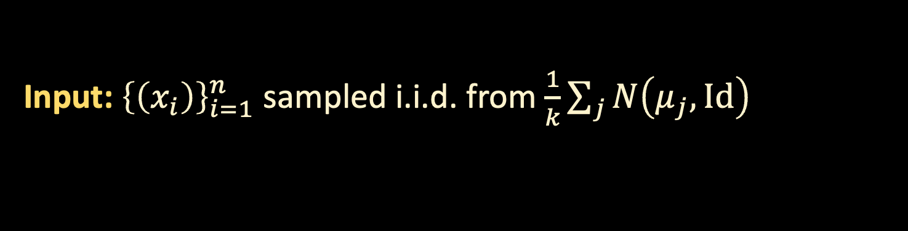
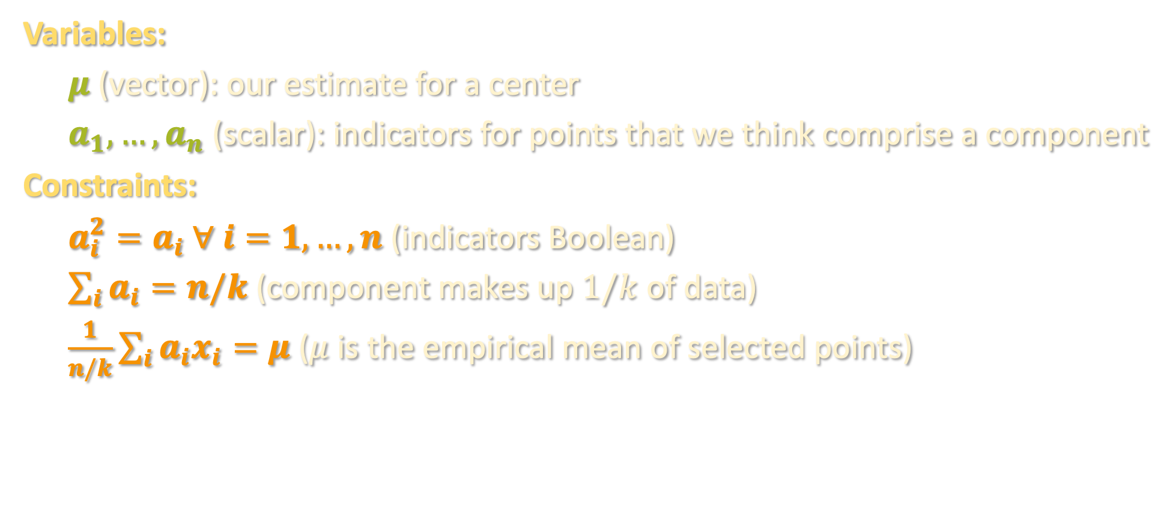
THE SOS PROGRAM
Input: ${\left\{\left(x_{i}\right)\right\}}_{i=1}^{n}$ sampled i.i.d. from $\frac{1}{k}\sum_{j}{N\left(μ_{j},Id\right)}$
Variables:
$μ$ (vector): our estimate for a center
$a_{1},…,a_{n}$ (scalar): indicators for points that we think comprise a component
Constraints:
$a_{i}^{2}=a_{i} ∀ i=1,…,n$ (indicators Boolean)
$\sum_{i}{a_{i}}=n/k$ (component makes up $1/k$ of data)
$\frac{1}{n/k}\sum_{i}{a_{i}x_{i}}=μ$ ($μ$ is the empirical mean of selected points)

Slide 20
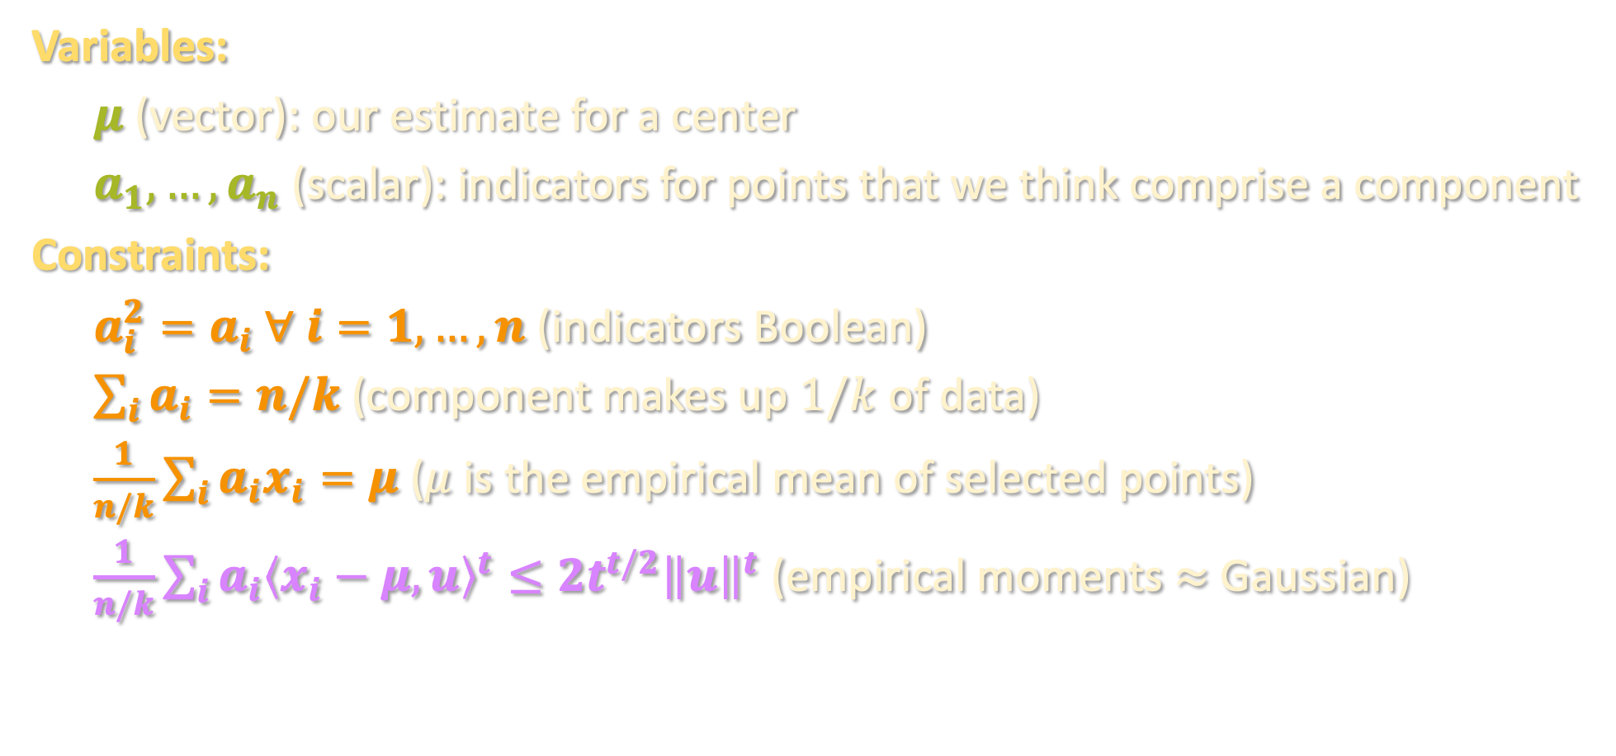

THE SOS PROGRAM
Input: ${\left\{\left(x_{i}\right)\right\}}_{i=1}^{n}$ sampled i.i.d. from $\frac{1}{k}\sum_{j}{N\left(μ_{j},Id\right)}$
Variables:
$μ$ (vector): our estimate for a center
$a_{1},…,a_{n}$ (scalar): indicators for points that we think comprise a component
Constraints:
$a_{i}^{2}=a_{i} ∀ i=1,…,n$ (indicators Boolean)
$\sum_{i}{a_{i}}=n/k$ (component makes up $1/k$ of data)
$\frac{1}{n/k}\sum_{i}{a_{i}x_{i}}=μ$ ($μ$ is the empirical mean of selected points)
$\frac{1}{n/k}\sum_{i}{a_{i}{\left\langle x_{i}−μ,u\right\rangle }^{t}}≤2t^{t/2}{\left\|u\right\|}^{t}$ (empirical moments $≈$ Gaussian)
for all vectors $u$

Slide 21
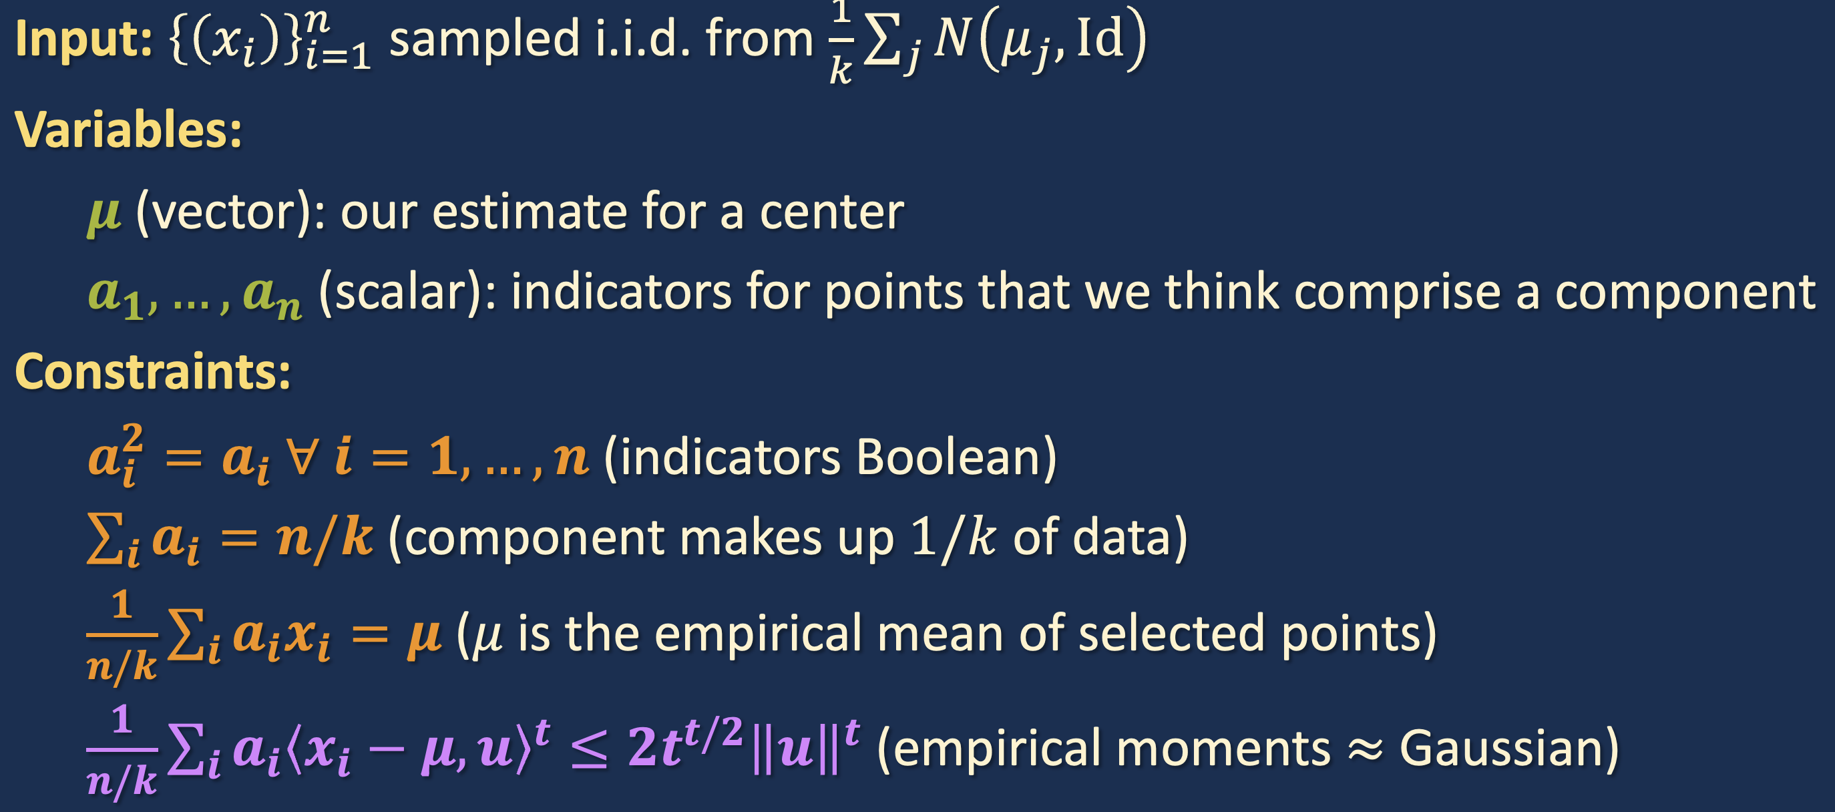
THE SOS PROGRAM
for all vectors $u$

Slide 22
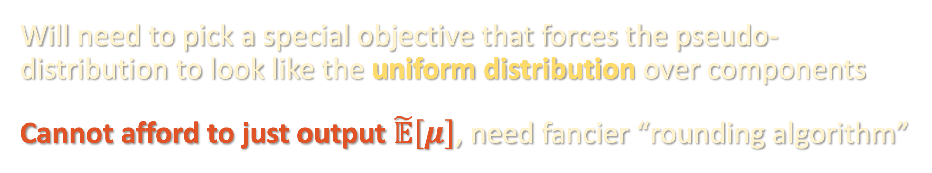
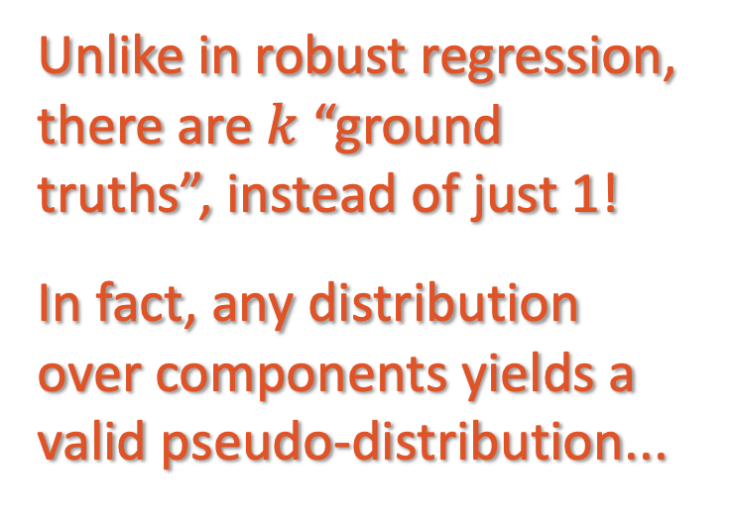
SUBTLETIES AHEAD
Unlike in robust regression, there are $k$ “ground truths”, instead of just 1!
In fact, any distribution over components yields a valid pseudo-distribution...
Will need to pick a special objective that forces the pseudo-distribution to look like the uniform distribution over components
Cannot afford to just output $\tilde{𝔼}\left[μ\right]$, need fancier “rounding algorithm”

Slide 23

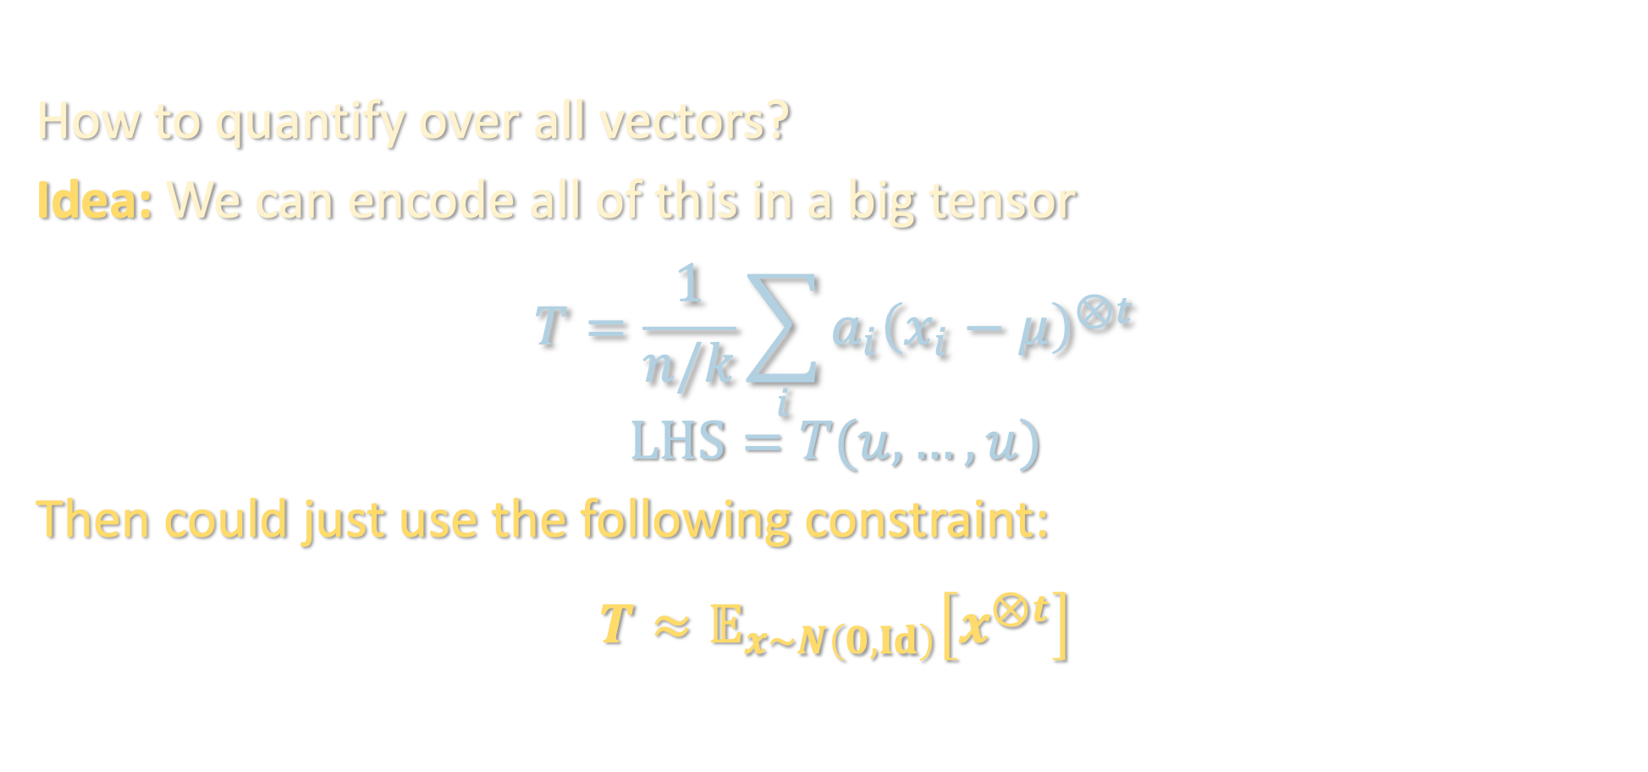
THE SOS PROGRAM
for all vectors $u$
How to quantify over all vectors?
Idea: We can encode all of this in a big tensor
$$T=\frac{1}{n/k}\sum_{i}{a_{i}{\left(x_{i}−μ\right)}^{⊗t}}$$
$$LHS=T(u,…,u)$$
Then could just use the following constraint:
$$T≈𝔼_{x∼N\left(0,Id\right)}\left[x^{⊗t}\right]$$

Slide 24
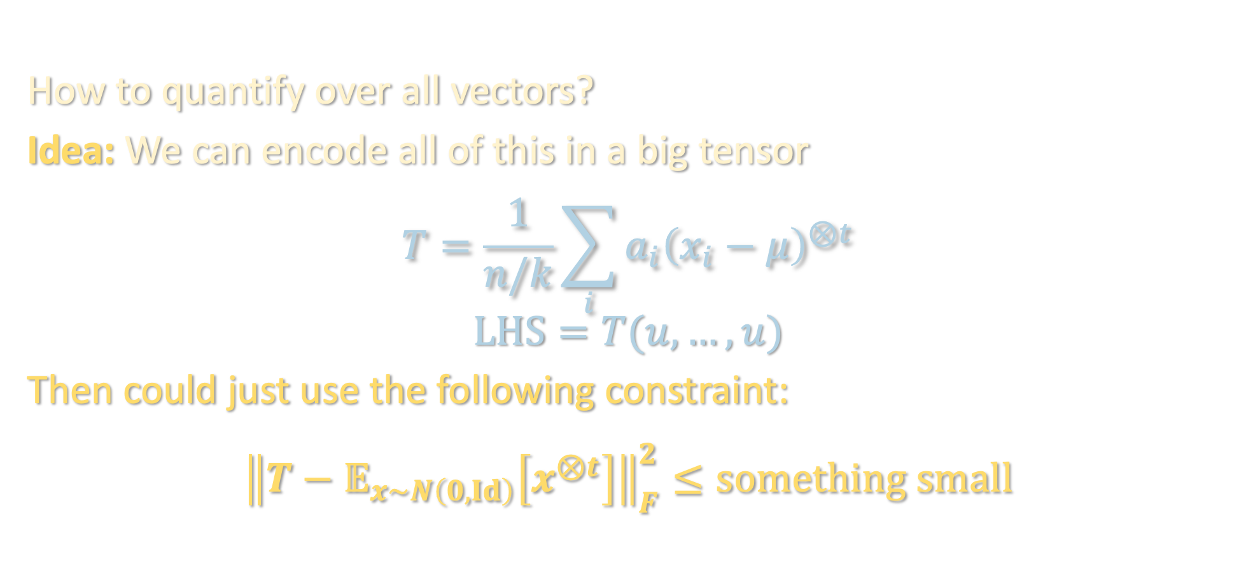
THE SOS PROGRAM
for all vectors $u$
How to quantify over all vectors?
Idea: We can encode all of this in a big tensor
$$T=\frac{1}{n/k}\sum_{i}{a_{i}{\left(x_{i}−μ\right)}^{⊗t}}$$
$$LHS=T(u,…,u)$$
Then could just use the following constraint:
$${\left\|T−𝔼_{x∼N\left(0,Id\right)}\left[x^{⊗t}\right]\right\|}_{F}^{2}≤something small$$

Slide 25
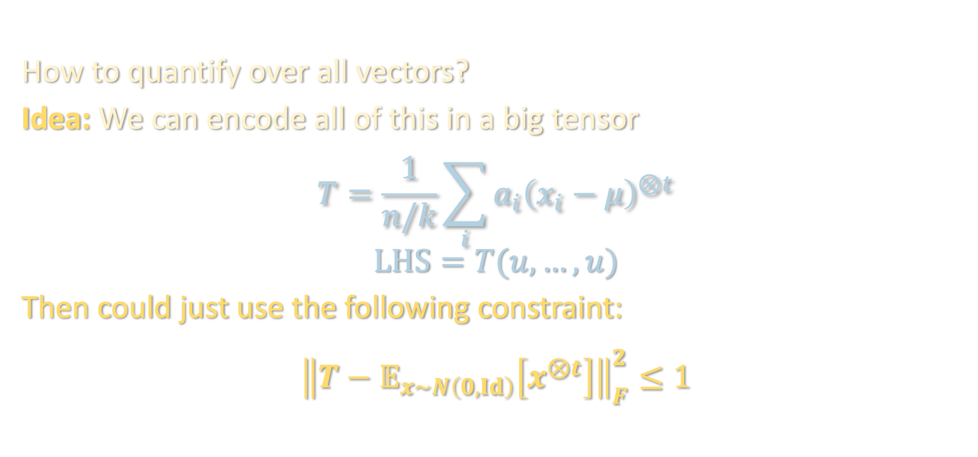
THE SOS PROGRAM
for all vectors $u$
How to quantify over all vectors?
Idea: We can encode all of this in a big tensor
$$T=\frac{1}{n/k}\sum_{i}{a_{i}{\left(x_{i}−μ\right)}^{⊗t}}$$
$$LHS=T(u,…,u)$$
Then could just use the following constraint:
$${\left\|T−𝔼_{x∼N\left(0,Id\right)}\left[x^{⊗t}\right]\right\|}_{F}^{2}≤1$$

