Slide 1

CS 2243: ALGORITHMS FOR DATA SCIENCE
LECTURE 21 (11/18)
Tensor decomposition
Sum-of-squares
Supervised learning
Computational complexity
Statistical physics
Generative modeling
STOCHASTIC CALCULUS, LANGEVIN DIFFUSION

Slide 2
ANNOUNCEMENTS
My office hours by appointment this week
Weiyuan + Marvin’s non-pset office hours still being held

Slide 3
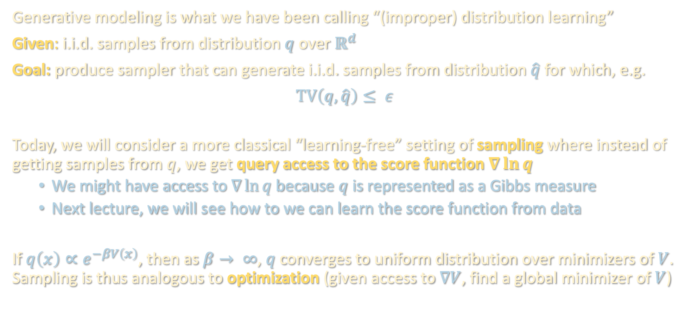
GENERATIVE MODELING
Generative modeling is what we have been calling “(improper) distribution learning”
Given: i.i.d. samples from distribution $q$ over $ℝ^{d}$
Goal: produce sampler that can generate i.i.d. samples from distribution $\hat{q}$ for which, e.g.
$TV\left(q,\hat{q}\right)≤ ε$
Today, we will consider a more classical “learning-free” setting of sampling where instead of getting samples from $q$, we get query access to the score function $∇\ln{q}$
  We might have access to $∇\ln{q}$because $q$ is represented as a Gibbs measure
  Next lecture, we will see how to we can learn the score function from data
If $q\left(x\right)∝e^{−βV\left(x\right)}$, then as $β→ ∞$, $q$ converges to uniform distribution over minimizers of $V$. Sampling is thus analogous to optimization (given access to $∇V$, find a global minimizer of $V$)

Slide 4
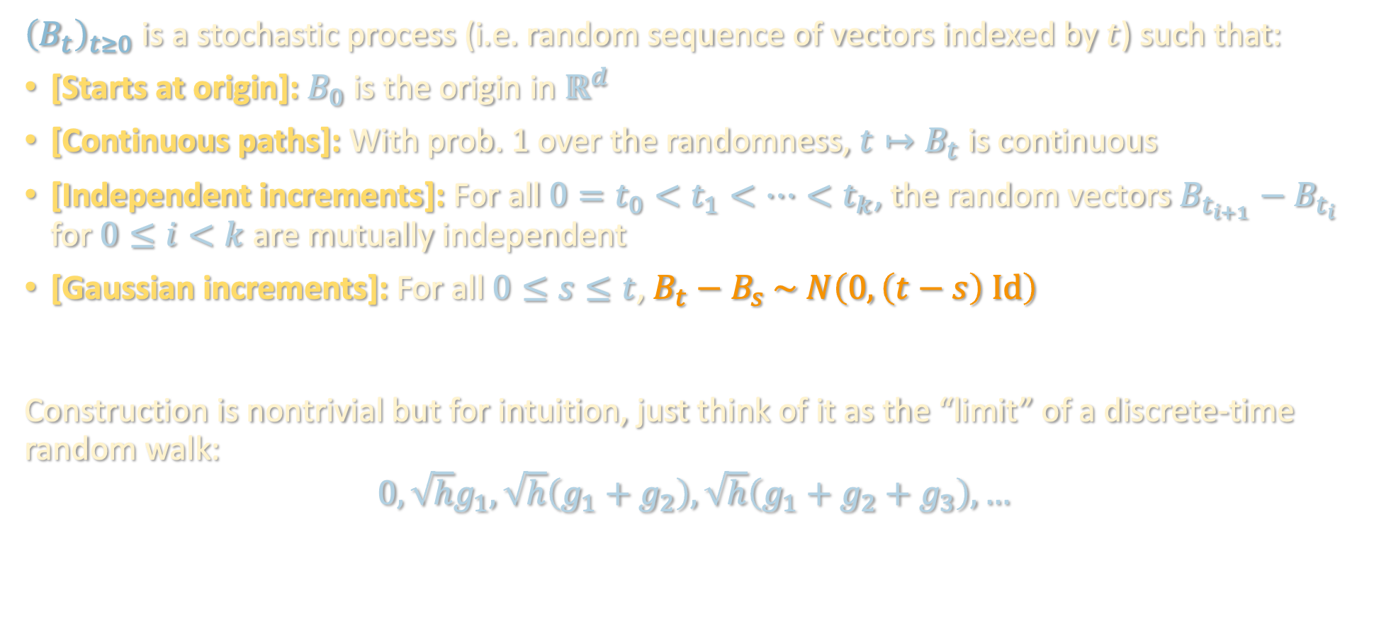
BROWNIAN MOTION
${\left(B_{t}\right)}_{t≥0}$ is a stochastic process (i.e. random sequence of vectors indexed by $t$) such that:
[Starts at origin]: $B_{0}$ is the origin in $ℝ^{d}$
[Continuous paths]: With prob. 1 over the randomness, $t↦B_{t}$ is continuous
[Independent increments]: For all $0=t_{0}<t_{1}<…<t_{k}$, the random vectors $B_{t_{i+1}}−B_{t_{i}}$ for $0≤i<k$ are mutually independent
[Gaussian increments]: For all $0≤s≤t$, $B_{t}−B_{s} \sim N\left(0,\left(t−s\right) Id\right)$
Construction is nontrivial but for intuition, just think of it as the “limit” of a discrete-time random walk:
$$0, \sqrt{h}g_{1},\sqrt{h}\left(g_{1}+g_{2}\right),\sqrt{h}\left(g_{1}+g_{2}+g_{3}\right),…$$

Slide 5
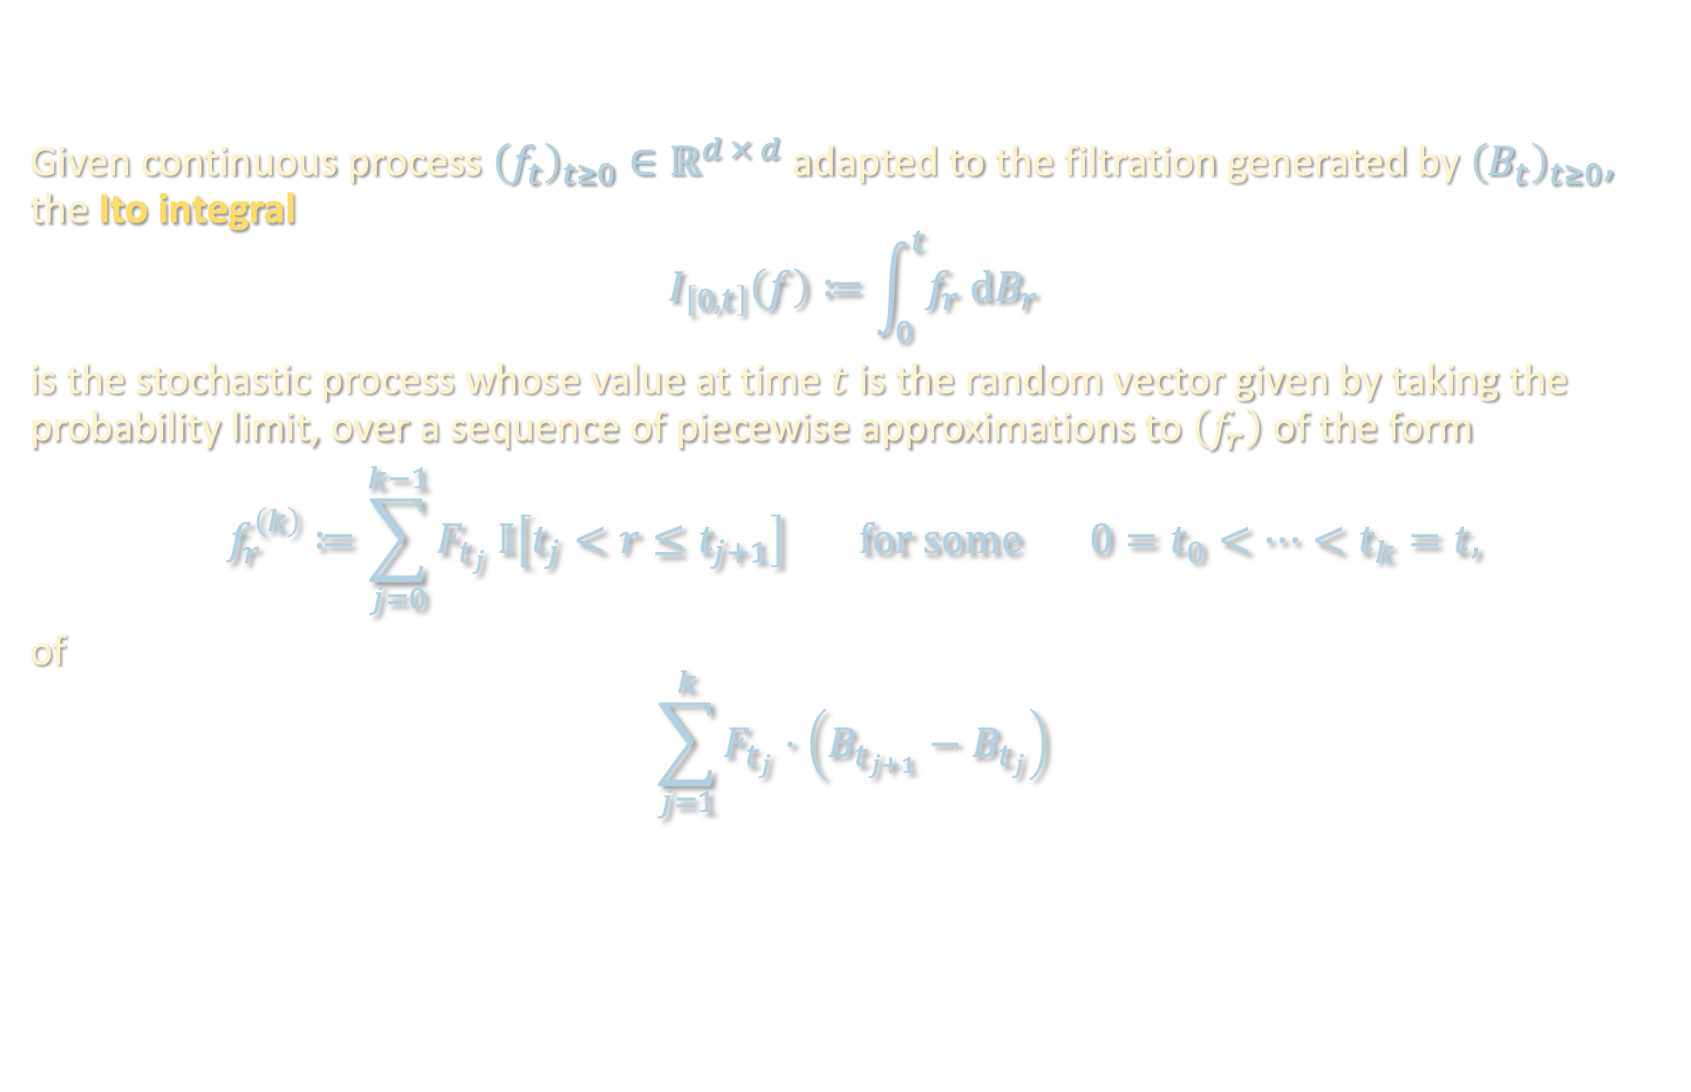
STOCHASTIC INTEGRALS
Given continuous process ${\left(f_{t}\right)}_{t≥0}∈ℝ^{d × d}$ adapted to the filtration generated by ${\left(B_{t}\right)}_{t≥0}$, the Ito integral
$$I_{\left[0,t\right]}\left(f\right)≔\int_{0}^{t}{f_{r} dB_{r}}$$
is the stochastic process whose value at time $t$ is the random vector given by taking the probability limit, over a sequence of piecewise approximations to $\left(f_{r}\right)$ of the form
$$f_{r}^{\left(k\right)}≔\sum_{j=0}^{k−1}{F_{t_{j}} 𝕀\left[t_{j}<r≤t_{j+1}\right]} for some 0=t_{0}<…<t_{k}=t,$$
of
$$\sum_{j=1}^{k}{F_{t_{j}}⋅\left(B_{t_{j+1}}−B_{t_{j}}\right)}$$
Notes:
Brownian motion increments of size sqrt(t) instead of t, so it is nowhere differentiable. Yet we can nevertheless define a suitable calculus
Subtlety in where to evaluate F (here we choose t_j but in fact if you chose it elsewhere you would get an entirely different stochastic process, e.g. the Stratonovich integral is given by evaluating at the midpoint of each interval)
Ito integral is useful because function evals uncorrelated with Brownian increments, thus giving rise to useful martingale property

Slide 6
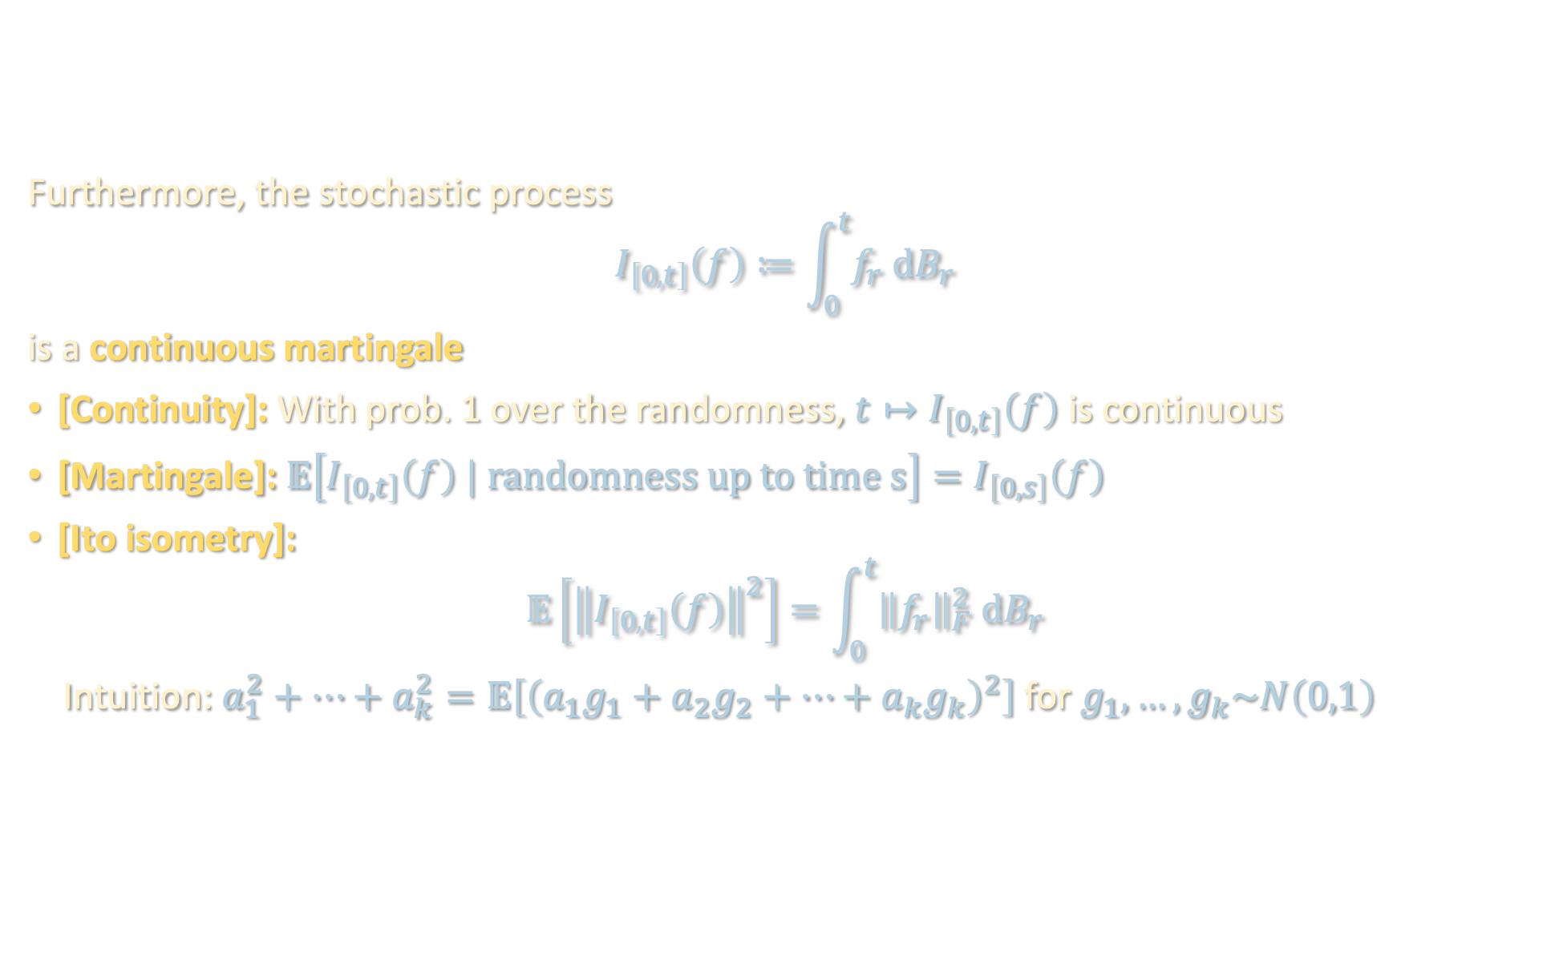
STOCHASTIC INTEGRALS
Furthermore, the stochastic process
$$I_{\left[0,t\right]}\left(f\right)≔\int_{0}^{t}{f_{r} dB_{r}}$$
is a continuous martingale
[Continuity]: With prob. 1 over the randomness, $t↦I_{\left[0,t\right]}\left(f\right)$ is continuous
[Martingale]: $𝔼\left[I_{\left[0,t\right]}\left(f\right) | randomness up to time s\right]=I_{\left[0,s\right]}\left(f\right)$
[Ito isometry]:
$$𝔼\left[{\left\|I_{\left[0,t\right]}\left(f\right)\right\|}^{2}\right]=\int_{0}^{t}{{\left\|f_{r}\right\|}_{F}^{2} dB_{r}}$$
Intuition: $a_{1}^{2}+…+a_{k}^{2}=𝔼\left[{\left(a_{1}g_{1}+a_{2}g_{2}+…+a_{k}g_{k}\right)}^{2}\right]$ for $g_{1},…,g_{k}\sim N\left(0,1\right)$
Notes:
continuous but not differentiable

Slide 7
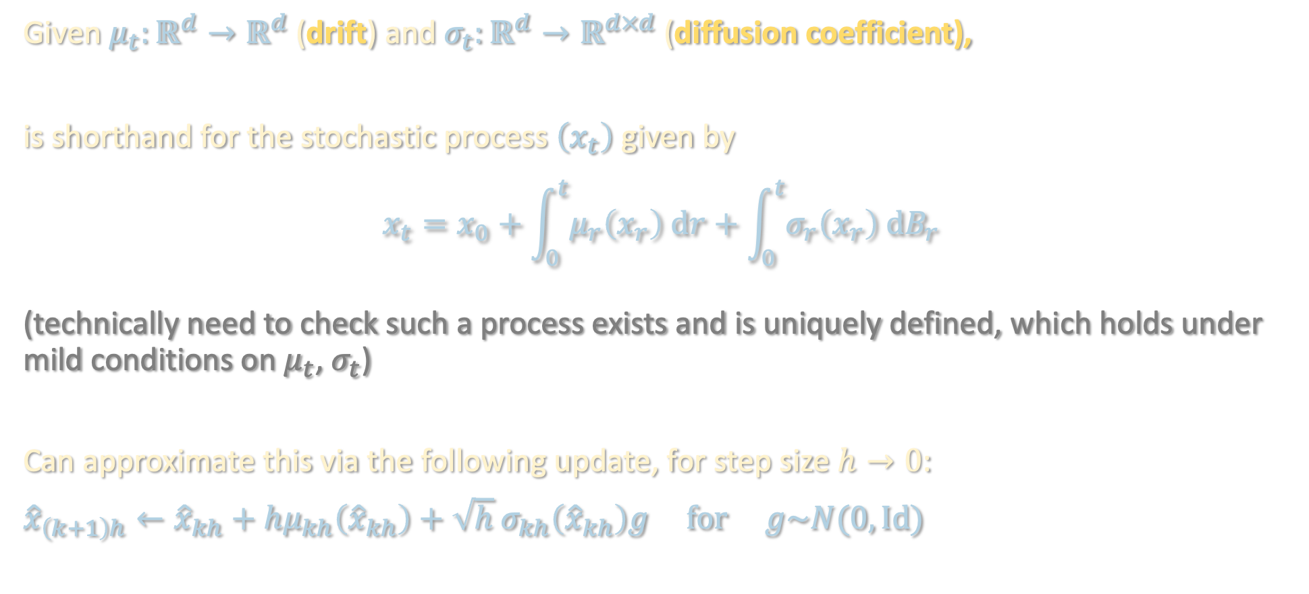
STOCHASTIC DIFFERENTIAL EQUATIONS
Given $μ_{t}:ℝ^{d}→ℝ^{d}$ (drift) and $σ_{t}:ℝ^{d}→ℝ^{d×d}$ (diffusion coefficient),
is shorthand for the stochastic process $\left(x_{t}\right)$ given by
$$x_{t}=x_{0}+\int_{0}^{t}{μ_{r}\left(x_{r}\right) dr}+\int_{0}^{t}{σ_{r}\left(x_{r}\right) {dB}_{r}}$$
(technically need to check such a process exists and is uniquely defined, which holds under mild conditions on $μ_{t}$, $σ_{t}$)
Can approximate this via the following update, for step size $h→0$:
$${\hat{x}}_{\left(k+1\right)h}←{\hat{x}}_{kh}+hμ_{kh}\left({\hat{x}}_{kh}\right)+\sqrt{h} σ_{kh}\left({\hat{x}}_{kh}\right)g for g\sim N(0,Id)$$
$$dx_{t}=μ_{t}\left(x_{t}\right)dt+σ_{t} dB_{t}$$
Ito process
Euler –Maruyama method

Slide 8
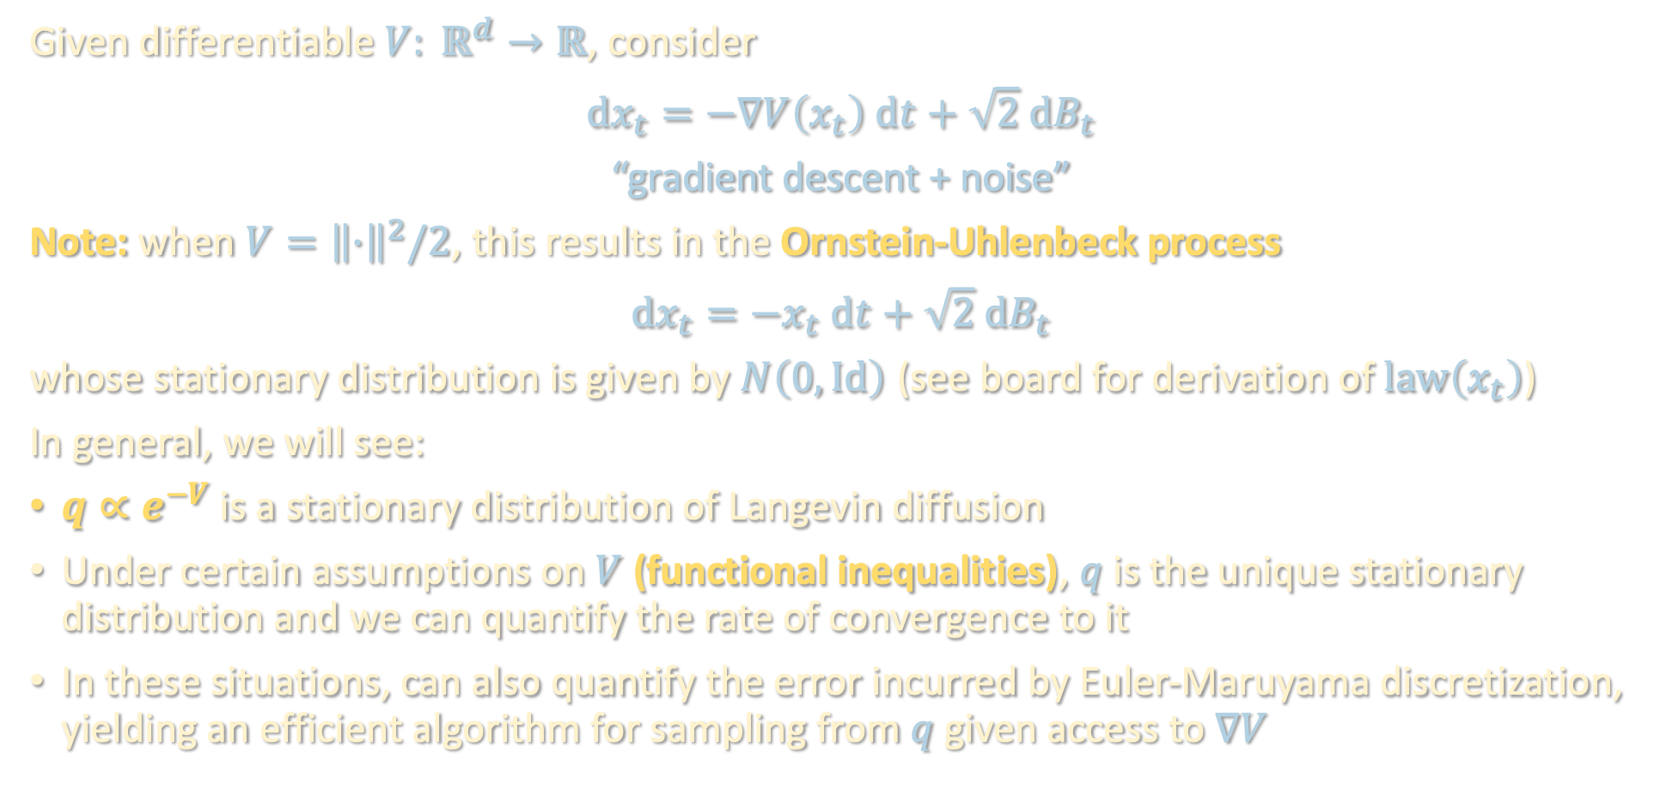
IMPORTANT EXAMPLE: LANGEVIN DIFFUSION
Given differentiable $V: ℝ^{d}→ℝ$, consider
$$dx_{t}=−∇V\left(x_{t}\right) dt+\sqrt{2} dB_{t}$$
“gradient descent + noise”
Note: when $V={\left\|∙\right\|}^{2}/2$, this results in the Ornstein-Uhlenbeck process
$$dx_{t}=−x_{t} dt+\sqrt{2} dB_{t}$$
whose stationary distribution is given by $N\left(0,Id\right)$. ( (see board for derivation of $law\left(x_{t}\right)$)
In general, we will see:
$q∝e^{−V}$ is a stationary distribution of Langevin diffusion
Under certain assumptions on $V$ (functional inequalities), $q$ is the unique stationary distribution and we can quantify the rate of convergence to it
In these situations, can also quantify the error incurred by Euler-Maruyama discretization, yielding an efficient algorithm for sampling from $q$ given access to $∇V$
Langevin diffusion
Notes:
(see board for linear

Slide 9
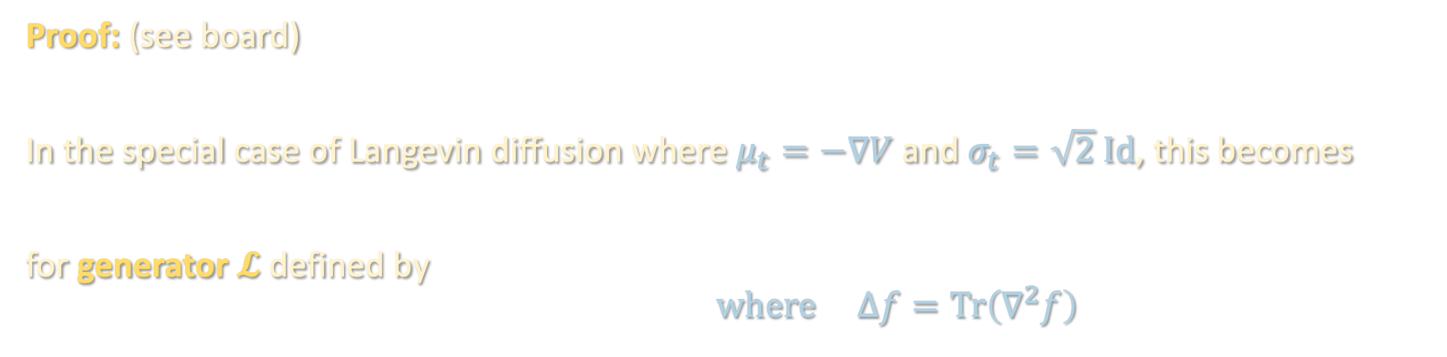
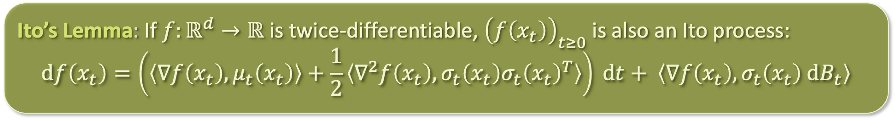
STOCHASTIC CHAIN RULE
$$dx_{t}=μ_{t}\left(x_{t}\right)dt+σ_{t} dB_{t}$$
Ito’s Lemma: If $f:ℝ^{d}→ℝ$ is twice-differentiable, ${\left(f\left(x_{t}\right)\right)}_{t≥0}$ is also an Ito process:
$$df\left(x_{t}\right)=\left(\left\langle ∇f\left(x_{t}\right),μ_{t}\left(x_{t}\right)\right\rangle +\frac{1}{2}\left\langle ∇^{2}f\left(x_{t}\right),σ_{t}\left(x_{t}\right)σ_{t}{\left(x_{t}\right)}^{T}\right\rangle \right) dt+ \left\langle ∇f\left(x_{t}\right),σ_{t}\left(x_{t}\right) dB_{t}\right\rangle$$
Proof: (see board)
In the special case of Langevin diffusion where $μ_{t}=−∇V$ and $σ_{t}=\sqrt{2} Id$, this becomes
$df\left(x_{t}\right)=𝓛f\left(x_{t}\right) dt+$ $\sqrt{2}$ $\left\langle ∇f\left(x_{t}\right), dB_{t}\right\rangle$
for generator $𝓛$ defined by
$$𝓛=∆f−\left\langle ∇V,∇f\right\rangle where ∆f=Tr\left(∇^{2}f\right)$$
$df\left(x_{t}\right)=𝓛f\left(x_{t}\right) dt+$ $\sqrt{2}$ $\left\langle ∇f\left(x_{t}\right), dB_{t}\right\rangle$
$$𝓛=∆f−\left\langle ∇V,∇f\right\rangle$$

Slide 10


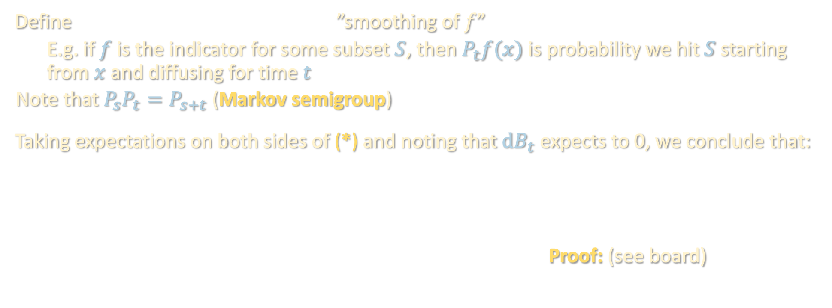

GENERATOR OF DIFFUSION
$$dx_{t}=μ_{t}\left(x_{t}\right)dt+σ_{t} dB_{t}$$
$$𝓛=∆f−\left\langle ∇V,∇f\right\rangle$$
$df\left(x_{t}\right)=𝓛f\left(x_{t}\right) dt+$ $\sqrt{2}$ $\left\langle ∇f\left(x_{t}\right), dB_{t}\right\rangle$
(*)
$$P_{t}f\left(x\right)≔𝔼\left[f\left(x_{t}\right) | x_{0}=x\right]$$
Define ”smoothing of $f$”
  E.g. if $f$ is the indicator for some subset $S$, then $P_{t}f(x)$ is probability we hit $S$ starting from $x$ and diffusing for time $t$
  Note that $P_{s}P_{t}=P_{s+t}$ (Markov semigroup)
Taking expectations on both sides of (*) and noting that $dB_{t}$ expects to 0, we conclude that:
Proof: (see board)
$$\lim_{t→0}{\frac{P_{t}f−f}{t}}=𝓛f$$
Kolmogorov backward equation: $∂_{t}P_{t}f=ℒP_{t}f=P_{t}ℒf$

Slide 11


GENERATOR OF DIFFUSION
$$dx_{t}=μ_{t}\left(x_{t}\right)dt+σ_{t} dB_{t}$$
$$𝓛=∆f−\left\langle ∇V,∇f\right\rangle$$
$df\left(x_{t}\right)=𝓛f\left(x_{t}\right) dt+$ $\sqrt{2}$ $\left\langle ∇f\left(x_{t}\right), dB_{t}\right\rangle$
(*)
$$P_{t}f\left(x\right)≔𝔼\left[f\left(x_{t}\right) | x_{0}=x\right]$$
$$\lim_{t→0}{\frac{P_{t}f−f}{t}}=𝓛f$$

Slide 12

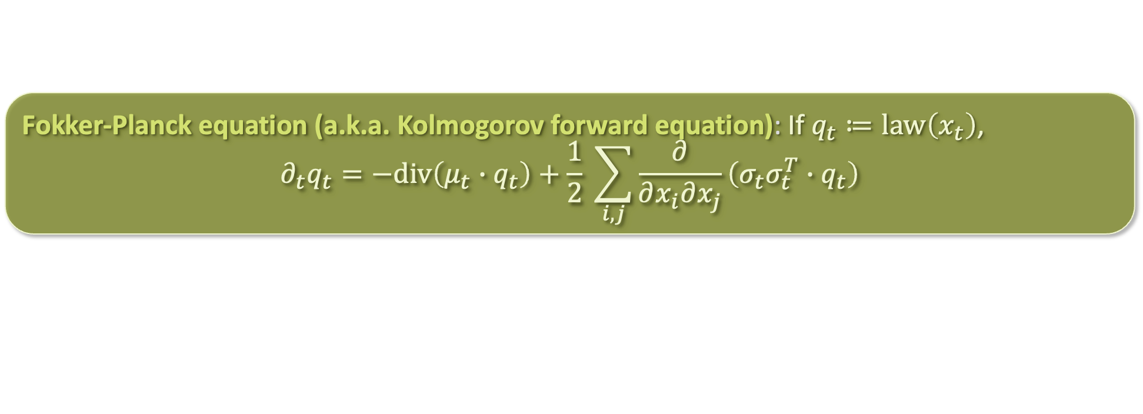
FROM PARTICLES TO MEASURES
$$dx_{t}=μ_{t}\left(x_{t}\right)dt+σ_{t} dB_{t}$$
An Ito diffusion defines a random evolution over $ℝ^{d}$
It also defines a deterministic evolution in the space of probability measures
  Stochastic equivalent of “continuity PDE” that we saw previously in mean-field lecture
  Proof: (see board)
In the special case of Langevin diffusion where $μ_{t}=−∇V$ and $σ_{t}=\sqrt{2} Id$, this becomes
for $𝓛^{∗}$ defined by
  $𝓛$ and $𝓛^{∗}$ are adjoint operators! (see board)
Fokker-Planck equation (a.k.a. Kolmogorov forward equation): If $q_{t}≔law\left(x_{t}\right)$,
$$∂_{t}q_{t}=−div\left(μ_{t}∙q_{t}\right)+\frac{1}{2} \sum_{i,j}{\frac{∂}{∂x_{i}∂x_{j}}\left(σ_{t}σ_{t}^{T}∙q_{t}\right)}$$
same term from continuity PDE
$$∂_{t}q_{t}=𝓛^{∗}q_{t}$$
$$𝓛^{∗}q=div\left(q∙∇V\right)+∆q$$
heat equation term

Slide 13
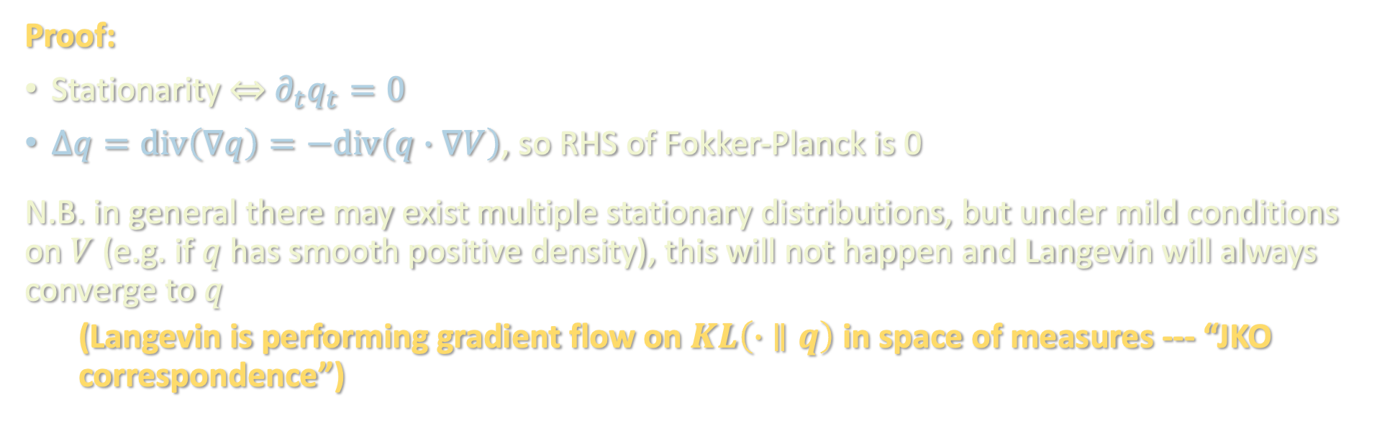
STATIONARY DISTRIBUTION OF LANGEVIN
$$dx_{t}=μ_{t}\left(x_{t}\right)dt+σ_{t} dB_{t}$$
$$∂_{t}q_{t}=𝓛^{∗}q_{t}$$
$$𝓛^{∗}q=div\left(q∙∇V\right)+∆q$$
Proposition: $q∝e^{−V}$ is a stationary distribution of the Langevin diffusion
Proof:
Stationarity $⇔$ $∂_{t}q_{t}=0$
$∆q=div\left(∇q\right)=−div\left(q∙∇V\right)$, so RHS of Fokker-Planck is 0
N.B. in general there may exist multiple stationary distributions, but under mild conditions on $V$ (e.g. if $q$ has smooth positive density), this will not happen and Langevin will always converge to $q$
  (Langevin is performing gradient flow on $KL\left(∙ ∥q\right)$ in space of measures --- “JKO correspondence”)

Slide 14
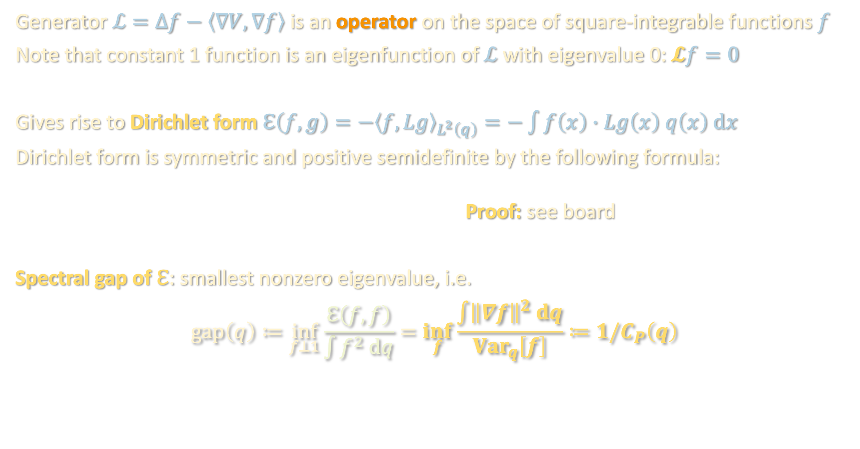

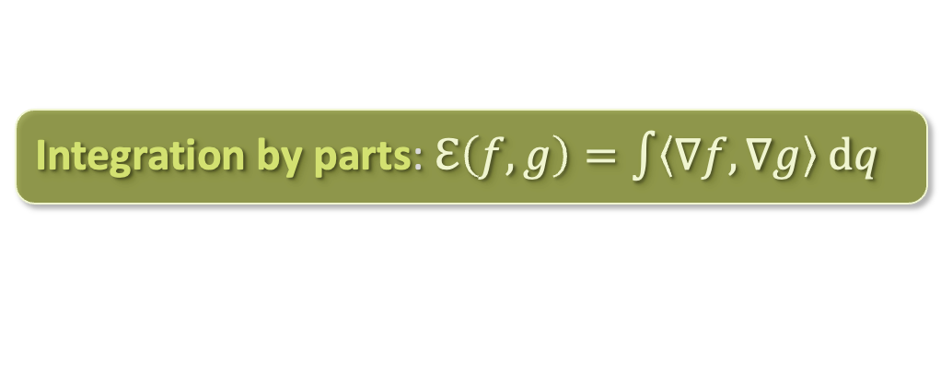
SPECTRUM OF $ℒ$
Generator $ℒ=∆f−\left\langle ∇V,∇f\right\rangle$ is an operator on the space of square-integrable functions $f$
Note that constant 1 function is an eigenfunction of $ℒ$ with eigenvalue 0: $𝓛f=0$
Gives rise to Dirichlet form $ℇ\left(f,g\right)=−{\left\langle f,Lg\right\rangle }_{L^{2}\left(q\right)}=−\int{f\left(x\right)∙Lg\left(x\right) q\left(x\right) dx}$
Dirichlet form is symmetric and positive semidefinite by the following formula:
Proof: see board
Spectral gap of $ℇ$: smallest nonzero eigenvalue, i.e.
$$gap\left(q\right)≔\inf_{f⊥1}{\frac{ℇ\left(f,f\right)}{\int{f^{2} dq}}}=\inf_{f}{\frac{\int{{\left\|∇f\right\|}^{2} dq}}{Var_{q}\left[f\right]}}≔1/C_{P}\left(q\right)$$
Integration by parts: $ℇ\left(f,g\right)=\int{\left\langle ∇f, ∇g\right\rangle dq}$
“Poincare constant”
(the smaller the better)

Slide 15
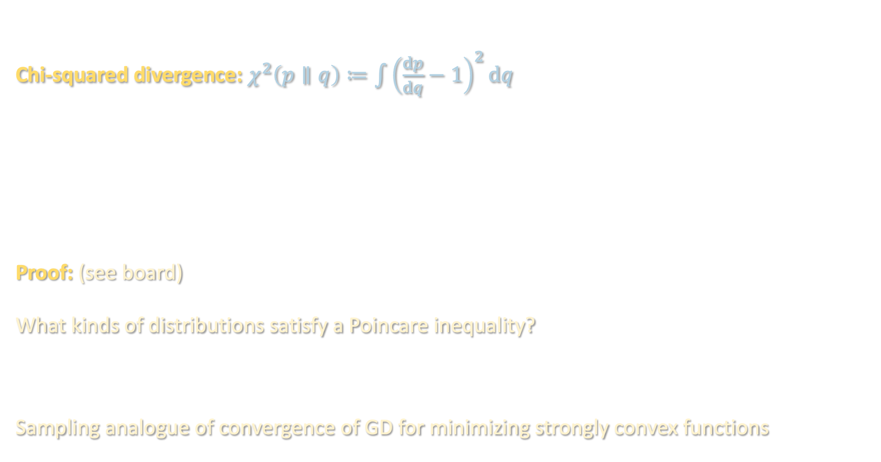
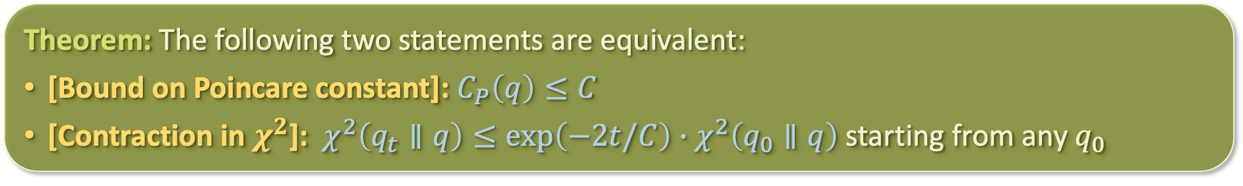
POINCARE CONSTANT = RATE OF CONVERGENCE
Chi-squared divergence: $χ^{2}\left(p∥q\right)≔\int{{\left(\frac{dp}{dq}−1\right)}^{2}dq}$
Proof: (see board)
What kinds of distributions satisfy a Poincare inequality?
Sampling analogue of convergence of GD for minimizing strongly convex functions
Theorem: The following two statements are equivalent:
[Bound on Poincare constant]: $C_{P}\left(q\right)≤C$
[Contraction in $χ^{2}$]: $χ^{2}\left(q_{t}∥q\right)≤exp\left(−2t/C\right)∙χ^{2}\left(q_{0}∥q\right)$ starting from any $q_{0}$
Theorem: For $q∝e^{−V}$ for which $∇^{2}V≽α∙Id$ ($α$-strongly-log-concave), $C_{P}\left(q\right)≤1/α$

Slide 16
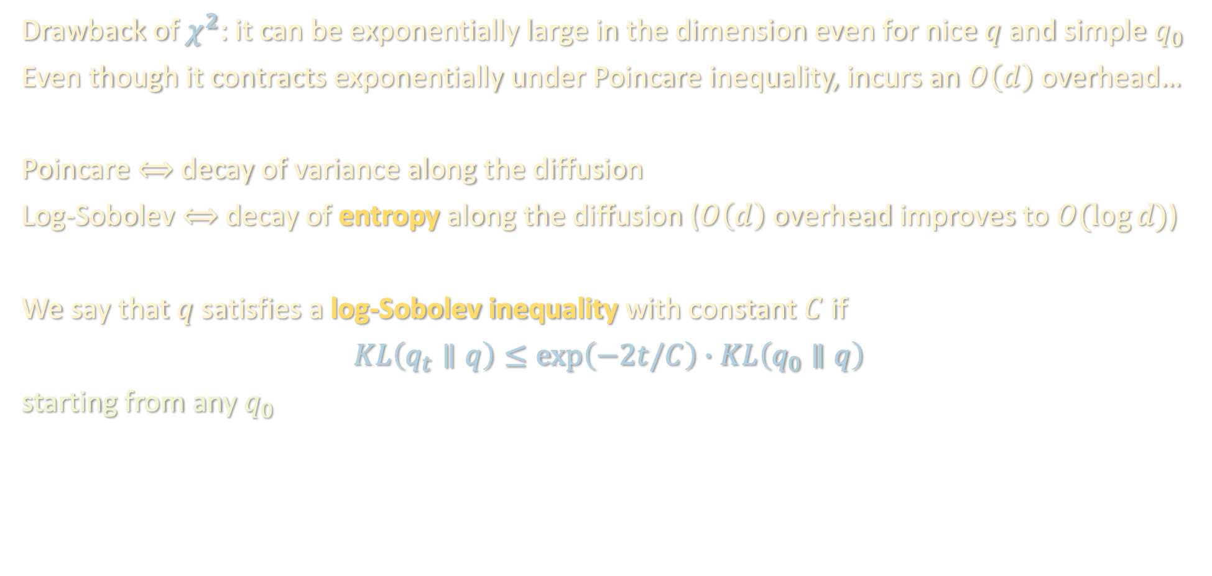
LOG-SOBOLEV INEQUALITY
Drawback of $χ^{2}$: it can be exponentially large in the dimension even for nice $q$ and simple $q_{0}$
Even though it contracts exponentially under Poincare inequality, incurs an $O\left(d\right)$ overhead…
Poincare $⟺$ decay of variance along the diffusion
Log-Sobolev $⟺$ decay of entropy along the diffusion ($O\left(d\right)$ overhead improves to $O(\log{d})$)
We say that $q$ satisfies a log-Sobolev inequality with constant $C$ if
$KL\left(q_{t}∥q\right)≤exp\left(−2t/C\right)∙KL\left(q_{0}∥q\right)$
starting from any $q_{0}$
Thm: $α$-strongly-log-concave → log-Sobolev w/ constant $1/α$ → Poincare w/ constant $1/α$

Slide 17
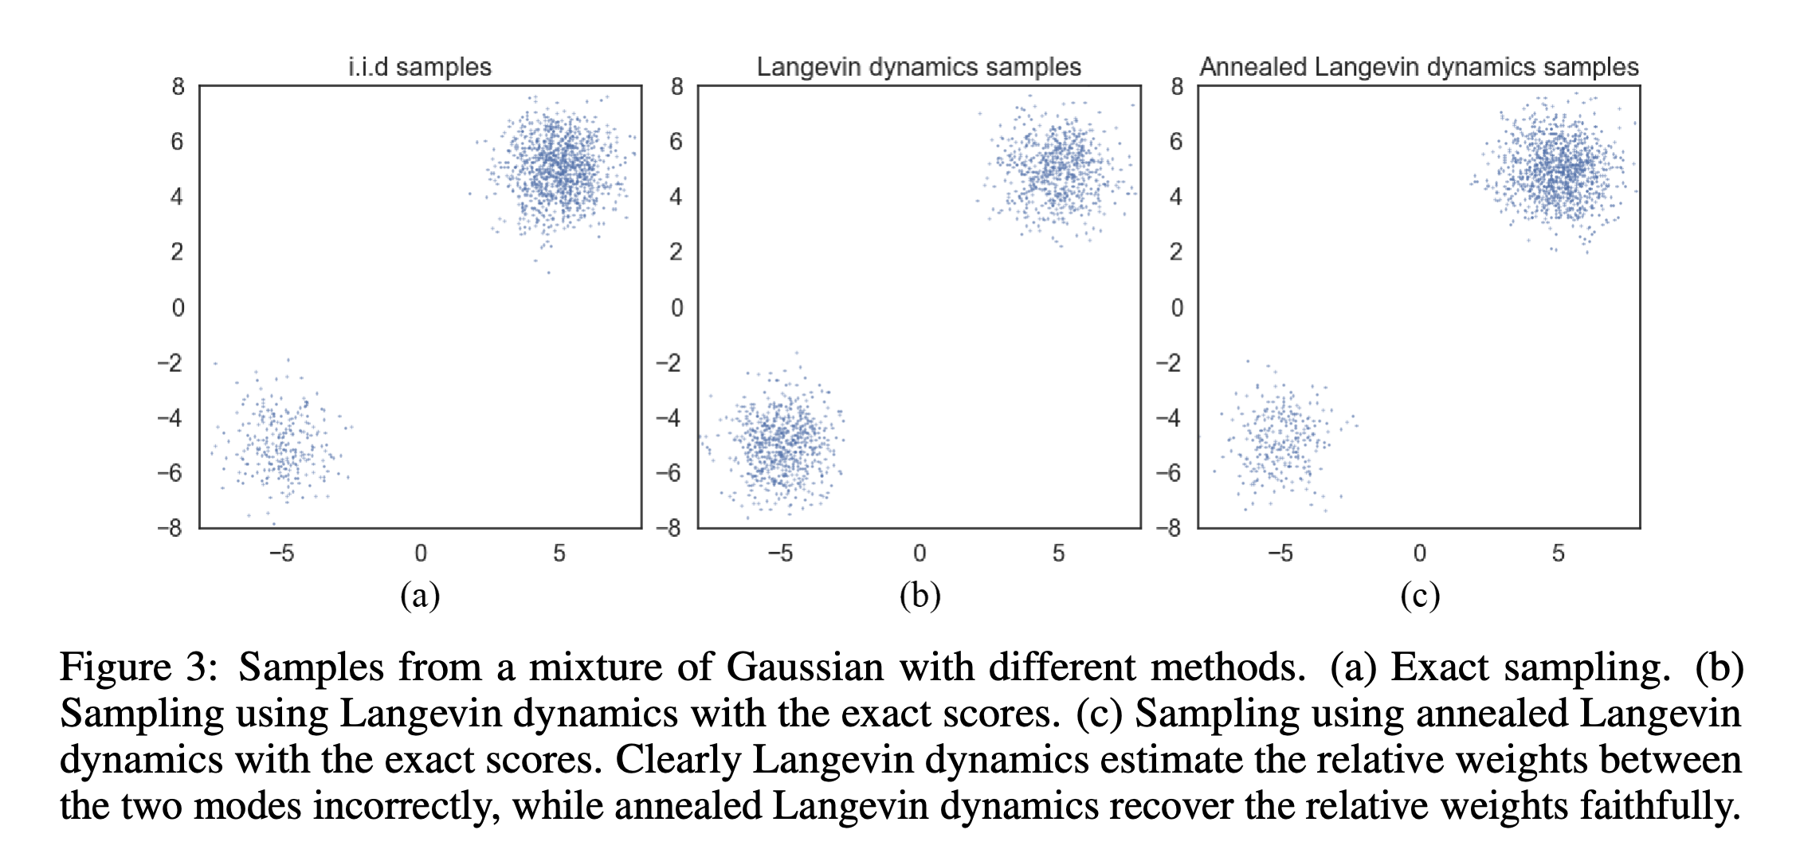
FAILURE OF LANGEVIN DIFFUSION
Issue: Many distributions of interest fail to have bounded Poincare/log-Sobolev constant (just as many functions of interest fail to be convex), and for these Langevin may take a long time to mix, e.g. for multimodal distributions like mixtures of Gaussians
  Sampling analogue of gradient descent getting stuck in local minima
  Reason is that the spaces between far-apart modes of the distribution form bottlenecks for the sampler. The dynamics take a long time to transport mass across these spaces
  Instead, Langevin diffusion will get stuck at metastable states that are not truly stationary but change very little for long periods of time
[Song-Ermon ’19]

Slide 18
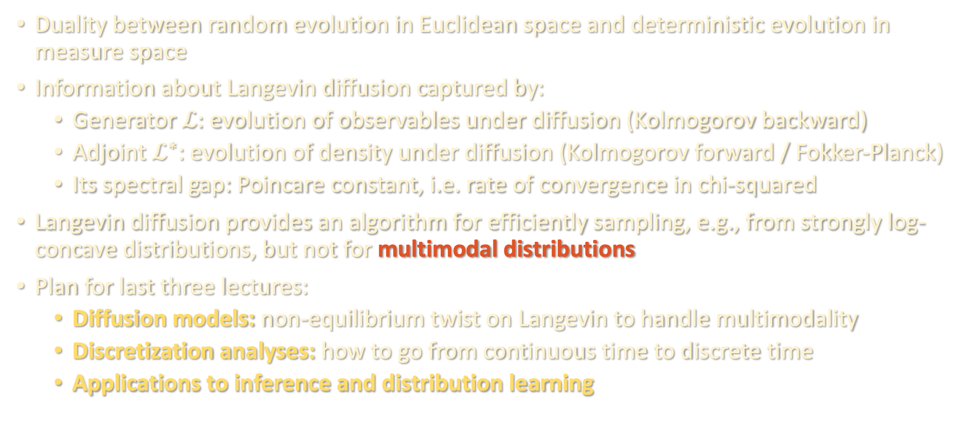
TAKEAWAYS
Duality between random evolution in Euclidean space and deterministic evolution in measure space
Information about Langevin diffusion captured by:
  Generator $ℒ:$ evolution of observables under diffusion (Kolmogorov backward)
  Adjoint $ℒ^{∗}$: evolution of density under diffusion (Kolmogorov forward / Fokker-Planck)
  Its spectral gap: Poincare constant, i.e. rate of convergence in chi-squared
Langevin diffusion provides an algorithm for efficiently sampling, e.g., from strongly log-concave distributions, but not for multimodal distributions
Plan for last three lectures:
  Diffusion models: non-equilibrium twist on Langevin to handle multimodality
  Discretization analyses: how to go from continuous time to discrete time
  Applications to inference and distribution learning

