Slide 1

CS 2243: ALGORITHMS FOR DATA SCIENCE
LECTURE 22 (11/18)
Tensor decomposition
Sum-of-squares
Supervised learning
Computational complexity
Statistical physics
Generative modeling
DIFFUSION MODELS

Slide 2
IOUs FROM LAST LECTURE
Fokker-Planck equation
Integration by parts with generator of diffusion
Poincare constant equivalent to variance decay

Slide 3

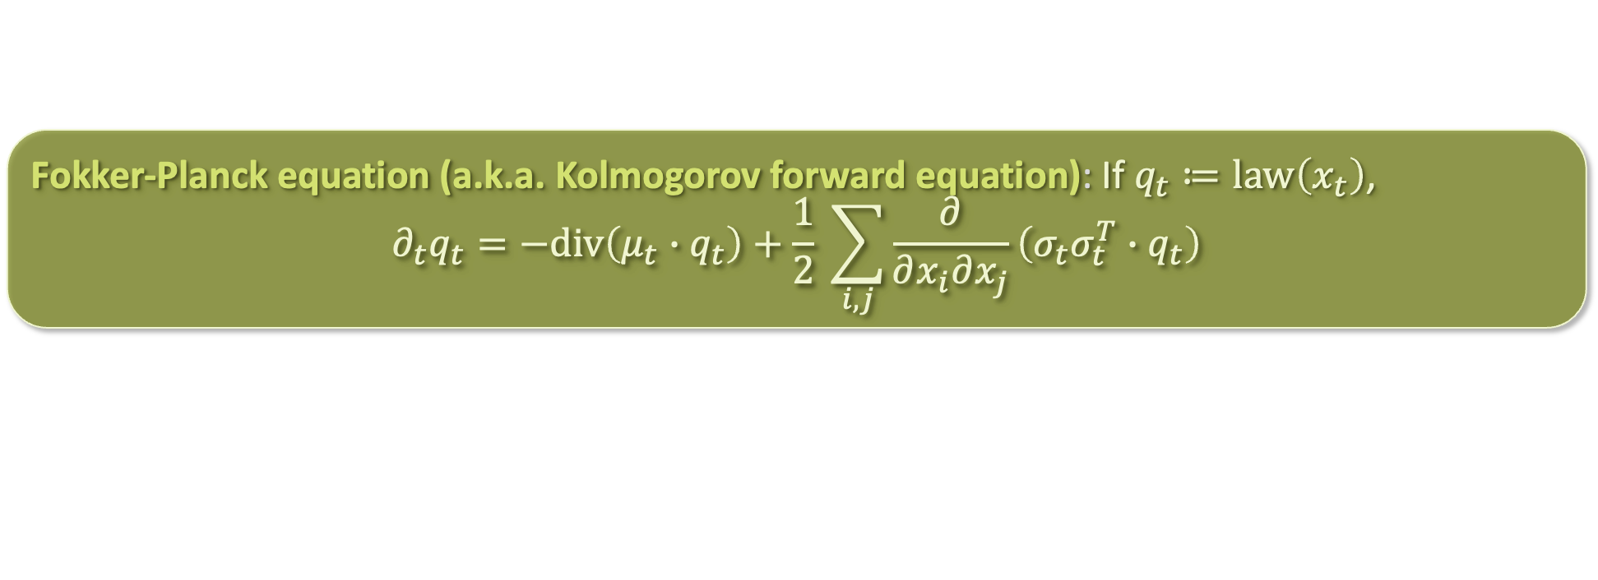
FROM PARTICLES TO MEASURES
$$dx_{t}=μ_{t}\left(x_{t}\right)dt+σ_{t} dB_{t}$$
An Ito diffusion defines a random evolution over $ℝ^{d}$
It also defines a deterministic evolution in the space of probability measures
  Stochastic equivalent of “continuity PDE” that we saw previously in mean-field lecture
  Proof: (see board)
In the special case of Langevin diffusion where $μ_{t}=−∇V$ and $σ_{t}=\sqrt{2} Id$, this becomes
for $𝓛^{∗}$ defined by
  $𝓛$ and $𝓛^{∗}$ are adjoint operators! (see board)
Fokker-Planck equation (a.k.a. Kolmogorov forward equation): If $q_{t}≔law\left(x_{t}\right)$,
$$∂_{t}q_{t}=−div\left(μ_{t}∙q_{t}\right)+\frac{1}{2} \sum_{i,j}{\frac{∂}{∂x_{i}∂x_{j}}\left(σ_{t}σ_{t}^{T}∙q_{t}\right)}$$
same term from continuity PDE
$$∂_{t}q_{t}=𝓛^{∗}q_{t}$$
$$𝓛^{∗}q=div\left(q∙∇V\right)+∆q$$
heat equation term

Slide 4
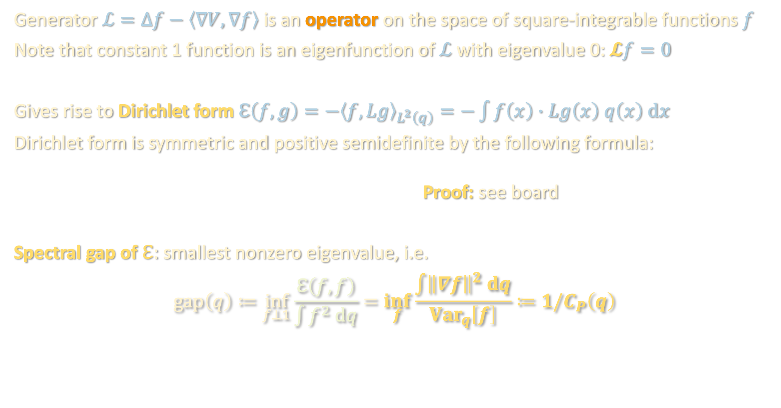

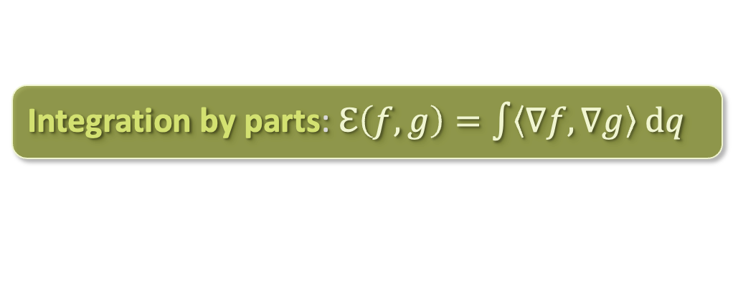
SPECTRUM OF $ℒ$
Generator $ℒ=∆f−\left\langle ∇V,∇f\right\rangle$ is an operator on the space of square-integrable functions $f$
Note that constant 1 function is an eigenfunction of $ℒ$ with eigenvalue 0: $𝓛f=0$
Gives rise to Dirichlet form $ℇ\left(f,g\right)=−{\left\langle f,Lg\right\rangle }_{L^{2}\left(q\right)}=−\int{f\left(x\right)∙Lg\left(x\right) q\left(x\right) dx}$
Dirichlet form is symmetric and positive semidefinite by the following formula:
Proof: see board
Spectral gap of $ℇ$: smallest nonzero eigenvalue, i.e.
$$gap\left(q\right)≔\inf_{f⊥1}{\frac{ℇ\left(f,f\right)}{\int{f^{2} dq}}}=\inf_{f}{\frac{\int{{\left\|∇f\right\|}^{2} dq}}{Var_{q}\left[f\right]}}≔1/C_{P}\left(q\right)$$
Integration by parts: $ℇ\left(f,g\right)=\int{\left\langle ∇f, ∇g\right\rangle dq}$
“Poincare constant”
(the smaller the better)

Slide 5
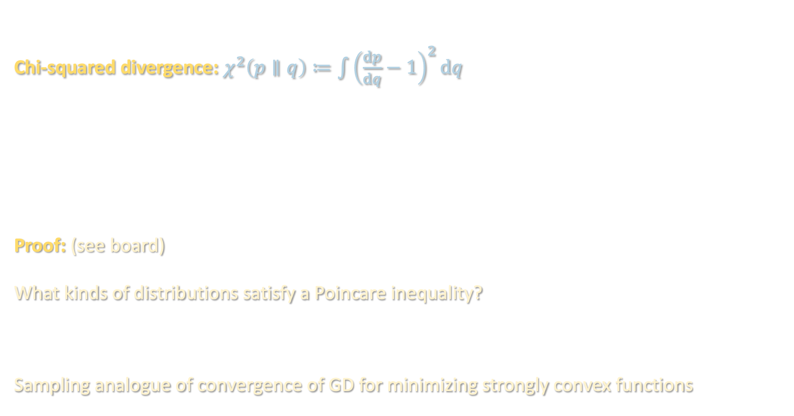
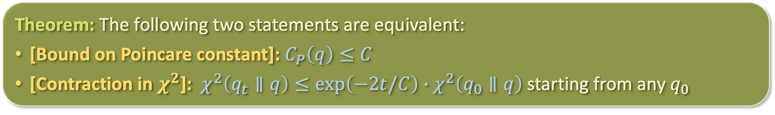
POINCARE CONSTANT = RATE OF CONVERGENCE
Chi-squared divergence: $χ^{2}\left(p∥q\right)≔\int{{\left(\frac{dp}{dq}−1\right)}^{2}dq}$
Proof: (see board)
What kinds of distributions satisfy a Poincare inequality?
Sampling analogue of convergence of GD for minimizing strongly convex functions
Theorem: The following two statements are equivalent:
[Bound on Poincare constant]: $C_{P}\left(q\right)≤C$
[Contraction in $χ^{2}$]: $χ^{2}\left(q_{t}∥q\right)≤exp\left(−2t/C\right)∙χ^{2}\left(q_{0}∥q\right)$ starting from any $q_{0}$
Theorem: For $q∝e^{−V}$ for which $∇^{2}V≽α∙Id$ ($α$-strongly-log-concave), $C_{P}\left(q\right)≤1/α$

Slide 6
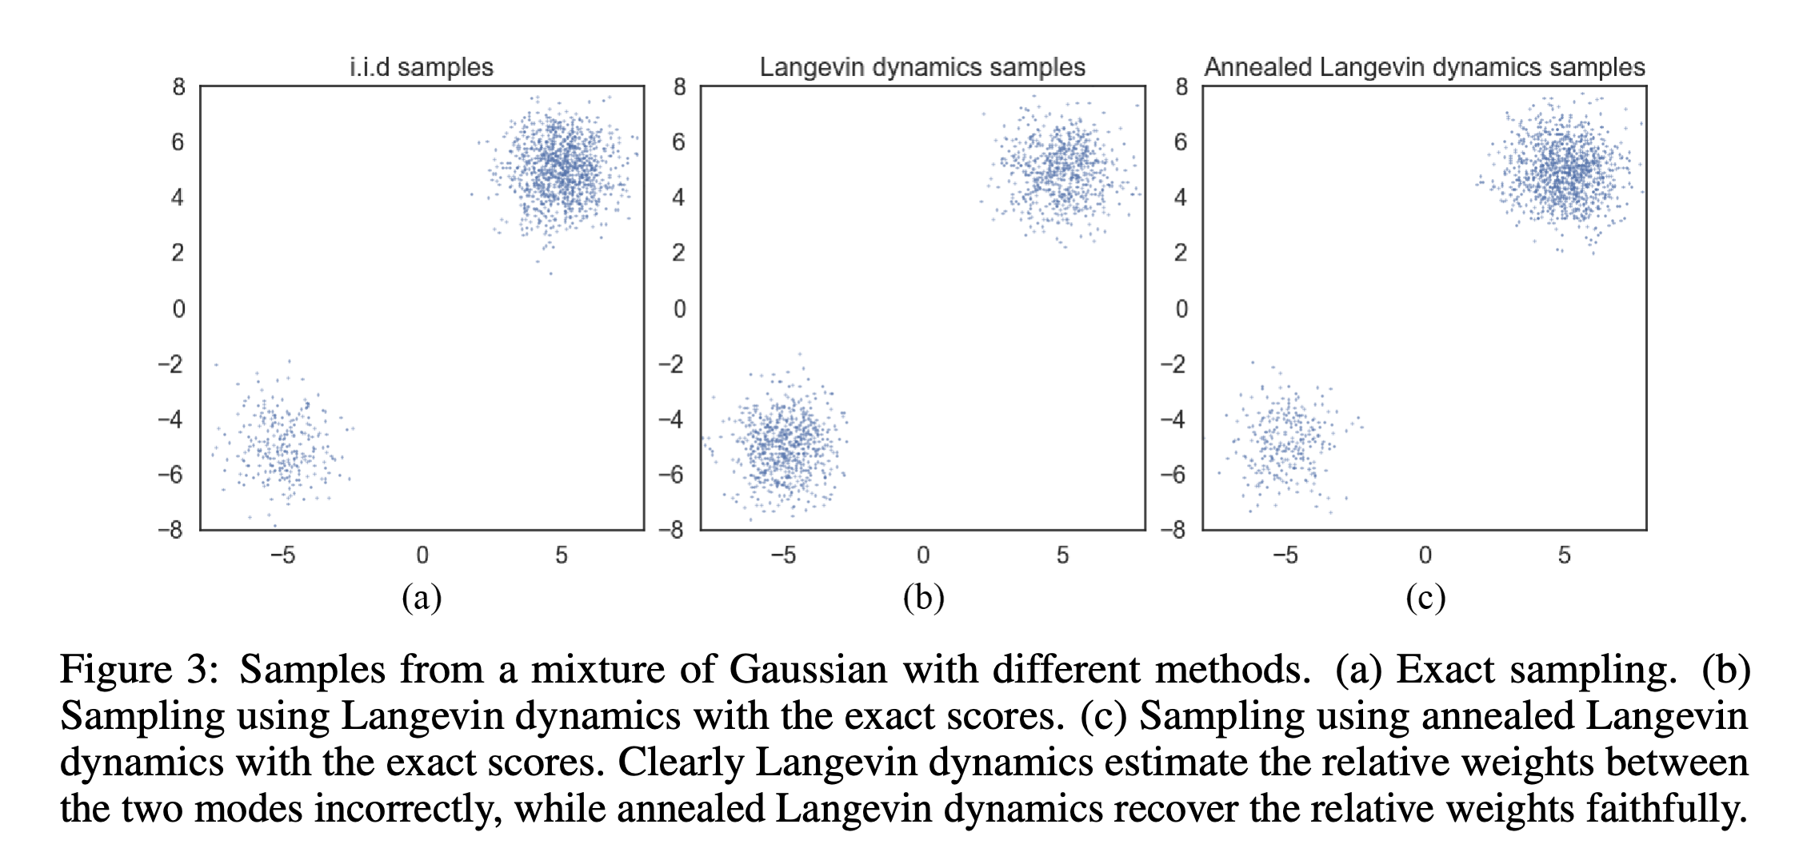
FAILURE OF LANGEVIN DIFFUSION
Issue: Many distributions of interest fail to have bounded Poincare/log-Sobolev constant (just as many functions of interest fail to be convex), and for these Langevin may take a long time to mix, e.g. for multimodal distributions like mixtures of Gaussians
  Sampling analogue of gradient descent getting stuck in local minima
  Reason is that the spaces between far-apart modes of the distribution form bottlenecks for the sampler. The dynamics take a long time to transport mass across these spaces
  Instead, Langevin diffusion will get stuck at metastable states that are not truly stationary but change very little for long periods of time
  Diffusion models offer a workaround!
[Song-Ermon ’19]

Slide 7
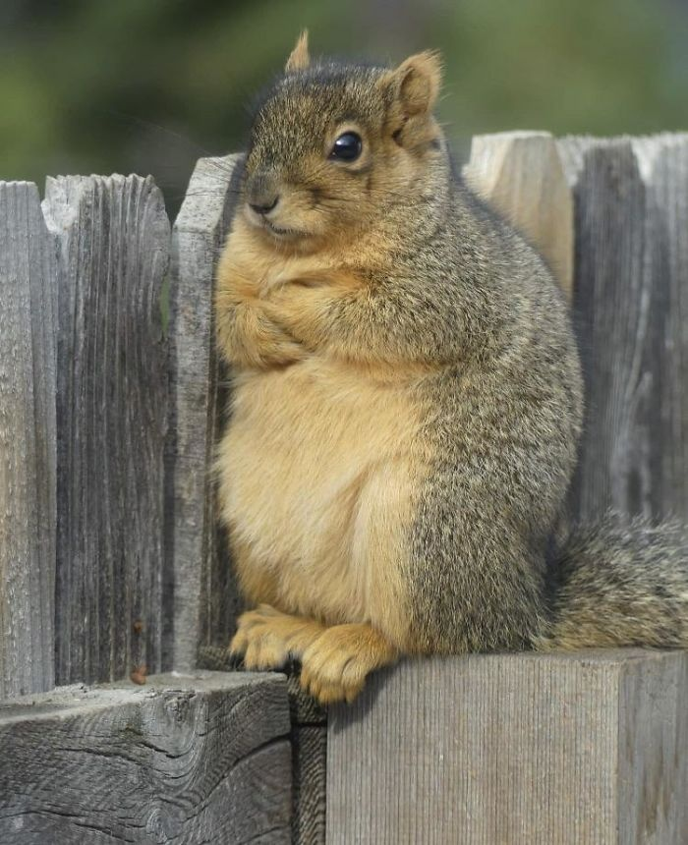
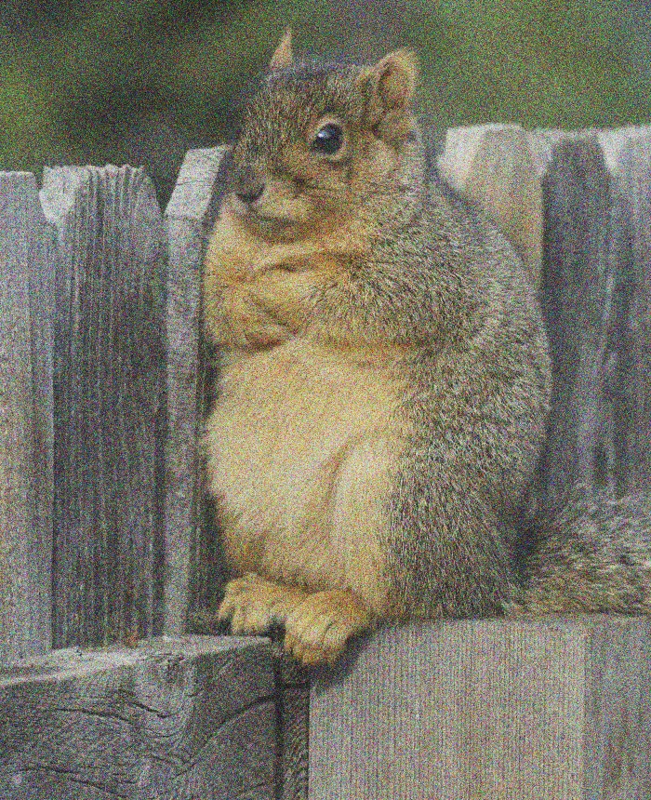
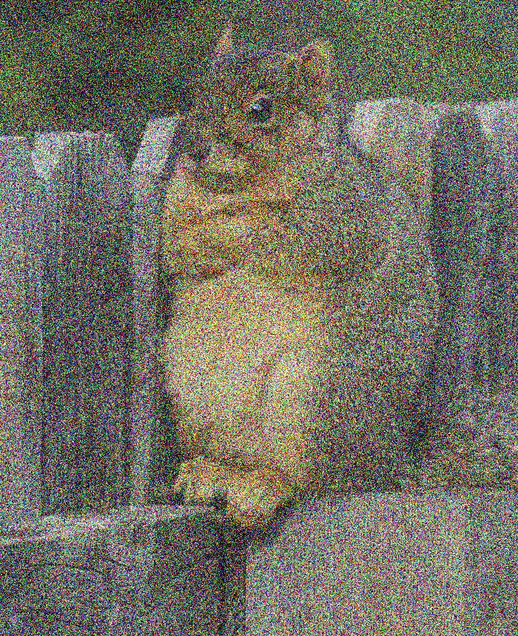
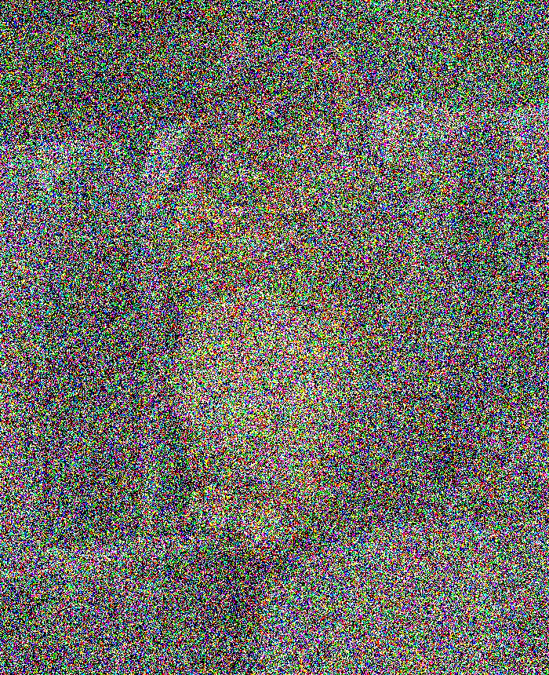

DIFFUSION MODELS
Forward process
$$t=0$$
$$t=∞$$
$$X_{t}=e^{−t}⋅X_{0}+\sqrt{1−e^{−2t}}⋅γ$$
$$dX_{t}=−X_{t}+\sqrt{2}dB_{t}$$
$X_{0}∼q$ (data distribution)
$$N\left(0,Id\right)$$

Slide 8
DIFFUSION MODELS
$$q_{0}=q$$
$$q_{t}$$
Forward process
$$t=0$$
$$t=∞$$
$$dX_{t}=−X_{t} dt+\sqrt{2} dB_{t}$$
$X_{0}∼q$ (data distribution)

Slide 9
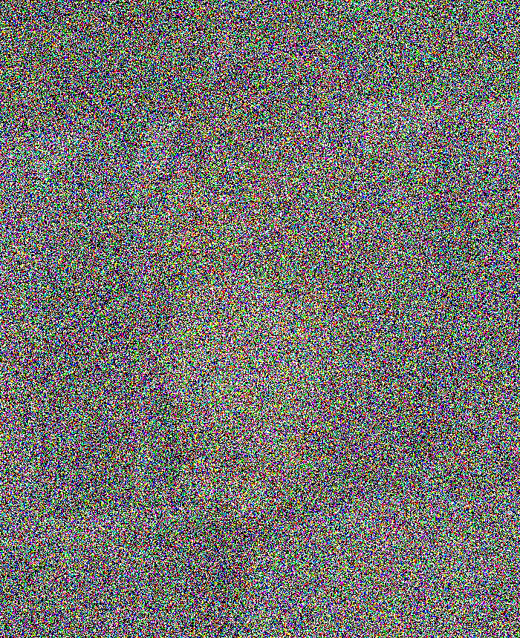
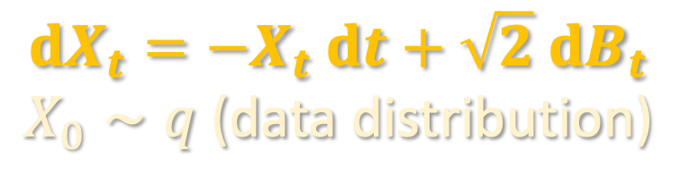
DIFFUSION MODELS
$$q_{0}=q$$
$$q_{t}$$
Forward process
$$t=0$$
$$t=T$$
$$dX_{t}=−X_{t} dt+\sqrt{2} dB_{t}$$
$X_{0}∼q$ (data distribution)
in practice, can only run for finite time

Slide 10
DIFFUSION MODELS
(a few slides later, we will prove why running this reverses the forward process)
$$q_{T}$$
$$q_{T−t}$$
$$q_{0}=q$$
Reverse process
$$t=0$$
$$t=T$$
$$dX_{t}^{←}=\left\{X_{t}^{←}+2∇ ln q_{T−t}\left(X_{t}^{←}\right)\right\} dt+\sqrt{2} dB_{t}$$
$X_{0}^{←}∼q_{T}$ (forward process at time $T$)

Slide 11

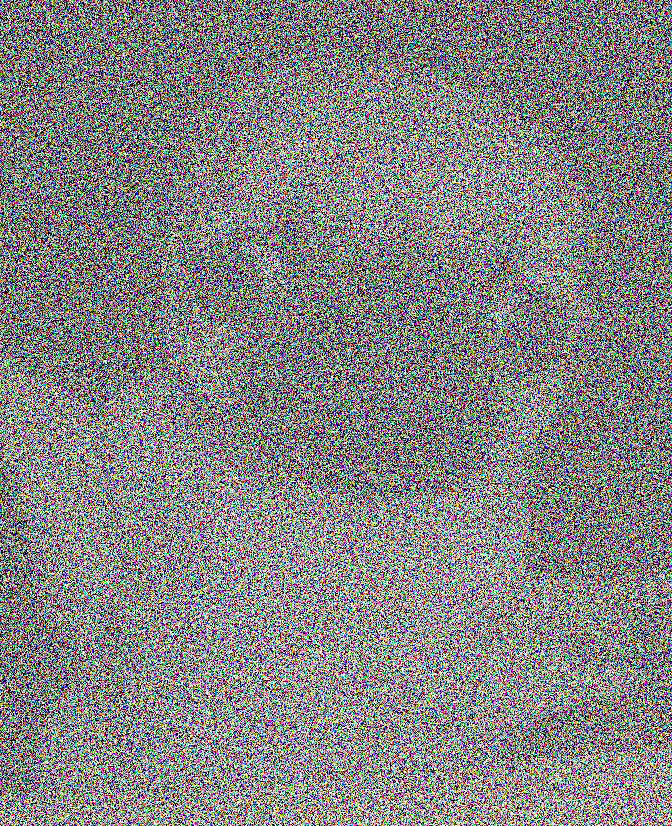
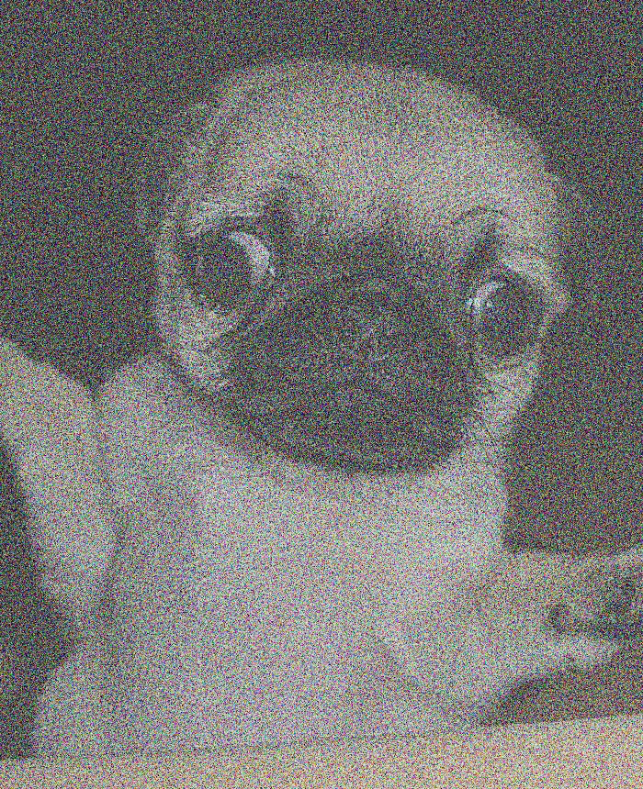
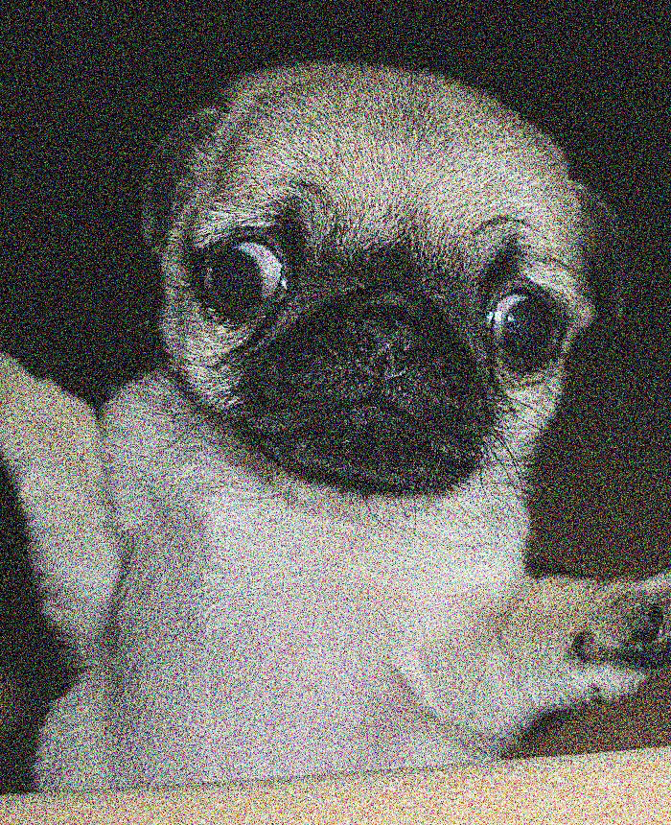
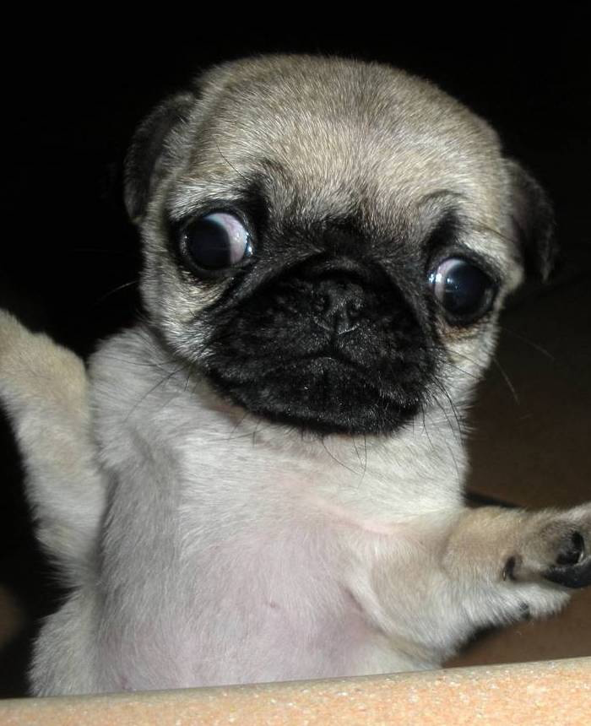
DIFFUSION MODELS
Sources of error:
Initialize at Gaussian instead of $q_{T}$
To sample fresh images, run reverse process w/ Gaussian initialization
initialize at pure Gaussian
$$t=0$$
$$t=T$$
$$dX_{t}^{←}=\left\{X_{t}^{←}+2∇ ln q_{T−t}\left(X_{t}^{←}\right)\right\} dt+\sqrt{2} dB_{t}$$
$X_{0}^{←}∼q_{T}$ (forward process at time $T$)

Slide 12
DIFFUSION MODELS
Sources of error:
Initialize at Gaussian instead of $q_{T}$
To sample fresh images, run reverse process w/ Gaussian initialization
initialize at pure Gaussian
$$t=0$$
$$t=T$$
“score function”
we don’t have access to this!
$$dX_{t}^{←}=\left\{X_{t}^{←}+2∇ ln q_{T−t}\left(X_{t}^{←}\right)\right\} dt+\sqrt{2} dB_{t}$$
$X_{0}^{←}∼q_{T}$ (forward process at time $T$)

Slide 13
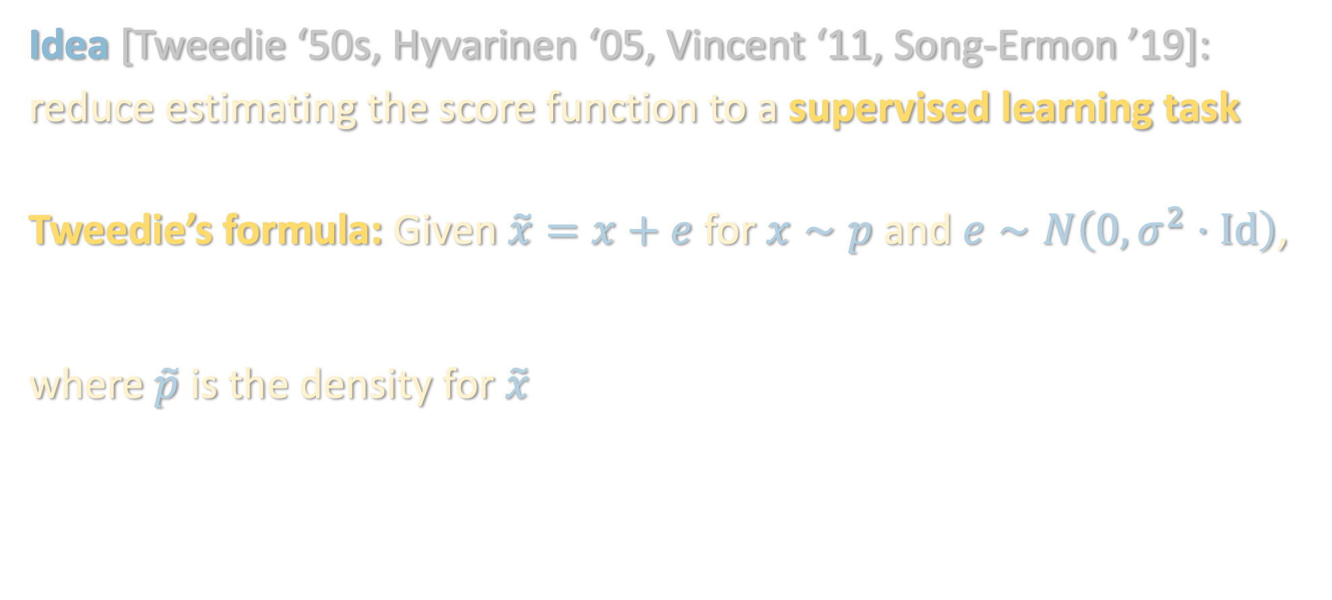

SCORE MATCHING
Sources of error:
Initialize at Gaussian instead of $q_{T}$
Idea [Tweedie ‘50s, Hyvarinen ‘05, Vincent ‘11, Song-Ermon ’19]:
reduce estimating the score function to a supervised learning task
Tweedie’s formula: Given $\tilde{x}=x+e$ for $x∼p$ and $e∼N\left(0,σ^{2}⋅Id\right)$,
$$𝔼\left[x | \tilde{x}\right]=\tilde{x}+σ^{2}⋅∇ ln \tilde{p}\left(\tilde{x}\right)$$
where $\tilde{p}$ is the density for $\tilde{x}$
$$𝔼\left[x | \tilde{x}\right]=\tilde{x}+σ^{2}⋅∇ ln \tilde{p}\left(\tilde{x}\right)$$
Score function: Bayes-optimal estimate for noise (up to scaling)

Slide 14

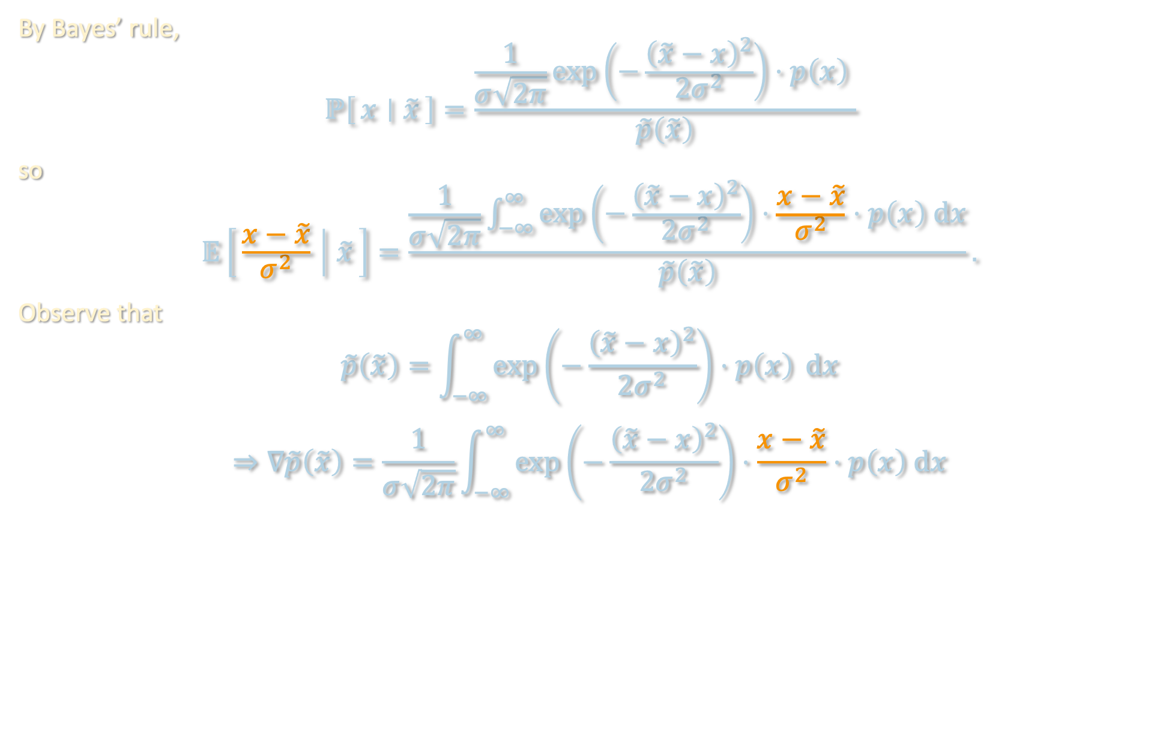
PROOF OF TWEEDIE’S FORMULA
$$𝔼\left[x | \tilde{x}\right]=\tilde{x}+σ^{2}⋅∇ ln \tilde{p}\left(\tilde{x}\right)$$
By Bayes’ rule,
$$ℙ\left[x ∣ \tilde{x}\right]=\frac{\frac{1}{σ\sqrt{2π}}\exp\left(−\frac{{\left(\tilde{x}−x\right)}^{2}}{2σ^{2}}\right)⋅p\left(x\right) }{\tilde{p}\left(\tilde{x}\right)}$$
so
$$𝔼\left[\frac{x−\tilde{x}}{σ^{2}} ∣ \tilde{x}\right]=\frac{\frac{1}{σ\sqrt{2π}}\int_{−∞}^{∞}{\exp\left(−\frac{{\left(\tilde{x}−x\right)}^{2}}{2σ^{2}}\right)⋅\frac{x−\tilde{x}}{σ^{2}}⋅p\left(x\right) dx}}{\tilde{p}\left(\tilde{x}\right)}.$$
Observe that
$$\tilde{p}\left(\tilde{x}\right)=\int_{−∞}^{∞}{\exp\left(−\frac{{\left(\tilde{x}−x\right)}^{2}}{2σ^{2}}\right)⋅p\left(x\right) }dx$$
$$⇒∇\tilde{p}\left(\tilde{x}\right)=\frac{1}{σ\sqrt{2π}}\int_{−∞}^{∞}{\exp\left(−\frac{{\left(\tilde{x}−x\right)}^{2}}{2σ^{2}}\right)⋅\frac{x−\tilde{x}}{σ^{2}}⋅p\left(x\right) dx}$$

Slide 15
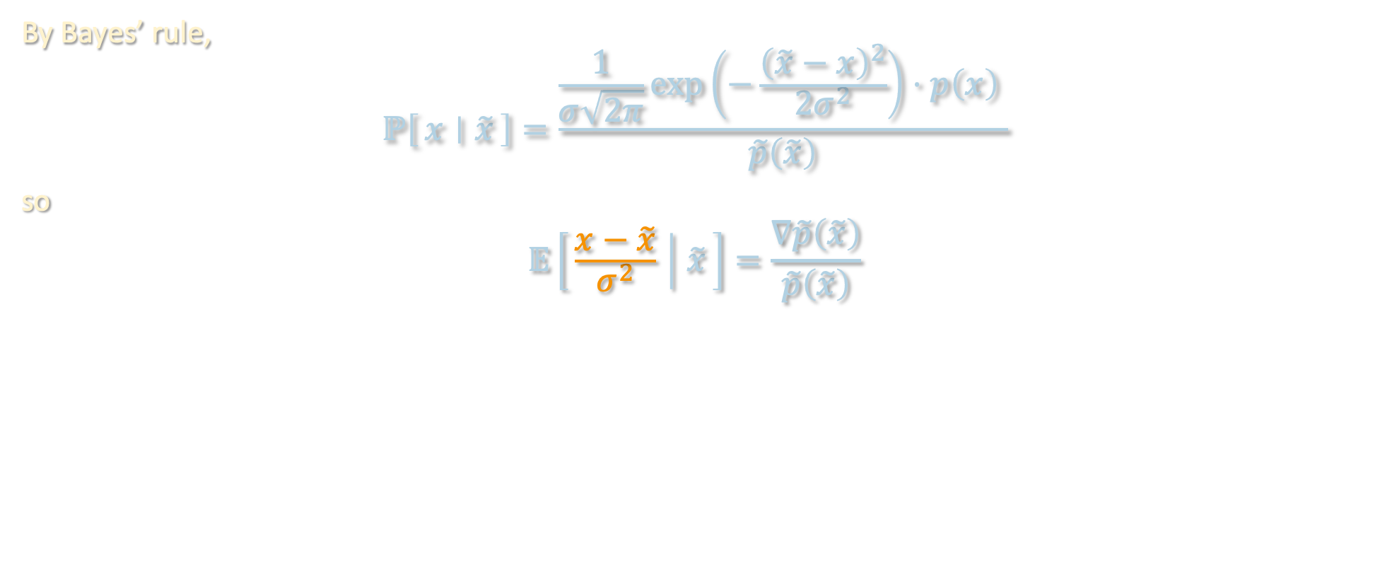

PROOF OF TWEEDIE’S FORMULA
$$𝔼\left[x | \tilde{x}\right]=\tilde{x}+σ^{2}⋅∇ ln \tilde{p}\left(\tilde{x}\right)$$
By Bayes’ rule,
$$ℙ\left[x ∣ \tilde{x}\right]=\frac{\frac{1}{σ\sqrt{2π}}\exp\left(−\frac{{\left(\tilde{x}−x\right)}^{2}}{2σ^{2}}\right)⋅p\left(x\right) }{\tilde{p}\left(\tilde{x}\right)}$$
so
$$𝔼\left[\frac{x−\tilde{x}}{σ^{2}} ∣ \tilde{x}\right]=\frac{∇\tilde{p}\left(\tilde{x}\right)}{\tilde{p}\left(\tilde{x}\right)}$$
$$=∇\ln{\tilde{p}\left(\tilde{x}\right)}$$

Slide 16
SCORE MATCHING
Sources of error:
Initialize at Gaussian instead of $q_{T}$
Idea [Tweedie ‘50s, Hyvarinen ‘05, Vincent ‘11, Song-Ermon ’19]:
reduce estimating the score function to a supervised learning task
Tweedie’s formula: Given $\tilde{x}=x+e$ for $x∼p$ and $e∼N\left(0,σ^{2}⋅Id\right)$,
$$𝔼\left[x | \tilde{x}\right]=\tilde{x}+σ^{2}⋅∇ ln \tilde{p}\left(\tilde{x}\right)$$
where $\tilde{p}$ is the density for $\tilde{x}$
$$𝔼\left[x | \tilde{x}\right]=\tilde{x}+σ^{2}⋅∇ ln \tilde{p}\left(\tilde{x}\right)$$
Score function: Bayes-optimal estimate for noise (up to scaling)

Slide 17
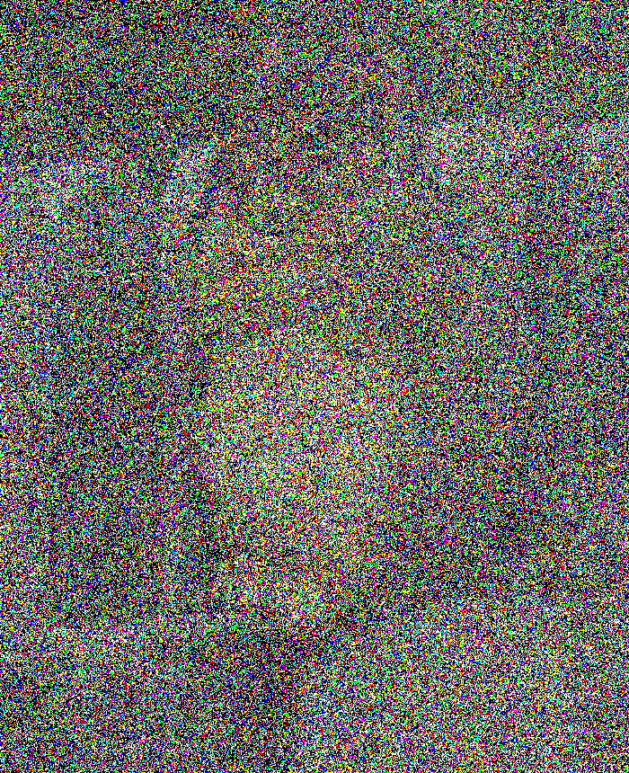
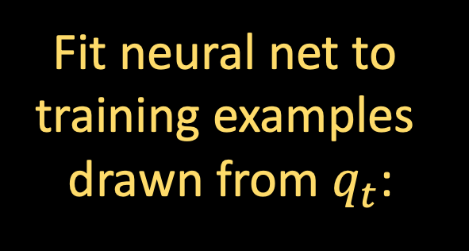

SCORE MATCHING
Sources of error:
Initialize at Gaussian instead of $q_{T}$
Idea [Tweedie ‘50s, Hyvarinen ‘05, Vincent ‘11, Song-Ermon ’19]:
reduce estimating the score function to a supervised learning task
Supervised task: given noisy image $X_{t}$, predict noise $γ$ that was added
Fit neural net to
training examples
drawn from $q_{t}$:

Slide 18

SCORE MATCHING
Sources of error:
Initialize at Gaussian instead of $q_{T}$
Score estimation error
Still far from rigorously understanding why neural nets can solve such supervised tasks well... We will just take on faith that they can
Assumption: For all $t$, have access to score estimate $s_{t}\left(⋅\right)$ satisfying
$$𝔼_{q_{t}}\left[{\left\|s_{t}\left(X_{t}\right)−∇\ln{q_{t}\left(X_{t}\right)}\right\|}^{2}\right]≤ε_{sc}^{2}$$
Fit neural net to
training examples
drawn from $q_{t}$:

Slide 19
DIFFUSION MODELS
Sources of error:
Initialize at Gaussian instead of $q_{T}$
Score estimation error
Reverse process (in practice)
initialize at pure Gaussian
$$t=0$$
$$t=T$$
$$dX_{t}^{←}=\left\{X_{t}^{←}+2∇ ln q_{T−t}\left(X_{t}^{←}\right)\right\} dt+\sqrt{2} dB_{t}$$
$X_{0}^{←}∼q_{T}$ (forward process at time $T$)

Slide 20
DIFFUSION MODELS
Sources of error:
Initialize at Gaussian instead of $q_{T}$
Score estimation error
Reverse process (in practice)
initialize at pure Gaussian
$$t=0$$
$$t=T$$
can’t run in continuous time, need to discretize
$$dX_{t}^{←}=\left\{X_{t}^{←}+2s_{T−t}\left(X_{t}^{←}\right)\right\} dt+\sqrt{2} dB_{t}$$
$X_{0}^{←}∼q_{T}$ (forward process at time $T$)

Slide 21
DIFFUSION MODELS
Sources of error:
Initialize at Gaussian instead of $q_{T}$
Score estimation error
Reverse process (in practice)
initialize at pure Gaussian
$$t=h, 2h, 3h, …$$
$$t=0$$
$$t=T$$
can’t run in continuous time, need to discretize
$$dX_{t}^{←}=\left\{X_{t}^{←}+2s_{T−t}\left(X_{t}^{←}\right)\right\} dt+\sqrt{2} dB_{t}$$
$X_{0}^{←}∼q_{T}$ (forward process at time $T$)

Slide 22
DIFFUSION MODELS
Sources of error:
Initialize at Gaussian instead of $q_{T}$
Score estimation error
Discretization error
Reverse process (in practice)
initialize at pure Gaussian
$$t=h, 2h, 3h, …$$
$$t=0$$
$$t=T$$
$$dX_{t}^{←}=\left\{X_{t}^{←}+2s_{T−kh}\left(X_{kh}^{←}\right)\right\} dt+\sqrt{2} dB_{t}$$
$X_{0}^{←}∼q_{T}$ (forward process at time $T$)
Linear SDE, so we can solve exactly
$$k=⌊t/h⌋$$

Slide 23

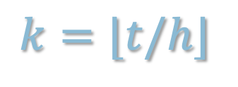


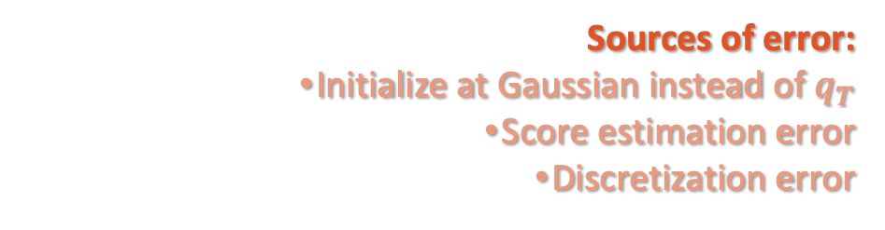
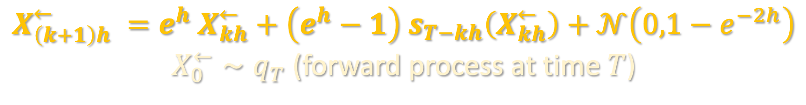
DIFFUSION MODELS
Sources of error:
Initialize at Gaussian instead of $q_{T}$
Score estimation error
Discretization error
Reverse process (in practice)
initialize at pure Gaussian
$$t=h, 2h, 3h, …$$
$$t=0$$
$$t=T$$
$$X_{\left(k+1\right)h}^{←} =e^{h} X_{kh}^{←}+\left(e^{h}−1\right) s_{T−kh}\left(X_{kh}^{←}\right)+𝒩\left(0,1−e^{−2h}\right)$$
$X_{0}^{←}∼q_{T}$ (forward process at time $T$)
$$k=⌊t/h⌋$$

Slide 24
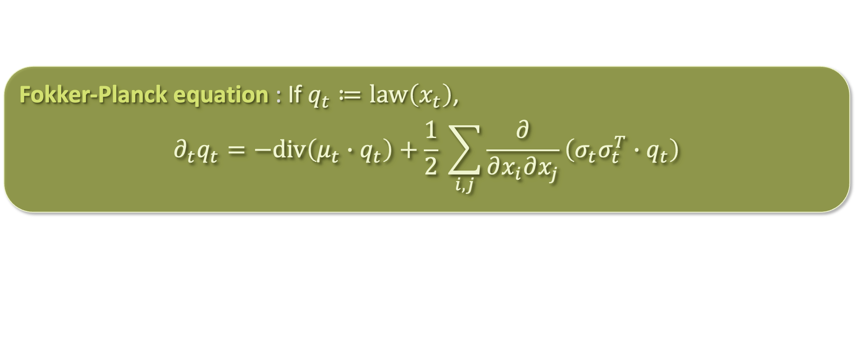

JUSTIFICATION FOR THE REVERSE SDE
Recall the Fokker-Planck equation: for Ito process $dx_{t}=μ_{t}\left(x_{t}\right)dt+σ_{t} dB_{t}$:
Claim: Fokker-Planck equations for forward and reverse processes are time-reversals of each other
Proof: see board
How do we prove that all of the sources of error compound benignly?
Fokker-Planck equation : If $q_{t}≔law\left(x_{t}\right)$,
$$∂_{t}q_{t}=−div\left(μ_{t}∙q_{t}\right)+\frac{1}{2} \sum_{i,j}{\frac{∂}{∂x_{i}∂x_{j}}\left(σ_{t}σ_{t}^{T}∙q_{t}\right)}$$

Slide 25
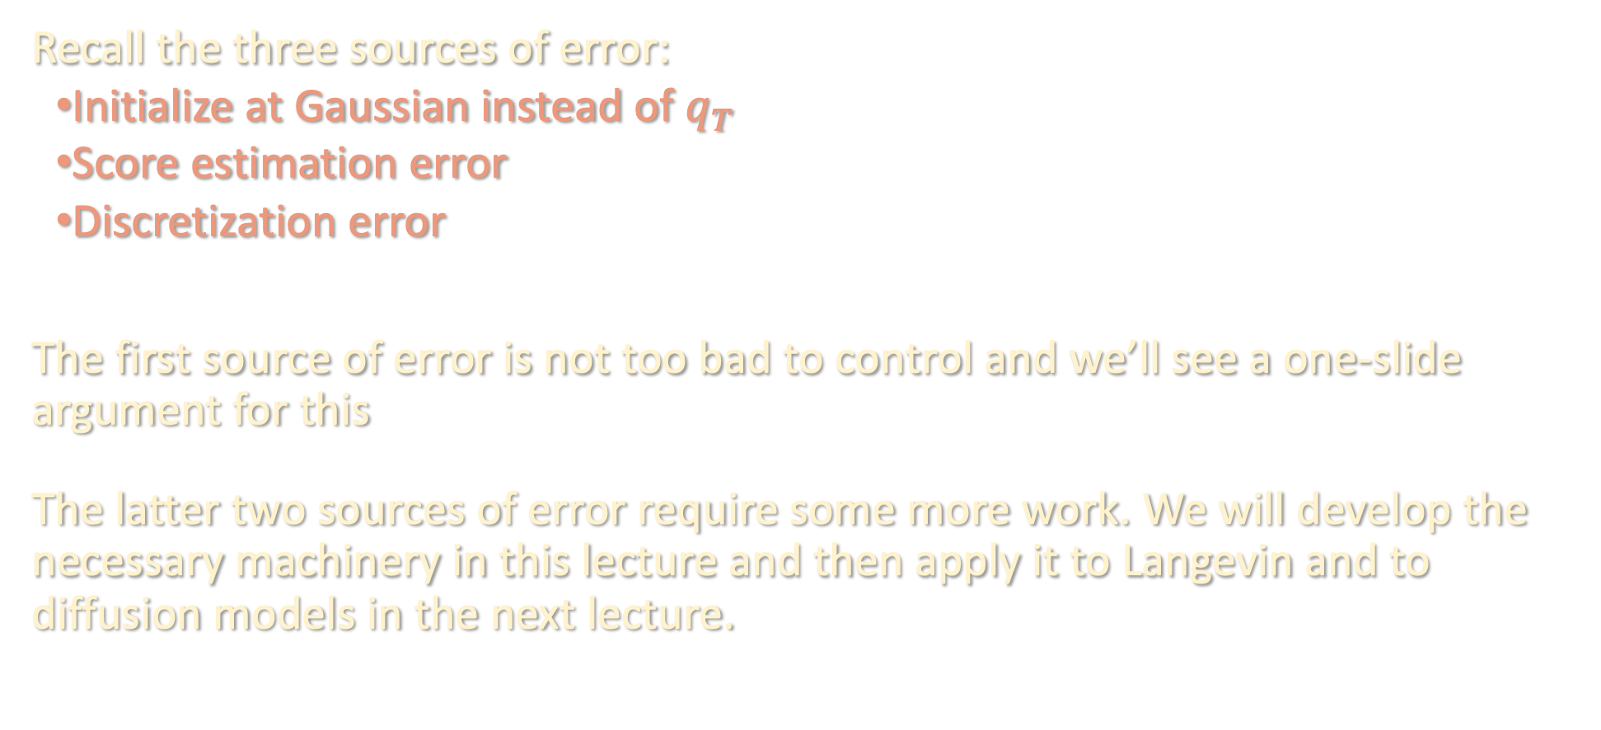
DISCRETIZATION ANALYSIS
Recall the three sources of error:
Initialize at Gaussian instead of $q_{T}$
Score estimation error
Discretization error
The first source of error is not too bad to control and we’ll see a one-slide argument for this
The latter two sources of error require some more work. We will develop the necessary machinery in this lecture and then apply it to Langevin and to diffusion models in the next lecture.

Slide 26
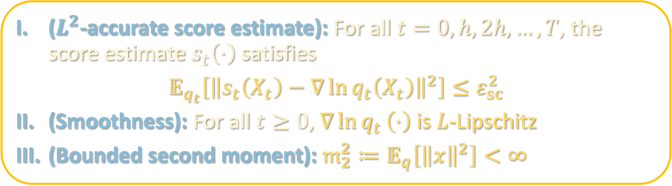
ASSUMPTIONS
($L^{2}$-accurate score estimate): For all $t=0,h,2h,…,T$, the score estimate $s_{t}\left(⋅\right)$ satisfies
$$𝔼_{q_{t}}\left[{\left\|s_{t}\left(X_{t}\right)−∇\ln{q_{t}\left(X_{t}\right)}\right\|}^{2}\right]≤ε_{sc}^{2}$$
(Smoothness): For all $t≥0$, $∇\ln{q_{t}}\left(⋅\right)$ is $L$-Lipschitz
(Bounded second moment): $𝔪_{2}^{2}≔𝔼_{q}\left[{\left\|x\right\|}^{2}\right]<∞$
We will discuss how to remove II next lecture
III is significantly weaker than what is needed for Langevin

Slide 27
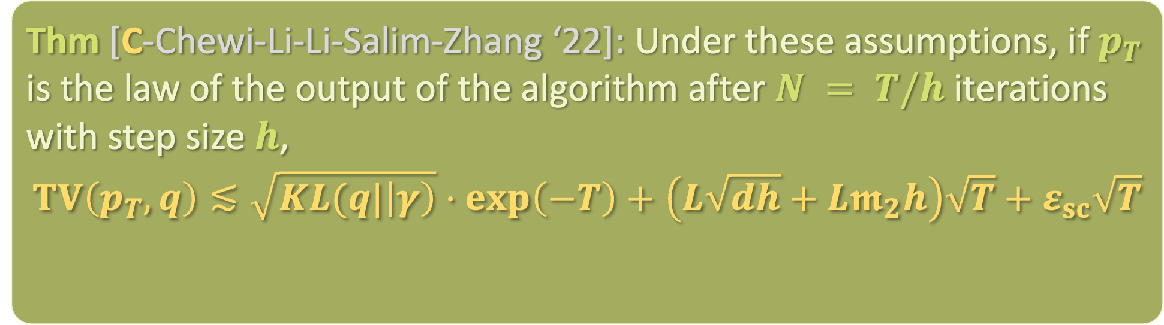
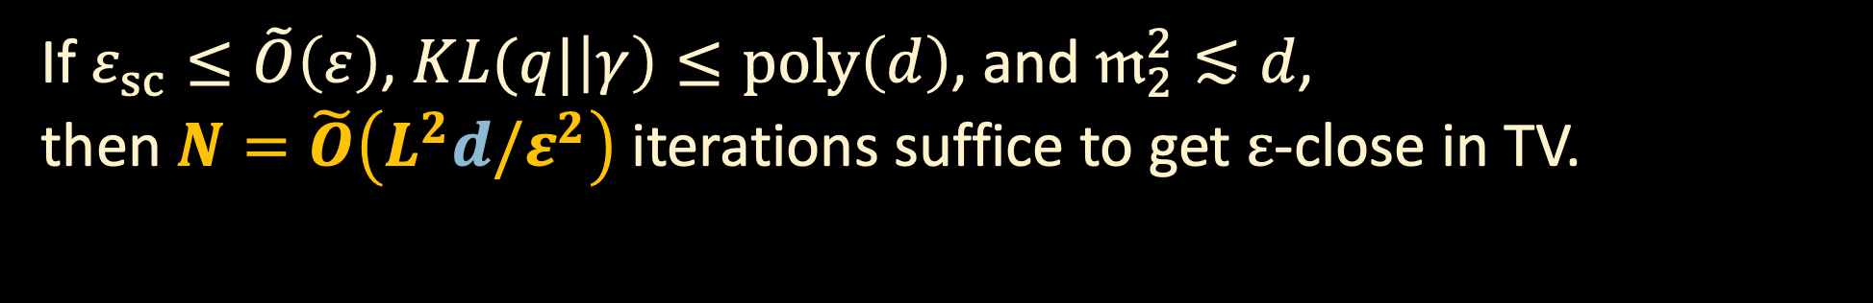
CONVERGENCE GUARANTEE
Thm [C-Chewi-Li-Li-Salim-Zhang ‘22]: Under these assumptions, if $p_{T}$ is the law of the output of the algorithm after $N = T/h$ iterations with step size $h$,
$$TV\left(p_{T},q\right)≲\sqrt{KL(q|\left|γ\right)}⋅\exp\left(−T\right)+\left(L\sqrt{dh}+L𝖒_{2}h\right)\sqrt{T}+ε_{sc}\sqrt{T}$$
error from initializing at $γ$ instead of $q_{T}$
discretization error
score error
If $ε_{sc}≤\tilde{O}\left(ε\right)$, $KL(q|\left|γ\right)≤poly\left(d\right)$, and $𝔪_{2}^{2}≲d$,
then $N=\tilde{O}\left(L^{2}d/ε^{2}\right)$ iterations suffice to get $ε$-close in TV.

Slide 28
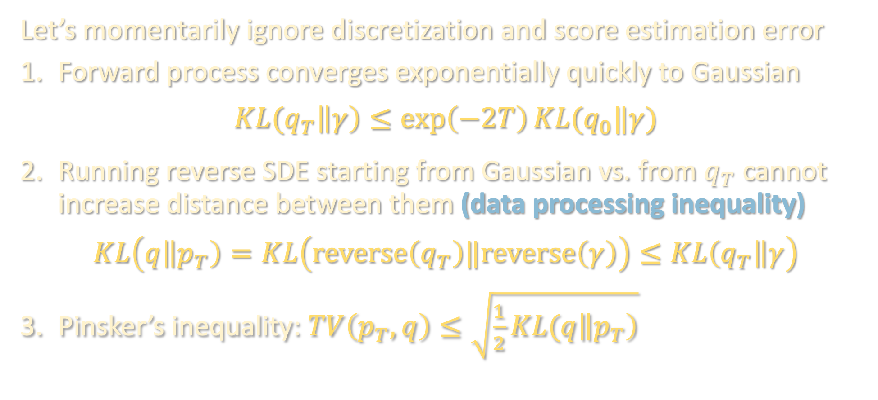
CONTINUOUS-TIME ARGUMENT
$q$: data distribution
$q_{t}$: forward process at time $t$
$p_{t}$: reverse process at time $t$
$$q_{0}=q,p_{0}=γ, p_{T}=alg. output$$
Let’s momentarily ignore discretization and score estimation error
Forward process converges exponentially quickly to Gaussian
$$KL(q_{T}\left\|γ\right)≤\exp\left(−2T\right)KL(q_{0}‖γ)$$
Running reverse SDE starting from Gaussian vs. from $q_{T}$ cannot increase distance between them (data processing inequality)
$$KL\left(q\left\|p_{T}\right)=KL\left(reverse\left(q_{T}\right)‖reverse\left(γ\right)\right)≤KL\left(q_{T}\right\|γ\right)$$
Pinsker’s inequality: $TV\left(p_{T},q\right)≤\sqrt{\frac{1}{2}KL(q\left\|p_{T}\right)}$

Slide 29

DISCRETIZATION ARGUMENT
Consider the ideal reverse process (continuous, perfect score) and algorithm (discrete, estimated score), with both now initialized at $q_{T}$
To control the distance between these processes, we use Girsanov’s theorem, a powerful tool for bounding distance between laws of processes driven by the same Brownian motion
Intuition: distribution over last iterate of reverse process is hard to characterize, but distribution over trajectory just given by a bunch of Gaussian samples

Slide 30

DISCRETIZATION ARGUMENT
Consider the ideal reverse process (continuous, perfect score) and algorithm (discrete, estimated score), with both now initialized at $q_{T}$
To control the distance between these processes, we use Girsanov’s theorem, a powerful tool for bounding distance between laws of processes driven by the same Brownian motion
Intuition: distribution over last iterate of reverse process is hard to characterize, but distribution over trajectory just given by a bunch of Gaussian samples

Slide 31
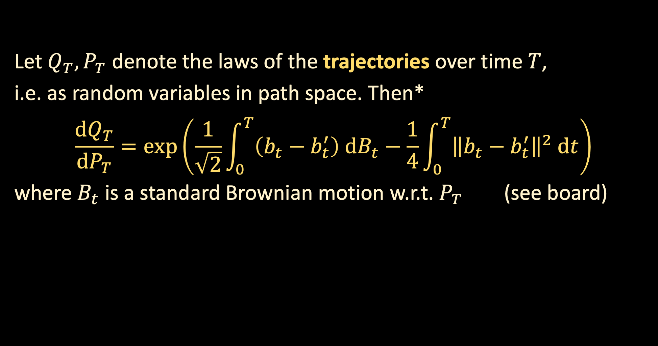

DISCRETIZATION ARGUMENT
Consider the SDE’s
$$dX_{t}=b_{t} dt+\sqrt{2} dB_{t}$$
$$dX_{t}=b_{t}^{′} dt+\sqrt{2} dB_{t}$$
with the same initial distribution.
Let $Q_{T}, P_{T}$ denote the laws of the trajectories over time $T$,
i.e. as random variables in path space. Then*
$$\frac{dQ_{T}}{dP_{T}}=\exp\left(\frac{1}{\sqrt{2}}\int_{0}^{T}{\left(b_{t}−b_{t}^{′}\right) dB_{t}}−\frac{1}{4}\int_{0}^{T}{{\left\|b_{t}−b_{t}^{′}\right\|}^{2} dt}\right)$$
where $B_{t}$ is a standard Brownian motion w.r.t. $P_{T}$ (see board)

Slide 32
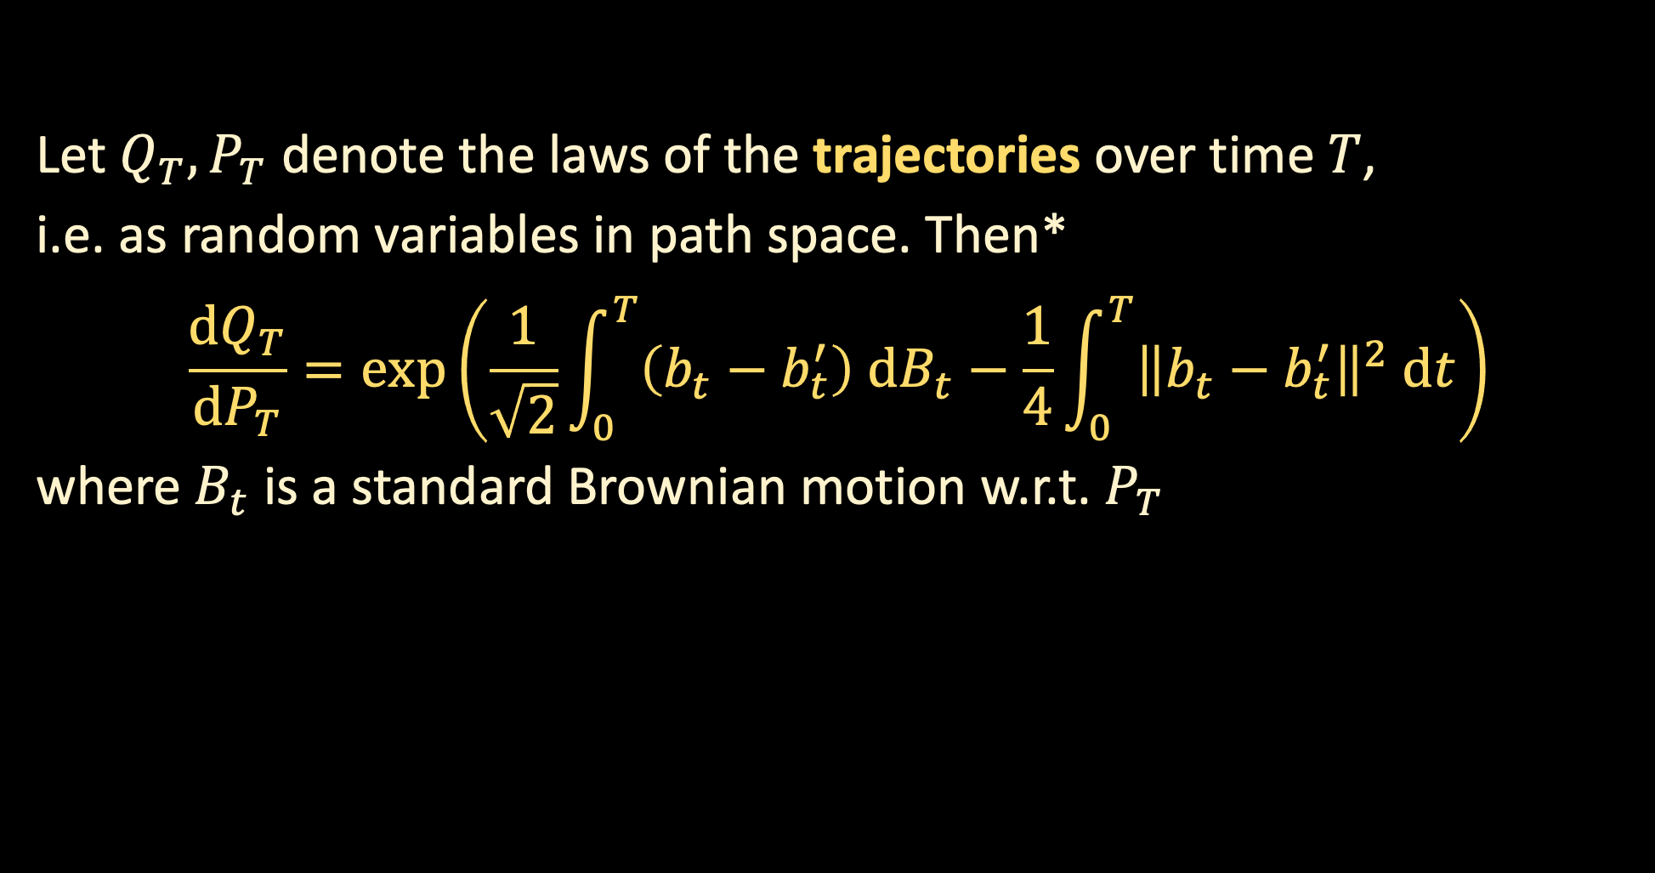

WARMUP: DISCRETIZATION ANALYSIS FOR LANGEVIN
Consider the SDE’s
$$dX_{t}=∇\ln{q\left(X_{t}\right)}dt+\sqrt{2} dB_{t}$$
$$dX_{t}=∇\ln{q\left(X_{kh}\right)}dt+\sqrt{2} dB_{t}$$
both initialized at $q_{T}$.
Let $Q_{T}, P_{T}$ denote the laws of the trajectories over time $T$,
i.e. as random variables in path space. Then*
$$\frac{dQ_{T}}{dP_{T}}=\exp\left(\frac{1}{\sqrt{2}}\int_{0}^{T}{\left(b_{t}−b_{t}^{′}\right) dB_{t}}−\frac{1}{4}\int_{0}^{T}{{\left\|b_{t}−b_{t}^{′}\right\|}^{2} dt}\right)$$
where $B_{t}$ is a standard Brownian motion w.r.t. $P_{T}$

Slide 33
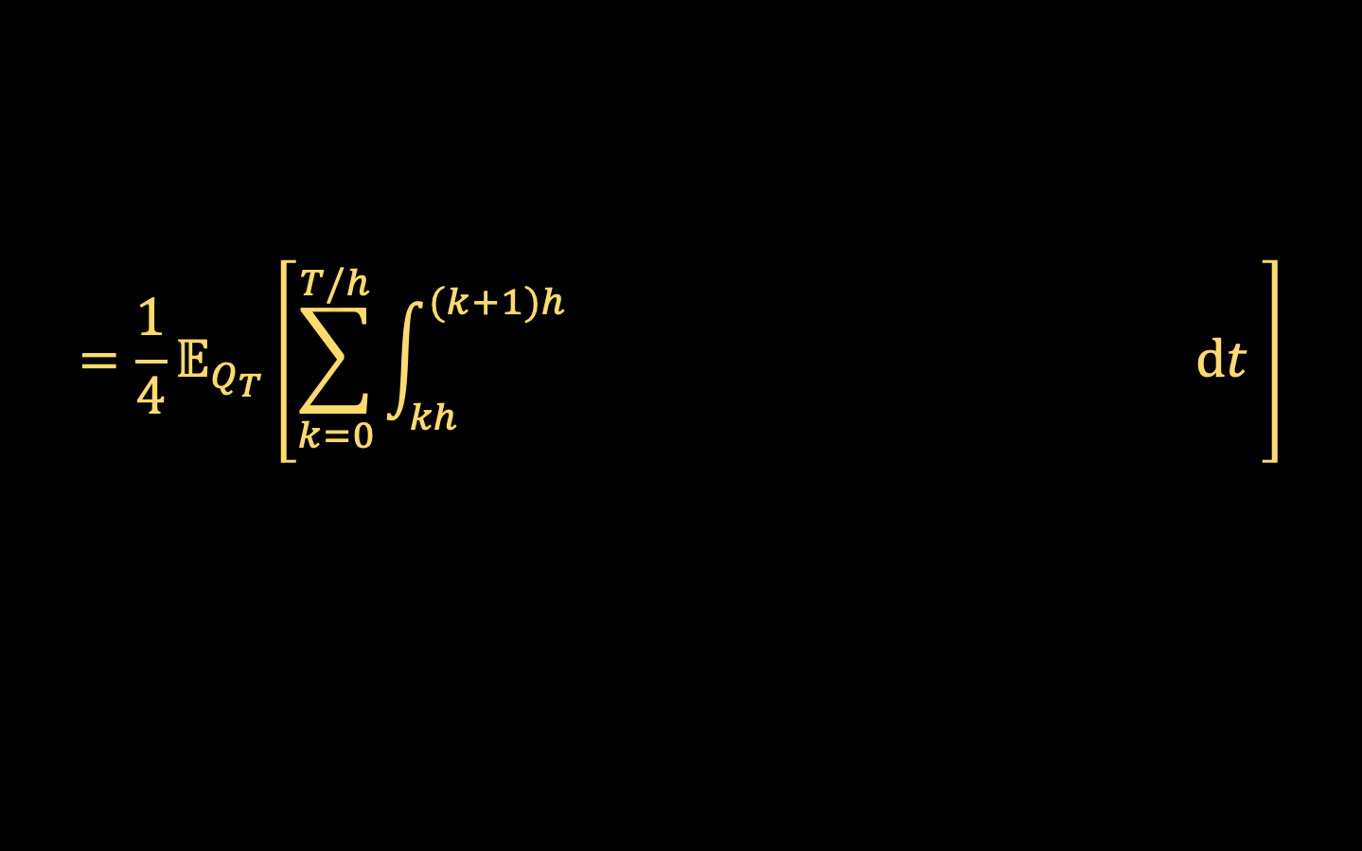

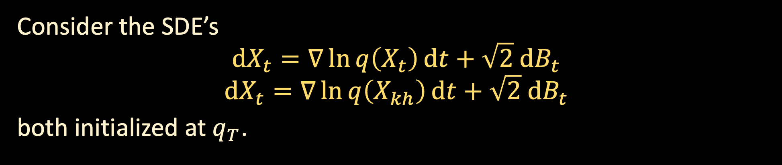


WARMUP: DISCRETIZATION ANALYSIS FOR LANGEVIN
Consider the SDE’s
$$dX_{t}=∇\ln{q\left(X_{t}\right)}dt+\sqrt{2} dB_{t}$$
$$dX_{t}=∇\ln{q\left(X_{kh}\right)}dt+\sqrt{2} dB_{t}$$
both initialized at $q_{T}$.
$$≥KL\left(ideal process‖algorithm\right)$$
Let $Q_{T}, P_{T}$ denote the laws of the trajectories over time $T$,
$KL(Q_{T}\left\|P_{T}\right)=𝔼_{Q_{T}}\left[\ln{\frac{dQ_{T}}{dP_{T}}}\right]$
(see board for argument)
$$=\frac{1}{4}𝔼_{Q_{T}}\left[\sum_{k=0}^{T/h}{\int_{kh}^{(k+1)h}{ dt }}\right]$$
$${\left\|∇\ln{q(X_{t})}−∇\ln{q(X_{kh})}\right\|}^{2}$$

Slide 34
TAKEAWAYS
Diffusion models offer a way around the torpid mixing / metastability issues of Langevin
Key idea: time-reversal of Fokker-Planck can be implemented provided one has access to the score at multiple noise levels
Score functions can be estimated via supervised learning (Tweedie’s formula aka Gaussian integration by parts)
Discretization analysis facilitated by pathwise analysis (Girsanov’s theorem)
Next time:
  Finishing the discretization analysis
  Acceleration via probability flow ODE

