Slide 1

CS 2243: ALGORITHMS FOR DATA SCIENCE
LECTURE 23 (11/25)
Tensor decomposition
Sum-of-squares
Supervised learning
Computational complexity
Statistical physics
Generative modeling
GIRSANOV’S THEOREM, DISCRETIZATION ANALYSIS

Slide 2

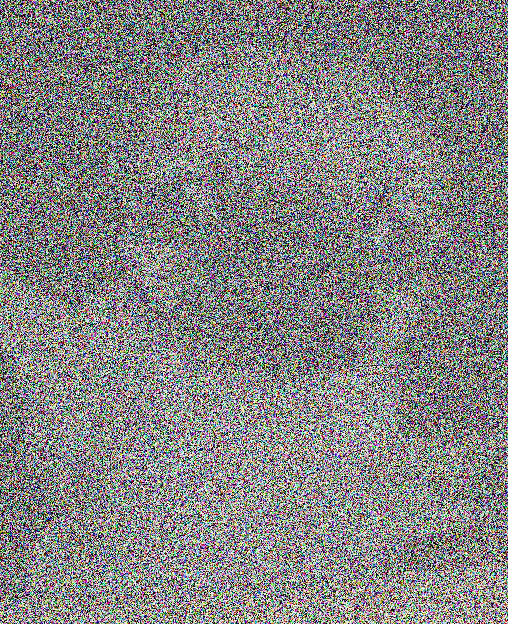
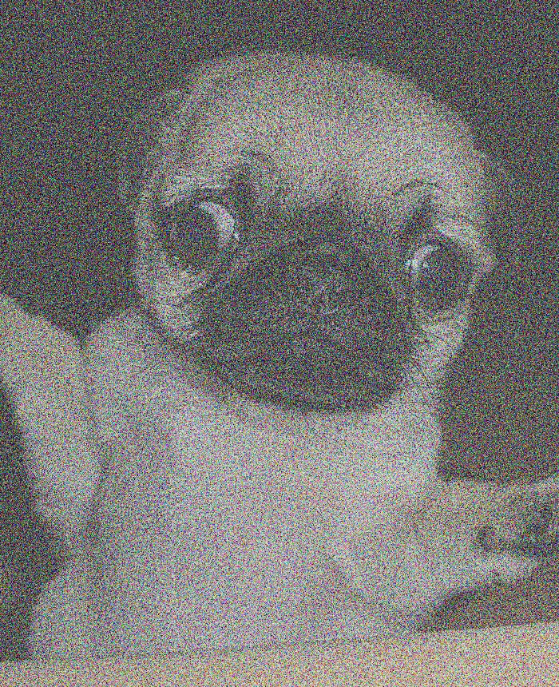
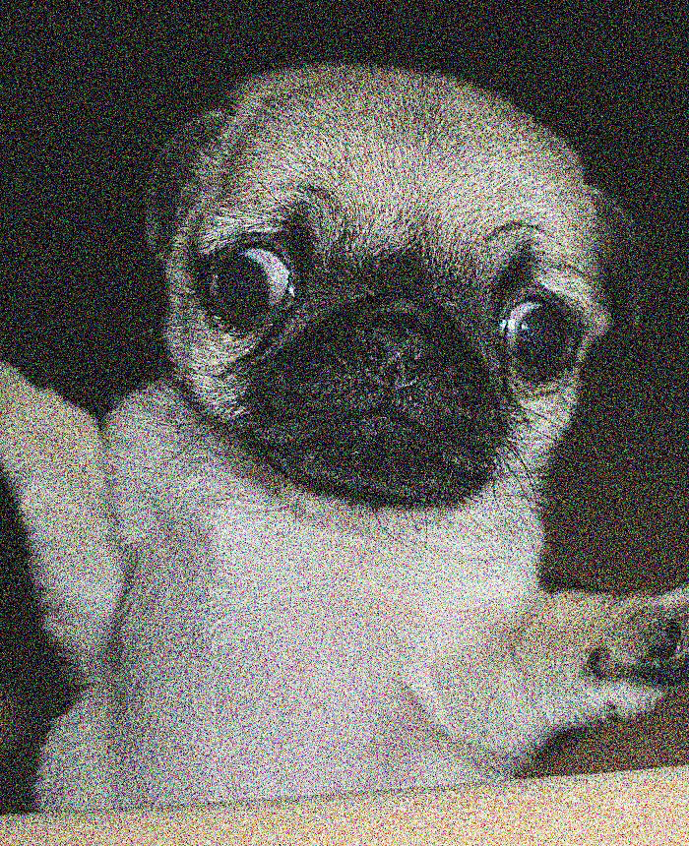

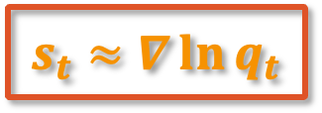
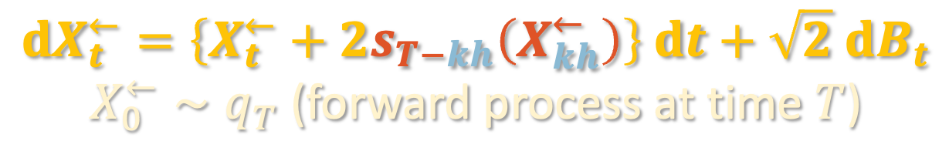
DIFFUSION MODELS
Sources of error:
Initialize at Gaussian instead of $q_{T}$
Score estimation error
Discretization error
Reverse process
initialize at pure Gaussian
$$t=h, 2h, 3h, …$$
$$t=0$$
$$t=T$$
$$dX_{t}^{←}=\left\{X_{t}^{←}+2s_{T−kh}\left(X_{kh}^{←}\right)\right\} dt+\sqrt{2} dB_{t}$$
$X_{0}^{←}∼q_{T}$ (forward process at time $T$)
$$s_{t}≈∇\ln{q_{t}}$$
$$k=⌊t/h⌋$$

Slide 3
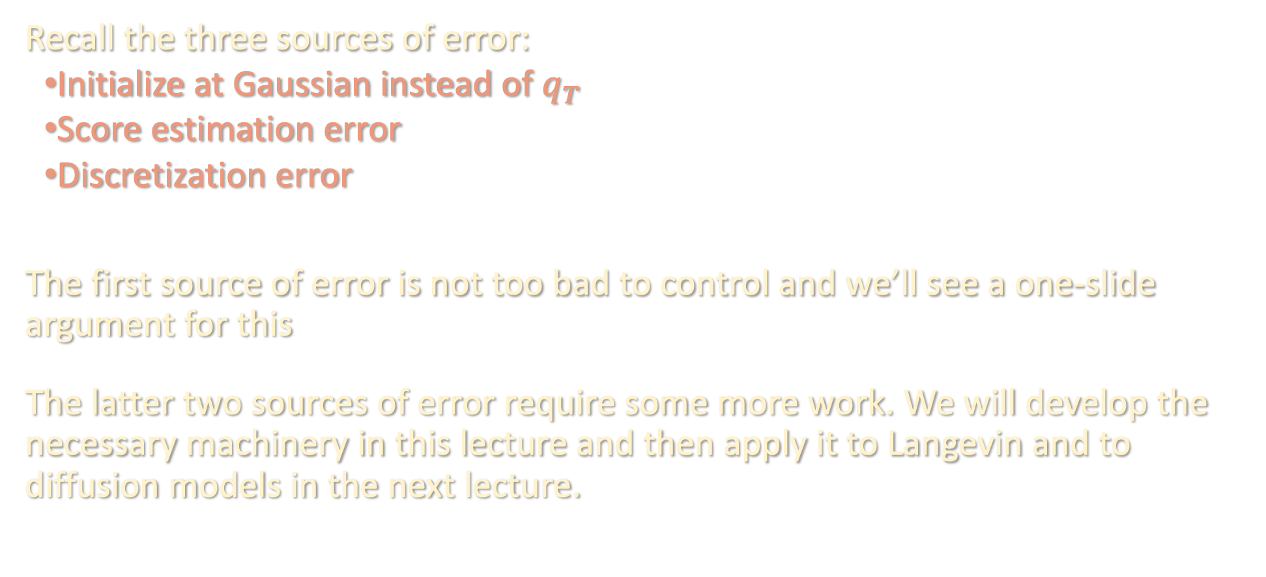
DISCRETIZATION ANALYSIS
Recall the three sources of error:
Initialize at Gaussian instead of $q_{T}$
Score estimation error
Discretization error
The first source of error is not too bad to control and we’ll see a one-slide argument for this
The latter two sources of error require some more work. We will develop the necessary machinery in this lecture and then apply it to Langevin and to diffusion models in the next lecture.

Slide 4
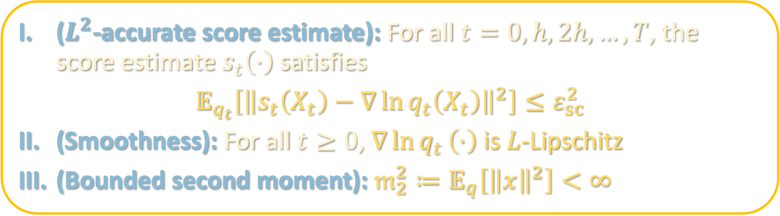
ASSUMPTIONS
($L^{2}$-accurate score estimate): For all $t=0,h,2h,…,T$, the score estimate $s_{t}\left(⋅\right)$ satisfies
$$𝔼_{q_{t}}\left[{\left\|s_{t}\left(X_{t}\right)−∇\ln{q_{t}\left(X_{t}\right)}\right\|}^{2}\right]≤ε_{sc}^{2}$$
(Smoothness): For all $t≥0$, $∇\ln{q_{t}}\left(⋅\right)$ is $L$-Lipschitz
(Bounded second moment): $𝔪_{2}^{2}≔𝔼_{q}\left[{\left\|x\right\|}^{2}\right]<∞$
We will discuss how to remove II next lecture
III is significantly weaker than what is needed for Langevin

Slide 5
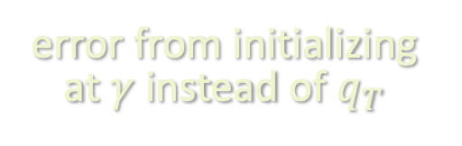
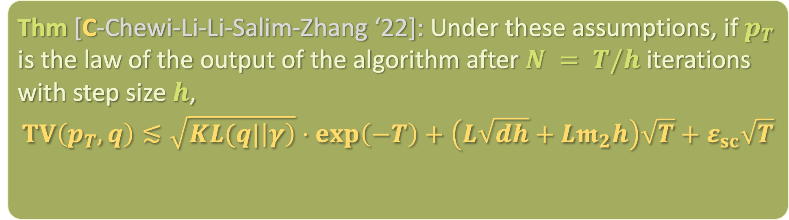
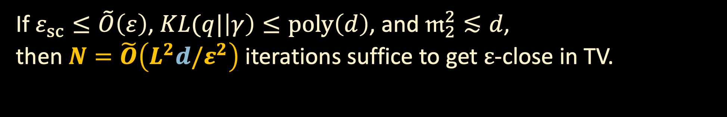
CONVERGENCE GUARANTEE
Thm [C-Chewi-Li-Li-Salim-Zhang ‘22]: Under these assumptions, if $p_{T}$ is the law of the output of the algorithm after $N = T/h$ iterations with step size $h$,
$$TV\left(p_{T},q\right)≲\sqrt{KL(q|\left|γ\right)}⋅\exp\left(−T\right)+\left(L\sqrt{dh}+L𝖒_{2}h\right)\sqrt{T}+ε_{sc}\sqrt{T}$$
error from initializing at $γ$ instead of $q_{T}$
discretization error
score error
If $ε_{sc}≤\tilde{O}\left(ε\right)$, $KL(q|\left|γ\right)≤poly\left(d\right)$, and $𝔪_{2}^{2}≲d$,
then $N=\tilde{O}\left(L^{2}d/ε^{2}\right)$ iterations suffice to get $ε$-close in TV.

Slide 6
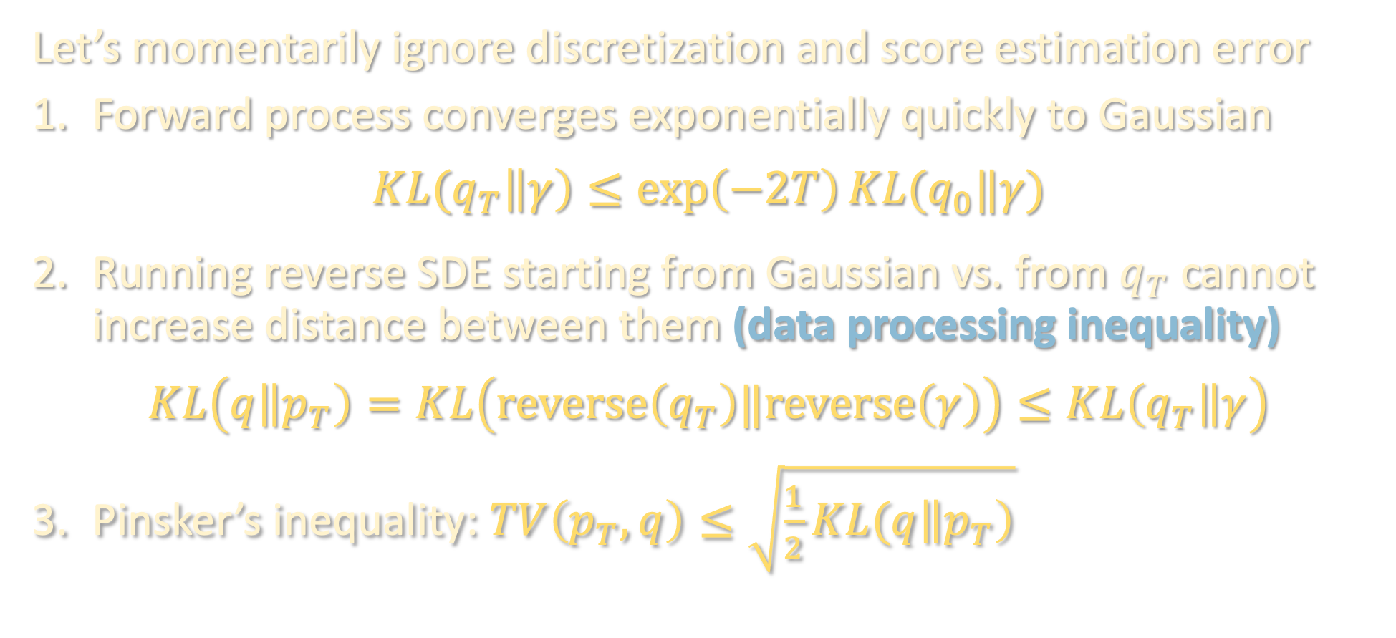
CONTINUOUS-TIME ARGUMENT
$q$: data distribution
$q_{t}$: forward process at time $t$
$p_{t}$: reverse process at time $t$
$$q_{0}=q,p_{0}=γ, p_{T}=alg. output$$
Let’s momentarily ignore discretization and score estimation error
Forward process converges exponentially quickly to Gaussian
$$KL(q_{T}\left\|γ\right)≤\exp\left(−2T\right)KL(q_{0}‖γ)$$
Running reverse SDE starting from Gaussian vs. from $q_{T}$ cannot increase distance between them (data processing inequality)
$$KL\left(q\left\|p_{T}\right)=KL\left(reverse\left(q_{T}\right)‖reverse\left(γ\right)\right)≤KL\left(q_{T}\right\|γ\right)$$
Pinsker’s inequality: $TV\left(p_{T},q\right)≤\sqrt{\frac{1}{2}KL(q\left\|p_{T}\right)}$

Slide 7

DISCRETIZATION ARGUMENT
Consider the ideal reverse process (continuous, perfect score) and algorithm (discrete, estimated score), with both now initialized at $q_{T}$
To control the distance between these processes, we use Girsanov’s theorem, a powerful tool for bounding distance between laws of processes driven by the same Brownian motion
Intuition: distribution over last iterate of reverse process is hard to characterize, but distribution over trajectory just given by a bunch of Gaussian samples

Slide 8

DISCRETIZATION ARGUMENT
Consider the ideal reverse process (continuous, perfect score) and algorithm (discrete, estimated score), with both now initialized at $q_{T}$
To control the distance between these processes, we use Girsanov’s theorem, a powerful tool for bounding distance between laws of processes driven by the same Brownian motion
Intuition: distribution over last iterate of reverse process is hard to characterize, but distribution over trajectory just given by a bunch of Gaussian samples

Slide 9
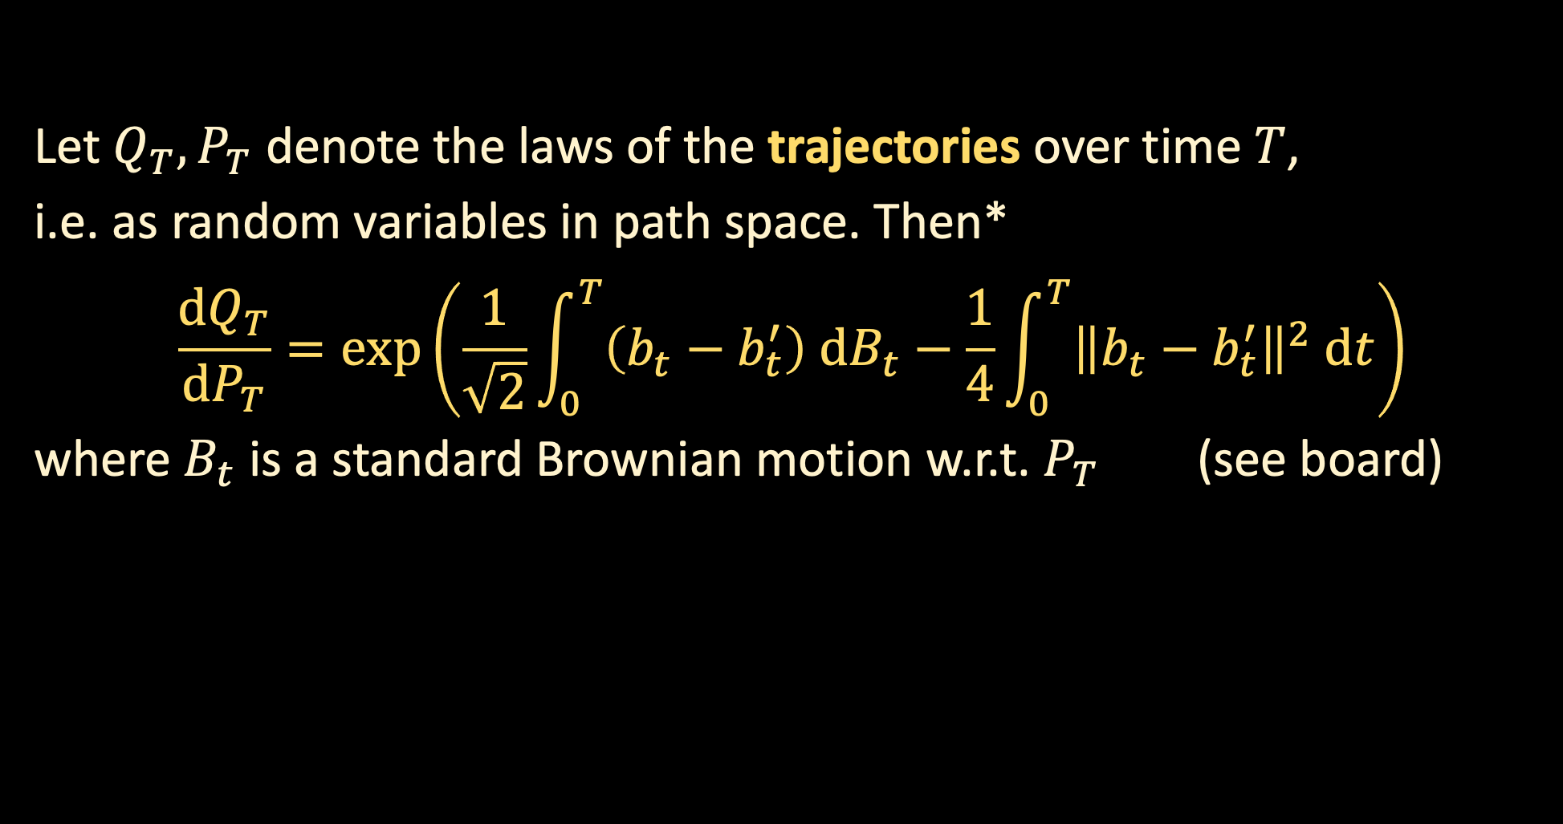

DISCRETIZATION ARGUMENT
Consider the SDE’s
$$dX_{t}=b_{t} dt+\sqrt{2} dB_{t}$$
$$dX_{t}=b_{t}^{′} dt+\sqrt{2} dB_{t}$$
with the same initial distribution.
Let $Q_{T}, P_{T}$ denote the laws of the trajectories over time $T$,
i.e. as random variables in path space. Then*
$$\frac{dQ_{T}}{dP_{T}}=\exp\left(\frac{1}{\sqrt{2}}\int_{0}^{T}{\left(b_{t}−b_{t}^{′}\right) dB_{t}}−\frac{1}{4}\int_{0}^{T}{{\left\|b_{t}−b_{t}^{′}\right\|}^{2} dt}\right)$$
where $B_{t}$ is a standard Brownian motion w.r.t. $P_{T}$ (see board)

Slide 10
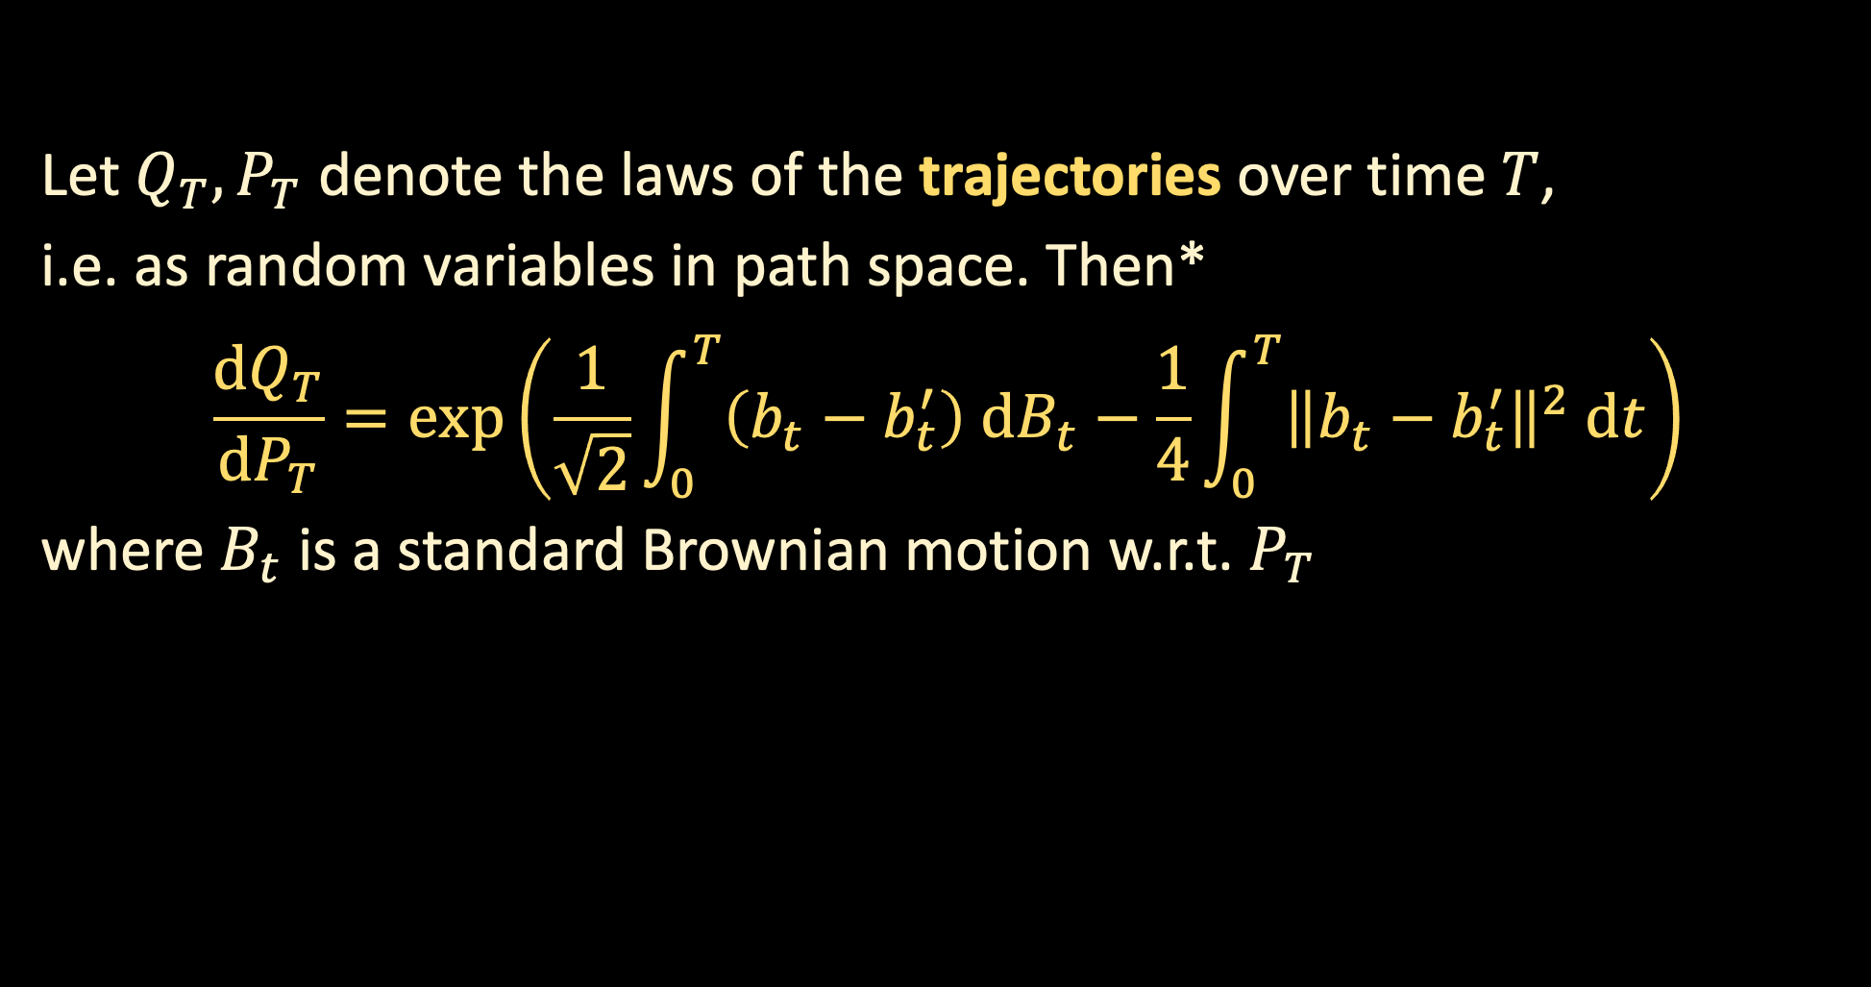

WARMUP: DISCRETIZATION ANALYSIS FOR LANGEVIN
Consider the SDE’s
$$dX_{t}=∇\ln{q\left(X_{t}\right)}dt+\sqrt{2} dB_{t}$$
$$dX_{t}=∇\ln{q\left(X_{kh}\right)}dt+\sqrt{2} dB_{t}$$
both initialized at $q_{T}$.
Let $Q_{T}, P_{T}$ denote the laws of the trajectories over time $T$,
i.e. as random variables in path space. Then*
$$\frac{dQ_{T}}{dP_{T}}=\exp\left(\frac{1}{\sqrt{2}}\int_{0}^{T}{\left(b_{t}−b_{t}^{′}\right) dB_{t}}−\frac{1}{4}\int_{0}^{T}{{\left\|b_{t}−b_{t}^{′}\right\|}^{2} dt}\right)$$
where $B_{t}$ is a standard Brownian motion w.r.t. $P_{T}$

Slide 11
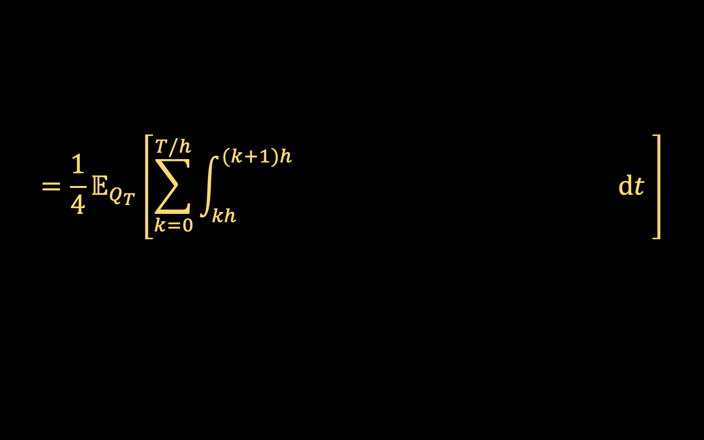

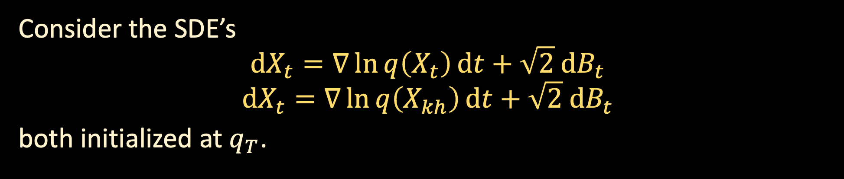


WARMUP: DISCRETIZATION ANALYSIS FOR LANGEVIN
Consider the SDE’s
$$dX_{t}=∇\ln{q\left(X_{t}\right)}dt+\sqrt{2} dB_{t}$$
$$dX_{t}=∇\ln{q\left(X_{kh}\right)}dt+\sqrt{2} dB_{t}$$
both initialized at $q_{T}$.
$$≥KL\left(ideal process‖algorithm\right)$$
Let $Q_{T}, P_{T}$ denote the laws of the trajectories over time $T$,
$KL(Q_{T}\left\|P_{T}\right)=𝔼_{Q_{T}}\left[\ln{\frac{dQ_{T}}{dP_{T}}}\right]$
(see board for argument)
$$=\frac{1}{4}𝔼_{Q_{T}}\left[\sum_{k=0}^{T/h}{\int_{kh}^{(k+1)h}{ dt }}\right]$$
$${\left\|∇\ln{q(X_{t})}−∇\ln{q(X_{kh})}\right\|}^{2}$$

Slide 12
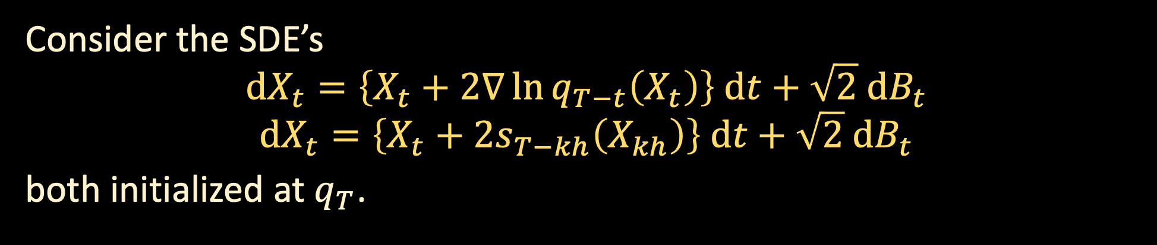
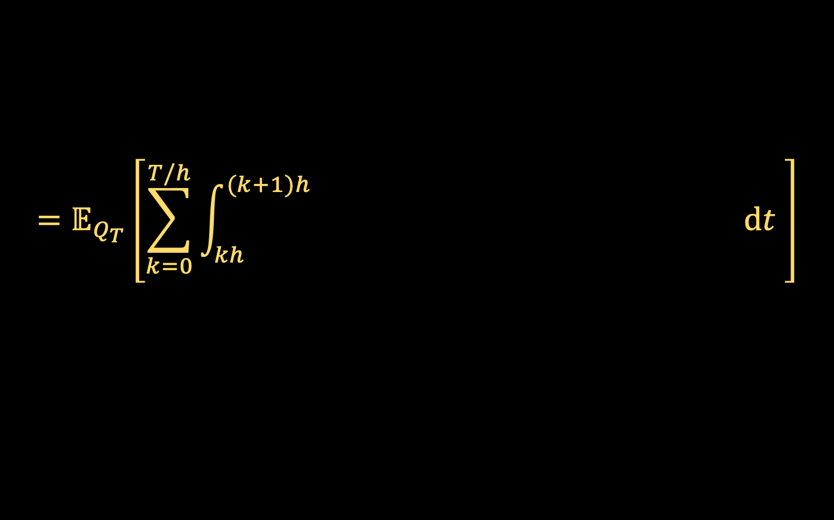


DISCRETIZATION ANALYSIS FOR DIFFUSIONS
Consider the SDE’s
$$dX_{t}=\left\{X_{t}+2∇\ln{q_{T−t}\left(X_{t}\right)}\right\} dt+\sqrt{2} dB_{t}$$
$$dX_{t}=\left\{X_{t}+2s_{T−kh}\left(X_{kh}\right)\right\} dt+\sqrt{2} dB_{t}$$
both initialized at $q_{T}$.
$$≥KL\left(ideal process‖algorithm\right)$$
Let $Q_{T}, P_{T}$ denote the laws of the trajectories over time $T$,
$KL(Q_{T}\left\|P_{T}\right)=𝔼_{Q_{T}}\left[\ln{\frac{dQ_{T}}{dP_{T}}}\right]$
(see board for argument)
$$=𝔼_{Q_{T}}\left[\sum_{k=0}^{T/h}{\int_{kh}^{(k+1)h}{{\left\|∇\ln{q_{T−t}(X_{t})}−s_{T−kh}\left(X_{k}\right)\right\|}^{2} dt }}\right]$$
$${\left\|∇\ln{q_{T−t}(X_{t})}−s_{T−kh}\left(X_{kh}\right)\right\|}^{2}$$

