Slide 1

CS 2243: ALGORITHMS FOR DATA SCIENCE
LECTURE 24 (12/2)
Tensor decomposition
Sum-of-squares
Supervised learning
Computational complexity
Statistical physics
Generative modeling
PROBABILITY FLOW ODE, REVERSE TRANSPORT INEQUALITIES, SHIFTED COMPOSITION

Slide 2
ANNOUNCEMENTS
12/4 (Wednesday): Last day of class
12/20: Final project deadline, 2pm

Slide 3
Finishing up discretization analysis for diffusions
Probability flow ODE, improved dimension dependence
Dropping the smoothness assumption

Slide 4
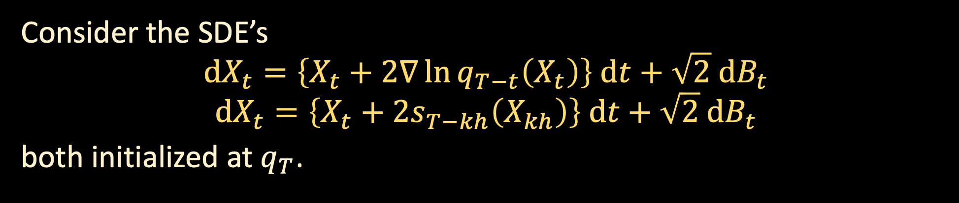
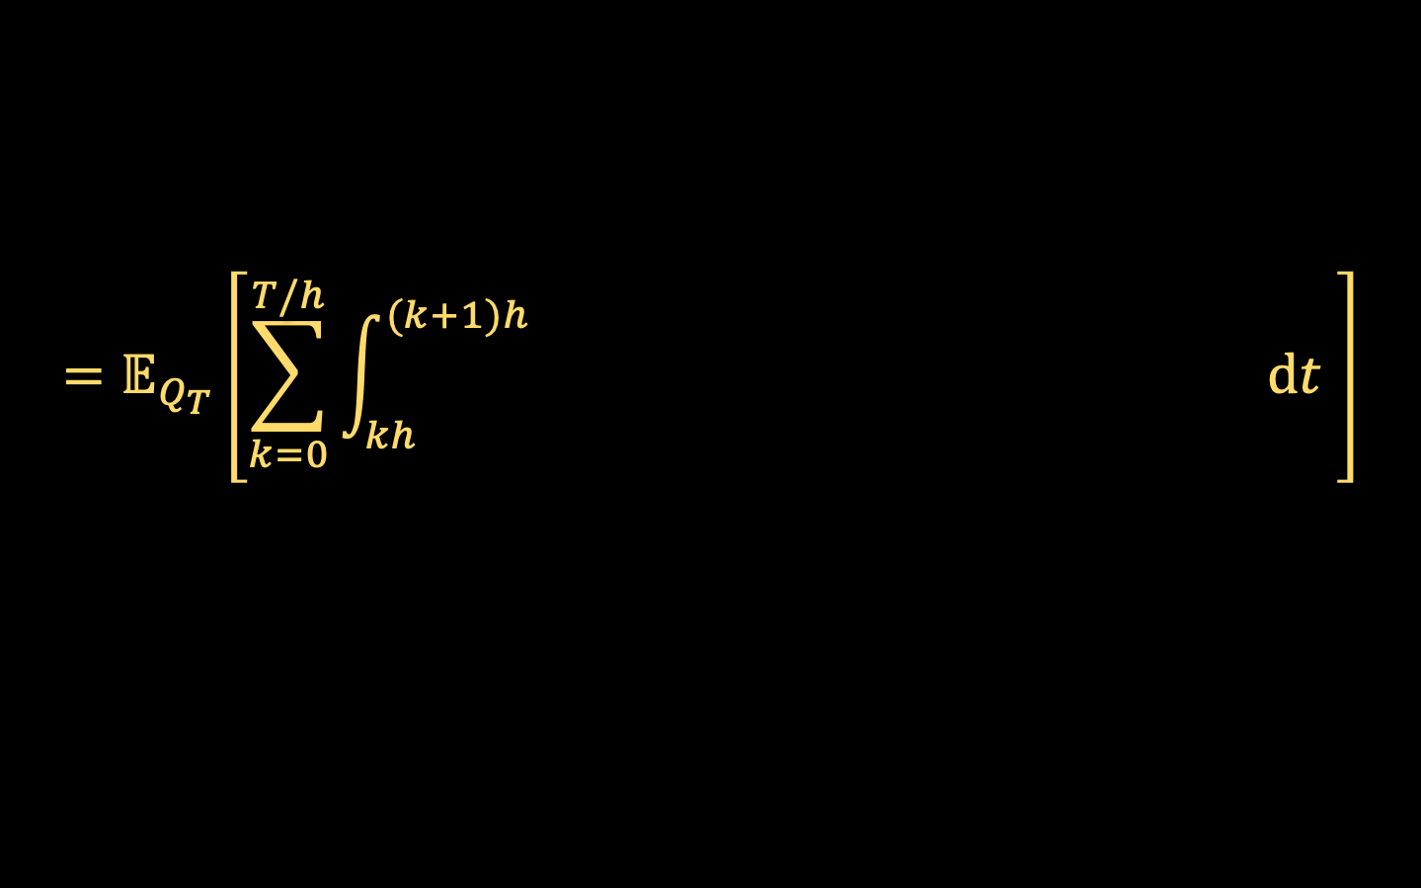


DISCRETIZATION ANALYSIS FOR DIFFUSIONS
Consider the SDE’s
$$dX_{t}=\left\{X_{t}+2∇\ln{q_{T−t}\left(X_{t}\right)}\right\} dt+\sqrt{2} dB_{t}$$
$$dX_{t}=\left\{X_{t}+2s_{T−kh}\left(X_{kh}\right)\right\} dt+\sqrt{2} dB_{t}$$
both initialized at $q_{T}$.
Let $Q_{T}, P_{T}$ denote the laws of the trajectories over time $T$,
$KL(Q_{T}\left\|P_{T}\right)=𝔼_{Q_{T}}\left[\ln{\frac{dQ_{T}}{dP_{T}}}\right]$
$$=𝔼_{Q_{T}}\left[\sum_{k=0}^{T/h}{\int_{kh}^{(k+1)h}{{\left\|∇\ln{q_{T−t}(X_{t})}−s_{T−kh}\left(X_{k}\right)\right\|}^{2} dt }}\right]$$
$${\left\|∇\ln{q_{T−t}(X_{t})}−s_{T−kh}\left(X_{kh}\right)\right\|}^{2}$$

Slide 5

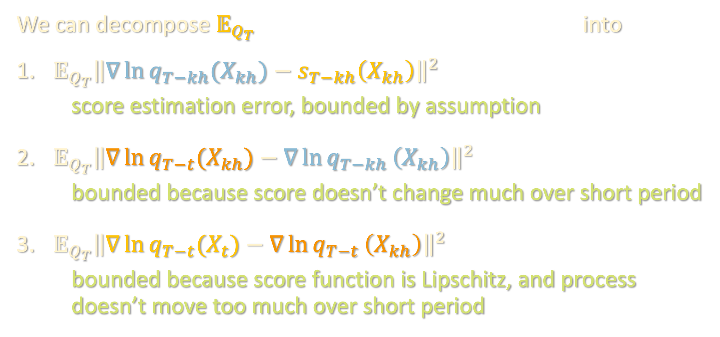
DISCRETIZATION ANALYSIS FOR DIFFUSIONS
$${\left\|∇\ln{q_{T−t}(X_{t})}−s_{T−kh}\left(X_{kh}\right)\right\|}^{2}$$
We can decompose $𝔼_{Q_{T}}$ into
${𝔼_{Q_{T}}\left\|∇\ln{q_{T−kh}(X_{kh})}−s_{T−kh}\left(X_{kh}\right)\right\|}^{2}$
score estimation error, bounded by assumption
${𝔼_{Q_{T}}\left\|∇\ln{q_{T−t}(X_{kh})}−∇\ln{q_{T−kh}}\left(X_{kh}\right)\right\|}^{2}$
bounded because score doesn’t change much over short period
${𝔼_{Q_{T}}\left\|∇\ln{q_{T−t}(X_{t})}−∇\ln{q_{T−t}}\left(X_{kh}\right)\right\|}^{2}$
bounded because score function is Lipschitz, and process doesn’t move too much over short period

Slide 6
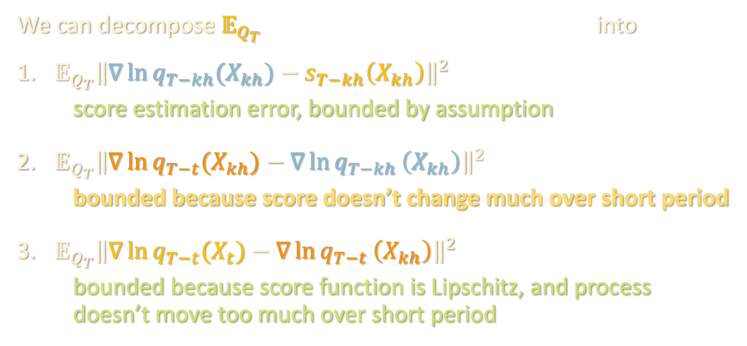
DISCRETIZATION ANALYSIS FOR DIFFUSIONS
$${\left\|∇\ln{q_{T−t}(X_{t})}−s_{T−kh}\left(X_{kh}\right)\right\|}^{2}$$
We can decompose $𝔼_{Q_{T}}$ into
${𝔼_{Q_{T}}\left\|∇\ln{q_{T−kh}(X_{kh})}−s_{T−kh}\left(X_{kh}\right)\right\|}^{2}$
score estimation error, bounded by assumption
${𝔼_{Q_{T}}\left\|∇\ln{q_{T−t}(X_{kh})}−∇\ln{q_{T−kh}}\left(X_{kh}\right)\right\|}^{2}$
bounded because score doesn’t change much over short period
${𝔼_{Q_{T}}\left\|∇\ln{q_{T−t}(X_{t})}−∇\ln{q_{T−t}}\left(X_{kh}\right)\right\|}^{2}$
bounded because score function is Lipschitz, and process doesn’t move too much over short period

Slide 7
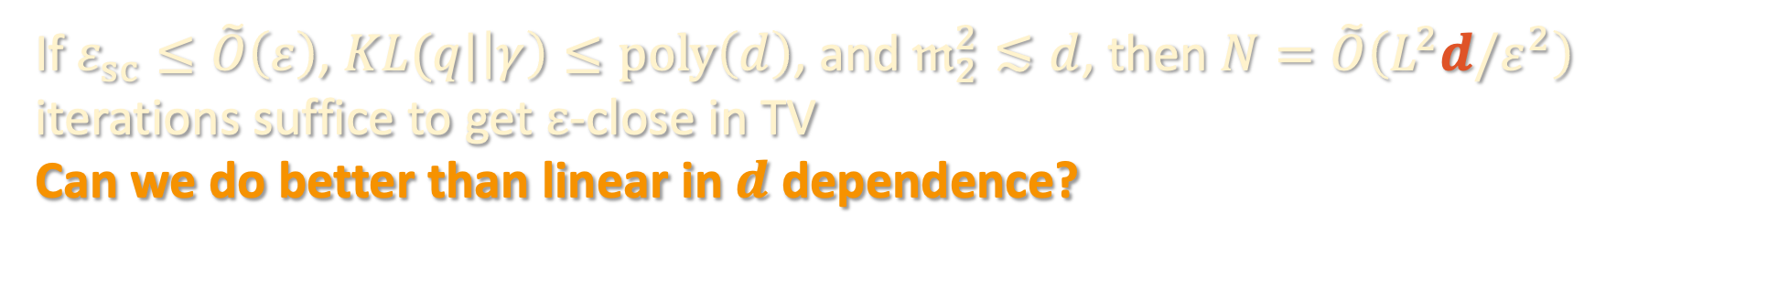
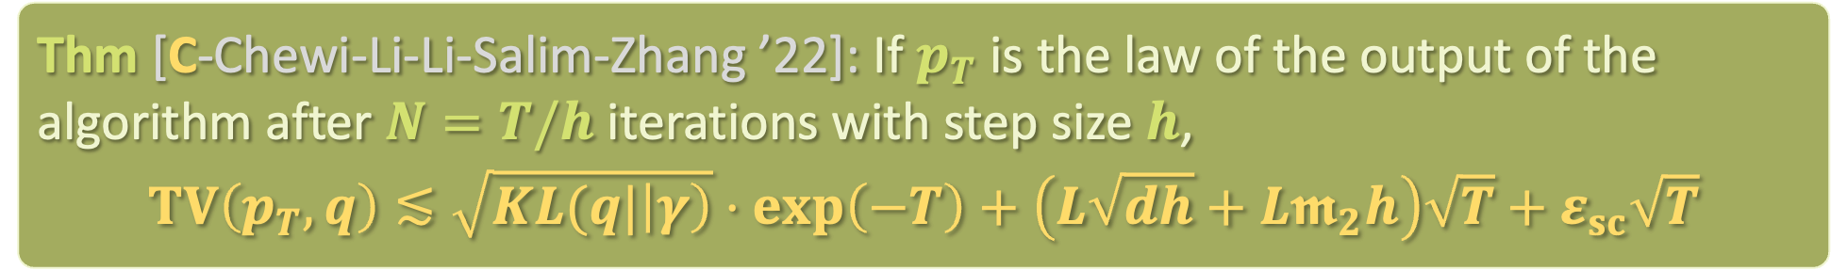
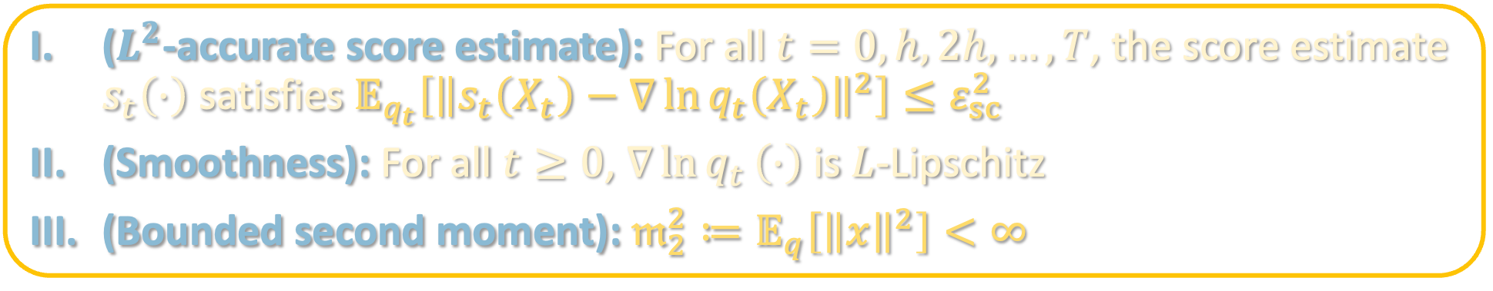
DISCRETIZATION ANALYSIS FOR DIFFUSIONS
($L^{2}$-accurate score estimate): For all $t=0,h,2h,…,T$, the score estimate $s_{t}\left(⋅\right)$ satisfies $𝔼_{q_{t}}\left[{\left\|s_{t}\left(X_{t}\right)−∇\ln{q_{t}\left(X_{t}\right)}\right\|}^{2}\right]≤ε_{sc}^{2}$
(Smoothness): For all $t≥0$, $∇\ln{q_{t}}\left(⋅\right)$ is $L$-Lipschitz
(Bounded second moment): $𝔪_{2}^{2}≔𝔼_{q}\left[{\left\|x\right\|}^{2}\right]<∞$
Thm [C-Chewi-Li-Li-Salim-Zhang ’22]: If $p_{T}$ is the law of the output of the algorithm after $N=T/h$ iterations with step size $h$,
$$TV\left(p_{T},q\right)≲\sqrt{KL(q|\left|γ\right)}⋅\exp\left(−T\right)+\left(L\sqrt{dh}+L𝖒_{2}h\right)\sqrt{T}+ε_{sc}\sqrt{T}$$
If $ε_{sc}≤\tilde{O}\left(ε\right)$, $KL(q|\left|γ\right)≤poly\left(d\right)$, and $𝔪_{2}^{2}≲d$, then $N=\tilde{O}\left(L^{2}d/ε^{2}\right)$ iterations suffice to get $ε$-close in TV
Can we do better than linear in $d$ dependence?

Slide 8
Finishing up discretization analysis for diffusions
Probability flow ODE, improved dimension dependence
Dropping the smoothness assumption

Slide 9

REVISITING THE MOVEMENT BOUND
Consider the movement over a short period of time
$$𝔼 {\left\|X_{t+h}−X_{t}\right\|}^{2}$$

Slide 10

REVISITING THE MOVEMENT BOUND
Consider the movement over a short period of time
$$𝔼 {\left\|X_{t+h}−X_{t}\right\|}^{2}$$ | $$=𝔼 {\left\|\int_{t}^{t+h}{\left\{X_{r}+2∇\ln{q_{T−r}\left(X_{r}\right)}\right\} dr}+\sqrt{2} \left(B_{t+h}−B_{t}\right)\right\|}^{2}$$

Slide 11



REVISITING THE MOVEMENT BOUND
Consider the movement over a short period of time
$$𝔼 {\left\|X_{t+h}−X_{t}\right\|}^{2}$$ | $$=𝔼 {\left\|\int_{t}^{t+h}{\left\{X_{r}+2∇\ln{q_{T−r}\left(X_{r}\right)}\right\} dr}+\sqrt{2} \left(B_{t+h}−B_{t}\right)\right\|}^{2}$$
 | $$≥𝔼 {\left\|B_{t+h}−B_{t}\right\|}^{2} −𝔼{\left\|\int_{t}^{t+h}{\left\{X_{r}+2∇\ln{q_{T−r}\left(X_{r}\right)}\right\} dr}\right\|}^{2}$$
$$dh$$
$$O(dh^{2})$$

Slide 12
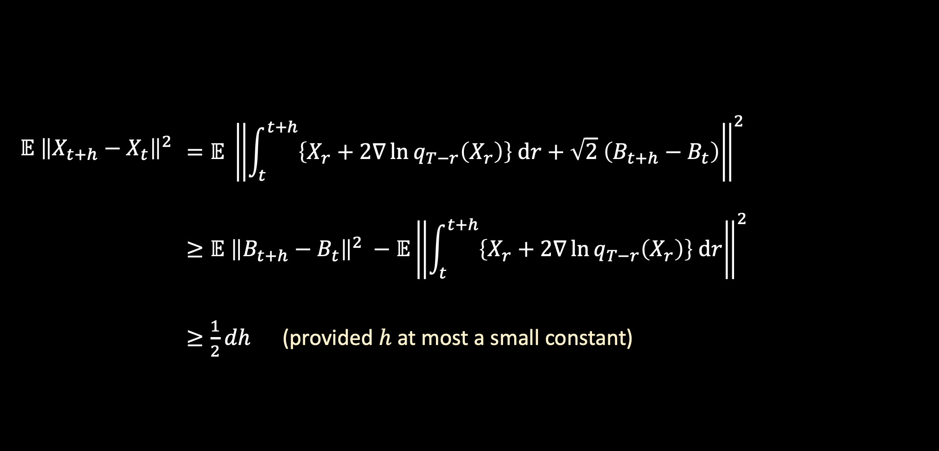
REVISITING THE MOVEMENT BOUND
Consider the movement over a short period of time
$$𝔼 {\left\|X_{t+h}−X_{t}\right\|}^{2}$$ | $$=𝔼 {\left\|\int_{t}^{t+h}{\left\{X_{r}+2∇\ln{q_{T−r}\left(X_{r}\right)}\right\} dr}+\sqrt{2} \left(B_{t+h}−B_{t}\right)\right\|}^{2}$$
 | $$≥𝔼 {\left\|B_{t+h}−B_{t}\right\|}^{2} −𝔼{\left\|\int_{t}^{t+h}{\left\{X_{r}+2∇\ln{q_{T−r}\left(X_{r}\right)}\right\} dr}\right\|}^{2}$$
 | $≥\frac{1}{2}dh$ (provided $h$ at most a small constant)
Bottlenecks the Girsanov analysis at $Θ\left(d\right)$ iterations...

Slide 13
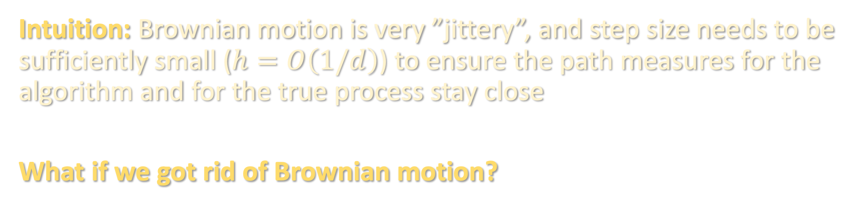
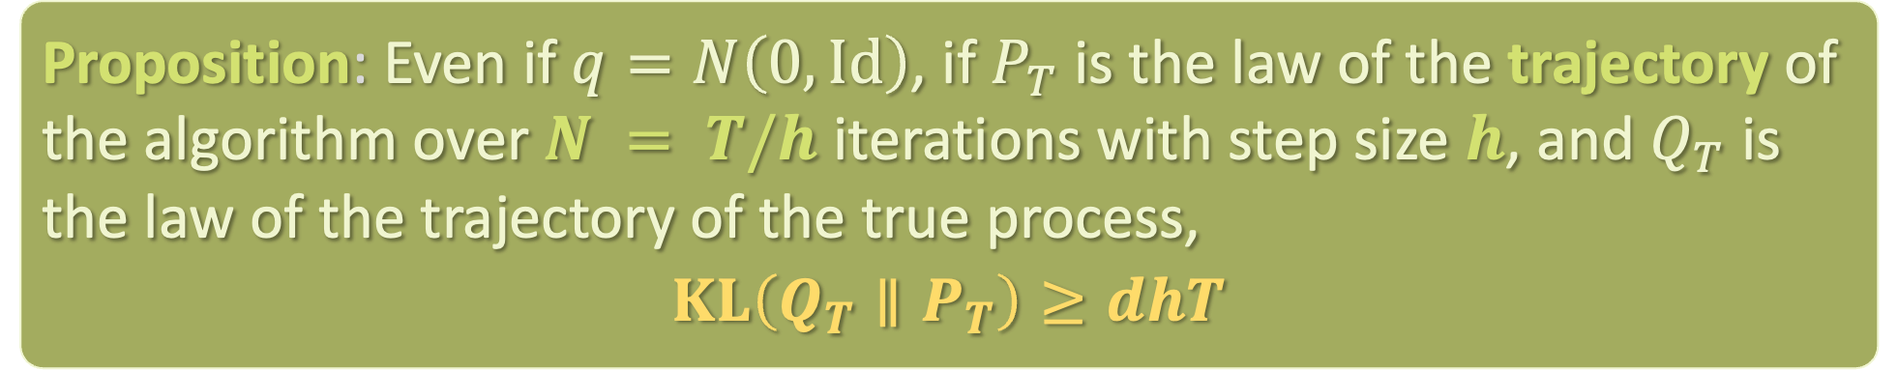
TIGHTNESS OF THE ANALYSIS
Proposition: Even if $q=N\left(0,Id\right)$, if $P_{T}$ is the law of the trajectory of the algorithm over $N = T/h$ iterations with step size $h$, and $Q_{T}$ is the law of the trajectory of the true process,
$$KL\left(Q_{T}∥P_{T}\right)≥dhT$$
Intuition: Brownian motion is very ”jittery”, and step size needs to be sufficiently small ($h=O\left(1/d\right)$) to ensure the path measures for the algorithm and for the true process stay close
What if we got rid of Brownian motion?

Slide 14

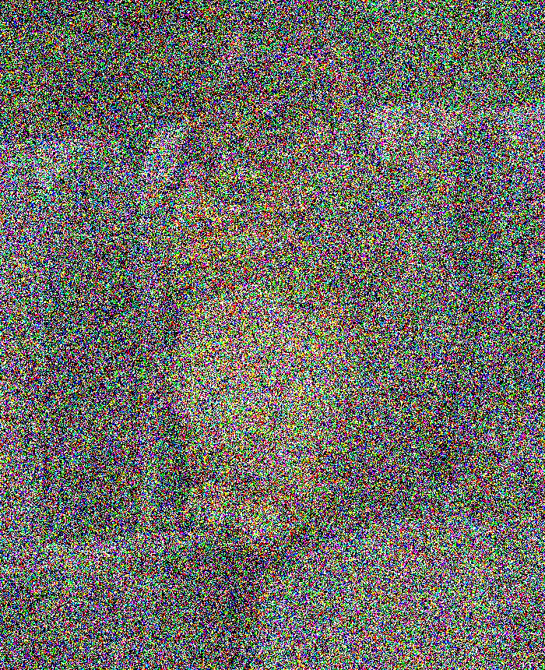
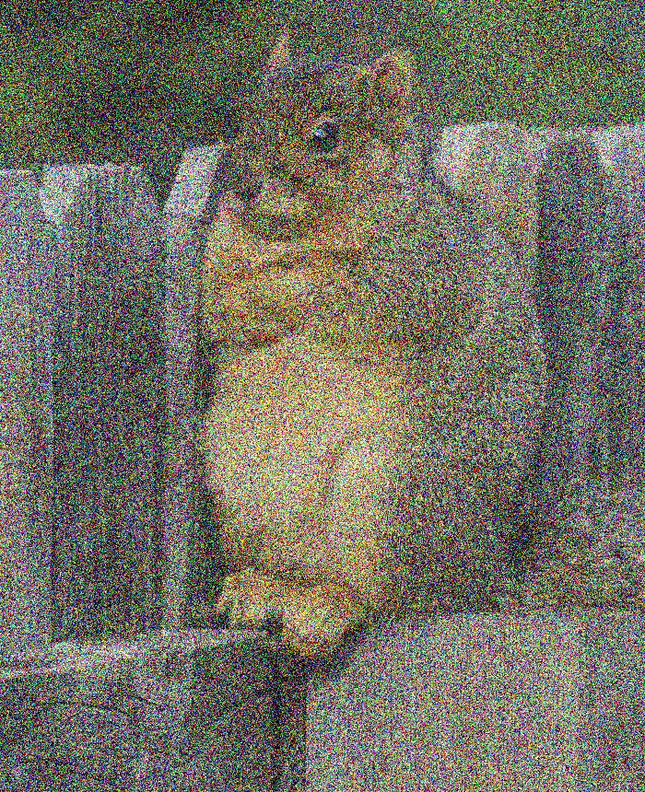
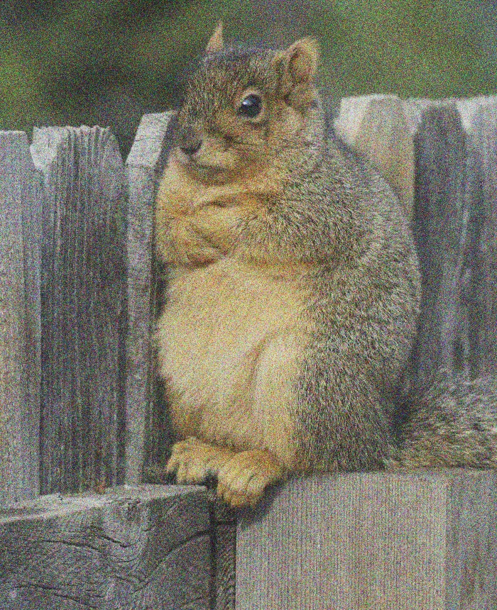
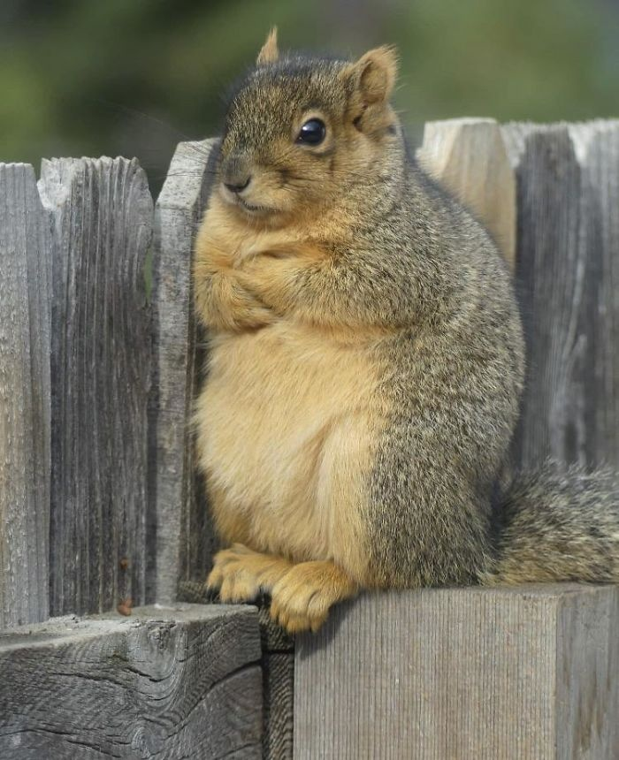
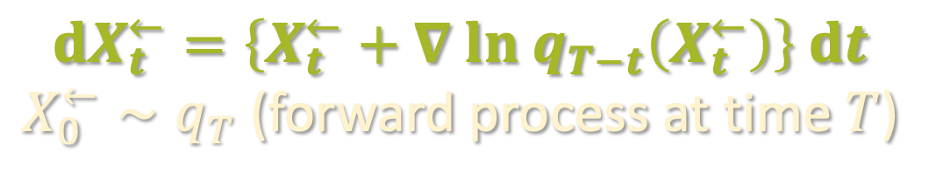
PROBABILITY FLOW ODE
Faster (10–50x speedup in wall-clock time)
Amenable to distillation
$$t=0$$
$$t=T$$
$$dX_{t}^{←}=\left\{X_{t}^{←}+∇ ln q_{T−t}\left(X_{t}^{←}\right)\right\} dt$$
$X_{0}^{←}∼q_{T}$ (forward process at time $T$)

Slide 15
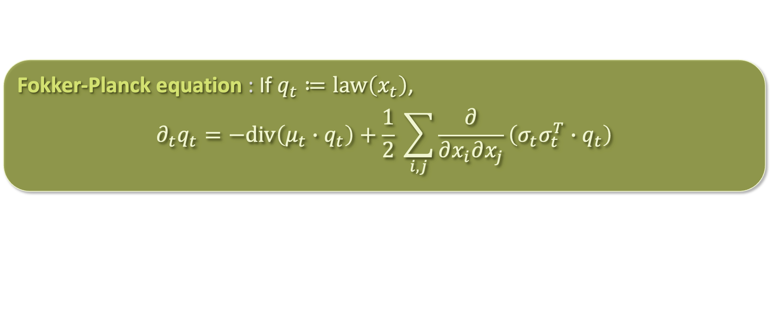

JUSTIFICATION FOR THE PROBABILITY FLOW ODE
Recall the Fokker-Planck equation: for Ito process $dx_{t}=μ_{t}\left(x_{t}\right)dt+σ_{t} dB_{t}$:
Recall Fokker-Planck equation for forward process:
$$∂_{t}q_{t}=div\left(x∙q_{t}\right)+∆q_{t}=div\left(\left(x+∇\ln{q_{t}}\right)∙q_{t}\right)$$
Fokker-Planck equation : If $q_{t}≔law\left(x_{t}\right)$,
$$∂_{t}q_{t}=−div\left(μ_{t}∙q_{t}\right)+\frac{1}{2} \sum_{i,j}{\frac{∂}{∂x_{i}∂x_{j}}\left(σ_{t}σ_{t}^{T}∙q_{t}\right)}$$

Slide 16

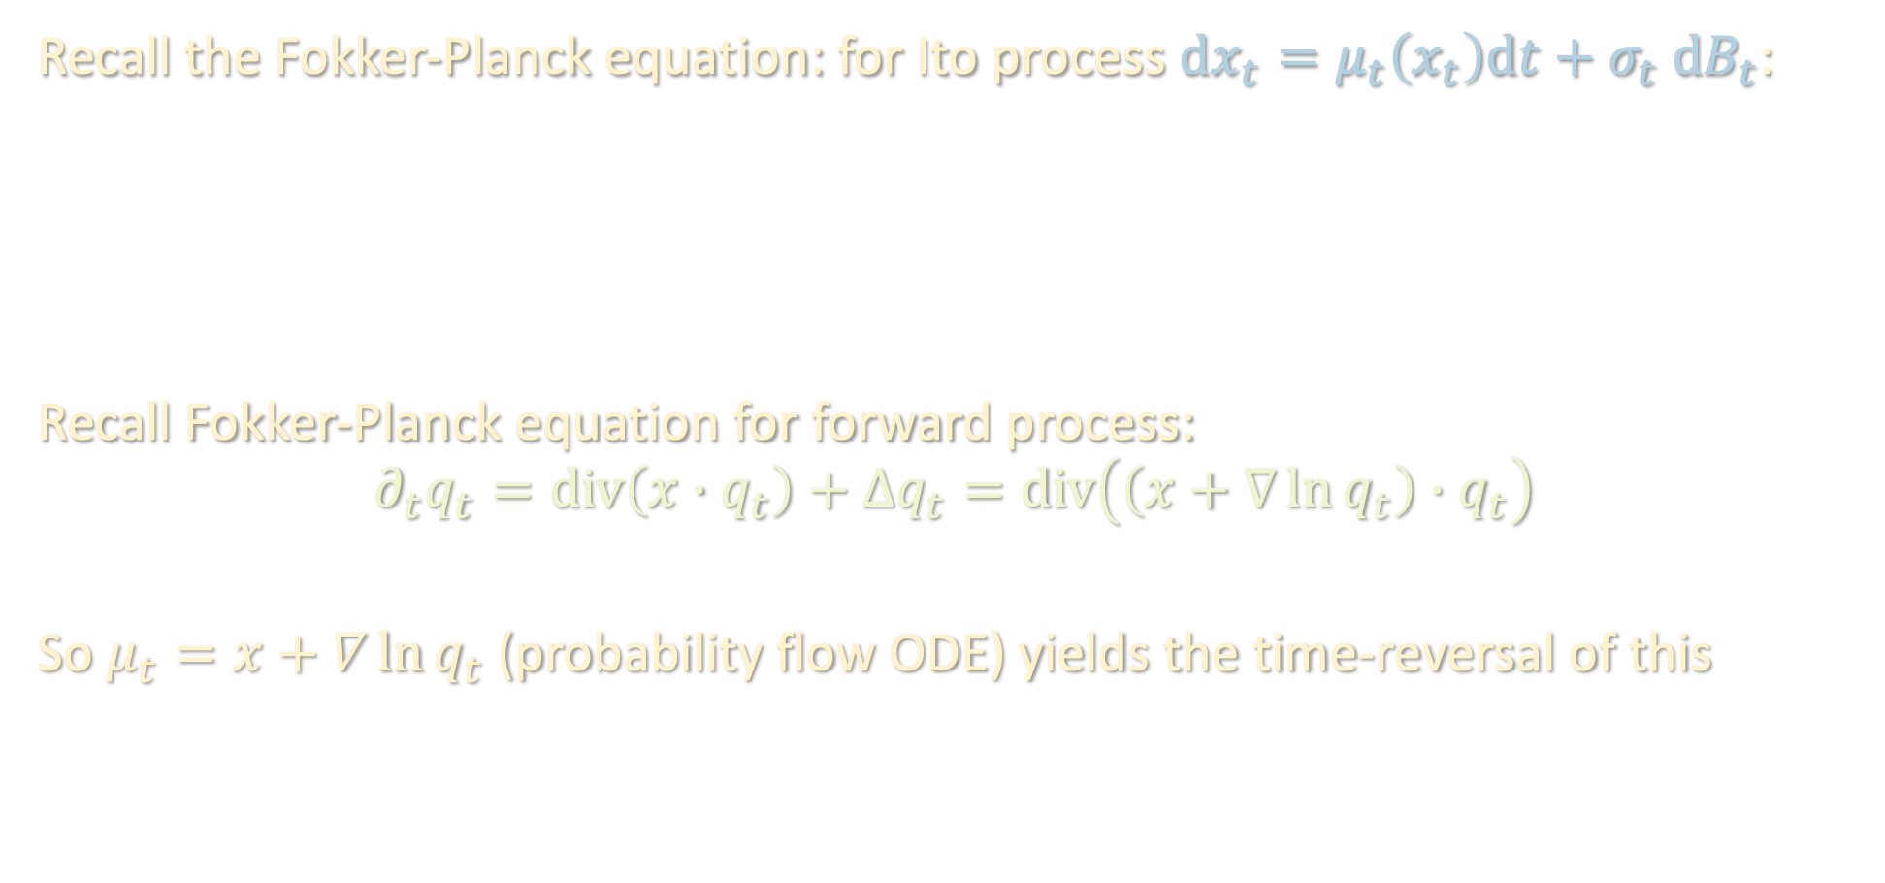
JUSTIFICATION FOR THE PROBABILITY FLOW ODE
Recall the Fokker-Planck equation: for Ito process $dx_{t}=μ_{t}\left(x_{t}\right)dt+σ_{t} dB_{t}$:
Recall Fokker-Planck equation for forward process:
$$∂_{t}q_{t}=div\left(x∙q_{t}\right)+∆q_{t}=div\left(\left(x+∇\ln{q_{t}}\right)∙q_{t}\right)$$
So $μ_{t}=x+∇\ln{q_{t}}$ (probability flow ODE) yields the time-reversal of this
Continuity equation : If $q_{t}≔law\left(x_{t}\right)$ and $σ_{t}=0$,
$$∂_{t}q_{t}=−div\left(μ_{t}∙q_{t}\right)$$

Slide 17
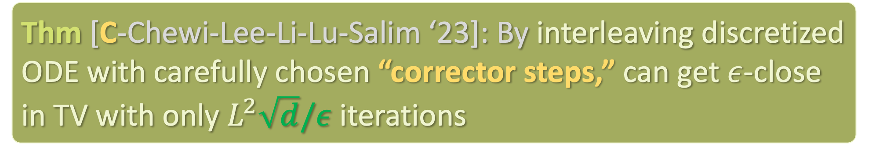
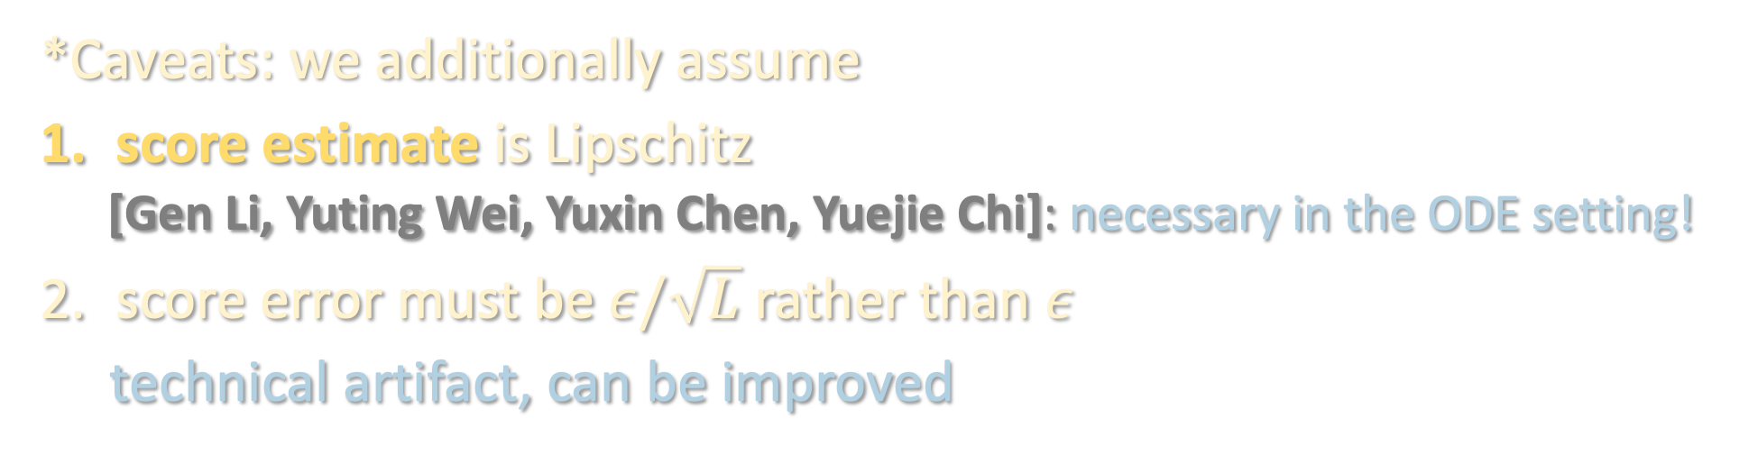
QUADRATIC SPEEDUP WITH ODE
Thm [C-Chewi-Lee-Li-Lu-Salim ‘23]: By interleaving discretized ODE with carefully chosen “corrector steps,” can get $ε$-close in TV with only $L^{2}\sqrt{d}/ε$ iterations
*Caveats: we additionally assume
score estimate is Lipschitz
  [Gen Li, Yuting Wei, Yuxin Chen, Yuejie Chi]: necessary in the ODE setting!
score error must be $ε/\sqrt{L}$ rather than $ε$
technical artifact, can be improved

Slide 18
QUADRATIC SPEEDUP WITH ODE
Thm [C-Chewi-Lee-Li-Lu-Salim ‘23]: By interleaving discretized ODE with carefully chosen “corrector steps,” can get $ε$-close in TV with only $L^{2}\sqrt{d}/ε$ iterations
Idea: instead of a KL analysis, implement a Wasserstein analysis, but periodically “restart” it using regularization from Langevin diffusion

Slide 19



WASSERSTEIN ANALYSIS
Suppose we ran the ODEs
$$dx_{t}=\left(x_{t}+∇\ln{q_{t}\left(x_{t}\right)}\right) dt and d{\hat{x}}_{t}=\left({\hat{x}}_{t}+s_{kh}\left({\hat{x}}_{kh}\right)\right) dt$$
starting from $x_{kh}={\hat{x}}_{kh}∼p$
 | $$=\left\langle x_{t}−{\hat{x}}_{t},\frac{d}{dt}\left(x_{t}−{\hat{x}}_{t}\right)\right\rangle$$
$$\frac{1}{2}∂_{t}{\left\|x_{t}−{\hat{x}}_{t}\right\|}^{2}$$

Slide 20

WASSERSTEIN ANALYSIS
Suppose we ran the ODEs
$$dx_{t}=\left(x_{t}+∇\ln{q_{t}\left(x_{t}\right)}\right) dt and d{\hat{x}}_{t}=\left({\hat{x}}_{t}+s_{kh}\left({\hat{x}}_{kh}\right)\right) dt$$
starting from $x_{kh}={\hat{x}}_{kh}∼p$
 | $$=\left\langle x_{t}−{\hat{x}}_{t},\frac{d}{dt}\left(x_{t}−{\hat{x}}_{t}\right)\right\rangle$$
 | $$=\left\langle x_{t}−{\hat{x}}_{t},x_{t}−{\hat{x}}_{t}+∇\ln{q_{t}\left(x_{t}\right)}−s_{kh}\left(x_{kh}\right)\right\rangle$$
$$\frac{1}{2}∂_{t}{\left\|x_{t}−{\hat{x}}_{t}\right\|}^{2}$$

Slide 21

WASSERSTEIN ANALYSIS
Suppose we ran the ODEs
$$dx_{t}=\left(x_{t}+∇\ln{q_{t}\left(x_{t}\right)}\right) dt and d{\hat{x}}_{t}=\left({\hat{x}}_{t}+s_{kh}\left({\hat{x}}_{kh}\right)\right) dt$$
starting from $x_{kh}={\hat{x}}_{kh}∼p$
 | $$=\left\langle x_{t}−{\hat{x}}_{t},\frac{d}{dt}\left(x_{t}−{\hat{x}}_{t}\right)\right\rangle$$
 | $$=\left\langle x_{t}−{\hat{x}}_{t},x_{t}−{\hat{x}}_{t}+∇\ln{q_{t}\left(x_{t}\right)}−s_{kh}\left(x_{kh}\right)\right\rangle$$
 | $$={\left\|x_{t}−{\hat{x}}_{t}\right\|}^{2}+\left\langle x_{t}−{\hat{x}}_{t},∇\ln{q_{t}\left(x_{t}\right)}−s_{kh}\left(x_{kh}\right)\right\rangle$$
$$\frac{1}{2}∂_{t}{\left\|x_{t}−{\hat{x}}_{t}\right\|}^{2}$$

Slide 22


WASSERSTEIN ANALYSIS
Suppose we ran the ODEs
$$dx_{t}=\left(x_{t}+∇\ln{q_{t}\left(x_{t}\right)}\right) dt and d{\hat{x}}_{t}=\left({\hat{x}}_{t}+s_{kh}\left({\hat{x}}_{kh}\right)\right) dt$$
starting from $x_{kh}={\hat{x}}_{kh}∼p$
 | $$=\left\langle x_{t}−{\hat{x}}_{t},\frac{d}{dt}\left(x_{t}−{\hat{x}}_{t}\right)\right\rangle$$
 | $$=\left\langle x_{t}−{\hat{x}}_{t},x_{t}−{\hat{x}}_{t}+∇\ln{q_{t}\left(x_{t}\right)}−s_{kh}\left(x_{kh}\right)\right\rangle$$
 | $$={\left\|x_{t}−{\hat{x}}_{t}\right\|}^{2}+\left\langle x_{t}−{\hat{x}}_{t},∇\ln{q_{t}\left(x_{t}\right)}−s_{kh}\left(x_{kh}\right)\right\rangle$$
 | $$≤\left(1+\frac{1}{4h}\right){\left\|x_{t}−{\hat{x}}_{t}\right\|}^{2}+h{ \left\|∇\ln{q_{t}\left(x_{t}\right)}−s_{kh}\left(x_{kh}\right)\right\|}^{2}$$
$$\frac{1}{2}∂_{t}{\left\|x_{t}−{\hat{x}}_{t}\right\|}^{2}$$
$$≤\left(1+\frac{1}{4h}\right){\left\|x_{t}−{\hat{x}}_{t}\right\|}^{2}+h⋅O\left(dh^{2}\right)$$

Slide 23
WASSERSTEIN ANALYSIS
Suppose we ran the ODEs
$$dx_{t}=\left(x_{t}+∇\ln{q_{t}\left(x_{t}\right)}\right) dt and d{\hat{x}}_{t}=\left({\hat{x}}_{t}+s_{kh}\left({\hat{x}}_{kh}\right)\right) dt$$
starting from $x_{kh}={\hat{x}}_{kh}∼p$
 | $$=\left\langle x_{t}−{\hat{x}}_{t},\frac{d}{dt}\left(x_{t}−{\hat{x}}_{t}\right)\right\rangle$$
 | $$=\left\langle x_{t}−{\hat{x}}_{t},x_{t}−{\hat{x}}_{t}+∇\ln{q_{t}\left(x_{t}\right)}−s_{kh}\left(x_{kh}\right)\right\rangle$$
 | $$={\left\|x_{t}−{\hat{x}}_{t}\right\|}^{2}+\left\langle x_{t}−{\hat{x}}_{t},∇\ln{q_{t}\left(x_{t}\right)}−s_{kh}\left(x_{kh}\right)\right\rangle$$
 | $$≤\left(1+\frac{1}{4h}\right){\left\|x_{t}−{\hat{x}}_{t}\right\|}^{2}+h{ \left\|∇\ln{q_{t}\left(x_{t}\right)}−s_{kh}\left(x_{kh}\right)\right\|}^{2}$$
$$\frac{1}{2}∂_{t}{\left\|x_{t}−{\hat{x}}_{t}\right\|}^{2}$$
$$≤O\left(1/h\right){\left\|x_{t}−{\hat{x}}_{t}\right\|}^{2}+O\left(dh^{3}\right)$$

Slide 24

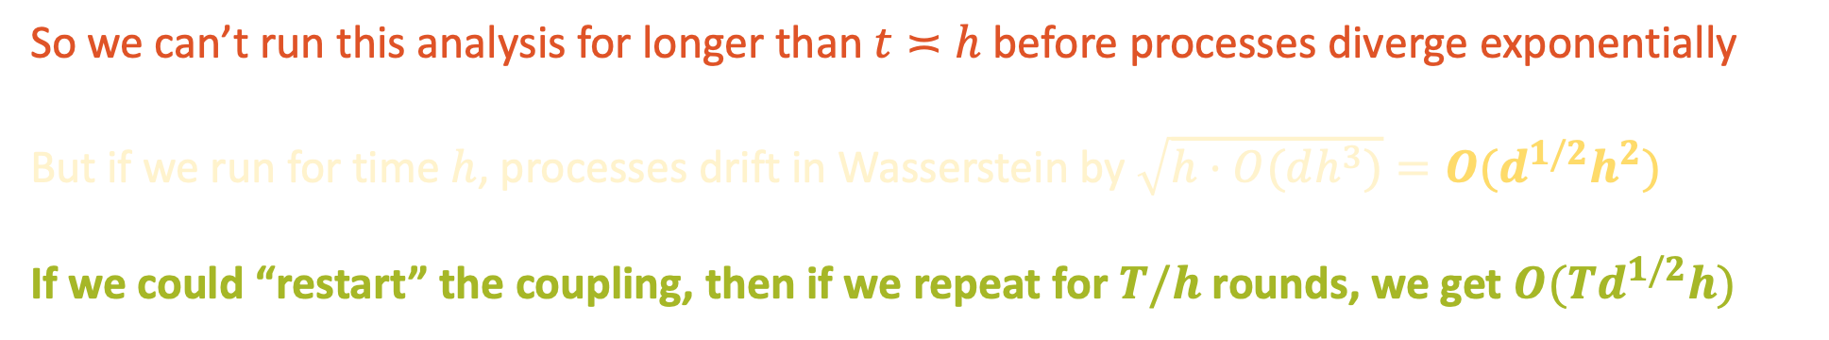

WASSERSTEIN ANALYSIS
Suppose we ran the ODEs
$$dx_{t}=\left(x_{t}+∇\ln{q_{t}\left(x_{t}\right)}\right) dt and d{\hat{x}}_{t}=\left({\hat{x}}_{t}+s_{kh}\left({\hat{x}}_{kh}\right)\right) dt$$
starting from $x_{kh}={\hat{x}}_{kh}∼p$
$$\frac{1}{2}∂_{t}{\left\|x_{t}−{\hat{x}}_{t}\right\|}^{2}$$
$$≤O\left(1/h\right){\left\|x_{t}−{\hat{x}}_{t}\right\|}^{2}+O\left(dh^{3}\right)$$
$$⇒{\left\|x_{kh+t}−{\hat{x}}_{kh+t}\right\|}^{2}≤\exp\left(O\left(t/h\right)\right)⋅t⋅O\left(dh^{3}\right)$$
So we can’t run this analysis for longer than $t≍h$ before processes diverge exponentially
But if we run for time $h$, processes drift in Wasserstein by $\sqrt{h⋅O(dh^{3})}=O(d^{1/2}h^{2})$
If we could “restart” the coupling, then if we repeat for $T/h$ rounds, we get $O(Td^{1/2}h)$

Slide 25
RESTARTING THE COUPLING
$P_{ODE}^{h}$: Continuous process
${\hat{P}}_{ODE}^{h}$: Discrete process
$$q_{T} vs q_{T}$$

Slide 26
RESTARTING THE COUPLING
$P_{ODE}^{h}$: Continuous process
${\hat{P}}_{ODE}^{h}$: Discrete process
$q_{T} P_{ODE}^{h} vs q_{T}$ ${\hat{P}}_{ODE}^{h}$
(close in Wasserstein via coupling argument)

Slide 27
RESTARTING THE COUPLING
$P_{ODE}^{h}$: Continuous process
${\hat{P}}_{ODE}^{h}$: Discrete process
$q_{T} P_{ODE}^{h} {\hat{P}}_{ODE}^{h} vs q_{T}$ ${\hat{P}}_{ODE}^{h}$ ${\hat{P}}_{ODE}^{h}$
(close via data processing inequality)

Slide 28
RESTARTING THE COUPLING
$P_{ODE}^{h}$: Continuous process
${\hat{P}}_{ODE}^{h}$: Discrete process
$q_{T} P_{ODE}^{h} {\hat{P}}_{ODE}^{h} vs q_{T}$ ${\hat{P}}_{ODE}^{2h}$
$vs$?
$$q_{T} P_{ODE}^{2h}$$

Slide 29
RESTARTING THE COUPLING
$P_{ODE}^{h}$: Continuous process
${\hat{P}}_{ODE}^{h}$: Discrete process
$q_{T} P_{ODE}^{h} {\hat{P}}_{ODE}^{h} vs q_{T}$ ${\hat{P}}_{ODE}^{2h}$
$vs$?
$$q_{T} P_{ODE}^{h} P_{ODE}^{h}$$

Slide 30
RESTARTING THE COUPLING
$P_{ODE}^{h}$: Continuous process
${\hat{P}}_{ODE}^{h}$: Discrete process
$q_{T} P_{ODE}^{h} {\hat{P}}_{ODE}^{h} vs q_{T}$ ${\hat{P}}_{ODE}^{2h}$
$vs?$
🤨
(close by restarting coupling initialized at $q_{T} P_{ODE}^{h}$)
$$q_{T} P_{ODE}^{h} P_{ODE}^{h}$$

Slide 31
RESTARTING THE COUPLING
$P_{ODE}^{h}$: Continuous process
${\hat{P}}_{ODE}^{h}$: Discrete process
$q_{T} P_{ODE}^{h} {\hat{P}}_{ODE}^{h} vs q_{T}$ ${\hat{P}}_{ODE}^{2h}$
$vs?$
$$q_{T} P_{ODE}^{h} P_{ODE}^{h}$$

Slide 32
RESTARTING THE COUPLING
$P_{ODE}^{h}$: Continuous process
${\hat{P}}_{ODE}^{h}$: Discrete process
$q_{T} P_{ODE}^{h} {\hat{P}}_{ODE}^{h} vs q_{T}$ ${\hat{P}}_{ODE}^{2h}$
$vs$?
$$q_{T} P_{ODE}^{2h}$$

Slide 33
RESTARTING THE COUPLING
$P_{ODE}^{h}$: Continuous process
${\hat{P}}_{ODE}^{h}$: Discrete process
$q_{T} P_{ODE}^{h} {\hat{P}}_{ODE}^{h} vs q_{T}$ ${\hat{P}}_{ODE}^{h}$ ${\hat{P}}_{ODE}^{h}$
(close via data processing inequality)

Slide 34
RESTARTING THE COUPLING
$P_{ODE}^{h}$: Continuous process
${\hat{P}}_{ODE}^{h}$: Discrete process
$q_{T} P_{ODE}^{h} (corrector) {\hat{P}}_{ODE}^{h} vs q_{T}$ ${\hat{P}}_{ODE}^{h}$ $(corrector) {\hat{P}}_{ODE}^{h}$
Short-time regularization:
corrector introduces small amount of stochasticity,
allowing us to convert Wasserstein closeness to KL closeness

Slide 35
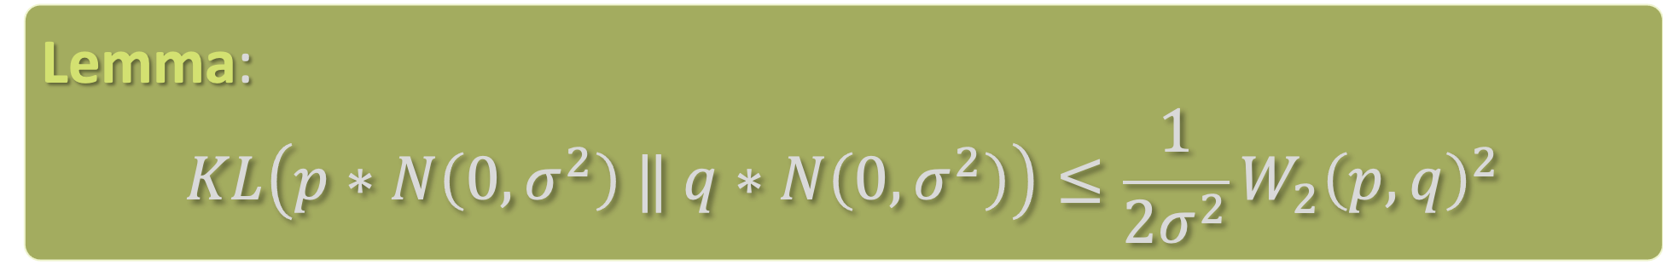
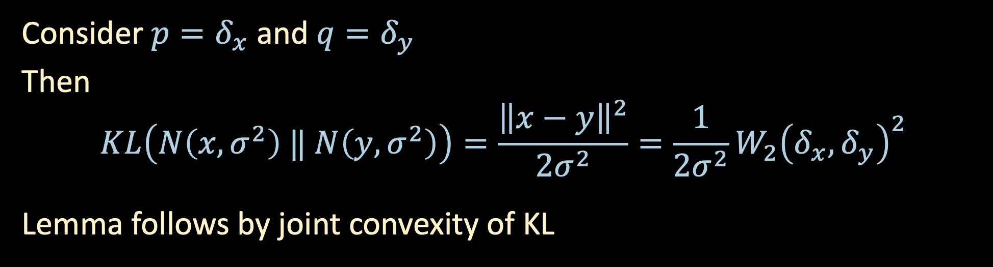
SHORT-TIME REGULARIZATION: BABY EXAMPLE
Lemma:
$$KL\left(p∗N\left(0,σ^{2}\right) ‖ q∗N\left(0,σ^{2}\right)\right)≤\frac{1}{2σ^{2}}W_{2}{\left(p,q\right)}^{2}$$
Consider $p=δ_{x}$ and $q=δ_{y}$
Then
$$KL\left(N\left(x,σ^{2}\right) ‖ N\left(y,σ^{2}\right)\right)=\frac{{\left\|x−y\right\|}^{2}}{2σ^{2}}=\frac{1}{2σ^{2}}W_{2}{\left(δ_{x},δ_{y}\right)}^{2}$$
Lemma follows by joint convexity of KL

Slide 36
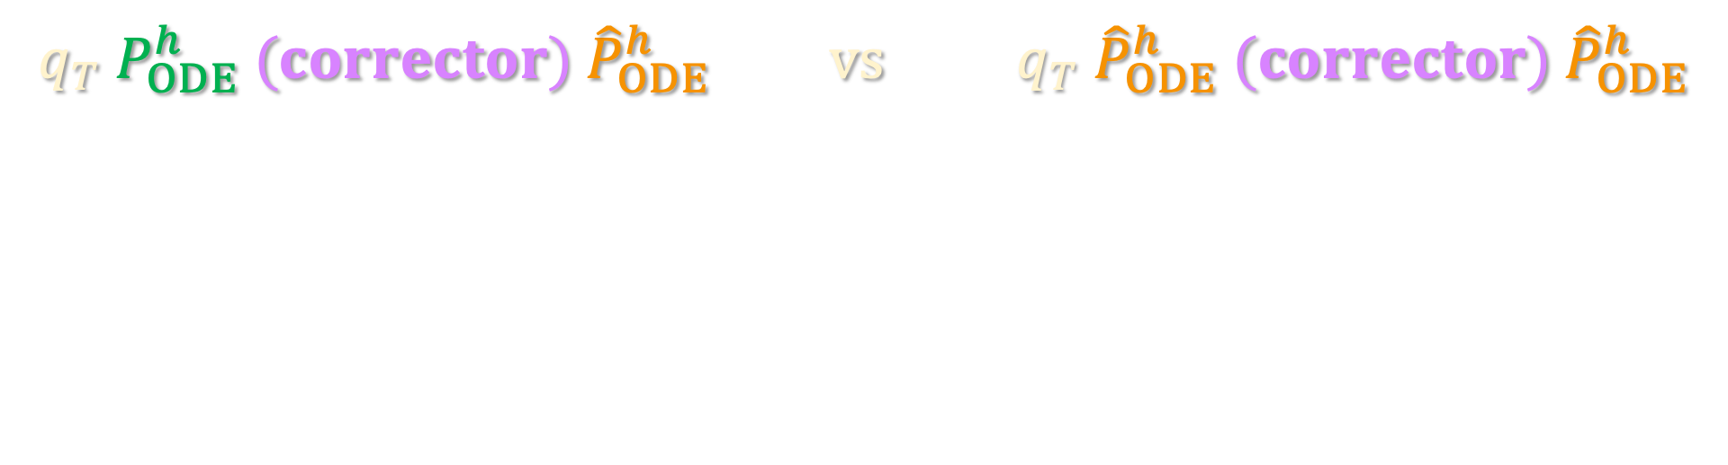

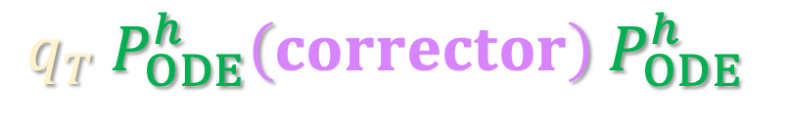
RESTARTING THE COUPLING
$P_{ODE}^{h}$: Continuous process
${\hat{P}}_{ODE}^{h}$: Discrete process
$q_{T} P_{ODE}^{h} (corrector) {\hat{P}}_{ODE}^{h} vs q_{T}$ ${\hat{P}}_{ODE}^{h}$ $(corrector) {\hat{P}}_{ODE}^{h}$
$vs?$
Issue: merely adding Gaussian noise for the corrector step will move us away from true reverse process ☹
$$q_{T} P_{ODE}^{h}\left(corrector\right) P_{ODE}^{h}$$

Slide 37
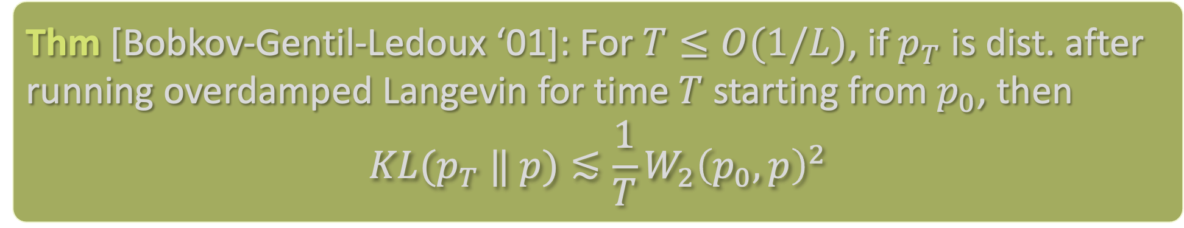

SHORT-TIME REGULARIZATION: LANGEVIN
(Overdamped) Langevin dynamics
$$dx_{t}=∇ ln p\left(x_{t}\right) dt+\sqrt{2} dB_{t}$$
has stationary distribution $p$, so just take $p$ to be current distribution $q_{s}$ along the reverse process.
Thm [Bobkov-Gentil-Ledoux ‘01]: For $T≤O(1/L)$, if $p_{T}$ is dist. after running overdamped Langevin for time $T$ starting from $p_{0}$, then
$$KL(p_{T} ‖ p)≲\frac{1}{T}W_{2}{\left(p_{0},p\right)}^{2}$$

Slide 38

SHORT-TIME REGULARIZATION: LANGEVIN
(Overdamped) Langevin dynamics
$$dx_{t}=∇ ln p\left(x_{t}\right) dt+\sqrt{2} dB_{t}$$
has stationary distribution $p$, so just take $p$ to be current distribution $q_{s}$ along the reverse process.
…still bottlenecked at $Θ\left(d\right)$ iterations because of Brownian motion
Thm [Bobkov-Gentil-Ledoux ‘01]: For $T≤O(1/L)$, if $p_{T}$ is dist. after running overdamped Langevin for time $T$ starting from $p_{0}$, then
$$KL(p_{T} ‖ p)≲\frac{1}{T}W_{2}{\left(p_{0},p\right)}^{2}$$

Slide 39
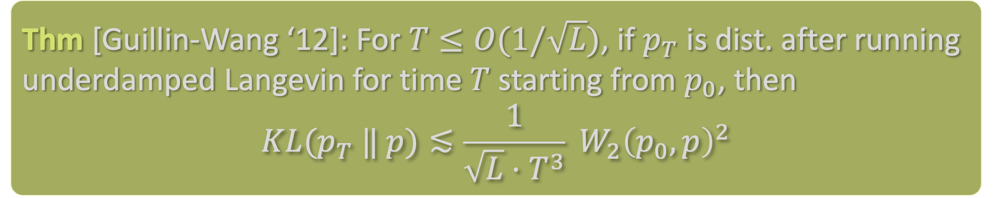

SHORT-TIME REGULARIZATION: LANGEVIN
Idea: use underdamped Langevin dynamics
$$dx_{t}=v_{t} dt$$
$$dv_{t}=\left(∇\ln{p}\left(x_{t}\right)−γ v_{t}\right) dt+\sqrt{2γ} dB_{t}$$
Intuition: bottleneck disappears because Brownian motion only in the “velocity” variable, so the trajectory is smoother
Thm [Guillin-Wang ‘12]: For $T≤O(1/\sqrt{L})$, if $p_{T}$ is dist. after running underdamped Langevin for time $T$ starting from $p_{0}$, then
$$KL(p_{T} ‖ p)≲\frac{1}{\sqrt{L}⋅T^{3}} {W_{2}\left(p_{0},p\right)}^{2}$$

Slide 40
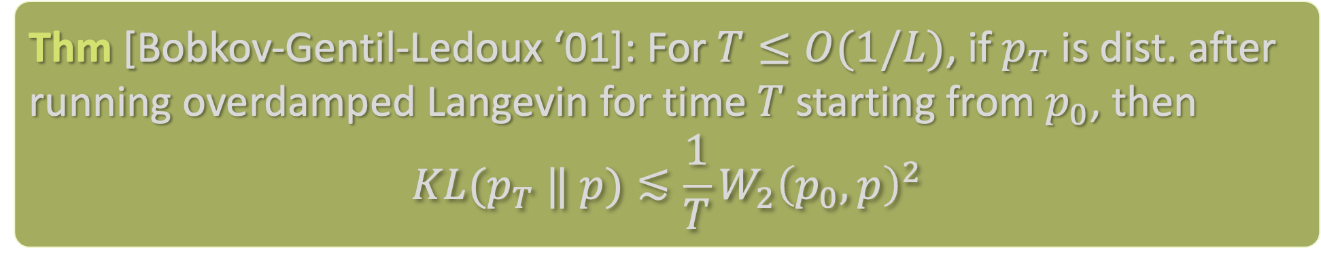
SHORT-TIME REGULARIZATION: PROOF SKETCH
Won’t cover underdamped in this course, but let’s try proving the result for overdamped to get intuition:
Original proof is a bit heavy. We will give a modern and conceptually simpler proof using a technique recently developed by [Altschuler-Chewi ‘23]: shifted composition
Thm [Bobkov-Gentil-Ledoux ‘01]: For $T≤O(1/L)$, if $p_{T}$ is dist. after running overdamped Langevin for time $T$ starting from $p_{0}$, then
$$KL(p_{T} ‖ p)≲\frac{1}{T}W_{2}{\left(p_{0},p\right)}^{2}$$
“reverse transport
inequality”

Slide 41
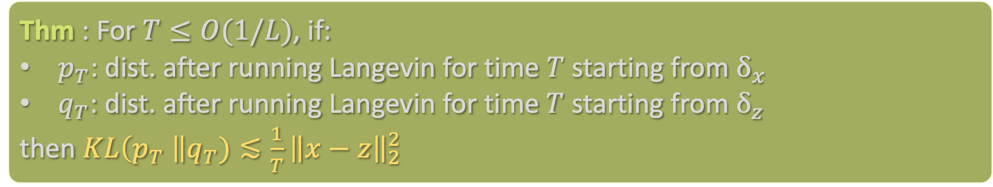

SHORT-TIME REGULARIZATION: PROOF SKETCH
As before, by convexity it suffices to show:
Under “1 step” of Langevin, this is true: Let $\tilde{x},\tilde{z}$ be result of one step w/ size $h$
$$\tilde{x} \sim N\left(x+h ∇\ln{p\left(x\right)},2h\right), \tilde{z} \sim N\left(z+h ∇\ln{p\left(z\right)},2h\right)$$
$$KL\left(law\left(\tilde{x}\right)∥law\left(\tilde{z}\right)\right)=\frac{1}{4h}{\left\|\left(x−z\right)+h\left(∇\ln{p\left(x\right)}−∇\ln{p\left(z\right)}\right)\right\|}^{2}$$
$$≲\frac{1}{h}\left(1+L^{2}h^{2}\right){\left\|x−z\right\|}^{2} ≲\frac{1}{h}{\left\|x−z\right\|}^{2}$$
Thm : For $T≤O(1/L)$, if:
$p_{T}$: dist. after running Langevin for time $T$ starting from $δ_{x}$
$q_{T}$: dist. after running Langevin for time $T$ starting from $δ_{z}$
then $KL\left(p_{T} \right\|q_{T})≲\frac{1}{T}{\left\|x−z\right\|}_{2}^{2}$

Slide 42
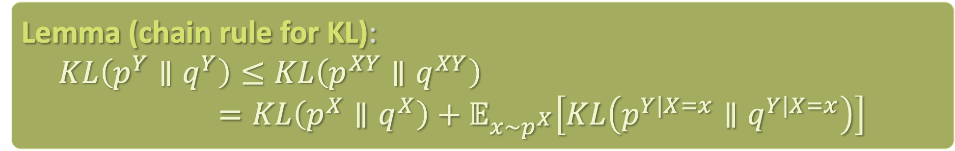
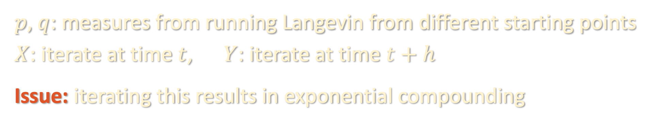
SHORT-TIME REGULARIZATION: PROOF SKETCH
How to chain together multiple steps?
Naïve attempt:
Lemma (chain rule for KL):
$$KL\left(p^{Y}∥q^{Y}\right)≤KL\left(p^{XY}∥q^{XY}\right)$$
$=KL\left(p^{X}∥q^{X}\right)+𝔼_{x\sim p^{X}}\left[KL\left(p^{Y|X=x}∥q^{Y|X=x}\right)\right]$
$p,$ $q$: measures from running Langevin from different starting points
$X$: iterate at time $t$, $Y$: iterate at time $t+h$
Issue: iterating this results in exponential compounding

Slide 43
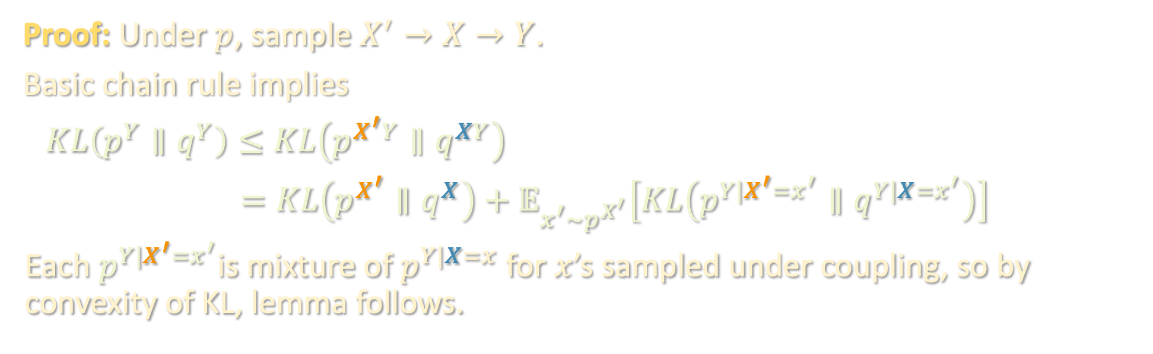
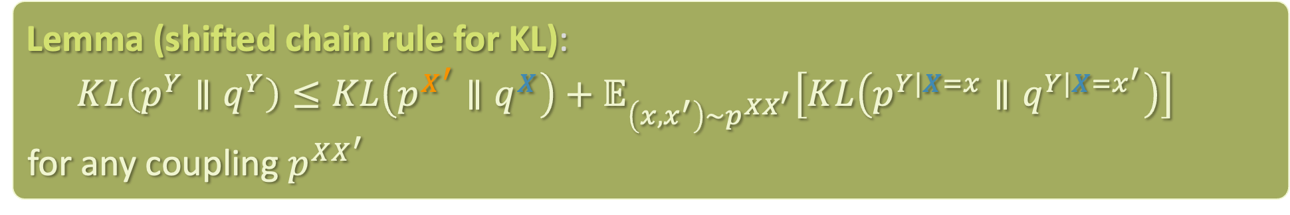
SHORT-TIME REGULARIZATION: PROOF SKETCH
Lemma (shifted chain rule for KL):
$$KL\left(p^{Y}∥q^{Y}\right)≤KL\left(p^{X^{′}}∥q^{X}\right)+𝔼_{\left(x,x^{′}\right)\sim p^{XX^{′}}}\left[KL\left(p^{Y|X=x}∥q^{Y|X=x^{′}}\right)\right]$$
for any coupling $p^{XX^{′}}$
Proof: Under $p$, sample $X^{′}→X→Y$.
Basic chain rule implies
$$KL\left(p^{Y}∥q^{Y}\right)≤KL\left(p^{X^{′}Y}∥q^{XY}\right)$$
$=KL\left(p^{X^{′}}∥q^{X}\right)+𝔼_{x^{′}\sim p^{X^{′}}}\left[KL\left(p^{Y|X^{′}=x^{′}}∥q^{Y|X=x^{′}}\right)\right]$
Each $p^{Y|X^{′}=x^{′}}$is mixture of $p^{Y|X=x}$ for $x$’s sampled under coupling, so by convexity of KL, lemma follows.

Slide 44
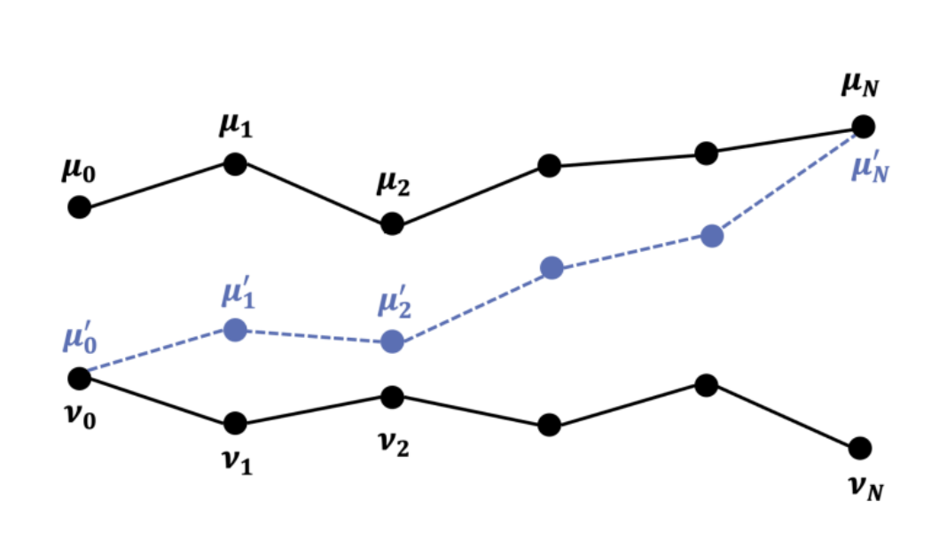


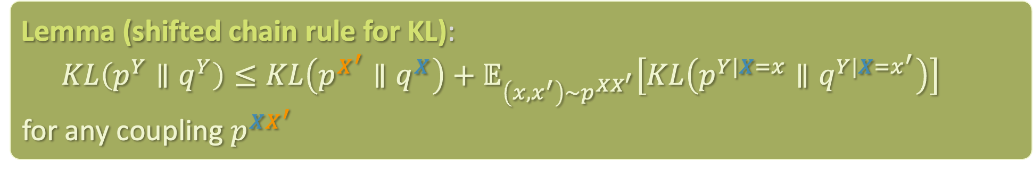











SHORT-TIME REGULARIZATION: PROOF SKETCH
Lemma (shifted chain rule for KL):
$$KL\left(p^{Y}∥q^{Y}\right)≤KL\left(p^{X^{′}}∥q^{X}\right)+𝔼_{\left(x,x^{′}\right)\sim p^{XX^{′}}}\left[KL\left(p^{Y|X=x}∥q^{Y|X=x^{′}}\right)\right]$$
for any coupling $p^{XX^{′}}$
$$p_{N}$$
$$p_{1}$$
$$p_{1}$$
$$p_{0}$$
$$p_{1}$$
$$p_{N}^{′}$$
$$p_{1}^{′}$$
$$p_{2}^{′}$$
$$p_{0}^{′}$$
$$q_{0}$$
$$q_{2}$$
$$q_{1}$$
$$q_{N}$$
Figure from [Altschuler-Chewi ‘23]

Slide 45


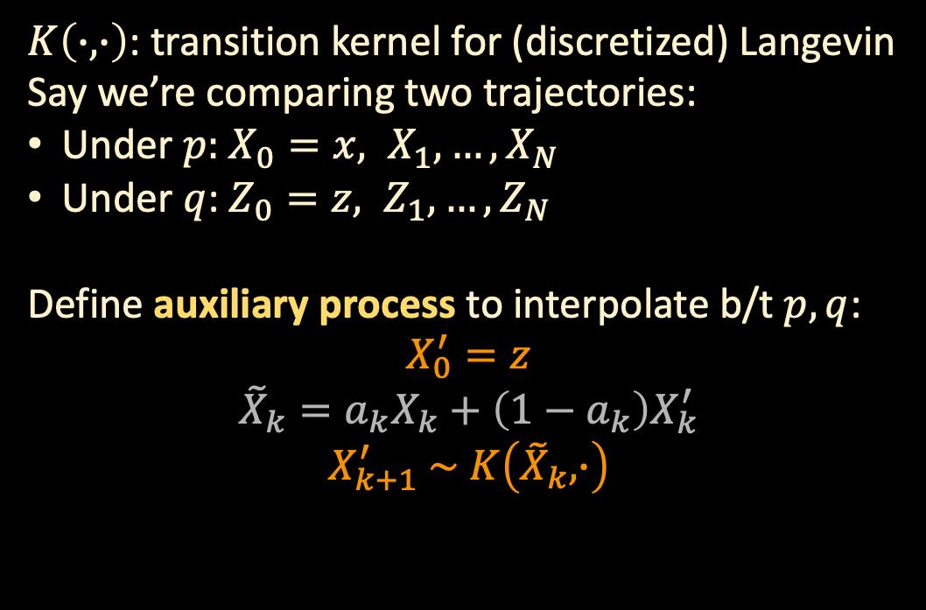











SHORT-TIME REGULARIZATION: PROOF SKETCH
Lemma (shifted chain rule for KL):
$$KL\left(p^{Y}∥q^{Y}\right)≤KL\left(p^{X^{′}}∥q^{X}\right)+𝔼_{\left(x,x^{′}\right)\sim p^{XX^{′}}}\left[KL\left(p^{Y|X=x}∥q^{Y|X=x^{′}}\right)\right]$$
for any coupling $p^{XX^{′}}$
$K\left(∙,∙\right)$: transition kernel for (discretized) Langevin
Say we’re comparing two trajectories:
Under $p:$ $X_{0}=x, X_{1},…,X_{N}$
Under $q$: $Z_{0}=z, Z_{1},…,Z_{N}$
Define auxiliary process to interpolate b/t $p, q$:
$$X_{0}^{′}=z$$
$${\tilde{X}}_{k}=a_{k}X_{k}+\left(1−a_{k}\right)X_{k}^{′}$$
$$X_{k+1}^{′} \sim K\left({\tilde{X}}_{k},∙\right)$$
$$p_{N}$$
$$p_{1}$$
$$p_{1}$$
$$p_{0}$$
$$p_{1}$$
$$p_{N}^{′}$$
$$p_{1}^{′}$$
$$p_{2}^{′}$$
$$p_{0}^{′}$$
$$q_{0}$$
$$q_{2}$$
$$q_{1}$$
$$q_{N}$$
Figure from [Altschuler-Chewi ‘23]

Slide 46
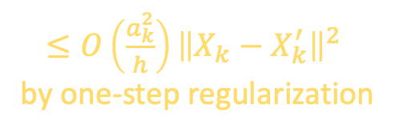
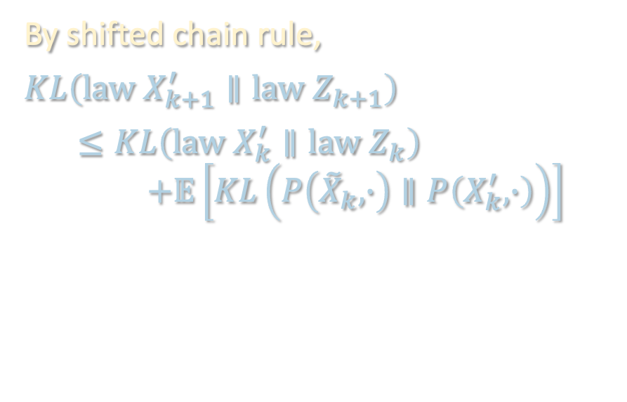
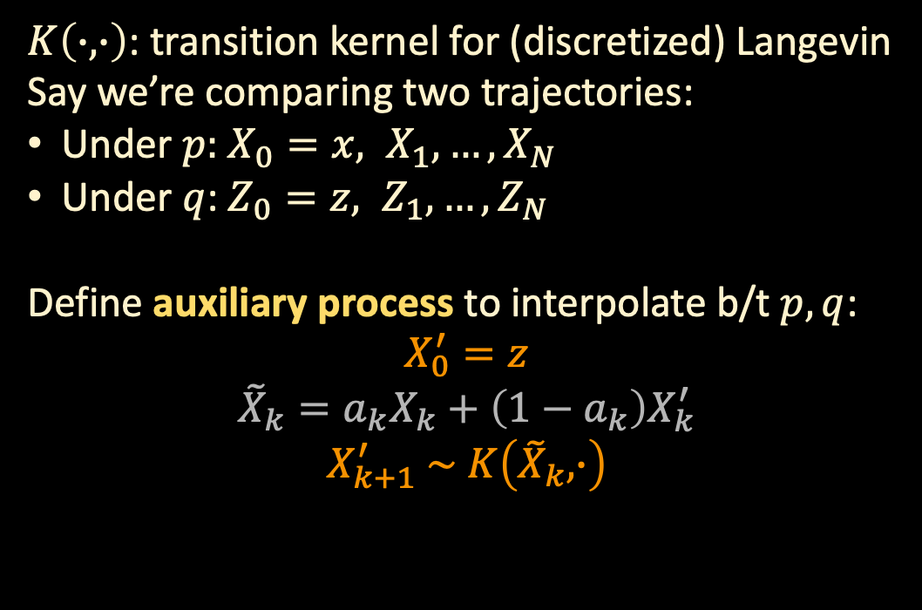
SHORT-TIME REGULARIZATION: PROOF SKETCH
Lemma (shifted chain rule for KL):
$$KL\left(p^{Y}∥q^{Y}\right)≤KL\left(p^{X^{′}}∥q^{X}\right)+𝔼_{\left(x,x^{′}\right)\sim p^{XX^{′}}}\left[KL\left(p^{Y|X=x}∥q^{Y|X=x^{′}}\right)\right]$$
for any coupling $p^{XX^{′}}$
By shifted chain rule,
$$KL\left(law X_{k+1}^{′}∥law Z_{k+1}\right)$$
$$≤KL\left(law X_{k}^{′}∥law Z_{k}\right)$$
$$+𝔼\left[KL\left(P\left({\tilde{X}}_{k},∙\right)∥P\left(X_{k}^{′},∙\right)\right)\right]$$
$K\left(∙,∙\right)$: transition kernel for (discretized) Langevin
Say we’re comparing two trajectories:
Under $p:$ $X_{0}=x, X_{1},…,X_{N}$
Under $q$: $Z_{0}=z, Z_{1},…,Z_{N}$
Define auxiliary process to interpolate b/t $p, q$:
$$X_{0}^{′}=z$$
$${\tilde{X}}_{k}=a_{k}X_{k}+\left(1−a_{k}\right)X_{k}^{′}$$
$$X_{k+1}^{′} \sim K\left({\tilde{X}}_{k},∙\right)$$
$≤O\left(\frac{a_{k}^{2}}{h}\right){\left\|X_{k}−X_{k}^{′}\right\|}^{2}$
by one-step regularization

Slide 47
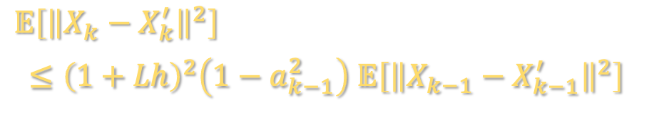
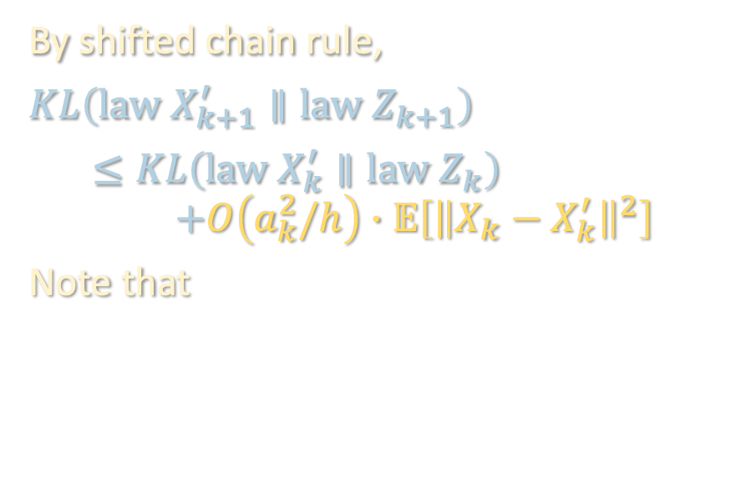
SHORT-TIME REGULARIZATION: PROOF SKETCH
Lemma (shifted chain rule for KL):
$$KL\left(p^{Y}∥q^{Y}\right)≤KL\left(p^{X^{′}}∥q^{X}\right)+𝔼_{\left(x,x^{′}\right)\sim p^{XX^{′}}}\left[KL\left(p^{Y|X=x}∥q^{Y|X=x^{′}}\right)\right]$$
for any coupling $p^{XX^{′}}$
By shifted chain rule,
$$KL\left(law X_{k+1}^{′}∥law Z_{k+1}\right)$$
$$≤KL\left(law X_{k}^{′}∥law Z_{k}\right)$$
$$+O\left(a_{k}^{2}/h\right)∙𝔼\left[{\left\|X_{k}−X_{k}^{′}\right\|}^{2}\right]$$
Note that
$K\left(∙,∙\right)$: transition kernel for (discretized) Langevin
Say we’re comparing two trajectories:
Under $p:$ $X_{0}=x, X_{1},…,X_{N}$
Under $q$: $Z_{0}=z, Z_{1},…,Z_{N}$
Define auxiliary process to interpolate b/t $p, q$:
$$X_{0}^{′}=z$$
$${\tilde{X}}_{k}=a_{k}X_{k}+\left(1−a_{k}\right)X_{k}^{′}$$
$$X_{k+1}^{′} \sim K\left({\tilde{X}}_{k},∙\right)$$
$$𝔼\left[{\left\|X_{k}−X_{k}^{′}\right\|}^{2}\right]$$
$≤{\left(1+Lh\right)}^{2}\left(1−a_{k−1}^{2}\right) 𝔼\left[{\left\|X_{k−1}−X_{k−1}^{′}\right\|}^{2}\right]$

Slide 48
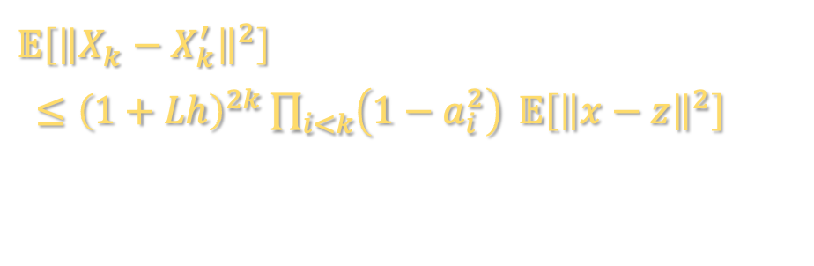
SHORT-TIME REGULARIZATION: PROOF SKETCH
Lemma (shifted chain rule for KL):
$$KL\left(p^{Y}∥q^{Y}\right)≤KL\left(p^{X^{′}}∥q^{X}\right)+𝔼_{\left(x,x^{′}\right)\sim p^{XX^{′}}}\left[KL\left(p^{Y|X=x}∥q^{Y|X=x^{′}}\right)\right]$$
for any coupling $p^{XX^{′}}$
By shifted chain rule,
$$KL\left(law X_{k+1}^{′}∥law Z_{k+1}\right)$$
$$≤KL\left(law X_{k}^{′}∥law Z_{k}\right)$$
$$+O\left(a_{k}^{2}/h\right)∙𝔼\left[{\left\|X_{k}−X_{k}^{′}\right\|}^{2}\right]$$
Note that
$K\left(∙,∙\right)$: transition kernel for (discretized) Langevin
Say we’re comparing two trajectories:
Under $p:$ $X_{0}=x, X_{1},…,X_{N}$
Under $q$: $Z_{0}=z, Z_{1},…,Z_{N}$
Define auxiliary process to interpolate b/t $p, q$:
$$X_{0}^{′}=z$$
$${\tilde{X}}_{k}=a_{k}X_{k}+\left(1−a_{k}\right)X_{k}^{′}$$
$$X_{k+1}^{′} \sim K\left({\tilde{X}}_{k},∙\right)$$
$$𝔼\left[{\left\|X_{k}−X_{k}^{′}\right\|}^{2}\right]$$
$≤{\left(1+Lh\right)}^{2k}\prod_{i<k}{\left(1−a_{i}^{2}\right)} 𝔼\left[{\left\|x−z\right\|}^{2}\right]$

Slide 49
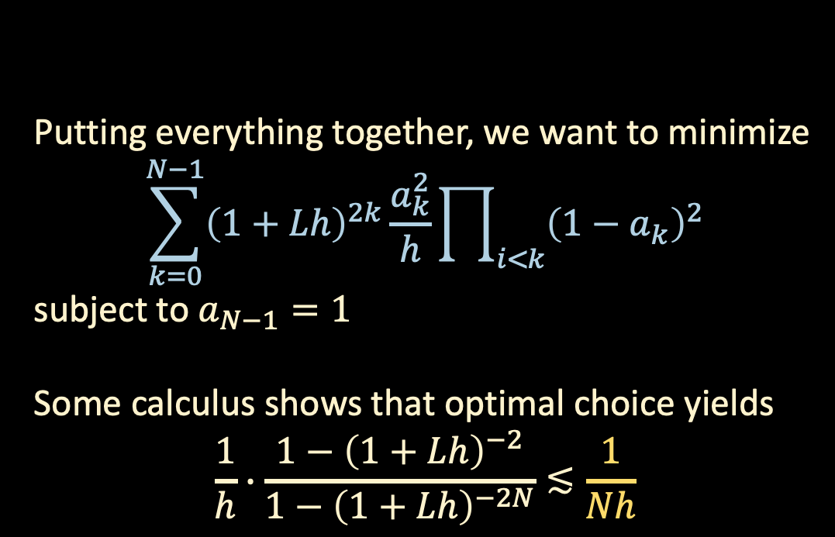
SHORT-TIME REGULARIZATION: PROOF SKETCH
Lemma (shifted chain rule for KL):
$$KL\left(p^{Y}∥q^{Y}\right)≤KL\left(p^{X^{′}}∥q^{X}\right)+𝔼_{\left(x,x^{′}\right)\sim p^{XX^{′}}}\left[KL\left(p^{Y|X=x}∥q^{Y|X=x^{′}}\right)\right]$$
for any coupling $p^{XX^{′}}$
By shifted chain rule,
$$KL\left(law X_{k+1}^{′}∥law Z_{k+1}\right)$$
$$≤KL\left(law X_{k}^{′}∥law Z_{k}\right)$$
$$+O\left(a_{k}^{2}/h\right)∙𝔼\left[{\left\|X_{k}−X_{k}^{′}\right\|}^{2}\right]$$
Note that
Putting everything together, we want to minimize
$$\sum_{k=0}^{N−1}{{\left(1+Lh\right)}^{2k}\frac{a_{k}^{2}}{h}\prod_{i<k}{{\left(1−a_{k}\right)}^{2}}}$$
subject to $a_{N−1}=1$
Some calculus shows that optimal choice yields
$$\frac{1}{h}∙\frac{1−{\left(1+Lh\right)}^{−2}}{1−{\left(1+Lh\right)}^{−2N}}≲\frac{1}{Nh}$$
$$𝔼\left[{\left\|X_{k}−X_{k}^{′}\right\|}^{2}\right]$$
$≤{\left(1+Lh\right)}^{2k}\prod_{i<k}{\left(1−a_{i}^{2}\right)} 𝔼\left[{\left\|x−z\right\|}^{2}\right]$

Slide 50
Finishing up discretization analysis for diffusions
Probability flow ODE, improved dimension dependence
Dropping the smoothness assumption

Slide 51
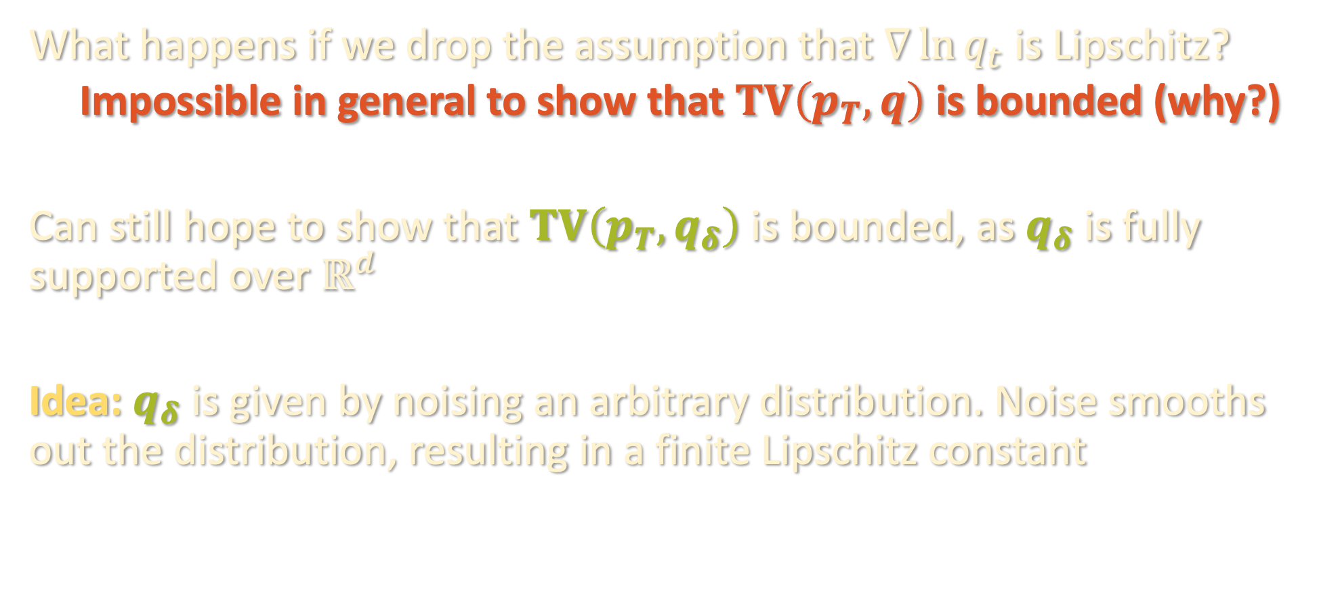
BEYOND SMOOTHNESS
What happens if we drop the assumption that $∇\ln{q_{t}}$ is Lipschitz?
  Impossible in general to show that $TV\left(p_{T},q\right)$ is bounded (why?)
Can still hope to show that $TV\left(p_{T},q_{δ}\right)$ is bounded, as $q_{δ}$ is fully supported over $ℝ^{d}$
Idea: $q_{δ}$ is given by noising an arbitrary distribution. Noise smooths out the distribution, resulting in a finite Lipschitz constant

Slide 52

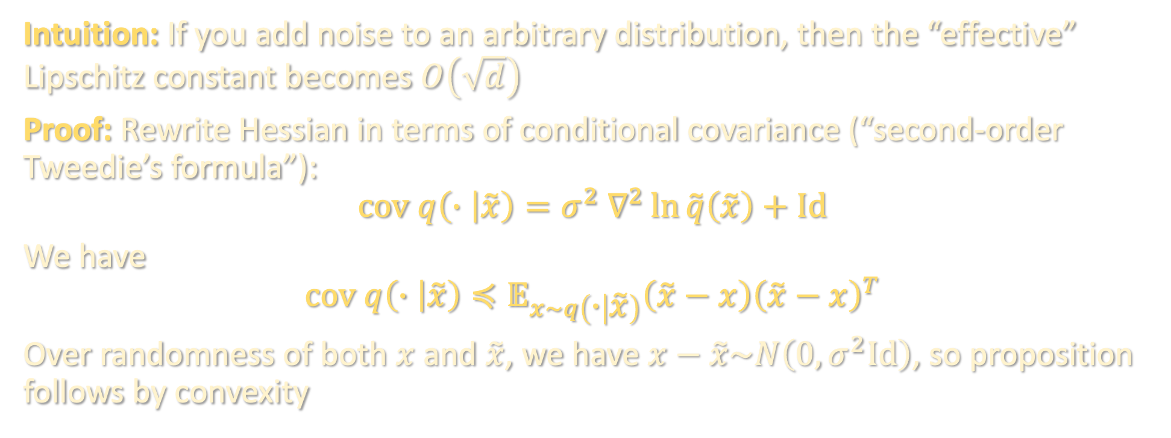
BEYOND SMOOTHNESS
Proposition [H.Chen-Lee-Lu ‘22]: For any $q$, if $\tilde{q}=q∗N\left(0,σ^{2}Id\right)$, then with high probability over $\tilde{x} \sim \tilde{q}$, ${\left\|∇^{2}\ln{\tilde{q}}\right\|}_{F}≲d/σ^{2}$
Intuition: If you add noise to an arbitrary distribution, then the “effective” Lipschitz constant becomes $O\left(\sqrt{d}\right)$
Proof: Rewrite Hessian in terms of conditional covariance (“second-order Tweedie’s formula”):
$$cov q\left(∙ | \tilde{x}\right)=σ^{2} ∇^{2}\ln{\tilde{q}\left(\tilde{x}\right)}+Id$$
We have
$$cov q\left(∙ | \tilde{x}\right)≼𝔼_{x\sim q\left(∙ | \tilde{x}\right)}\left(\tilde{x}−x\right){\left(\tilde{x}−x\right)}^{T}$$
Over randomness of both $x$ and $\tilde{x}$, we have $x−\tilde{x}\sim N\left(0,σ^{2}Id\right)$, so proposition follows by convexity

Slide 53
NEXT TIME
The theory in the last three lectures sheds light on why diffusion models are so effective in practice. But are they useful “in theory”?
In particular, how do we provably perform score estimation?
Final lecture: applying diffusions to obtain a state-of-the-art guarantee for learning Gaussian mixtures

