Slide 1

CS 2243: ALGORITHMS FOR DATA SCIENCE LECTURE 25 (12/4)
Tensor decomposition
Sum-of-squares
Supervised learning
Computational complexity
Statistical physics
Generative modeling
DIFFUSIONS MODELS AND MIXTURE MODELS

Slide 2
ANNOUNCEMENTS
12/20: Final project deadline, 2pm
Please fill out Q! Deadline 12/23

Slide 3
Learning Gaussian mixtures
Prior work, main results
Piecewise polynomial approximation
Clustering, score simplification
Empirical phenomena
Parting thoughts

Slide 4
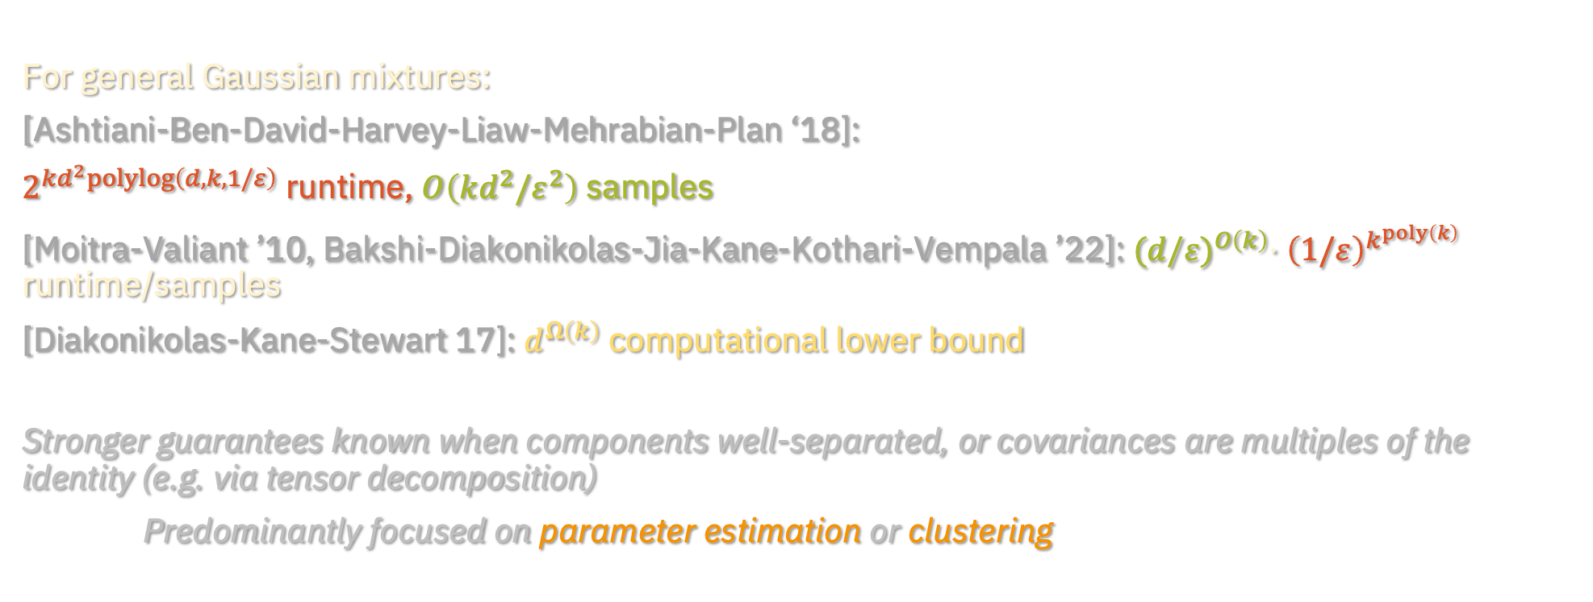
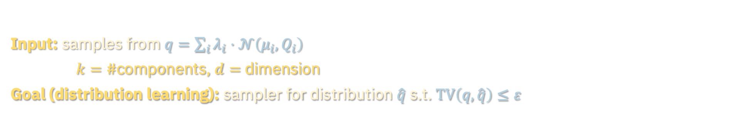
GAUSSIAN MIXTURES
Input: samples from $q=\sum_{i}{λ_{i}}⋅𝒩\left(μ_{i},Q_{i}\right)$
$k=\#$components, $d=$ dimension
Goal (distribution learning): sampler for distribution $\hat{q}$ s.t. $TV\left(q,\hat{q}\right)≤ε$
For general Gaussian mixtures:
[Ashtiani-Ben-David-Harvey-Liaw-Mehrabian-Plan ‘18]:
$2^{kd^{2}polylog\left(d,k,1/ε\right)}$ runtime, $O\left(kd^{2}/ε^{2}\right)$ samples
[Moitra-Valiant ’10, Bakshi-Diakonikolas-Jia-Kane-Kothari-Vempala ’22]: ${(d/ε)}^{O\left(k\right)}⋅{\left(1/ε\right)}^{k^{poly\left(k\right)}}$ runtime/samples
[Diakonikolas-Kane-Stewart 17]: $d^{Ω\left(k\right)}$ computational lower bound
Stronger guarantees known when components well-separated, or covariances are multiples of the identity (e.g. via tensor decomposition)
Predominantly focused on parameter estimation or clustering

Slide 5
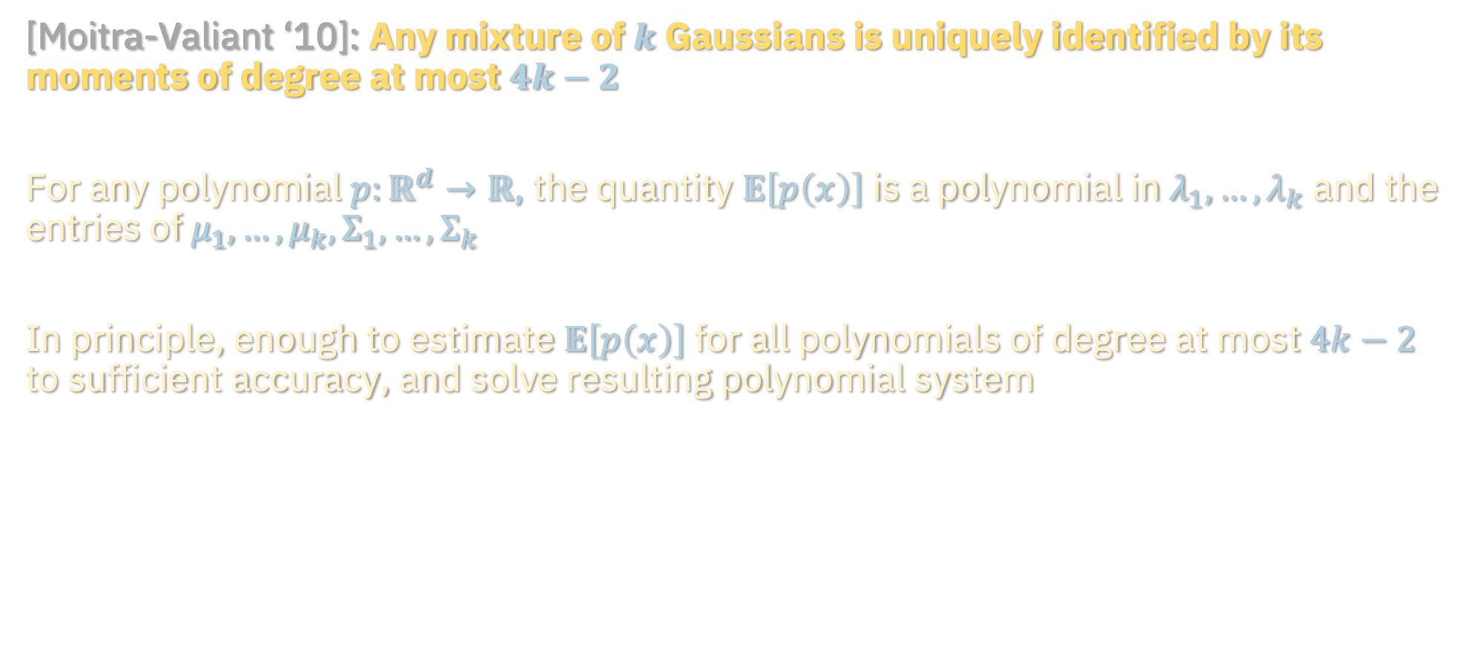
METHOD OF MOMENTS
[Moitra-Valiant ‘10]: Any mixture of $k$ Gaussians is uniquely identified by its moments of degree at most $4k−2$
For any polynomial $p:ℝ^{d}→ℝ$, the quantity $𝔼\left[p\left(x\right)\right]$ is a polynomial in $λ_{1},…,λ_{k}$ and the entries of $μ_{1},…,μ_{k},Σ_{1},…,Σ_{k}$
In principle, enough to estimate $𝔼\left[p\left(x\right)\right]$ for all polynomials of degree at most $4k−2$ to sufficient accuracy, and solve resulting polynomial system
how accurate do we need to be?

Slide 6
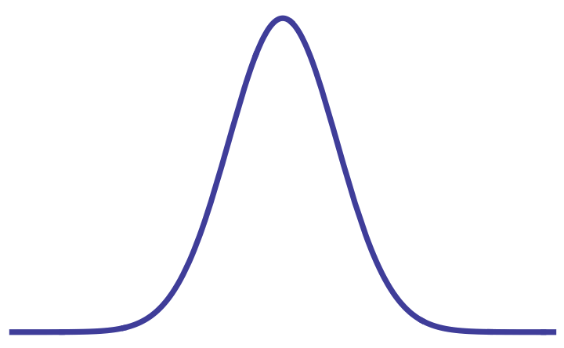


METHOD OF MOMENTS
For simplicity, suppose $d=1$ and all components have unit variance
If min separation $Δ=Ω\left(ε\right)$, suffices to
Estimate moments to error $ε^{Θ\left(k\right)}$
Brute-force over estimates ${\hat{μ}}_{1},…, {\hat{μ}}_{k}$ for the means to granularity $Θ(ε)$
Output estimates which match moments up to error $ε^{Θ\left(k\right)}$
$$Δ$$

Slide 7

METHOD OF MOMENTS
$$Δ$$
What if the min separation is arbitrarily small? Can’t brute-force to arbitrary granularity…
If some components are arbitrarily close together, they are close in TV to single component. Why not just “merge”?

Slide 8
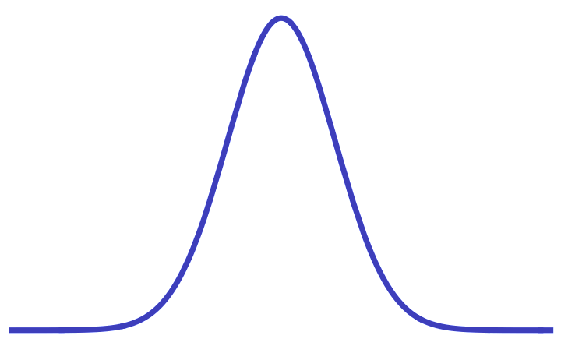
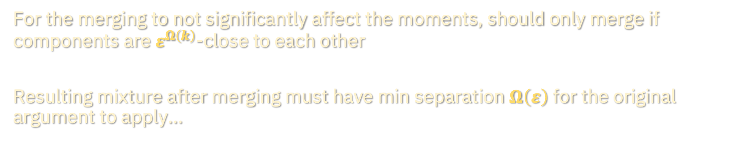
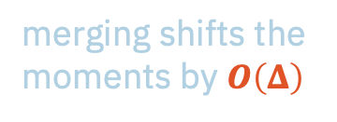
METHOD OF MOMENTS
merging shifts the moments by $O\left(Δ\right)$
For the merging to not significantly affect the moments, should only merge if components are $ε^{Ω\left(k\right)}$-close to each other
Resulting mixture after merging must have min separation $Ω\left(ε\right)$ for the original argument to apply…

Slide 9
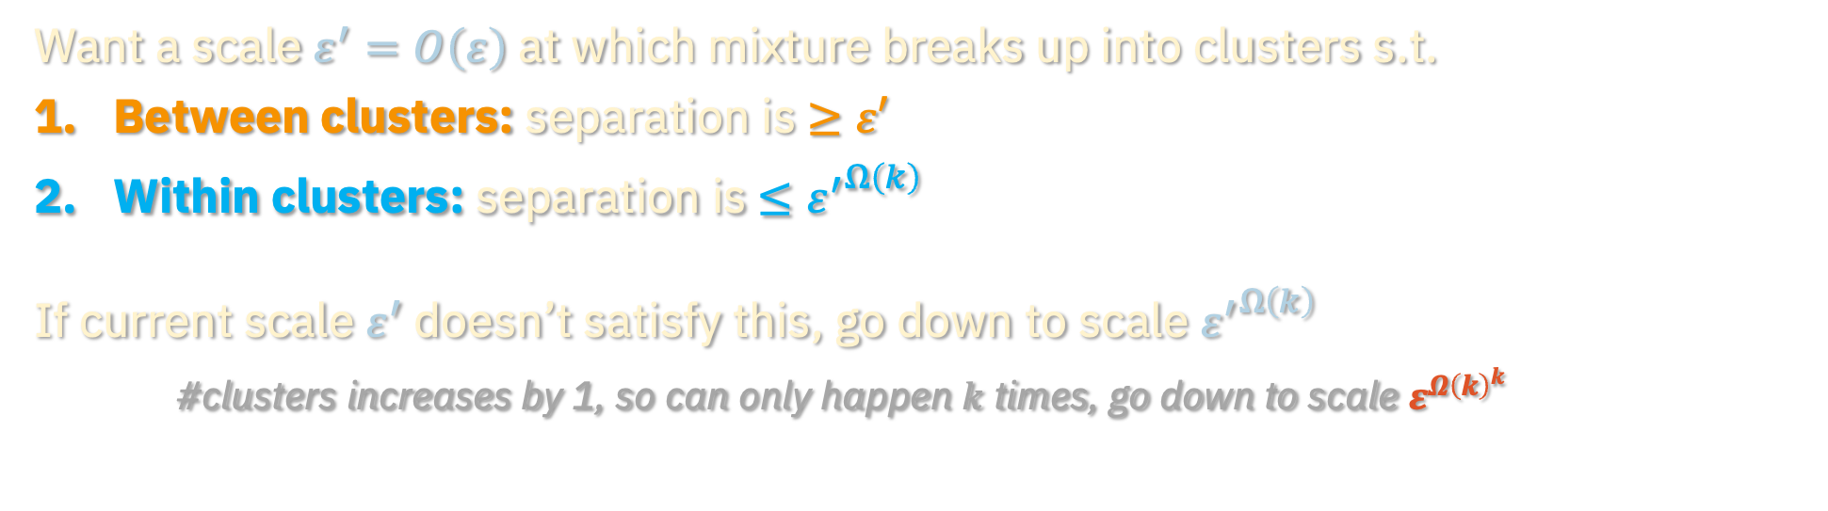
METHOD OF MOMENTS
Want a scale $ε^{′}=O\left(ε\right)$ at which mixture breaks up into clusters s.t.
Between clusters: separation is $≥ε′$
Within clusters: separation is $≤{ε^{′}}^{Ω\left(k\right)}$
If current scale $ε^{′}$doesn’t satisfy this, go down to scale ${ε^{′}}^{Ω\left(k\right)}$
#clusters increases by 1, so can only happen $k$ times, go down to scale $ε^{Ω{\left(k\right)}^{k}}$

Slide 10
METHOD OF MOMENTS
This doubly exponential bottleneck applies to all known applications of the method of moments to learning general Gaussian mixtures
An interpretation of this conundrum:
Method of moments intrinsically tied to parameter estimation and works well when parameters of the components are well-separated
From the perspective of sampling, unclear why any of these subtleties about separation should be relevant
In the absence of separation conditions, are there faster alternatives to the method of moments?

Slide 11
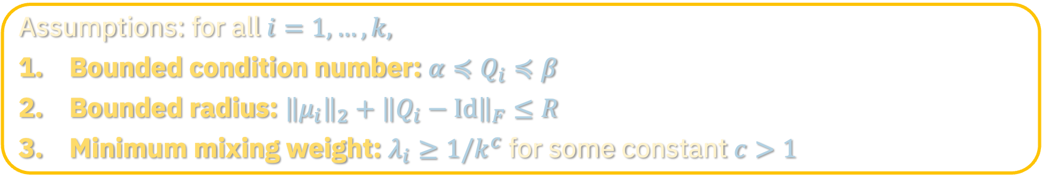
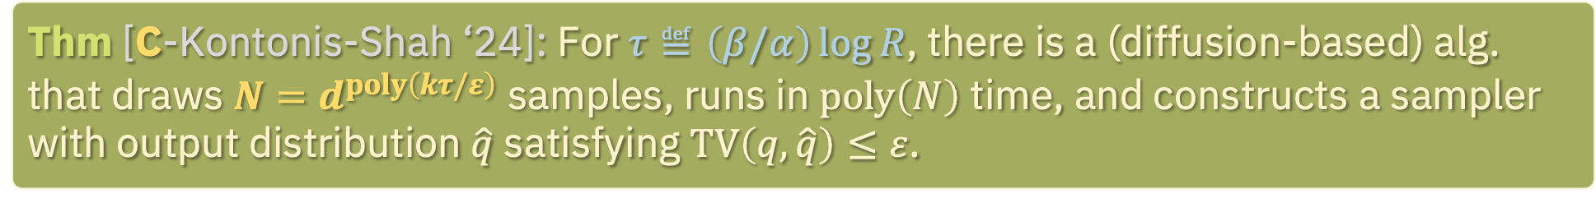
LEARNING WITH DIFFUSIONS
Thm [C-Kontonis-Shah ‘24]: For $τ≝\left(β/α\right)\log{R}$, there is a (diffusion-based) alg. that draws $N=d^{poly\left(kτ/ε\right)}$ samples, runs in $poly\left(N\right)$ time, and constructs a sampler with output distribution $\hat{q}$ satisfying $TV\left(q,\hat{q}\right)≤ε$.
Assumptions: for all $i=1,…,k,$
Bounded condition number: $α≼Q_{i}≼β$
Bounded radius: ${\left\|μ_{i}\right\|}_{2}+{\left\|Q_{i}−Id\right\|}_{F}≤R$
Minimum mixing weight: $λ_{i}≥1/k^{c}$ for some constant $c>1$
First example of a learning problem where diffusion-based algorithm outperforms the state-of-the-art approach [Bakshi et al. ‘22] in theory
For new algorithms based on diffusions in sampling contexts, c.f. [El Alaoui-Montanari-Sellke ‘22, 23], [Montanari-Wu ‘23], [Huang-Montanari-Pham ‘24]

Slide 12

PROOF IDEA
Diffusions give general reduction from distribution learning to supervised learning
Recipe for supervised learning:
Pick hypothesis class $𝓒$ for which ERM is computationally tractable
Argue that the score function of any Gaussian mixture is well-approximated by a function in $𝓒$
Generate training examples $\left(sample+noise, noise\right)$ and run ERM
Invoke standard generalization bounds
Natural/standard choice for $𝓒$ would be low-degree polynomials…
Doesn’t quite work and we will instead rely on piecewise polynomials

Slide 13
Learning Gaussian mixtures
Prior work, main results
Piecewise polynomial approximation
Clustering, score simplification
Empirical phenomena
Parting thoughts

Slide 14
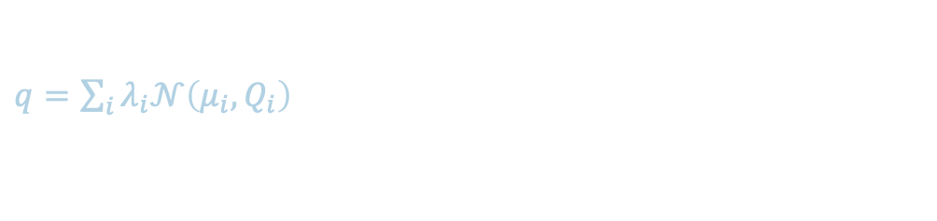
SCORE ESTIMATION FOR GAUSSIAN MIXTURES
$q=\sum_{i}{λ_{i}𝒩\left(μ_{i},Q_{i}\right)}$

Slide 15
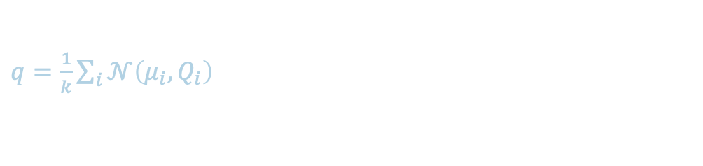
SCORE ESTIMATION FOR GAUSSIAN MIXTURES
$q=\frac{1}{k}\sum_{i}{𝒩\left(μ_{i},Q_{i}\right)}$
Score function:

Slide 16
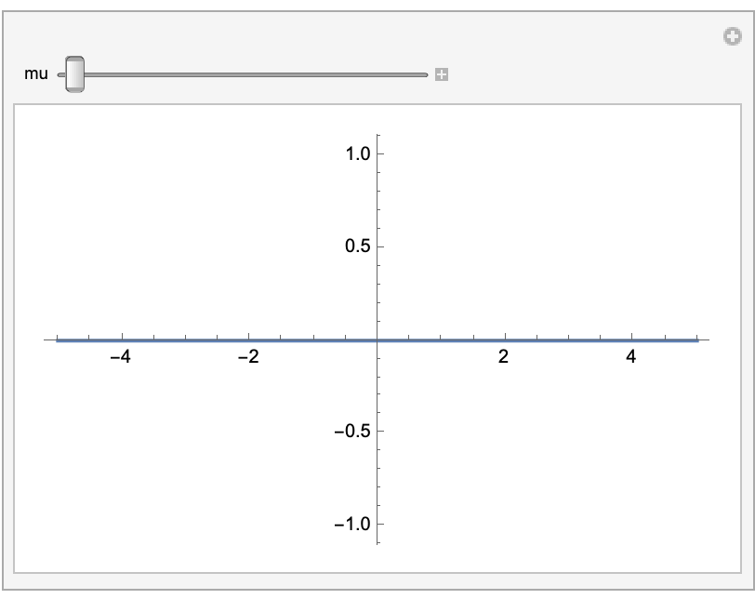
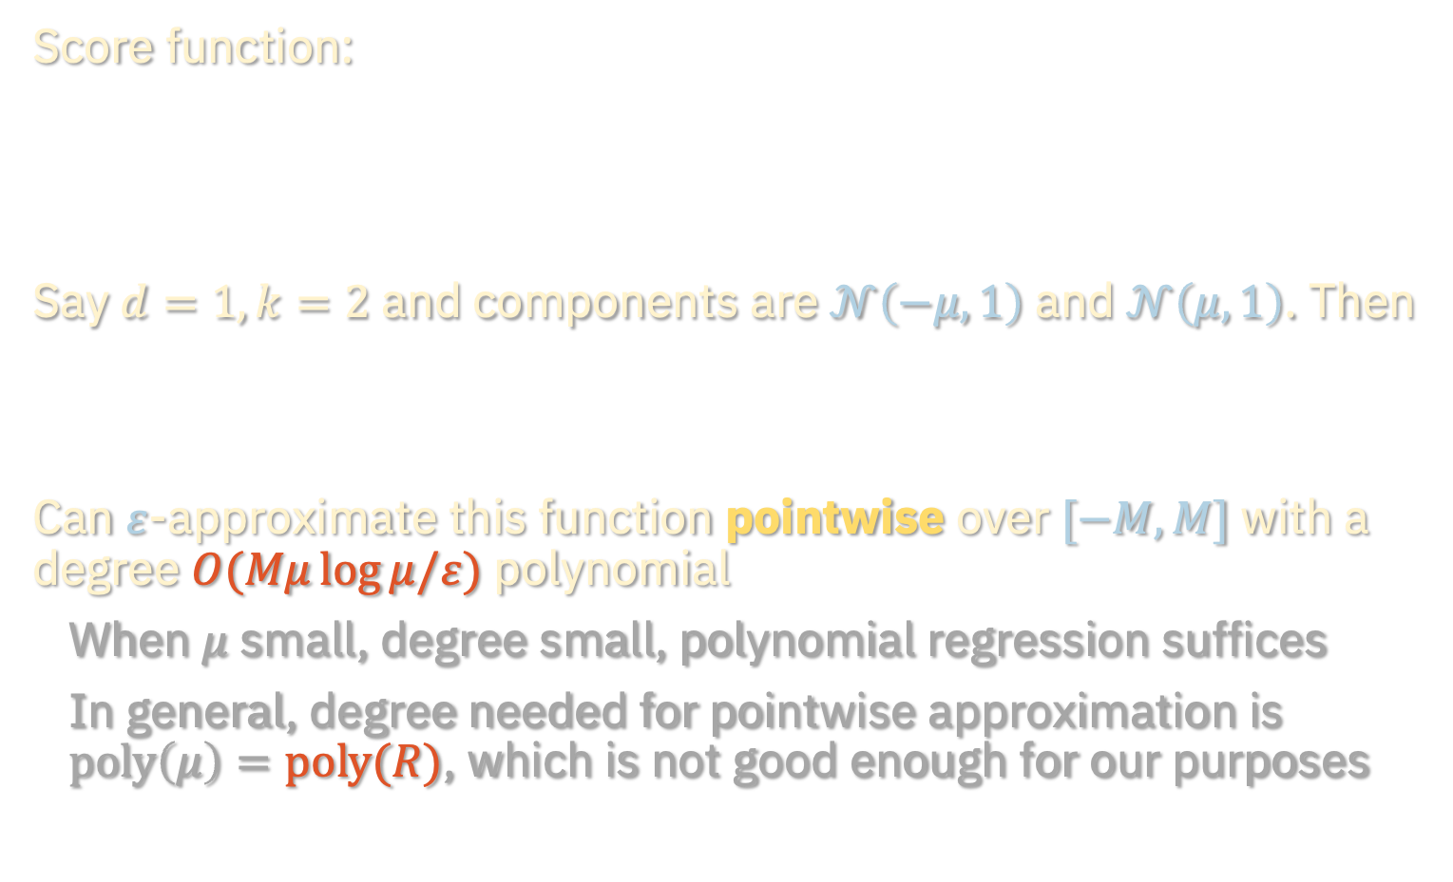
SCORE ESTIMATION FOR GAUSSIAN MIXTURES
$q=\frac{1}{k}\sum_{i}{𝒩\left(μ_{i},Q_{i}\right)}$
Score function:
Say $d=1,k=2$ and components are $𝒩\left(−μ,1\right)$ and $𝒩\left(μ,1\right)$. Then
$$∇\ln{q\left(x\right)}=\tanh\left(μ⋅x\right)μ−x$$
Can $ε$-approximate this function pointwise over $[−M,M]$ with a degree $O(Mμ\log{μ/ε})$ polynomial
When $μ$ small, degree small, polynomial regression suffices
In general, degree needed for pointwise approximation is $poly\left(μ\right)=poly(R)$, which is not good enough for our purposes
$$∇\ln{q\left(x\right)}=\tanh\left(μ⋅x\right)μ−x$$

Slide 17
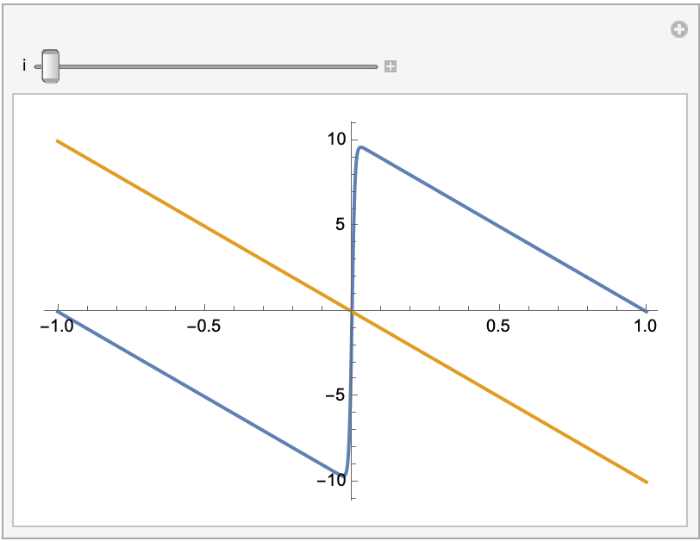
BEYOND $L_{∞}$ APPROXIMATION
$q=\frac{1}{k}\sum_{i}{𝒩\left(μ_{i},Q_{i}\right)}$
Score function:
Can’t pointwise-approximate step function with low-degree polynomial, but only need to approximate the step function over the “effective support”

Slide 18
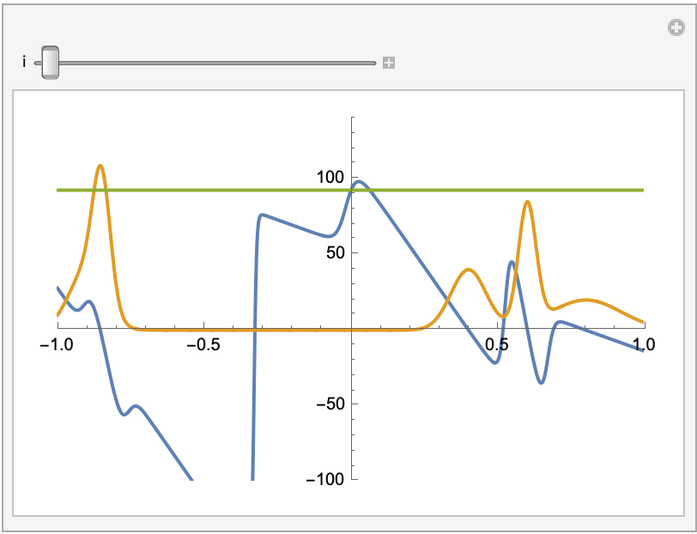
BEYOND $L_{∞}$ APPROXIMATION
$q=\frac{1}{k}\sum_{i}{𝒩\left(μ_{i},Q_{i}\right)}$
Score function:
…But for general mixtures, unclear if this is possible using a single polynomial
Issue: can’t think of components as compactly supported. “Race condition” between tail decay of components and growth of polynomial outside effective support

Slide 19
PIECEWISE POLYNOMIAL REGRESSION
$q=\frac{1}{k}\sum_{i}{𝒩\left(μ_{i},Q_{i}\right)}$
Score function:
Idea: when polynomial approximation is hard, clustering is easy
Instead of using a single polynomial, fit a different polynomial to each “cluster” of components

Slide 20

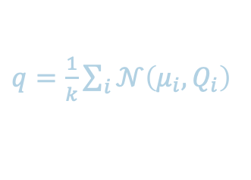
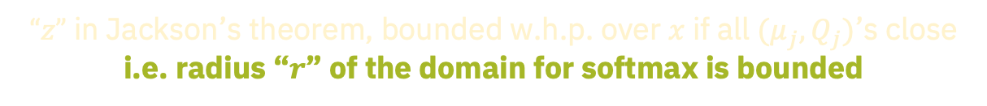
APPROXIMATION WITHIN A CLUSTER
$q=\frac{1}{k}\sum_{i}{𝒩\left(μ_{i},Q_{i}\right)}$
Multivariate Jackson’s theorem: For $F:ℝ^{m}→ℝ$ which is $L$-Lipschitz, for any $ℓ≥1$ there exists a polynomial $p_{ℓ}$ of degree $ℓ$ s.t.
$$\sup_{\left\|z\right\|≤r}\left|F\left(z\right)−p_{ℓ}\left(z\right)\right|≲rmL/ℓ$$
degree is polynomial in smoothness, radius of domain, and $1/$error
Implies that if all the components are close, the score function is well-approximated by a polynomial:
softmax is 1-Lipschitz
$“z”$ in Jackson’s theorem, bounded w.h.p. over $x$ if all $(μ_{j},Q_{j})$’s close
i.e. radius “$r$” of the domain for softmax is bounded

Slide 21

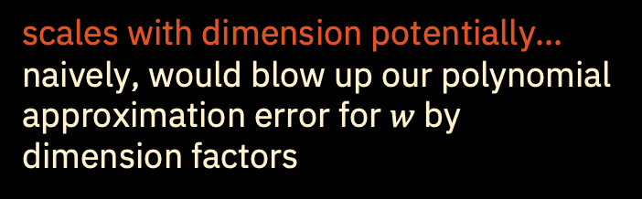
APPROXIMATION WITHIN A CLUSTER
$q=\frac{1}{k}\sum_{i}{𝒩\left(μ_{i},Q_{i}\right)}$
Multivariate Jackson’s theorem: For $F:ℝ^{m}→ℝ$ which is $L$-Lipschitz, for any $ℓ≥1$ there exists a polynomial $p_{ℓ}$ of degree $ℓ$ s.t.
$$\sup_{\left\|z\right\|≤r}\left|F\left(z\right)−p_{ℓ}\left(z\right)\right|≲rmL/ℓ$$
degree is polynomial in smoothness, radius of domain, and $1/$error
Implies that if all the components are close, the score function is well-approximated by a polynomial:
scales with dimension potentially…
naively, would blow up our polynomial approximation error for $w$ by dimension factors

Slide 22

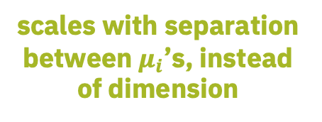
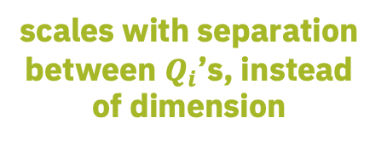
APPROXIMATION WITHIN A CLUSTER
$q=\frac{1}{k}\sum_{i}{𝒩\left(μ_{i},Q_{i}\right)}$
Multivariate Jackson’s theorem: For $F:ℝ^{m}→ℝ$ which is $L$-Lipschitz, for any $ℓ≥1$ there exists a polynomial $p_{ℓ}$ of degree $ℓ$ s.t.
$$\sup_{\left\|z\right\|≤r}\left|F\left(z\right)−p_{ℓ}\left(z\right)\right|≲rmL/ℓ$$
degree is polynomial in smoothness, radius of domain, and $1/$error
Implies that if all the components are close, the score function is well-approximated by a polynomial:
polynomially approximable
scales with separation between $Q_{i}$’s, instead of dimension
scales with separation between $μ_{i}$’s, instead of dimension
linear term

Slide 23
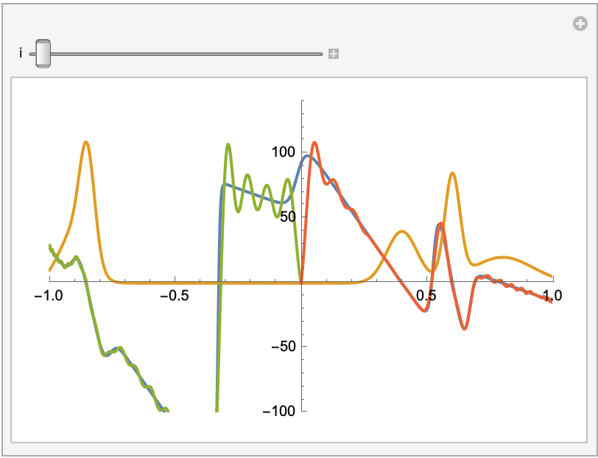
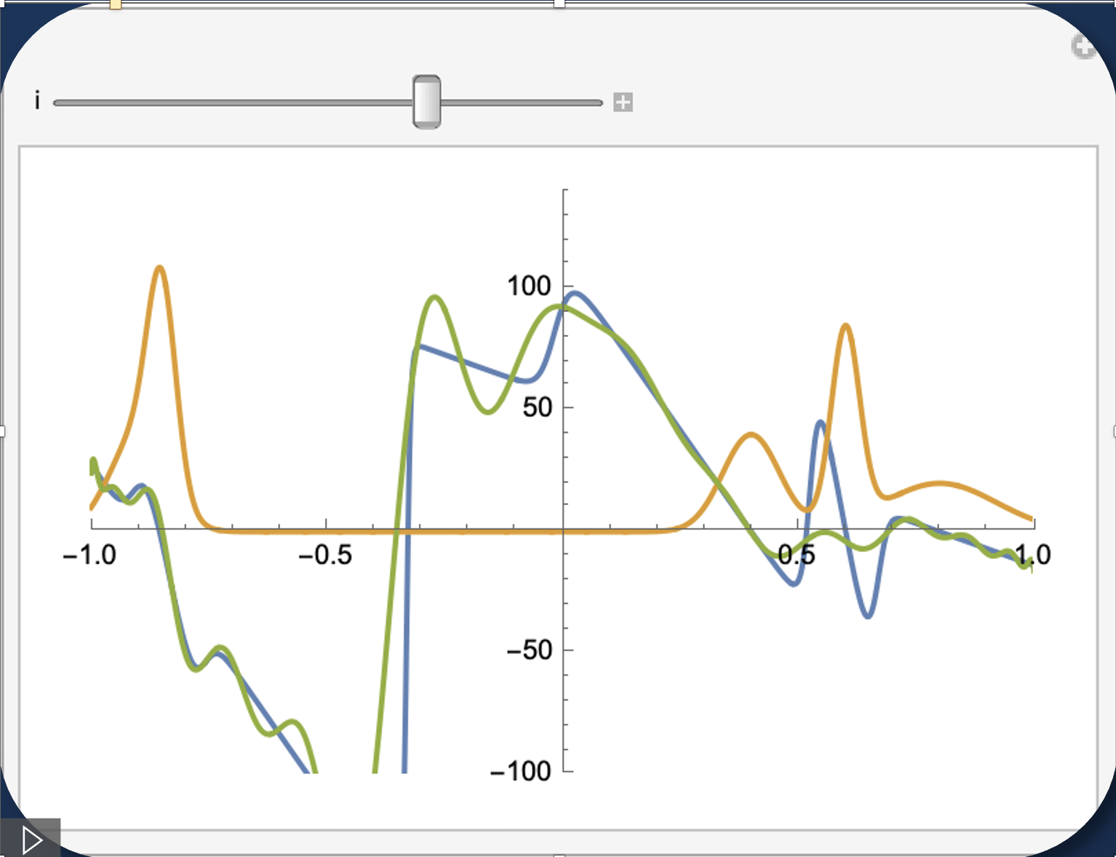
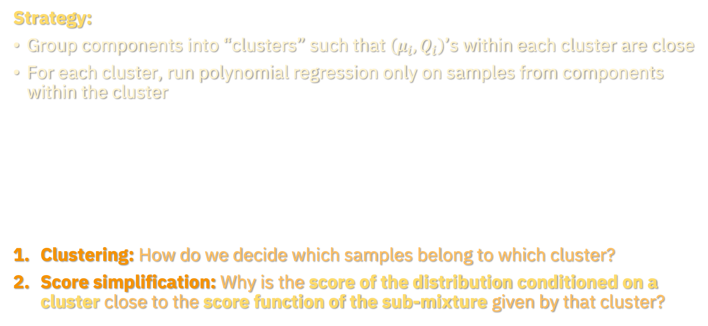
PIECEWISE APPROXIMATION
$q=\frac{1}{k}\sum_{i}{𝒩\left(μ_{i},Q_{i}\right)}$
Strategy:
Group components into “clusters” such that $\left(μ_{i},Q_{i}\right)$’s within each cluster are close
For each cluster, run polynomial regression only on samples from components within the cluster
Clustering: How do we decide which samples belong to which cluster?
Score simplification: Why is the score of the distribution conditioned on a cluster close to the score function of the sub-mixture given by that cluster?

Slide 24
Learning Gaussian mixtures
Prior work, main results
Piecewise polynomial approximation
Clustering, score simplification
Empirical phenomena
Parting thoughts

Slide 25
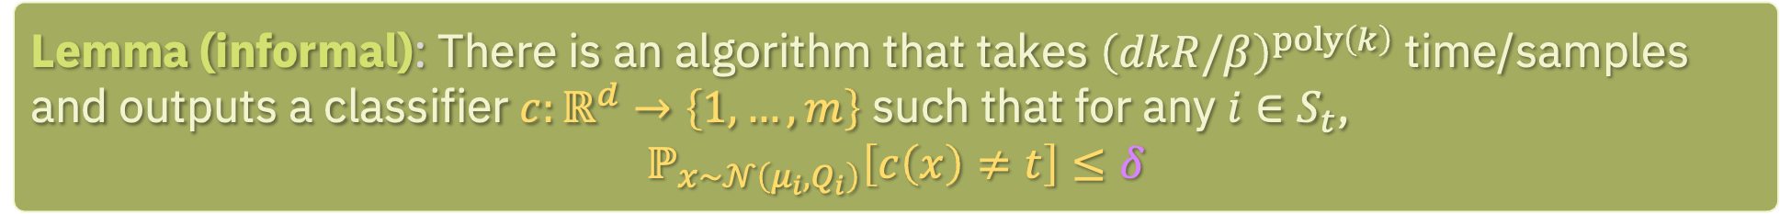
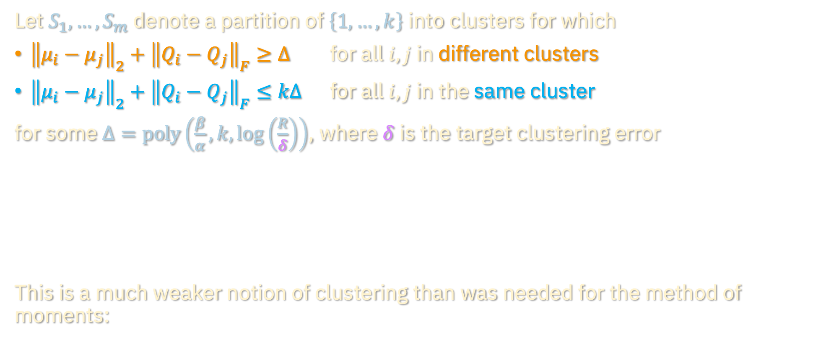
CLUSTERING
Let $S_{1},…,S_{m}$ denote a partition of $\left\{1,…,k\right\}$ into clusters for which
${\left\|μ_{i}−μ_{j}\right\|}_{2}+{\left\|Q_{i}−Q_{j}\right\|}_{F}≥Δ$ for all $i,j$ in different clusters
${\left\|μ_{i}−μ_{j}\right\|}_{2}+{\left\|Q_{i}−Q_{j}\right\|}_{F}≤kΔ$ for all $i,j$ in the same cluster
for some $Δ=poly\left(\frac{β}{α},k,\log\left(\frac{R}{δ}\right)\right)$, where $δ$ is the target clustering error
This is a much weaker notion of clustering than was needed for the method of moments:
Lemma (informal): There is an algorithm that takes ${\left(dkR/β\right)}^{poly\left(k\right)}$ time/samples and outputs a classifier $c:ℝ^{d}→\left\{1,…,m\right\}$ such that for any $i∈S_{t}$,
$$ℙ_{x\sim 𝒩\left(μ_{i},Q_{i}\right)}\left[c\left(x\right)≠t\right]≤δ$$

Slide 26
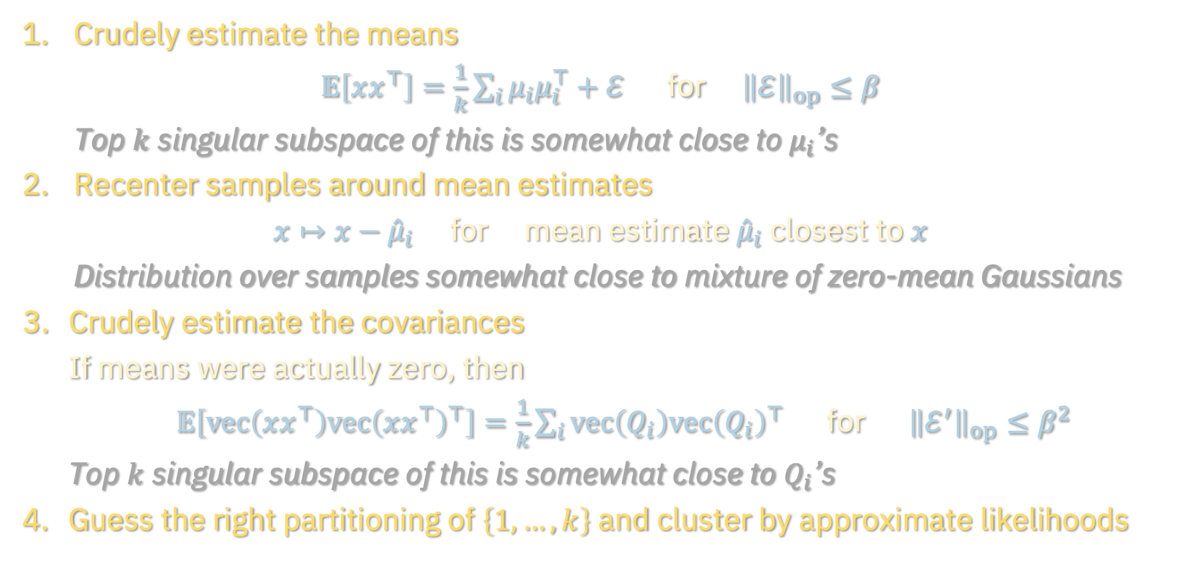
CLUSTERING
Crudely estimate the means
$𝔼\left[xx^{⊤}\right]=\frac{1}{k}\sum_{i}{μ_{i}μ_{i}^{⊤}}+ℰ$ for ${\left\|ℰ\right\|}_{op}≤β$
Top $k$ singular subspace of this is somewhat close to $μ_{i}$’s
Recenter samples around mean estimates
$x↦x−{\hat{μ}}_{i}$ for mean estimate ${\hat{μ}}_{i}$ closest to $x$
Distribution over samples somewhat close to mixture of zero-mean Gaussians
Crudely estimate the covariances
If means were actually zero, then
$𝔼\left[vec\left(xx^{⊤}\right)vec{\left(xx^{⊤}\right)}^{⊤}\right]=\frac{1}{k}\sum_{i}{vec\left(Q_{i}\right)vec{\left(Q_{i}\right)}^{⊤}}$ for ${\left\|ℰ^{′}\right\|}_{op}≤β^{2}$
Top $k$ singular subspace of this is somewhat close to $Q_{i}$’s
Guess the right partitioning of $\left\{1,…,k\right\}$ and cluster by approximate likelihoods

Slide 27
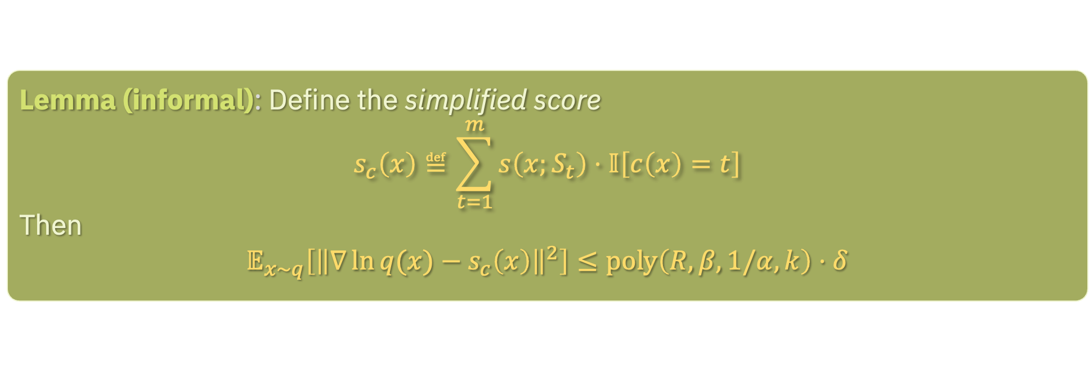

SCORE SIMPLIFICATION
Let $c:ℝ^{d}→\left\{1,…,m\right\}$ denote the classifier obtained from clustering
Let $s\left(x;S_{t}\right)$ denote the score of the sub-mixture $\frac{1}{\left|S_{t}\right|}\sum_{i∈S_{t}}{𝒩\left(μ_{i},Q_{i}\right)}$
For any cluster, components outside of cluster don’t contribute much to the score
Lemma (informal): Define the simplified score
$$s_{c}\left(x\right)≝\sum_{t=1}^{m}{s\left(x;S_{t}\right)⋅𝕀\left[c\left(x\right)=t\right]}$$
Then
$$𝔼_{x∼q}\left[{\left\|∇\ln{q(x)}−s_{c}\left(x\right)\right\|}^{2}\right]≤poly\left(R,β,1/α,k\right)⋅δ$$

Slide 28
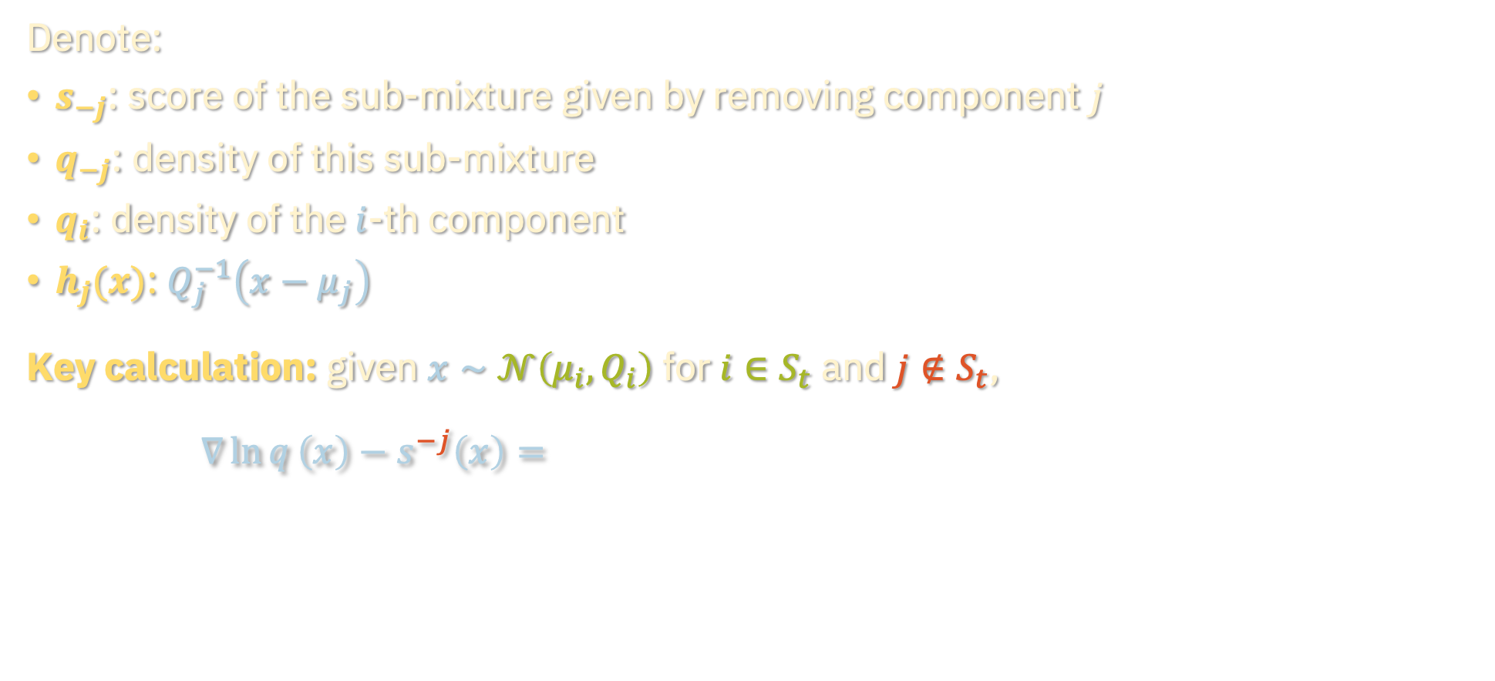
SCORE SIMPLIFICATION
Denote:
$s_{−j}$: score of the sub-mixture given by removing component $j$
$q_{−j}$: density of this sub-mixture
$q_{i}$: density of the $i$-th component
$h_{j}(x)$: $Q_{j}^{−1}\left(x−μ_{j}\right)$
Key calculation: given $x∼𝒩\left(μ_{i},Q_{i}\right)$ for $i∈S_{t}$ and $j∉S_{t}$,
$$∇\ln{q}\left(x\right)−s^{−j}\left(x\right)=−\frac{q_{j}\left(x\right)}{q\left(x\right)}⋅h_{j}\left(x\right)−\sum_{ℓ≠j}{\left(\frac{q_{ℓ}\left(x\right)}{q\left(x\right)}−\frac{q_{ℓ}\left(x\right)}{q_{−j}\left(x\right)}\right)⋅h_{ℓ}(x)}$$

Slide 29
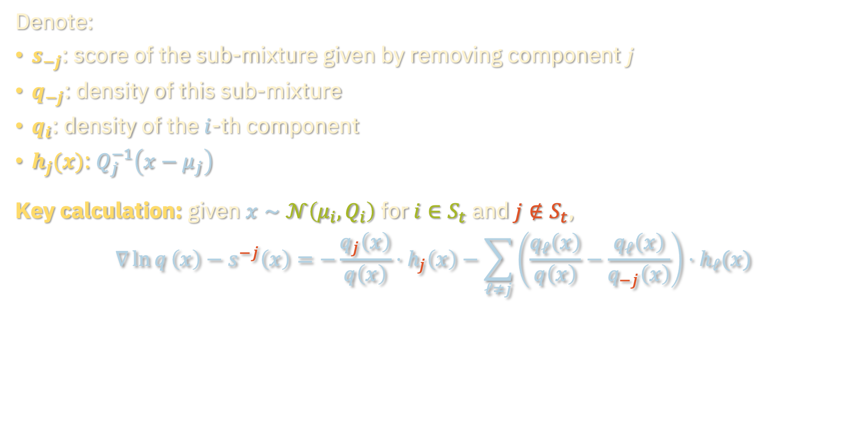
SCORE SIMPLIFICATION
Denote:
$s_{−j}$: score of the sub-mixture given by removing component $j$
$q_{−j}$: density of this sub-mixture
$q_{i}$: density of the $i$-th component
$h_{j}(x)$: $Q_{j}^{−1}\left(x−μ_{j}\right)$
Key calculation: given $x∼𝒩\left(μ_{i},Q_{i}\right)$ for $i∈S_{t}$ and $j∉S_{t}$,
$$∇\ln{q}\left(x\right)−s^{−j}\left(x\right)=−\frac{q_{j}\left(x\right)}{q\left(x\right)}⋅h_{j}\left(x\right)−\sum_{ℓ≠j}{\left(\frac{q_{ℓ}\left(x\right)}{q\left(x\right)}−\frac{q_{ℓ}\left(x\right)}{q_{−j}\left(x\right)}\right)⋅h_{ℓ}(x)}$$

Slide 30
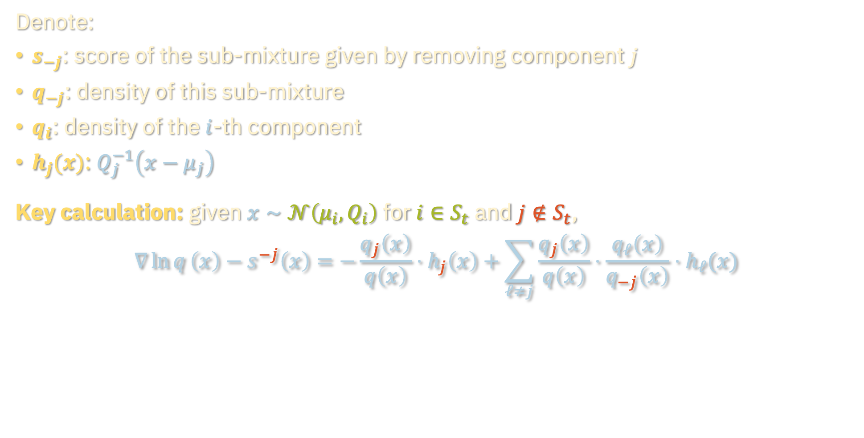
SCORE SIMPLIFICATION
Denote:
$s_{−j}$: score of the sub-mixture given by removing component $j$
$q_{−j}$: density of this sub-mixture
$q_{i}$: density of the $i$-th component
$h_{j}(x)$: $Q_{j}^{−1}\left(x−μ_{j}\right)$
Key calculation: given $x∼𝒩\left(μ_{i},Q_{i}\right)$ for $i∈S_{t}$ and $j∉S_{t}$,
$$∇\ln{q}\left(x\right)−s^{−j}\left(x\right)=−\frac{q_{j}\left(x\right)}{q\left(x\right)}⋅h_{j}\left(x\right)+\sum_{ℓ≠j}{\frac{q_{j}\left(x\right)}{q\left(x\right)}⋅\frac{q_{ℓ}\left(x\right)}{q_{−j}\left(x\right)}⋅h_{ℓ}(x)}$$

Slide 31
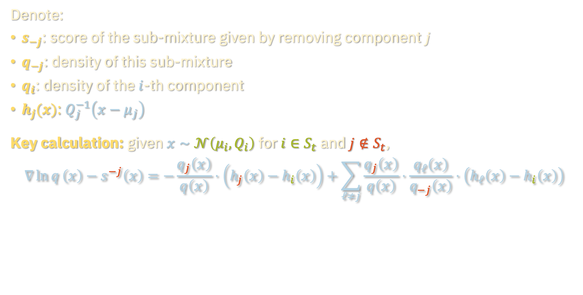
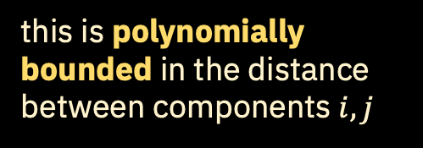
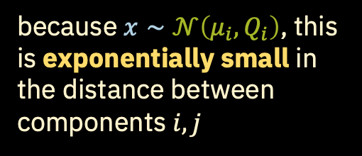
SCORE SIMPLIFICATION
Denote:
$s_{−j}$: score of the sub-mixture given by removing component $j$
$q_{−j}$: density of this sub-mixture
$q_{i}$: density of the $i$-th component
$h_{j}(x)$: $Q_{j}^{−1}\left(x−μ_{j}\right)$
Key calculation: given $x∼𝒩\left(μ_{i},Q_{i}\right)$ for $i∈S_{t}$ and $j∉S_{t}$,
$$∇\ln{q}\left(x\right)−s^{−j}\left(x\right)=−\frac{q_{j}\left(x\right)}{q\left(x\right)}⋅\left(h_{j}\left(x\right)−h_{i}\left(x\right)\right)+\sum_{ℓ≠j}{\frac{q_{j}\left(x\right)}{q\left(x\right)}⋅\frac{q_{ℓ}\left(x\right)}{q_{−j}\left(x\right)}⋅\left(h_{ℓ}\left(x\right)−h_{i}\left(x\right)\right)}$$
because $x∼𝒩\left(μ_{i},Q_{i}\right)$, this is exponentially small in the distance between components $i,j$
this is polynomially bounded in the distance between components $i,j$
can be handled similarly

Slide 32
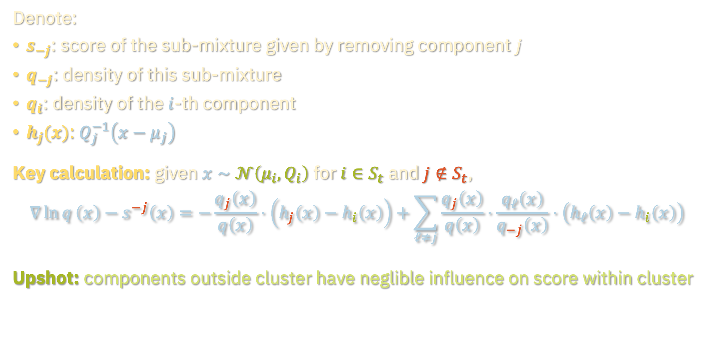
SCORE SIMPLIFICATION
Denote:
$s_{−j}$: score of the sub-mixture given by removing component $j$
$q_{−j}$: density of this sub-mixture
$q_{i}$: density of the $i$-th component
$h_{j}(x)$: $Q_{j}^{−1}\left(x−μ_{j}\right)$
Key calculation: given $x∼𝒩\left(μ_{i},Q_{i}\right)$ for $i∈S_{t}$ and $j∉S_{t}$,
$$∇\ln{q}\left(x\right)−s^{−j}\left(x\right)=−\frac{q_{j}\left(x\right)}{q\left(x\right)}⋅\left(h_{j}\left(x\right)−h_{i}\left(x\right)\right)+\sum_{ℓ≠j}{\frac{q_{j}\left(x\right)}{q\left(x\right)}⋅\frac{q_{ℓ}\left(x\right)}{q_{−j}\left(x\right)}⋅\left(h_{ℓ}\left(x\right)−h_{i}\left(x\right)\right)}$$
Upshot: components outside cluster have neglible influence on score within cluster

Slide 33
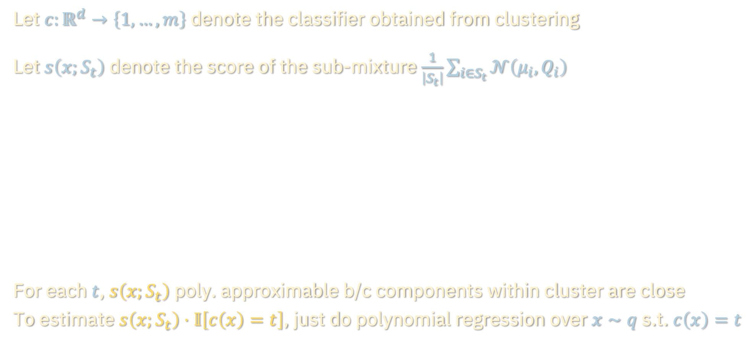
SCORE SIMPLIFICATION
Let $c:ℝ^{d}→\left\{1,…,m\right\}$ denote the classifier obtained from clustering
Let $s\left(x;S_{t}\right)$ denote the score of the sub-mixture $\frac{1}{\left|S_{t}\right|}\sum_{i∈S_{t}}{𝒩\left(μ_{i},Q_{i}\right)}$
For each $t$, $s\left(x;S_{t}\right)$ poly. approximable b/c components within cluster are close
To estimate $s\left(x;S_{t}\right)⋅𝕀\left[c\left(x\right)=t\right]$, just do polynomial regression over $x∼q$ s.t. $c\left(x\right)=t$
Lemma (informal): Define the simplified score
$$s_{c}\left(x\right)≝\sum_{t=1}^{m}{s\left(x;S_{t}\right)⋅𝕀\left[c\left(x\right)=t\right]}$$
Then
$$𝔼_{x∼q}\left[{\left\|∇\ln{q(x)}−s_{c}\left(x\right)\right\|}^{2}\right]≤poly\left(R,β,1/α,k\right)⋅δ$$

Slide 34

RECAP OF ALGORITHM
Score estimation (at each discrete noise level $t$):
Cluster the samples from $\sum_{i}{λ_{i}𝒩\left(e^{−t}μ_{i}, e^{−t}Q_{i}+\left(1−e^{−2t}\right)Id\right)}$
Run polynomial regression over each cluster
Assemble the polynomials into a piecewise polynomial score estimate
Sampling: run discretized reverse SDE starting from Gaussian noise, with score estimates given by the above at each discrete time step

Slide 35
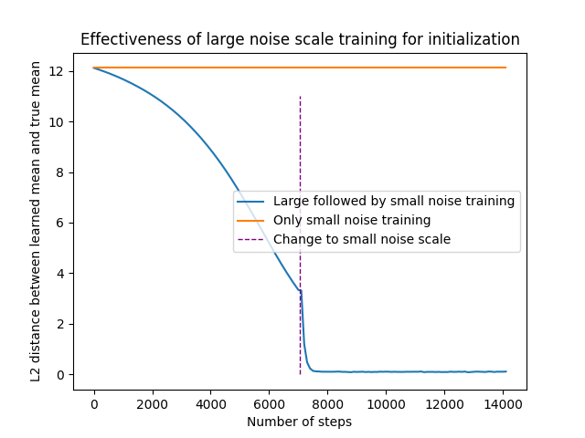
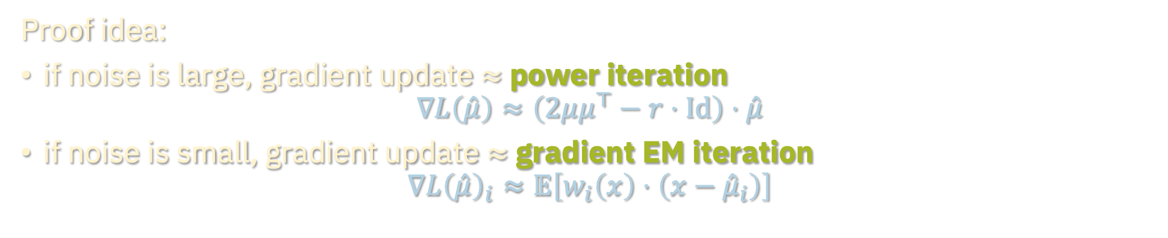

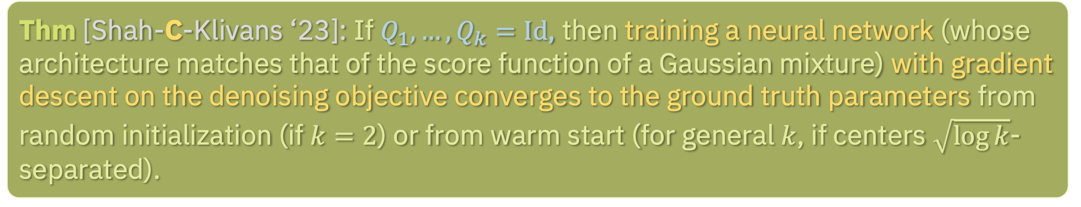

GRADIENT DESCENT FOR SCORE ESTIMATION
Thm [Shah-C-Klivans ‘23]: If $Q_{1},…,Q_{k}=Id$, then training a neural network (whose architecture matches that of the score function of a Gaussian mixture) with gradient descent on the denoising objective converges to the ground truth parameters from random initialization (if $k=2$) or from warm start (for general $k$, if centers $\sqrt{\log{k}}$-separated).
Proof idea:
if noise is large, gradient update $≈$ power iteration
$$∇L\left(\hat{μ}\right)≈\left(2μμ^{⊤}−r⋅Id\right)⋅\hat{μ}$$
if noise is small, gradient update $≈$ gradient EM iteration
$$∇L{\left(\hat{μ}\right)}_{i}≈𝔼\left[w_{i}\left(x\right)⋅\left(x−{\hat{μ}}_{i}\right)\right]$$
for $q=\frac{1}{2}𝒩\left(−μ,Id\right)+\frac{1}{2}𝒩\left(μ,Id\right)$
for general $k$
Learning Mixtures of Gaussians Using the DDPM Objective. NeurIPS 2023

Slide 36
Learning Gaussian mixtures
Prior work, main results
Piecewise polynomial approximation
Clustering, score simplification
Empirical phenomena
Parting thoughts

Slide 37


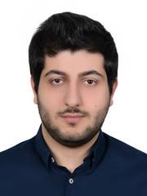
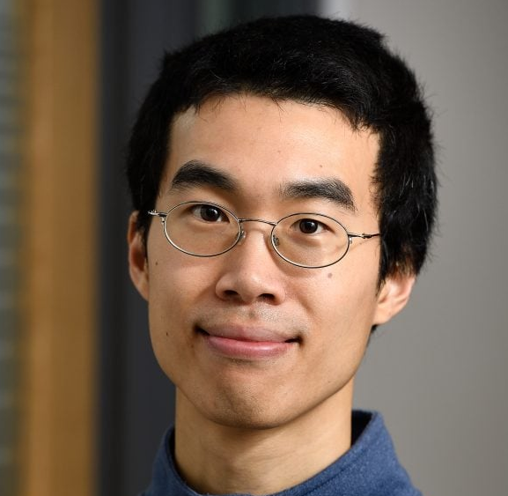
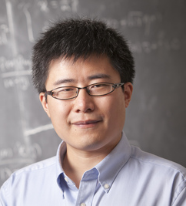
MIXTURE MODELS AS A MODEL ORGANISM
Natural way to capture heterogeneity in real-world data and turn a microscope to interesting empirical phenomena exhibited by diffusions
Two vignettes:
Features of images emerge in narrow windows of reverse process
Critical windows: non-asymptotic theory for feature emergence in diffusion models
joint with Marvin Li
ICML 2024
Characterizing the dynamics of diffusion guidance
What does guidance do? A fine-grained analysis in a simple setting
joint with Muthu Chidambaram, Khashayar Gatmiry, Holden Lee, Jianfeng Lu,
NeurIPS 2024

Slide 38
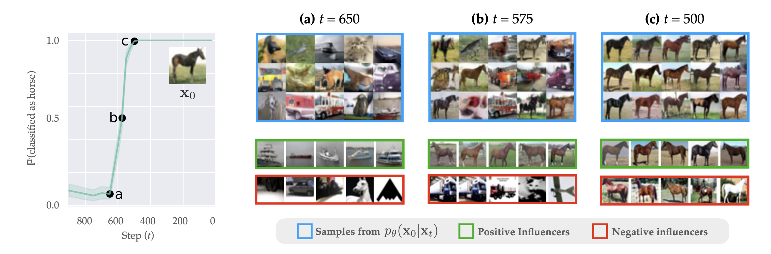
VIGNETTE 1: CRITICAL WINDOWS
In practice, it has been observed that diffusion models “decide” on crucial features of the generated output in a narrow window of times in the reverse process
[Georgiev et al. ’23]

Slide 39
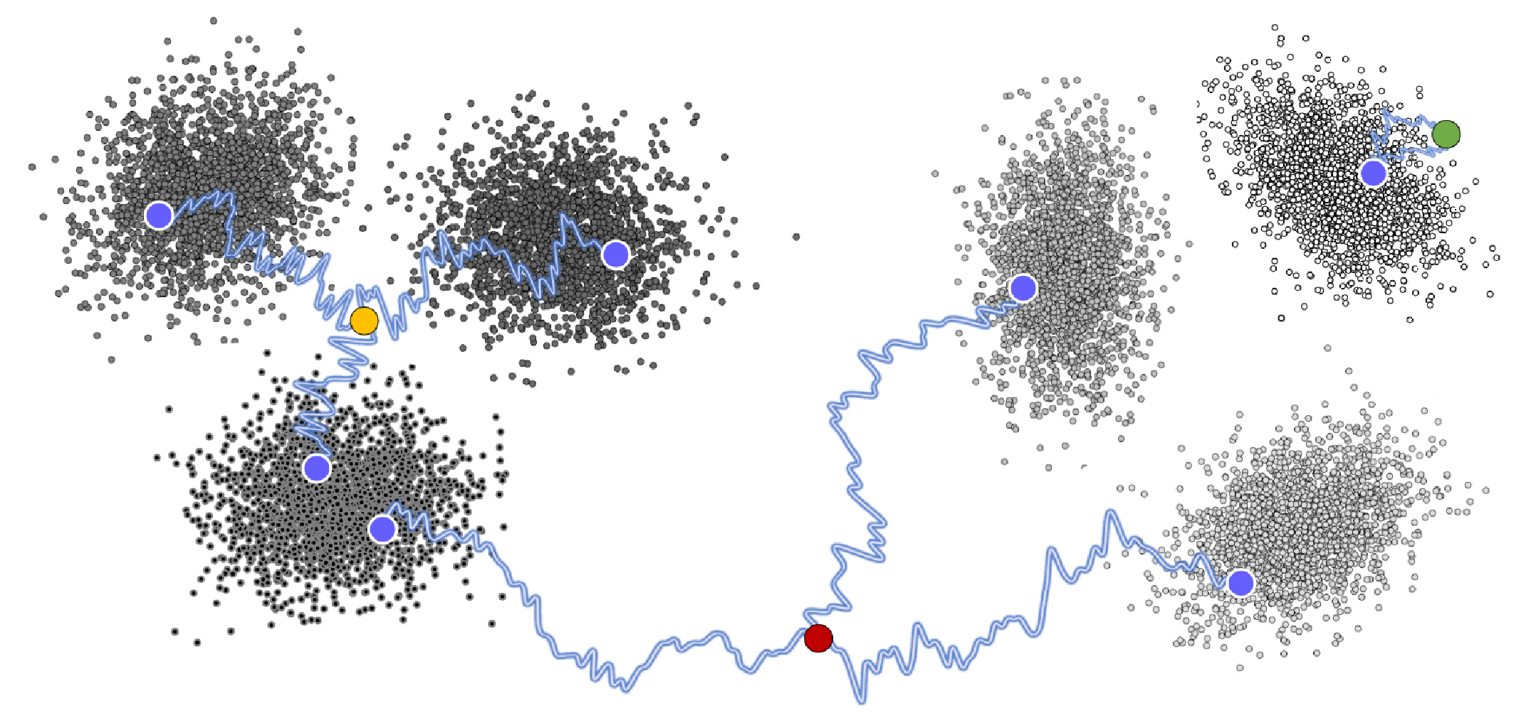


VIGNETTE 1: CRITICAL WINDOWS
In practice, it has been observed that diffusion models “decide” on crucial features of the generated output in a narrow window of times in the reverse process
We model the data distribution as a mixture $q=\sum_{i}{λ_{i}q_{i}}$, where sub-populations with a particular attribute correspond to sub-mixtures $q^{S}=\sum_{i∈S}{λ_{i}q_{i}}$
$q^{S}\left[t\right]$: dist. from running noise-denoise for time $t$ starting from sample from $q^{S}$
Noise-denoise experiment:
Starting with image $x_{0}$ with some attribute (e.g. “picture of horse”),
Run forward process for time $t$ to get $x_{t}$
Run reverse process from $x_{t}$ to get ${\tilde{x}}_{0}$
Q: How does $ℙ\left[x_{0},{\tilde{x}}_{0} share same attribute\right]$ depend on $t$?

Slide 40




VIGNETTE 1: CRITICAL WINDOWS
Thm [Li-C, ICML ’24, Li ‘24]: For subpopulations $S⊆T$ , let
$t_{0}=\inf\left\{t: TV\left(q_{t}^{S},q_{t}^{T}\right)≤ε\right\}$
$t_{1}=\sup{ \left\{t:TV\left(q_{t}^{T},q_{t}^{T^{c}}\right)≥1−ε^{2}\right\}}$
Then for any $t∈\left[t_{0},t_{1}\right]$,
$$TV\left(q^{S}\left[t\right],q^{T}\right)≲ε$$
minimal noise before $S,T$ indistinguishable
maximal noise before $T,T^{c}$ overlap
When components in mixture are well-separated and have “hierarchical structure” (e.g. components within same cluster closer than components in different clusters), windows are non-empty, can get explicit bounds
Also applies to autoregressive sampling and localization-based samplers more generally

Slide 41

VIGNETTE 2: DIFFUSION GUIDANCE
Guided generation: Given score functions for $q$, reward model $H,$ and parameter $β≥0$, sample from
$$\tilde{q}∝q∙e^{βH}$$
When $β=0$, this is just $q$
When $β=1$ and $H\left(x\right)=\ln{q\left(y | x\right)}$, this is just $q\left(x | y\right)$
In practice, want to take large $β$ to get high-quality images
A popular hack (“diffusion guidance”):
$$∇\ln{\tilde{q}}=∇\ln{q}+β∙∇H$$

Slide 42


VIGNETTE 2: DIFFUSION GUIDANCE
Guided generation: Given score functions for $q$, reward model $H,$ and parameter $β≥0$, sample from
$$\tilde{q}∝q∙e^{βH}$$
When $β=0$, this is just $q$
When $β=1$ and $H\left(x\right)=\ln{q\left(y | x\right)}$, this is just $q\left(x | y\right)$
In practice, want to take large $β$ to get high-quality images
A popular hack (“diffusion guidance”):
$$∇\ln{{\tilde{q}}_{t}}≈ ∇\ln{q_{t}}+β∙∇H$$
Issue: noise and “tilting” don’t commute!

Slide 43


VIGNETTE 2: DIFFUSION GUIDANCE
Suppose $q$ is a mixture of uniform distributions over disjoint intervals $\left[−b,−a\right], [a,b]$
If $H\left(x\right)=𝕀\left[x∈right interval\right]$, then $\tilde{q}=Unif(right interval)$ for all $β>0$…
What does guidance sample from?
Thm [Chidambaram-Gatmiry-C-Lee-Lu, NeurIPS ’24]: With probability $1−e^{−Ω(β)}$, the probability flow ODE with guidance parameter $β$ samples from a distribution supported on the interval
$$[b\left(1−O\left(1/\sqrt{\ln{w}}\right),b\right]$$

Slide 44


VIGNETTE 2: DIFFUSION GUIDANCE
Dynamics of diffusion guidance breaks down into two phases:
Particle travels towards rightmost edge of $\left[a,b\right]$ and swings past
Near end of the process, velocity field exerts negative push to guide particle back to the support (little movement at this stage)

Slide 45

VIGNETTE 2: DIFFUSION GUIDANCE
Dynamics of diffusion guidance breaks down into two phases:
Particle travels towards rightmost edge of $\left[a,b\right]$ and swings past
Near end of the process, velocity field exerts negative push to guide particle back to the support (little movement at this stage)
Elucidates two empirical findings:
When $β$ is large, generations are low-diversity and archetypal
When $β$ is too large, image quality degrades
Sampler is forced to swing far off the data manifold, where score estimation is high

Slide 46
Learning Gaussian mixtures
Prior work, main results
Piecewise polynomial approximation
Clustering, score simplification
Empirical phenomena
Parting thoughts

Slide 47
BEYOND CS 2243
Differential privacy (Vadhan, Dwork, Neel): https://privacytools.seas.harvard.edu/classes
Algorithmic fairness (CS 226r, Dwork)
More on deep learning (CS 229br, Barak)
Online / reinforcement learning (CS 184, Janson)
More on optimization (AM 121, Y. Chen; ENG-SCI 257, Yang)
Economics and ML (CS 236r, Y. Chen)
Causal inference (https://datascience.harvard.edu/programs/causal-inference/)
Control theory (AM 232, Li)
Sampling / MCMC (CS 291, Sellke)

Slide 48

LOOKING BACK: ALGORITHMIC QUESTIONS
Distribution learning
“Given samples from $q$, estimate $q$”
Supervised learning
“Given labeled examples generated by $F$, estimate $F$”
Robust versions thereof
“If an $η$-fraction of the data is adversarially corrupted, …”
Bayesian inference
”Given noisy observation $Y$ of signal $X$, recover $X$ as best as possible”

Slide 49
LOOKING BACK: UPPER BOUNDS
“Moment”/polynomial-based methods
Polynomial regression: what linearized neural networks are implicitly doing
Tensor decomposition
Sum-of-squares: “programming language”, useful for exploiting moments of data distribution in principled way
”Optimal” in the sense that they often saturate CSQ / SQ lower bounds
…but not the end of the story (e.g. filtered PCA)

Slide 50
LOOKING BACK: UPPER BOUNDS
Most things in life are some form of nonconvex optimization
Practitioner’s method of choice, often hard to analyze in theory
Many algos in class are implicitly performing nonconvex optimization:
Tensor power method
Belief propagation / AMP
Sum-of-squares relaxations
Conversely, gradient descent sometimes secretly mimics “theory” algos:
NTK is just doing kernel regression
SGD for learning single index models is just finding nontrivial Hermite coefficient
Score estimation for learning mixtures of Gaussians is doing power method / EM
Asymptotic methods (mean-field, state evolution) for getting sharp predictions

Slide 51
LOOKING BACK: LOWER BOUNDS
Traditional reduction-based hardness is hard to prove because we want to preserve the “average-case” nature of the instance
An exception from class: cryptographic reductions for continuous problems
CLWE (continuous learning with errors)
In lieu of reductions, in ML theory we often try prove failure of families of popular / conjecturally optimal algorithms
“Easier” because there are standard “recipes”, e.g. statistical query dimension, statistical dimension
Recipes often based on failure of specific algorithms (e.g. method of moments / random projections), suggesting these techniques are “optimal”
Statistical query (SQ) and correlational statistical query (CSQ) algorithms (CS style)
Failure of belief propagation / AMP (physics style)

Slide 52
LOOKING BACK: MODELING
We largely focused on the “realizable” / “student-teacher” setting
Self-contained testbed over which we know for certain that algorithms in practice succeed – we just don’t know why and, for the time being, just want to find some algorithm that we can prove succeeds
Beyond worst case: problem instances in practice are not fully adversarial
Smoothed analysis: model this by considering adversarial instances that have been slightly perturbed by noise
Robustness
Can be subtle picking right corruption model: RCN -> Massart -> agnostic
Modeling data as adversarially corrupted can be useful even in the absence of an adversary (e.g. semirandom noise)

Slide 53
LOOKING AHEAD: MODELING
In the diffusions unit we saw a glimpse of another approach: oracle reductions
Instead of trying to fully understand a deep learning system (e.g. diffusion models), break it into modular parts (e.g. score estimation + sampling) and prove one component works well assuming the other works somewhat well
In lieu of “end-to-end” guarantees, can we obtain other nontrivial reductions between different learning tasks?
(as usual, need to be careful how the reductions transform the relevant input distributions)

Slide 54
LOOKING AHEAD
This area is still incredibly young, and this course may look very different in 5-10 years (e.g. last unit already revamped from last year)
As theorists, we are unbelievably fortunate to be living in a time where the practice of machine learning is constantly offering tantalizing mathematical mysteries waiting to be understood rigorously
I hope many of you will contribute to understanding these mysteries!

