Slide 1

CS 2243: ALGORITHMS FOR DATA SCIENCE
LECTURE 2 (9/9)
Tensor decomposition
Sum-of-squares
Supervised learning
Computational complexity
Statistical physics
Generative modeling
TENSORS, JENNRICH’S ALGORITHM, APPLICATIONS

Slide 2
ANNOUNCEMENTS
Pset 1 out tonight on Gradescope, due Friday Sep 20 11:59pm​
Office hours posted on course page
Scribing: check “scribe” folder in course Overleaf
Talk announcements:
  Nataniel Ruiz (DreamBooth): Tuesday 9/10, SEC 2.122 & 2.123
  Avi Wigderson (IAS, Turing Award, Abel Prize): Friday 9/13, SEC 1.321

Slide 3
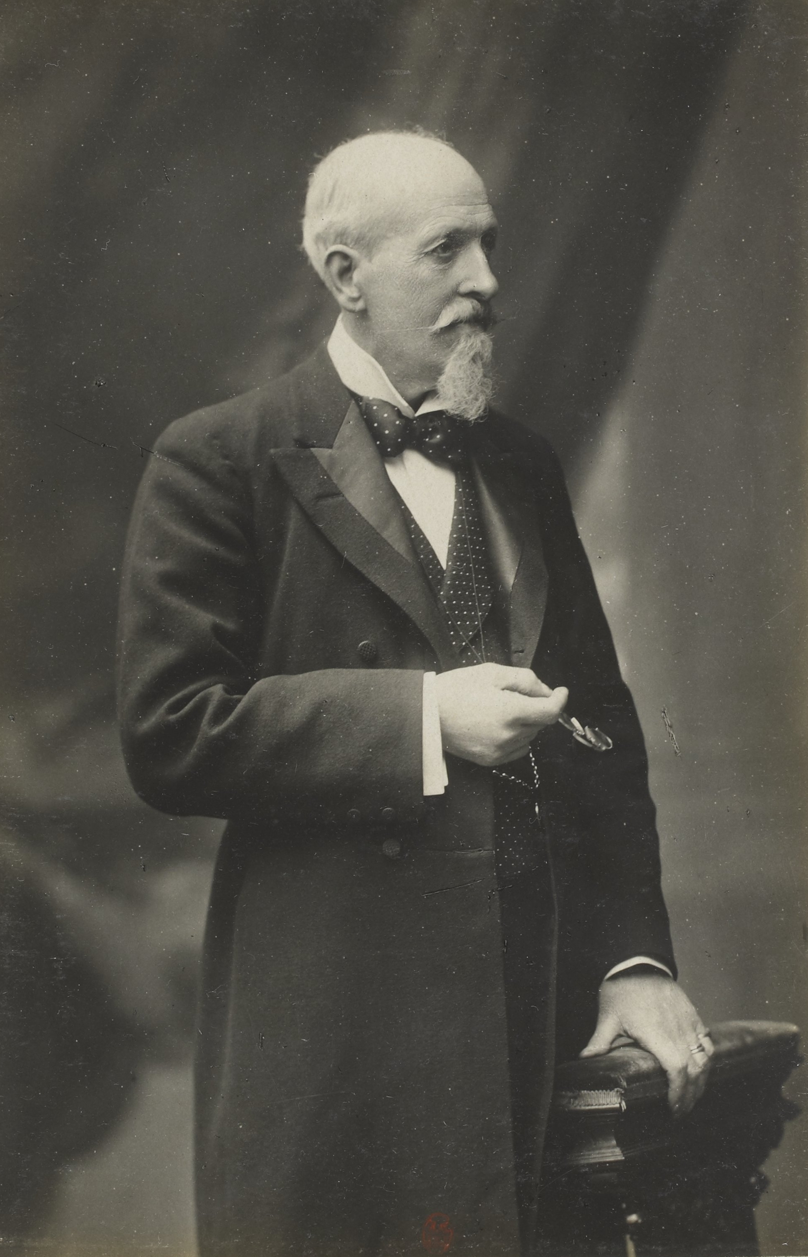






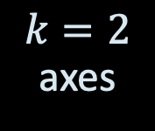





SOME HISTORY
Charles Spearman (1863-1945): posited there are two types of intelligence --- “mathematical” and “verbal”
$k=2$ axes
$m$ tests
$$M$$
$$U$$
$$×$$
$$V^{⊤}$$
$$(0.4,0.5)$$
$n$ students
$$≈$$
$$(1.7,1.3)$$

Slide 4
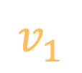

SOME HISTORY
Charles Spearman (1863-1945): posited there are two types of intelligence --- “mathematical” and “verbal”
$k=2$ axes
$m$ tests
$$v_{1}$$
$$M$$
$$U$$
$$×$$
$$V^{⊤}$$
$n$ students
$$≈$$
$$u_{1}$$

Slide 5


SOME HISTORY
Charles Spearman (1863-1945): posited there are two types of intelligence --- “mathematical” and “verbal”
$k=2$ axes
$m$ tests
$$M$$
$$U$$
$$×$$
$$V^{⊤}$$
$$v_{2}$$
$n$ students
$$≈$$
$$u_{2}$$

Slide 6
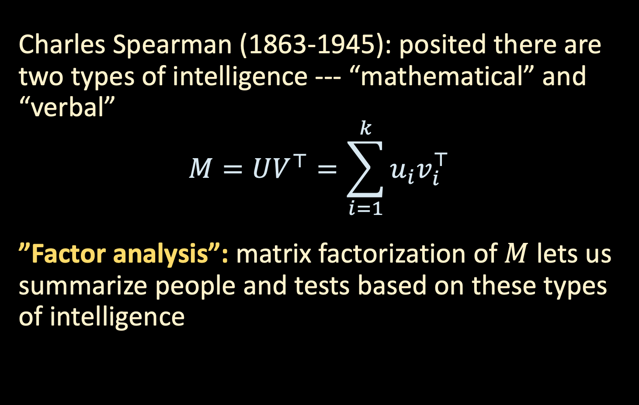
SOME HISTORY
Charles Spearman (1863-1945): posited there are two types of intelligence --- “mathematical” and “verbal”
$$M=UV^{⊤}=\sum_{i=1}^{k}{u_{i}v_{i}^{⊤}}$$
”Factor analysis”: matrix factorization of $M$ lets us summarize people and tests based on these types of intelligence

Slide 7
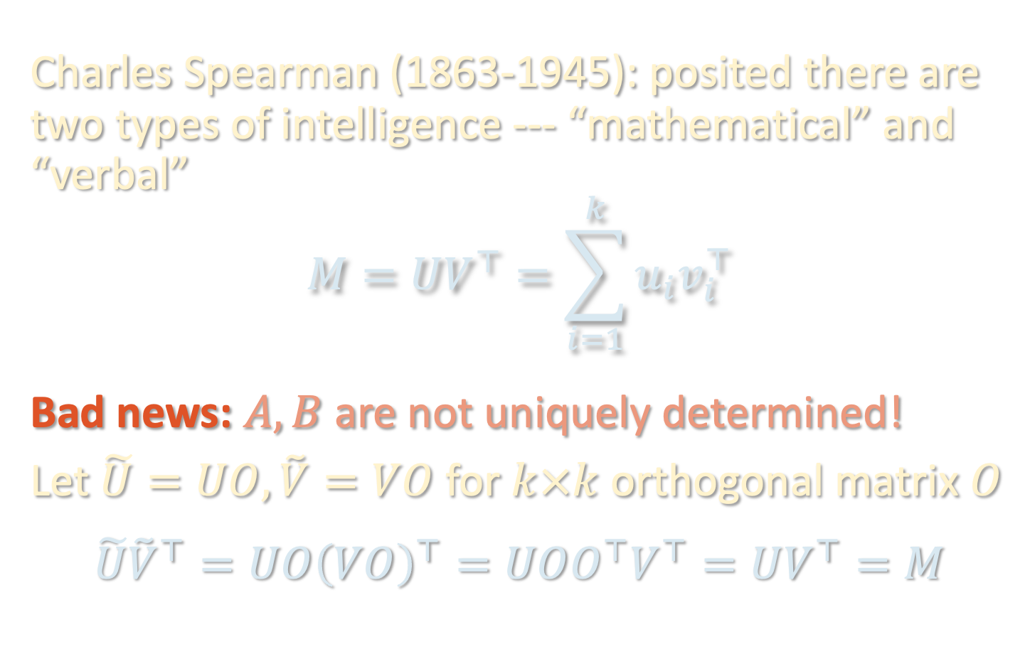
SOME HISTORY
Charles Spearman (1863-1945): posited there are two types of intelligence --- “mathematical” and “verbal”
$$M=UV^{⊤}=\sum_{i=1}^{k}{u_{i}v_{i}^{⊤}}$$
Bad news: $A, B$ are not uniquely determined!
Let $\tilde{U}=UO, \tilde{V}=VO$ for $k×k$ orthogonal matrix $O$
$$\tilde{U}{\tilde{V}}^{⊤}=UO{\left(VO\right)}^{⊤}=UOO^{⊤}V^{⊤}=UV^{⊤}=M$$
“Rotation problem”

Slide 8
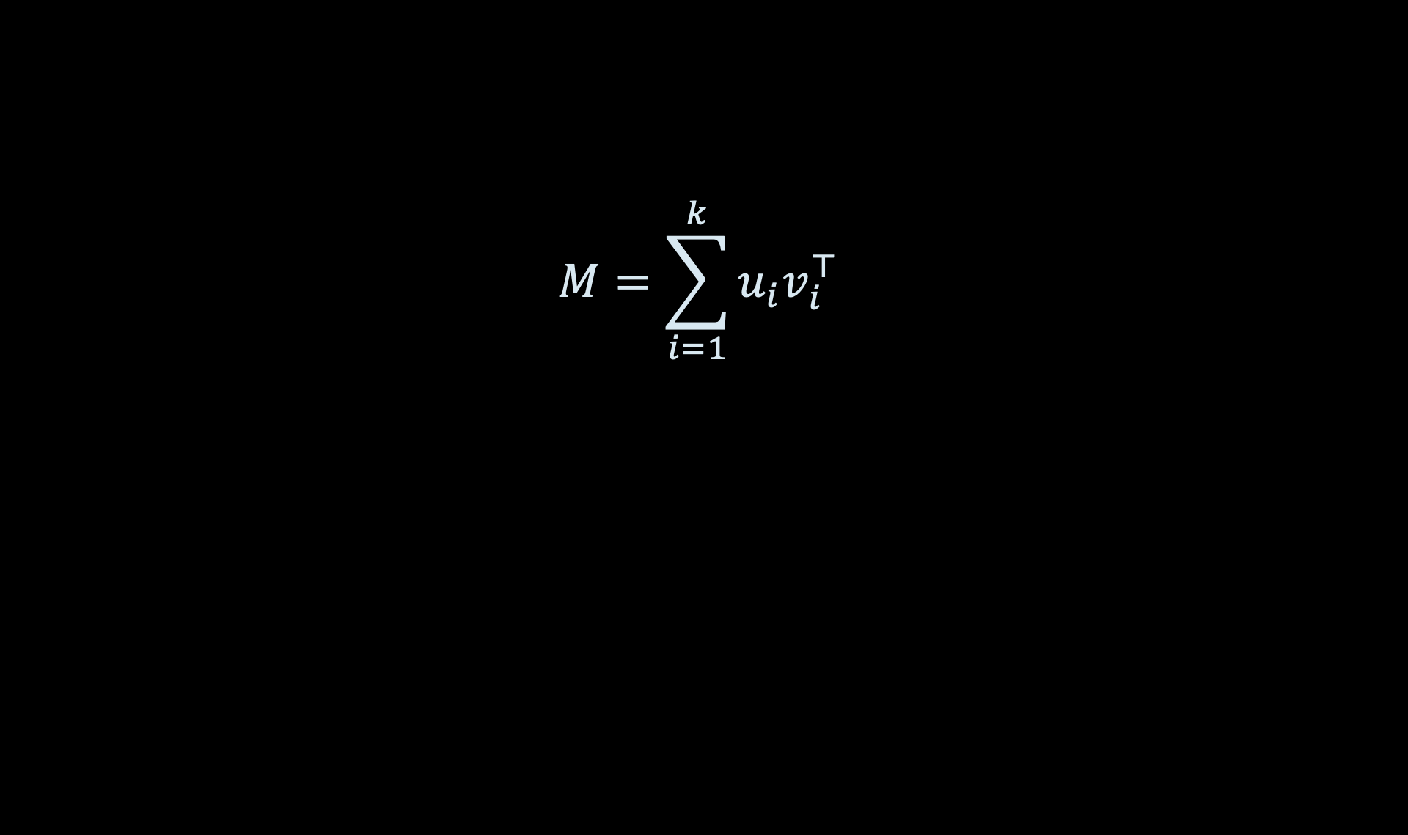
TENSORS TO THE RESCUE
$$M=\sum_{i=1}^{k}{u_{i}v_{i}^{⊤}}$$

Slide 9
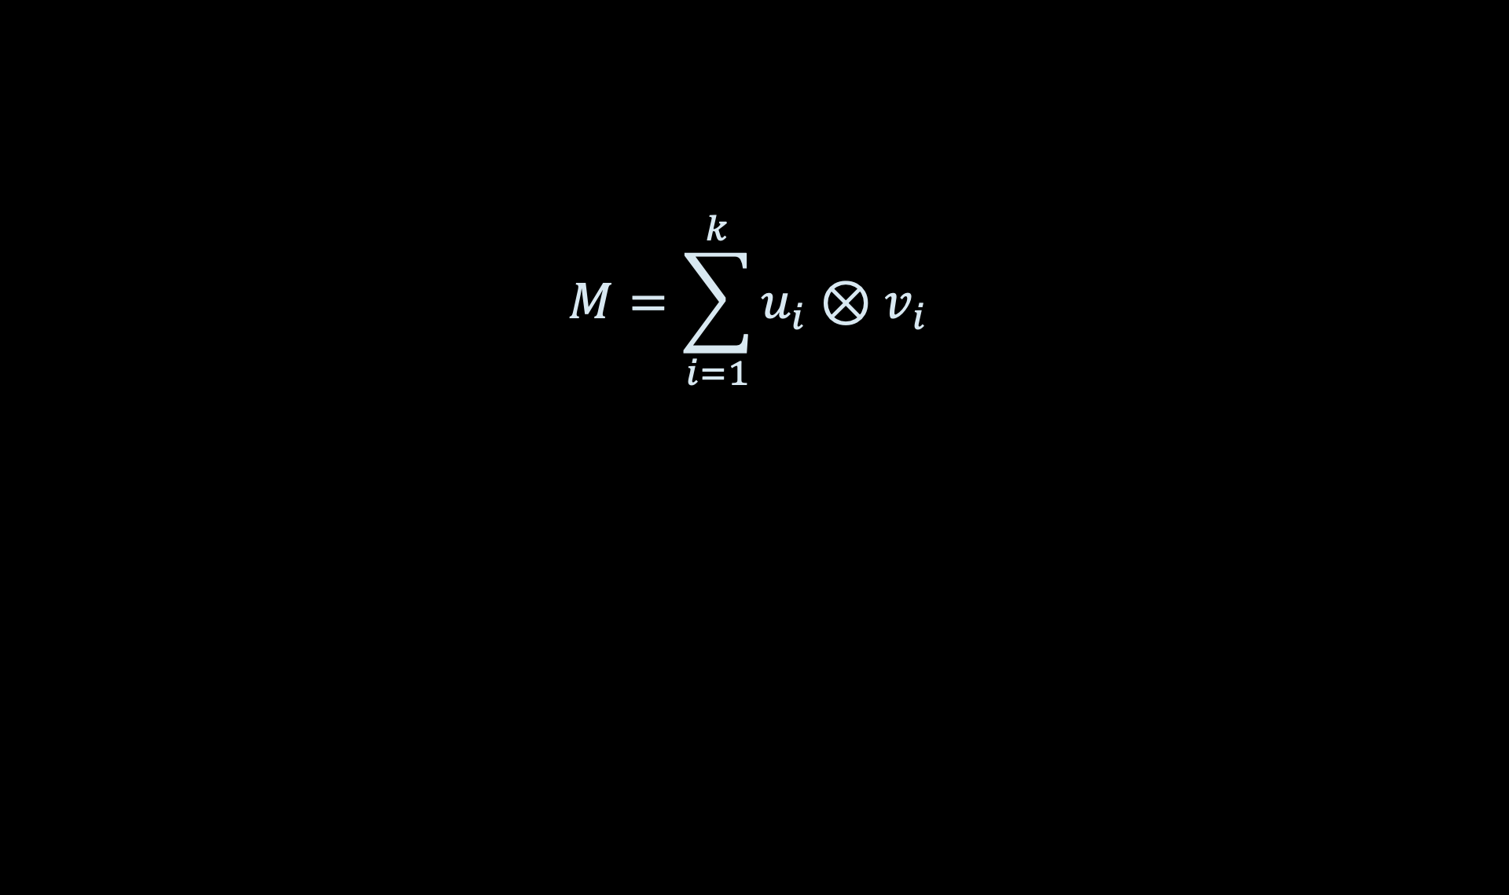
TENSORS TO THE RESCUE
$$M=\sum_{i=1}^{k}{u_{i}⊗v_{i}}$$

Slide 10
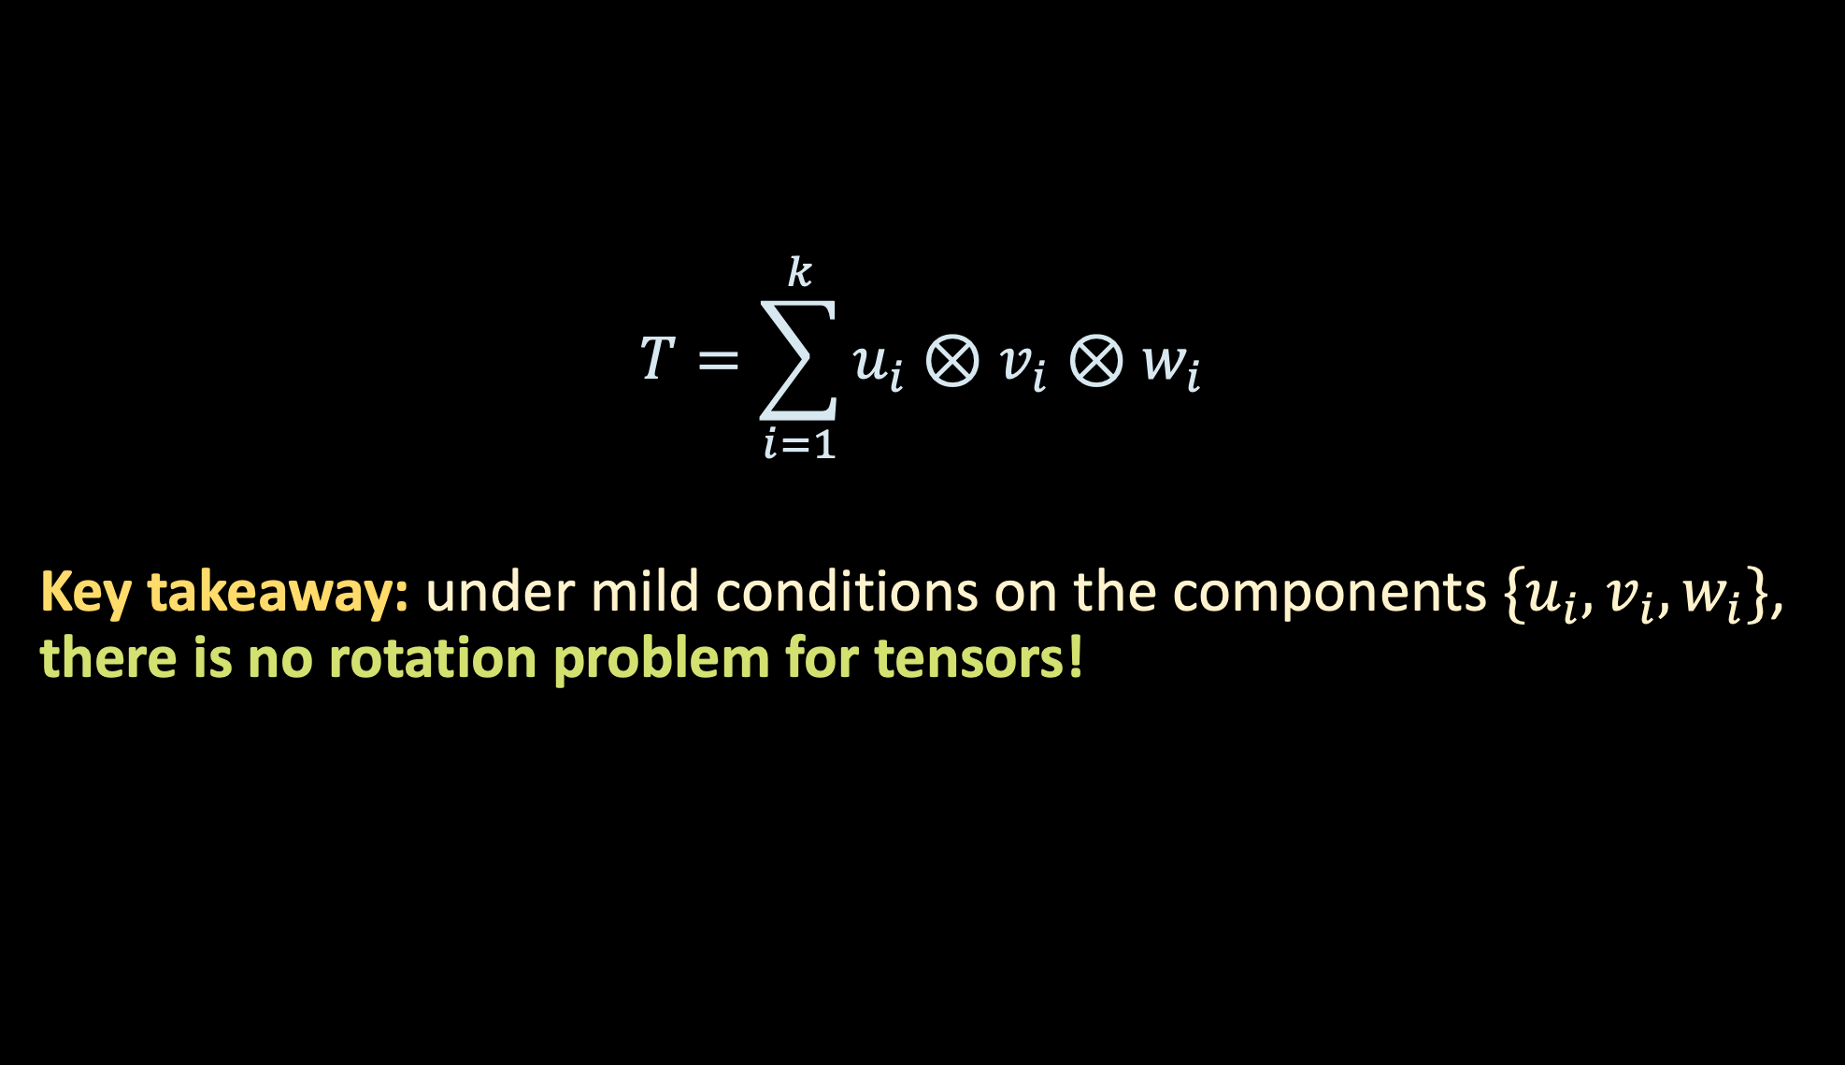
TENSORS TO THE RESCUE
tests
$$T=\sum_{i=1}^{k}{u_{i}⊗v_{i}⊗w_{i}}$$
Key takeaway: under mild conditions on the components $\{u_{i},v_{i},w_{i}\}$, there is no rotation problem for tensors!
experimental
conditions
students

Slide 11
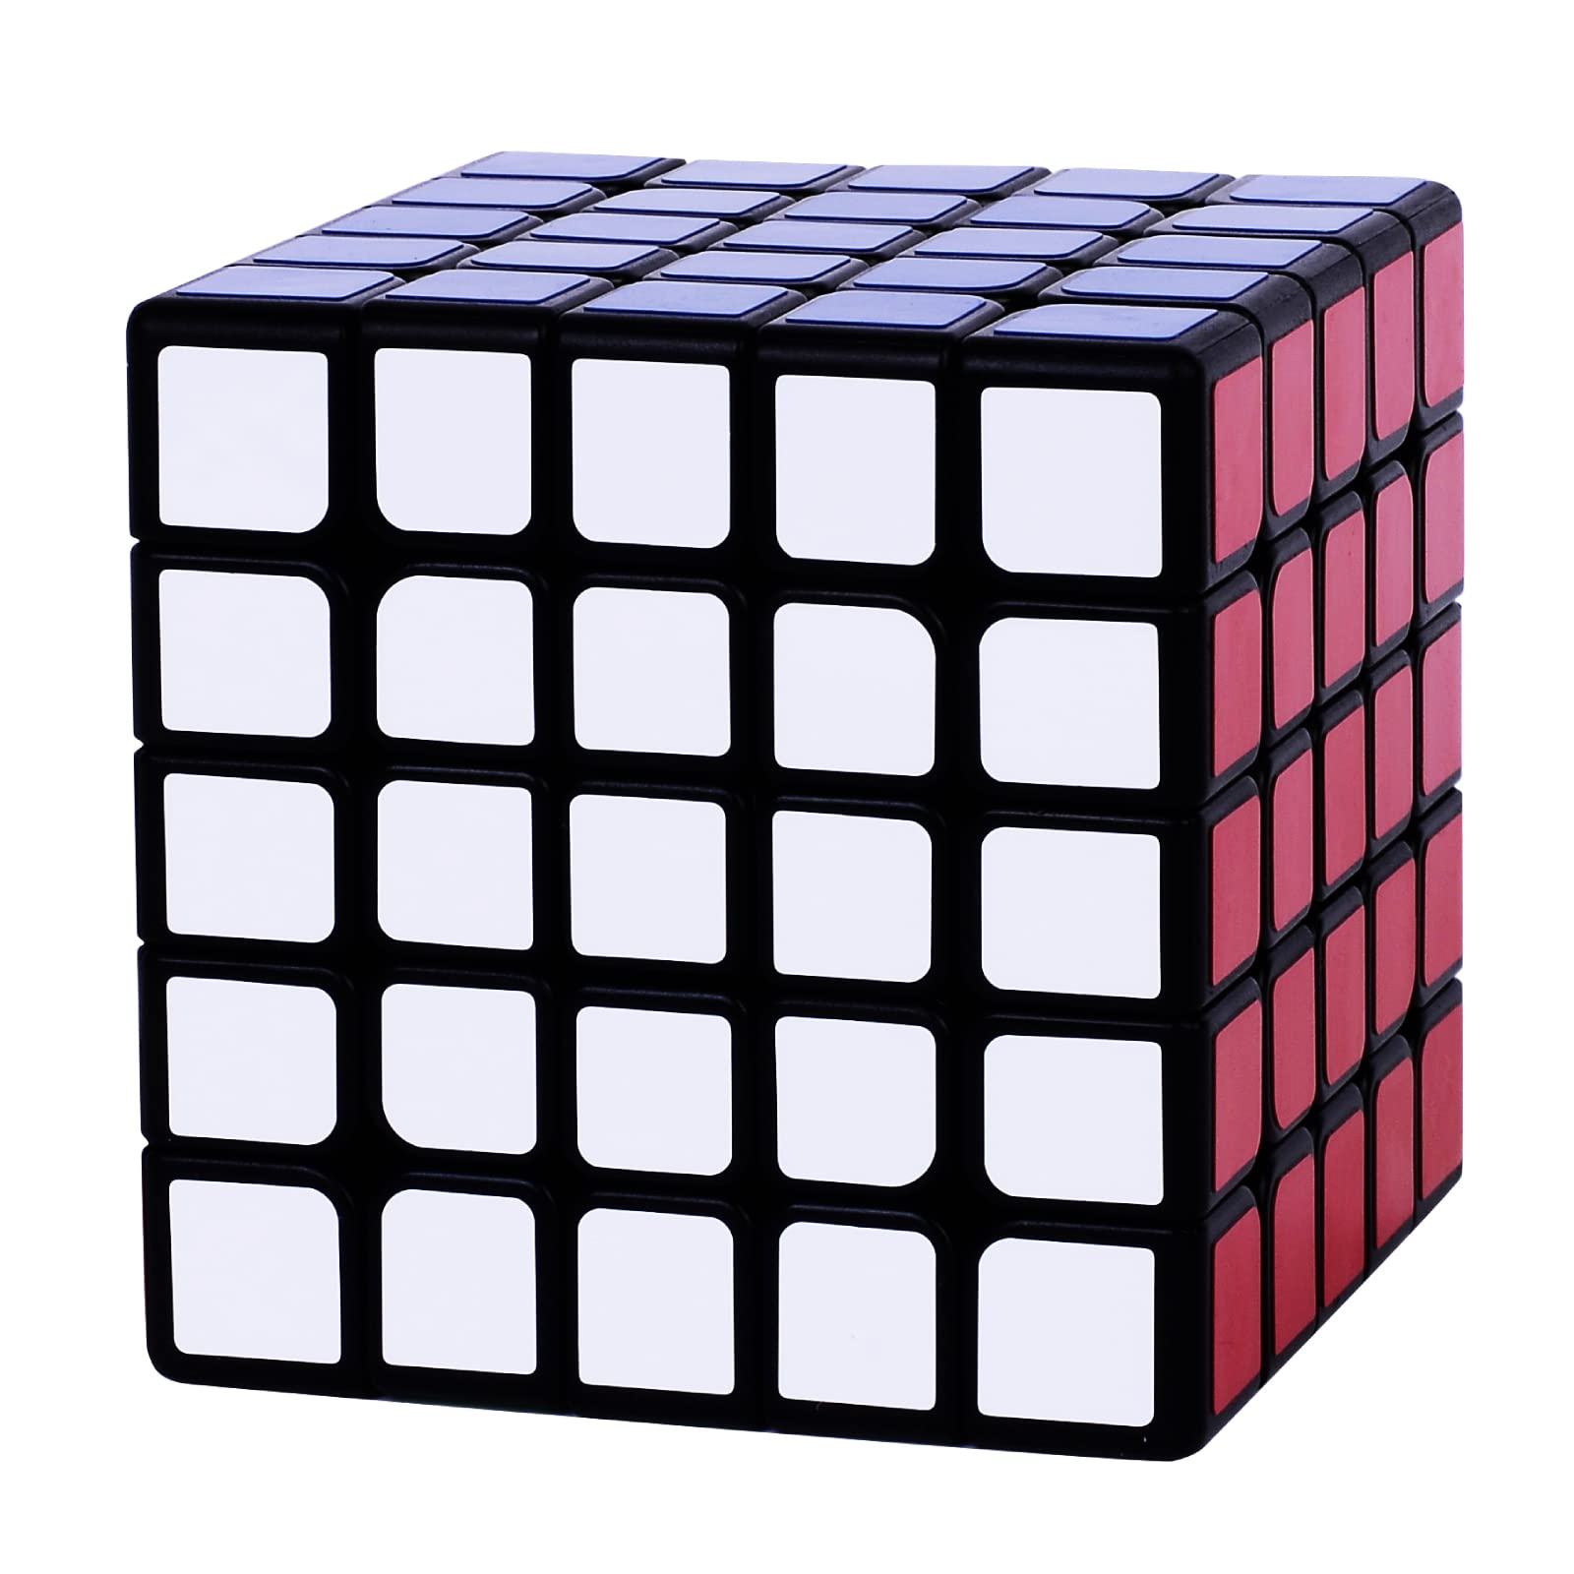
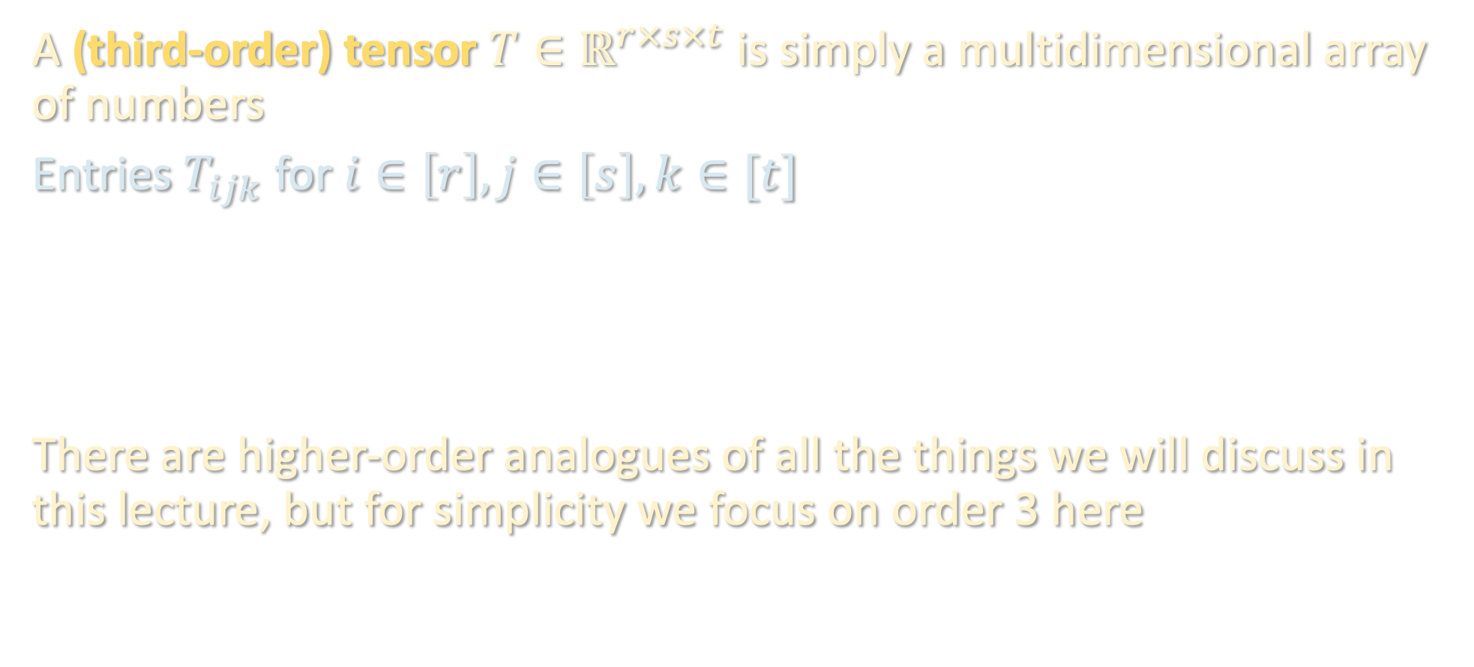
BRIEF INTERLUDE: TENSOR BASICS
A (third-order) tensor $T∈ℝ^{r×s×t}$ is simply a multidimensional array of numbers
Entries $T_{ijk}$ for $i∈\left[r\right], j∈\left[s\right], k∈[t]$
There are higher-order analogues of all the things we will discuss in this lecture, but for simplicity we focus on order 3 here

Slide 12
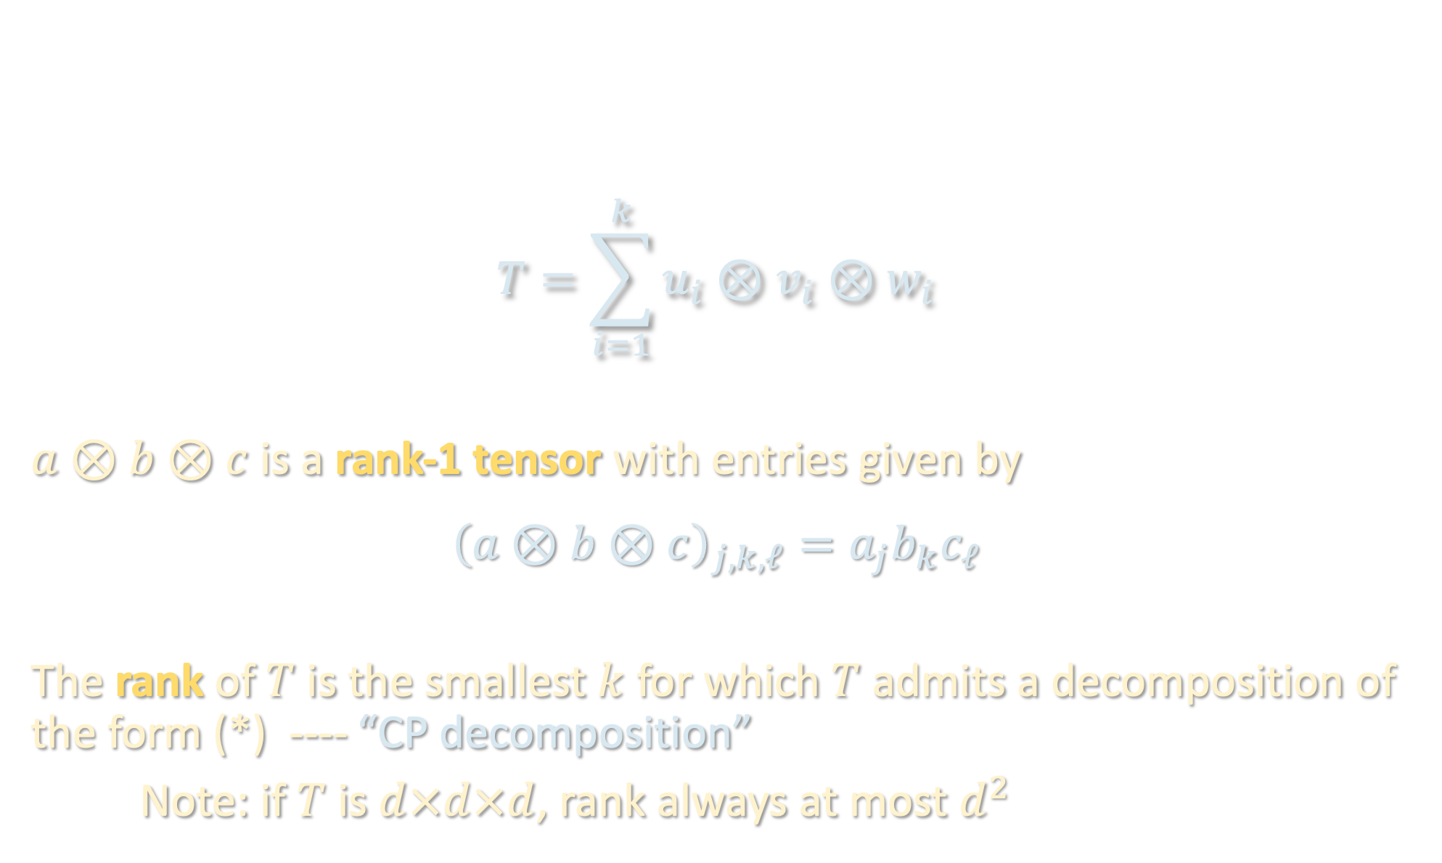
BRIEF INTERLUDE: TENSOR BASICS
$$T=\sum_{i=1}^{k}{u_{i}⊗v_{i}⊗w_{i}}$$
$a⊗b⊗c$ is a rank-1 tensor with entries given by
$${\left(a⊗b⊗c\right)}_{j,k,ℓ}=a_{j}b_{k}c_{ℓ}$$
The rank of $T$ is the smallest $k$ for which $T$ admits a decomposition of the form (*) ---- “CP decomposition”
Note: if $T$ is $d×d×d$, rank always at most $d^{2}$
(*)

Slide 13
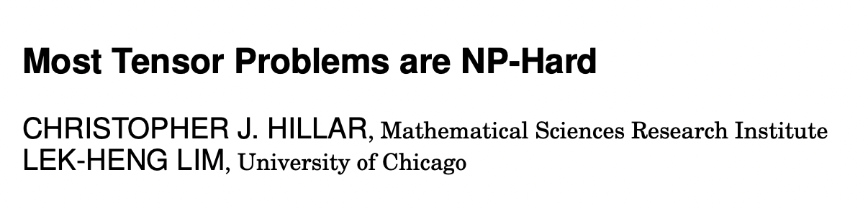
BRIEF INTERLUDE: TENSOR BASICS
Many features of matrices that we take for granted simply do not hold for tensors
especially tractability of basic linear algebraic primitives!
The following are NP-hard to compute or even approximate for tensors:
Best low-rank (or even rank-1!) approximation
Rank
Operator norm
Eigenvalues and eigenvectors
...

Slide 14
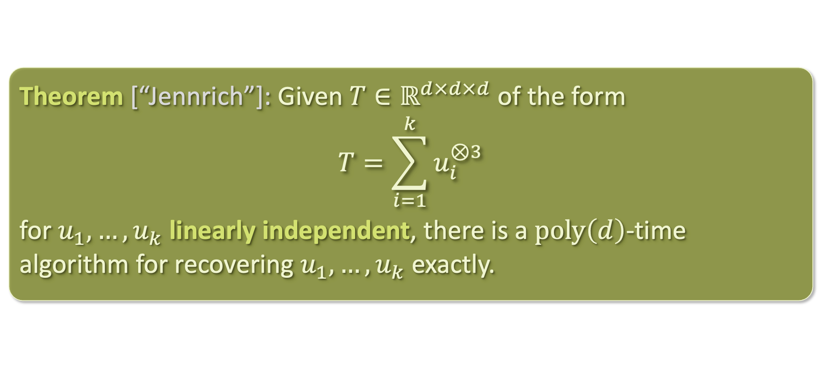
TENSOR DECOMPOSITION
Theorem [“Jennrich”]: Given $T∈ℝ^{d×d×d}$ of the form
$$T=\sum_{i=1}^{k}{u_{i}^{⊗3}}$$
for $u_{1},…,u_{k}$ linearly independent, there is a $poly\left(d\right)$-time algorithm for recovering $u_{1},…,u_{k}$ exactly.
Low rank tensors can be decomposed if their components are linearly independent

Slide 15
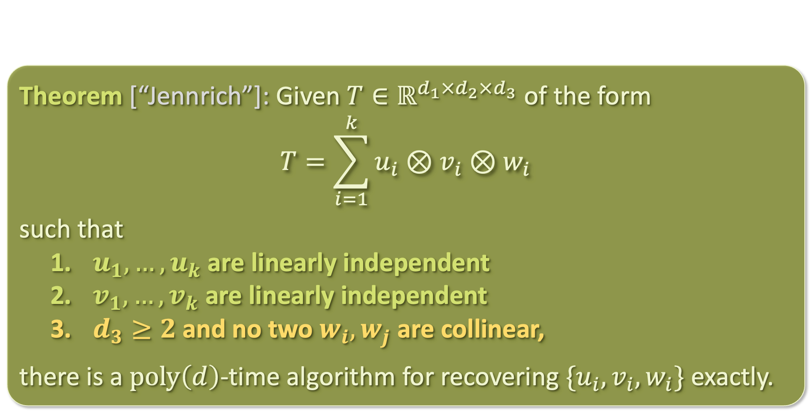
TENSOR DECOMPOSITION
Theorem [“Jennrich”]: Given $T∈ℝ^{d_{1}×d_{2}×d_{3}}$ of the form
$$T=\sum_{i=1}^{k}{u_{i}⊗v_{i}⊗w_{i}}$$
such that
$u_{1},…, u_{k}$ are linearly independent
$v_{1},…,v_{k}$ are linearly independent
$d_{3}≥2$and no two $w_{i}, w_{j}$ are collinear,
there is a $poly\left(d\right)$-time algorithm for recovering $\{u_{i},v_{i},w_{i}\}$ exactly.

Slide 16
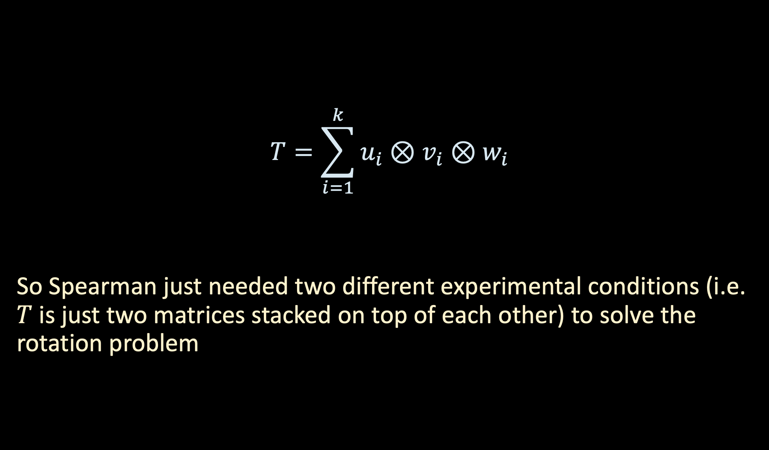
TENSOR DECOMPOSITION
tests
$$T=\sum_{i=1}^{k}{u_{i}⊗v_{i}⊗w_{i}}$$
So Spearman just needed two different experimental conditions (i.e. $T$ is just two matrices stacked on top of each other) to solve the rotation problem
experimental
conditions
students

Slide 17
TENSOR DECOMPOSITION
Theorem [“Jennrich”]: Given $T∈ℝ^{d_{1}×d_{2}×d_{3}}$ of the form
$$T=\sum_{i=1}^{k}{u_{i}⊗v_{i}⊗w_{i}}$$
such that
$u_{1},…, u_{k}$ are linearly independent
$v_{1},…,v_{k}$ are linearly independent
$d_{3}≥2$and no two $w_{i}, w_{j}$ are collinear,
there is a $poly\left(d\right)$-time algorithm for recovering $\{u_{i},v_{i},w_{i}\}$ exactly.

Slide 18
TENSOR DECOMPOSITION (SEE BOARD)
Theorem [“Jennrich”]: Given $T∈ℝ^{d_{1}×d_{2}×d_{3}}$ of the form
$$T=\sum_{i=1}^{k}{u_{i}⊗v_{i}⊗w_{i}}$$
such that
$u_{1},…, u_{k}$ are linearly independent
$v_{1},…,v_{k}$ are linearly independent
$d_{3}≥2$and no two $w_{i}, w_{j}$ are collinear,
there is a $poly\left(d\right)$-time algorithm for recovering $\{u_{i},v_{i},w_{i}\}$ exactly.

Slide 19
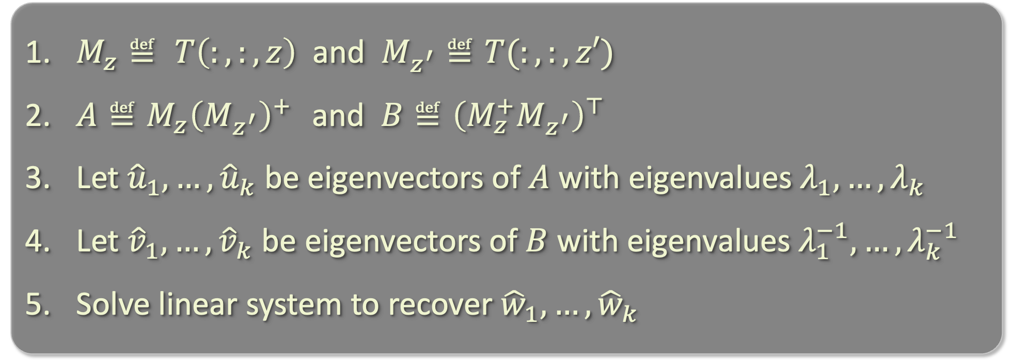
JENNRICH’S ALGORITHM
$M_{z}≝ T\left(:,:,z\right)$ and $M_{z^{′}}≝T(:,:,z′)$
$A≝M_{z}{\left(M_{z^{′}}\right)}^{+}$ and $B≝{\left(M_{z}^{+}M_{z^{′}}\right)}^{⊤}$
Let ${\hat{u}}_{1},…,{\hat{u}}_{k}$ be eigenvectors of $A$ with eigenvalues $λ_{1},…,λ_{k}$
Let ${\hat{v}}_{1},…,{\hat{v}}_{k}$ be eigenvectors of $B$ with eigenvalues $λ_{1}^{−1},…,λ_{k}^{−1 }$
Solve linear system to recover ${\hat{w}}_{1},…,{\hat{w}}_{k}$

Slide 20
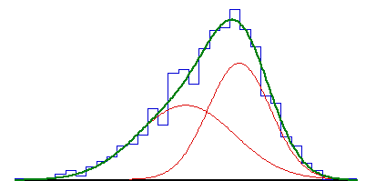
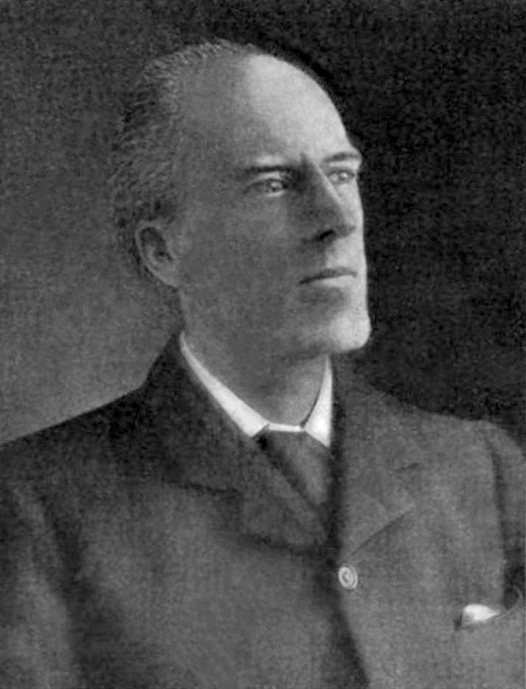
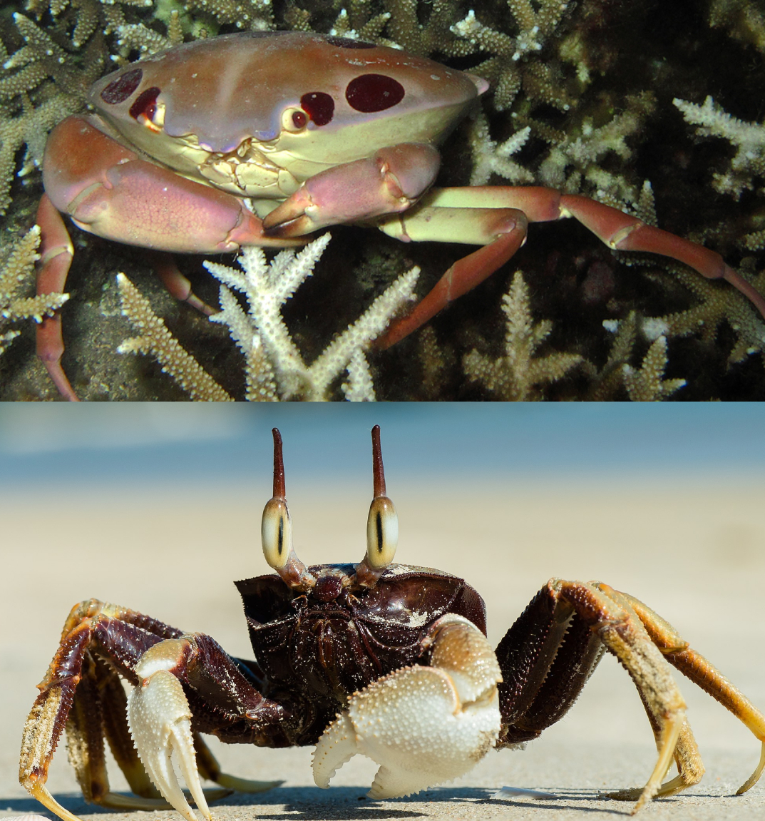
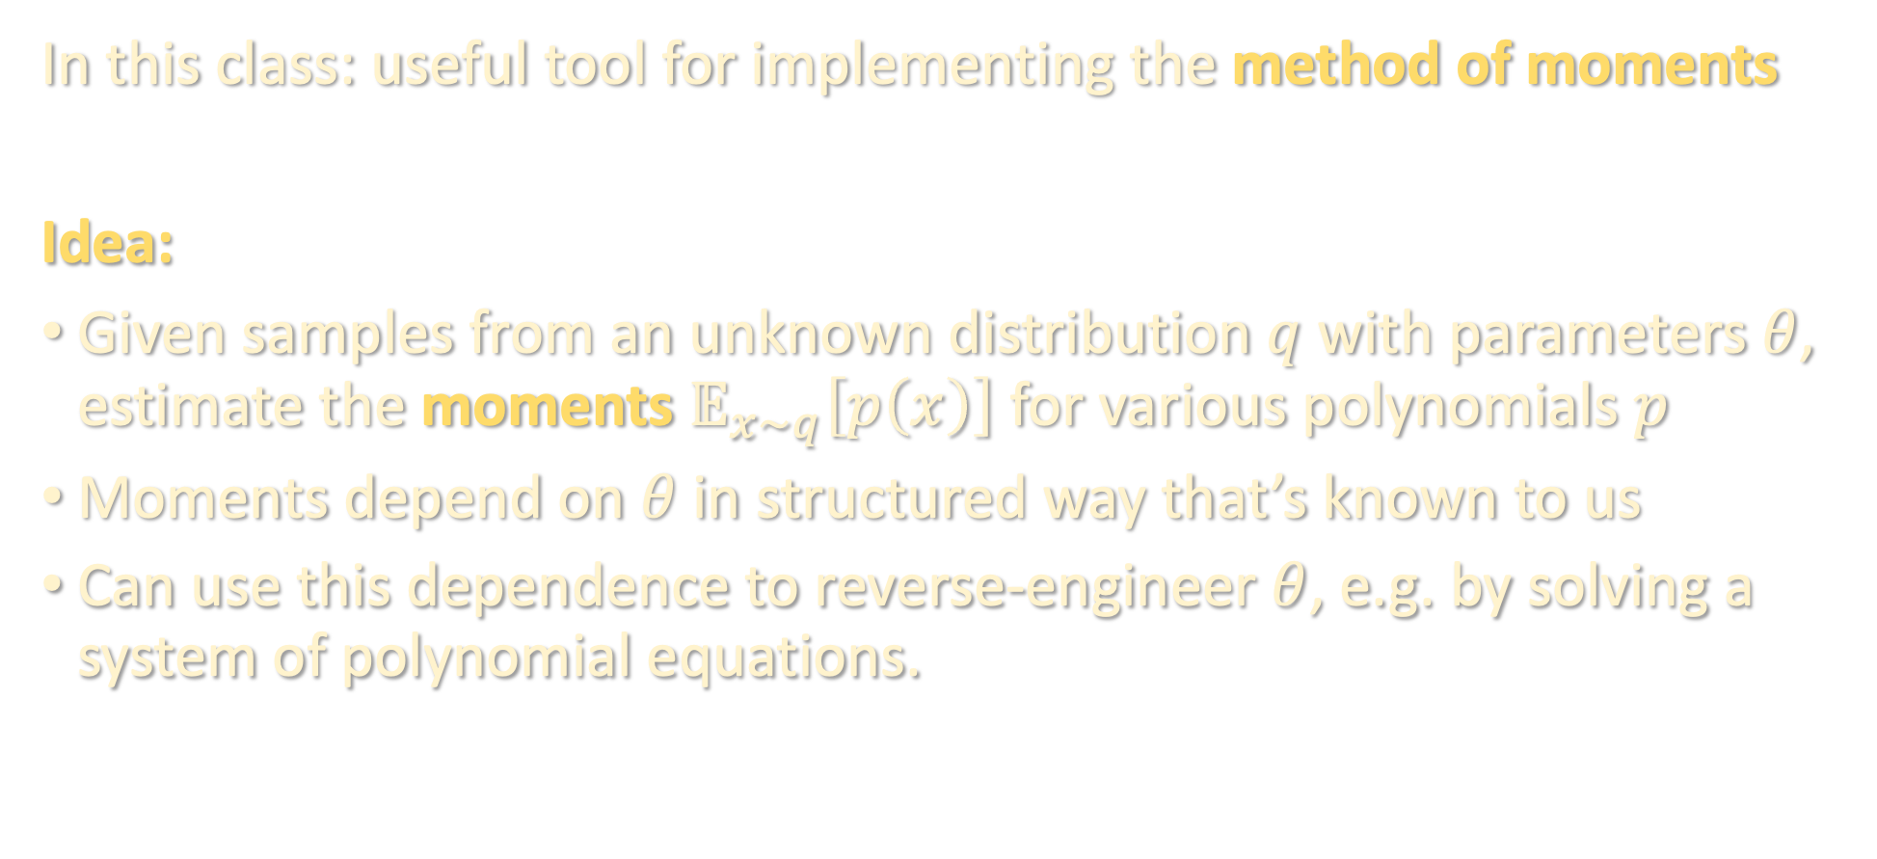
WHAT ARE TENSORS GOOD FOR?
In this class: useful tool for implementing the method of moments
Idea:
Given samples from an unknown distribution $q$ with parameters $θ$, estimate the moments $𝔼_{x∼q}\left[p\left(x\right)\right]$ for various polynomials $p$
Moments depend on $θ$ in structured way that’s known to us
Can use this dependence to reverse-engineer $θ$, e.g. by solving a system of polynomial equations.
Karl Pearson
(1857-1936)

Slide 21
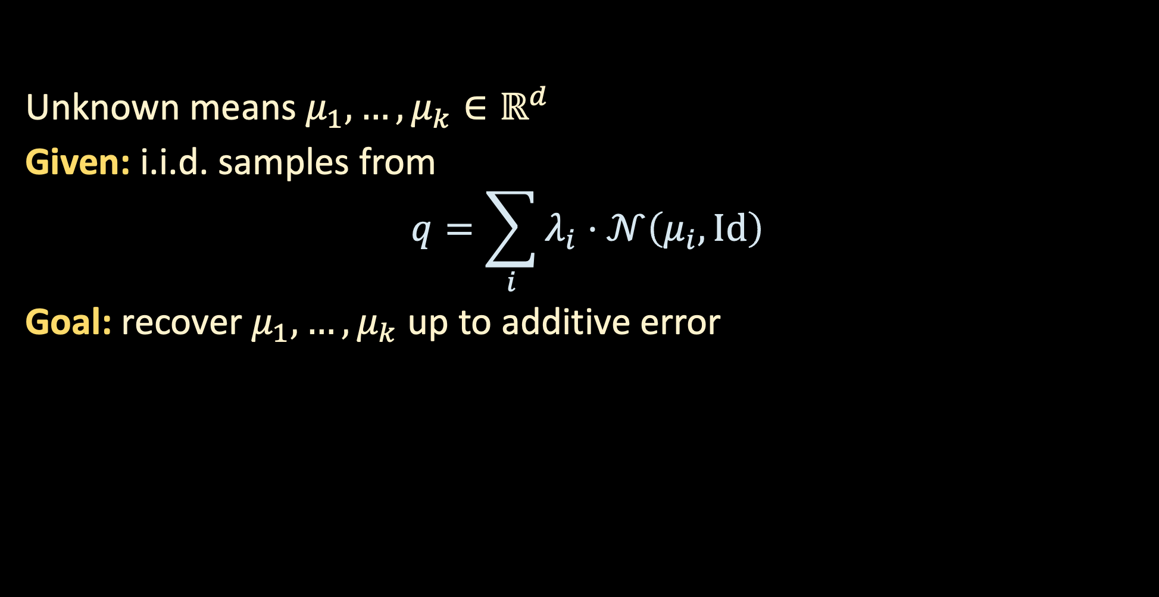
APPLICATION 1: MIXTURES OF GAUSSIANS
Unknown means $μ_{1},…,μ_{k}∈ℝ^{d}$
Given: i.i.d. samples from
$$q=\sum_{i}{λ_{i}⋅𝒩\left(μ_{i},Id\right)}$$
Goal: recover $μ_{1},…,μ_{k}$ up to additive error

Slide 22
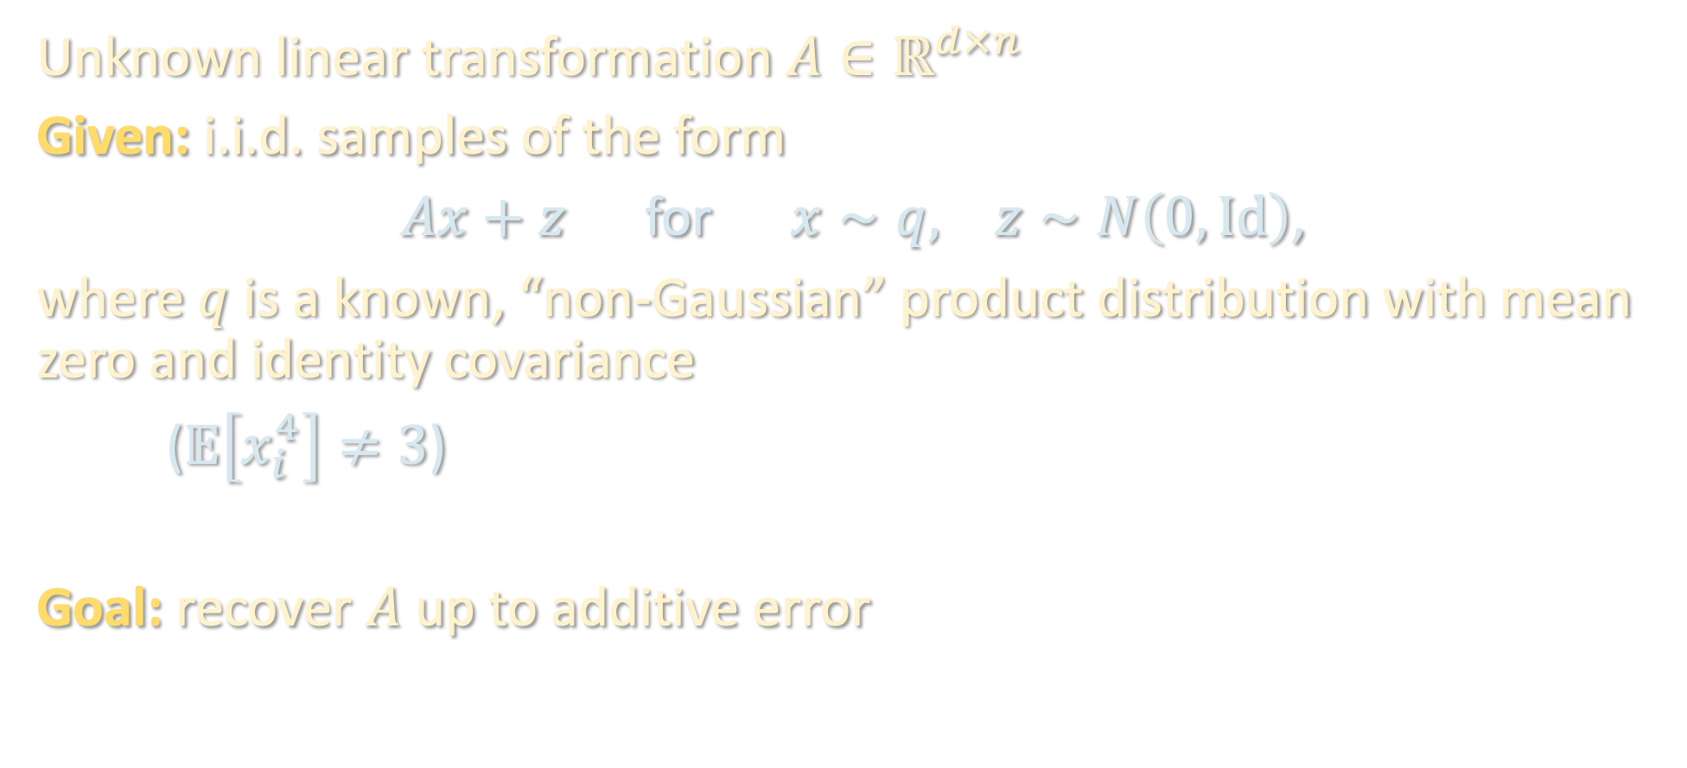
APPLICATION 2: INDEPENDENT COMPONENT ANALYSIS
Unknown linear transformation $A∈ℝ^{d×n}$
Given: i.i.d. samples of the form
$Ax+z$ for $x∼q, z∼N\left(0,Id\right)$,
where $q$ is a known, “non-Gaussian” product distribution with mean zero and identity covariance
($𝔼\left[x_{i}^{4}\right]≠3$)
Goal: recover $A$ up to additive error

Slide 23
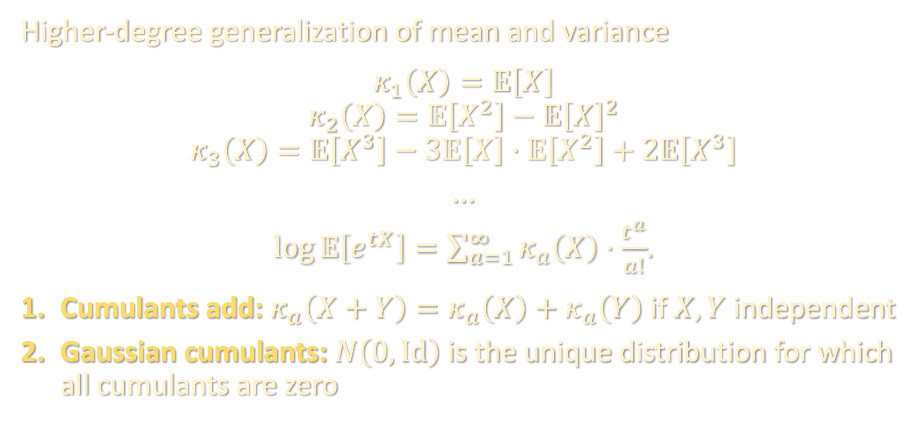
CUMULANTS
Higher-degree generalization of mean and variance
$$κ_{1}\left(X\right)=𝔼\left[X\right]$$
$$κ_{2}\left(X\right)=𝔼\left[X^{2}\right]−𝔼{\left[X\right]}^{2}$$
$$κ_{3}\left(X\right)=𝔼\left[X^{3}\right]−3𝔼\left[X\right]⋅𝔼\left[X^{2}\right]+2𝔼\left[X^{3}\right]$$
...
$\log{𝔼\left[e^{tX}\right]}=\sum_{a=1}^{∞}{κ_{a}\left(X\right)⋅\frac{t^{a}}{a!}}$.
Cumulants add: $κ_{a}\left(X+Y\right)=κ_{a}\left(X\right)+κ_{a}\left(Y\right)$ if $X,Y$ independent
Gaussian cumulants: $N\left(0,Id\right)$ is the unique distribution for which all cumulants are zero

Slide 24
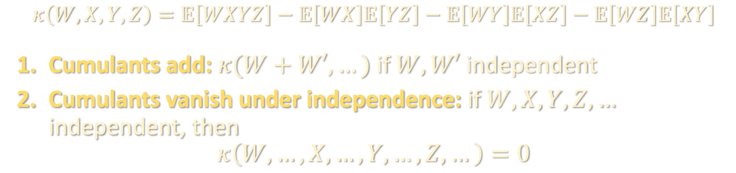

JOINT CUMULANTS
Higher-degree generalization of covariance
Suppose $W,X,Y,Z$ have mean zero, not necessarily independent
$$κ\left(W\right)=0$$
$$κ\left(W,X\right)=𝔼\left[WX\right]$$
$$κ\left(W,X,Y\right)=𝔼\left[WXY\right]$$
$$κ\left(W,X,Y,Z\right)=𝔼\left[WXYZ\right]−𝔼\left[WX\right]𝔼\left[YZ\right]−𝔼\left[WY\right]𝔼\left[XZ\right]−𝔼\left[WZ\right]𝔼\left[XY\right]$$
Cumulants add: $κ(W+W′, …)$ if $W,W′$ independent
Cumulants vanish under independence: if $W,X,Y,Z,…$ independent, then
$$κ\left(W,…,X,…,Y,…,Z,…\right)=0$$

Slide 25

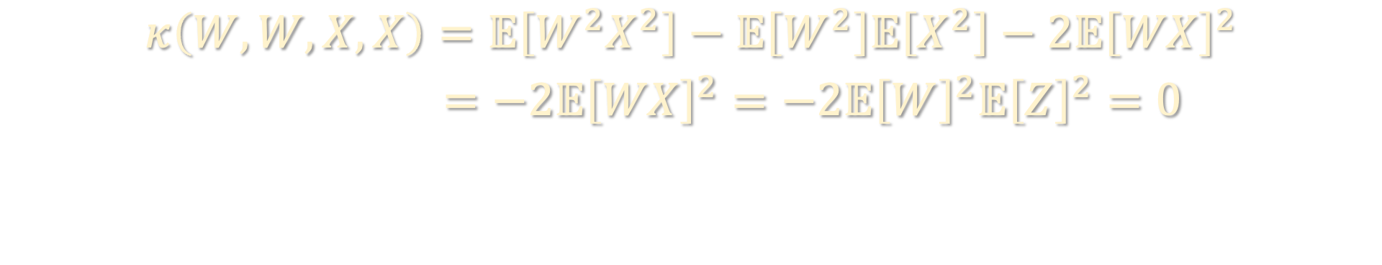
JOINT CUMULANTS
$$κ\left(W,X,Y,Z\right)=𝔼\left[WXYZ\right]−𝔼\left[WX\right]𝔼\left[YZ\right]−𝔼\left[WY\right]𝔼\left[XZ\right]−𝔼\left[WZ\right]𝔼\left[XY\right]$$
Cumulants add: $κ(W+W′, …)$ if $W,W′$ independent
Cumulants vanish under independence: if $W,X,Y,Z,…$ independent, then
$$κ\left(W,…,X,…,Y,…,Z,…\right)=0$$
$$κ\left(W,W,X,X\right)=𝔼\left[W^{2}X^{2}\right]−𝔼\left[W^{2}\right]𝔼\left[X^{2}\right]−2𝔼{\left[WX\right]}^{2}$$
$=−2𝔼{\left[WX\right]}^{2}=−2𝔼{\left[W\right]}^{2}𝔼{\left[Z\right]}^{2}=0$

Slide 26
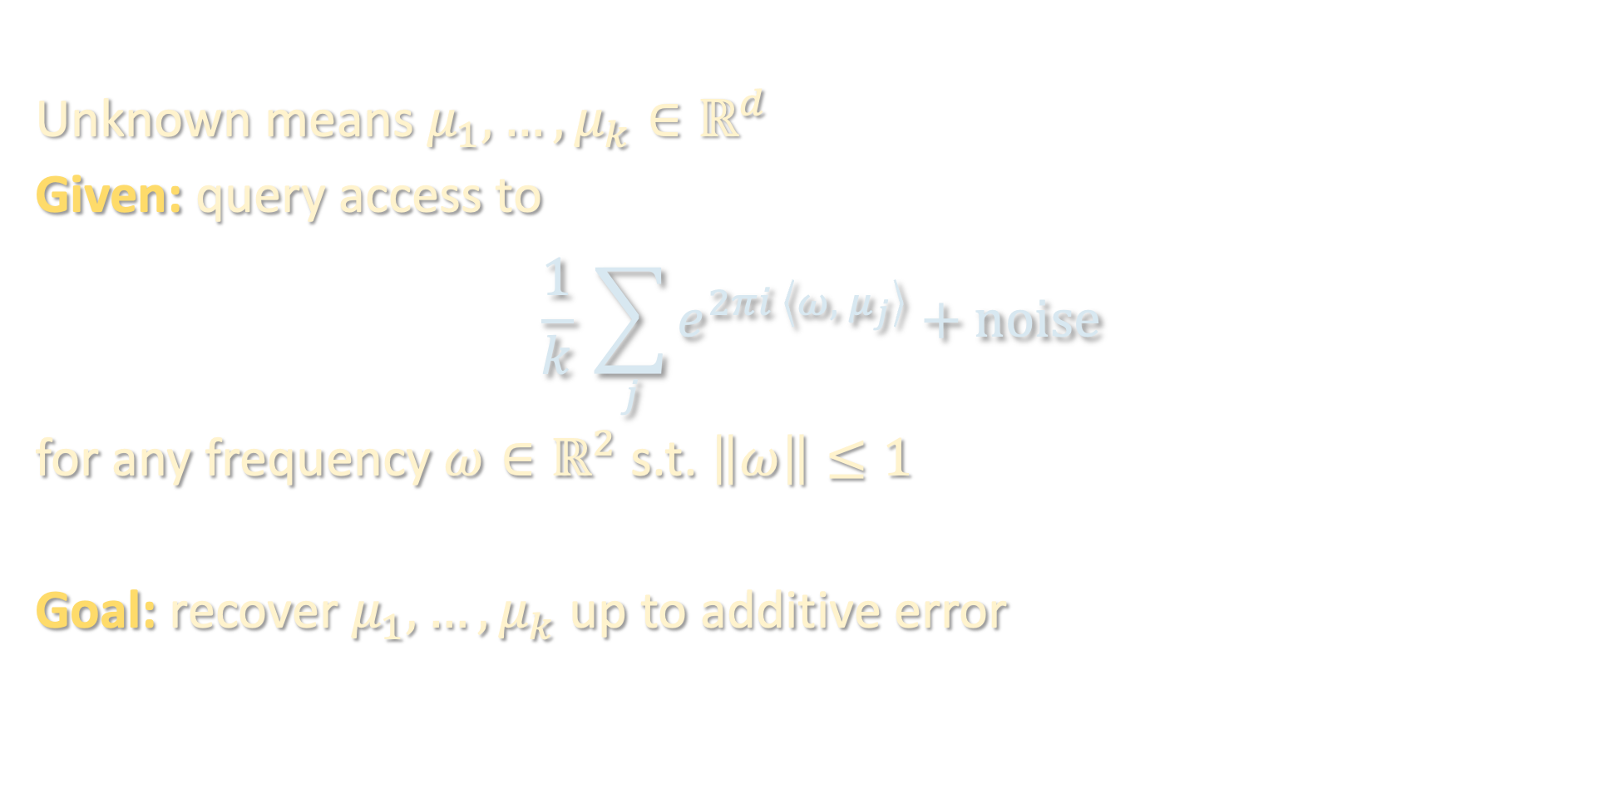
APPLICATION 3: >1D SUPERRESOLUTION
Unknown means $μ_{1},…,μ_{k}∈ℝ^{d}$
Given: query access to
$$\frac{1}{k} \sum_{j}{e^{2πi \left\langle ω, μ_{j}\right\rangle }}+noise$$
for any frequency $ω∈ℝ^{2}$ s.t. $\left\|ω\right\|≤1$
Goal: recover $μ_{1},…,μ_{k}$ up to additive error

Slide 27
RECAP
With matrices, “factor analysis” suffers from rotation problem, but with tensors, it does not
Jennrich’s is a simple algorithm for decomposing low-rank tensors whose components are linearly independent
Useful primitive for applying method of moments to provably learn parametric distributions with “low-rank” structure
Next lecture: tensor decomposition using gradient descent

