Slide 1

CS 224: ALGORITHMS FOR DATA SCIENCE
LECTURE 5 (9/18)
Tensor decomposition
Sum-of-squares
Supervised learning
Computational complexity
Statistical physics
Generative modeling
SoS I: PSEUDODISTRIBUTIONS, SUM-OF-SQUARES PROOFS

Slide 2
ANNOUNCEMENTS
Notation cheatsheet on course Overleaf
Reminder to please start the pset early as it’s quite dense
Harvard ToC seminar (biweekly) today after class --- “Postdoc Day”
If today’s content piques your interest, check out MIT 6.S977 (full course on SoS)

Slide 3

sum-of-squares
optimization
tensors

Slide 4
SUM-OF-SQUARES (SOS)
Powerful generic framework for algorithm design / nonconvex optimization
Yields the most powerful algorithms for many statistical problems
Tensor decomposition, dictionary learning, matrix/tensor completion, sparse PCA, Gaussian mixture models, differential privacy, generative modeling
Inefficient algorithm with a “simple” proof of correctness
Efficient algorithm with the same guarantees

Slide 5
SUM-OF-SQUARES (SOS)
Powerful generic framework for algorithm design / nonconvex optimization
Yields the most powerful algorithms for many statistical problems
Tensor decomposition, dictionary learning, matrix/tensor completion, sparse PCA, Gaussian mixture models, differential privacy, generative modeling
Robust statistics (learning in the presence of corrupted data):
e.g. mean estimation, regression, bandits, community detection, clustering, estimating linear dynamical systems
Inefficient algorithm with a “simple” proof of correctness
Efficient algorithm with the same guarantees

Slide 6
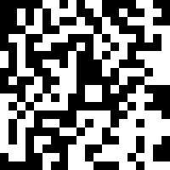
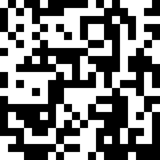
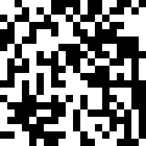
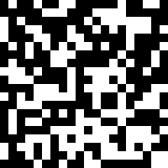


ROBUST REGRESSION
”Standard linear regression setup, but where an $η$ fraction of the data is arbitrarily corrupted”
$$x_{1}$$
$$y_{1}$$
Scaling:
$$\left\|x_{i}\right\|≤1$$
$$\left\|w^{∗}\right\|≤R$$
(so $\left|y_{i}\right|≲R$)
$$x_{2}$$
$$y_{2}$$
$$x_{3}$$
$$y_{3}$$
$$x_{4}$$
$$y_{4}$$
$$x_{5}$$
$$w^{∗}$$
$$y_{5}$$
Noise :
$$𝒩\left(0,σ^{2}\right)$$
$$x_{N}$$
$$y_{N}$$

Slide 7

ROBUST REGRESSION
”Standard linear regression setup, but where an $η$ fraction of the data is arbitrarily corrupted”
$$x_{1}$$
$$y_{1}$$
Scaling:
$$\left\|x_{i}\right\|≤1$$
$$\left\|w^{∗}\right\|≤R$$
(so $\left|y_{i}\right|≲R$)
$$x_{2}$$
$$y_{2}$$
$$x_{3}$$
$$y_{3}$$
$$x_{4}$$
$$y_{4}$$
$$x_{5}$$
$$w^{∗}$$
$$y_{5}$$
Noise :
$$𝒩\left(0,σ^{2}\right)$$
$$x_{N}$$
$$y_{N}$$

Slide 8
ROBUST REGRESSION
”Standard linear regression setup, but where an $η$ fraction of the data is arbitrarily corrupted”
$$x_{1}$$
$$y_{1}$$
Scaling:
$$\left\|x_{i}\right\|≤1$$
$$\left\|w^{∗}\right\|≤R$$
(so $\left|y_{i}\right|≲R$)
$$x_{2}$$
$$y_{2}$$
$$x_{3}$$
$$y_{3}$$
$$x_{4}$$
$$y_{4}$$
$$x_{5}$$
$$w^{∗}$$
$$y_{5}$$
Noise :
$$𝒩\left(0,σ^{2}\right)$$
$$x_{N}$$
$$y_{N}$$
Sensor failures, missing data, data poisoning attacks, societal biases, heterogeneous noise, etc

Slide 9
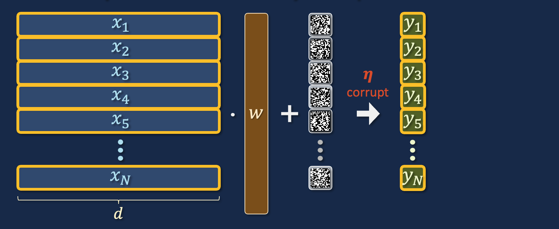
ROBUST REGRESSION
”Standard linear regression setup, but where an $η$ fraction of the data is arbitrarily corrupted”
Scaling:
$$\left\|x_{i}\right\|≤1$$
$$\left\|w^{∗}\right\|≤R$$
(so $\left|y_{i}\right|≲R$)
$$w^{∗}$$
Noise :
$$𝒩\left(0,σ^{2}\right)$$

Slide 10
ROBUST REGRESSION
”Standard linear regression setup, but where an $η$ fraction of the data is arbitrarily corrupted”
If we knew which points were corrupted, we can just throw them out and run ordinary least squares on the rest
Objective: compete with this “all-powerful baseline”
$$\min_{w}{\frac{1}{N}\sum_{1≤i≤N}{{\left(y_{i}−\left\langle w,x_{i}\right\rangle \right)}^{2}}}$$

Slide 11

ROBUST REGRESSION
”Standard linear regression setup, but where an $η$ fraction of the data is arbitrarily corrupted”
If we knew which points were corrupted, we can just throw them out and run ordinary least squares on the rest
Objective: compete with this “all-powerful baseline”
$$\min_{w}{\frac{1}{N}\sum_{clean i}{{\left(y_{i}−\left\langle w,x_{i}\right\rangle \right)}^{2}}}$$
Clean
MSE
How to degrade gracefully in corruption $η$?

Slide 12
ROBUST REGRESSION
How bad is it to just run OLS on the whole dataset?
Achieves clean MSE $“OPT”+ηR^{2}$
Information-theoretically optimal error is $“OPT”+η^{2}σ^{2}$

Slide 13



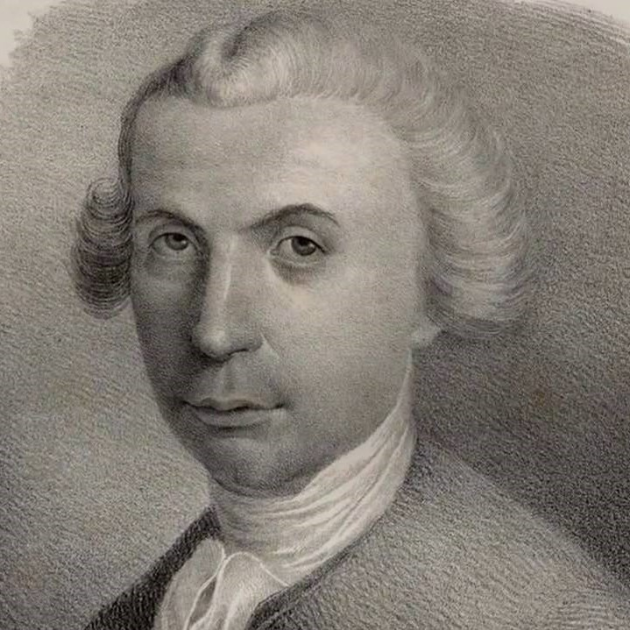
ROBUST REGRESSION
OK...then just regularize? Or minimize a less sensitive loss?
$$ℓ$$
L1
Huber
$$\min_{\hat{w}}{\sum_{i}{ℓ(y_{i}−\left\langle \hat{w},x_{i}\right\rangle )}}$$

Slide 14
ROBUST REGRESSION
OK...then just regularize? Or minimize a less sensitive loss?
Theorem [C-Koehler-Moitra-Yau ‘21]: Any algorithm based on minimizing a convex loss gets clean MSE $η^{3}R.$

Slide 15
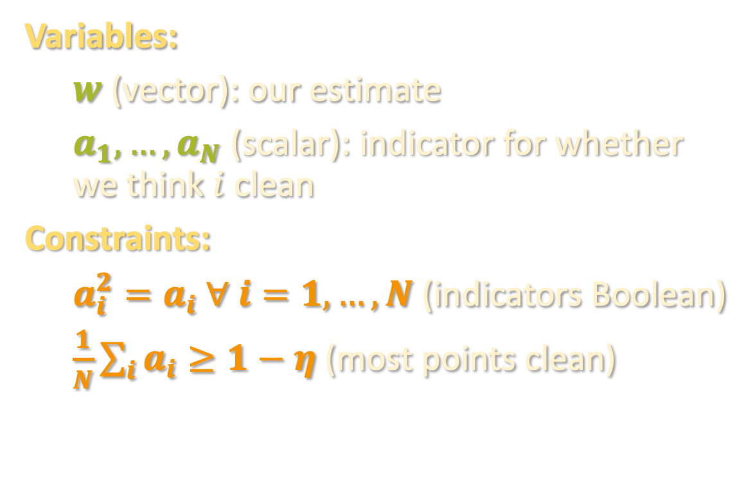
AN INEFFICIENT ALGORITHM
Input: ${\left\{\left(x_{i},y_{i}\right)\right\}}_{i=1}^{N}$ (some fraction of these are corrupted)
Consider the following system of polynomial constraints
Variables:
$w$ (vector): our estimate
$a_{1},…,a_{N}$ (scalar): indicator for whether we think $i$ clean
Constraints:
$a_{i}^{2}=a_{i} ∀ i=1,…,N$ (indicators Boolean)
$\frac{1}{N}\sum_{i}{a_{i}}≥1−η$ (most points clean)
Objective:
$$\min_{w}{\frac{1}{N}\sum_{clean i}{{\left(y_{i}−\left\langle w,x_{i}\right\rangle \right)}^{2}}}$$
points we “think” are clean, i.e.
$$i:a_{i}=1$$

Slide 16
AN INEFFICIENT ALGORITHM
Input: ${\left\{\left(x_{i},y_{i}\right)\right\}}_{i=1}^{N}$ (some fraction of these are corrupted)
Consider the following system of polynomial constraints
Variables:
$w$ (vector): our estimate
$a_{1},…,a_{N}$ (scalar): indicator for whether we think $i$ clean
Constraints:
$a_{i}^{2}=a_{i} ∀ i=1,…,N$ (indicators Boolean)
$\frac{1}{N}\sum_{i}{a_{i}}≥1−η$ (most points clean)
Objective:
Note: ground truth is feasible
i.e. $a_{i}=1$if $i$ clean, $w=w^{∗}$
$$\min_{w}{\frac{1}{N}\sum_{1≤i≤N}{{a_{i}\left(y_{i}−\left\langle w,x_{i}\right\rangle \right)}^{2}}}$$

Slide 17
FROM PROOFS TO ALGORITHMS
This is a highly non-convex problem. And in general, solving polynomial systems is NP-hard...
Goal: devise a convex relaxation of the problem
Idea 1: Rather than optimize over feasible solution, optimize over distributions over feasible solutions
No easier than finding a single solution ☹
Idea 2: Relax the notion of “distribution”!

Slide 18
FROM PROOFS TO ALGORITHMS
(Degree-$t$) Pseudo-distribution:
given by “pseudo-expectation” $\tilde{𝔼}\left[⋅\right]$ that behaves like the expectation operator of a distribution over assignments to the variables of the program
$\tilde{𝔼}\left[⋅\right]$ takes any degree-$≤t$ polynomial in the variables $a_{1},…,a_{N},w_{1},…,w_{d}$ and outputs a number. Must satisfy:
Normalization: $\tilde{𝔼}\left[1\right]=1$
Linearity: $\tilde{𝔼}\left[α⋅p+β⋅q\right]=α⋅\tilde{𝔼}\left[p\right]+β⋅\tilde{𝔼}\left[q\right]$
Positivity: $\tilde{𝔼}\left[p^{2}\right]≥0$ for all degree-$≤t/2$ polynomials $p$

Slide 19
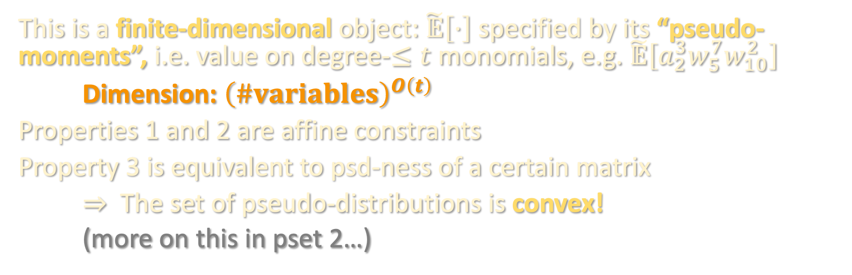
FROM PROOFS TO ALGORITHMS
Normalization: $\tilde{𝔼}\left[1\right]=1$
Linearity: $\tilde{𝔼}\left[α⋅p+β⋅q\right]=α⋅\tilde{𝔼}\left[p\right]+β⋅\tilde{𝔼}\left[q\right]$
Positivity: $\tilde{𝔼}\left[p^{2}\right]≥0$ for all degree-$≤t/2$ polynomials $p$
This is a finite-dimensional object: $\tilde{𝔼}\left[⋅\right]$ specified by its “pseudo-moments”, i.e. value on degree-$≤t$ monomials, e.g. $\tilde{𝔼}\left[a_{2}^{3}w_{5}^{7}w_{10}^{2}\right]$
Dimension: ${\left(\#variables\right)}^{O\left(t\right)}$
Properties 1 and 2 are affine constraints
Property 3 is equivalent to psd-ness of a certain matrix
$⇒$ The set of pseudo-distributions is convex!
(more on this in pset 2…)

Slide 20
FROM PROOFS TO ALGORITHMS
Normalization: $\tilde{𝔼}\left[1\right]=1$
Linearity: $\tilde{𝔼}\left[α⋅p+β⋅q\right]=α⋅\tilde{𝔼}\left[p\right]+β⋅\tilde{𝔼}\left[q\right]$
Positivity: $\tilde{𝔼}\left[p^{2}\right]≥0$ for all degree-$≤t/2$ polynomials $p$
How do the constraints from the program come into play?
Program constraints: $\tilde{𝔼}\left[p\right]≥0$ for any poly. $p$ for which there is a “simple” (degree-$t$) proof that $p≥0$ using the program constraints.
Example: $\tilde{𝔼}\left[a_{i}^{2}−a_{i}\right]=0$
Example: $\tilde{𝔼}\left[a_{i}\right]≥0$ (in a few slides)
Program constraints: $\tilde{𝔼}\left[p\right]≥0$ for any poly. $p$ for which there is a “simple” (degree-$t$) proof that $p≥0$ using the program constraints.

Slide 21
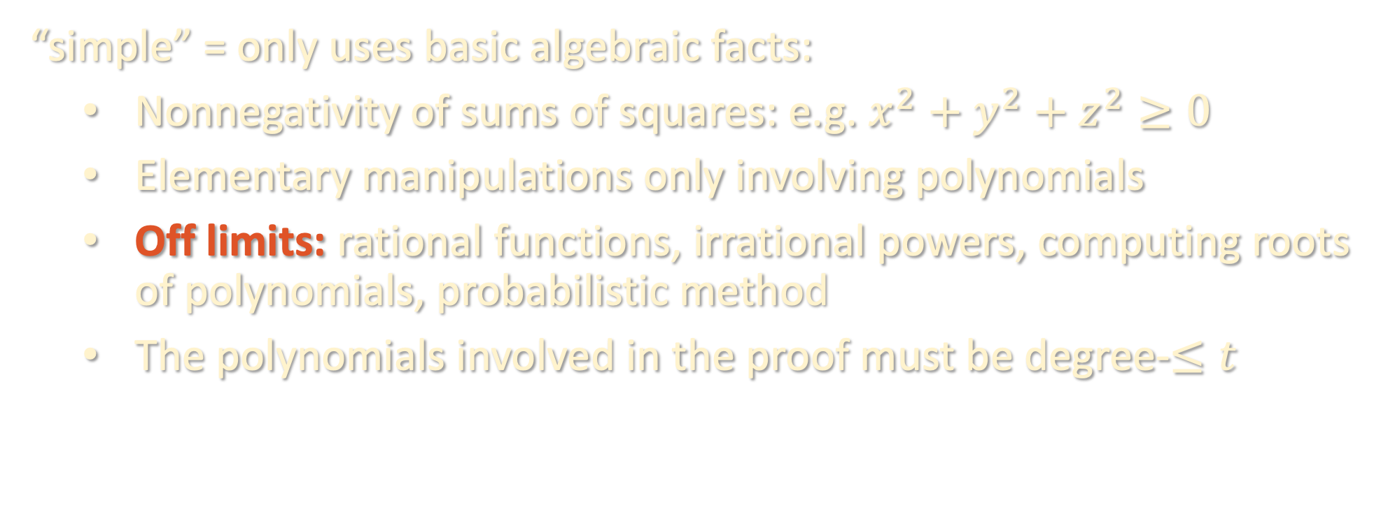
RULES OF THE GAME
Program constraints: $\tilde{𝔼}\left[p\right]≥0$ for any poly. $p$ for which there is a “simple” (degree-$t$) proof that $p≥0$ using the program constraints.
“simple” = only uses basic algebraic facts:
Nonnegativity of sums of squares: e.g. $x^{2}+y^{2}+z^{2}≥0$
Elementary manipulations only involving polynomials
Off limits: rational functions, irrational powers, computing roots of polynomials, probabilistic method
The polynomials involved in the proof must be degree-$≤t$

Slide 22
RULES OF THE GAME- EXAMPLES
Using the constraint $a_{i}^{2}=a_{i}$ and only simple proofs
We can deduce: $0≤a_{i}≤1$
  Proof: We know $a_{i}^{2}≥0$ and ${\left(a_{i}−1\right)}^{2}≥0$, so
  - $a_{i}=a_{i}^{2}≥0$
  - $0≥a_{i}^{2}−a_{i}−{\left(a_{i}−1\right)}^{2}=a_{i}−1$.
  Therefore, $0≤\tilde{𝔼}\left[a_{i}\right]≤1$ for any degree-2 pseudo-expectation $\tilde{𝔼}\left[⋅\right]$
We cannot deduce: $a_{i}=0,1$

Slide 23
RULES OF THE GAME- EXAMPLES
Cauchy-Schwarz can be proved in SoS
$${\left(\sum_{i}{u_{i}v_{i}}\right)}^{2}≤\left(\sum_{i}{u_{i}^{2}}\right)\left(\sum_{i}{v_{i}^{2}}\right)$$
Proof:
$$RHS−LHS=\sum_{i,j}{{\left(u_{i}v_{j}−u_{j}v_{i}\right)}^{2}}≥0$$
For example, lets us conclude things like
$$\tilde{𝔼}\left[{\left(\sum_{i}{\left(1−a_{i}\right){\left(y_{i}−\left\langle w,x_{i}\right\rangle \right)}^{2}}\right)}^{2}\right]≤\tilde{𝔼}\left[{\left(\sum_{i}{{\left(1−a_{i}\right)}^{2}}\right)}^{2}{\left(\sum_{i}{{\left(y_{i}−\left\langle w,x_{i}\right\rangle \right)}^{4}}\right)}^{2}\right]$$

Slide 24
RULES OF THE GAME - EXAMPLES
More examples on the board…

Slide 25
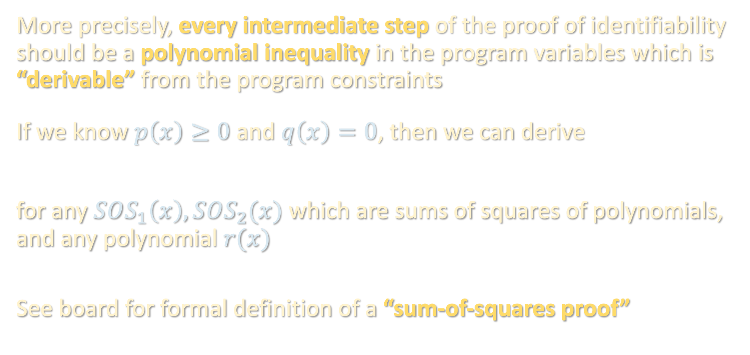
RULES OF THE GAME
More precisely, every intermediate step of the proof of identifiability should be a polynomial inequality in the program variables which is “derivable” from the program constraints
If we know $p\left(x\right)≥0$ and $q\left(x\right)=0$, then we can derive
for any $SOS_{1}\left(x\right),SOS_{2}(x)$ which are sums of squares of polynomials, and any polynomial $r(x)$
See board for formal definition of a “sum-of-squares proof”
$$SOS_{1}\left(x\right)+p\left(x\right)⋅SOS_{2}\left(x\right)+q\left(x\right)⋅r\left(x\right)≥0$$

Slide 26
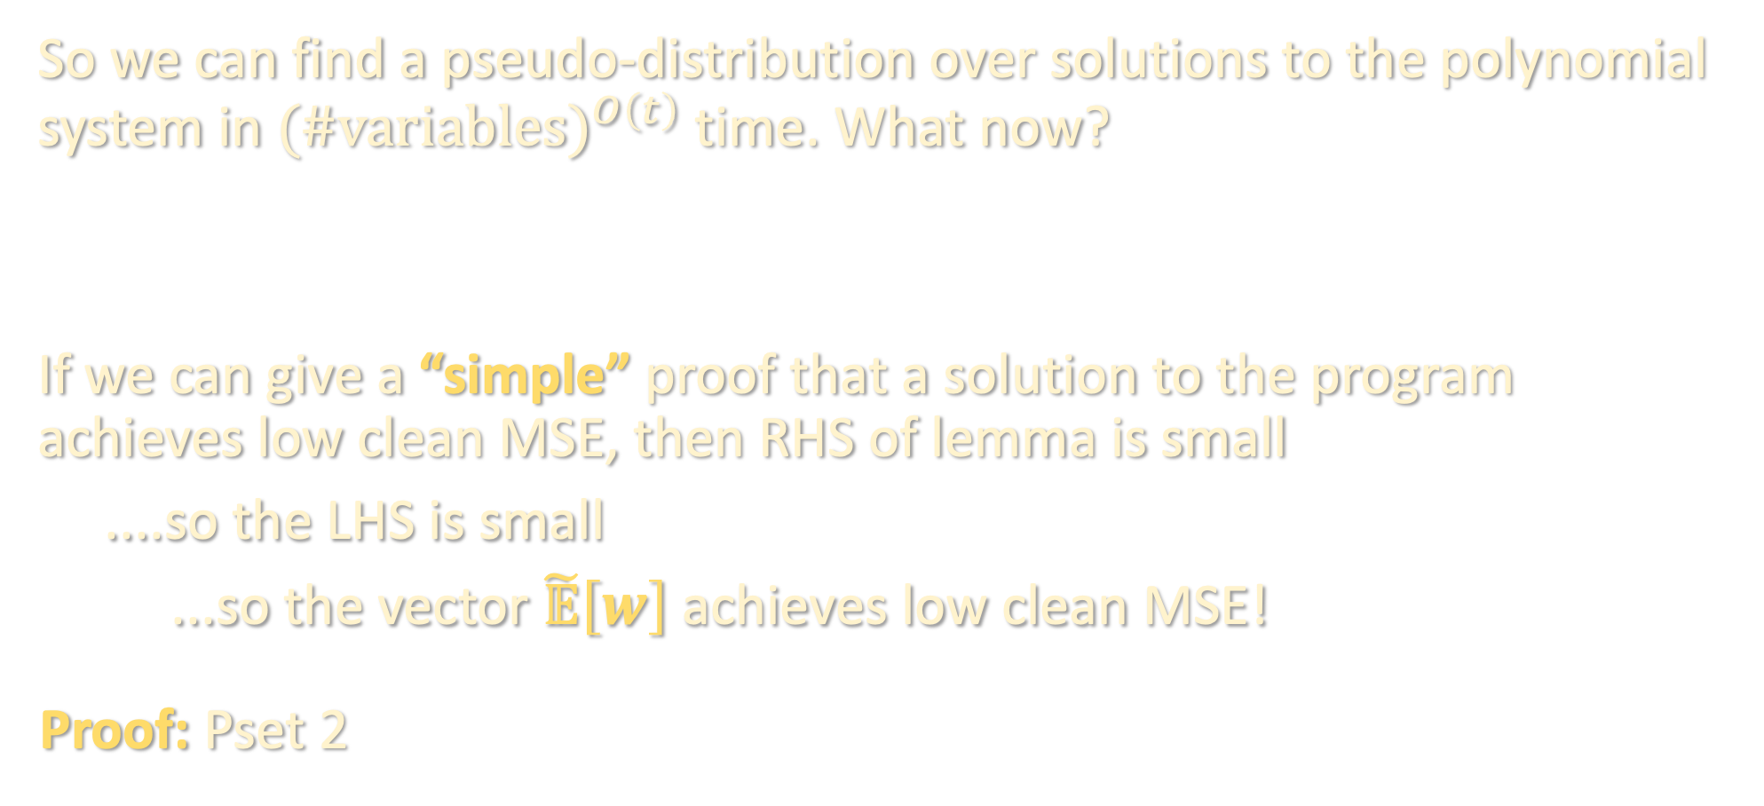
ROUNDING A PSEUDO-DISTRIBUTION
So we can find a pseudo-distribution over solutions to the polynomial system in ${(\#variables)}^{O\left(t\right)}$ time. What now?
If we can give a “simple” proof that a solution to the program achieves low clean MSE, then RHS of lemma is small
....so the LHS is small
...so the vector $\tilde{𝔼}\left[w\right]$ achieves low clean MSE!
Proof: Pset 2
Lemma: $\sum_{clean i}{{\left(\left\langle \tilde{𝔼}\left[w\right],x_{i}\right\rangle −y_{i}\right)}^{2}}≤\sum_{clean i}{\tilde{𝔼}\left[{\left(\left\langle w,x_{i}\right\rangle −y_{i}\right)}^{2}\right]}$

Slide 27
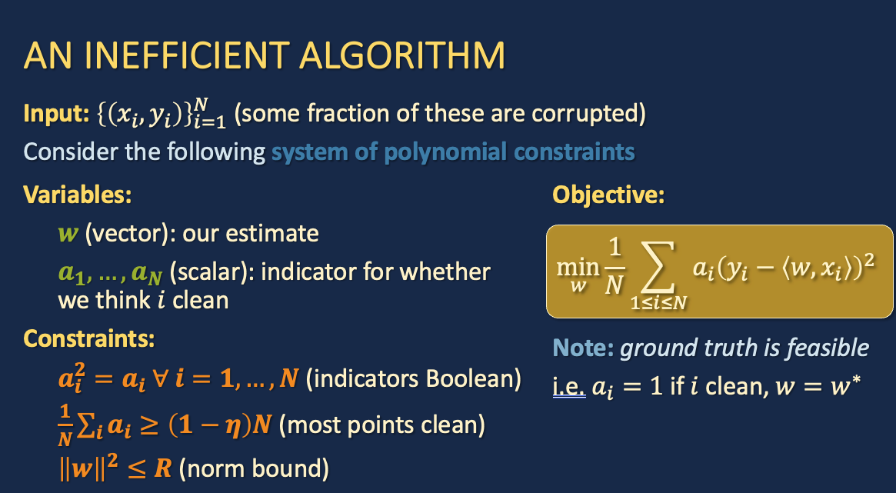
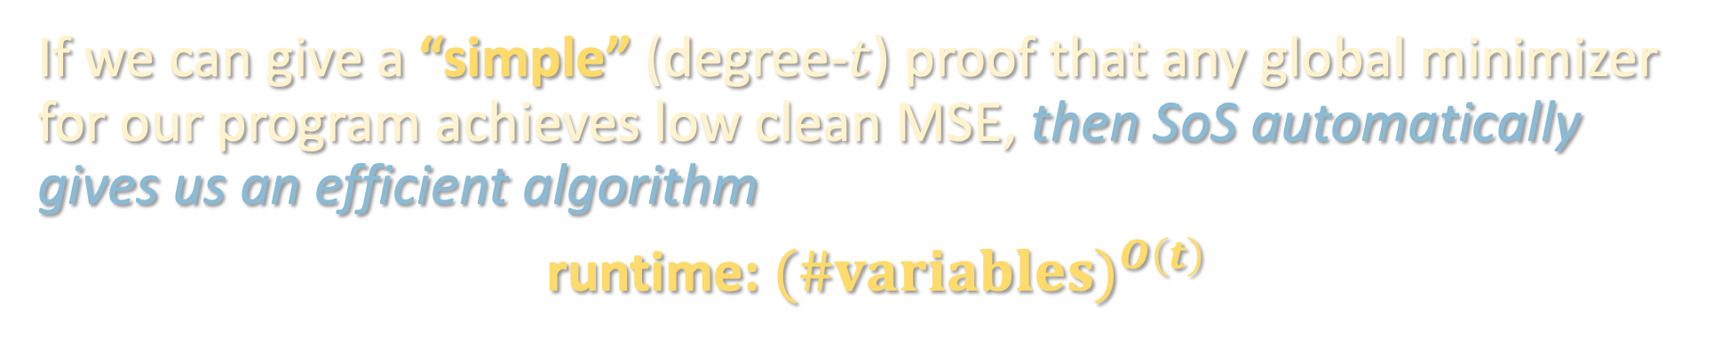
TL;DR
If we can give a “simple” (degree-$t$) proof that any global minimizer for our program achieves low clean MSE, then SoS automatically gives us an efficient algorithm
runtime: ${(\#variables)}^{O\left(t\right)}$

Slide 28
COMING UP
Using SoS to get poly-time algorithms for:
Robust regression with nearly optimal clean MSE
Clustering mixtures of Gaussians down to nearly optimal separation

