Slide 1

CS 2243: ALGORITHMS FOR DATA SCIENCE
LECTURE 8 (9/30)
Tensor decomposition
Sum-of-squares
Supervised learning
Computational complexity
Statistical physics
Generative modeling
PAC LEARNING, FOURIER ANALYSIS, SEMIRANDOM NOISE

Slide 2
ANNOUNCEMENTS
For subsequent pset submissions, make sure to assign pages in Gradescope (see Ed post)

Slide 3
PAC learning – motivation and problem setup
Boolean functions and Fourier analysis
Extensions to agnostic / general distributions
Learning halfspaces and the importance of noise modeling

Slide 4

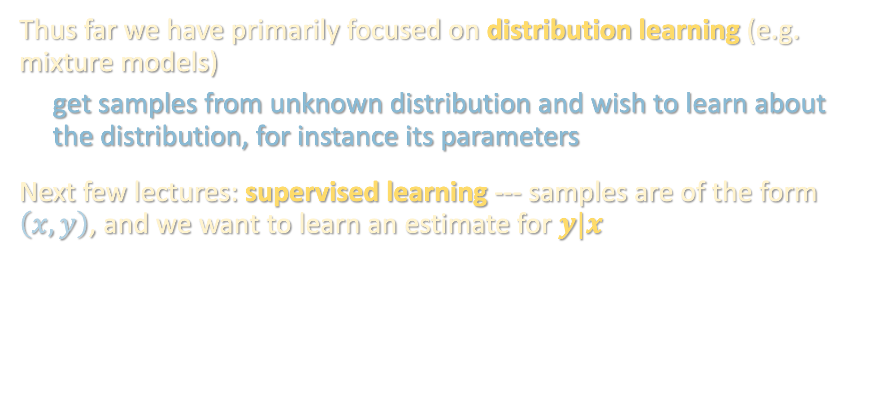
SUPERVISED LEARNING
Thus far we have primarily focused on distribution learning (e.g. mixture models)
get samples from unknown distribution and wish to learn about the distribution, for instance its parameters
Next few lectures: supervised learning --- samples are of the form $\left(x,y\right)$, and we want to learn an estimate for $y|x$
Cat
-----
Dog

Slide 5
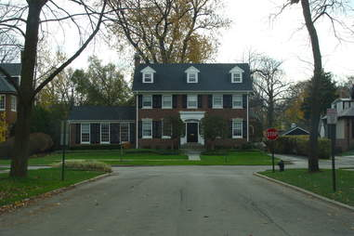
SUPERVISED LEARNING
Thus far we have primarily focused on distribution learning (e.g. mixture models)
get samples from unknown distribution and wish to learn about the distribution, for instance its parameters
Next few lectures: supervised learning --- samples are of the form $\left(x,y\right)$, and we want to learn an estimate for $y|x$
$1,477,600
{ms_sub_class: 60, lot_frontage: 65, lot_area: 8450, overall_qual: 7, overall_cond: 5, age: 37, bsm_fin_sf: 706, gr_liv_area: 1710, bedrooms_abv_gr: 3, garage_area: 548, ...}

Slide 6
SUPERVISED LEARNING
Thus far we have primarily focused on distribution learning (e.g. mixture models)
get samples from unknown distribution and wish to learn about the distribution, for instance its parameters
Next few lectures: supervised learning --- samples are of the form $\left(x,y\right)$, and we want to learn an estimate for $y|x$
{“The”, “quick”, “brown”, “fox”, “jumps”, “over”, “the”, “lazy”, _}
“dog”

Slide 7
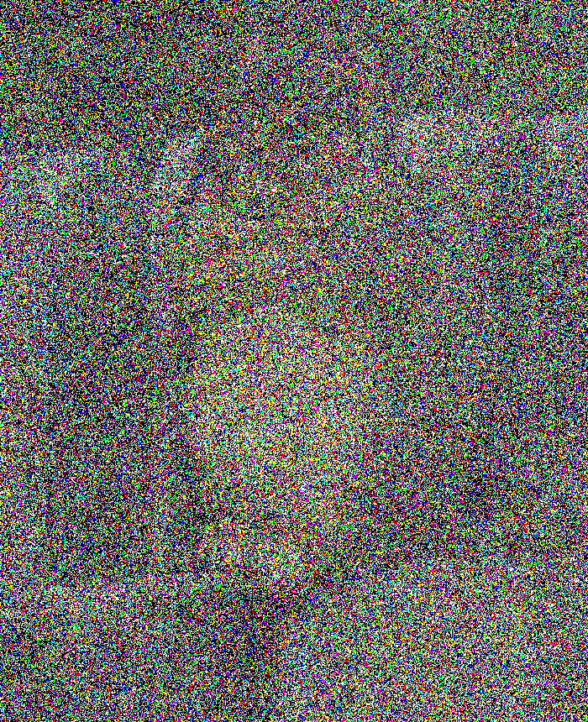
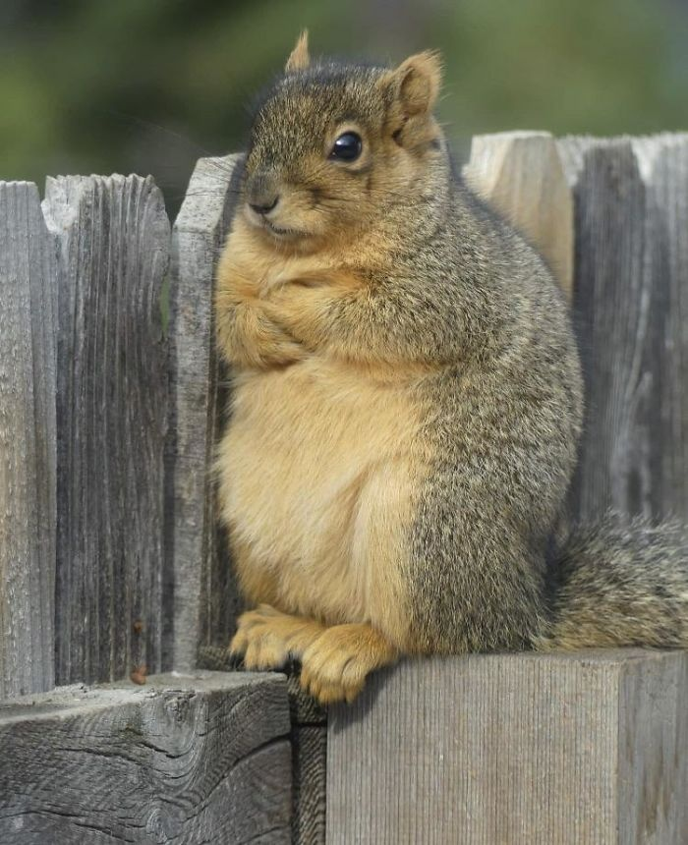
SUPERVISED LEARNING
Thus far we have primarily focused on distribution learning (e.g. mixture models)
get samples from unknown distribution and wish to learn about the distribution, for instance its parameters
Next few lectures: supervised learning --- samples are of the form $\left(x,y\right)$, and we want to learn an estimate for $y|x$

Slide 8
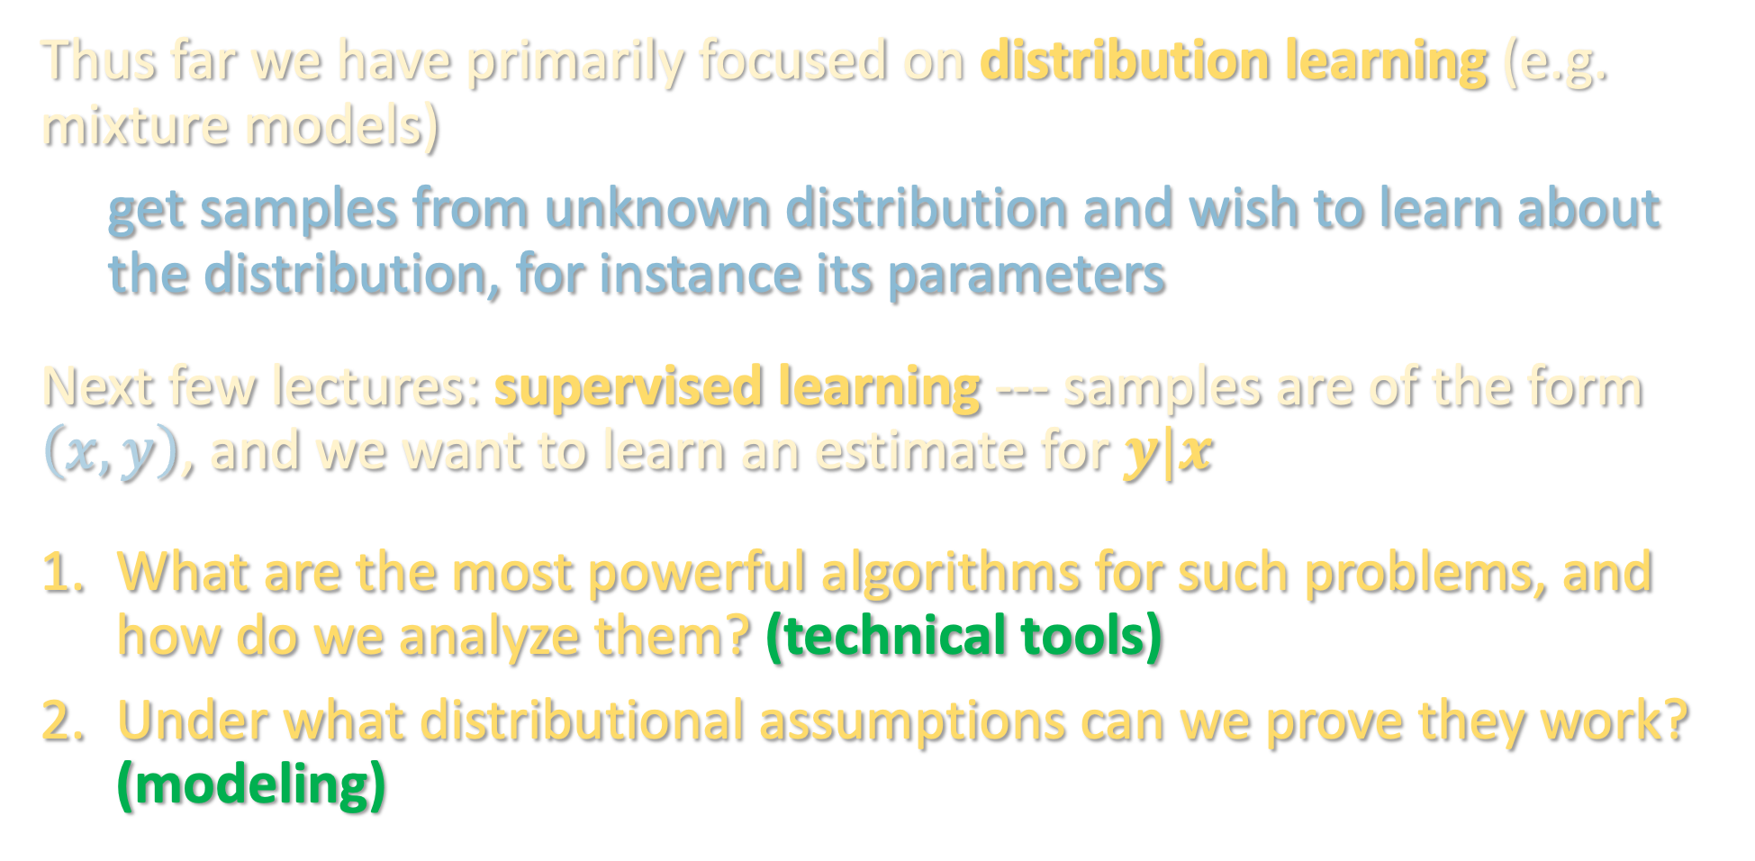
SUPERVISED LEARNING
Thus far we have primarily focused on distribution learning (e.g. mixture models)
get samples from unknown distribution and wish to learn about the distribution, for instance its parameters
Next few lectures: supervised learning --- samples are of the form $\left(x,y\right)$, and we want to learn an estimate for $y|x$
What are the most powerful algorithms for such problems, and how do we analyze them? (technical tools)
Under what distributional assumptions can we prove they work? (modeling)

Slide 9
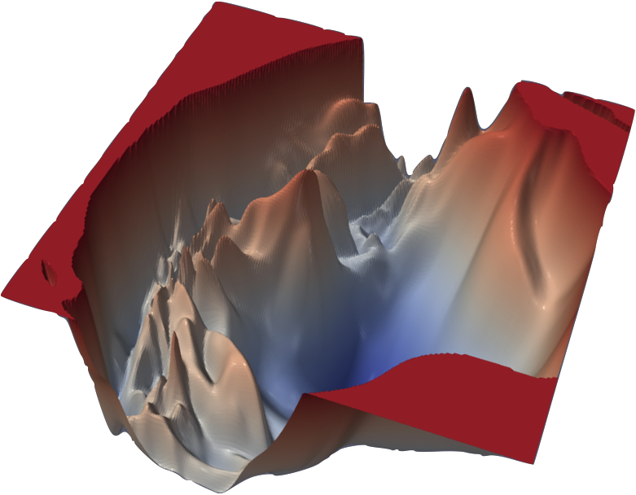
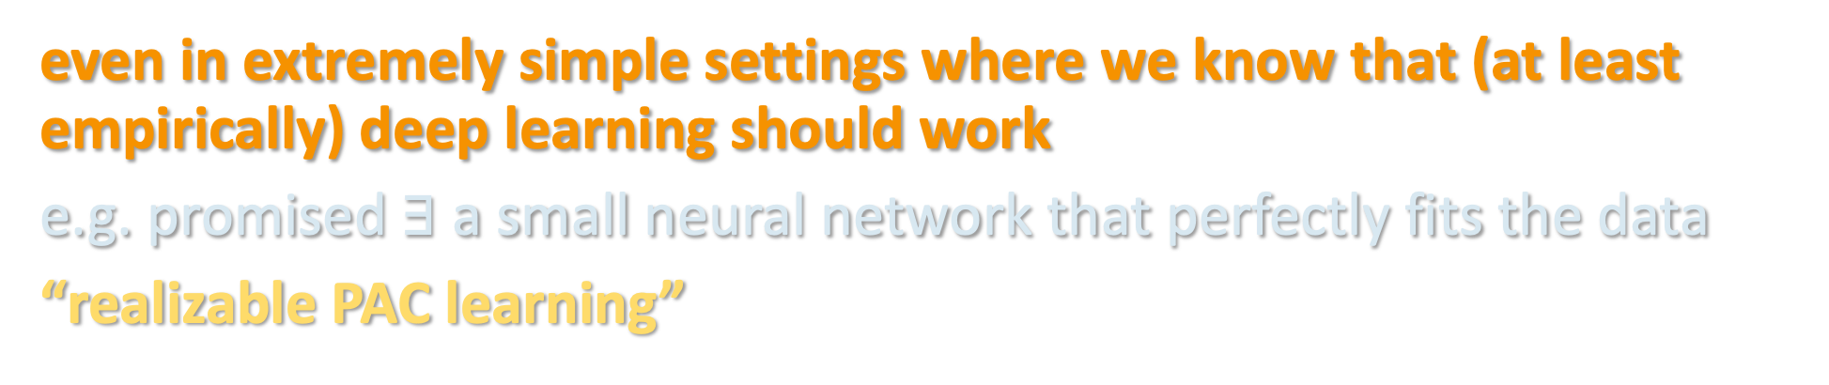
SUPERVISED LEARNING
Algorithm of choice in practice: “deep learning” - run SGD to optimize a deep neural network to fit training examples. Still mostly a mystery why this works except in very specialized settings...
Before we can understand why this works so well, should first understand why any polynomial-time algorithm could work
even in extremely simple settings where we know that (at least empirically) deep learning should work
e.g. promised $∃$ a small neural network that perfectly fits the data
“realizable PAC learning”

Slide 10
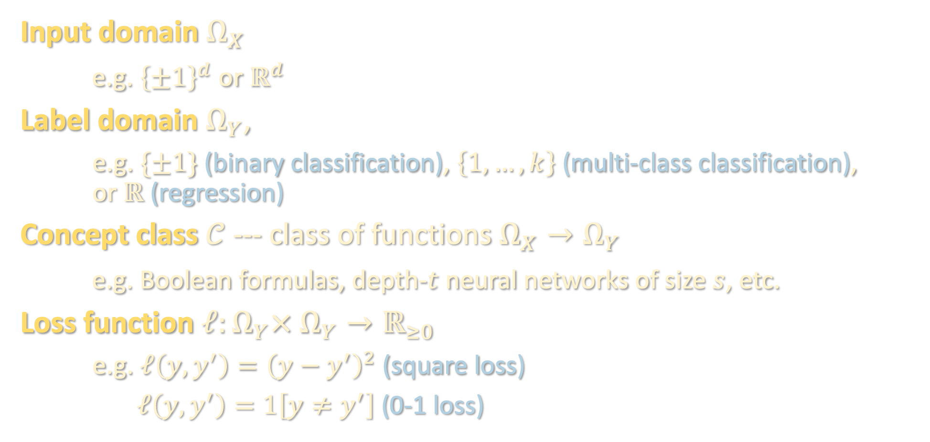
PROBABLY APPROXIMATELY CORRECT (PAC) LEARNING
[Valiant ‘84]
Input domain $Ω_{X}$
e.g. ${\left\{±1\right\}}^{d}$ or $ℝ^{d}$
Label domain $Ω_{Y}$,
e.g. $\{±1\}$ (binary classification), $\left\{1,…,k\right\}$ (multi-class classification), or $ℝ$ (regression)
Concept class $𝒞$ --- class of functions $Ω_{X}→Ω_{Y}$
e.g. Boolean formulas, depth-$t$ neural networks of size $s$, etc.
Loss function $ℓ:Ω_{Y}× Ω_{Y}→ℝ_{≥0}$
e.g. $ℓ\left(y,y^{′}\right)={\left(y−y^{′}\right)}^{2}$ (square loss)
$ℓ\left(y,y^{′}\right)=1\left[y≠y^{′}\right]$ (0-1 loss)

Slide 11
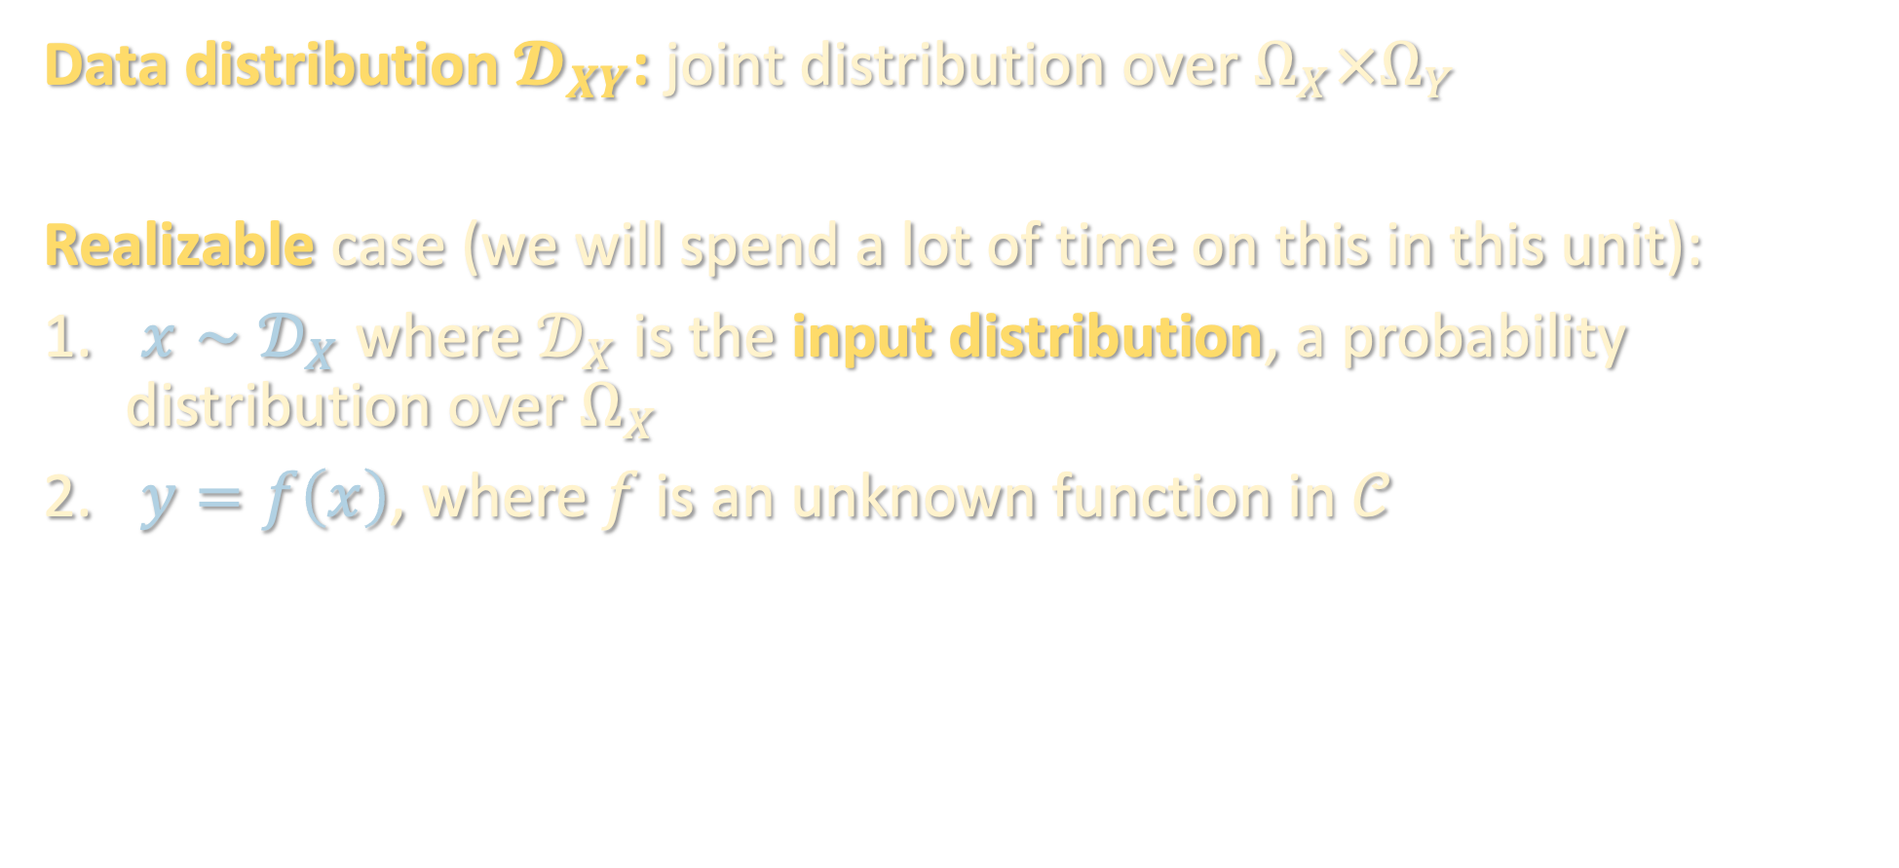
PROBABLY APPROXIMATELY CORRECT (PAC) LEARNING
Data distribution $𝓓_{XY}$: joint distribution over $Ω_{X}×Ω_{Y}$
Realizable case (we will spend a lot of time on this in this unit):
$x∼𝒟_{X}$ where $𝒟_{X}$ is the input distribution, a probability distribution over $Ω_{X}$
$y=f\left(x\right)$, where $f$ is an unknown function in $𝒞$

Slide 12
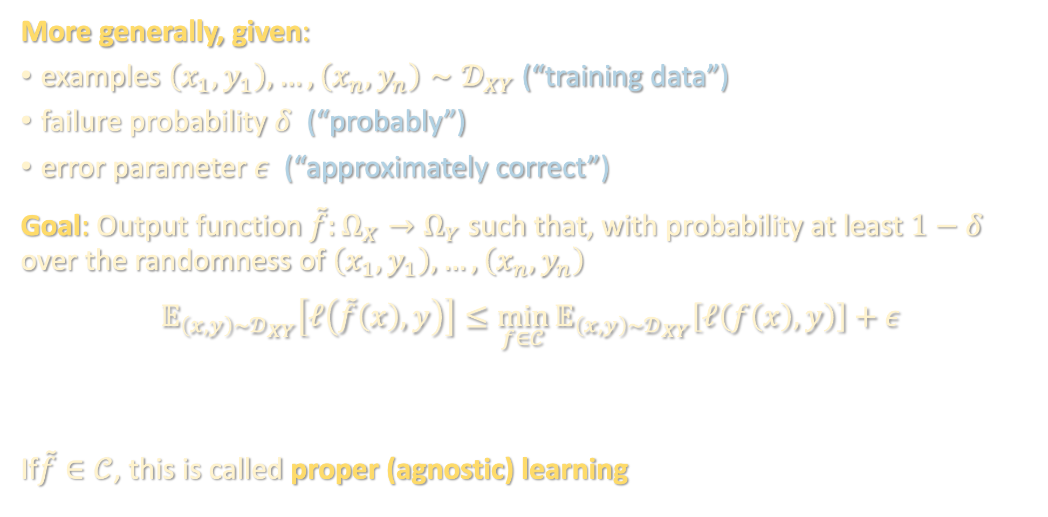
PROBABLY APPROXIMATELY CORRECT (PAC) LEARNING
More generally, given:
examples $\left(x_{1},y_{1}\right),…,\left(x_{n},y_{n}\right)∼𝒟_{XY}$ (“training data”)
failure probability $δ$ (“probably”)
error parameter $ε$ (“approximately correct”)
Goal: Output function $\tilde{f}:Ω_{X}→Ω_{Y}$ such that, with probability at least $1−δ$ over the randomness of $\left(x_{1},y_{1}\right),…,\left(x_{n},y_{n}\right)$
$$𝔼_{\left(x,y\right)∼𝒟_{XY}}\left[ℓ\left(\tilde{f}\left(x\right),y\right)\right]≤\min_{f∈𝒞}{𝔼_{\left(x,y\right)∼𝒟_{XY}}\left[ℓ\left(f\left(x\right),y\right)\right]}+ε$$
If$\tilde{f}∈𝒞$, this is called proper (agnostic) learning
test loss
OPT
(in realizable case, OPT = 0)

Slide 13
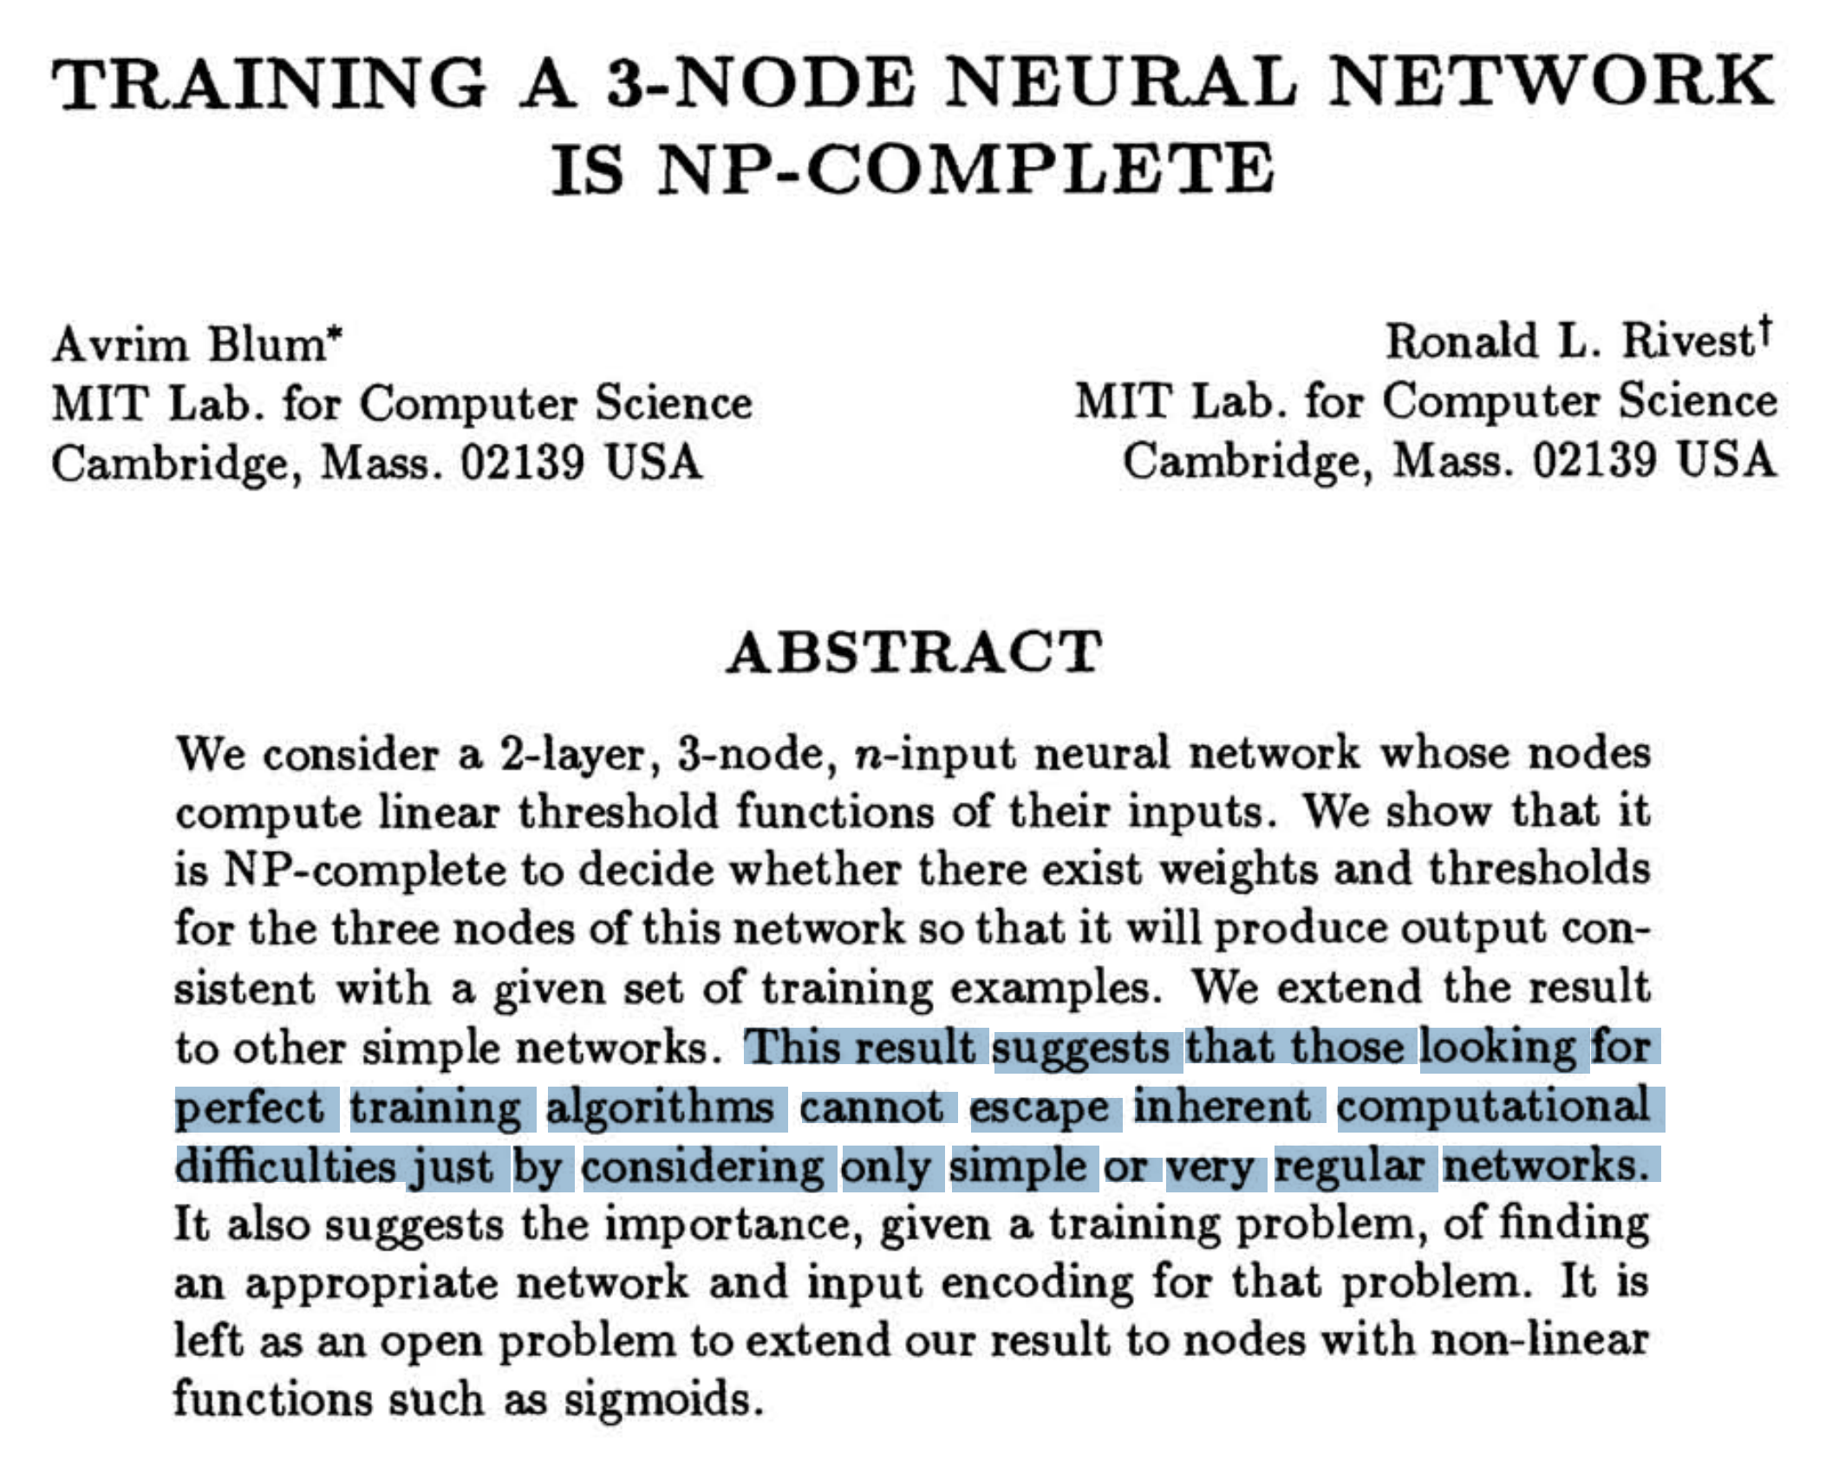

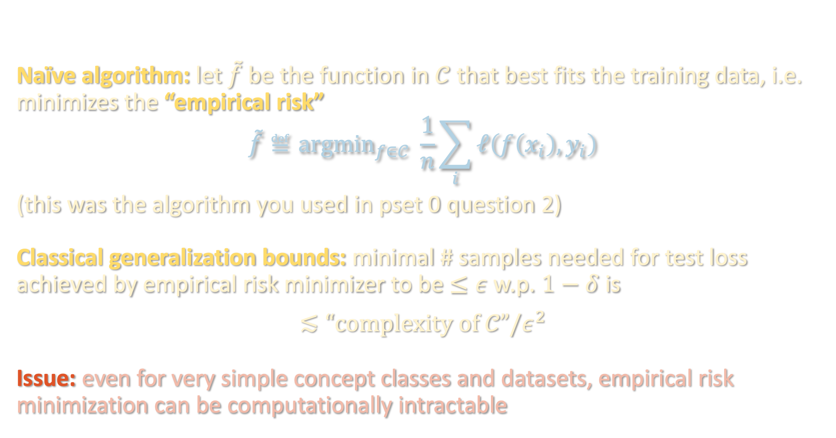
EMPIRICAL RISK MINIMIZATION
Naïve algorithm: let $\tilde{f}$ be the function in $𝒞$ that best fits the training data, i.e. minimizes the “empirical risk”
$$\tilde{f}≝{argmin}_{f∈𝒞} \frac{1}{n}\sum_{i}{ℓ\left(f\left(x_{i}\right),y_{i}\right)}$$
(this was the algorithm you used in pset 0 question 2)
Classical generalization bounds: minimal # samples needed for test loss achieved by empirical risk minimizer to be $≤ε$ w.p. $1−δ$ is
$$≲“complexity of 𝒞”/ε^{2}$$
Issue: even for very simple concept classes and datasets, empirical risk minimization can be computationally intractable
$\log{|𝒞|}$
Rademacher complexity
VC dimension
Covering number
Fat-shattering number
….

Slide 14

EFFICIENT ALGORITHMS
Here we will focus on provably correct algorithms for PAC learning that run in polynomial time
Distribution-free with Massart noise
Known
Truth?
generality of
distributional
assumption
Gaussian/
uniform over ${\left\{±1\right\}}^{n}$
*
Halfspaces
Neural networks
expressivity of function class

Slide 15
PAC learning – motivation and problem setup
Boolean functions and Fourier analysis
Extensions to agnostic / general distributions
Learning halfspaces and the importance of noise modeling

Slide 16
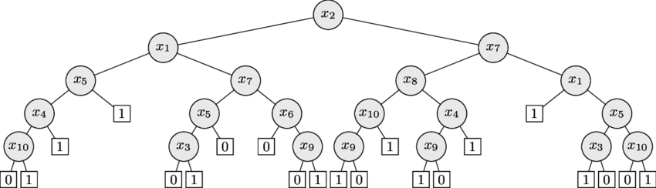
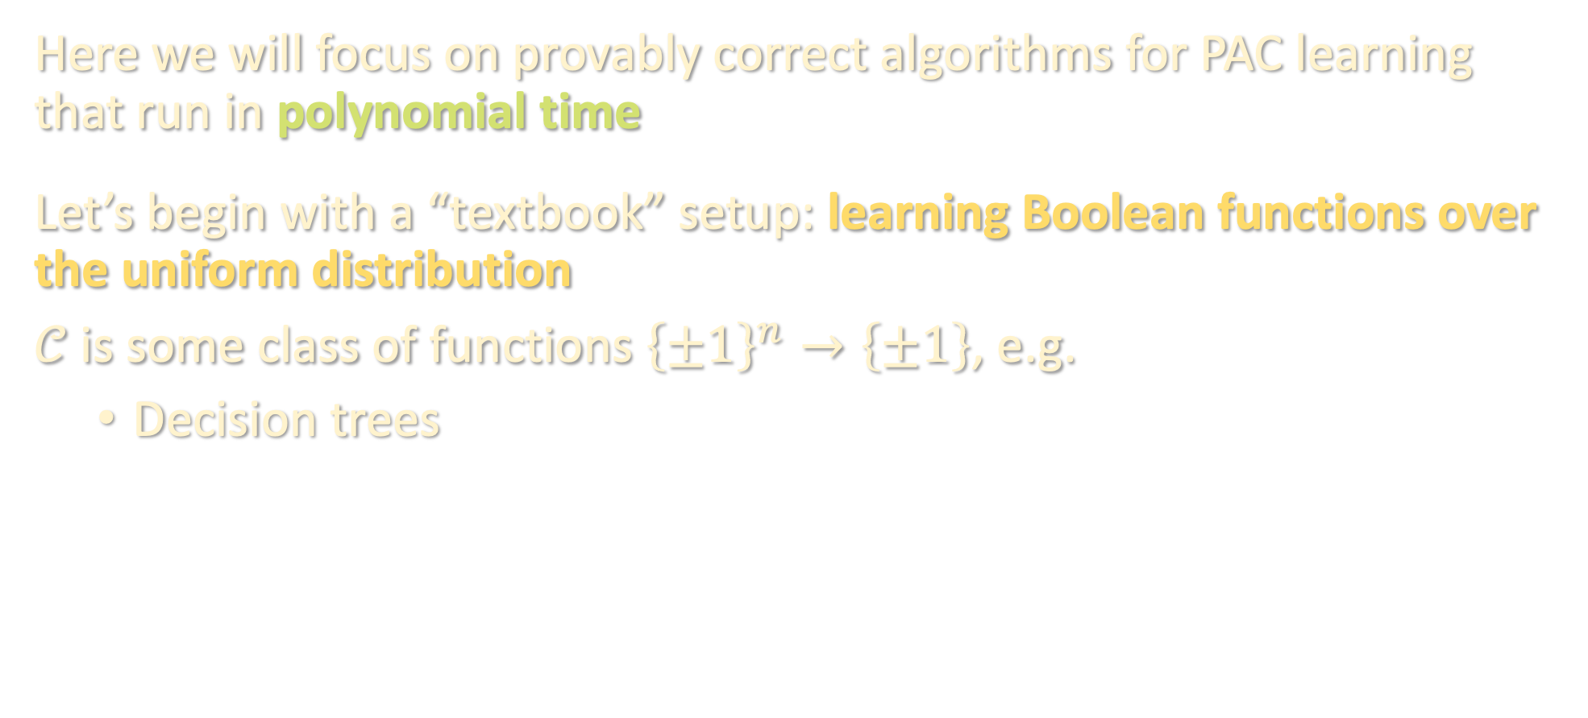
EFFICIENT ALGORITHMS
Here we will focus on provably correct algorithms for PAC learning that run in polynomial time
Let’s begin with a “textbook” setup: learning Boolean functions over the uniform distribution
$𝒞$ is some class of functions ${\left\{±1\right\}}^{n}→\left\{±1\right\}$, e.g.
Decision trees

Slide 17
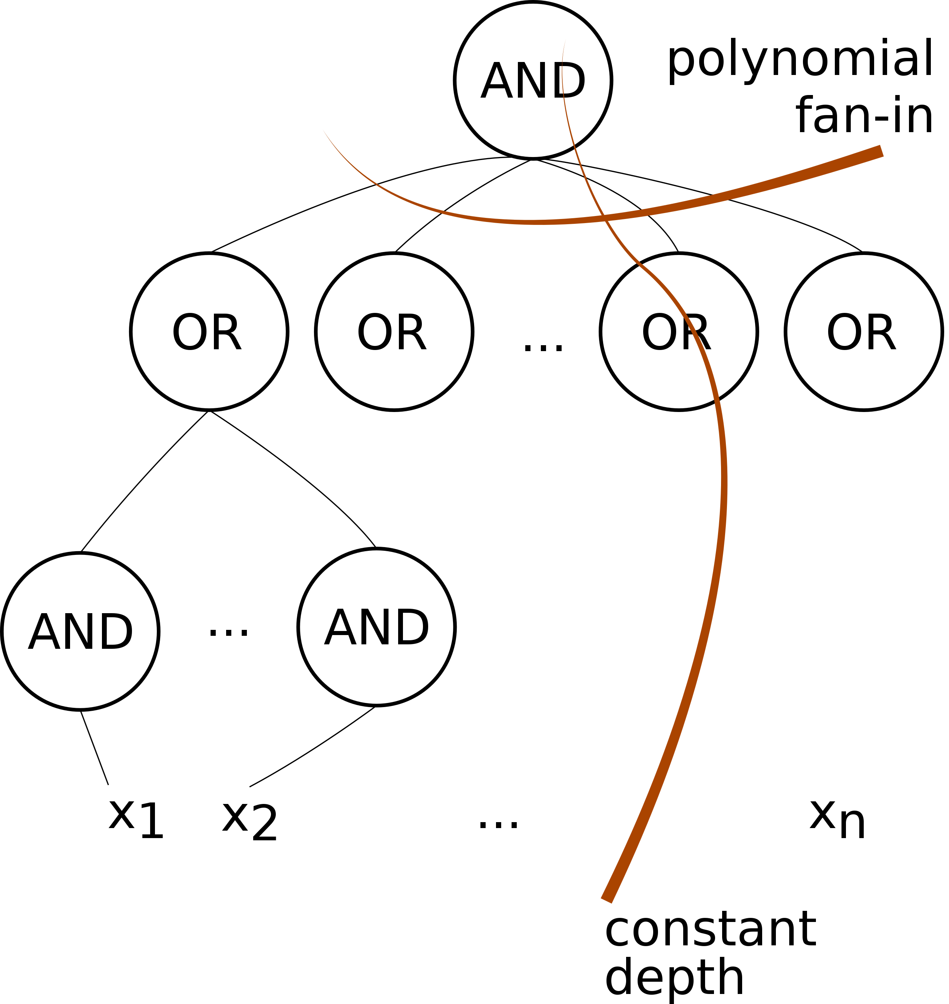
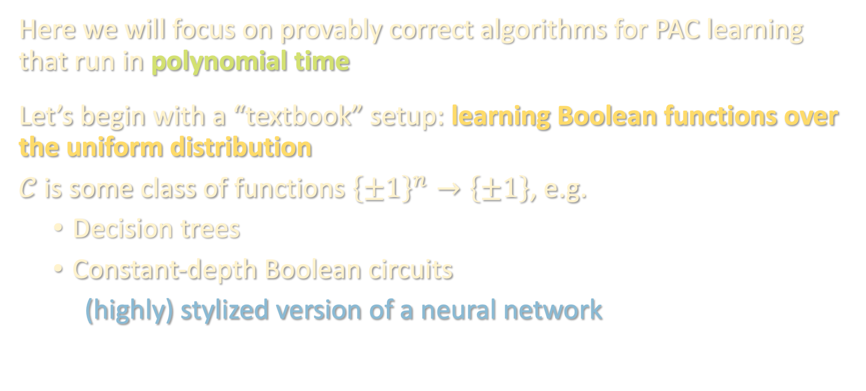
EFFICIENT ALGORITHMS
Here we will focus on provably correct algorithms for PAC learning that run in polynomial time
Let’s begin with a “textbook” setup: learning Boolean functions over the uniform distribution
$𝒞$ is some class of functions ${\left\{±1\right\}}^{n}→\left\{±1\right\}$, e.g.
Decision trees
Constant-depth Boolean circuits
(highly) stylized version of a neural network

Slide 18
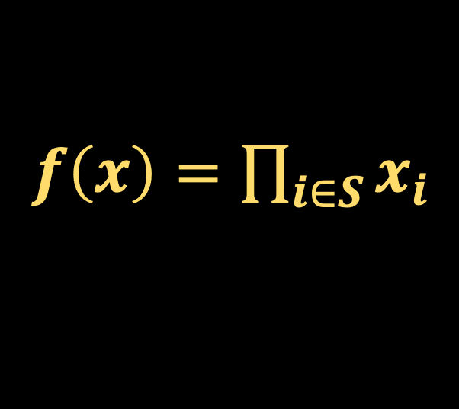
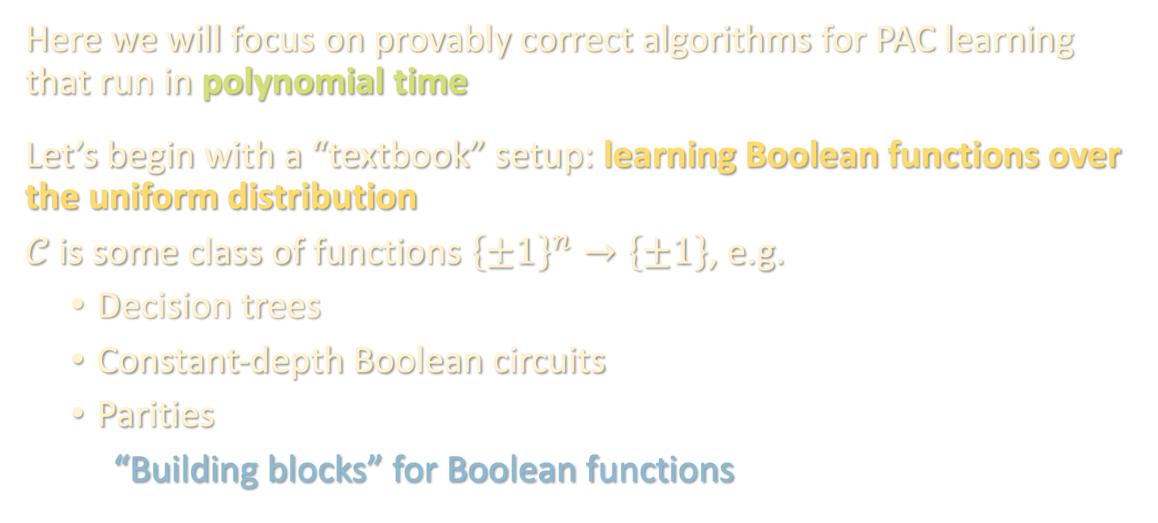
EFFICIENT ALGORITHMS
Here we will focus on provably correct algorithms for PAC learning that run in polynomial time
Let’s begin with a “textbook” setup: learning Boolean functions over the uniform distribution
$𝒞$ is some class of functions ${\left\{±1\right\}}^{n}→\left\{±1\right\}$, e.g.
Decision trees
Constant-depth Boolean circuits
Parities
“Building blocks” for Boolean functions
$f\left(x\right)=\prod_{i∈S}{x_{i}}$

Slide 19
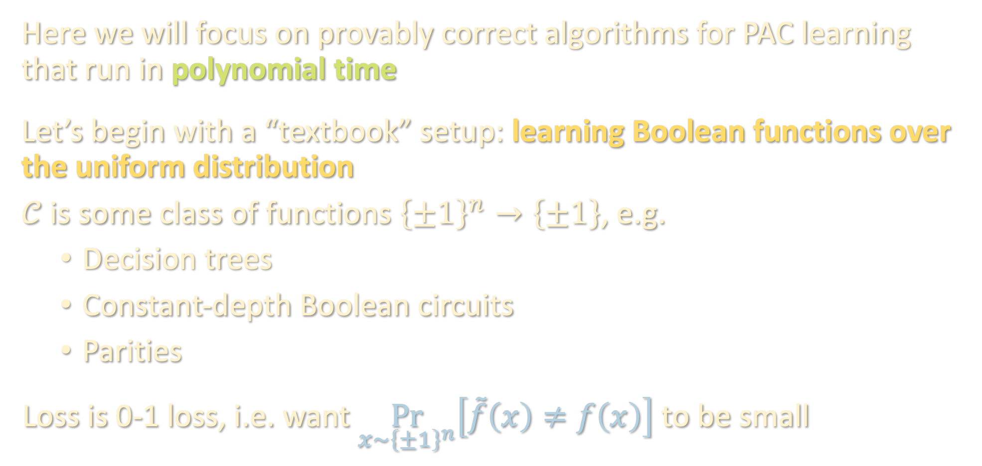
EFFICIENT ALGORITHMS
Here we will focus on provably correct algorithms for PAC learning that run in polynomial time
Let’s begin with a “textbook” setup: learning Boolean functions over the uniform distribution
$𝒞$ is some class of functions ${\left\{±1\right\}}^{n}→\left\{±1\right\}$, e.g.
Decision trees
Constant-depth Boolean circuits
Parities
Loss is 0-1 loss, i.e. want $\underset{x∼{\left\{±1\right\}}^{n}}{Pr}\left[\tilde{f}\left(x\right)≠f\left(x\right)\right]$ to be small

Slide 20
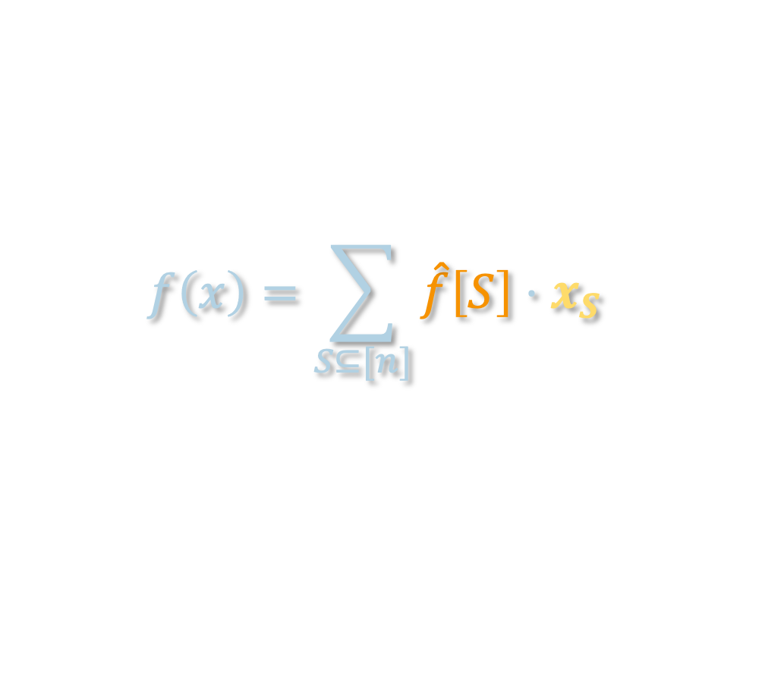
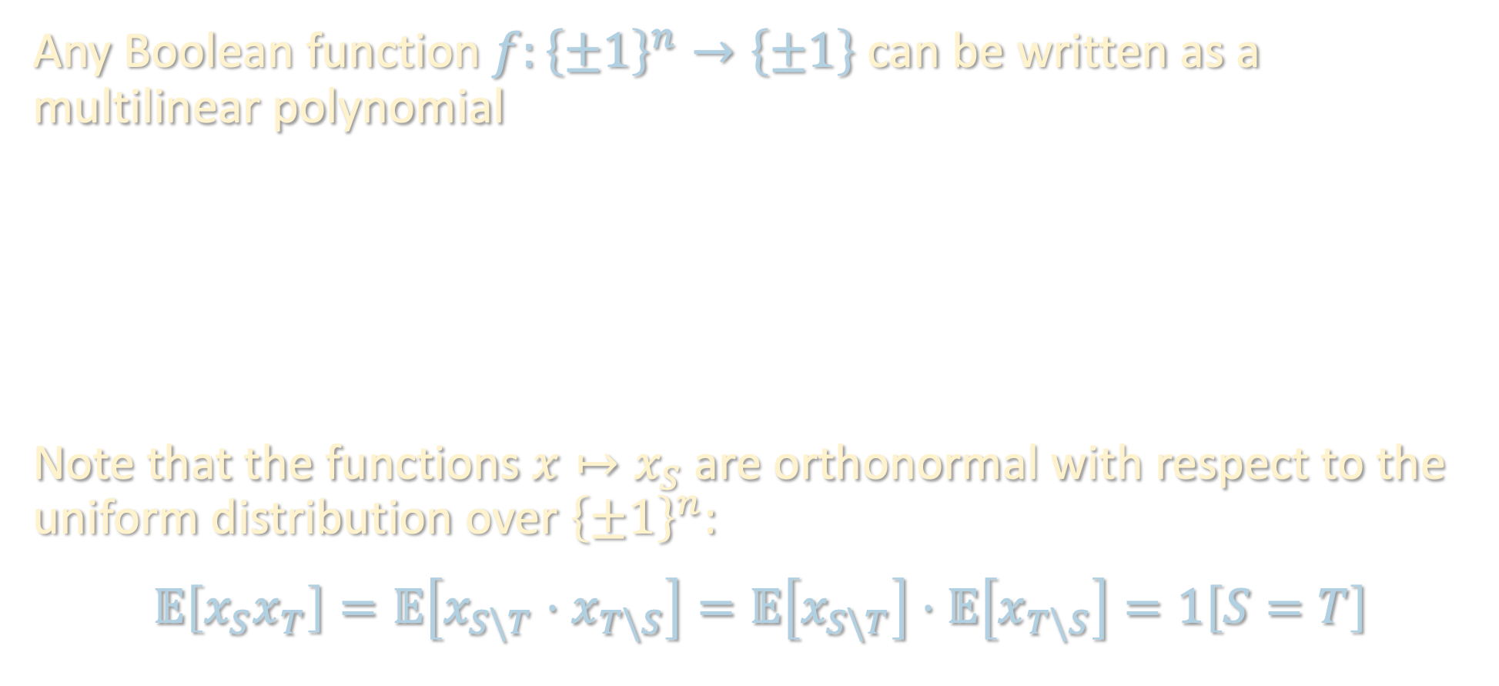

FOURIER ANALYSIS OF BOOLEAN FUNCTIONS
Any Boolean function $f:{\left\{±1\right\}}^{n}→\left\{±1\right\}$ can be written as a multilinear polynomial
$$f\left(x\right)=\sum_{S⊆[n]}{\hat{f}\left[S\right]⋅x_{S}}$$
Note that the functions $x↦x_{S}$ are orthonormal with respect to the uniform distribution over ${\left\{±1\right\}}^{n}$:
$$𝔼\left[x_{S}x_{T}\right]=𝔼\left[x_{S\backslash T}⋅x_{T\backslash S}\right]=𝔼\left[x_{S\backslash T}\right]⋅𝔼\left[x_{T\backslash S}\right]=1\left[S=T\right]$$
$$f\left(x\right)=\sum_{S⊆[n]}{\hat{f}\left[S\right]⋅x_{S}}$$
Parity / Fourier character / basis function
Fourier coefficient
Example: $f\left[∅\right]=𝔼\left[f\right]$

Slide 21

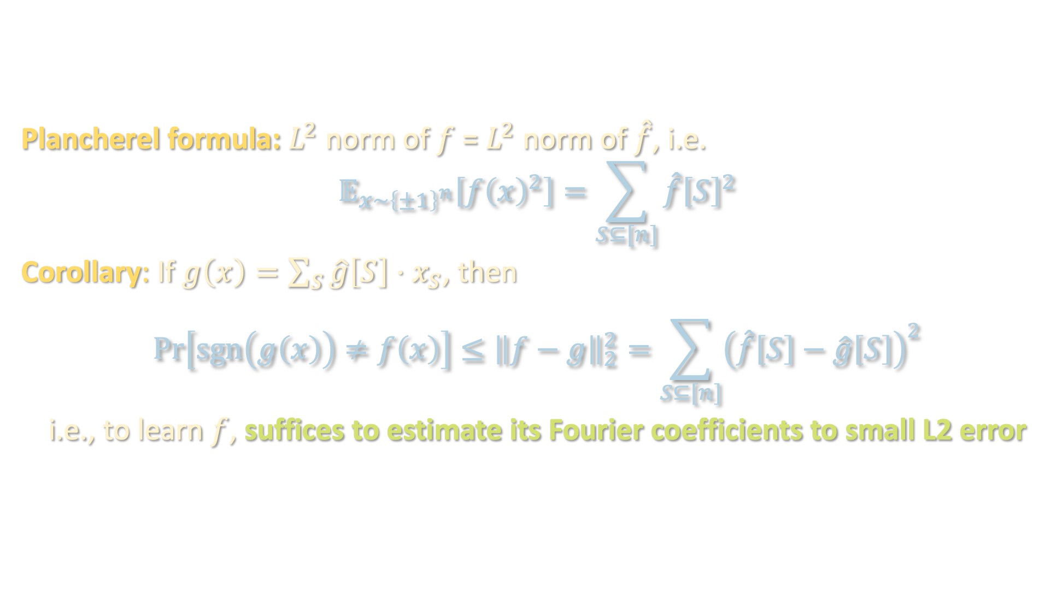

FOURIER ANALYSIS OF BOOLEAN FUNCTIONS
Plancherel formula: $L^{2}$ norm of $f$ = $L^{2}$ norm of $\hat{f}$, i.e.
$$𝔼_{x∼{\left\{±1\right\}}^{n}}\left[f{\left(x\right)}^{2}\right]=\sum_{S⊆[n]}{\hat{f}{\left[S\right]}^{2}}$$
Corollary: If $g\left(x\right)=\sum_{S}{\hat{g}\left[S\right]⋅x_{S}}$, then
$$\operatorname{Pr}\left[\operatorname{sgn}\left(g\left(x\right)\right)≠f\left(x\right)\right]≤{\left\|f−g\right\|}_{2}^{2}=\sum_{S⊆[n]}{{\left(\hat{f}\left[S\right]−\hat{g}\left[S\right]\right)}^{2}}$$
i.e., to learn $f$, suffices to estimate its Fourier coefficients to small L2 error
$$f\left(x\right)=\sum_{S⊆[n]}{\hat{f}\left[S\right]⋅x_{S}}$$
We denote this by ${\left\|f\right\|}_{2}^{2}$

Slide 22
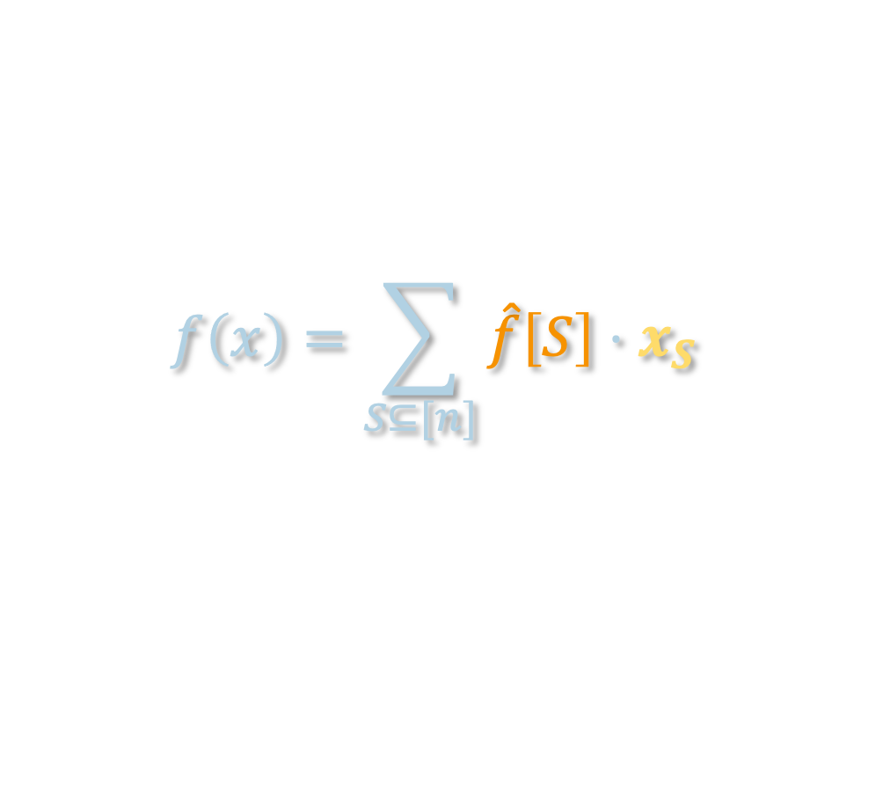
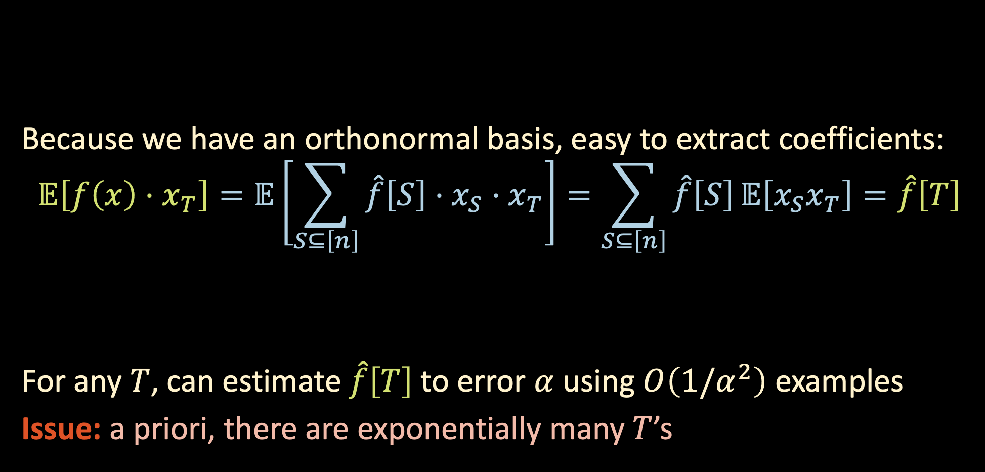
FOURIER ANALYSIS OF BOOLEAN FUNCTIONS
$$f\left(x\right)=\sum_{S⊆[n]}{\hat{f}\left[S\right]⋅x_{S}}$$
Because we have an orthonormal basis, easy to extract coefficients:
$$𝔼\left[f\left(x\right)⋅x_{T}\right]=𝔼\left[\sum_{S⊆\left[n\right]}{\hat{f}\left[S\right]⋅x_{S}}⋅x_{T}\right]=\sum_{S⊆\left[n\right]}{\hat{f}\left[S\right]}𝔼\left[x_{S}x_{T}\right]=\hat{f}\left[T\right]$$
For any $T$, can estimate $\hat{f}\left[T\right]$to error $α$ using $O\left(1/α^{2}\right)$ examples
Issue: a priori, there are exponentially many $T$’s
We can estimate this empirically using our training data!

Slide 23
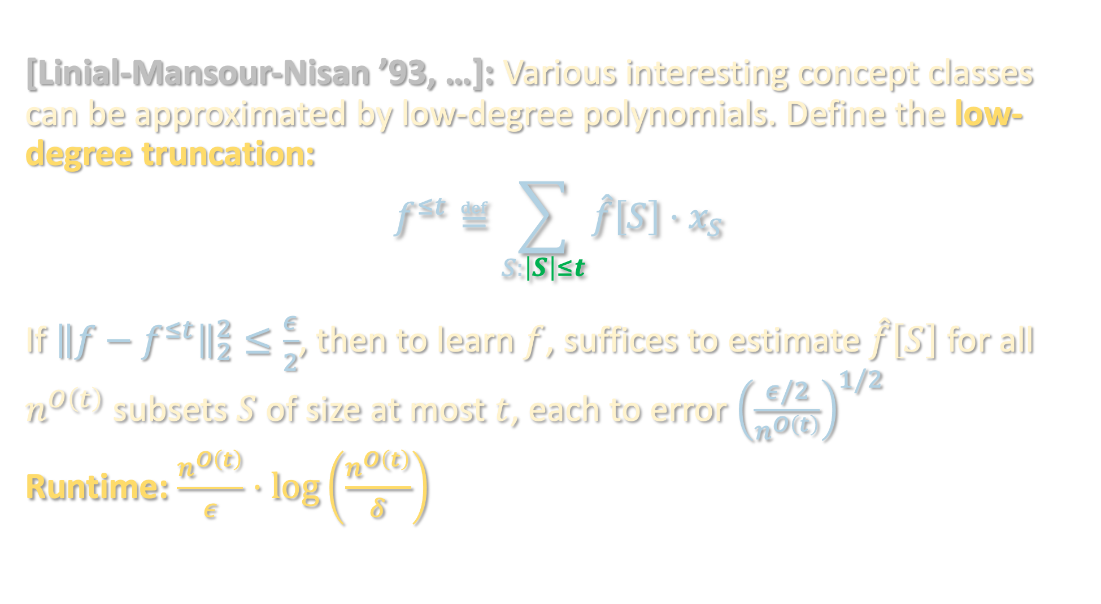
LOW-DEGREE ALGORITHM
[Linial-Mansour-Nisan ’93, …]: Various interesting concept classes can be approximated by low-degree polynomials. Define the low-degree truncation:
$$f^{≤t}≝\sum_{S:\left|S\right|≤t}{\hat{f}\left[S\right]⋅x_{S}}$$
If ${\left\|f−f^{≤t}\right\|}_{2}^{2}≤\frac{ε}{2}$, then to learn $f$, suffices to estimate $\hat{f}\left[S\right]$ for all $n^{O\left(t\right)}$ subsets $S$ of size at most $t$, each to error ${\left(\frac{ε/2}{n^{O\left(t\right)}}\right)}^{1/2}$
Runtime: $\frac{n^{O\left(t\right)}}{ε}⋅\log\left(\frac{n^{O\left(t\right)}}{δ}\right)$

Slide 24
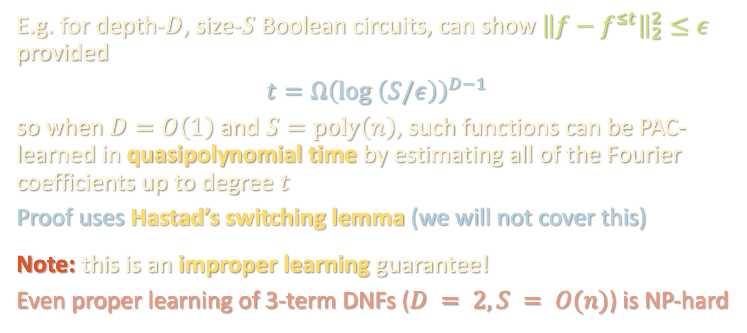
LOW-DEGREE ALGORITHM
E.g. for depth-$D$, size-$S$ Boolean circuits, can show ${\left\|f−f^{≤t}\right\|}_{2}^{2}≤ε$ provided
$$t=Ω{\left(\log\left(S/ε\right)\right)}^{D−1 }$$
so when $D=O\left(1\right)$ and $S=poly\left(n\right)$, such functions can be PAC-learned in quasipolynomial time by estimating all of the Fourier coefficients up to degree $t$
Proof uses Hastad’s switching lemma (we will not cover this)
Note: this is an improper learning guarantee!
Even proper learning of 3-term DNFs ($D = 2, S = O(n)$) is NP-hard

Slide 25
PAC learning – motivation and problem setup
Boolean functions and Fourier analysis
Extensions to agnostic / general distributions
Learning halfspaces and the importance of noise modeling

Slide 26


REMARK ON AGNOSTIC LEARNING
Low-degree algorithm also provides guarantees in agnostic setting:
$\min_{g:\deg\left(g\right)≤t}{𝔼\left[{\left(g\left(x\right)−y\right)}^{2}\right]}$ | $$≤𝔼\left[{\left(f^{≤t}\left(x\right)−y\right)}^{2}\right]$$
 | $$=𝔼\left[{\left(\left(f^{≤t}\left(x\right)−f\left(x\right)\right)+\left(f\left(x\right)−y\right)\right)}^{2}\right]$$
 | $$≤2 𝔼\left[{\left(f^{≤t}\left(x\right)−f\left(x\right)\right)}^{2}\right]+2 𝔼\left[{\left(f\left(x\right)−y\right)}^{2}\right]$$
 | $$≤O\left(ε\right)+8\operatorname{Pr}\left[f\left(x\right)≠y\right]$$
 | $$=O\left(ε\right)+8 OPT$$
The low-degree algorithm is finding (an approximation to) the best low-degree approximation to the label. Optimal $g$ can be found with polynomial regression

Slide 27


REMARK ON AGNOSTIC LEARNING
Low-degree algorithm also provides guarantees in agnostic setting:
Note that $Pr\left[\operatorname{sgn}\left(g\left(x\right)\right)≠y\right]≤𝔼\left[{\left(g\left(x\right)−y\right)}^{2}\right]$, so low-degree algorithm achieves constant-factor approximation to OPT
Solving $\min_{g:\deg\left(g\right)≤t}{𝔼\left[\left|g\left(x\right)−y\right|\right]}$ and taking $\operatorname{sgn}\left(g\left(x\right)−s\right)$ for optimal $s$ upgrades this to $OPT+O\left(ε\right)$ “for free” [Kalai-Klivans-Mansour-Servedio ‘06] “L1 polynomial regression”
$\min_{g:\deg\left(g\right)≤t}{𝔼\left[{\left(g\left(x\right)−y\right)}^{2}\right]}$ | $$≤𝔼\left[{\left(f^{≤t}\left(x\right)−y\right)}^{2}\right]$$
 | $$=𝔼\left[{\left(\left(f^{≤t}\left(x\right)−f\left(x\right)\right)+\left(f\left(x\right)−y\right)\right)}^{2}\right]$$
 | $$≤2 𝔼\left[{\left(f^{≤t}\left(x\right)−f\left(x\right)\right)}^{2}\right]+2 𝔼\left[{\left(f\left(x\right)−y\right)}^{2}\right]$$
 | $$≤O\left(ε\right)+8\operatorname{Pr}\left[f\left(x\right)≠y\right]$$
 | $$=O\left(ε\right)+8 OPT$$

Slide 28

REMARK ON AGNOSTIC LEARNING
Low-degree algorithm also provides guarantees in agnostic setting:
$\min_{g:\deg\left(g\right)≤t}{𝔼\left[{\left(g\left(x\right)−y\right)}^{2}\right]}$ | $$≤𝔼\left[{\left(f^{≤t}\left(x\right)−y\right)}^{2}\right]$$
 | $$=𝔼\left[{\left(\left(f^{≤t}\left(x\right)−f\left(x\right)\right)+\left(f\left(x\right)−y\right)\right)}^{2}\right]$$
 | $$≤2 𝔼\left[{\left(f^{≤t}\left(x\right)−f\left(x\right)\right)}^{2}\right]+2 𝔼\left[{\left(f\left(x\right)−y\right)}^{2}\right]$$
 | $$≤O\left(ε\right)+8\operatorname{Pr}\left[f\left(x\right)≠y\right]$$
 | $$=O\left(ε\right)+8 OPT$$

Slide 29

REMARK ON AGNOSTIC LEARNING
Low-degree algorithm also provides guarantees in agnostic setting:
$\min_{g:\deg\left(g\right)≤t}{𝔼\left[{\left(g\left(x\right)−y\right)}^{2}\right]}$ | $$≤𝔼\left[{\left(f^{≤t}\left(x\right)−y\right)}^{2}\right]$$
 | $$=𝔼\left[{\left(\left(f^{≤t}\left(x\right)−f\left(x\right)\right)+\left(f\left(x\right)−y\right)\right)}^{2}\right]$$
 | $$≤2 𝔼\left[{\left(f^{≤t}\left(x\right)−f\left(x\right)\right)}^{2}\right]+2 𝔼\left[{\left(f\left(x\right)−y\right)}^{2}\right]$$
 | $$≤O\left(ε\right)+8\operatorname{Pr}\left[f\left(x\right)≠y\right]$$
 | $$=O\left(ε\right)+8 OPT$$

Slide 30

REMARK ON AGNOSTIC LEARNING
Low-degree algorithm also provides guarantees in agnostic setting:
$\min_{g:\deg\left(g\right)≤t}{𝔼\left[{\left(g\left(x\right)−y\right)}^{2}\right]}$ | $$≤𝔼\left[{\left(f^{≤t}\left(x\right)−y\right)}^{2}\right]$$
 | $$=𝔼\left[{\left(\left(f^{≤t}\left(x\right)−f\left(x\right)\right)+\left(f\left(x\right)−y\right)\right)}^{2}\right]$$
 | $$≤2 𝔼\left[{\left(f^{≤t}\left(x\right)−f\left(x\right)\right)}^{2}\right]+2 𝔼\left[{\left(f\left(x\right)−y\right)}^{2}\right]$$
 | $$≤O\left(ε\right)+8\operatorname{Pr}\left[f\left(x\right)≠y\right]$$
 | $$=O\left(ε\right)+8 OPT$$

Slide 31
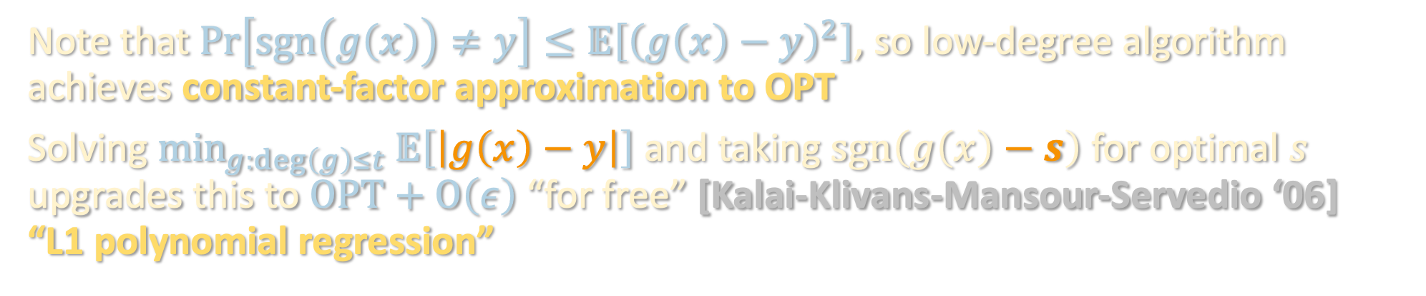

REMARK ON AGNOSTIC LEARNING
Low-degree algorithm also provides guarantees in agnostic setting:
$\min_{g:\deg\left(g\right)≤t}{𝔼\left[{\left(g\left(x\right)−y\right)}^{2}\right]}$ | $$≤𝔼\left[{\left(f^{≤t}\left(x\right)−y\right)}^{2}\right]$$
 | $$=𝔼\left[{\left(\left(f^{≤t}\left(x\right)−f\left(x\right)\right)+\left(f\left(x\right)−y\right)\right)}^{2}\right]$$
 | $$≤2 𝔼\left[{\left(f^{≤t}\left(x\right)−f\left(x\right)\right)}^{2}\right]+2 𝔼\left[{\left(f\left(x\right)−y\right)}^{2}\right]$$
 | $$≤O\left(ε\right)+8\operatorname{Pr}\left[f\left(x\right)≠y\right]$$
 | $$=O\left(ε\right)+8 OPT$$
Note that $Pr\left[\operatorname{sgn}\left(g\left(x\right)\right)≠y\right]≤𝔼\left[{\left(g\left(x\right)−y\right)}^{2}\right]$, so low-degree algorithm achieves constant-factor approximation to OPT
Solving $\min_{g:\deg\left(g\right)≤t}{𝔼\left[\left|g\left(x\right)−y\right|\right]}$ and taking $\operatorname{sgn}\left(g\left(x\right)−s\right)$ for optimal $s$ upgrades this to $OPT+O\left(ε\right)$ “for free” [Kalai-Klivans-Mansour-Servedio ‘06] “L1 polynomial regression”

Slide 32

REMARK ON AGNOSTIC LEARNING
Low-degree algorithm also provides guarantees in agnostic setting:
Note that $Pr\left[\operatorname{sgn}\left(g\left(x\right)\right)≠y\right]≤𝔼\left[{\left(g\left(x\right)−y\right)}^{2}\right]$, so low-degree algorithm achieves constant-factor approximation to OPT
Solving $\min_{g:\deg\left(g\right)≤t}{𝔼\left[\left|g\left(x\right)−y\right|\right]}$ and taking $\operatorname{sgn}\left(g\left(x\right)−s\right)$ for optimal $s$ upgrades this to $OPT+O\left(ε\right)$ “for free” [Kalai-Klivans-Mansour-Servedio ‘06] “L1 polynomial regression”
Takeaway: functions which are well-approximated by low-degree polynomials can be learned even in the challenging agnostic learning setting!

Slide 33
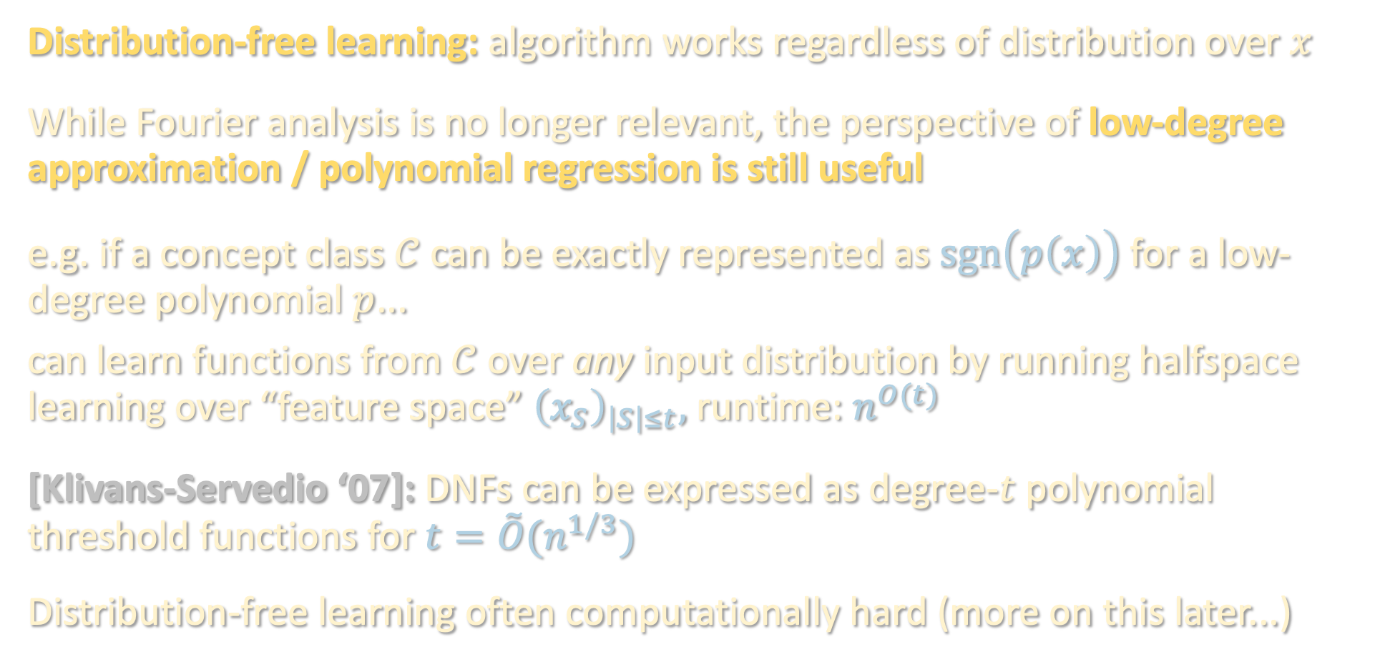
BEYOND THE UNIFORM DISTRIBUTION
Distribution-free learning: algorithm works regardless of distribution over $x$
While Fourier analysis is no longer relevant, the perspective of low-degree approximation / polynomial regression is still useful
e.g. if a concept class $𝒞$ can be exactly represented as $\operatorname{sgn}\left(p\left(x\right)\right)$ for a low-degree polynomial $p$...
can learn functions from $𝒞$ over any input distribution by running halfspace learning over “feature space” ${\left(x_{S}\right)}_{\left|S\right|≤t},$runtime: $n^{O(t)}$
[Klivans-Servedio ‘07]: DNFs can be expressed as degree-$t$ polynomial threshold functions for $t=\tilde{O}(n^{1/3})$
Distribution-free learning often computationally hard (more on this later...)

Slide 34
PAC learning – motivation and problem setup
Boolean functions and Fourier analysis
Extensions to agnostic / general distributions
Learning halfspaces and the importance of noise modeling

Slide 35
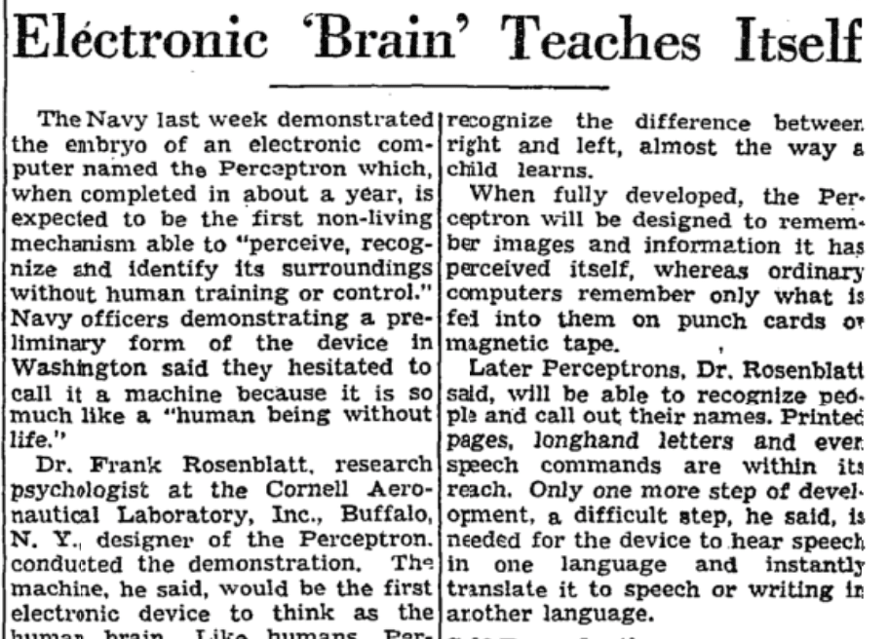


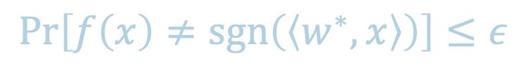
PAC LEARNING HALFSPACES
Here we focus on distribution-free learning
Given: examples of the form $\left(x,y\right)$ where
$x∼𝒟$ and $y=\operatorname{sgn}\left(\left\langle w^{∗},x\right\rangle \right)$
for unknown $w^{∗}$
Goal: output $f\left(x\right)$ that achieves
low test loss, i.e.
Solved problem since 50’s (perceptron, LP, etc), alg’s work for any $𝓓$!
$$w^{∗}$$
$$\operatorname{Pr}\left[f\left(x\right)≠\operatorname{sgn}\left(\left\langle w^{∗},x\right\rangle \right)\right]≤ε$$

Slide 36
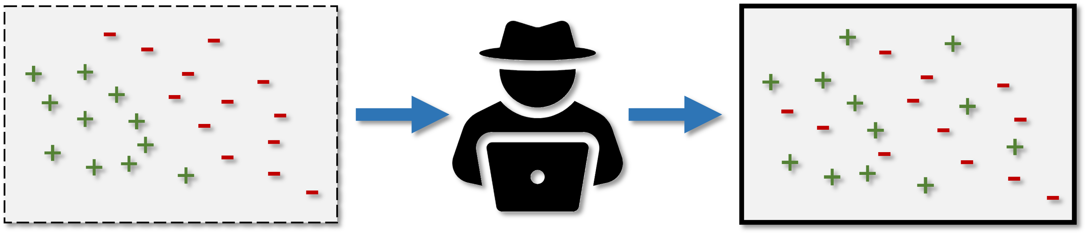


PAC LEARNING (NOISY) HALFSPACES
What if no halfspace perfectly fits the data?
A. Agnostic learning:
Assume nothing about relationship b/t $x$ and $y$, try to find $w$ s.t.
$$𝔼\left[\operatorname{sgn}\left(\left\langle w,x\right\rangle \right)≠y\right]=\min_{w^{′}}{𝔼\left[\operatorname{sgn}\left(\left\langle w′,x\right\rangle \right)≠y\right]}+ε$$

Slide 37
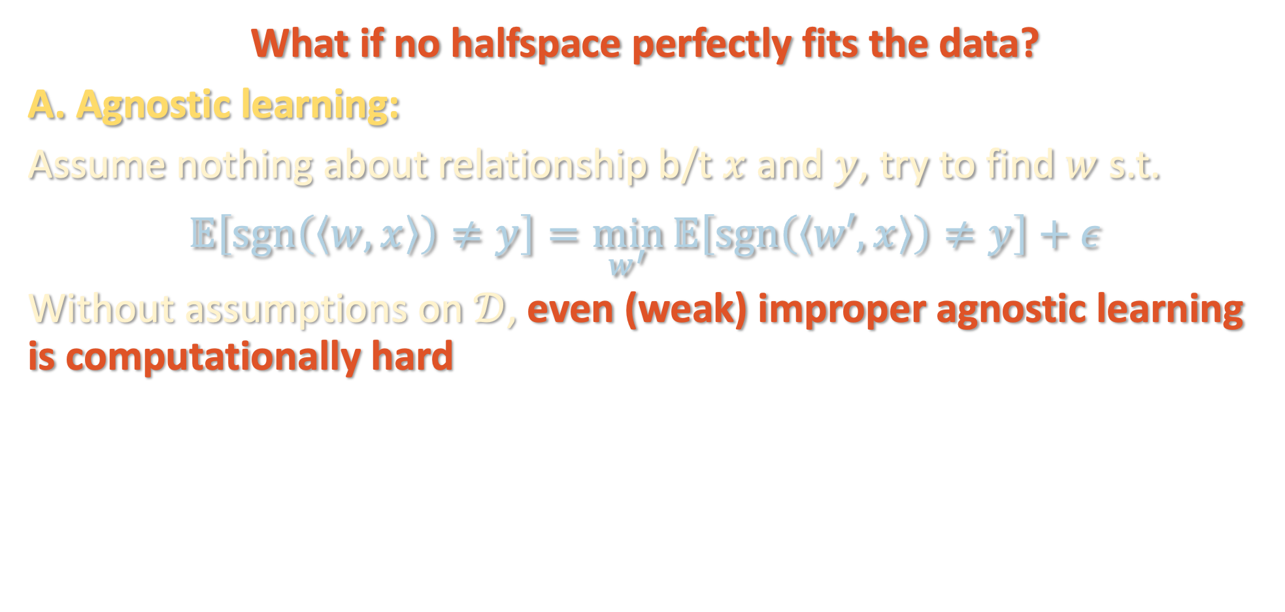
PAC LEARNING (NOISY) HALFSPACES
* Feige’s random 3SAT hypothesis or hardness of lattice problems
What if no halfspace perfectly fits the data?
A. Agnostic learning:
Assume nothing about relationship b/t $x$ and $y$, try to find $w$ s.t.
$$𝔼\left[\operatorname{sgn}\left(\left\langle w,x\right\rangle \right)≠y\right]=\min_{w^{′}}{𝔼\left[\operatorname{sgn}\left(\left\langle w′,x\right\rangle \right)≠y\right]}+ε$$
Without assumptions on $𝒟$, even (weak) improper agnostic learning is computationally hard
Theorem [Daniely ‘15], [Tiegel ‘22]: Under standard complexity assumptions*, there are instances where, even if a halfspace with 1% test loss exists, hard to find any classifier achieving even 49% (!)

Slide 38

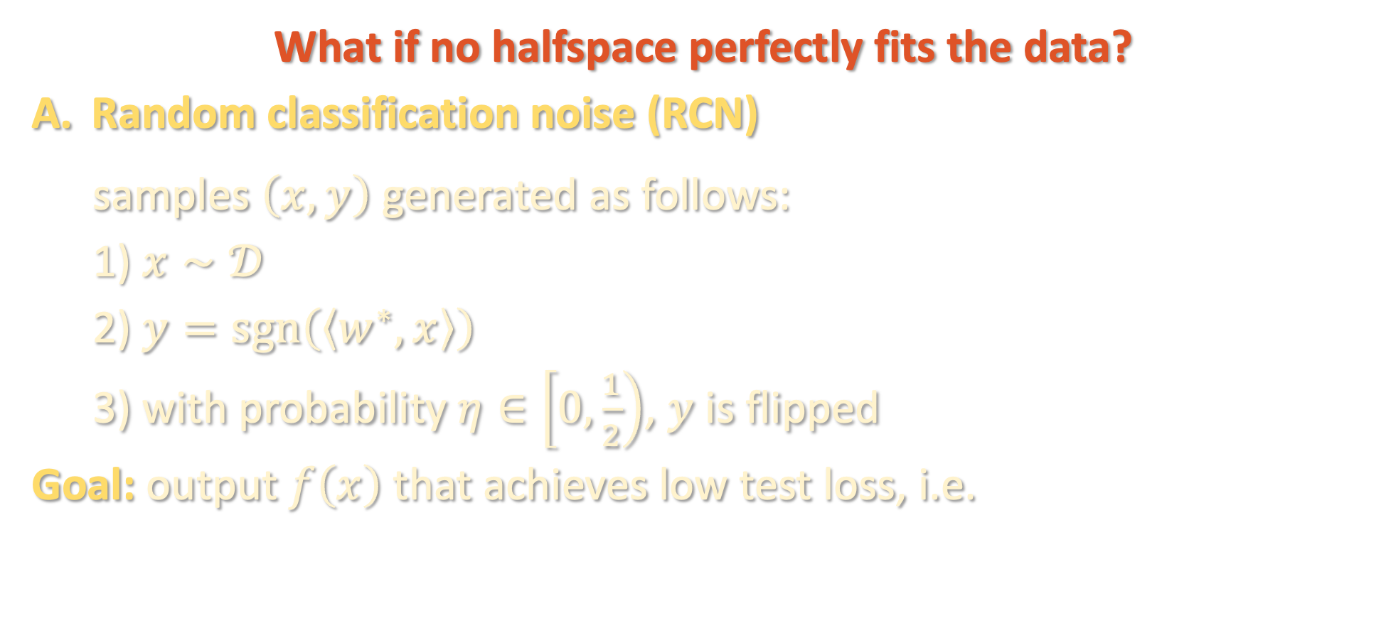
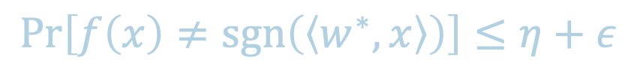
PAC LEARNING (NOISY) HALFSPACES
What if no halfspace perfectly fits the data?
Random classification noise (RCN)
samples $\left(x,y\right)$ generated as follows:
1) $x∼𝒟$
2) $y=\operatorname{sgn}\left(\left\langle w^{∗},x\right\rangle \right)$
3) with probability $η∈\left[0,\frac{1}{2}\right)$, $y$ is flipped
Goal: output $f\left(x\right)$ that achieves low test loss, i.e.
$$w^{∗}$$
$$\operatorname{Pr}\left[f\left(x\right)≠\operatorname{sgn}\left(\left\langle w^{∗},x\right\rangle \right)\right]≤η+ε$$

Slide 39

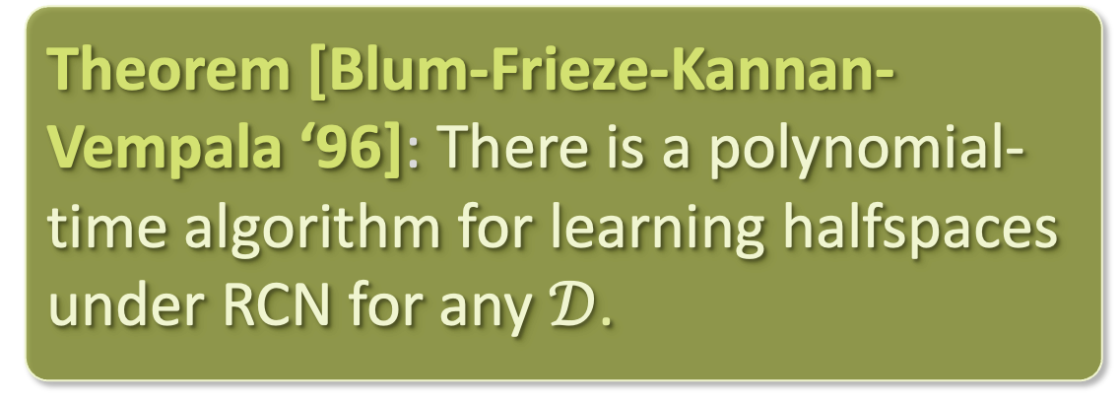

PAC LEARNING (NOISY) HALFSPACES
The margin is the largest $τ$ for which $\left|\left\langle w^{∗}, x\right\rangle \right|≥τ$ almost surely over $x∼𝒟$
What if no halfspace perfectly fits the data?
Random classification noise (RCN)
In large-margin case, SGD on a convex loss already works!
Theorem [Blum-Frieze-Kannan-Vempala ‘96]: There is a polynomial-time algorithm for learning halfspaces under RCN for any $𝒟$.
$$w^{∗}$$
$$τ$$

Slide 40

MINIMIZING CONVEX LOSSES
Our goal is to find a halfspace with low 0-1 loss:
$$err\left(w\right)≝\operatorname{Pr}\left[\operatorname{sgn}\left(\left\langle w,x\right\rangle \right)≠y\right]$$

Slide 41

MINIMIZING CONVEX LOSSES
Our goal is to find a halfspace with low 0-1 loss:
$$err\left(w\right)≝𝔼\left[𝕀\left[−y⋅\left\langle w,x\right\rangle >0\right]\right]$$
Issue: loss function is nonconvex

Slide 42

MINIMIZING CONVEX LOSSES
Standard fix: replace 0-1 loss with a convex surrogate
$$err\left(w\right)≝𝔼\left[𝕀\left[−y⋅\left\langle w,x\right\rangle >0\right]\right]$$
Issue: loss function is nonconvex

Slide 43
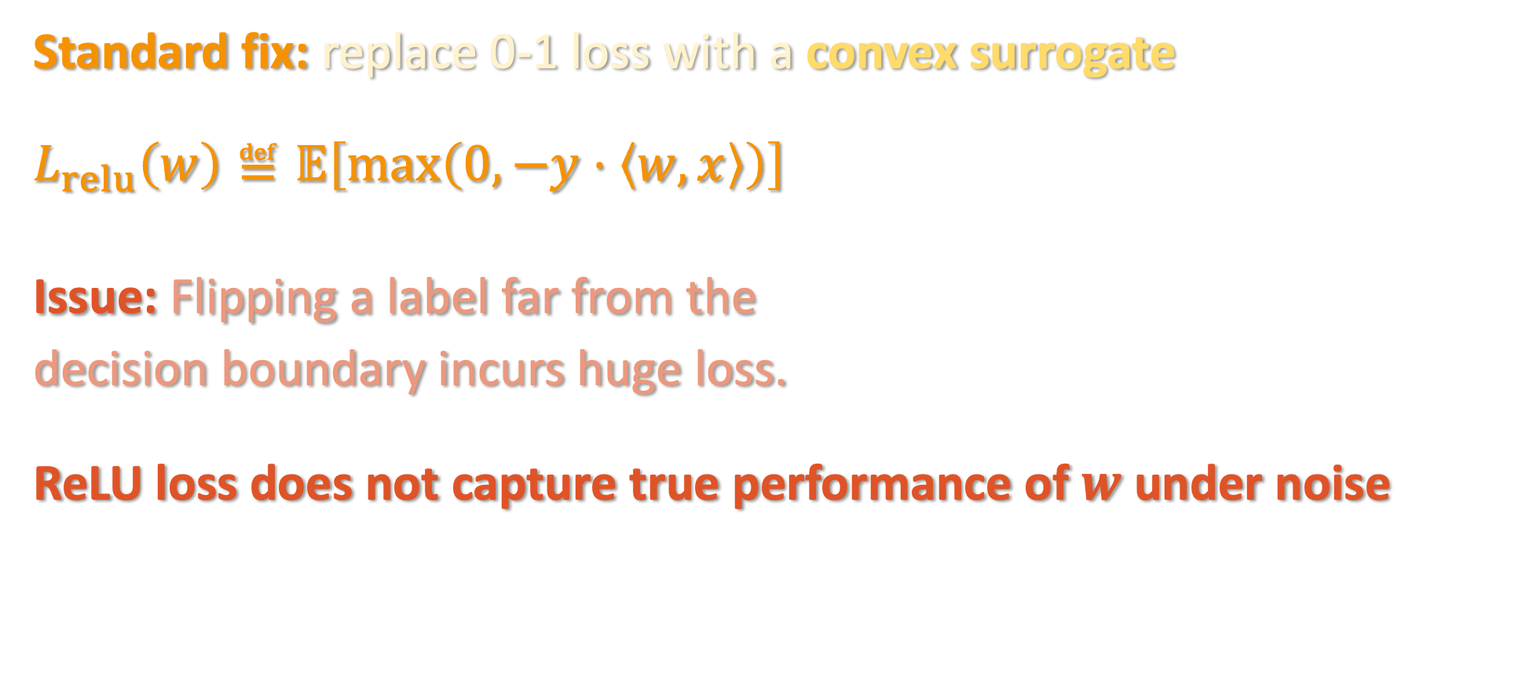
MINIMIZING CONVEX LOSSES
Standard fix: replace 0-1 loss with a convex surrogate
$$L_{relu}\left(w\right)≝𝔼\left[\max\left(0,−y⋅\left\langle w,x\right\rangle \right)\right]$$
Issue: Flipping a label far from the
decision boundary incurs huge loss.
ReLU loss does not capture true performance of $w$ under noise

Slide 44
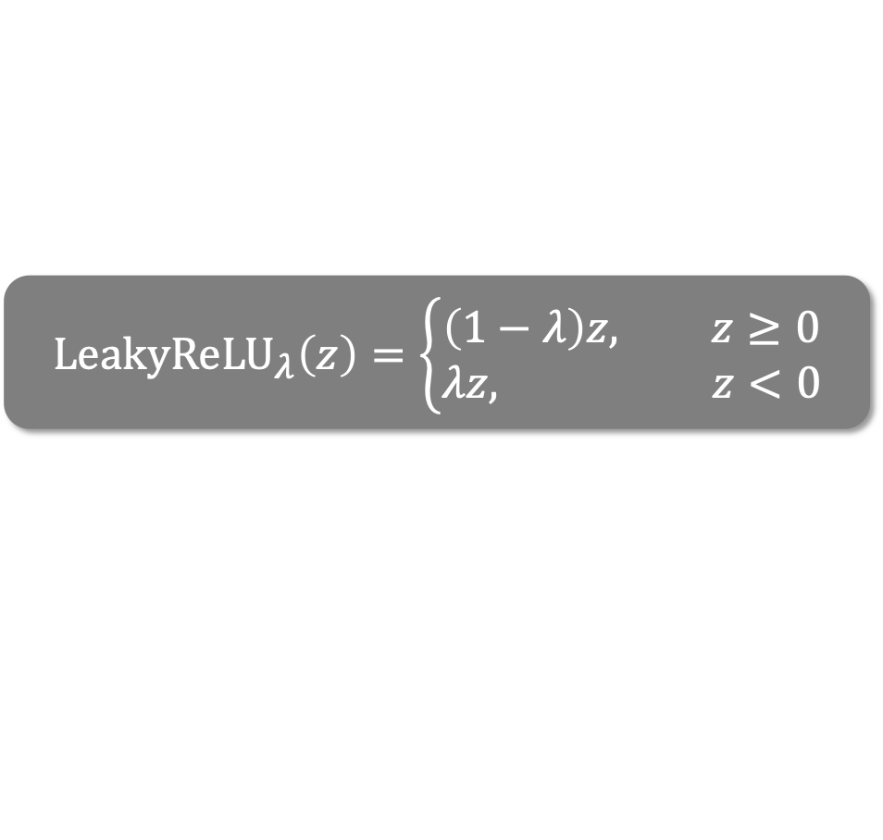

MINIMIZING CONVEX LOSSES
Standard fix: replace 0-1 loss with a convex surrogate
$$ℓ_{LR}\left(w\right)≝𝔼\left[{LeakyReLU}_{λ}\left(−y⋅\left\langle w,x\right\rangle \right)\right]$$
Theorem [implicit in Bylander ‘94]: Gradient descent with respect to LeakyReLU loss learns large-margin halfspaces under RCN.
$${LeakyReLU}_{λ}\left(z\right)=\left\{\begin{aligned}\left(1−λ\right)z, z≥0 \\ λz, z<0\end{aligned}\right.$$

Slide 45
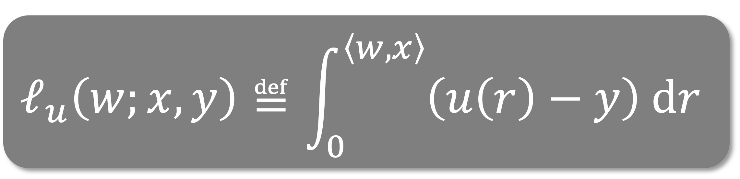
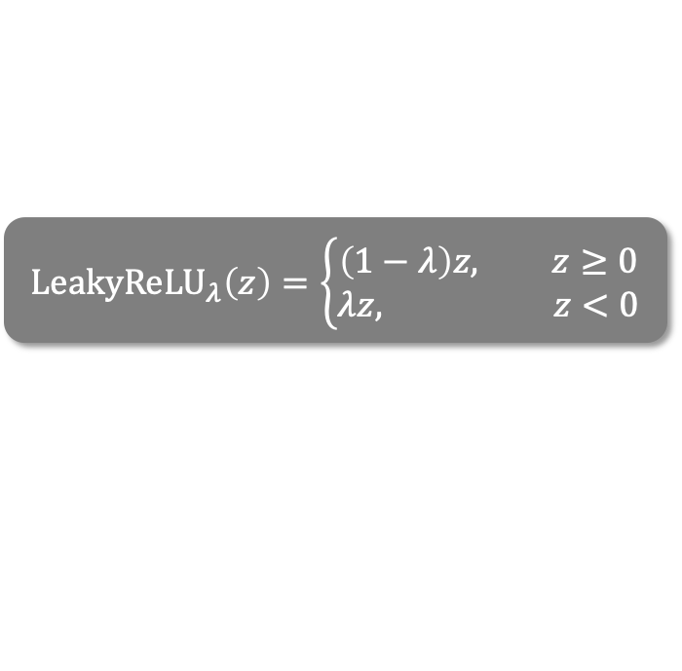
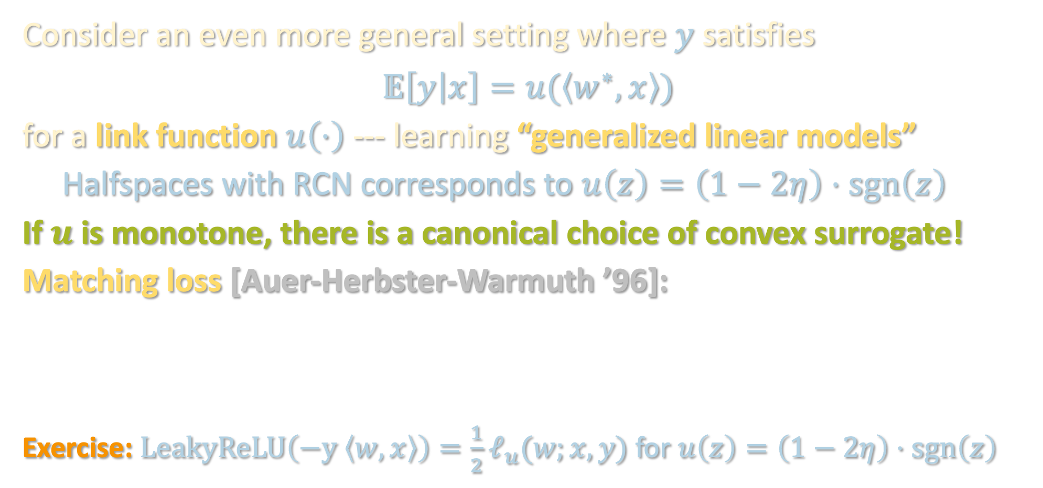
LEAKYRELU SUFFICES FOR RCN
$${LeakyReLU}_{λ}\left(z\right)=\left\{\begin{aligned}\left(1−λ\right)z, z≥0 \\ λz, z<0\end{aligned}\right.$$
Consider an even more general setting where $y$ satisfies
$$𝔼\left[y | x\right]=u(\left\langle w^{∗},x\right\rangle )$$
for a link function $u\left(⋅\right)$ --- learning “generalized linear models”
Halfspaces with RCN corresponds to $u\left(z\right)=\left(1−2η\right)⋅sgn\left(z\right)$
If $u$ is monotone, there is a canonical choice of convex surrogate!
Matching loss [Auer-Herbster-Warmuth ’96]:
Exercise: $LeakyReLU\left(−y \left\langle w,x\right\rangle \right)=\frac{1}{2}ℓ_{u}(w;x,y)$ for $u\left(z\right)=\left(1−2η\right)⋅sgn\left(z\right)$

Slide 46


LEAKYRELU SUFFICES FOR RCN
Claim 1: The matching loss is convex
Claim 2: If $\left|u\left(a\right)−u\left(b\right)\right|≤L |a−b|$ for all $a,b$, then
$$𝔼_{x,y}\left[ℓ_{u}\left(w;x,y\right)−ℓ_{u}\left(w^{∗};x,y\right)\right]≥\frac{1}{2L}⋅𝔼\left[{\left(u\left(\left\langle w,x\right\rangle \right)−u\left(\left\langle w^{∗},x\right\rangle \right)\right)}^{2}\right]$$
i.e. if $w$ achieves large test loss, it achieves large matching loss
Proof:
$$𝔼_{x,y}\left[ℓ_{u}\left(w;x,y\right)−ℓ_{u}\left(w^{∗};x,y\right)\right]$$ | $$=𝔼_{x,y}\left[\int_{⟨w^{∗},x⟩}^{⟨w,x⟩}{(u(r)−y)}dr\right]$$
 | $$=𝔼_{x}\left[\int_{⟨w^{∗},x⟩}^{⟨w,x⟩}{(u(r)−u\left(\left\langle w^{∗},x\right\rangle \right)}dr\right]$$
 | $$≥\frac{L}{2}⋅𝔼\left[{\left(u\left(\left\langle w,x\right\rangle \right)−u\left(\left\langle w^{∗},x\right\rangle \right)\right)}^{2}\right]$$

Slide 47


LEAKYRELU SUFFICES FOR RCN
Claim 1: The matching loss is convex
Claim 2: If $\left|u\left(a\right)−u\left(b\right)\right|≤L |a−b|$ for all $a$, then
$$𝔼_{x,y}\left[ℓ_{u}\left(w;x,y\right)−ℓ_{u}\left(w^{∗};x,y\right)\right]≥\frac{1}{2L}⋅𝔼\left[{\left(u\left(\left\langle w,x\right\rangle \right)−u\left(\left\langle w^{∗},x\right\rangle \right)\right)}^{2}\right]$$
i.e. if $w$ achieves large test loss, it achieves large matching loss
Proof:
$$𝔼_{x,y}\left[ℓ_{u}\left(w;x,y\right)−ℓ_{u}\left(w^{∗};x,y\right)\right]$$ | $$=𝔼_{x,y}\left[\int_{⟨w^{∗},x⟩}^{⟨w,x⟩}{(u(r)−y)}dr\right]$$

Slide 48




LEAKYRELU SUFFICES FOR RCN
Claim 1: The matching loss is convex
Claim 2: If $\left|u\left(a\right)−u\left(b\right)\right|≤L |a−b|$ for all $a$, then
$$𝔼_{x,y}\left[ℓ_{u}\left(w;x,y\right)−ℓ_{u}\left(w^{∗};x,y\right)\right]≥\frac{1}{2L}⋅𝔼\left[{\left(u\left(\left\langle w,x\right\rangle \right)−u\left(\left\langle w^{∗},x\right\rangle \right)\right)}^{2}\right]$$
i.e. if $w$ achieves large test loss, it achieves large matching loss
Proof:
$$𝔼_{x,y}\left[ℓ_{u}\left(w;x,y\right)−ℓ_{u}\left(w^{∗};x,y\right)\right]$$ | $$=𝔼_{x,y}\left[\int_{⟨w^{∗},x⟩}^{⟨w,x⟩}{(u(r)−y)}dr\right]$$
 | $$=𝔼_{x}\left[\int_{⟨w^{∗},x⟩}^{⟨w,x⟩}{(u(r)−u\left(\left\langle w^{∗},x\right\rangle \right)}dr\right]$$
$$u(\left\langle r\right)−u\left(\left\langle w^{∗},x\right\rangle \right)$$
$$⟨w^{∗},x⟩$$
$$⟨w,x⟩$$

Slide 49




LEAKYRELU SUFFICES FOR RCN
Claim 1: The matching loss is convex
Claim 2: If $\left|u\left(a\right)−u\left(b\right)\right|≤L |a−b|$ for all $a$, then
$$𝔼_{x,y}\left[ℓ_{u}\left(w;x,y\right)−ℓ_{u}\left(w^{∗};x,y\right)\right]≥\frac{1}{2L}⋅𝔼\left[{\left(u\left(\left\langle w,x\right\rangle \right)−u\left(\left\langle w^{∗},x\right\rangle \right)\right)}^{2}\right]$$
i.e. if $w$ achieves large test loss, it achieves large matching loss
Proof:
$$𝔼_{x,y}\left[ℓ_{u}\left(w;x,y\right)−ℓ_{u}\left(w^{∗};x,y\right)\right]$$ | $$=𝔼_{x,y}\left[\int_{⟨w^{∗},x⟩}^{⟨w,x⟩}{(u(r)−y)}dr\right]$$
 | $$=𝔼_{x}\left[\int_{⟨w^{∗},x⟩}^{⟨w,x⟩}{(u(r)−u\left(\left\langle w^{∗},x\right\rangle \right)}dr\right]$$
 | $$≥\frac{1}{2L}⋅𝔼\left[{\left(u\left(\left\langle w,x\right\rangle \right)−u\left(\left\langle w^{∗},x\right\rangle \right)\right)}^{2}\right]$$
$$u(\left\langle r\right)−u\left(\left\langle w^{∗},x\right\rangle \right)$$
(by change of variable)
$$u\left(\left\langle w^{∗},x\right\rangle \right)$$
$$u\left(\left\langle w,x\right\rangle \right)$$

Slide 50
LANDSCAPE OF NOISE MODELS
Computational
Hardness
Noiseless
RCN
Massart
Agnostic
Clean but less realistic
General but intractable
Are there rich intermediate noise models under which we can design efficient algorithms that work for general input distributions?

Slide 51

SEMIRANDOM NOISE
What if the noise is random-ish?
C. Massart noise:
Natural model for heterogeneous stochastic noise
Every point $x$ has a flip probability $η\left(x\right)$, i.e. we observe
  $(x,\operatorname{sgn}\left(\left\langle w^{∗},x\right\rangle \right)$ with probability $1−η\left(x\right)$
  $\left(x,−\operatorname{sgn}\left(\left\langle w^{∗},x\right\rangle \right)\right)$ with probability $η\left(x\right)$
  Flip probabilities are chosen in advance and can be adversarial, but we assume that
  $$η\left(x\right)≤η ∀x$$

Slide 52

SEMIRANDOM NOISE
What if the noise is random-ish?
C. Massart noise:
Natural model for heterogeneous stochastic noise
Every point $x$ has a flip probability $η\left(x\right)$
Interpretation 1 (sort of): adversary gets arbitrary control over a random $η$ fraction of the data

Slide 53

SEMIRANDOM NOISE
What if the noise is random-ish?
C. Massart noise:
Natural model for heterogeneous stochastic noise
Every point $x$ has a flip probability $η\left(x\right)$
Interpretation 2: dataset is given by RCN, except an adversary is allowed to come and correct any labels that were flipped
RCN

Slide 54

SEMIRANDOM NOISE
What if the noise is random-ish?
C. Massart noise:
Natural model for heterogeneous stochastic noise
Every point $x$ has a flip probability $η\left(x\right)$
Interpretation 2: dataset is given by RCN, except an adversary is allowed to come and correct any labels that were flipped
RCN

Slide 55

SEMIRANDOM NOISE
What if the noise is random-ish?
C. Massart noise:
Natural model for heterogeneous stochastic noise
Every point $x$ has a flip probability $η\left(x\right)$
Interpretation 2: dataset is given by RCN, except an adversary is allowed to come and correct any labels that were flipped
Semirandom noise: noise initially generated under simple (perhaps too simple) model, and adversary then makes any number of “helpful” changes
These “helpful” changes can sometimes break existing algorithms!
Powerful tool for probing whether algorithms “overfit” to a model

Slide 56

CONVEX SURROGATES FAIL FOR MASSART NOISE
Theorem [Diakonikolas-Gouleakis-Tzamos ‘19]: For any convex surrogate, there exists an instance of learning $τ$-margin halfspaces under Massart noise for which the minimizer $w$ of the convex surrogate achieves at least $Ω\left(η/τ\right)$ test loss, i.e.
$$𝔼\left[\operatorname{sgn}\left(\left\langle w,x\right\rangle \right)≠y\right]=Ω\left(η/τ\right)$$
[Sloan ‘88], [Cohen ‘97]: Are there polynomial-time algorithms for learning halfspaces under Massart noise?

Slide 57








AN IMPROPER LEARNING ALGORITHM
Theorem [Diakonikolas-Gouleakis-Tzamos ‘19]: There is a polynomial-time algorithm for (improperly) learning halfspaces under Massart noise that achieve test loss $η+ε$ without any assumptions on $𝒟.$
Outputs a “linear threshold circuit” (hard to interpret) - can we get the same guarantee with proper learning?
Note: achieving $OPT+ε$ is computationally hard [C-Koehler-Moitra-Yau ‘20]
$$\left|\left\langle w_{1},x\right\rangle \right|>τ_{1}?$$
Output $\operatorname{sgn}\left(\left\langle v_{1},x\right\rangle \right)$
$$\left|\left\langle w_{2},x\right\rangle \right|>τ_{2}?$$
Output $\operatorname{sgn}\left(\left\langle v_{2},x\right\rangle \right)$
$$\left|\left\langle w_{3},x\right\rangle \right|>τ_{3}?$$
…
Output $\operatorname{sgn}\left(\left\langle v_{3},x\right\rangle \right)$

Slide 58


A PROPER LEARNING ALGORITHM
Theorem [C-Koehler-Moitra-Yau ‘20] : There is a polynomial-time algorithm for properly learning halfspaces under Massart noise that achieve test loss $η+ε$ without any assumptions on $𝒟.$
Theorem [C-Koehler-Moitra-Yau ‘20] : There is an $O\left(\frac{d}{τ^{4}ε^{5}}\right)$-sample, linear-time algorithm for properly learning $τ$-margin halfspaces under Massart noise that achieve test loss $η+ε$ without any assumptions on $𝒟.$

Slide 59

A PROPER LEARNING ALGORITHM
Theorem [C-Koehler-Moitra-Yau ‘20] : There is a polynomial-time algorithm for properly learning halfspaces under Massart noise that achieve test loss $η+ε$ without any assumptions on $𝒟.$
Theorem [C-Koehler-Moitra-Yau ‘20] : There is an $O\left(\frac{d}{τ^{4}ε^{5}}\right)$-sample, linear-time algorithm for properly learning $τ$-margin halfspaces under Massart noise that achieve test loss $η+ε$ without any assumptions on $𝒟.$

Slide 60



TWO-PLAYER GAME
$$\min_{\left\|w\right\|=1 }{\max_{φ}{𝔼\left[{LeakyReLU}_{λ}\left(−y⋅\left\langle w,x\right\rangle \right)⋅φ\left(x\right)\right]}}$$

Slide 61



TWO-PLAYER GAME
$$\min_{\left\|w\right\|=1 }{\max_{φ}{𝔼\left[{LeakyReLU}_{λ}\left(−y⋅\left\langle w,x\right\rangle \right)⋅φ\left(x\right)\right]}}$$
$$w= (1,1)$$
reweighting $φ$
Cost: LeakyReLU loss incurred by $w$ over the distribution reweighted by $φ$

Slide 62


TWO-PLAYER GAME
$$\min_{\left\|w\right\|=1 }{\max_{φ}{𝔼\left[{LeakyReLU}_{λ}\left(−y⋅\left\langle w,x\right\rangle \right)⋅φ\left(x\right)\right]}}$$
$$w^{′}= (−3,2)$$
reweighting $φ′$
Cost: LeakyReLU loss incurred by $w$ over the distribution reweighted by $φ$

Slide 63



TWO-PLAYER GAME
$$\min_{\left\|w\right\|=1 }{\max_{φ}{𝔼\left[{LeakyReLU}_{λ}\left(−y⋅\left\langle w,x\right\rangle \right)⋅φ\left(x\right)\right]}}$$
Turns out Alice’s optimal strategy is to play $w^{∗}$, in fact minimizing this objective is equivalent to achieving optimal test loss
Issue: ’s optimization problem is intractable.
Idea: Restrict ’s search space. Only search over “slabs” around $w$!

Slide 64

TWO-PLAYER GAME
$$\min_{\left\|w\right\|=1 }{\max_{φ}{𝔼\left[{LeakyReLU}_{λ}\left(−y⋅\left\langle w,x\right\rangle \right)⋅φ\left(x\right)\right]}}$$
$$w= (1,1)$$
reweighting $φ$
Cost: LeakyReLU loss incurred by $w$ over the distribution reweighted by $φ$
$$γ$$

Slide 65

TWO-PLAYER GAME
$$\min_{\left\|w\right\|=1 }{\max_{φ}{𝔼\left[{LeakyReLU}_{λ}\left(−y⋅\left\langle w,x\right\rangle \right)⋅φ\left(x\right)\right]}}$$
$$w= (1,1)$$
slab width $γ$
Cost: LeakyReLU loss incurred by $w$ over the distribution reweighted by $φ$
$$γ$$

Slide 66



TWO-PLAYER GAME
$$\min_{\left\|w\right\|=1 }{\max_{γ}{𝔼\left[{LeakyReLU}_{λ}\left(−y⋅\left\langle w,x\right\rangle \right)∣ \left|\left\langle w,x\right\rangle \right|≤γ\right]}}$$
$$w= (1,1)$$
slab width $γ$
Cost: LeakyReLU loss incurred by $w$ over the distribution reweighted by $φ$
$$γ$$

Slide 67


TWO-PLAYER GAME
$$\min_{\left\|w\right\|=1 }{\max_{γ}{𝔼\left[{LeakyReLU}_{λ}\left(−y⋅\left\langle w,x\right\rangle \right)∣ \left|\left\langle w,x\right\rangle \right|≤γ\right]}}$$
’s optimization problem is now just a 1-dimensional problem!
Will show: equilibria for this game yield $w$’s with test error $η+ε$

Slide 68



ALGORITHM PSEUDOCODE
$$L^{γ}\left(w\right)$$
$$\min_{\left\|w\right\|=1 }{\max_{γ}{𝔼\left[{LeakyReLU}_{λ}\left(−y⋅\left\langle w,x\right\rangle \right)∣ \left|\left\langle w,x\right\rangle \right|≤γ\right]}}$$
FILTERTRON
Every time this happens,
incurs regret from not playing the true $w^{∗}$
initializes $w$ to arbitrary unit vector
Repeat:
  plays slab $γ$ maximizing $L^{γ}\left(w\right)$
  If $L_{0−1}\left(w\right)≤η+ε$, return $w$
  Else, updates $w←Π\left(w−η⋅∇L^{γ}\left(w\right)\right)$
Guarantee for projected gradient descent: can’t keep having large regret

Slide 69

PROOF INGREDIENTS
$$L^{γ}\left(w\right)$$
$$\min_{\left\|w\right\|=1 }{\max_{γ}{𝔼\left[{LeakyReLU}_{λ}\left(−y⋅\left\langle w,x\right\rangle \right)∣ \left|\left\langle w,x\right\rangle \right|≤γ\right]}}$$
True halfspace $w^{∗}$ achieves small $L^{γ}\left(w\right)$ regardless of $γ$
For any $w$ with high 0-1 loss, there is a good strategy $γ$ for ,
i.e. one that achieves large $L^{γ}\left(w\right)$

Slide 70
TAKEAWAYS
PAC learning is a useful formalism for asking some of the most fundamental questions about supervised learning
Unavoidable tradeoff between expressivity of function class being learned and distributional assumption over which guarantees apply
  Still open: what properties of real-world data make learning deep neural networks tractable?
Low-degree approximation of function class → efficient PAC learning
Must be careful when moving beyond the realizable setting
  If noise model too general: computational hardness
  If noise model too specific: algorithm “overfits” to modeling assumptions
Next two lectures: techniques in the realizable setting

