Slide 1
Algorithmic Foundations for the Diffraction Limit
Sitan Chen | Ankur Moitra
MIT | MIT
Main Takeaway: Insights from unsupervised learning can shed new light on fundamental problems in optics.
Notes:
As the title suggests, this is an interdisciplinary work that broadly falls under the agenda of using theoretical computer science as a lens through which one can better understand the natural sciences. More specifically...

Slide 2
OUTLINE
Introduction
  Fraunhofer Diffraction
  Debate about Diffraction Limit
  Our Results
Sparse FT (Off the Grid)
  Definition and Reduction
  1D case: Matrix Pencil Method
3. Learning in Two Dimensions
  Learning Without Separation
Open Questions

Slide 3
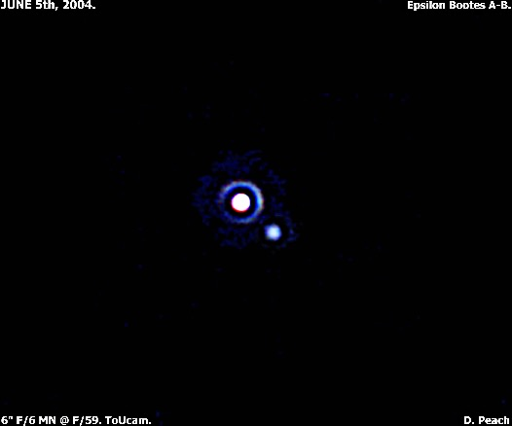
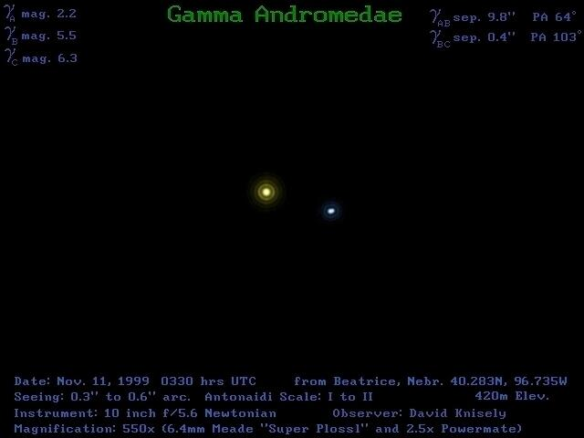
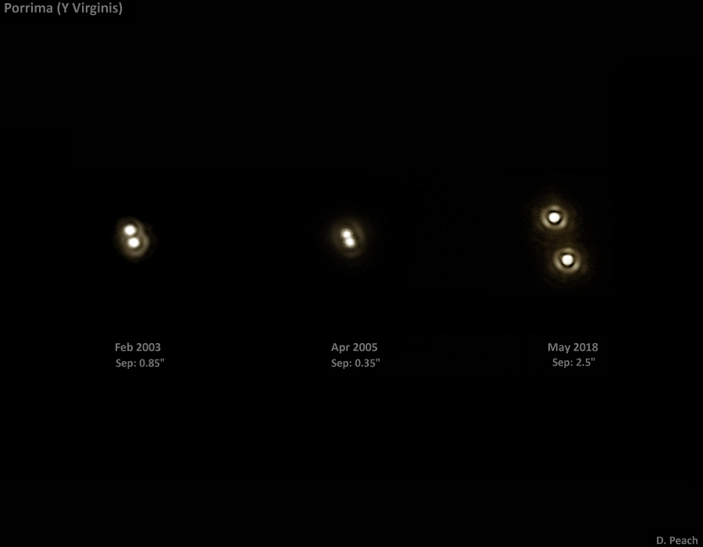
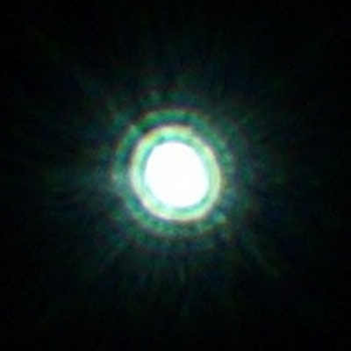
Taken with permission from http://www.damianpeach.com/binaries.htm
Notes:
If you pointed a telescope into the night sky, you might see something like this. Each of these pictures depicts a particular binary star imaged by a relatively powerful telescope under fairly ideal atmospheric conditions. The salient feature that they all have in common is the presence of a ring, or if you look closely, a sequence of rings around the bright spots. Now if you took an intro to optics class, you’d know these rings aren’t intrinsic to the stars themselves. Here’s an artificial light source imaged by a 2000mm camera lens, and you can see a similar ring pattern. It turns out this is an artifact of the optical system itself, and it arises from the phenomenon of diffraction.

Slide 4





Fraunhofer Diffraction
$$u$$
$$θ$$
$$v$$
$$P$$
$$φ$$

Slide 5
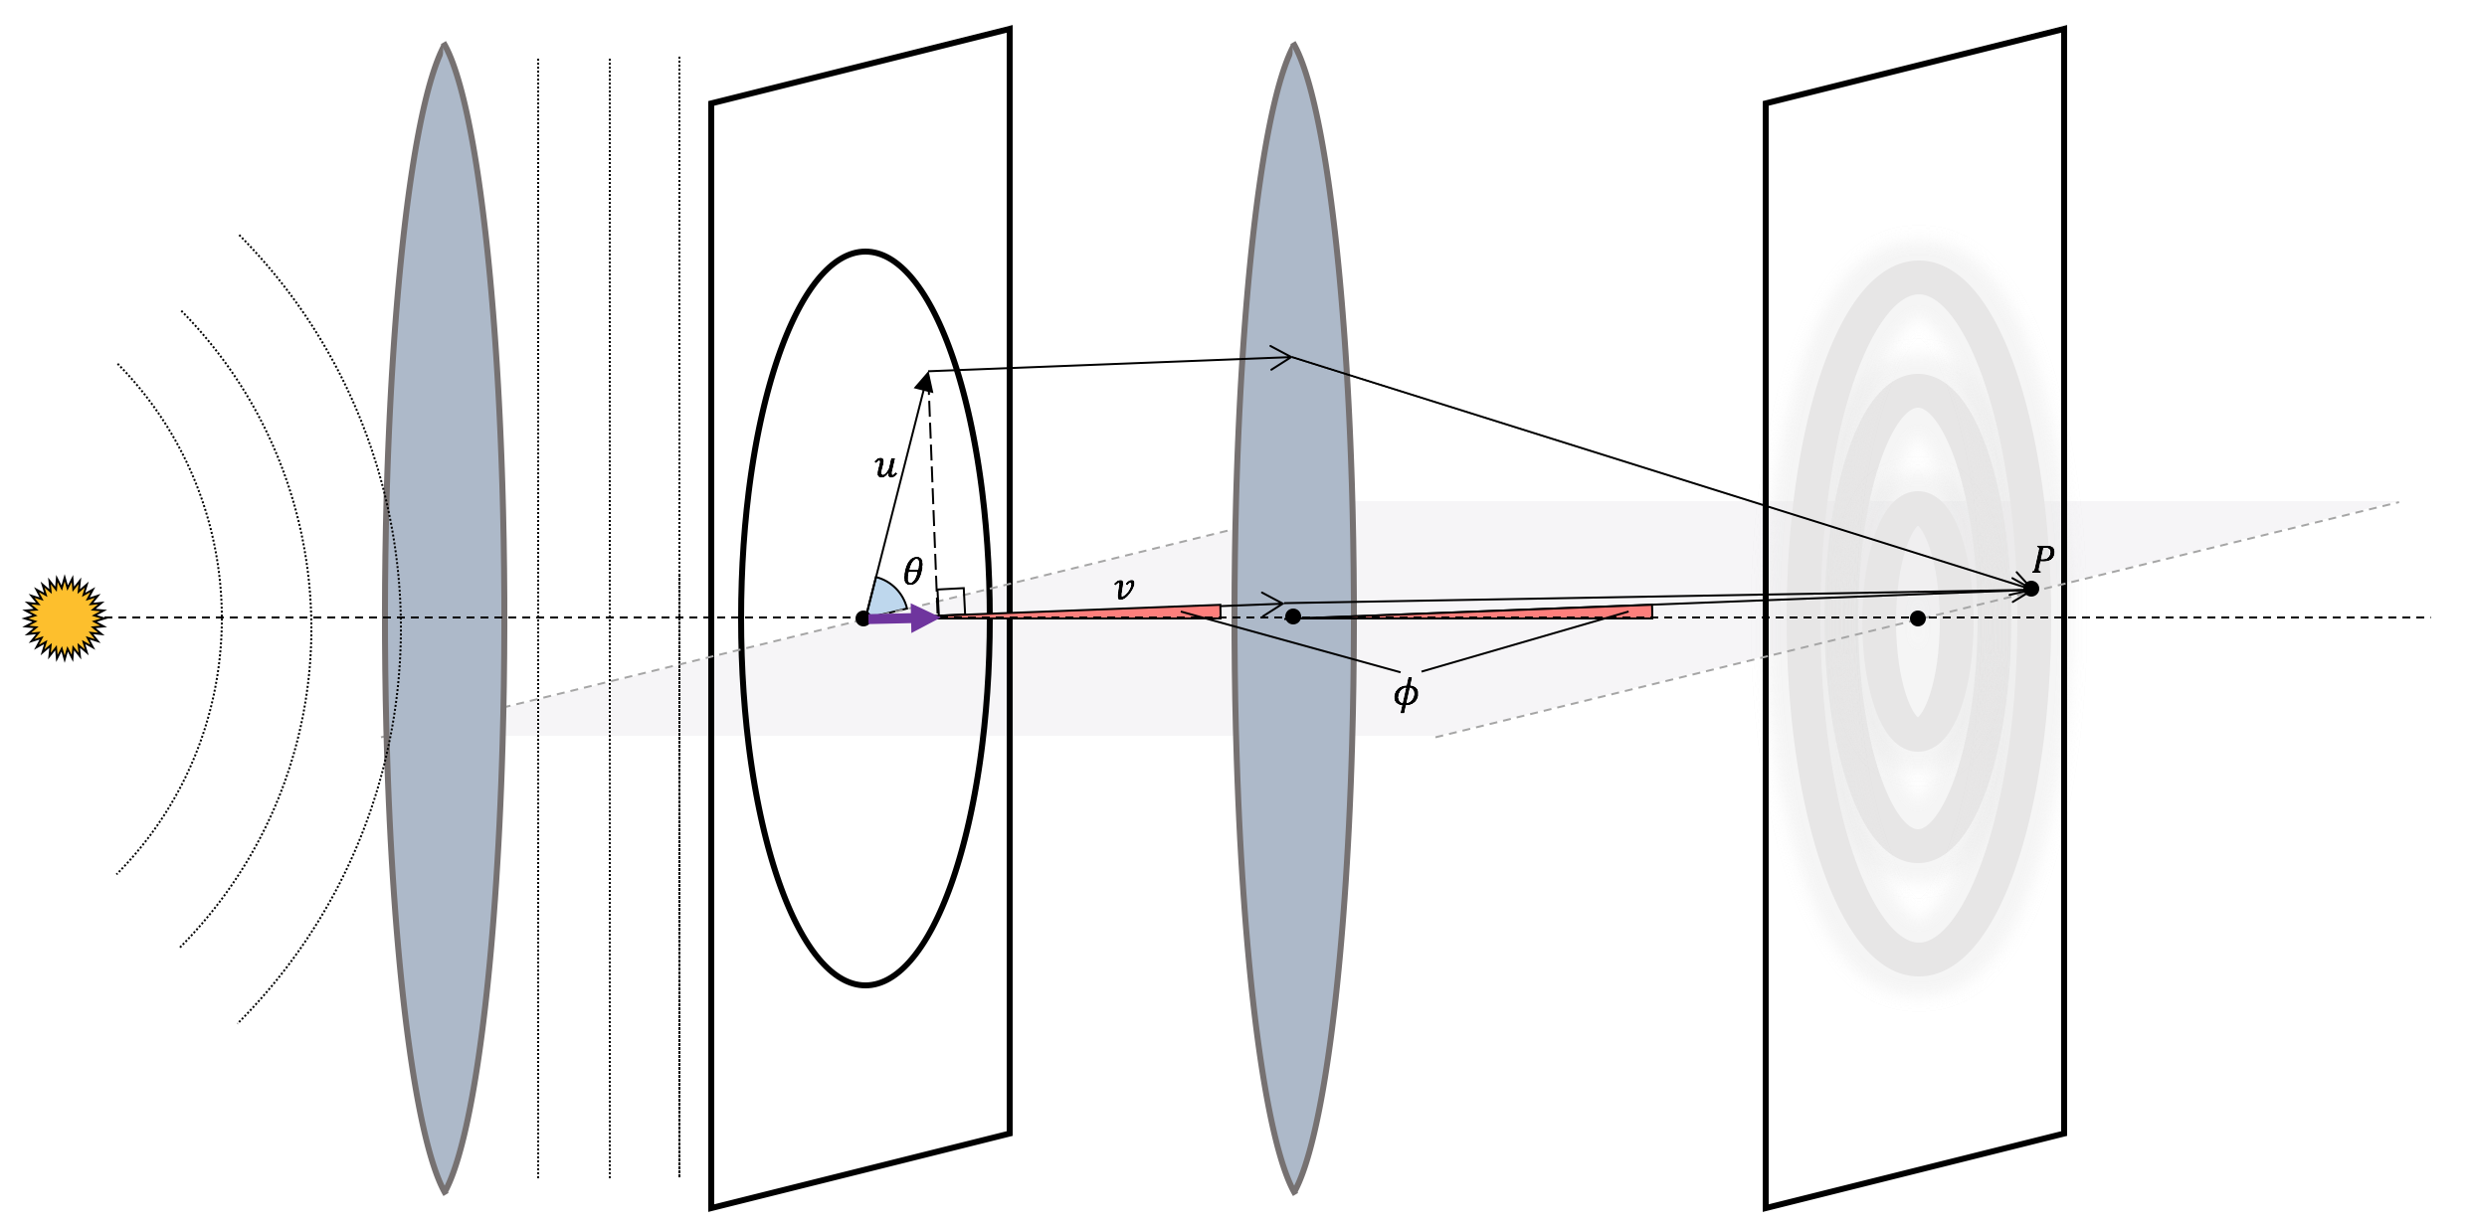
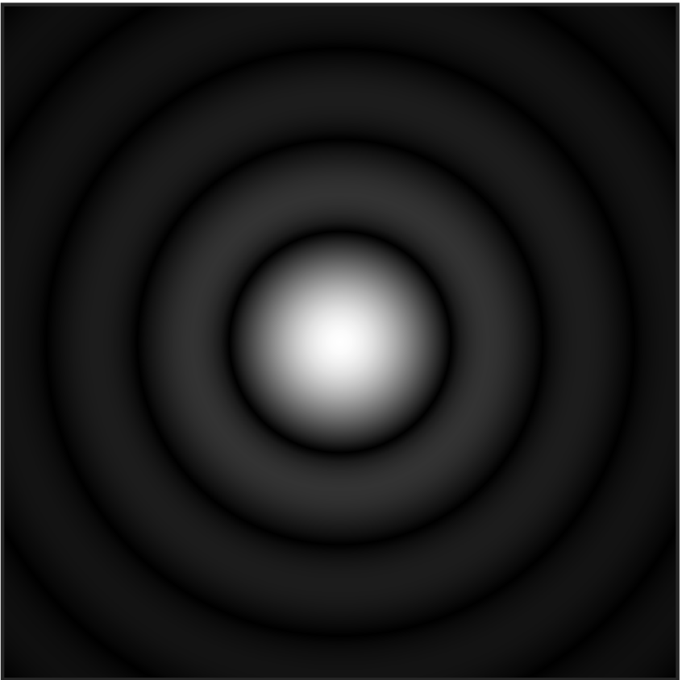
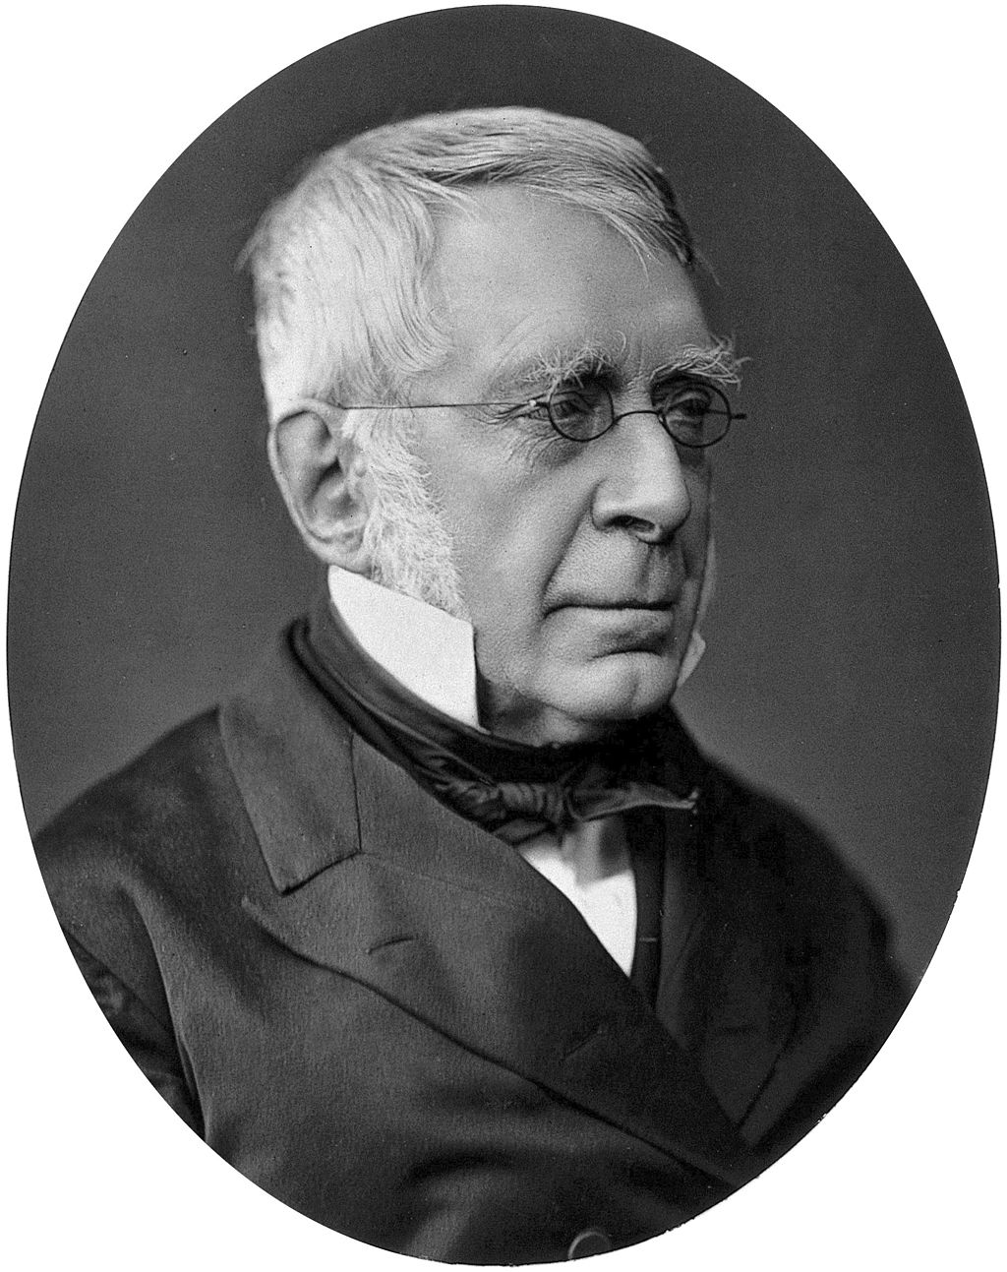
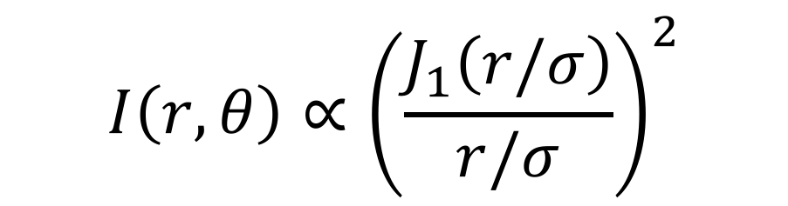
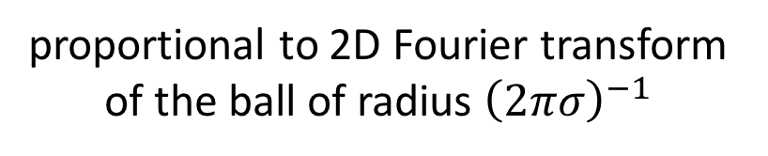
Fraunhofer Diffraction
“Airy Disk”
$$I\left(r,θ\right)∝{\left(\frac{J_{1}\left(r/σ\right)}{r/σ}\right)}^{2}$$
“spread” parameter,
prop. to wavelength,
inv. prop. to radius of aperture
proportional to 2D Fourier transform of the ball of radius ${\left(2πσ\right)}^{−1}$
Sir George Biddell Airy

Slide 6
OUTLINE
Introduction
  Fraunhofer Diffraction
  Debate about Diffraction Limit
  Our Results
Sparse FT (Off the Grid)
  Definition and Reduction
  1D case: Matrix Pencil Method
3. Learning in Two Dimensions
  Learning Without Separation
Open Questions

Slide 7
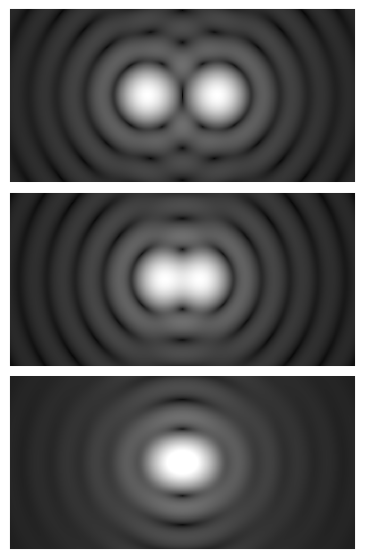

Diffraction Limits
Conventional wisdom: Diffraction imposes fundamental limits on the resolution of an optical system.
Q: How close do Airy disks have to be before it becomes impossible to distinguish them?
Rayleigh Criterion: When the center of one disk intersects the first ring of the other.
$$≈1.22πσ$$

Slide 8
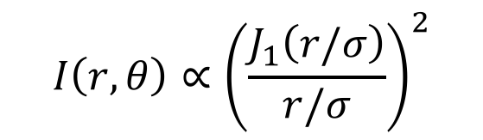
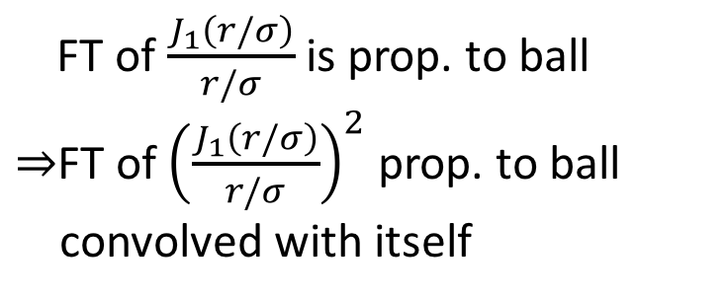
Diffraction Limits
Conventional wisdom: Diffraction imposes fundamental limits on the resolution of an optical system.
Q: How close do Airy disks have to be before it becomes impossible to distinguish them?
$$I\left(r,θ\right)∝{\left(\frac{J_{1}\left(r/σ\right)}{r/σ}\right)}^{2}$$
Abbe Limit:
When the separation is less than 1/radius of the support of the Fourier transform.
FT of $\frac{J_{1}\left(r/σ\right)}{r/σ}$ is prop. to ball
$⇒$FT of ${\left(\frac{J_{1}\left(r/σ\right)}{r/σ}\right)}^{2}$ prop. to ball
convolved with itself

Slide 9
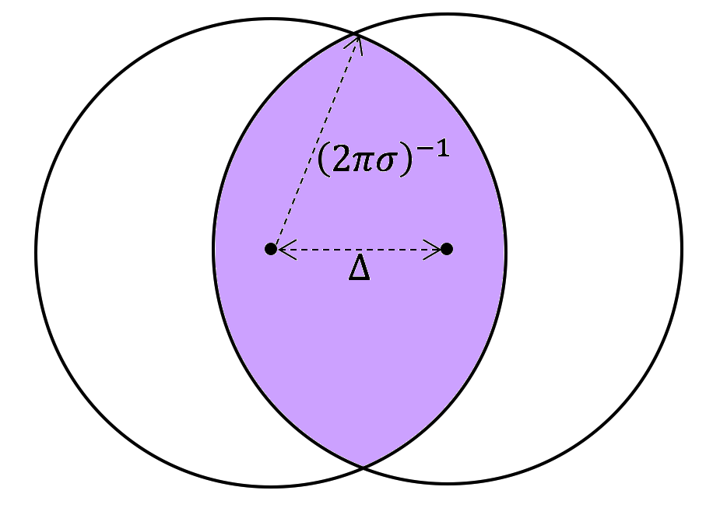

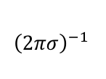
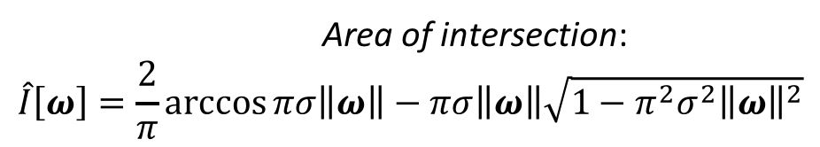
Diffraction Limits
$${\left(2πσ\right)}^{−1 }$$
$Δ$
Conventional wisdom: Diffraction imposes fundamental limits on the resolution of an optical system.
Q: How close do Airy disks have to be before it becomes impossible to distinguish them?
Abbe Limit:
When the separation is less than 1/radius of the support of the Fourier transform.
Area of intersection:
$$\hat{I}\left[ω\right]=\frac{2}{π}\arccos{πσ\left\|ω\right\|}−πσ\left\|ω\right\|\sqrt{1−π^{2}σ^{2}{\left\|ω\right\|}^{2}}$$

Slide 10


Diffraction Limits
$${\left(2πσ\right)}^{−1 }$$
$Δ$
Conventional wisdom: Diffraction imposes fundamental limits on the resolution of an optical system.
Q: How close do Airy disks have to be before it becomes impossible to distinguish them?
Abbe Limit:
When the separation is less than 1/radius of the support of the Fourier transform.
$$\hat{I}\left[ω\right]$$
$${\left(πσ\right)}^{−1}‖ω‖$$

Slide 11

Diffraction Limits
$${\left(2πσ\right)}^{−1 }$$
$Δ$
Conventional wisdom: Diffraction imposes fundamental limits on the resolution of an optical system.
Q: How close do Airy disks have to be before it becomes impossible to distinguish them?
$$≈0.94πσ$$
Sparrow Criterion:
When the density of the mixture of two Airy disks becomes unimodal.

Slide 12
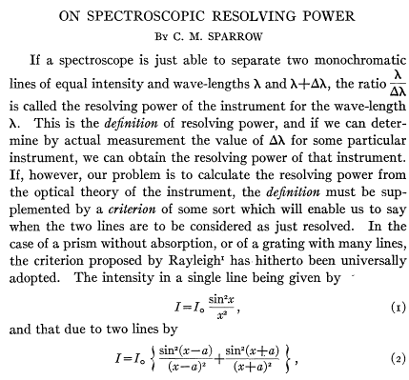
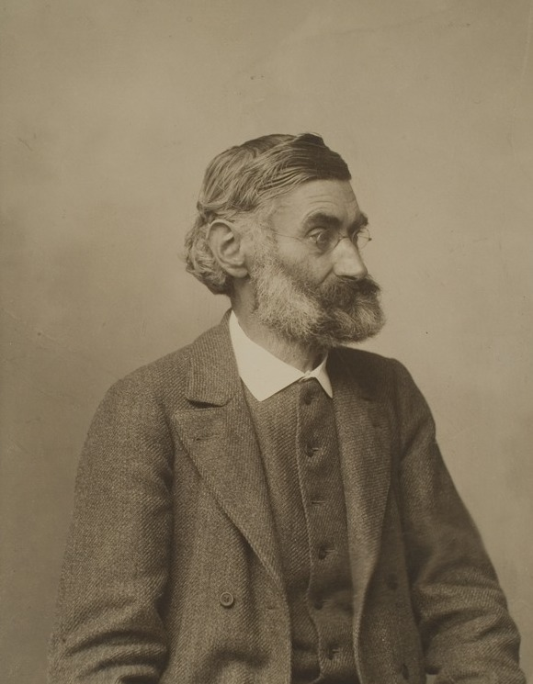
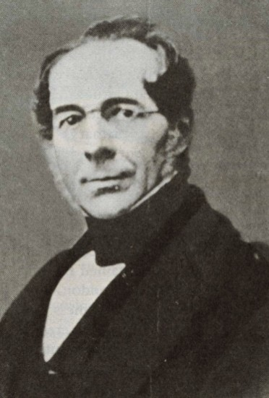
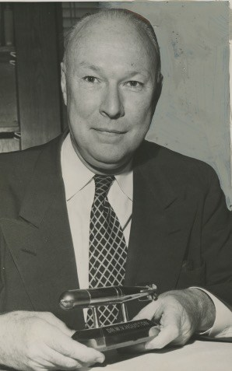
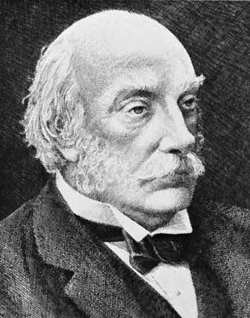
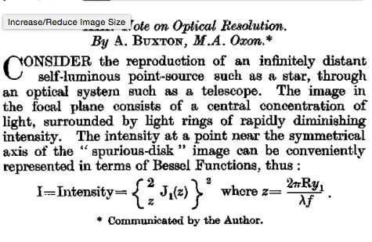
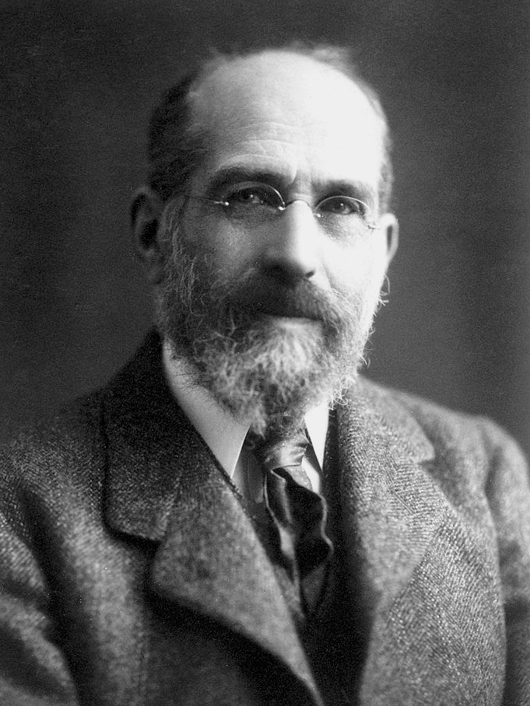
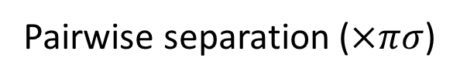
Diffraction Limits: The Zoo
Sparrow
Abbe
Dawes
Houston
Rayleigh
Buxton
Schuster
0.94
1
1.02
1.03
1.22
1.46
2.44
Pairwise separation ($×πσ$)
Which notion of diffraction limit is the right one?

Slide 13
Diffraction Limits: A Persistent Debate
“There is something arbitrary in (the Rayleigh criterion) as the dip in intensity necessary to indicate resolution is a physiological phenomenon.”
Sir Arthur Schuster, 1904
“It is obvious that (the point at which the density becomes unimodal) should set an upper limit to the resolving power.”
- Carroll Mason Sparrow, 1916
“...it seems a little pedantic to put such precision into the resolving power formula. This is because Rayleigh’s criterion is a rough idea in the first place. It tells you where it begins to get very hard to tell whether the image was made by one or by two stars. Actually, if sufficiently careful measurements of the exact intensity distribution over the diffracted image spot can be made, the fact that two sources make the spot can be proved even (below the Abbe limit).”
- Richard Feynman, 1964

Slide 14
Diffraction Limits: A Persistent Debate
“…it is only too obvious that from the mathematical standpoint, the image of two points, however close to one another, is different from that of one point. There is only a practical limit (if any) and not a theoretical limit for two-point resolving power.”
Toraldo di Francia, 1955
“In fact, the ability to resolve two point sources depends fundamentally on the signal-to-noise ratio…criteria that do not take account of noise are subjective.
Joseph Goodman, 2015
Despite over a century of study in the optics community, our understanding of what can and cannot be resolved has never risen above heuristic arguments.
Notes:
given that it’s possible to go below the proposed diffraction limits in certain settings, do they have any meaning?

Slide 15
OUTLINE
Introduction
  Fraunhofer Diffraction
  Debate about Diffraction Limit
  Our Results
Sparse FT (Off the Grid)
  Definition and Reduction
  1D case: Matrix Pencil Method
3. Learning in Two Dimensions
  Learning Without Separation
Open Questions

Slide 16
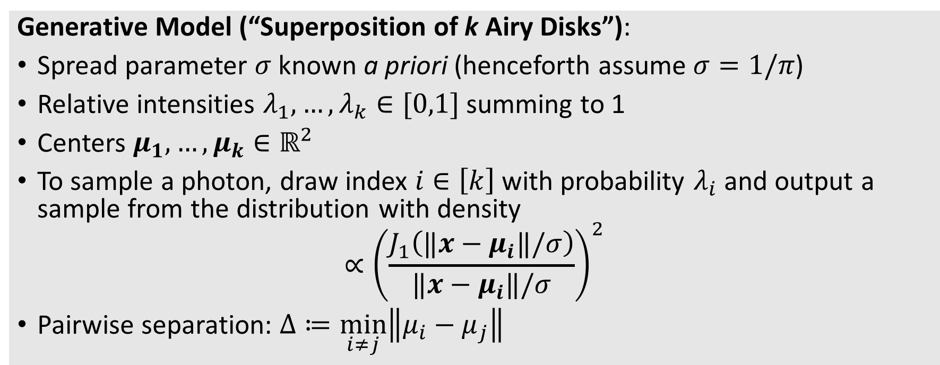
Our Results
Resolution can be thought of as parameter learning a mixture model.
Generative Model (“Superposition of k Airy Disks”):
Spread parameter $σ$ known a priori (henceforth assume $σ=1/π$)
Relative intensities $λ_{1},…,λ_{k}∈[0,1]$ summing to 1
Centers $μ_{1},…,μ_{k}∈ℝ^{2}$
To sample a photon, draw index $i∈\left[k\right]$ with probability $λ_{i}$ and output a sample from the distribution with density
$${∝\left(\frac{J_{1}\left(‖x−μ_{i}‖/σ\right)}{‖x−μ_{i}‖/σ}\right)}^{2}$$
Pairwise separation: $Δ≔\min_{i≠j}\left\|μ_{i}−μ_{j}\right\|$

Slide 17
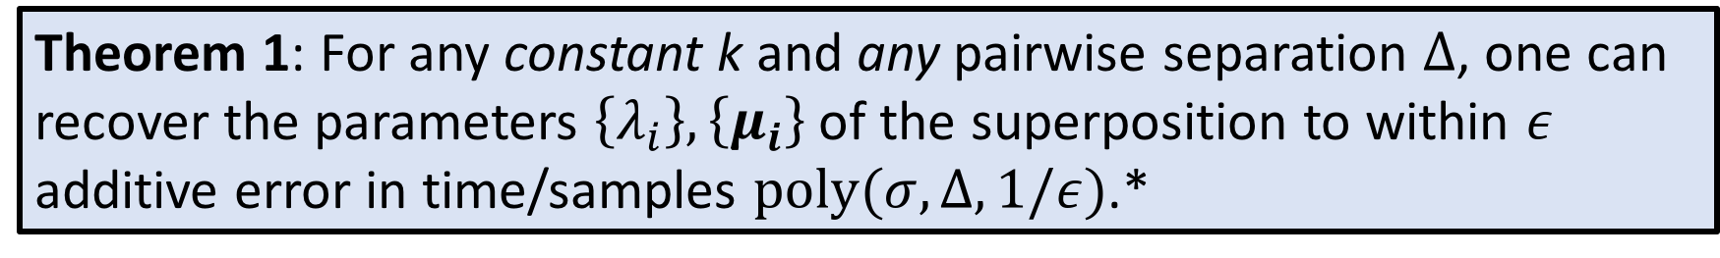
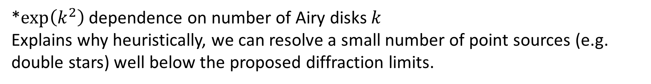
Our Results
Resolution can be thought of as parameter learning a mixture model.
Theorem 1: For any constant k and any pairwise separation $Δ$, one can recover the parameters $\left\{λ_{i}\right\},\left\{μ_{i}\right\}$ of the superposition to within $ε$ additive error in time/samples $poly(σ,Δ,1/ε)$.*
*$\exp\left(k^{2}\right)$ dependence on number of Airy disks $k$
Explains why heuristically, we can resolve a small number of point sources (e.g. double stars) well below the proposed diffraction limits.

Slide 18
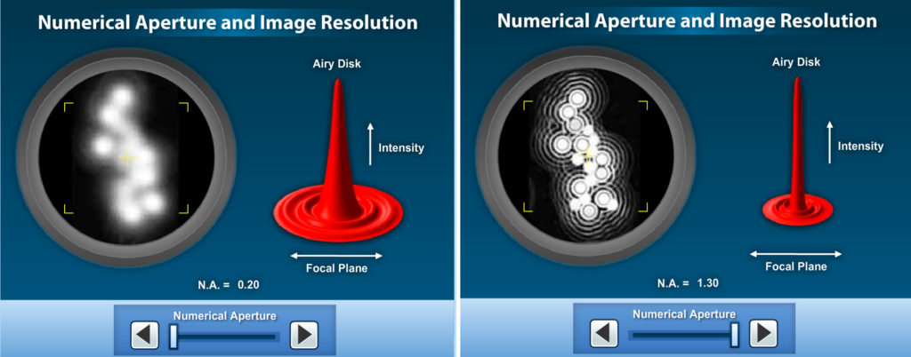
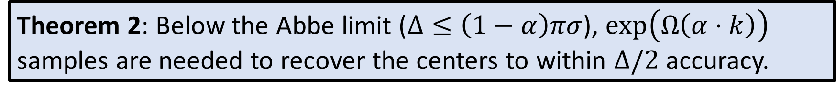
Our Results
Resolution can be thought of as parameter learning a mixture model.
Theorem 2: Below the Abbe limit ($Δ≤\left(1−α\right)πσ$), $\exp\left(Ω\left(α⋅k\right)\right)$ samples are needed to recover the centers to within $Δ/2$ accuracy.
i.e. limitations from diffraction only kick in when the number of centers is large

Slide 19

Our Results
Resolution can be thought of as parameter learning a mixture model.
Theorem 1: For any constant k and any pairwise separation $Δ$, one can recover the parameters $\left\{λ_{i}\right\},\left\{μ_{i}\right\}$ of the superposition to within $ε$ additive error in time/samples $poly(σ,Δ,1/ε)$.*
Theorem 2: Below the Abbe limit ($Δ≤\left(1−α\right)πσ$), $\exp\left(Ω\left(α⋅k\right)\right)$ samples are needed to recover the centers to within $Δ/2$ accuracy.
Theorem 3: When $Δ>1.530πσ$, $poly(k, 1/ε)$ time/samples suffice.

Slide 20
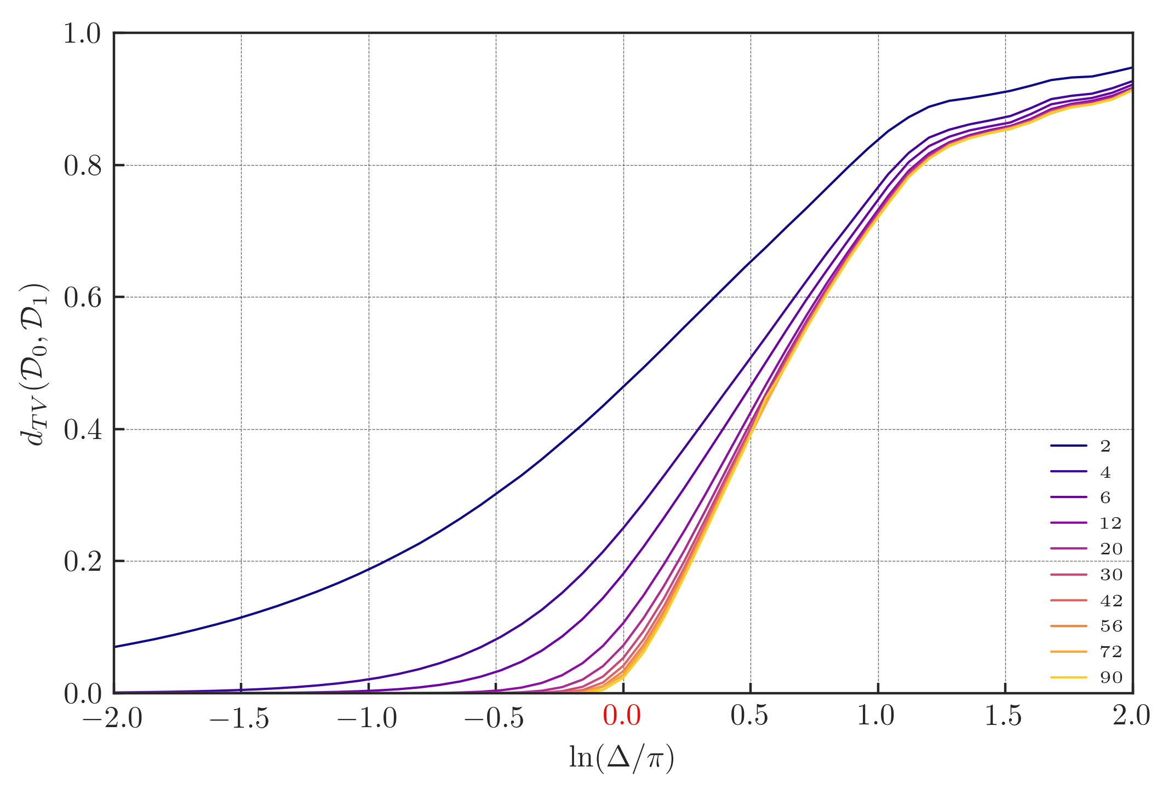
Our Results
Up to constant factor, indicates phase transition in sample complexity!

Slide 21
OUTLINE
Introduction
  Fraunhofer Diffraction
  Debate about Diffraction Limit
  Our Results
Sparse FT (Off the Grid)
  Definition and Reduction
  1D case: Matrix Pencil Method
3. Learning in Two Dimensions
  Learning Without Separation
Open Questions

Slide 22
OUTLINE
Introduction
  Fraunhofer Diffraction
  Debate about Diffraction Limit
  Our Results
Sparse FT (Off the Grid)
  Definition and Reduction
  1D case: Matrix Pencil Method
Learning in Two Dimensions
  Learning Without Separation
  Tensor Decomposition
Lower Bound
  Proof Sketch
Open Questions

Slide 23
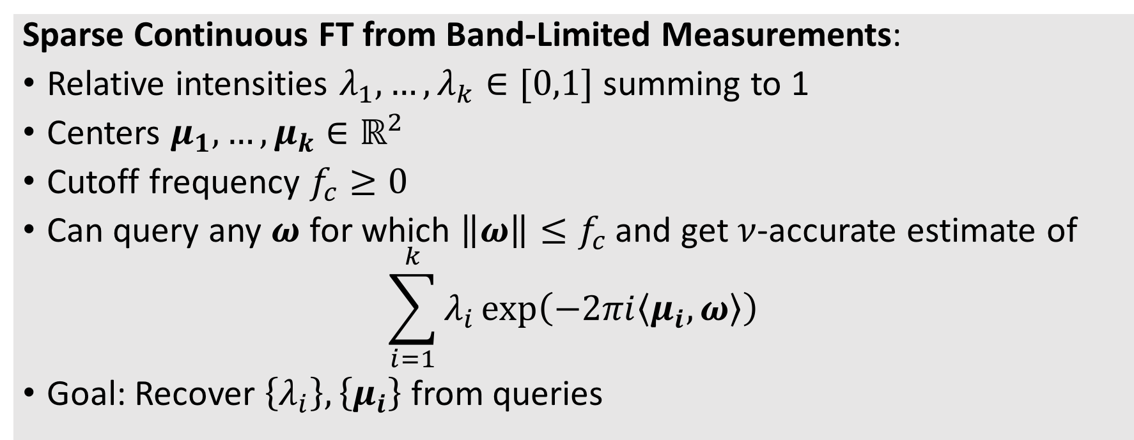
Sparse Fourier Transform (Off the Grid)
Sparse Continuous FT from Band-Limited Measurements:
Relative intensities $λ_{1},…,λ_{k}∈[0,1]$ summing to 1
Centers $μ_{1},…,μ_{k}∈ℝ^{2}$
Cutoff frequency $f_{c}≥0$
Can query any $ω$ for which $\left\|ω\right\|≤f_{c}$ and get $ν$-accurate estimate of
$$\sum_{i=1}^{k}{λ_{i}\exp\left(−2πi〈μ_{i},ω〉\right)}$$
Goal: Recover $\left\{λ_{i}\right\},\left\{μ_{i}\right\}$ from queries
Long line of work: [Donoho-Stark ’89], [Donoho ’92], [Hassanieh-Indky-Katabi-Price ‘12], [Tang et al. ’13], [Candes-Fernandez Granda ‘14], [Moitra ‘15], etc.

Slide 24
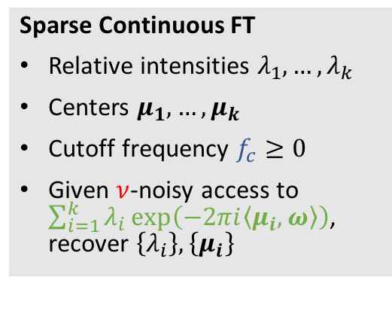
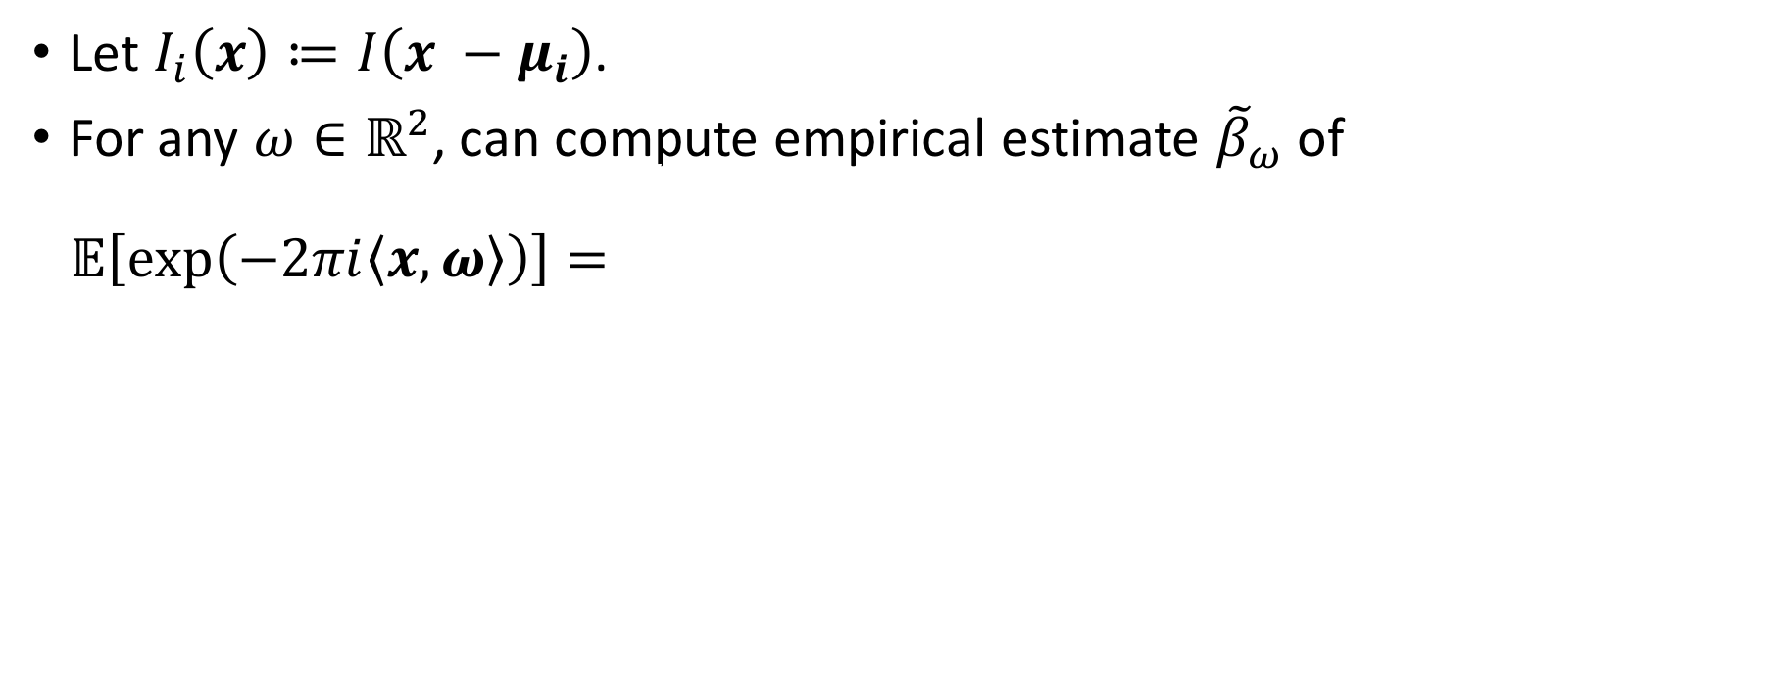
The Reduction
Sparse Continuous FT
Relative intensities $λ_{1},…,λ_{k}$
Centers $μ_{1},…,μ_{k}$
Cutoff frequency $f_{c}≥0$
Given $ν$-noisy access to $\sum_{i=1}^{k}{λ_{i}\exp\left(−2πi〈μ_{i},ω〉\right)}$, recover $\left\{λ_{i}\right\},\left\{μ_{i}\right\}$
Let $I_{i}\left(x\right)≔I\left(x −μ_{i}\right)$.
For any $ω∈ℝ^{2}$, can compute empirical estimate ${\tilde{β}}_{ω}$ of
$$𝔼\left[\exp\left(−2πi〈x,ω〉\right)\right]=\sum_{i=1}^{k}{λ_{i}\hat{I}[ω]}=\left(\sum_{i=1}^{k}{λ_{i}}\exp\left(−2πi〈μ_{i},ω〉\right)\right)⋅\hat{I}[ω]$$
If $\hat{I}\left[ω\right]≠0$ and ${\tilde{β}}_{ω}$ is $ν′$-close to $𝔼\left[\exp\left(−2πi〈x,ω〉\right)\right]$, then
${\tilde{β}}_{ω}/\hat{I}[ω]$ is $ν≔ν^{′}/\hat{I}[ω]$-close to $\sum_{i=1}^{k}{λ_{i}\exp\left(−2πi〈μ_{i},ω〉\right)}$
Recall: know $\hat{I}\left[ω\right]$ explicitly, supported on the ball of radius ${f_{c}≔\left(πσ\right)}^{−1}$.
Notes:
technically we need to pick f_c slightly smaller than (pi sigma)^{-1} in order for \nu to be bounded

Slide 25
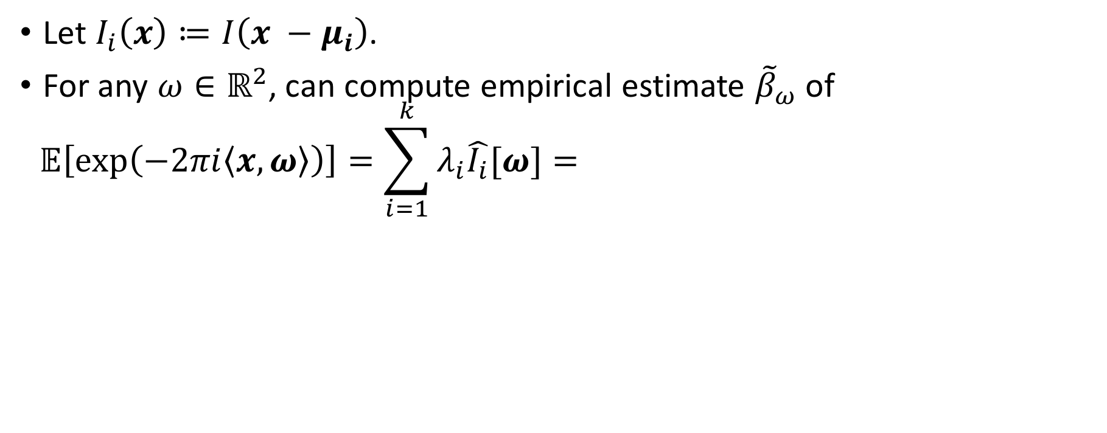
The Reduction
Sparse Continuous FT
Relative intensities $λ_{1},…,λ_{k}$
Centers $μ_{1},…,μ_{k}$
Cutoff frequency $f_{c}≥0$
Given $ν$-noisy access to $\sum_{i=1}^{k}{λ_{i}\exp\left(−2πi〈μ_{i},ω〉\right)}$, recover $\left\{λ_{i}\right\},\left\{μ_{i}\right\}$
Let $I_{i}\left(x\right)≔I\left(x −μ_{i}\right)$.
For any $ω∈ℝ^{2}$, can compute empirical estimate ${\tilde{β}}_{ω}$ of
$$𝔼\left[\exp\left(−2πi〈x,ω〉\right)\right]=\sum_{i=1}^{k}{λ_{i}\hat{I_{i}}[ω]}=\left(\sum_{i=1}^{k}{λ_{i}}\exp\left(−2πi〈μ_{i},ω〉\right)\right)⋅\hat{I}[ω]$$
If $\hat{I}\left[ω\right]≠0$ and ${\tilde{β}}_{ω}$ is $ν′$-close to $𝔼\left[\exp\left(−2πi〈x,ω〉\right)\right]$, then
${\tilde{β}}_{ω}/\hat{I}[ω]$ is $ν≔ν^{′}/\hat{I}[ω]$-close to $\sum_{i=1}^{k}{λ_{i}\exp\left(−2πi〈μ_{i},ω〉\right)}$
Recall: know $\hat{I}\left[ω\right]$ explicitly, supported on the ball of radius ${f_{c}≔\left(πσ\right)}^{−1}$.
Notes:
technically we need to pick f_c slightly smaller than (pi sigma)^{-1} in order for \nu to be bounded

Slide 26
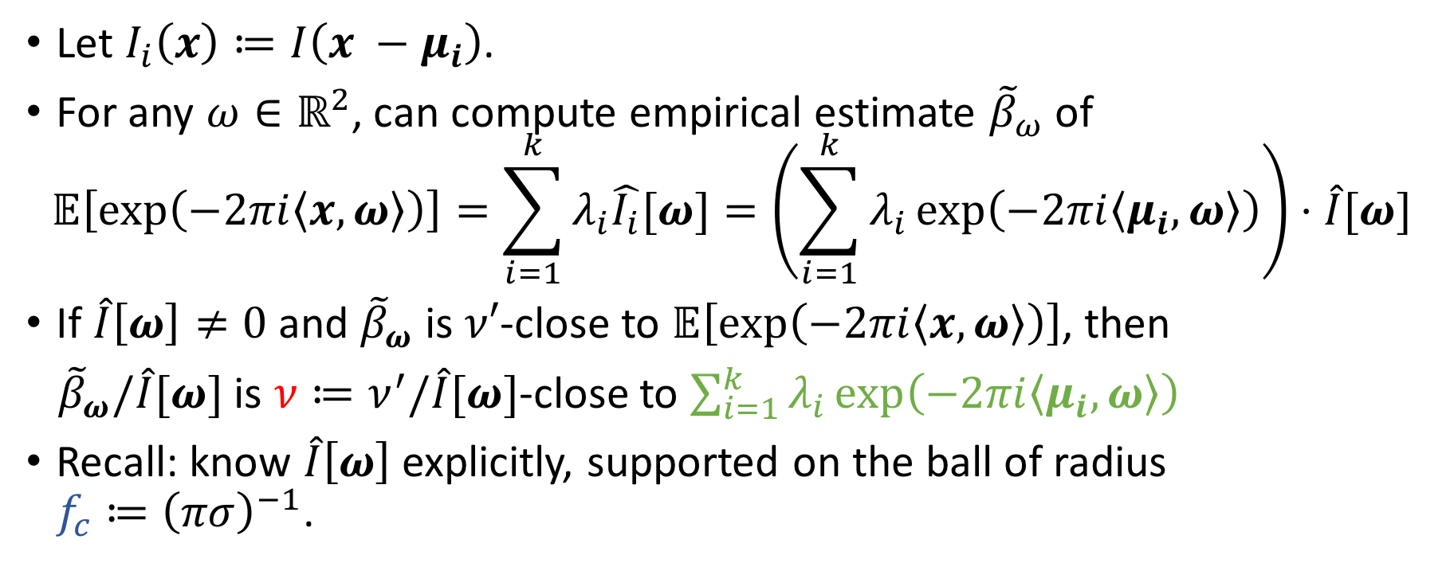
The Reduction
Sparse Continuous FT
Relative intensities $λ_{1},…,λ_{k}$
Centers $μ_{1},…,μ_{k}$
Cutoff frequency $f_{c}≥0$
Given $ν$-noisy access to $\sum_{i=1}^{k}{λ_{i}\exp\left(−2πi〈μ_{i},ω〉\right)}$, recover $\left\{λ_{i}\right\},\left\{μ_{i}\right\}$
Let $I_{i}\left(x\right)≔I\left(x −μ_{i}\right)$.
For any $ω∈ℝ^{2}$, can compute empirical estimate ${\tilde{β}}_{ω}$ of
$$𝔼\left[\exp\left(−2πi〈x,ω〉\right)\right]=\sum_{i=1}^{k}{λ_{i}\hat{I_{i}}[ω]}=\left(\sum_{i=1}^{k}{λ_{i}}\exp\left(−2πi〈μ_{i},ω〉\right)\right)⋅\hat{I}[ω]$$
If $\hat{I}\left[ω\right]≠0$ and ${\tilde{β}}_{ω}$ is $ν′$-close to $𝔼\left[\exp\left(−2πi〈x,ω〉\right)\right]$, then
${\tilde{β}}_{ω}/\hat{I}[ω]$ is $ν≔ν^{′}/\hat{I}[ω]$-close to $\sum_{i=1}^{k}{λ_{i}\exp\left(−2πi〈μ_{i},ω〉\right)}$
Recall: know $\hat{I}\left[ω\right]$ explicitly, supported on the ball of radius ${f_{c}≔\left(πσ\right)}^{−1}$.
Notes:
technically we need to pick f_c slightly smaller than (pi sigma)^{-1} in order for \nu to be bounded

Slide 27
OUTLINE
Introduction
  Fraunhofer Diffraction
  Debate about Diffraction Limit
  Our Results
Sparse FT (Off the Grid)
  Definition and Reduction
  1D case: Matrix Pencil Method
Learning in Two Dimensions
  Learning Without Separation
  Tensor Decomposition
Lower Bound
  Proof Sketch
Open Questions

Slide 28
OUTLINE
Introduction
  Fraunhofer Diffraction
  Debate about Diffraction Limit
  Our Results
Sparse FT (Off the Grid)
  Definition and Reduction
  1D case: Matrix Pencil Method
3. Learning in Two Dimensions
  Learning Without Separation
Open Questions

Slide 29
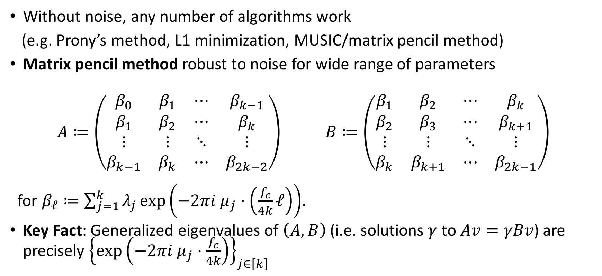
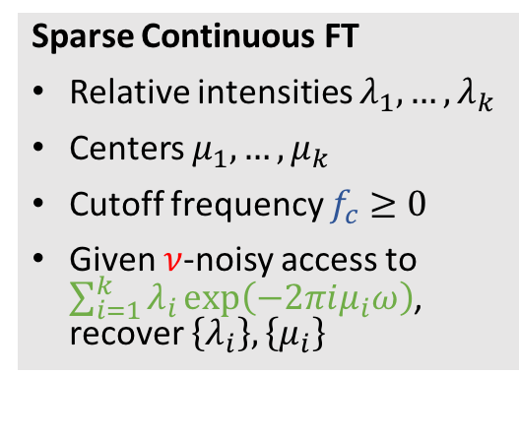
One-Dimensional Sparse FT
Sparse Continuous FT
Relative intensities $λ_{1},…,λ_{k}$
Centers $μ_{1},…,μ_{k}$
Cutoff frequency $f_{c}≥0$
Given $ν$-noisy access to $\sum_{i=1}^{k}{λ_{i}\exp\left(−2πiμ_{i}ω\right)}$, recover $\left\{λ_{i}\right\},\left\{μ_{i}\right\}$
Without noise, any number of algorithms work
(e.g. Prony’s method, L1 minimization, MUSIC/matrix pencil method)
Matrix pencil method robust to noise for wide range of parameters
$$A≔\left(\begin{matrix}β_{0} & β_{1} & ⋯ & β_{k−1} \\ β_{1} & β_{2} & ⋯ & β_{k} \\ ⋮ & ⋮ & ⋱ & ⋮ \\ β_{k−1} & β_{k} & ⋯ & β_{2k−2}\end{matrix}\right) B≔\left(\begin{matrix}β_{1} & β_{2} & ⋯ & β_{k} \\ β_{2} & β_{3} & ⋯ & β_{k+1} \\ ⋮ & ⋮ & ⋱ & ⋮ \\ β_{k} & β_{k+1} & ⋯ & β_{2k−1}\end{matrix}\right)$$
for $β_{ℓ}≔\sum_{j=1}^{k}{λ_{j}}exp\left(−2πi μ_{j}⋅\left(\frac{f_{c}}{4k}ℓ\right)\right)$.
Key Fact: Generalized eigenvalues of $\left(A,B\right)$ (i.e. solutions $γ$ to $Av=γBv$) are precisely ${\left\{\exp\left(−2πi μ_{j}⋅\frac{f_{c}}{4k}\right)\right\}}_{j∈\left[k\right]}$

Slide 30

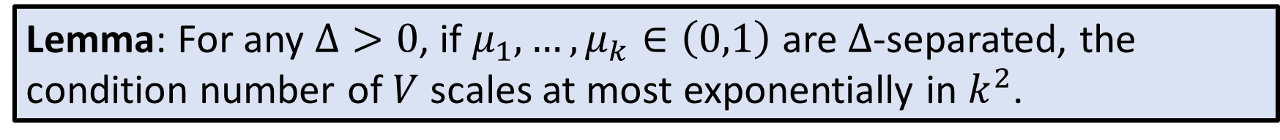
Stability of Matrix Pencil Method
[Moitra ‘15]: Matrix pencil method is robust to noise as long as the $k×k$ Vandermonde matrix $V$ generated by $\left\{\exp\left(−2πi μ_{j}⋅\frac{f_{c}}{4k}\right)\right\}$ is well-conditioned.
Lemma: For any $Δ>0$, if $μ_{1},…,μ_{k}∈\left(0,1\right)$ are $Δ$-separated, the condition number of $V$ scales at most exponentially in $k^{2}$.

Slide 31
OUTLINE
Introduction
  Fraunhofer Diffraction
  Debate about Diffraction Limit
  Our Results
Sparse FT (Off the Grid)
  Definition and Reduction
  1D case: Matrix Pencil Method
Learning in Two Dimensions
  Learning Without Separation
  Tensor Decomposition
Lower Bound
  Proof Sketch
Open Questions

Slide 32
OUTLINE
Introduction
  Fraunhofer Diffraction
  Debate about Diffraction Limit
  Our Results
Sparse FT (Off the Grid)
  Definition and Reduction
  1D case: Matrix Pencil Method
3. Learning in Two Dimensions
  Learning Without Separation
Open Questions

Slide 33
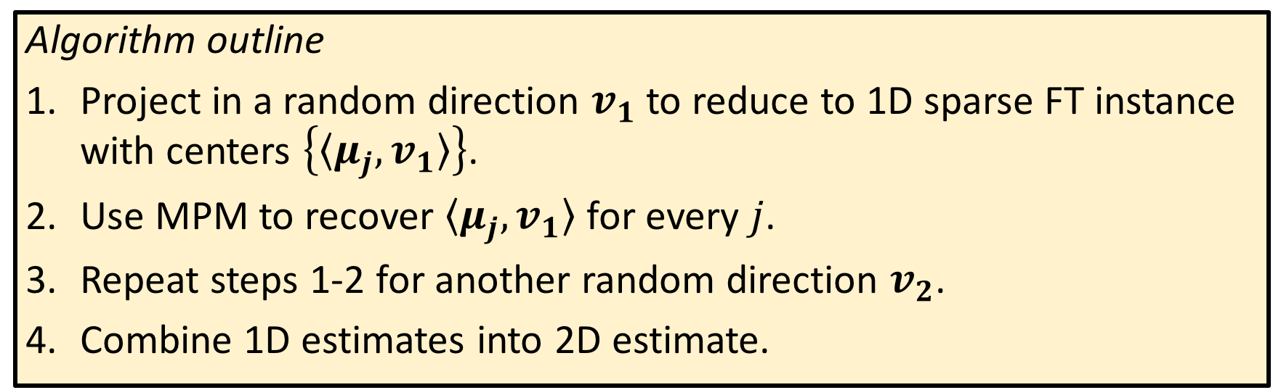
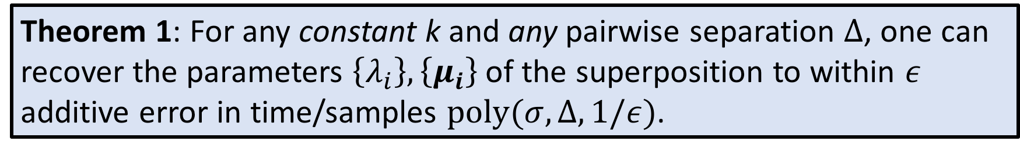
Learning Without Separation
Theorem 1: For any constant k and any pairwise separation $Δ$, one can recover the parameters $\left\{λ_{i}\right\},\left\{μ_{i}\right\}$ of the superposition to within $ε$ additive error in time/samples $poly(σ,Δ,1/ε)$.
Algorithm outline
Project in a random direction $v_{1}$ to reduce to 1D sparse FT instance with centers $\left\{〈μ_{j},v_{1}〉\right\}$.
Use MPM to recover $〈μ_{j},v_{1}〉$ for every $j$.
Repeat steps 1-2 for another random direction $v_{2}$.
Combine 1D estimates into 2D estimate.

Slide 34
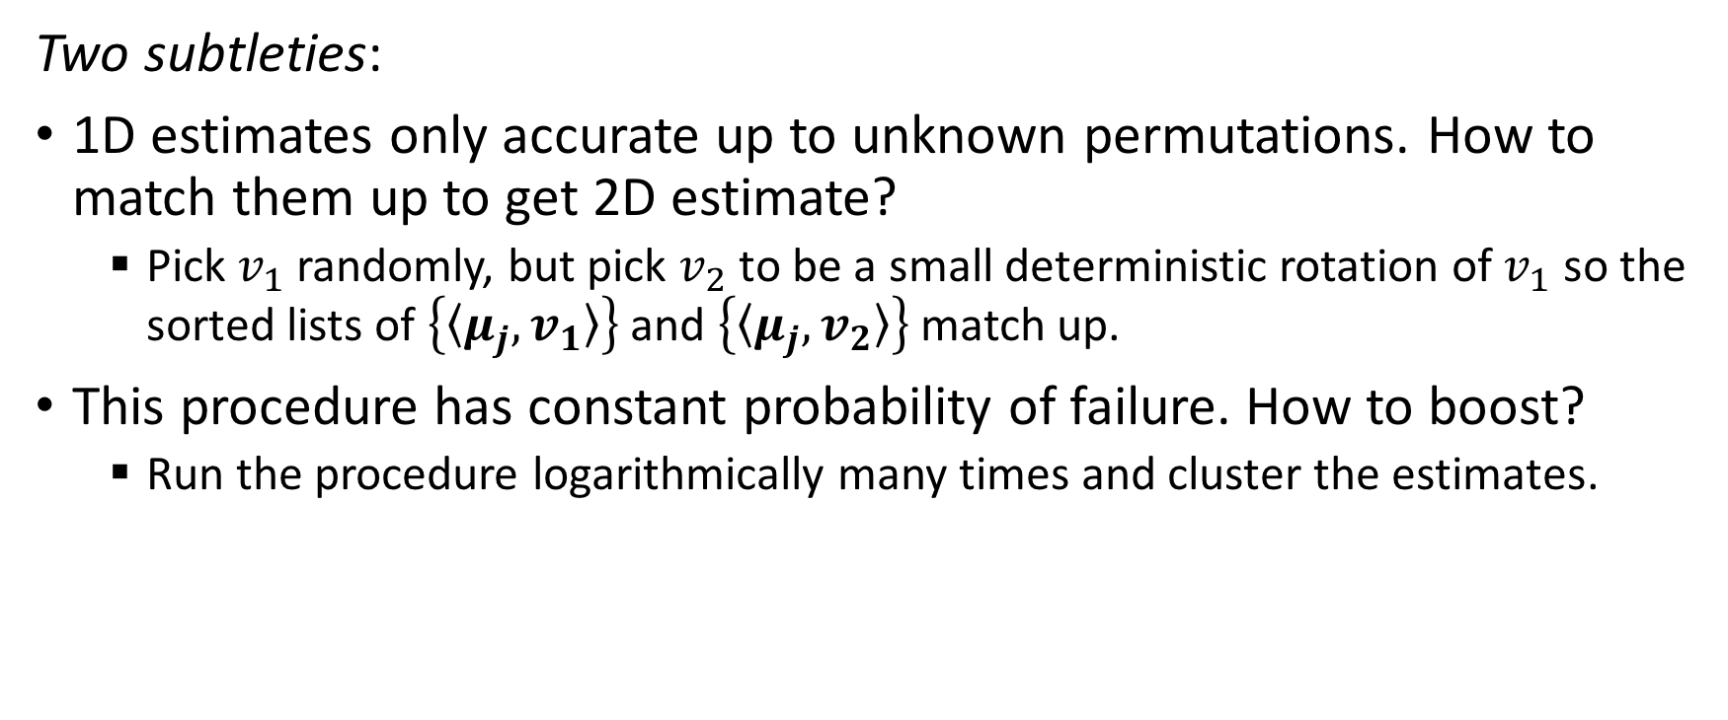
Learning Without Separation
Two subtleties:
1D estimates only accurate up to unknown permutations. How to match them up to get 2D estimate?
  Pick $v_{1}$ randomly, but pick $v_{2}$ to be a small deterministic rotation of $v_{1}$ so the sorted lists of $\left\{〈μ_{j},v_{1}〉\right\}$ and $\left\{〈μ_{j},v_{2}〉\right\}$ match up.
This procedure has constant probability of failure. How to boost?
  Run the procedure logarithmically many times and cluster the estimates.

Slide 35
OUTLINE
Introduction
  Fraunhofer Diffraction
  Debate about Diffraction Limit
  Our Results
Sparse FT (Off the Grid)
  Definition and Reduction
  1D case: Matrix Pencil Method
Learning in Two Dimensions
  Learning Without Separation
  Tensor Decomposition
Lower Bound
  Proof Sketch
Open Questions

Slide 36
Learning Above the Diffraction Limit
Theorem 3: When $Δ>1.530πσ$, $poly(k, 1/ε)$ time/samples suffice.
Our algorithm is based on an approach of [Huang-Kakade ‘15] for sparse FT in high dimensions, which can be thought of as a higher-order generalization of matrix pencil method.
Main technical component: high-dimensional analogue of condition number bound for Vandermonde matrix

Slide 37
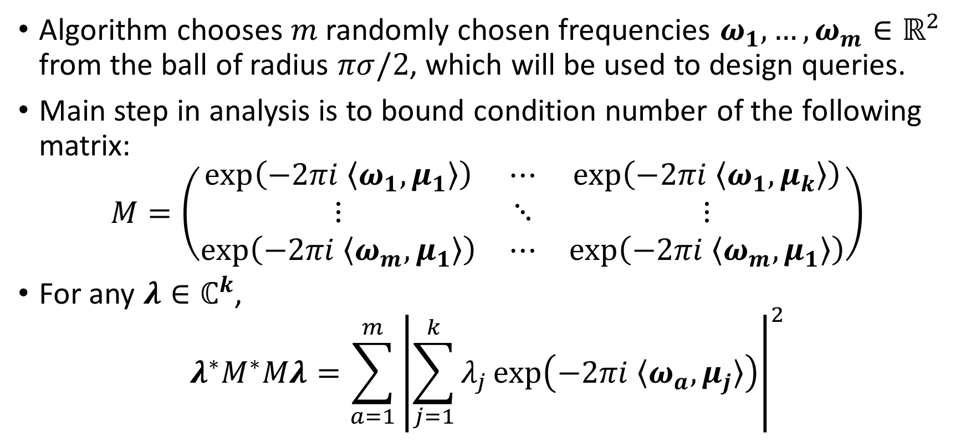
Condition Number Bound
Algorithm chooses $m$randomly chosen frequencies $ω_{1},…,ω_{m}∈ℝ^{2}$ from the ball of radius $πσ/2$, which will be used to design queries.
Main step in analysis is to bound condition number of the following matrix:
$$M=\left(\begin{matrix}\exp\left(−2πi 〈ω_{1},μ_{1}〉\right) & ⋯ & \exp\left(−2πi 〈ω_{1},μ_{k}〉\right) \\ ⋮ & ⋱ & ⋮ \\ \exp\left(−2πi 〈ω_{m},μ_{1}〉\right) & ⋯ & \exp\left(−2πi 〈ω_{m},μ_{1}〉\right)\end{matrix}\right)$$
For any $λ∈ℂ^{k}$,
$$λ^{∗}M^{∗}Mλ=\sum_{a=1}^{m}{{\left|\sum_{j=1}^{k}{λ_{j}}\exp\left(−2πi 〈ω_{a},μ_{j}〉\right)\right|}^{2}}$$

Slide 38
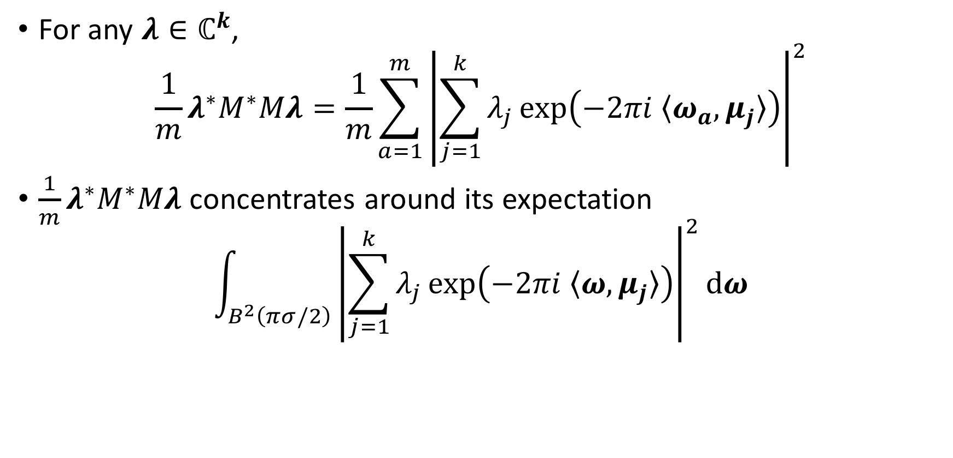
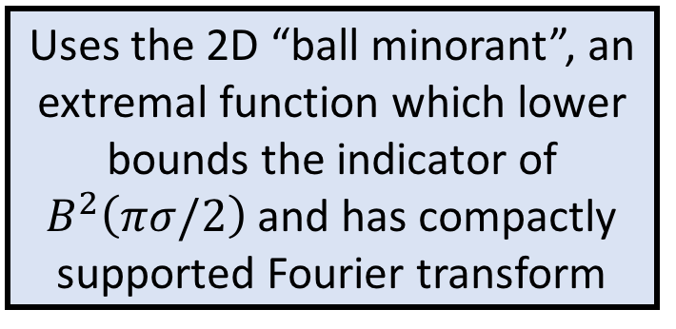
Condition Number Bound
Uses the 2D “ball minorant”, an extremal function which lower bounds the indicator of $B^{2}\left(πσ/2\right)$ and has compactly supported Fourier transform
For any $λ∈ℂ^{k}$,
$$\frac{1}{m}λ^{∗}M^{∗}Mλ=\frac{1}{m}\sum_{a=1}^{m}{{\left|\sum_{j=1}^{k}{λ_{j}}\exp\left(−2πi 〈ω_{a},μ_{j}〉\right)\right|}^{2}}$$
$\frac{1}{m}λ^{∗}M^{∗}Mλ$ concentrates around its expectation
$$\int_{B^{2}\left(πσ/2\right)}{{\left|\sum_{j=1}^{k}{λ_{j}}\exp\left(−2πi 〈ω,μ_{j}〉\right)\right|}^{2}dω}$$
Key Lemma: If $\left\{μ_{j}\right\}$ are at least $1.530πσ$-separated, this is $Ω\left({\left\|λ\right\|}^{2}\right)$.
Notes:
key step is to show that if the mu’s are sufficiently separated, there cannot be too many cancellations

Slide 39
OUTLINE
Introduction
  Fraunhofer Diffraction
  Debate about Diffraction Limit
  Our Results
Sparse FT (Off the Grid)
  Definition and Reduction
  1D case: Matrix Pencil Method
Learning in Two Dimensions
  Learning Without Separation
  Tensor Decomposition
Lower Bound
  Proof Sketch
Open Questions

Slide 40
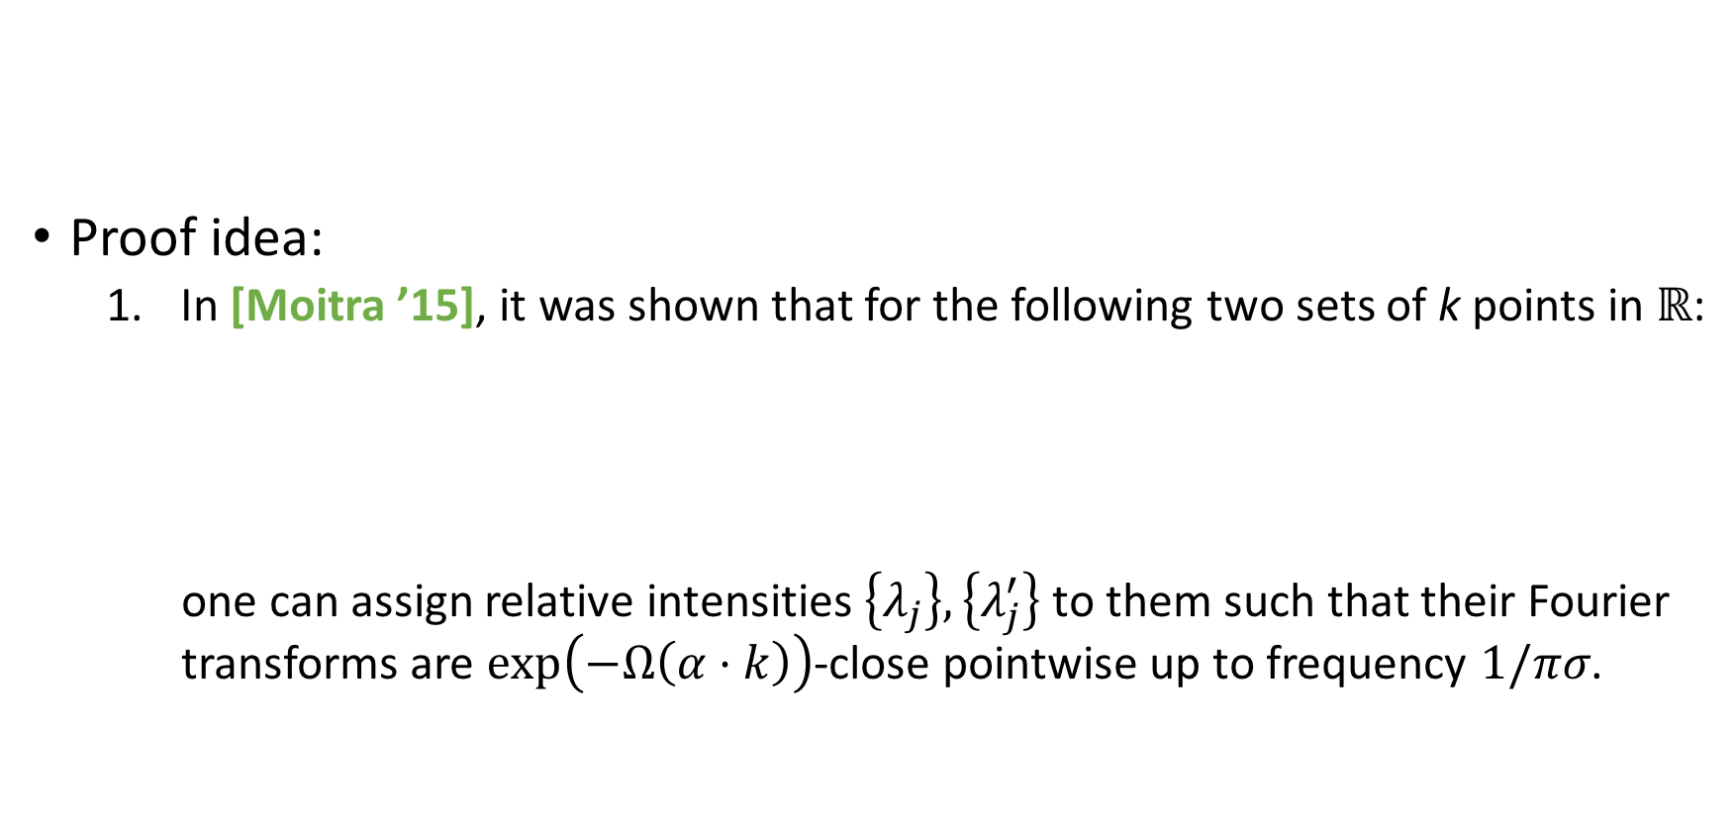


Proof of Lower Bound
Proof idea:
  In [Moitra ’15], it was shown that for the following two sets of k points in $ℝ$:
  one can assign relative intensities $\left\{λ_{j}\right\},\left\{λ_{j}^{′}\right\}$ to them such that their Fourier transforms are $\exp\left(−Ω\left(α⋅k\right)\right)$-close pointwise up to frequency $1/πσ$.
Theorem 2: Below the Abbe limit ($Δ≤\left(1−α\right)πσ$), $\exp\left(Ω\left(α⋅k\right)\right)$ samples are needed to recover the centers to within $Δ/2$ accuracy.
…
…
$$Δ=\left(1−α\right)πσ$$

Slide 41
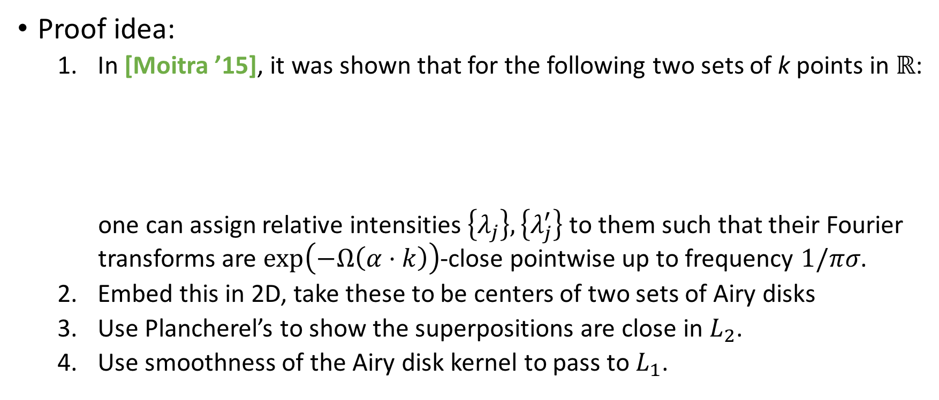

Proof of Lower Bound
Proof idea:
  In [Moitra ’15], it was shown that for the following two sets of k points in $ℝ$:
  one can assign relative intensities $\left\{λ_{j}\right\},\left\{λ_{j}^{′}\right\}$ to them such that their Fourier transforms are $\exp\left(−Ω\left(α⋅k\right)\right)$-close pointwise up to frequency $1/πσ$.
  Embed this in 2D, take these to be centers of two sets of Airy disks
  Use Plancherel’s to show the superpositions are close in $L_{2}$.
  Use smoothness of the Airy disk kernel to pass to $L_{1}$.
…
…
$$Δ=\left(1−α\right)πσ$$

Slide 42
OUTLINE
Introduction
  Fraunhofer Diffraction
  Debate about Diffraction Limit
  Our Results
Sparse FT (Off the Grid)
  Definition and Reduction
  1D case: Matrix Pencil Method
Learning in Two Dimensions
  Learning Without Separation
  Tensor Decomposition
Lower Bound
  Proof Sketch
Open Questions

Slide 43
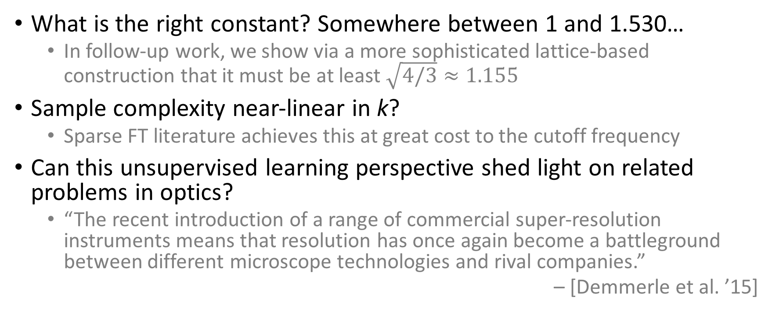
Open Questions
What is the right constant? Somewhere between 1 and 1.530…
  In follow-up work, we show via a more sophisticated lattice-based construction that it must be at least $\sqrt{4/3}≈1.155$
Sample complexity near-linear in k?
  Sparse FT literature achieves this at great cost to the cutoff frequency
Can this unsupervised learning perspective shed light on related problems in optics?
  “The recent introduction of a range of commercial super-resolution instruments means that resolution has once again become a battleground between different microscope technologies and rival companies.”
  – [Demmerle et al. ’15]
Notes:
i.e. Abbe limit is not the right answer!
there has been recent work on designing benchmarks for assessing the claims by various recent technologies of achieving superresolution. our results fall under a broader research agenda of leveraging insights from distribution learning to develop principled means of quantifying such claims. to clarify, this is not a mere academic task: (read quote)
I hope this work is a stepping stone towards future work in putting this scientifically and practically pressing challenge on a rigorous mathematical footing.

