Slide 1
Efficiently Learning from Untrusted Batches
Sitan Chen | Jerry Li | Ankur Moitra
MIT | MSR | MIT

Slide 2
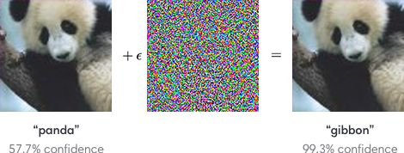
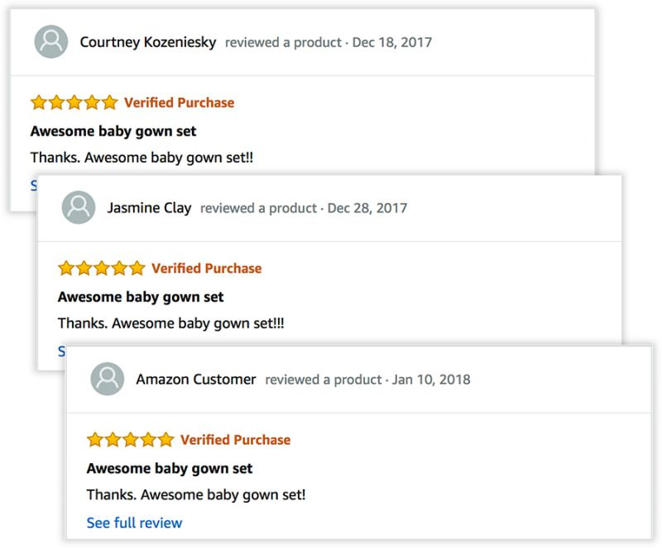
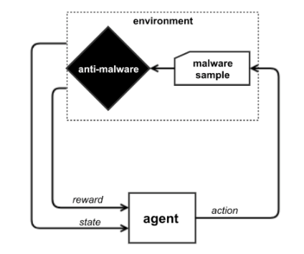
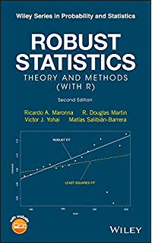
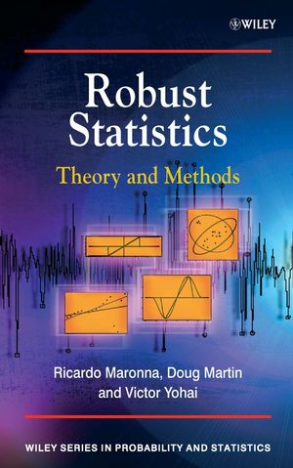
ROBUST LEARNING
Can we design learning algorithms that can tolerate a constant fraction of corruptions in the data?

Slide 3
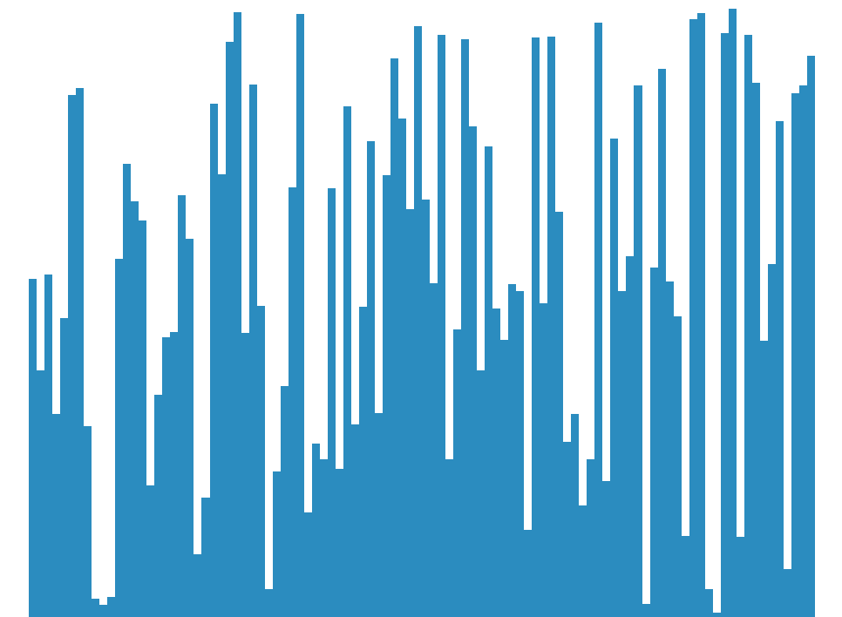
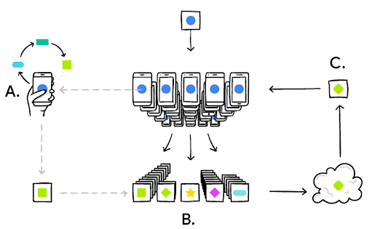
LEARNING FROM CROWDSOURCED DATA
$p$: distribution over $[n]$
What if a constant $ε$ fraction of users give adversarially chosen samples?
A priori can’t distinguish between $p$ and any other $p′$ that’s $ε$-close in TV.
User’s device sends a draw from $p$ to the learner.
Learner aggregates user data, tries to learn $p$.
Image from: Google AI Blog

Slide 4
LEARNING FROM CROWDSOURCED DATA
$p$: distribution over $[n]$
What if a constant $ε$ fraction of users give adversarially chosen samples?
With bigger batches, can hope to learn $p$ to within smaller and smaller error!
User’s device sends a batch of draws from $p$ to the learner.
Learner aggregates user data, tries to learn $p$.
Image from: Google AI Blog

Slide 5
LEARNING FROM CROWDSOURCED DATA
$p$: distribution over $[n]$
What if a constant $ε$ fraction of users give adversarially chosen samples?
With bigger batches, can hope to learn $p$ to within smaller and smaller error!
User’s device sends a batch of draws from $p_{i}$ to the learner.
Learner aggregates user data, tries to learn $p$.
Want to tolerate deviations from $p$ from user to user.
“Federated learning”
Image from: Google AI Blog

Slide 6
OUTLINE
Introduction
Motivations
Problem and Known Bounds
Our Results
Sum-of-Squares + Learning
A Polynomial System
SoS for Learning
Quantifying over $L_{∞}$ ball
Shape Constraints
$𝒜_{K}$ Norms
A New Relaxation
Sublinear Sample Complexity
Open Questions

Slide 7
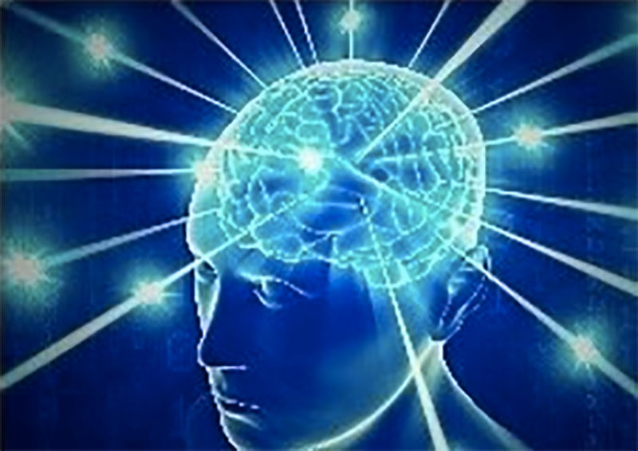
PROBLEM STATEMENT
$$p_{i}:d_{TV}\left(p,p_{i}\right)≤δ$$
“Learning from untrusted batches”, introduced by [Qiao-Valiant ’17]
User $i$
$p$: distribution over $[n]$
$$Z_{1}^{i},…,Z_{k}^{i}∼p_{i}$$
$N$ users, $ε$ fraction malicious
Each non-malicious user $i$ gives batch of $k$ iid draws from $p_{i}$ s.t. $d_{TV}\left(p_{i},p\right)≤δ$
Each malicious user gives $k$ adversarially chosen elements from $[n]$
Goal: Output estimator $\hat{p}$ for $p$ in TV

Slide 8
PROBLEM STATEMENT
$$p_{i}:d_{TV}\left(p,p_{i}\right)≤δ$$
“Learning from untrusted batches”, introduced by [Qiao-Valiant ’17]
User $i$
$p$: distribution over $[n]$
$$Z_{1}^{i},…,Z_{k}^{i}∼p_{i}$$
$N$ users, $ε$ fraction malicious
Each non-malicious user $i$ gives batch of $k$ iid draws from $p_{i}$ s.t. $d_{TV}\left(p_{i},p\right)≤δ$
Each malicious user gives $k$ adversarially chosen elements from $[n]$
Goal: Output estimator $\hat{p}$ for $p$ in TV

Slide 9
INFORMATION-THEORETIC LOWER BOUND
Theorem [Qiao-Valiant]: Given any $ε<1/2$ and $δ<1/4$, no algorithm can w.h.p. learn $𝒟$ to error $2δ+ε/\sqrt{k}$, regardless of $N$.
E.g. if all $p_{i}$’s were identical $δ$-perturbations of $p$.
Because of rate at which TV tensorizes
Domain size $n$
# users $N$
Corruption $ε$
$$d_{TV}\left(p_{i},p\right)≤δ$$
Batches of size $k$

Slide 10
UPPER BOUNDS
[Qiao-Valiant]: $poly\left(2^{n},k,1/ε,1/δ \right)$-time algorithm to learn within error $O\left(δ+ε/\sqrt{k}\right)$.
Idea: Design a linear program which has a variable $x_{S}$ for each $S⊆[n]$, corresponding to the probability mass $p$ assigns to $S$.
[Qiao-Valiant]: $poly\left({\left(nk\right)}^{k},1/ε\right)$-time algorithm to learn within error $O\left(ε/\sqrt{k}\right)$ when $p_{i}=p ∀i$.
Idea: Brute-force over slices of the $k$-th empirical moment tensor.
Can we achieve error $O\left(δ+ε/\sqrt{k}\right)$ with runtime polynomial in all parameters?

Slide 11
OUTLINE
Introduction
Motivations
Problem and Known Bounds
Our Results
Sum-of-Squares + Learning
A Polynomial System
SoS for Learning
Quantifying over $L_{∞}$ ball
Shape Constraints
$𝒜_{K}$ Norms
A New Relaxation
Sublinear Sample Complexity
Open Questions

Slide 12
OUR RESULTS
Theorem 1: For any even $t>0$, we can learn within error $O\left(δ+\frac{t^{1/2}ε^{1−1/t}}{\sqrt{k}}\right)$ in time $poly\left({\left(nk\right)}^{t^{2}},1/ε,1/δ\right)$ and given $poly\left({\left(nk\right)}^{t},1/ε,1/δ\right)$ users.
Note: For $t=2\log{1/ε}$, get error $O\left(δ+\frac{ε\sqrt{\log{1/ε}}}{\sqrt{k}}\right)$ in quasipoly time.
Caveats (more on this later):
Impractical runtime
$\sqrt{\log{1/ε}}$ factor in error bound
Huge sample complexity

Slide 13
OUR RESULTS
Theorem 1: For any even $t>0$, we can learn within error $O\left(δ+\frac{{t^{1/2}ε}^{1−1/t}}{\sqrt{k}}\right)$ in time $poly\left({\left(nk\right)}^{t^{2}},1/ε,1/δ\right)$ and given $poly\left({\left(nk\right)}^{t},1/ε,1/δ\right)$ users.
Note: For $t=2\log{1/ε}$, get error $O\left(δ+\frac{ε\sqrt{\log{1/ε}}}{\sqrt{k}}\right)$ in quasipoly time.
Caveats (more on this later):
Impractical runtime
$\sqrt{\log{1/ε}}$ factor in error bound
Huge sample complexity
We conjecture getting $o\left(\frac{ε\sqrt{\log{1/ε}}}{\sqrt{k}}\right)$ error requires at least quasipoly dependence on $1/ε$.

Slide 14
OUR RESULTS
Theorem 1: For any even $t>0$, we can learn within error $O\left(δ+\frac{{t^{1/2}ε}^{1−1/t}}{\sqrt{k}}\right)$ in time $poly\left({\left(nk\right)}^{t^{2}},1/ε,1/δ\right)$ and given $poly\left({\left(nk\right)}^{t},1/ε,1/δ\right)$ users.
Note: For $t=2\log{1/ε}$, get error $O\left(δ+\frac{ε\sqrt{\log{1/ε}}}{\sqrt{k}}\right)$ in quasipoly time.
Caveats (more on this later):
Impractical runtime
$\sqrt{\log{1/ε}}$ factor in error bound
Huge sample complexity
Under certain “shape” assumptions on $p$, we show we can get sample complexity sublinear in $n$.

Slide 15
OUTLINE
Introduction
Motivations
Problem and Known Bounds
Our Results
Sum-of-Squares + Learning
A Polynomial System
SoS for Learning
Quantifying over $L_{∞}$ ball
Shape Constraints
$𝒜_{K}$ Norms
A New Relaxation
Sublinear Sample Complexity
Open Questions
For the rest of this talk, we will focus on $p_{i}=p$.

Slide 16
LEARNING FROM UNTRUSTED BATCHES AS ROBUST L1 MEAN ESTIMATION PROBLEM
Given a batch $(Z^{1},…,Z^{k})$, write it as a vector of frequencies $X∈Δ^{n}$, where $X_{a}=\frac{1}{k}\sum_{i=1}^{k}{𝕀\left[Z^{i}=a\right]}$ for each $a∈\left[n\right]$.
Learner gets $N$ samples $X^{1},…,X^{N}∈Δ^{n}$ from normalized multinomial distribution $Mul_{k}\left(p\right)$, where $ε$ fraction of samples have been corrupted.
$p=𝔼_{X∼Mul_{k}(p)}\left[X\right]$, so learning $p$ in total variation distance is equivalent to robust $L_{1}$ mean estimation for multinomial distributions.
Domain size $n$
# users $N$
Corruption $ε$
Batches of size $k$

Slide 17
SEARCHING FOR A MOMENT-BOUNDED SUBSET
(Normalized) Binomial distributions have bounded central moments:
$$𝔼_{X∼Bin(k,p)}{\left[{\left(X−p\right)}^{s}\right]}^{1/s}≲\sqrt{s/k} ∀s≤k$$
…so multinomial distributions do too:
$$𝔼_{X∼{Mul}_{k}(p)}{\left[{〈X−p,v〉}^{s}\right]}^{1/s}≲\sqrt{s/k} ∀s≤k, v∈{\left\{±1\right\}}^{n}$$
To find uncorrupted points, we will search for a $\left(1−ε\right)N$-sized subset of points with similarly bounded empirical moments.

Slide 18
A POLYNOMIAL SYSTEM
To find uncorrupted points, we will search for a $\left(1−ε\right)N$-sized subset of points with similarly bounded empirical moments.
Variables:
Estimate for the mean: $\hat{p}∈Δ^{n}$
Indicators for uncorrupted points: $w_{1},…,w_{N}∈\{0,1\}$
Constants:
Samples $X^{1},…,X^{N}∈Δ^{n}$
Degree $t$
Constraints:
$$∑w_{i}=\left(1−ε\right)N$$
$$w_{i}^{2}=w_{i} ∀i∈\left[N\right]$$
$$\hat{p}=\frac{1}{(1−ε)N}∑w_{i}X^{i}$$
$$∑w_{i}{\left\langle X^{i}−\hat{p},v\right\rangle }^{s}≤{\left(8s/k\right)}^{s/2}∑w_{i}$$
$∀ even 2≤s≤t$
and $v∈{\left\{±1\right\}}^{n}$

Slide 19
A POLYNOMIAL SYSTEM
Claim: For any solution $\left(\{w_{i}\},\hat{p}\right)$, $d_{TV}\left(p,\hat{p}\right)≤O\left(ε^{1−1/t}\sqrt{t/k}\right)$.
Proof: By dual characterization of $L_{1}$, enough to show that
$$〈\hat{p}−p,v〉≤O\left(ε^{1−1/t}\sqrt{t/k}\right)$$
Write $\left[N\right]=S_{g}⊔S_{b}$.
$$∀v∈{\left\{±1\right\}}^{n}$$
$\sum_{i∈\left[N\right]}{w_{i}〈\hat{p}−p,v〉}$

Slide 20
A POLYNOMIAL SYSTEM
Claim: For any solution $\left(\{w_{i}\},\hat{p}\right)$, $d_{TV}\left(p,\hat{p}\right)≤O\left(ε^{1−1/t}\sqrt{t/k}\right)$.
Proof: By dual characterization of $L_{1}$, enough to show that
$$〈\hat{p}−p,v〉≤O\left(ε^{1−1/t}\sqrt{t/k}\right)$$
Write $\left[N\right]=S_{g}⊔S_{b}$.
$$∀v∈{\left\{±1\right\}}^{n}$$
$\sum_{i∈\left[N\right]}{w_{i}〈\hat{p}−p,v〉}$ | = | $\sum_{i∈\left[N\right]}{w_{i}〈X^{i}−p,v〉}$

Slide 21
A POLYNOMIAL SYSTEM
Claim: For any solution $\left(\{w_{i}\},\hat{p}\right)$, $d_{TV}\left(p,\hat{p}\right)≤O\left(ε^{1−1/t}\sqrt{t/k}\right)$.
Proof: By dual characterization of $L_{1}$, enough to show that
$$〈\hat{p}−p,v〉≤O\left(ε^{1−1/t}\sqrt{t/k}\right)$$
Write $\left[N\right]=S_{g}⊔S_{b}$.
$$∀v∈{\left\{±1\right\}}^{n}$$
$\sum_{i∈\left[N\right]}{w_{i}〈\hat{p}−p,v〉}$ | = | $\sum_{i∈\left[N\right]}{w_{i}〈X^{i}−p,v〉}$
 | = | $\sum_{i∈S_{g}}{w_{i}〈X^{i}−p,v〉}+\sum_{i∈S_{b}}{w_{i}〈X^{i}−p,v〉}$

Slide 22
A POLYNOMIAL SYSTEM
Claim: For any solution $\left(\{w_{i}\},\hat{p}\right)$, $d_{TV}\left(p,\hat{p}\right)≤O\left(ε^{1−1/t}\sqrt{t/k}\right)$.
Proof: By dual characterization of $L_{1}$, enough to show that
$$〈\hat{p}−p,v〉≤O\left(ε^{1−1/t}\sqrt{t/k}\right)$$
Write $\left[N\right]=S_{g}⊔S_{b}$.
$$∀v∈{\left\{±1\right\}}^{n}$$
$\sum_{i∈\left[N\right]}{w_{i}〈\hat{p}−p,v〉}$ | = | $\sum_{i∈\left[N\right]}{w_{i}〈X^{i}−p,v〉}$
 | = | $\sum_{i∈S_{g}}{w_{i}〈X^{i}−p,v〉}+\sum_{i∈S_{b}}{w_{i}〈X^{i}−p,v〉}$
 | = | $\sum_{i∈S_{g}}{〈X^{i}−p,v〉}+\sum_{i∈S_{g}}{\left(w_{i}−1\right)〈X^{i}−p,v〉}$
 |  | $+\sum_{i∈S_{b}}{w_{i}〈X^{i}−\hat{p},v〉}+\sum_{i∈S_{b}}{w_{i}〈\hat{p}−p,v〉}$

Slide 23
A POLYNOMIAL SYSTEM
Claim: For any solution $\left(\{w_{i}\},\hat{p}\right)$, $d_{TV}\left(p,\hat{p}\right)≤O\left(ε^{1−1/t}\sqrt{t/k}\right)$.
Proof: By dual characterization of $L_{1}$, enough to show that
$$〈\hat{p}−p,v〉≤O\left(ε^{1−1/t}\sqrt{t/k}\right)$$
Write $\left[N\right]=S_{g}⊔S_{b}$.
$$∀v∈{\left\{±1\right\}}^{n}$$
$\sum_{i∈S_{g}}{w_{i}〈\hat{p}−p,v〉}$ | = | $\sum_{i∈S_{g}}{〈X^{i}−p,v〉}+\sum_{i∈S_{g}}{\left(w_{i}−1\right)〈X^{i}−p,v〉}$ $+\sum_{i∈S_{b}}{w_{i}〈X^{i}−\hat{p},v〉}$
A
B
C
A: Sampling error from uncorrupted samples
B: Failure of $w_{i}$’s to capture some small fraction of uncorrupted samples
C: Error from adversarially chosen $X^{i}$’s

Slide 24
A POLYNOMIAL SYSTEM
Claim: For any solution $\left(\{w_{i}\},\hat{p}\right)$, $d_{TV}\left(p,\hat{p}\right)≤O\left(ε^{1−1/t}\sqrt{t/k}\right)$.
$\sum_{i∈S_{g}}{w_{i}〈\hat{p}−p,v〉}$ | = | $\sum_{i∈S_{g}}{〈X^{i}−p,v〉}+\sum_{i∈S_{g}}{\left(w_{i}−1\right)〈X^{i}−p,v〉}$ $+\sum_{i∈S_{b}}{w_{i}〈X^{i}−\hat{p},v〉}$
A
B
C
Using the fact that ${\left(a+b+c\right)}^{t}≤\exp\left(t\right)\left(a^{t}+b^{t}+c^{t}\right)$:
${\left(\sum_{i∈S_{g}}{w_{i}}\right)}^{t}{〈\hat{p}−p,v〉}^{t}$ | ≤ | $$\exp\left(t\right)\left(A^{t}+B^{t}+C^{t}\right)$$
$$≥{N^{t}⋅2}^{−t}$$
Enough to bound by $N^{t}ε^{t−1}{\left(t/k\right)}^{t/2}$

Slide 25
A POLYNOMIAL SYSTEM
Claim: For any solution $\left(\{w_{i}\},\hat{p}\right)$, $d_{TV}\left(p,\hat{p}\right)≤O\left(ε^{1−1/t}\sqrt{t/k}\right)$.
${\left(\sum_{i∈S_{b}}{w_{i}〈X^{i}−\hat{p},v〉}\right)}^{t}$
$$C^{t}$$

Slide 26
A POLYNOMIAL SYSTEM
Claim: For any solution $\left(\{w_{i}\},\hat{p}\right)$, $d_{TV}\left(p,\hat{p}\right)≤O\left(ε^{1−1/t}\sqrt{t/k}\right)$.
${\left(\sum_{i∈S_{b}}{w_{i}〈X^{i}−\hat{p},v〉}\right)}^{t}$ | = | ${\left(\sum_{i∈S_{b}}{w_{i}⋅w_{i}〈X^{i}−\hat{p},v〉}\right)}^{t}$
$$C^{t}$$

Slide 27
A POLYNOMIAL SYSTEM
Claim: For any solution $\left(\{w_{i}\},\hat{p}\right)$, $d_{TV}\left(p,\hat{p}\right)≤O\left(ε^{1−1/t}\sqrt{t/k}\right)$.
${\left(\sum_{i∈S_{b}}{w_{i}〈X^{i}−\hat{p},v〉}\right)}^{t}$ | = | ${\left(\sum_{i∈S_{b}}{w_{i}⋅w_{i}〈X^{i}−\hat{p},v〉}\right)}^{t}$
 | ≤ | ${\left(\sum_{i∈S_{b}}{w_{i}}\right)}^{t−1}⋅\left(\sum_{i∈S_{b}}{w_{i}{〈X^{i}−\hat{p},v〉}^{t}}\right)$
$$C^{t}$$

Slide 28
A POLYNOMIAL SYSTEM
Claim: For any solution $\left(\{w_{i}\},\hat{p}\right)$, $d_{TV}\left(p,\hat{p}\right)≤O\left(ε^{1−1/t}\sqrt{t/k}\right)$.
${\left(\sum_{i∈S_{b}}{w_{i}〈X^{i}−\hat{p},v〉}\right)}^{t}$ | = | ${\left(\sum_{i∈S_{b}}{w_{i}⋅w_{i}〈X^{i}−\hat{p},v〉}\right)}^{t}$
 | ≤ | ${\left(\sum_{i∈S_{b}}{w_{i}}\right)}^{t−1}⋅\left(\sum_{i∈S_{b}}{w_{i}{〈X^{i}−\hat{p},v〉}^{t}}\right)$
 | ≤ | ${\left(\sum_{i∈S_{b}}{w_{i}}\right)}^{t−1}⋅\left(\sum_{i∈[N]}{w_{i}{〈X^{i}−\hat{p},v〉}^{t}}\right)$
$$C^{t}$$

Slide 29
A POLYNOMIAL SYSTEM
Claim: For any solution $\left(\{w_{i}\},\hat{p}\right)$, $d_{TV}\left(p,\hat{p}\right)≤O\left(ε^{1−1/t}\sqrt{t/k}\right)$.
${\left(\sum_{i∈S_{b}}{w_{i}〈X^{i}−\hat{p},v〉}\right)}^{t}$ | = | ${\left(\sum_{i∈S_{b}}{w_{i}⋅w_{i}〈X^{i}−\hat{p},v〉}\right)}^{t}$
 | ≤ | ${\left(\sum_{i∈S_{b}}{w_{i}}\right)}^{t−1}⋅\left(\sum_{i∈S_{b}}{w_{i}{〈X^{i}−\hat{p},v〉}^{t}}\right)$
 | ≤ | ${\left(\sum_{i∈S_{b}}{w_{i}}\right)}^{t−1}⋅\left(\sum_{i∈[N]}{w_{i}{〈X^{i}−\hat{p},v〉}^{t}}\right)$
 | ≤ | ${\left(εN\right)}^{t−1}⋅{\left(8t/k\right)}^{t/2}\sum_{i}{w_{i}}$
$$C^{t}$$

Slide 30
A POLYNOMIAL SYSTEM
Claim: For any solution $\left(\{w_{i}\},\hat{p}\right)$, $d_{TV}\left(p,\hat{p}\right)≤O\left(ε^{1−1/t}\sqrt{t/k}\right)$.
${\left(\sum_{i∈S_{b}}{w_{i}〈X^{i}−\hat{p},v〉}\right)}^{t}$ | = | ${\left(\sum_{i∈S_{b}}{w_{i}⋅w_{i}〈X^{i}−\hat{p},v〉}\right)}^{t}$
 | ≤ | ${\left(\sum_{i∈S_{b}}{w_{i}}\right)}^{t−1}⋅\left(\sum_{i∈S_{b}}{w_{i}{〈X^{i}−\hat{p},v〉}^{t}}\right)$
 | ≤ | ${\left(\sum_{i∈S_{b}}{w_{i}}\right)}^{t−1}⋅\left(\sum_{i∈[N]}{w_{i}{〈X^{i}−\hat{p},v〉}^{t}}\right)$
 | ≤ | ${\left(εN\right)}^{t−1}⋅{\left(8t/k\right)}^{t/2}⋅{\left(\sum_{i}{w_{i}}\right)}^{t}$
 | ≤ | $${\left(εN\right)}^{t−1}⋅{\left(8t/k\right)}^{t/2}⋅N^{t}$$
$$C^{t}$$

Slide 31
A POLYNOMIAL SYSTEM
Claim: For any solution $\left(\{w_{i}\},\hat{p}\right)$, $d_{TV}\left(p,\hat{p}\right)≤O\left(ε^{1−1/t}\sqrt{t/k}\right)$.
Done after taking $t$-th roots.
${\left(\sum_{i∈S_{b}}{w_{i}〈X^{i}−\hat{p},v〉}\right)}^{t}$ | = | ${\left(\sum_{i∈S_{b}}{w_{i}⋅w_{i}〈X^{i}−\hat{p},v〉}\right)}^{t}$
 | ≤ | ${\left(\sum_{i∈S_{b}}{w_{i}}\right)}^{t−1}⋅\left(\sum_{i∈S_{b}}{w_{i}{〈X^{i}−\hat{p},v〉}^{t}}\right)$
 | ≤ | ${\left(\sum_{i∈S_{b}}{w_{i}}\right)}^{t−1}⋅\left(\sum_{i∈[N]}{w_{i}{〈X^{i}−\hat{p},v〉}^{t}}\right)$
 | ≤ | ${\left(εN\right)}^{t−1}⋅{\left(8t/k\right)}^{t/2}⋅{\left(\sum_{i}{w_{i}}\right)}^{t}$
 | ≤ | $${\left(εN\right)}^{t−1}⋅{\left(8t/k\right)}^{t/2}⋅N^{t}$$
$$C^{t}$$

Slide 32
A POLYNOMIAL SYSTEM
$\sum_{i∈S_{g}}{w_{i}〈\hat{p}−p,v〉}$ | = | $\sum_{i∈S_{g}}{〈X^{i}−p,v〉}+\sum_{i∈S_{g}}{\left(w_{i}−1\right)〈X^{i}−p,v〉}$ $+\sum_{i∈S_{b}}{w_{i}〈X^{i}−\hat{p},v〉}$
A
B
C
To bound $A^{t}$:
Holder’s
Concentration of the empirical mean of the uncorrupted points
To bound $B^{t}$:
Holder’s
Concentration of flattened empirical $t$-th moment
Deterministic conditions on the data that hold w.h.p.

Slide 33
A POLYNOMIAL SYSTEM
So if we could find any solution to this polynomial system, we’d be done!
Variables:
Estimate for the mean: $\hat{p}∈Δ^{n}$
Indicators for uncorrupted points: $w_{1},…,w_{N}∈\{0,1\}$
Constants:
Samples $X^{1},…,X^{N}∈Δ^{n}$
Degree $t$
Constraints:
$$∑w_{i}=\left(1−ε\right)N$$
$$w_{i}^{2}=w_{i} ∀i∈\left[N\right]$$
$$\hat{p}=\frac{1}{(1−ε)N}∑w_{i}X^{i}$$
$$∑w_{i}{\left\langle X_{i}−\hat{p},v\right\rangle }^{s}≤{\left(8s/k\right)}^{s/2}∑w_{i}$$
$∀ even 2≤s≤t$
and $v∈{\left\{±1\right\}}^{n}$

Slide 34
A POLYNOMIAL SYSTEM
So if we could find any distribution over solutions, we’d be done!
Variables:
Estimate for the mean: $\hat{p}∈Δ^{n}$
Indicators for uncorrupted points: $w_{1},…,w_{N}∈\{0,1\}$
Constants:
Samples $X^{1},…,X^{N}∈Δ^{n}$
Degree $t$
Constraints:
$$∑w_{i}=\left(1−ε\right)N$$
$$w_{i}^{2}=w_{i} ∀i∈\left[N\right]$$
$$\hat{p}=\frac{1}{(1−ε)N}∑w_{i}X^{i}$$
$$∑w_{i}{\left\langle X_{i}−\hat{p},v\right\rangle }^{s}≤{\left(8s/k\right)}^{s/2}∑w_{i}$$
$∀ even 2≤s≤t$
and $v∈{\left\{±1\right\}}^{n}$

Slide 35
A POLYNOMIAL SYSTEM
So if we could find any pseudo-distribution over solutions, we’d be done!
Variables:
Estimate for the mean: $\hat{p}∈Δ^{n}$
Indicators for uncorrupted points: $w_{1},…,w_{N}∈\{0,1\}$
Constants:
Samples $X^{1},…,X^{N}∈Δ^{n}$
Degree $t$
Constraints:
$$∑w_{i}=\left(1−ε\right)N$$
$$w_{i}^{2}=w_{i} ∀i∈\left[N\right]$$
$$\hat{p}=\frac{1}{(1−ε)N}∑w_{i}X^{i}$$
$$∑w_{i}{\left\langle X_{i}−\hat{p},v\right\rangle }^{s}≤{\left(8s/k\right)}^{s/2}∑w_{i}$$
$∀ even 2≤s≤t$
and $v∈{\left\{±1\right\}}^{n}$

Slide 36
OUTLINE
Introduction
Motivations
Problem and Known Bounds
Our Results
Sum-of-Squares + Learning
A Polynomial System
SoS for Learning
Quantifying over $L_{∞}$ ball
Shape Constraints
$𝒜_{K}$ Norms
A New Relaxation
Sublinear Sample Complexity
Open Questions

Slide 37
THE METHOD OF MOMENTS BLUEPRINT
Common strategy for designing algorithms for learning distributions from some class $𝒞$:
Robust degree-$t$ identifiability: For any pair of distributions $p_{1},p_{2}∈𝒞$ that are far from each other, prove there is a moment of degree $≤t$ on which they differ noticeably.
Already suggests a highly inefficient algorithm: 1) draw enough samples to accurately estimate the moments, 2) brute-force search for a distribution in $𝒞$whose moments are close to the empirical moments.
Design the algorithm: Tensor decomposition/spectral methods on flattened tensors, “moment descent”, polynomial system solving, basis-building, black magic, etc.
Step 2 often involves ad hoc arguments tailored to the specific learning problem.

Slide 38
THE SUM-OF-SQUARES BLUEPRINT
An easier strategy for designing algorithms for learning distributions from some class $𝒞$:
Robust degree-$t$ identifiability with a “simple” proof: For any pair of distributions $p_{1},p_{2}∈𝒞$ that are far from each other, prove under the SoS proof system there is a moment of degree $≤t$ on which they differ noticeably.

Slide 39
THE SUM-OF-SQUARES BLUEPRINT
An easier strategy for designing algorithms for learning distributions from some class $𝒞$:
Robust degree-$t$ identifiability with a “simple” proof: For any pair of distributions $p_{1},p_{2}∈𝒞$ that are far from each other, prove using only Cauchy-Schwarz/Holder’s there is a moment of degree $≤t$ on which they differ noticeably.
Design the algorithm: Solve the “natural” SoS relaxation, round in the most naïve way, profit.

Slide 40
THE SUM-OF-SQUARES BLUEPRINT
An easier strategy for designing algorithms for learning distributions from some class $𝒞$:
Robust degree-$t$ identifiability with a “simple” proof: For any pair of distributions $p_{1},p_{2}∈𝒞$ that are far from each other, prove using only Cauchy-Schwarz/Holder’s there is a moment of degree $≤t$ on which they differ noticeably.
Design the algorithm: Solve the “natural” SoS relaxation, round in the most naïve way, profit.

Slide 41
SOS FOR MACHINE LEARNING
Tensor PCA: [Hopkins-Shi-Steurer ‘15]
Robust Regression: [Klivans-Kothari-Meka ’18], [Raghavendra-Yau ‘19], [Karmalkar-Klivans-Kothari ‘19]
Tensor Decomposition: [Barak-Kelner-Steurer ’14], [Ge-Ma ’15], [Ma-Shi-Steurer ‘16]
Tensor Completion: [Barak-Moitra ‘15], [Potechin-Steurer ‘16], [Foster-Risteski ‘19]
Clustering GMM’s/Robust Mean Estimation: [Hopkins-Li ‘18], [Kothari-Steinhardt ‘18]

Slide 42
A CAVEAT
In our identifiability proof we crucially use the fact that the underlying distribution has bounded moments.
For there to be an SoS algorithm, the SoS proof system must “know” this fact as an axiom.
Formally, a distribution $p$ on $ℝ^{n}$ is degree-$t$ certifiably bounded with variance proxy $σ$ if there is a degree-$t$ sum-of-squares proof in the variables $v_{1},…,v_{n}$, using the axioms $v_{1}^{2}=⋯=v_{n}^{2}=1$, that
$𝔼_{x∼p}\left[{\left\langle x−p,v\right\rangle }^{s}\right]≤{\left(σs\right)}^{s/2}$ $∀ even 2≤s≤t$
We show that multinomial distributions are certifiably bounded with variance proxy $O\left(1/k\right)$.

Slide 43
OUTLINE
Introduction
Motivations
Problem and Known Bounds
Our Results
Sum-of-Squares + Learning
A Polynomial System
SoS for Learning
Quantifying over $L_{∞}$ ball
Shape Constraints
$𝒜_{K}$ Norms
A New Relaxation
Sublinear Sample Complexity
Open Questions

Slide 44
A POLYNOMIAL SYSTEM
Variables:
Estimate for the mean: $\hat{p}∈Δ^{n}$
Indicators for uncorrupted points: $w_{1},…,w_{N}∈\{0,1\}$
Constants:
Samples $X^{1},…,X^{N}∈Δ^{n}$
Degree $t$
Constraints:
$$∑w_{i}=\left(1−ε\right)N$$
$$w_{i}^{2}=w_{i} ∀i∈\left[N\right]$$
$$\hat{p}=\frac{1}{\left(1−ε\right)N}∑w_{i}X^{i}$$
$$∑w_{i}{\left\langle X_{i}−\hat{p},v\right\rangle }^{s}≤{\left(8s/k\right)}^{s/2}∑w_{i}$$
$∀ even 2≤s≤t$
and $v∈{\left\{±1\right\}}^{n}$

Slide 45
A POLYNOMIAL SYSTEM
This is no good, quantified over $2^{n}$ vectors!
Variables:
Estimate for the mean: $\hat{p}∈Δ^{n}$
Indicators for uncorrupted points: $w_{1},…,w_{N}∈\{0,1\}$
Constants:
Samples $X^{1},…,X^{N}∈Δ^{n}$
Degree $t$
Constraints:
$$∑w_{i}=\left(1−ε\right)N$$
$$w_{i}^{2}=w_{i} ∀i∈\left[N\right]$$
$$\hat{p}=\frac{1}{\left(1−ε\right)N}∑w_{i}X^{i}$$
$$∑w_{i}{\left\langle X_{i}−\hat{p},v\right\rangle }^{s}≤{\left(8s/k\right)}^{s/2}∑w_{i}$$
$∀ even 2≤s≤t$
and $v∈{\left\{±1\right\}}^{n}$

Slide 46
QUANTIFYING OVER ${v∈\left\{±1\right\}}^{n}$
By certifiable bounded-ness, there exists an SoS proof that $p$ has bounded moments.
Deviation of empirical moments from true moments:
$$\frac{1}{\left|S_{g}\right|}\sum_{i∈S_{g}}{{〈X^{i}−p,v〉}^{t}}−𝔼_{x∼Mul_{k}\left(p\right)}\left[{〈X−p,v〉}^{t}\right]=\left\langle v^{⊗t/2} | E_{t} | v^{⊗t/2}\right\rangle$$
$$E_{t}=\frac{1}{\left|S_{g}\right|}\sum_{i}{\left[{\left(X_{i}−p\right)}^{⊗t/2}\right]{\left[{\left(X_{i}−p\right)}^{⊗t/2}\right]}^{⊤}}−𝔼_{x∼Mul_{k}\left(p\right)}\left[\left[{\left(X−p\right)}^{⊗t/2}\right]{\left[{\left(X−p\right)}^{⊗t/2}\right]}^{⊤}\right]$$
$$\max_{v∈{\left\{±1\right\}}^{n}}\left\langle v^{⊗t/2} | E_{t} | v^{⊗t/2}\right\rangle ={\left\|E_{t}\right\|}_{∞→2}^{2}$$
SoS witnesses this

Slide 47
QUANTIFYING OVER ${v∈\left\{±1\right\}}^{n}$
By certifiable bounded-ness, there exists an SoS proof that $p$ has bounded moments.
There exists an SoS proof that the empirical moments of the uncorrupted sample are bounded.
Write another (matrix) SoS relaxation which looks for that SoS proof!
By definition, this new relaxation SoS-implies the original relaxation.

Slide 48
OUTLINE
Introduction
Motivations
Problem and Known Bounds
Our Results
Sum-of-Squares + Learning
A Polynomial System
SoS for Learning
Quantifying over $L_{∞}$ ball
Shape Constraints
$𝓐_{K}$ Norms
A New Relaxation
Sublinear Sample Complexity
Open Questions

Slide 49
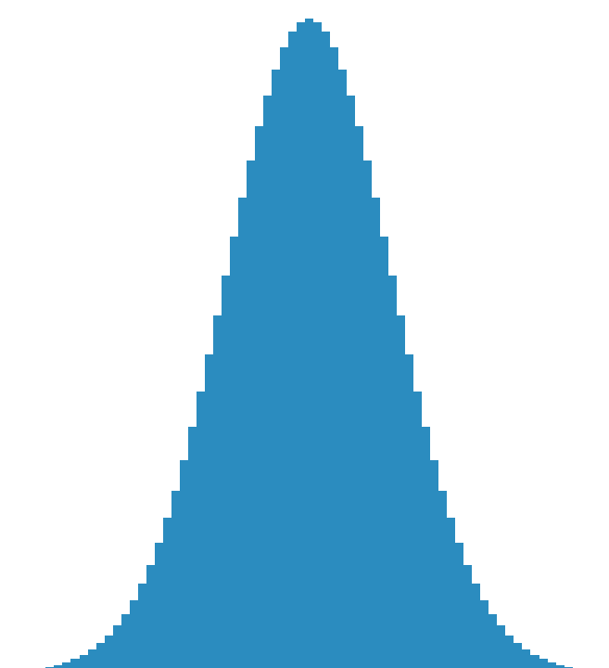
LEARNING STRUCTURED DISTRIBUTIONS
Can we improve the sample complexity if we make assumptions on the “shape” of $p$? Naturally occurring in economics, reliability theory, etc.
Example: Sample complexity for learning monotone distributions is only logarithmic in the domain size.
monotone
log-concave
t-modal
MHR

Slide 50
LEARNING STRUCTURED DISTRIBUTIONS
Let $𝒜_{K}$ be the set of all unions of at most $K$ intervals over $\left[n\right]$.
E.g. for $n=20$, $\left\{1,2,3\right\}⊔\left\{5,6\right\}⊔\{10,11,12,13,14,15\}∈𝒜_{3}$
Define the $𝒜_{K}$ distance between distributions $p,q$ to be
$$d_{𝒜_{K}}\left(p,q\right)=\max_{S∈𝒜_{K}}\left|p\left(S\right)−q\left(S\right)\right|$$
Note: $d_{𝒜_{1}}≤d_{𝒜_{2}}≤⋯≤d_{𝒜_{n}}=d_{TV}$
VC Inequality: For any distribution $p$ over $\left[n\right]$, let $\hat{p_{N}}$ be the empirical frequency estimator given $N$ samples. Then
$$d_{𝒜_{K}}\left(p,\hat{p_{N}}\right)≤O\left(\sqrt{K/N}\right)$$

Slide 51
LEARNING STRUCTURED DISTRIBUTIONS
VC Inequality: For any distribution $p$ over $\left[n\right]$, let $\hat{p_{N}}$ be the empirical frequency estimator given $N$ samples. Then
$$d_{𝒜_{K}}\left(p,\hat{p_{N}}\right)≤O\left(\sqrt{K/N}\right)$$
If $p$ well-approximated by a $K$-step function:
Draw $O\left(K/ε^{2}\right)$ samples and form $\hat{p_{N}}$.
Compute best $ε$-approximation to $\hat{p_{N}}$ by a $K$-step function $p^{∗}$.
Output $p^{∗}$.
Can we port these ideas over to the untrusted batches setting?

Slide 52
LEARNING STRUCTURED DISTRIBUTIONS
VC Inequality: For any distribution $p$ over $\left[n\right]$, let $\hat{p_{N}}$ be the empirical frequency estimator given $N$ samples. Then
$$d_{𝒜_{K}}\left(p,\hat{p_{N}}\right)≤O\left(\sqrt{K/N}\right)$$
If $p$ well-approximated by a $K$-step function:
Draw $O\left(K/ε^{2}\right)$ samples and form $\hat{p_{N}}$.
Compute best $ε$-approximation to $\hat{p_{N}}$ by a $K$-step function $p^{∗}$.
Output $p^{∗}$.
Monotone | $$O\left(ε^{−3}log\left(n\right)\right)$$
Log-concave | $$O\left(ε^{−3}\right)$$
t-modal | $$O\left({tε}^{−3}log\left(n/t\right)\right)$$
MHR | $$O\left(ε^{−3}log\left(n\right)\right)$$
Can we port these ideas over to the untrusted batches setting?

Slide 53
PROBLEM STATEMENT
“Learning from untrusted batches”, introduced by [Qiao-Valiant ’17]
$p$: distribution over $[n]$
$N$ users, $ε$ fraction malicious
Each non-malicious user $i$ gives batch of $k$ iid draws from $p_{i}$ s.t. $d_{TV}\left(p_{i},p\right)≤δ$
Each malicious user gives $k$ adversarially chosen elements from $[n]$
Goal: Output estimator $\hat{p}$ for $p$ in TV

Slide 54
PROBLEM STATEMENT
$$p_{i}:d_{TV}\left(p,p_{i}\right)≤δ$$
“Learning from untrusted batches”, introduced by [Qiao-Valiant ’17]
User $i$
$p$: distribution over $[n]$
$$Z_{1}^{i},…,Z_{k}^{i}∼p_{i}$$
$N$ users, $ε$ fraction malicious
Each non-malicious user $i$ gives batch of $k$ iid draws from $p_{i}$ s.t. $d_{TV}\left(p_{i},p\right)≤δ$
Each malicious user gives $k$ adversarially chosen elements from $[n]$
Goal: Output estimator $\hat{p}$ for $p$ in TV

Slide 55
PROBLEM STATEMENT
$$p_{i}:d_{TV}\left(p,p_{i}\right)≤δ$$
“Learning from untrusted batches”, introduced by [Qiao-Valiant ’17]
User $i$
$p$: distribution over $[n]$
$$Z_{1}^{i},…,Z_{k}^{i}∼p_{i}$$
$N$ users, $ε$ fraction malicious
Each non-malicious user $i$ gives batch of $k$ iid draws from $p_{i}$ s.t. $d_{TV}\left(p_{i},p\right)≤δ$
Each malicious user gives $k$ adversarially chosen elements from $[n]$
Goal: Output estimator $\hat{p}$ for $p$ in $𝓐_{K}$.

Slide 56
OUTLINE
Introduction
Motivations
Problem and Known Bounds
Our Results
Sum-of-Squares + Learning
A Polynomial System
SoS for Learning
Quantifying over $L_{∞}$ ball
Shape Constraints
$𝒜_{K}$ Norms
A New Relaxation
Sublinear Sample Complexity
Open Questions

Slide 57
THE SOS RELAXATION
Variables:
Estimate for the mean: $\hat{p}$
Indicators for uncorrupted points: $w_{1},…,w_{N}$
Constants:
Samples $X^{1},…,X^{N}∈Δ^{n}$
Degree $t$
Constraints:
$$∑w_{i}=\left(1−ε\right)N$$
$$w_{i}^{2}=w_{i} ∀i∈\left[N\right]$$
$$\hat{p}=\frac{1}{\left(1−ε\right)N}∑w_{i}X^{i}$$
$$∑w_{i}{\left\langle X_{i}−\hat{p},v\right\rangle }^{s}≤{\left(8s/k\right)}^{s/2}∑w_{i}$$
$∀ even 2≤s≤t$
and $v∈{\left\{±1\right\}}^{n}$

Slide 58
THE SOS RELAXATION
Variables:
Estimate for the mean: $\hat{p}$
Indicators for uncorrupted points: $w_{1},…,w_{N}$
Constants:
Samples $X^{1},…,X^{N}∈Δ^{n}$
Degree $t$
Constraints:
$$∑w_{i}=\left(1−ε\right)N$$
$$w_{i}^{2}=w_{i} ∀i∈\left[N\right]$$
$$\hat{p}=\frac{1}{\left(1−ε\right)N}∑w_{i}X^{i}$$
$$∑w_{i}{\left\langle X_{i}−\hat{p},v\right\rangle }^{s}≤{\left(8s/k\right)}^{s/2}∑w_{i}$$
$∀ even 2≤s≤t$
and $v∈{\left\{±1\right\}}^{n}$ with $≤2K$ sign changes

Slide 59
THE SOS RELAXATION
How to quantify over $n^{O(K)}$ vectors?
Workaround:
Such $v$ are sparse in the Haar wavelet basis.
Relax to $L_{1}$ sparsity.
Argue that w.h.p. over data, $L_{1}$-Haar-sparsity of $v$ SoS-implies uncorrupted points’ empirical moments in the $v$ direction are bounded.
(Because metric entropy of $𝒜_{K}$ $≪n$, moments concentrate sufficiently for our purposes in much fewer samples).
Use matrix SoS to search for that SoS proof.
By definition, this new relaxation SoS-implies the original relaxation.
Variables:
Estimate for the mean: $\hat{p}$
Indicators for uncorrupted points: $w_{1},…,w_{N}$
Constants:
Samples $X^{1},…,X^{N}∈Δ^{n}$
Degree $t$
Constraints:
$$∑w_{i}=\left(1−ε\right)N$$
$$w_{i}^{2}=w_{i} ∀i∈\left[N\right]$$
$$\hat{p}=\frac{1}{\left(1−ε\right)N}∑w_{i}X^{i}$$
$$∑w_{i}{\left\langle X_{i}−\hat{p},v\right\rangle }^{s}≤{\left(8s/k\right)}^{s/2}∑w_{i}$$
$∀ even 2≤s≤t$
and $v∈{\left\{±1\right\}}^{n}$ with $≤2K$ sign changes

Slide 60
OUTLINE
Introduction
Motivations
Problem and Known Bounds
Our Results
Sum-of-Squares + Learning
A Polynomial System
SoS for Learning
Quantifying over $L_{∞}$ ball
Shape Constraints
$𝒜_{K}$ Norms
A New Relaxation
Sublinear Sample Complexity
Open Questions

Slide 61
OUR RESULTS
Theorem 1: For any even $t>0$, we can learn within TV error $O\left(δ+\frac{{t^{1/2}ε}^{1−1/t}}{\sqrt{k}}\right)$ in time $poly\left({\left(nk\right)}^{t^{2}},1/ε,1/δ\right)$ and given $poly\left({\left(nk\right)}^{t},1/ε,1/δ\right)$ users.

Slide 62
OUR RESULTS
Theorem 2: For any even $t>0$, we can learn within TV error $O\left(δ+\frac{t^{1/2}ε^{1−1/t}}{\sqrt{k}}\right)$ in time $poly\left({\left(Kk\right)}^{t^{2}},1/ε,1/δ\right)$ and given $poly\left({\left(Kk\right)}^{t},1/ε,1/δ\right)$ users if $p$ is well-approximated by a $K$-step function.
 | Sample complexity
Monotone | $$poly{\left(k, log\left(n\right),ε^{−1},δ^{−1}\right)}^{t}$$
Log-concave | $$poly{\left(k,ε^{−1},δ^{−1}\right)}^{t}$$
s-modal | $$poly{\left(s,k, log\left(n\right),ε^{−1},δ^{−1}\right)}^{t}$$
MHR | $$poly{\left(k, log\left(n\right),ε^{−1},δ^{−1}\right)}^{t}$$

Slide 63
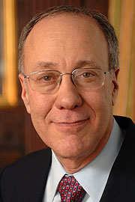
OUR RESULTS
Theorem 2: For any even $t>0$, we can learn within TV error $O\left(δ+\frac{{t^{1/2}ε}^{1−1/t}}{\sqrt{k}}\right)$ in time $poly\left({\left(Kk\right)}^{t^{2}},1/ε,1/δ\right)$ and given $poly\left({\left(Kk\right)}^{t},1/ε,1/δ\right)$ users if $p$ is well-approximated by a $K$-step function.

Slide 64
OUTLINE
Introduction
Motivations
Problem and Known Bounds
Our Results
Sum-of-Squares + Learning
A Polynomial System
SoS for Learning
Quantifying over $L_{∞}$ ball
Shape Constraints
$𝒜_{K}$ Norms
A New Relaxation
Sublinear Sample Complexity
Open Questions

Slide 65
SUMMARY/OPEN QUESTIONS
First algorithm for learning from untrusted batches with polynomial dependence on $n,k$
SoS for robust $L_{1}$ mean estimation for multinomials
Sample complexity sublinear in $n$when $p$ is shape-constrained
SoS for robust $𝒜_{K}$ mean estimation
Practical spectral algorithm to learn to error $\frac{ε\sqrt{log\left(1/ε\right)}}{\sqrt{k}}$ ?
Not even known for robust $L_{2}$ mean estimation for certifiable sub-Gaussians…
Robust mean estimation in other norms?
Can we cluster mixtures of non-spherical Gaussians whose covariances are separated in, e.g., Frobenius norm?

Slide 66
Thanks! Questions?

