Slide 1
LEARNING TO PREDICT ARBITRARY QUANTUM PROCESSES
SITAN CHEN UC BERKELEY
joint WORK w/ HSin-Yuan HUANG (Caltech) and John preskill (Caltech)

Slide 2
Setup
Warmup
Norm inequalities
Algorithm
Takeaways

Slide 3






PREDICTING QUANTUM PROCESSES
$$O$$
Predicting outcomes of physical experiments
Training quantum neural networks
Speeding up complex quantum dynamics
$$ℰ$$
Goal: Given observable $O$ and query access to unknown channel $ℰ$, learn the function $σ↦tr\left(O𝓔\left[σ\right]\right)$
Notes:
the input state sigma might correspond to an encoding of classical parameters characterizing the input to the physical process, e.g. the chemicals involved in a reaction, a description of the molecule, etc. in this case we’re interested in how these input parameters affect the final observable value after applying the quantum evolution happening in the lab.
another example is if we posit that some training data is consistent or closely approximated by a quantum neural network. learning a predictor for the function tr(O E[sigma]) , where E is the unknown quantum neural network, thus corresponds to training a quantum neural network that achieves low squared error with respect to the distribution on encoded inputs x.
lastly, there is also substantial interest in the quantum simulation literature on speeding up simulations of complex quantum dynamics. if one can learn to predict the function taking sigma to this observable value using a simpler, perhaps even classical ML model, then in lieu of running the actual process, we can use the ML model as a surrogate.

Slide 4


CLASSICAL HARDNESS
$$O$$
$$ℰ$$

Slide 5









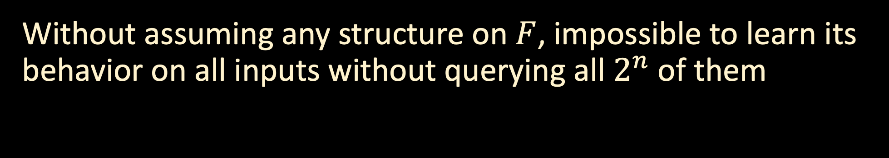




CLASSICAL HARDNESS
$$∨$$
$$Z$$
0
Classical analogue: learning Boolean functions from membership queries
$$∧$$
$$∧$$
1
$$∧$$
$$F$$
$$∨$$
1
$$∨$$
0
$$∨$$
$$¬$$
$$∧$$
1
$$∧$$
$$∨$$
Without assuming any structure on $F$, impossible to learn its behavior on all inputs without querying all $2^{n}$ of them

Slide 6
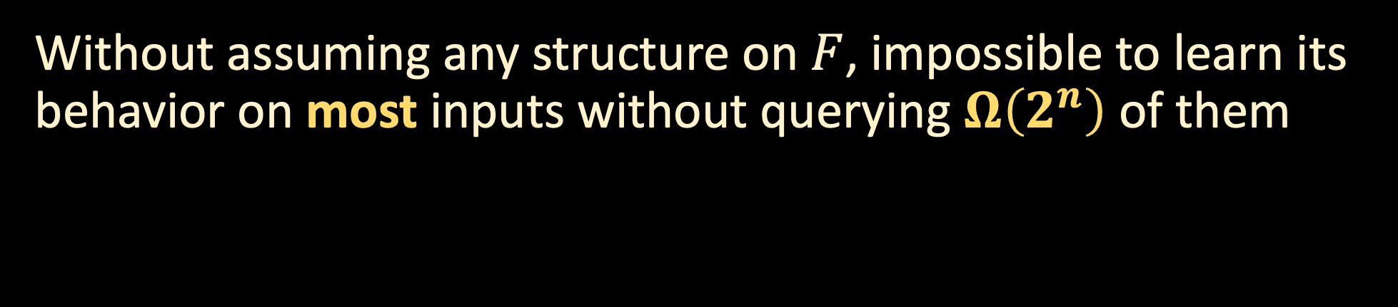
CLASSICAL HARDNESS
$$∨$$
$$Z$$
-1
Classical analogue: learning Boolean functions from membership queries
$$∧$$
$$∧$$
1
$$∧$$
$$F$$
$$∨$$
1
$$∨$$
-1
$$∨$$
$$¬$$
$$∧$$
1
$$∧$$
$$∨$$
Without assuming any structure on $F$, impossible to learn its behavior on most inputs without querying $Ω\left(2^{n}\right)$ of them

Slide 7
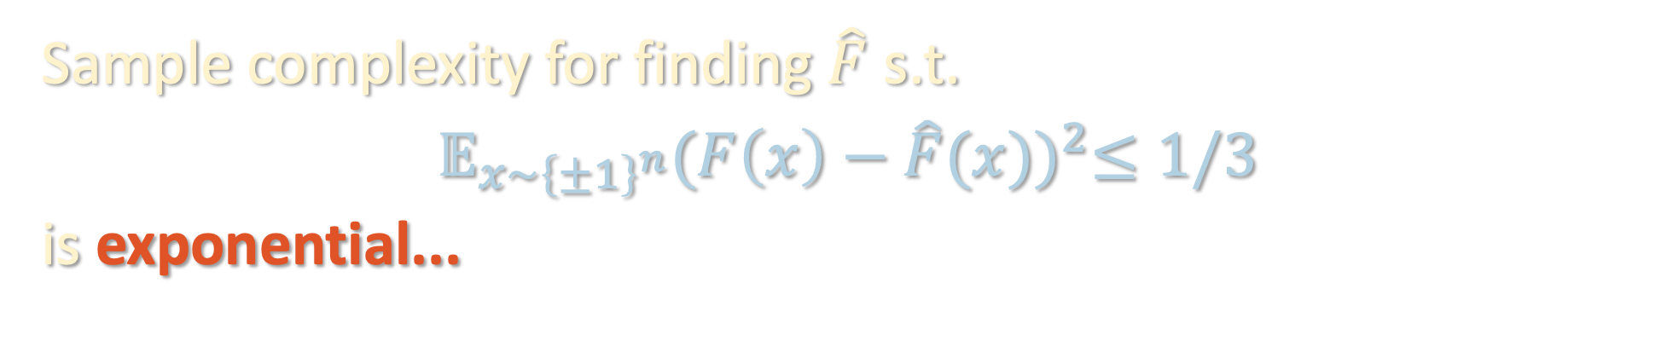
CLASSICAL HARDNESS
$$∨$$
$$Z$$
-1
Classical analogue: learning Boolean functions from membership queries
$$∧$$
$$∧$$
1
$$∧$$
$$F$$
$$∨$$
1
$$∨$$
-1
$$∨$$
$$¬$$
$$∧$$
1
$$∧$$
$$∨$$
Sample complexity for finding $\hat{F}$ s.t.
$𝔼_{x∼{\left\{±1\right\}}^{n}}{(F\left(x\right)−\hat{F}(x))}^{2}≤1/3$
is exponential...

Slide 8
QUANTUM HARDNESS?
$$O$$
Quantum at least as hard as classical...
End of story?
$$ℰ$$
Sample complexity for finding $\hat{F}$ s.t.
$𝔼_{x∼{\left\{±1\right\}}^{n}}{(F\left(x\right)−\hat{F}(x))}^{2}≤1/3$
is exponential...

Slide 9
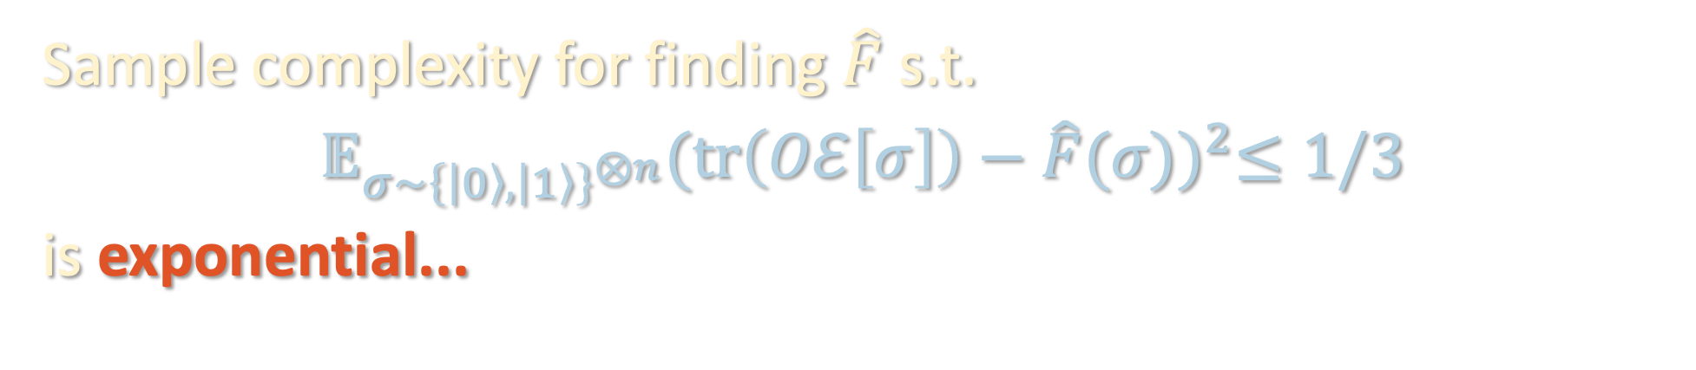
QUANTUM HARDNESS?
$$O$$
Quantum at least as hard as classical...
End of story?
$$ℰ$$
Sample complexity for finding $\hat{F}$ s.t.
$𝔼_{σ∼{\left\{\left|0\right\rangle ,\left|1\right\rangle \right\}}^{⊗n}}{(tr\left(Oℰ\left[σ\right]\right)−\hat{F}(σ))}^{2}≤1/3$
is exponential...

Slide 10
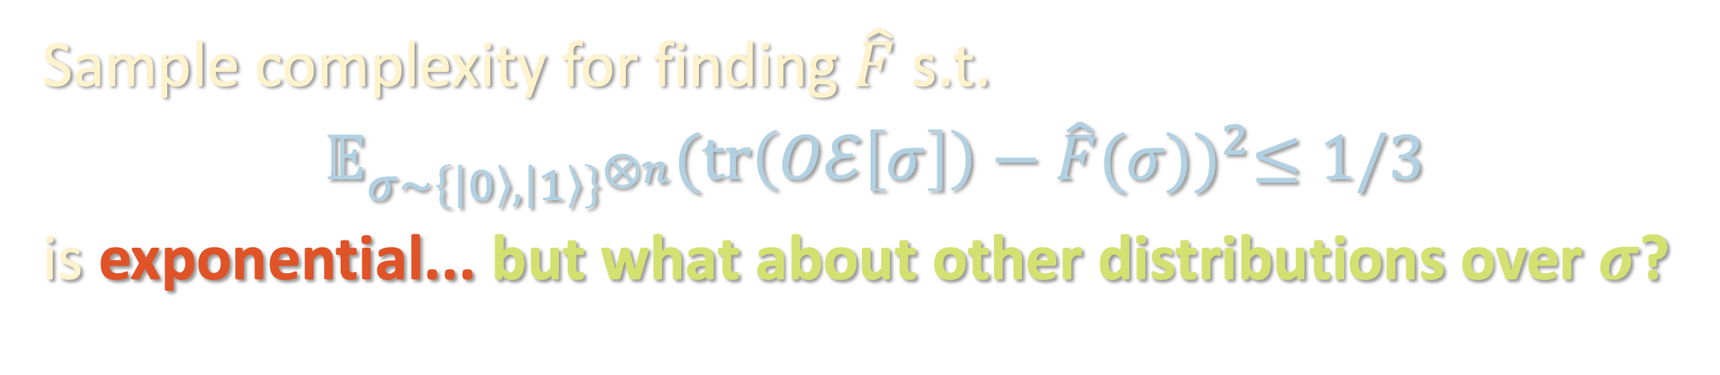
QUANTUM HARDNESS?
$$O$$
Quantum at least as hard as classical...
End of story?
$$ℰ$$
Sample complexity for finding $\hat{F}$ s.t.
$𝔼_{σ∼{\left\{\left|0\right\rangle ,\left|1\right\rangle \right\}}^{⊗n}}{(tr\left(Oℰ\left[σ\right]\right)−\hat{F}(σ))}^{2}≤1/3$
is exponential... but what about other distributions over $σ$?

Slide 11
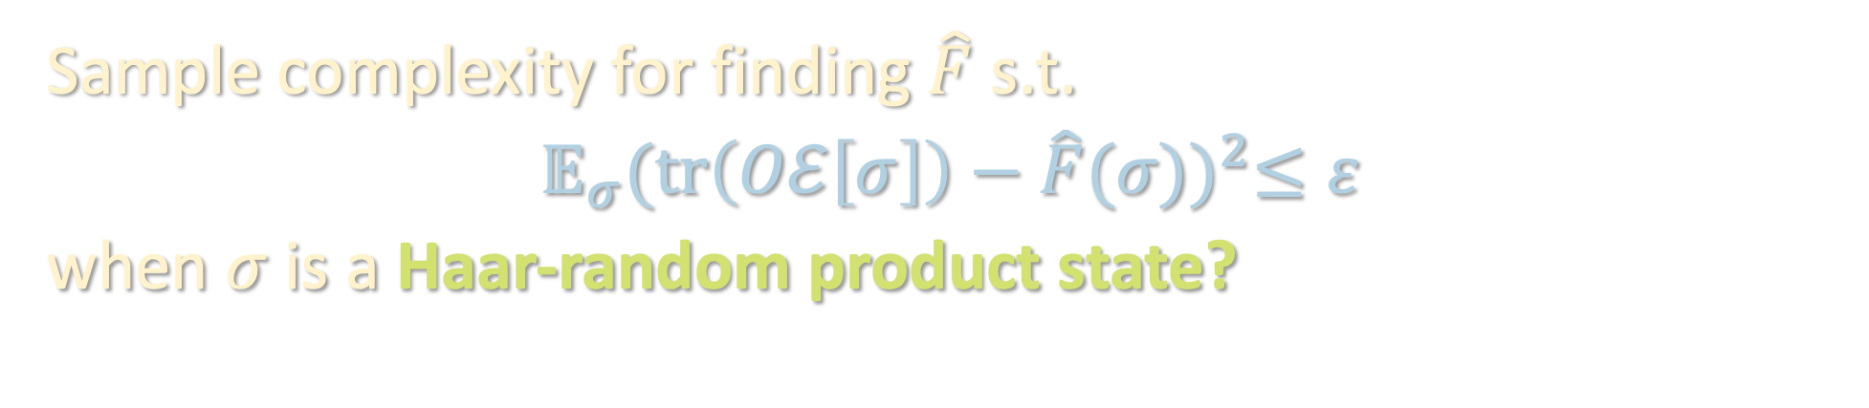
QUANTUM HARDNESS?
$$O$$
Quantum at least as hard as classical...
End of story?
$$ℰ$$
Sample complexity for finding $\hat{F}$ s.t.
$𝔼_{σ}{(tr\left(Oℰ\left[σ\right]\right)−\hat{F}(σ))}^{2}≤ε$
when $σ$ is a Haar-random product state?

Slide 12
Setup
Warmup
Norm inequalities
Algorithm
Takeaways

Slide 13
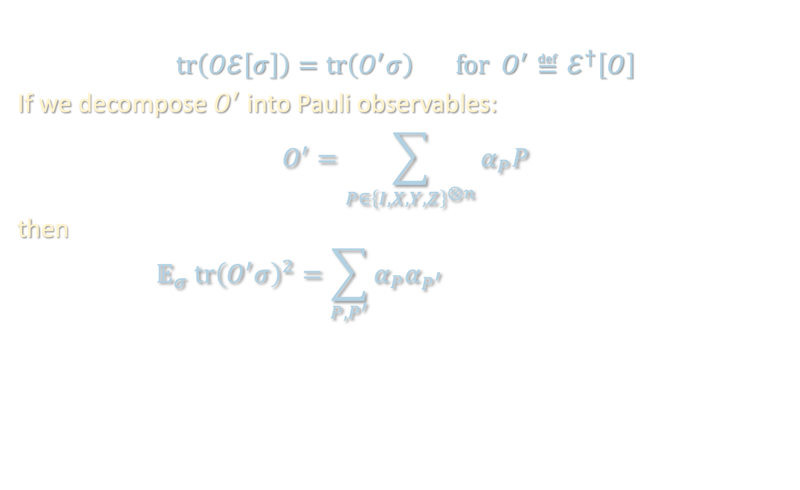
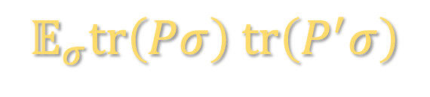
WARMUP
$$tr\left(Oℰ\left[σ\right]\right)=tr\left(O^{′}σ\right) for O^{′}≝ℰ^{†}\left[O\right]$$
If we decompose $O^{′}$ into Pauli observables:
<
$$O^{′}=\sum_{P∈{\left\{I,X,Y,Z\right\}}^{⊗n}}{α_{P}P}$$
then
$$𝔼_{σ} tr{\left(O^{′}σ\right)}^{2}=\sum_{P,P^{′}}{α_{P}α_{P^{′}} 𝔼_{σ}}tr\left(Pσ\right) tr\left(P^{′}σ\right)$$
$$𝔼_{σ}tr\left(Pσ\right) tr\left(P^{′}σ\right)$$

Slide 14
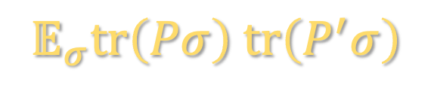
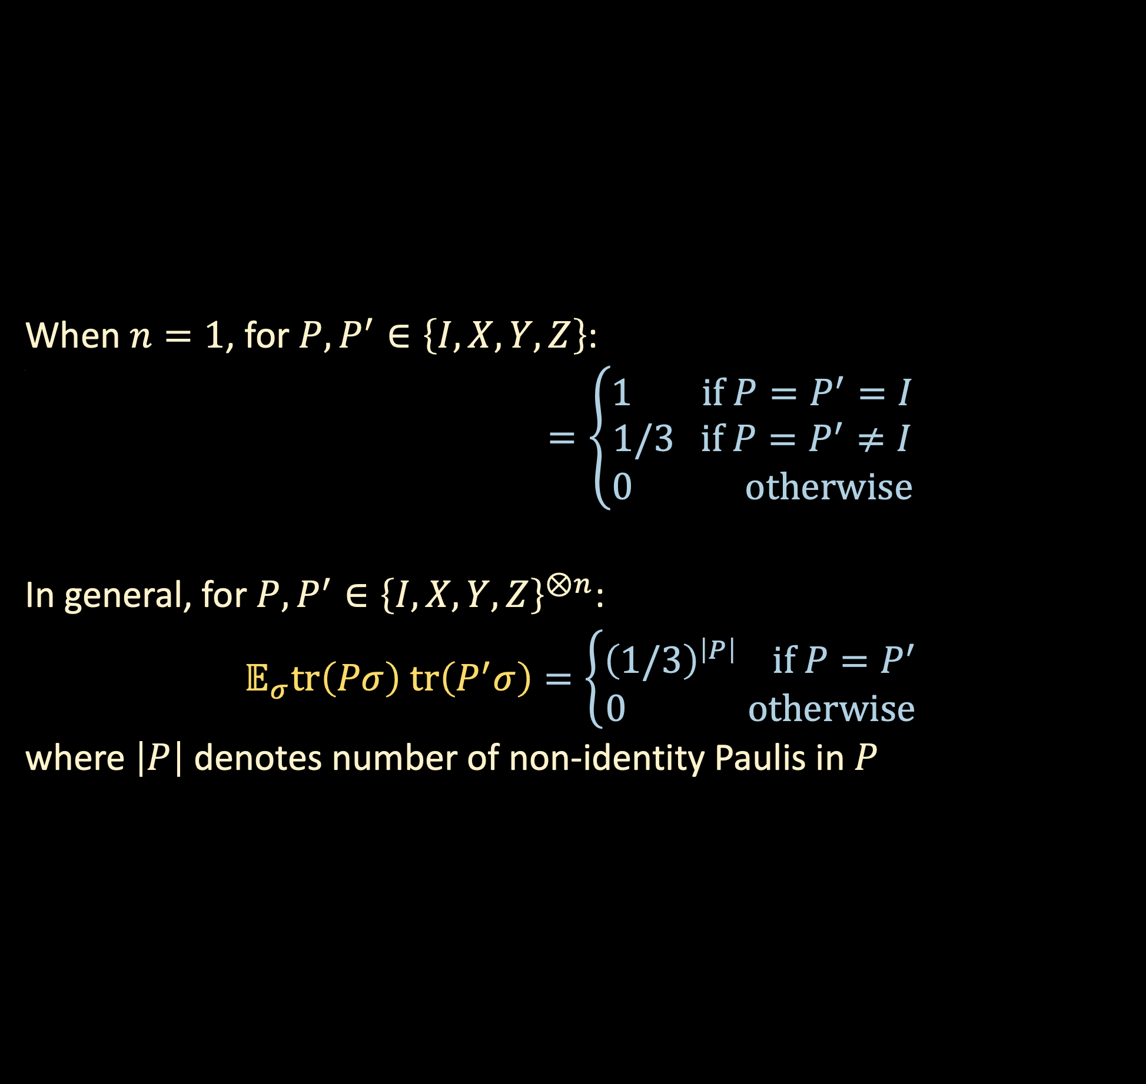
WARMUP
When $n=1$, for $P,P^{′}∈\left\{I,X,Y,Z\right\}$:
<
$$𝔼_{σ}tr\left(Pσ\right) tr\left(P^{′}σ\right)=\left\{\begin{aligned}1 if P=P^{′}=I \\ 1/3 if P=P^{′}≠I \\ 0 otherwise\end{aligned}\right.$$
In general, for $P,P^{′}∈{\left\{I,X,Y,Z\right\}}^{⊗n}$:
$$𝔼_{σ}tr\left(Pσ\right) tr\left(P^{′}σ\right)=\left\{\begin{aligned}{\left(1/3\right)}^{\left|P\right|} if P=P^{′} \\ 0 otherwise\end{aligned}\right.$$
where $\left|P\right|$ denotes number of non-identity Paulis in $P$
$$𝔼_{σ}tr\left(Pσ\right) tr\left(P^{′}σ\right)$$

Slide 15

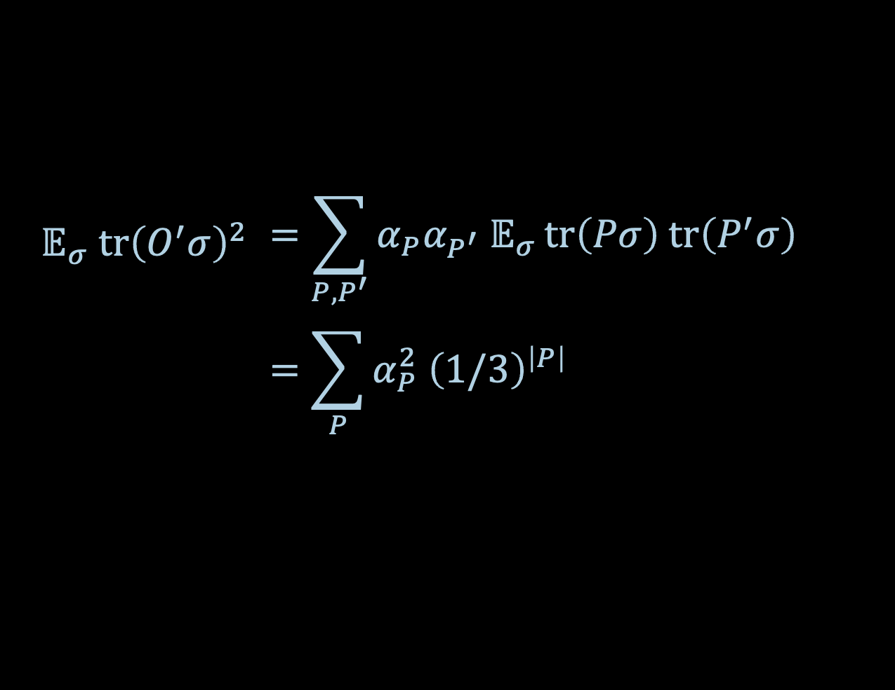

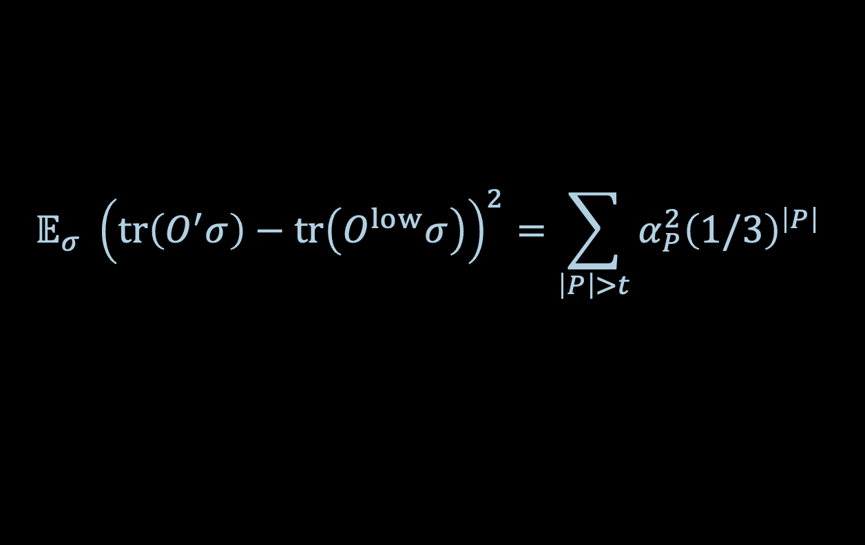
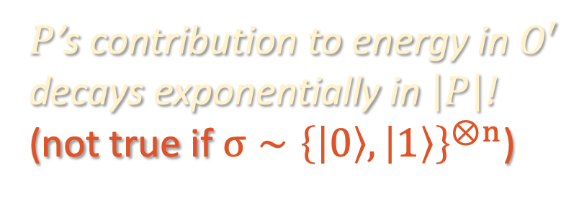
WARMUP
$$𝔼_{σ} tr{\left(O^{′}σ\right)}^{2}$$ | $$=\sum_{P,P^{′}}{α_{P}α_{P^{′}} 𝔼_{σ}}tr\left(Pσ\right) tr\left(P^{′}σ\right)$$
 | $$=\sum_{P}{α_{P}^{2} {\left(1/3\right)}^{\left|P\right|}}$$
$P$’s contribution to energy in $O′$ decays exponentially in $\left|P\right|$!
(not true if $σ∼{\left\{\left|0\right\rangle ,\left|1\right\rangle \right\}}^{⊗n}$)
If we took
$$O^{low}≝\sum_{\left|P\right|≤t}{α_{P}P},$$
<
then
$$O^{low}≝\sum_{\left|P\right|≤t}{α_{P}P},$$
$$𝔼_{σ} {\left(tr\left(O^{′}σ\right)−tr\left(O^{low}σ\right)\right)}^{2}=\sum_{\left|P\right|>t}{α_{P}^{2}{\left(1/3\right)}^{\left|P\right|}}$$

Slide 16
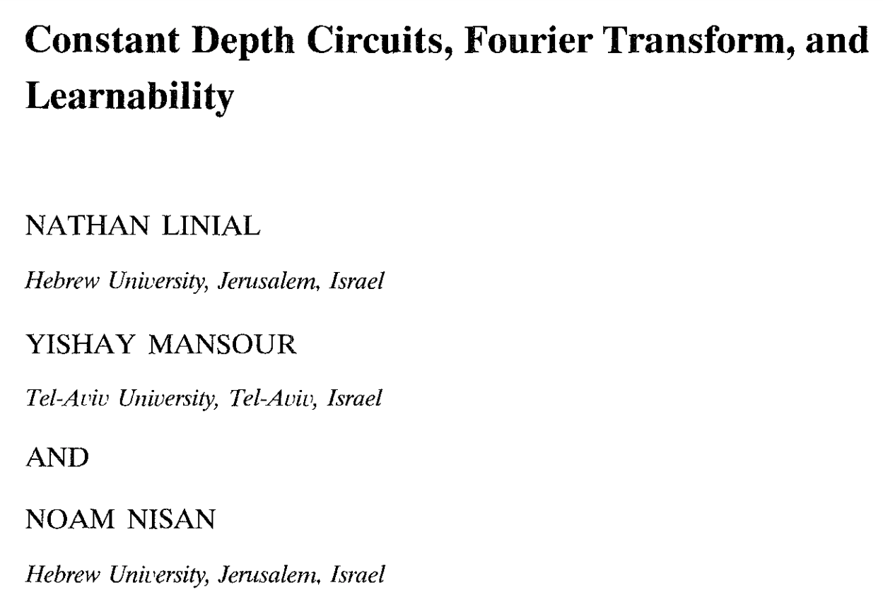
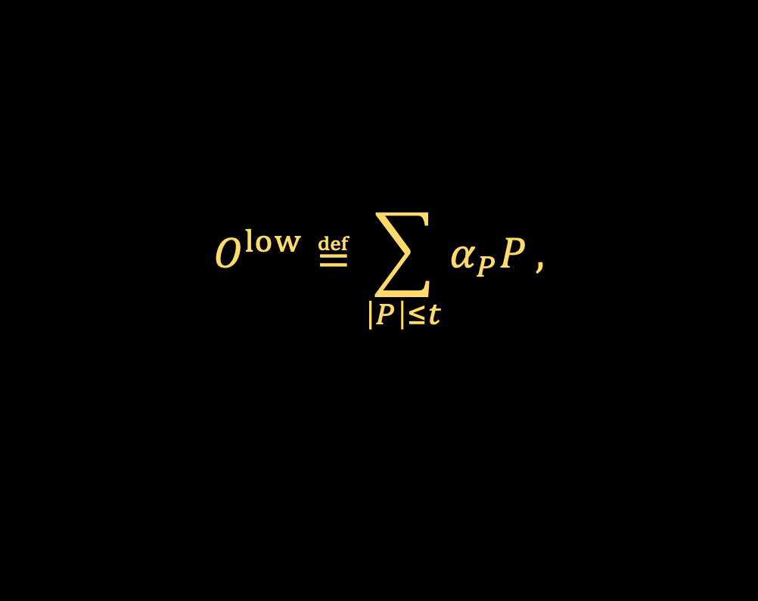
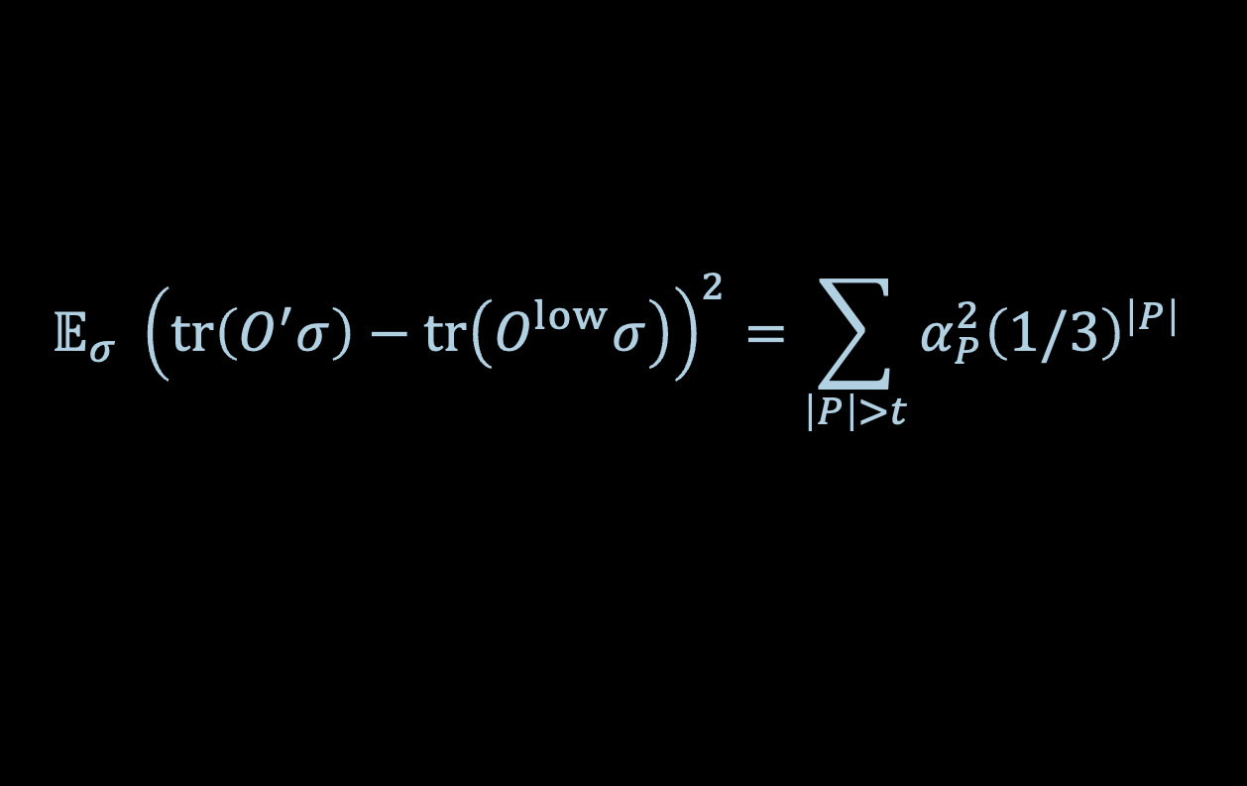

WARMUP
$$O^{low}≝\sum_{\left|P\right|≤t}{α_{P}P},$$
$$𝔼_{σ} {\left(tr\left(O^{′}σ\right)−tr\left(O^{low}σ\right)\right)}^{2}=\sum_{\left|P\right|>t}{α_{P}^{2}{\left(1/3\right)}^{\left|P\right|}}$$
If we take $t=Ω\left(\log{1/ε}\right)$ then the above is $O(ε)$. So we’d like to take
$$F\left(σ\right)≝tr\left(O^{low}σ\right)$$
Note that
$$α_{P}=3^{\left|P\right|}{ 𝔼}_{σ} tr\left(O^{′}σ\right) tr\left(Pσ\right)$$
So we can empirically estimate any $α_{P}$ by querying $ℰ$ on random product states $σ$ and averaging together $3^{\left|P\right|}tr\left(Oℰ\left[σ\right]\right) tr\left(Pσ\right)$

Slide 17
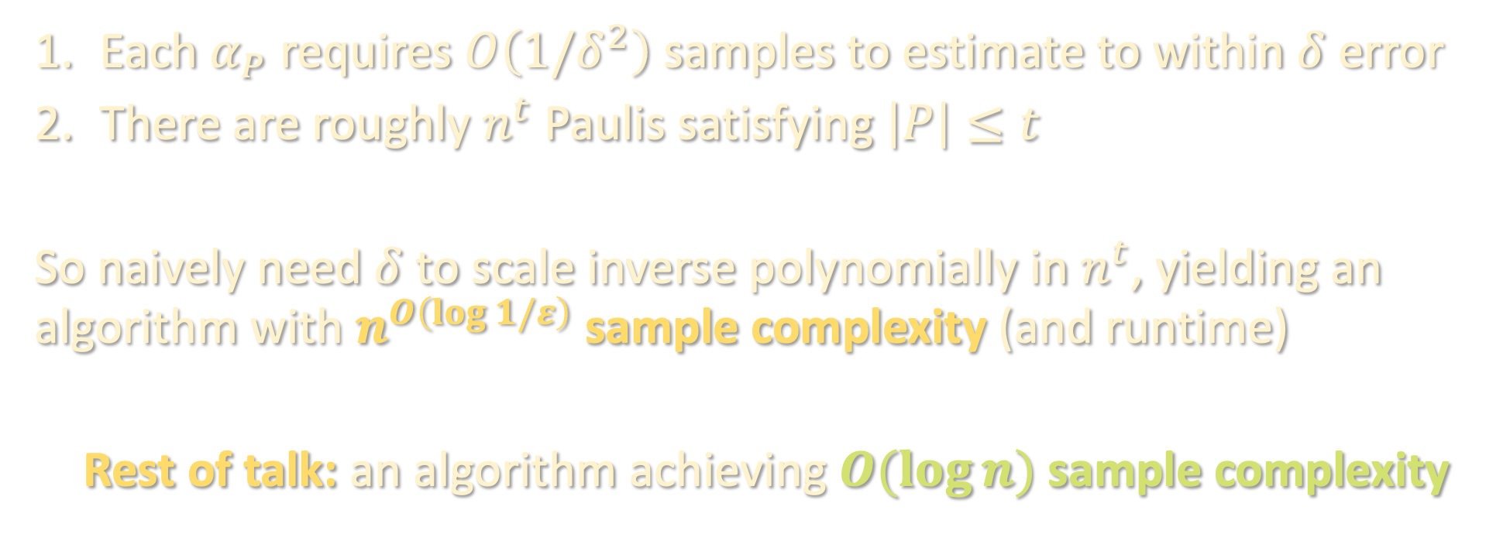
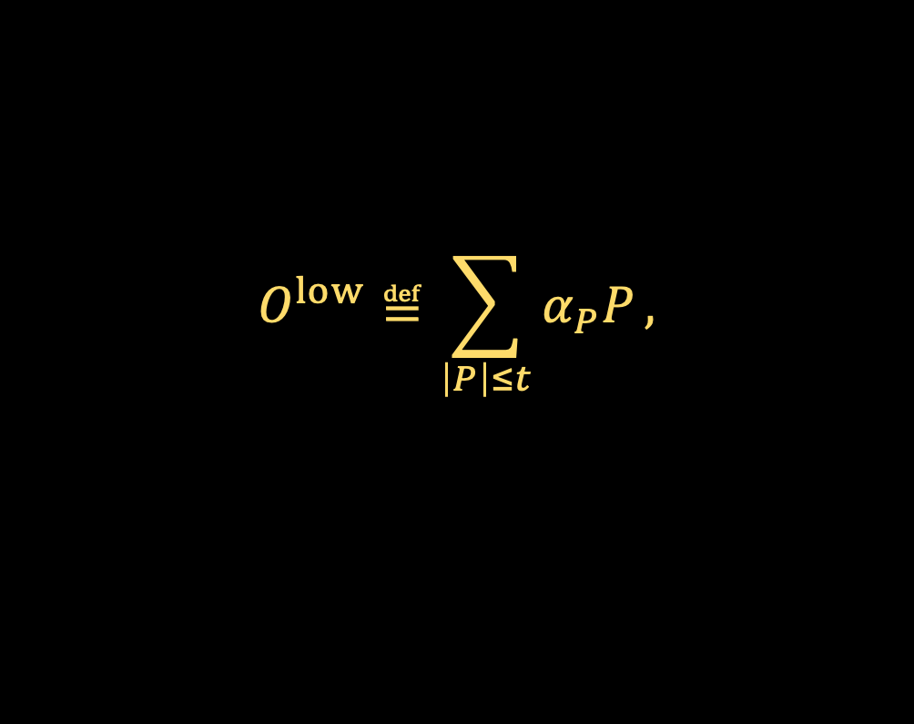
WARMUP
$$O^{low}≝\sum_{\left|P\right|≤t}{α_{P}P},$$
Each $α_{P}$ requires $O\left(1/δ^{2}\right)$ samples to estimate to within $δ$ error
There are roughly $n^{t}$ Paulis satisfying $\left|P\right|≤t$
So naively need $δ$ to scale inverse polynomially in $n^{t}$, yielding an algorithm with $n^{O\left(\log{1/ε}\right)}$ sample complexity (and runtime)
Rest of talk: an algorithm achieving $O(\log{n})$ sample complexity

Slide 18
Setup
Warmup
Norm inequalities
Algorithm
Takeaways

Slide 19
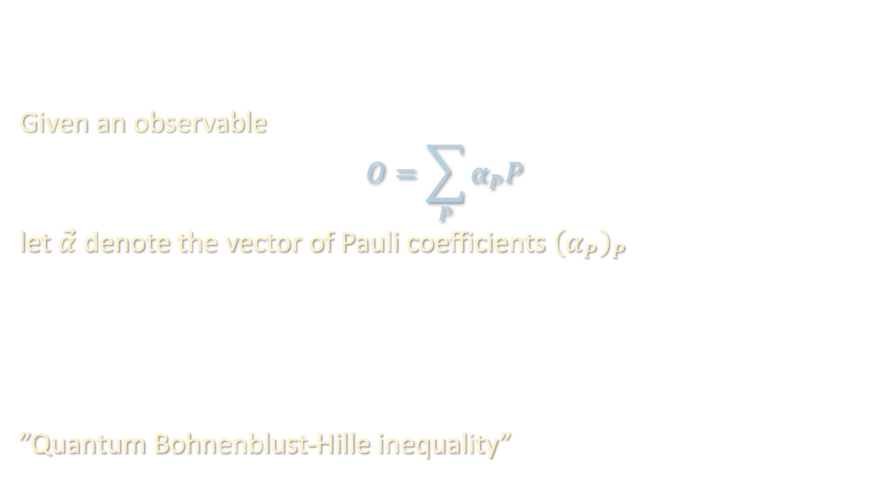
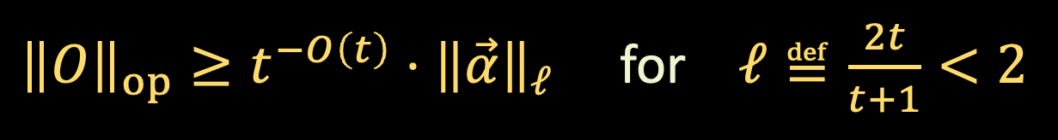

NORM INEQUALITIES
Given an observable
$$O=\sum_{P}{α_{P}P}$$
let $\vec{α}$ denote the vector of Pauli coefficients ${\left(α_{P}\right)}_{P}$
”Quantum Bohnenblust-Hille inequality”
Thm [Huang-C-Preskill ‘22]: If $O$ is $t$-local, then
${\left\|O\right\|}_{op}≥t^{−O\left(t\right)}⋅{\left\|\vec{α}\right\|}_{ℓ}$ for $ℓ≝\frac{2t}{t+1}<2$
${\left\|O\right\|}_{op}≥t^{−O\left(t\right)}⋅{\left\|\vec{α}\right\|}_{ℓ}$ for $ℓ≝\frac{2t}{t+1}<2$

Slide 20
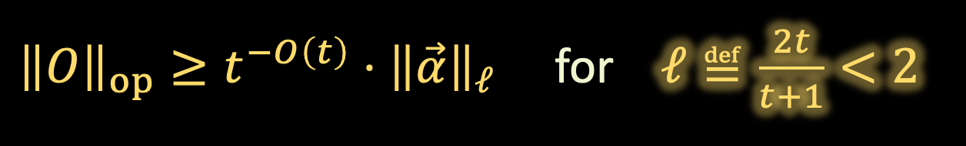
NORM INEQUALITIES
Given an observable
$$O=\sum_{P}{α_{P}P}$$
let $\vec{α}$ denote the vector of Pauli coefficients ${\left(α_{P}\right)}_{P}$
”Quantum Bohnenblust-Hille inequality”
Thm [Huang-C-Preskill ‘22]: If $O$ is $t$-local, then
${\left\|O\right\|}_{op}≥t^{−O\left(t\right)}⋅{\left\|\vec{α}\right\|}_{ℓ}$ for $ℓ≝\frac{2t}{t+1}<2$
${\left\|O\right\|}_{op}≥t^{−O\left(t\right)}⋅{\left\|\vec{α}\right\|}_{ℓ}$ for $ℓ≝\frac{2t}{t+1}<2$

Slide 21
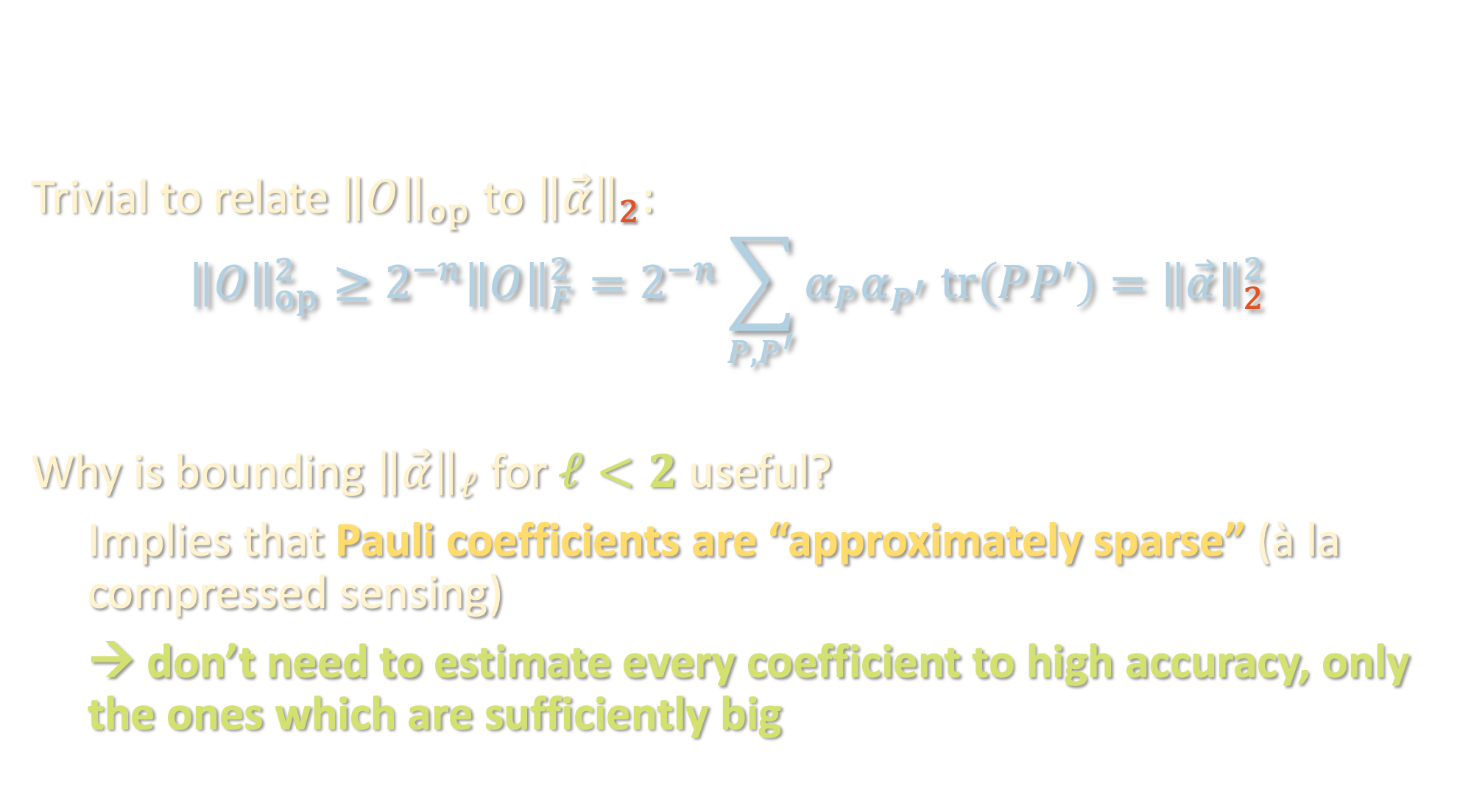
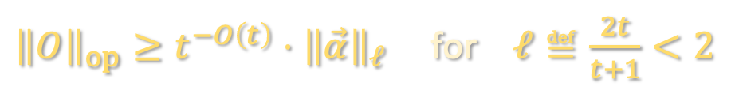
NORM INEQUALITIES
${\left\|O\right\|}_{op}≥t^{−O\left(t\right)}⋅{\left\|\vec{α}\right\|}_{ℓ}$ for $ℓ≝\frac{2t}{t+1}<2$
Trivial to relate ${\left\|O\right\|}_{op}$ to ${\left\|\vec{α}\right\|}_{2}$:
$${\left\|O\right\|}_{op}^{2}≥2^{−n}{\left\|O\right\|}_{F}^{2}=2^{−n}\sum_{P,P^{′}}{α_{P}α_{P^{′}} tr\left(PP^{′}\right)}={\left\|\vec{α}\right\|}_{2}^{2}$$
Why is bounding ${\left\|\vec{α}\right\|}_{ℓ}$ for $ℓ<2$ useful?
Implies that Pauli coefficients are “approximately sparse” (à la compressed sensing)
→ don’t need to estimate every coefficient to high accuracy, only the ones which are sufficiently big

Slide 22


NORM INEQUALITIES
${\left\|O\right\|}_{op}≥t^{−O\left(t\right)}⋅{\left\|\vec{α}\right\|}_{ℓ}$ for $ℓ≝\frac{2t}{t+1}<2$
Let $\vec{β}$ denote vector given by zeroing out entries of $\vec{α}$ smaller than $ξ$
$${\left\|\vec{β}−\vec{α}\right\|}_{2}^{2}=\sum_{P: \left|α_{P}\right|≤ξ}{α_{P}^{2}}$$

Slide 23

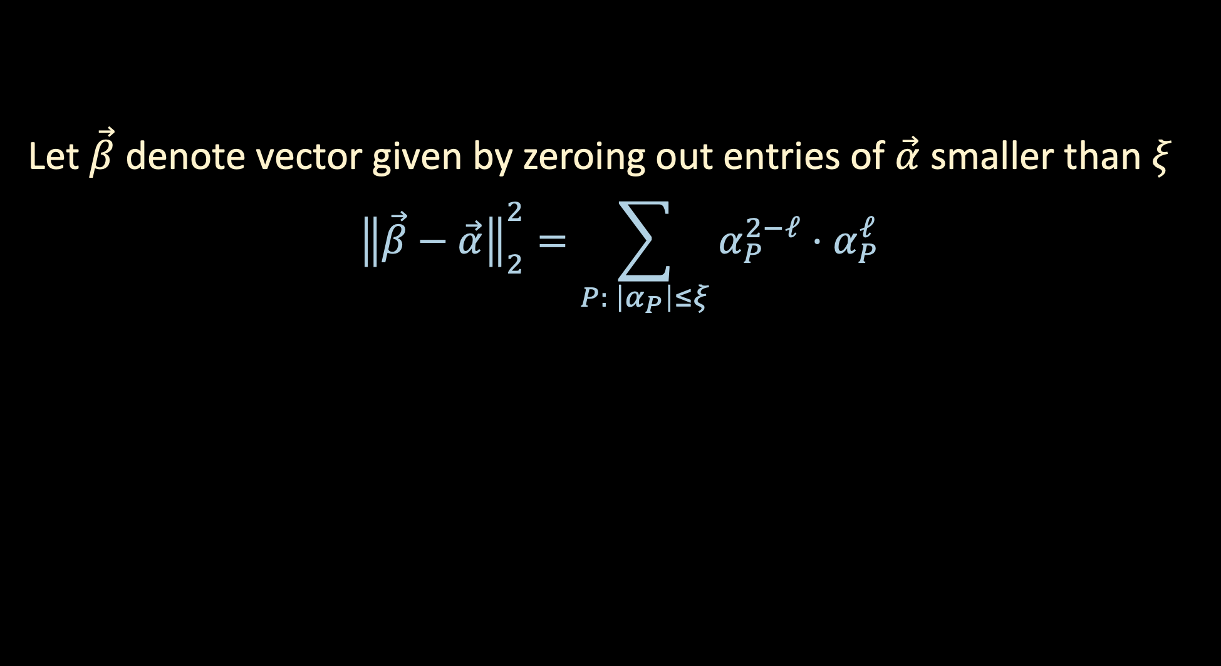
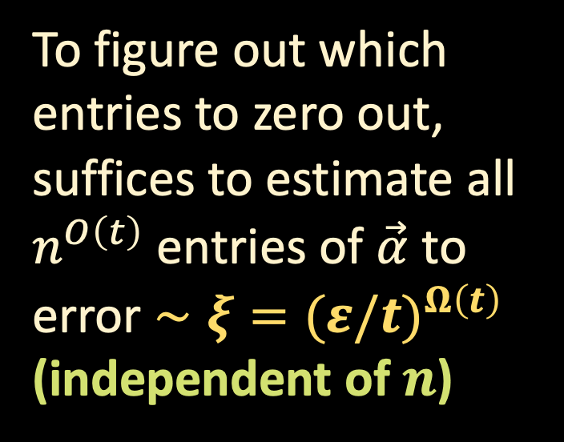

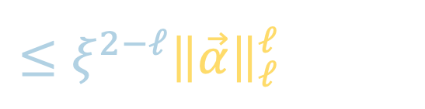
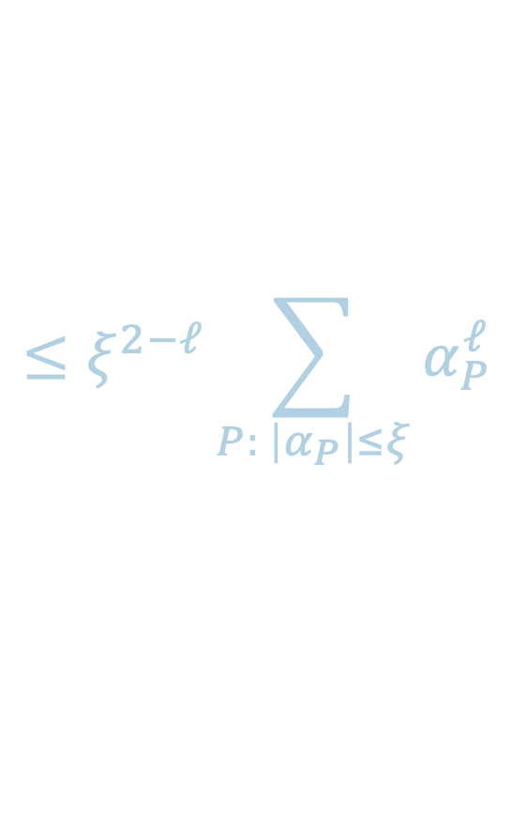
NORM INEQUALITIES
${\left\|O\right\|}_{op}≥t^{−O\left(t\right)}⋅{\left\|\vec{α}\right\|}_{ℓ}$ for $ℓ≝\frac{2t}{t+1}<2$
Let $\vec{β}$ denote vector given by zeroing out entries of $\vec{α}$ smaller than $ξ$
$${\left\|\vec{β}−\vec{α}\right\|}_{2}^{2}=\sum_{P: \left|α_{P}\right|≤ξ}{α_{P}^{2−ℓ}⋅α_{P}^{ℓ}}$$
To figure out which entries to zero out, suffices to estimate all $n^{O\left(t\right)}$ entries of $\vec{α}$ to error $∼ξ={(ε/t)}^{Ω\left(t\right)}$
(independent of $n$)
$$≤ξ^{2−ℓ}\sum_{P: \left|α_{P}\right|≤ξ}{α_{P}^{ℓ}}$$
$$≤ξ^{2−ℓ}{\left\|\vec{α}\right\|}_{ℓ}^{ℓ}$$
$$≤ξ^{2−ℓ}⋅t^{O\left(ℓt\right)}{\left\|O\right\|}_{op}^{ℓ}$$
Union bound → $\log{n}$ samples suffice

Slide 24


ALGORITHMIC PROOF
${\left\|O\right\|}_{op}≥t^{−O\left(t\right)}⋅{\left\|\vec{α}\right\|}_{ℓ}$ for $ℓ≝\frac{2t}{t+1}<2$
We give an algorithm for finding a product state $\left|ψ\right\rangle$ for which
$$\left|\left\langle ψ\right|O\left|ψ\right\rangle \right|≥t^{−O\left(t\right)}⋅{\left\|\vec{α}\right\|}_{ℓ}$$
$$n$$
Notes:
we will assume that the observable is homogeneous, that is each term is an exactly t-body term

Slide 25

ALGORITHMIC PROOF
${\left\|O\right\|}_{op}≥t^{−O\left(t\right)}⋅{\left\|\vec{α}\right\|}_{ℓ}$ for $ℓ≝\frac{2t}{t+1}<2$
We give an algorithm for finding a product state $\left|ψ\right\rangle$ for which
$$\left|\left\langle ψ\right|O\left|ψ\right\rangle \right|≥t^{−O\left(t\right)}⋅{\left\|\vec{α}\right\|}_{ℓ}$$
$$t$$

Slide 26
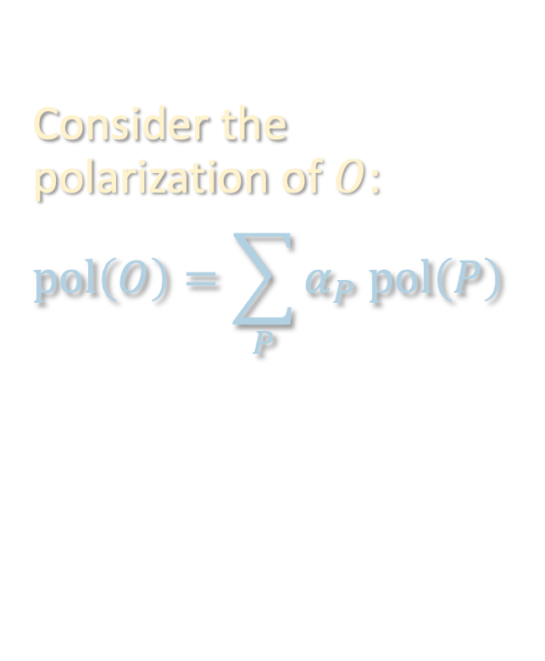
ALGORITHMIC PROOF
${\left\|O\right\|}_{op}≥t^{−O\left(t\right)}⋅{\left\|\vec{α}\right\|}_{ℓ}$ for $ℓ≝\frac{2t}{t+1}<2$
We give an algorithm for finding a product state $\left|ψ\right\rangle$ for which
$$\left|\left\langle ψ\right|O\left|ψ\right\rangle \right|≥t^{−O\left(t\right)}⋅{\left\|\vec{α}\right\|}_{ℓ}$$
X
Y
X
Z
Consider the polarization of $O$:
$$pol\left(O\right)=\sum_{P}{α_{P} pol\left(P\right)}$$
$$t$$

Slide 27
ALGORITHMIC PROOF
${\left\|O\right\|}_{op}≥t^{−O\left(t\right)}⋅{\left\|\vec{α}\right\|}_{ℓ}$ for $ℓ≝\frac{2t}{t+1}<2$
We give an algorithm for finding a product state $\left|ψ\right\rangle$ for which
$$\left|\left\langle ψ\right|O\left|ψ\right\rangle \right|≥t^{−O\left(t\right)}⋅{\left\|\vec{α}\right\|}_{ℓ}$$
X
Consider the polarization of $O$:
$$pol\left(O\right)=\sum_{P}{α_{P} pol\left(P\right)}$$
Y
$$t$$
X
Z

Slide 28
ALGORITHMIC PROOF
${\left\|O\right\|}_{op}≥t^{−O\left(t\right)}⋅{\left\|\vec{α}\right\|}_{ℓ}$ for $ℓ≝\frac{2t}{t+1}<2$
We give an algorithm for finding a product state $\left|ψ\right\rangle$ for which
$$\left|\left\langle ψ\right|O\left|ψ\right\rangle \right|≥t^{−O\left(t\right)}⋅{\left\|\vec{α}\right\|}_{ℓ}$$
X
Consider the polarization of $O$:
$$pol\left(O\right)=\sum_{P}{α_{P} pol\left(P\right)}$$
Y
$$t$$
Z
X

Slide 29
ALGORITHMIC PROOF
${\left\|O\right\|}_{op}≥t^{−O\left(t\right)}⋅{\left\|\vec{α}\right\|}_{ℓ}$ for $ℓ≝\frac{2t}{t+1}<2$
We give an algorithm for finding a product state $\left|ψ\right\rangle$ for which
$$\left|\left\langle ψ\right|O\left|ψ\right\rangle \right|≥t^{−O\left(t\right)}⋅{\left\|\vec{α}\right\|}_{ℓ}$$
X
Consider the polarization of $O$:
$$pol\left(O\right)=\sum_{P}{α_{P} pol\left(P\right)}$$
X
$$t$$
Y
Z

Slide 30
ALGORITHMIC PROOF
${\left\|O\right\|}_{op}≥t^{−O\left(t\right)}⋅{\left\|\vec{α}\right\|}_{ℓ}$ for $ℓ≝\frac{2t}{t+1}<2$
We give an algorithm for finding a product state $\left|ψ\right\rangle$ for which
$$\left|\left\langle ψ\right|O\left|ψ\right\rangle \right|≥t^{−O\left(t\right)}⋅{\left\|\vec{α}\right\|}_{ℓ}$$
X
Consider the polarization of $O$:
$$pol\left(O\right)=\sum_{P}{α_{P} pol\left(P\right)}$$
Z
$$t$$
Y
X

Slide 31
ALGORITHMIC PROOF
${\left\|O\right\|}_{op}≥t^{−O\left(t\right)}⋅{\left\|\vec{α}\right\|}_{ℓ}$ for $ℓ≝\frac{2t}{t+1}<2$
We give an algorithm for finding a product state $\left|ψ\right\rangle$ for which
$$\left|\left\langle ψ\right|O\left|ψ\right\rangle \right|≥t^{−O\left(t\right)}⋅{\left\|\vec{α}\right\|}_{ℓ}$$
X
Consider the polarization of $O$:
$$pol\left(O\right)=\sum_{P}{α_{P} pol\left(P\right)}$$
X
$$t$$
Z
Y

Slide 32
ALGORITHMIC PROOF
${\left\|O\right\|}_{op}≥t^{−O\left(t\right)}⋅{\left\|\vec{α}\right\|}_{ℓ}$ for $ℓ≝\frac{2t}{t+1}<2$
We give an algorithm for finding a product state $\left|ψ\right\rangle$ for which
$$\left|\left\langle ψ\right|O\left|ψ\right\rangle \right|≥t^{−O\left(t\right)}⋅{\left\|\vec{α}\right\|}_{ℓ}$$
X
Consider the polarization of $O$:
$$pol\left(O\right)=\sum_{P}{α_{P} pol\left(P\right)}$$
Z
$$t$$
X
Y

Slide 33
ALGORITHMIC PROOF
${\left\|O\right\|}_{op}≥t^{−O\left(t\right)}⋅{\left\|\vec{α}\right\|}_{ℓ}$ for $ℓ≝\frac{2t}{t+1}<2$
We give an algorithm for finding a product state $\left|ψ\right\rangle$ for which
$$\left|\left\langle ψ\right|O\left|ψ\right\rangle \right|≥t^{−O\left(t\right)}⋅{\left\|\vec{α}\right\|}_{ℓ}$$
Y
Consider the polarization of $O$:
$$pol\left(O\right)=\sum_{P}{α_{P} pol\left(P\right)}$$
X
$$t$$
Z
X

Slide 34
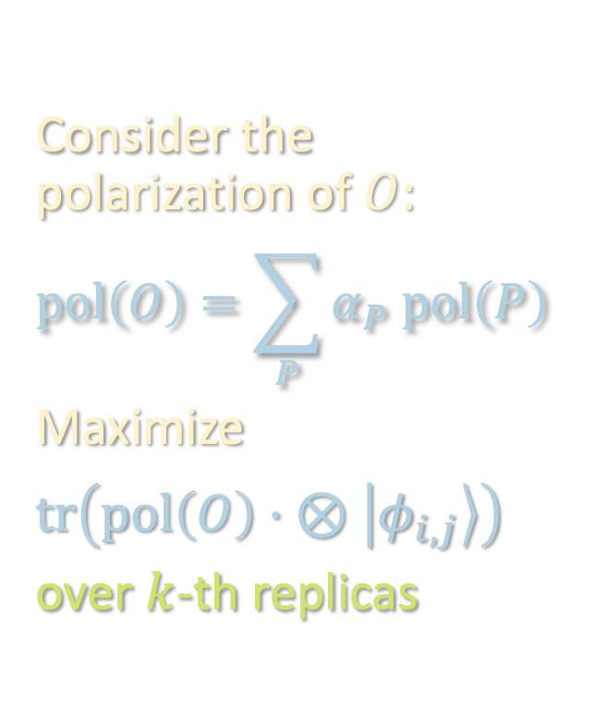
ALGORITHMIC PROOF
${\left\|O\right\|}_{op}≥t^{−O\left(t\right)}⋅{\left\|\vec{α}\right\|}_{ℓ}$ for $ℓ≝\frac{2t}{t+1}<2$
We give an algorithm for finding a product state $\left|ψ\right\rangle$ for which
$$\left|\left\langle ψ\right|O\left|ψ\right\rangle \right|≥t^{−O\left(t\right)}⋅{\left\|\vec{α}\right\|}_{ℓ}$$
Y
Consider the polarization of $O$:
$$pol\left(O\right)=\sum_{P}{α_{P} pol\left(P\right)}$$
Maximize
$$tr\left(pol\left(O\right)⋅ ⊗\left|φ_{i,j}\right\rangle \right)$$
over $k$-th replicas
X
$$t$$
Z
X

Slide 35
ALGORITHMIC PROOF
${\left\|O\right\|}_{op}≥t^{−O\left(t\right)}⋅{\left\|\vec{α}\right\|}_{ℓ}$ for $ℓ≝\frac{2t}{t+1}<2$
We give an algorithm for finding a product state $\left|ψ\right\rangle$ for which
$$\left|\left\langle ψ\right|O\left|ψ\right\rangle \right|≥t^{−O\left(t\right)}⋅{\left\|\vec{α}\right\|}_{ℓ}$$
Form a suitable weighted combination

Slide 36

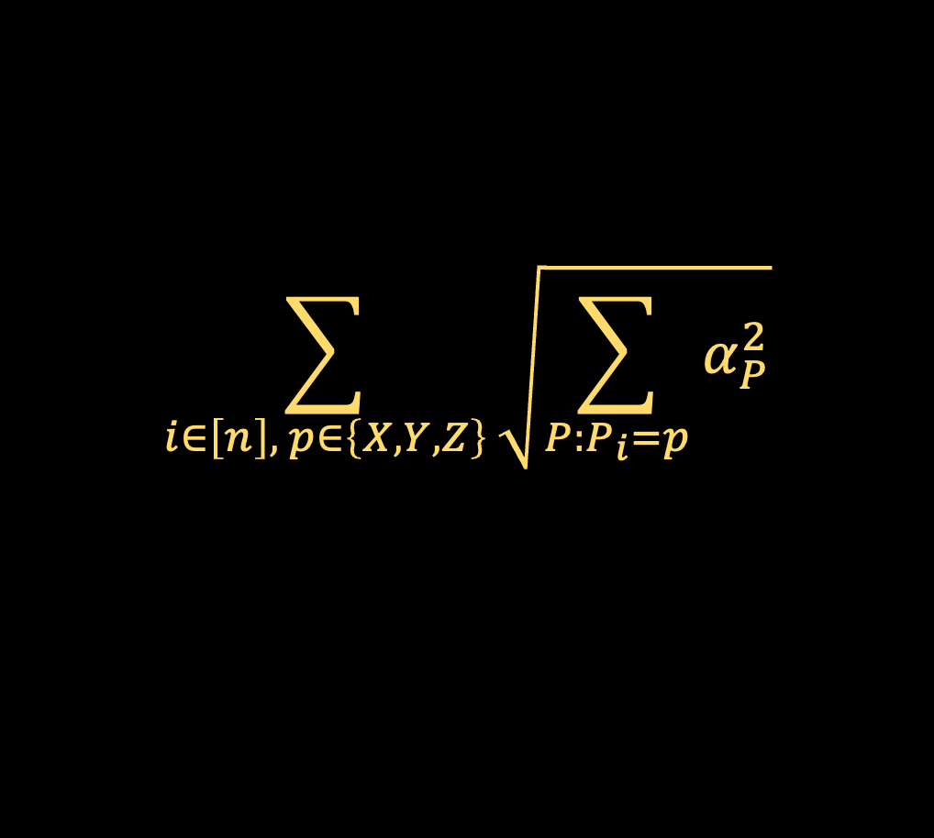
ALGORITHMIC PROOF
${\left\|O\right\|}_{op}≥t^{−O\left(t\right)}⋅{\left\|\vec{α}\right\|}_{ℓ}$ for $ℓ≝\frac{2t}{t+1}<2$
We give an algorithm for finding a product state $\left|ψ\right\rangle$ for which
$$\left|\left\langle ψ\right|O\left|ψ\right\rangle \right|≥t^{−O\left(t\right)}⋅{\left\|\vec{α}\right\|}_{ℓ}$$
Can use quantum generalizations of the polarization identity and Khintchine inequality to show that the output $\left|ψ\right\rangle$ satisfies
$$\left|\left\langle ψ\left|O\right|ψ\right\rangle \right|≥t^{−O\left(t\right)}\sum_{i∈\left[n\right], p∈\left\{X,Y,Z\right\}}{\sqrt{\sum_{P:P_{i}=p}{α_{P}^{2}}}}$$
Sample a pure state from the resulting product of mixed states
$$\sum_{i∈\left[n\right], p∈\left\{X,Y,Z\right\}}{\sqrt{\sum_{P:P_{i}=p}{α_{P}^{2}}}}$$
Improves upon Hamiltonian optimization result of [Harrow-Montanaro ‘15]

Slide 37
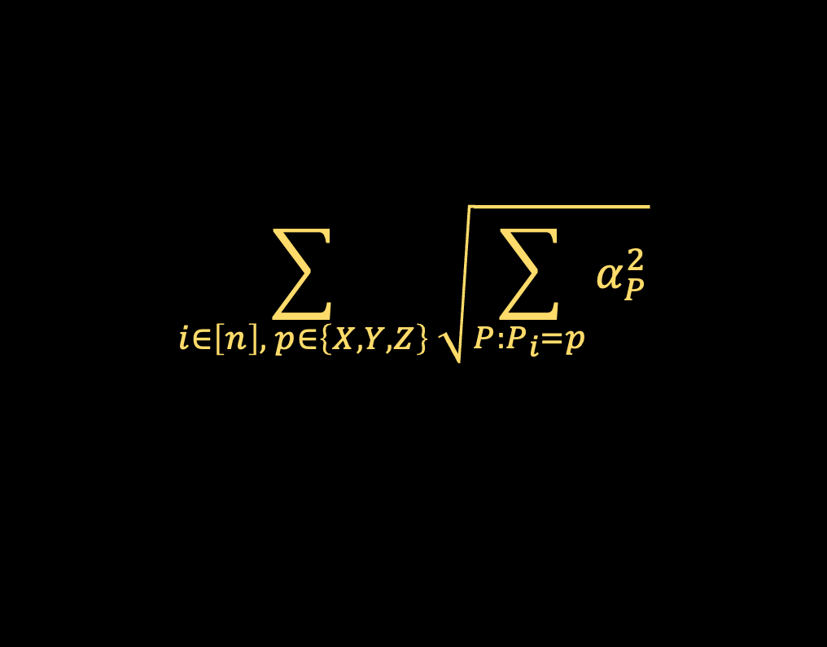

WHERE DOES $2t/(t+1)$ COME FROM?
$$\sum_{i∈\left[n\right], p∈\left\{X,Y,Z\right\}}{\sqrt{\sum_{P:P_{i}=p}{α_{P}^{2}}}}$$

Slide 38
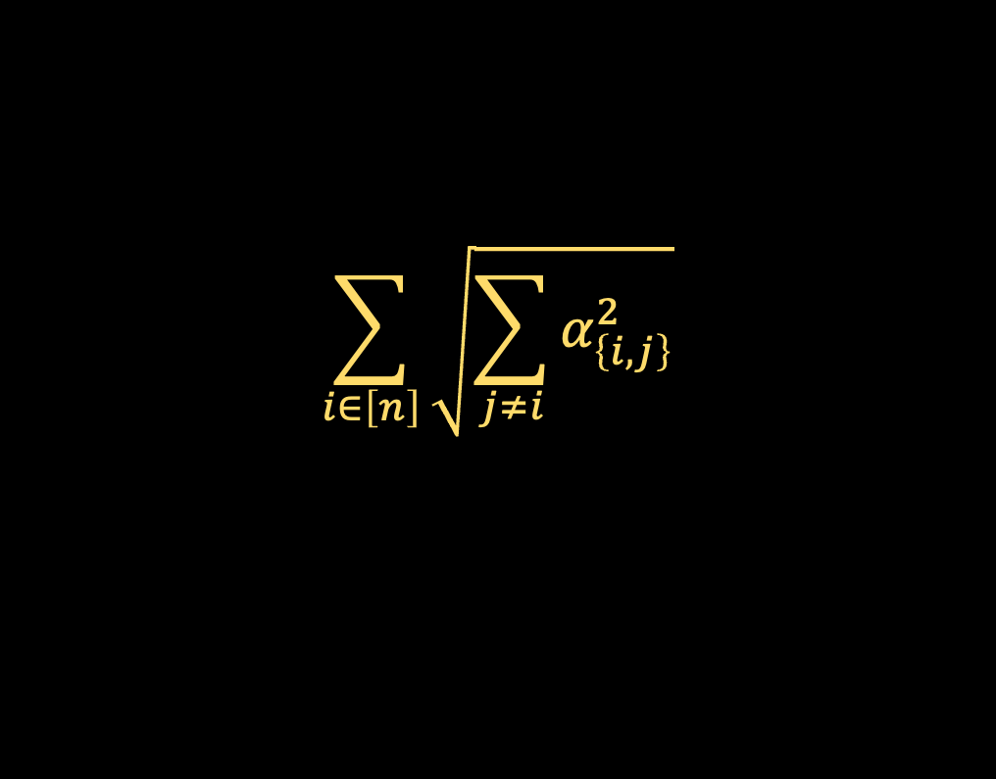
WHERE DOES $2t/(t+1)$ COME FROM?
$$\sum_{i∈\left[n\right]}{\sqrt{\sum_{j≠i}{α_{\left\{i,j\right\}}^{2}}}}$$

Slide 39
WHERE DOES $2t/(t+1)$ COME FROM?
$$\sum_{i∈\left[n\right]}{\sqrt{\sum_{j≠i}{α_{\left\{i,j\right\}}^{2}}}}$$

Slide 40
WHERE DOES $2t/(t+1)$ COME FROM?
$$\sum_{i∈\left[n\right]}{\sqrt{\sum_{j≠i}{α_{\left\{i,j\right\}}^{2}}}}$$

Slide 41
WHERE DOES $2t/(t+1)$ COME FROM?
$$\sum_{i∈\left[n\right]}{\sqrt{\sum_{j≠i}{α_{\left\{i,j\right\}}^{2}}}}$$

Slide 42
WHERE DOES $2t/(t+1)$ COME FROM?
$$\sum_{i∈\left[n\right]}{\sqrt{\sum_{j≠i}{α_{\left\{i,j\right\}}^{2}}}}$$

Slide 43
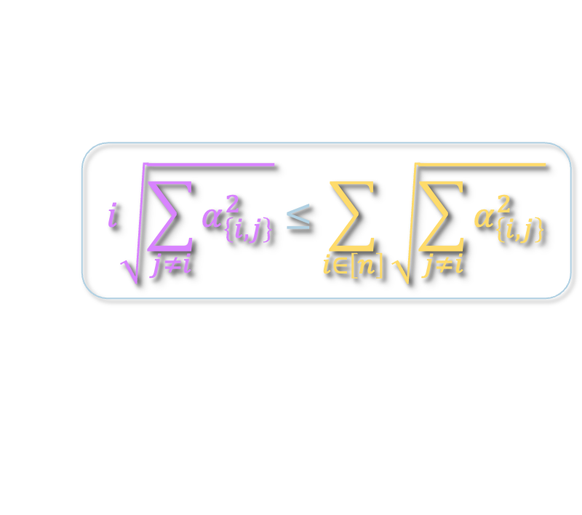
WHERE DOES $2t/(t+1)$ COME FROM?
$$\sum_{i∈\left[n\right]}{\sqrt{\sum_{j≠i}{α_{\left\{i,j\right\}}^{2}}}}$$
$$i\sqrt{\sum_{j≠i}{α_{\left\{i,j\right\}}^{2}}}≤\sum_{i∈\left[n\right]}{\sqrt{\sum_{j≠i}{α_{\left\{i,j\right\}}^{2}}}}$$

Slide 44
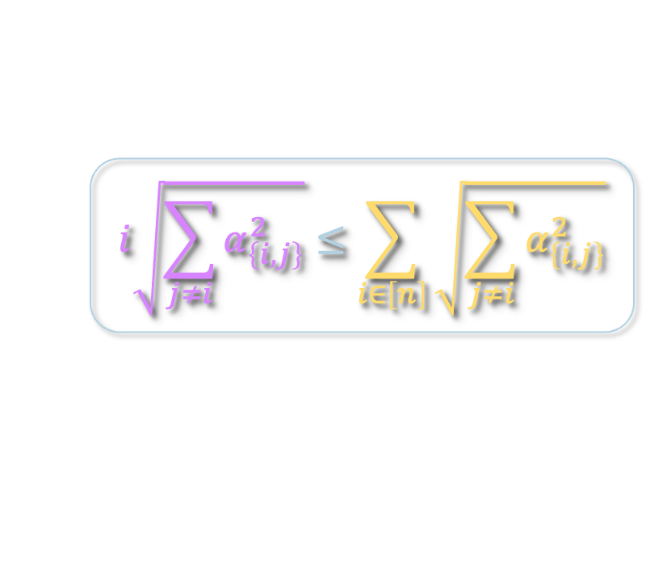
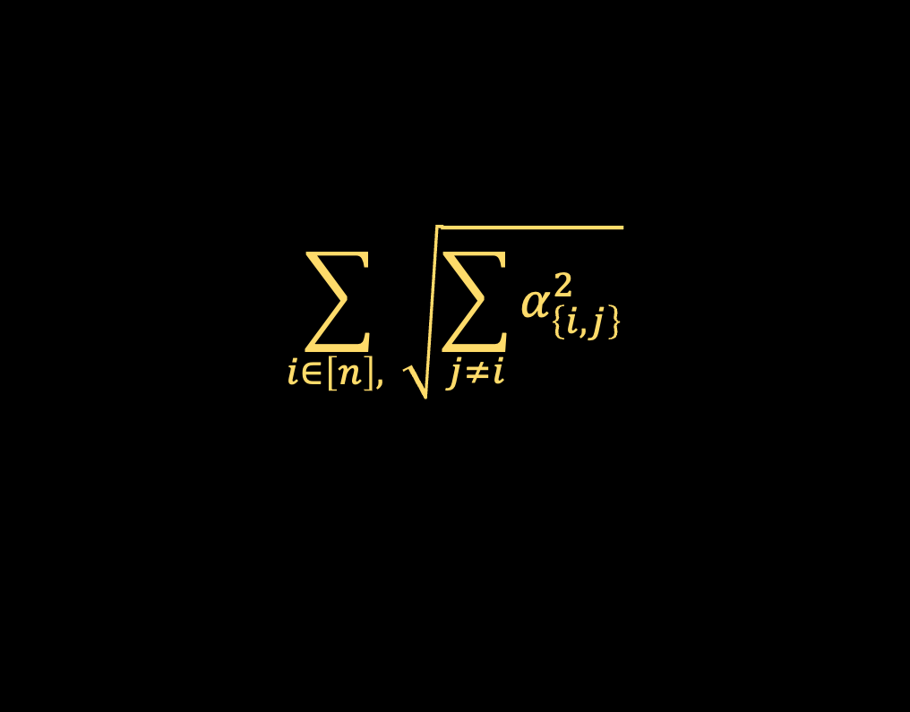
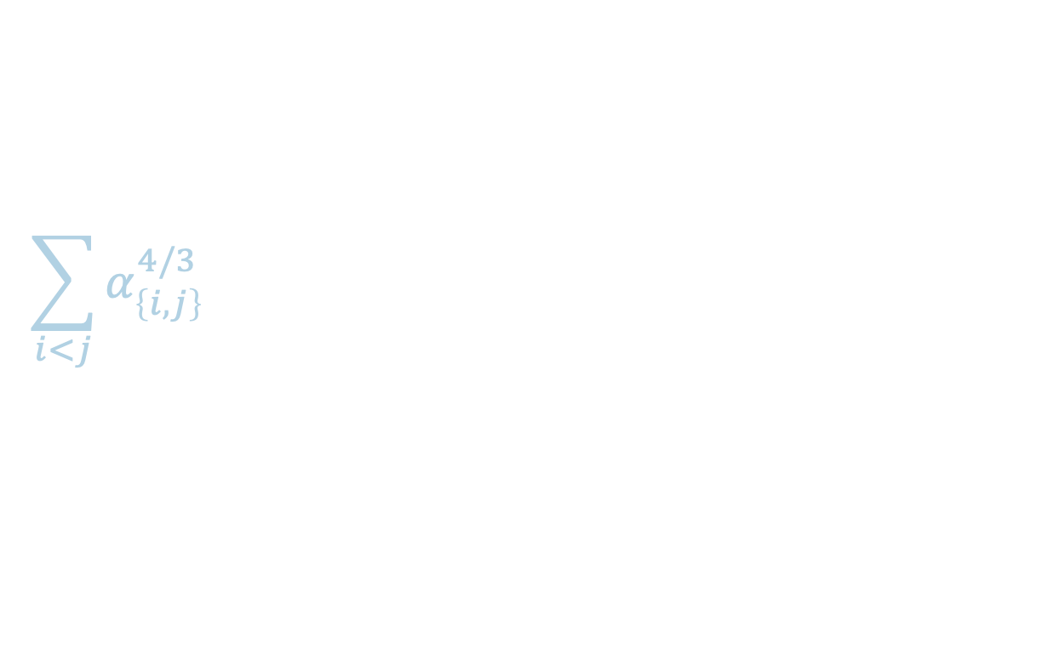
WHERE DOES $2t/(t+1)$ COME FROM?
$$\sum_{i∈\left[n\right], }{\sqrt{\sum_{j≠i}{α_{\left\{i,j\right\}}^{2}}}}$$
$$i\sqrt{\sum_{j≠i}{α_{\left\{i,j\right\}}^{2}}}≤\sum_{i∈\left[n\right]}{\sqrt{\sum_{j≠i}{α_{\left\{i,j\right\}}^{2}}}}$$
$$\sum_{i<j}{α_{\left\{i,j\right\}}^{4/3}}$$

Slide 45
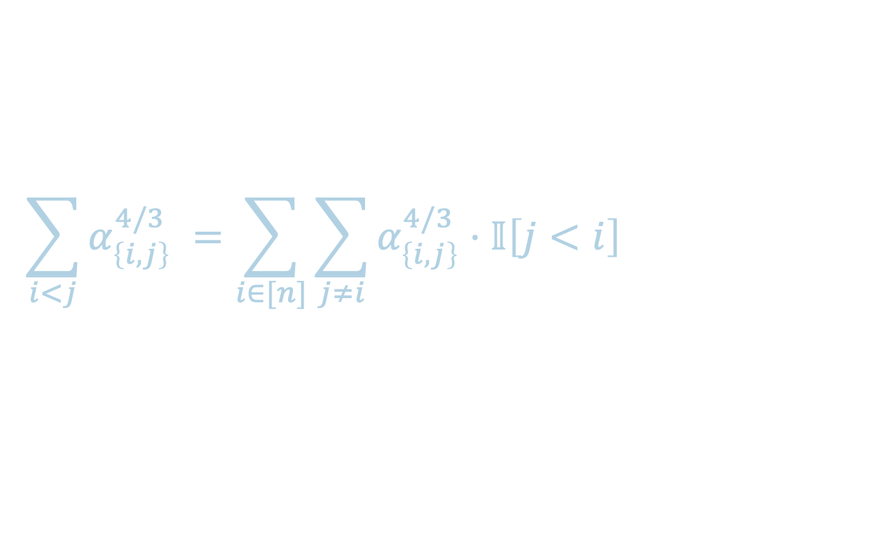
WHERE DOES $2t/(t+1)$ COME FROM?
$$\sum_{i∈\left[n\right], }{\sqrt{\sum_{j≠i}{α_{\left\{i,j\right\}}^{2}}}}$$
$$i\sqrt{\sum_{j≠i}{α_{\left\{i,j\right\}}^{2}}}≤\sum_{i∈\left[n\right]}{\sqrt{\sum_{j≠i}{α_{\left\{i,j\right\}}^{2}}}}$$
$$\sum_{i<j}{α_{\left\{i,j\right\}}^{4/3}}$$ | $$=\sum_{i∈[n]}{\sum_{j≠i}{α_{\left\{i,j\right\}}^{4/3}⋅𝕀\left[j<i\right]}}$$

Slide 46
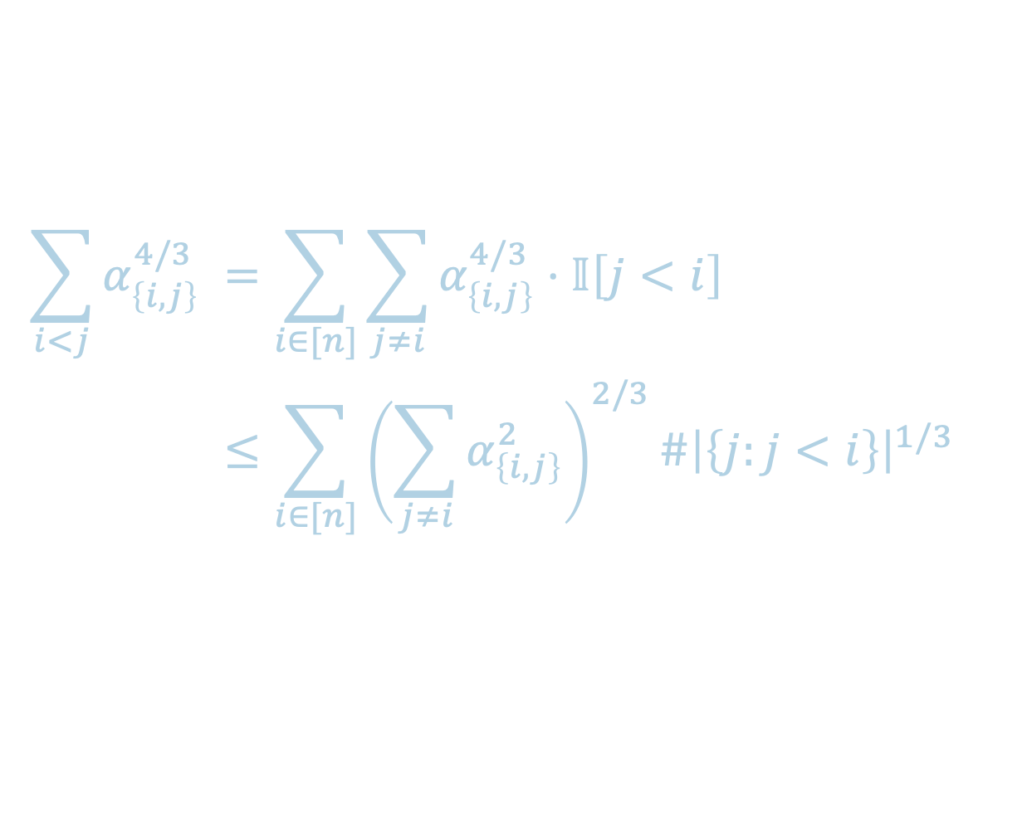
WHERE DOES $2t/(t+1)$ COME FROM?
$$\sum_{i∈\left[n\right], }{\sqrt{\sum_{j≠i}{α_{\left\{i,j\right\}}^{2}}}}$$
$$i\sqrt{\sum_{j≠i}{α_{\left\{i,j\right\}}^{2}}}≤\sum_{i∈\left[n\right]}{\sqrt{\sum_{j≠i}{α_{\left\{i,j\right\}}^{2}}}}$$
$$\sum_{i<j}{α_{\left\{i,j\right\}}^{4/3}}$$ | $$=\sum_{i∈[n]}{\sum_{j≠i}{α_{\left\{i,j\right\}}^{4/3}⋅𝕀\left[j<i\right]}}$$
 | $$≤\sum_{i∈[n]}{{\left(\sum_{j≠i}{α_{\left\{i,j\right\}}^{2}}\right)}^{2/3}{\#\left|\left\{j:j<i\right\}\right|}^{1/3}}$$

Slide 47
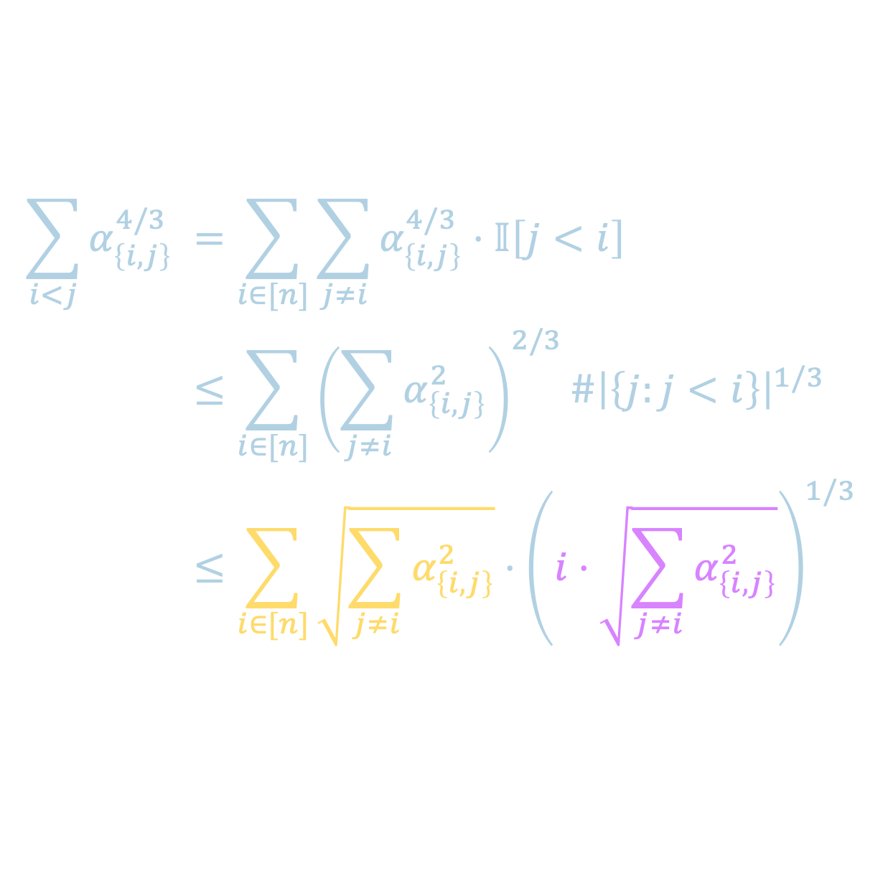
WHERE DOES $2t/(t+1)$ COME FROM?
$$\sum_{i∈\left[n\right], }{\sqrt{\sum_{j≠i}{α_{\left\{i,j\right\}}^{2}}}}$$
$$i\sqrt{\sum_{j≠i}{α_{\left\{i,j\right\}}^{2}}}≤\sum_{i∈\left[n\right]}{\sqrt{\sum_{j≠i}{α_{\left\{i,j\right\}}^{2}}}}$$
$$\sum_{i<j}{α_{\left\{i,j\right\}}^{4/3}}$$ | $$=\sum_{i∈[n]}{\sum_{j≠i}{α_{\left\{i,j\right\}}^{4/3}⋅𝕀\left[j<i\right]}}$$
 | $$≤\sum_{i∈[n]}{{\left(\sum_{j≠i}{α_{\left\{i,j\right\}}^{2}}\right)}^{2/3}{\#\left|\left\{j:j<i\right\}\right|}^{1/3}}$$
 | $$≤\sum_{i∈[n]}{\sqrt{\sum_{j≠i}{α_{\left\{i,j\right\}}^{2}}}⋅{\left(i⋅\sqrt{\sum_{j≠i}{α_{\left\{i,j\right\}}^{2}}}\right)}^{1/3}}$$

Slide 48
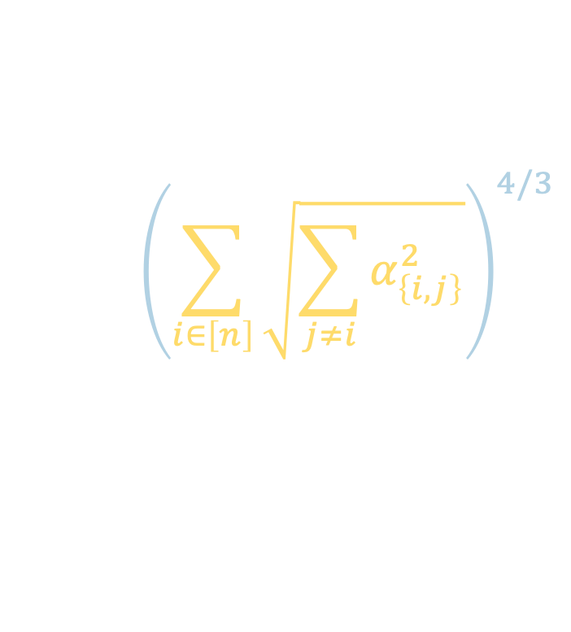

WHERE DOES $2t/(t+1)$ COME FROM?
$$\sum_{i∈\left[n\right], }{\sqrt{\sum_{j≠i}{α_{\left\{i,j\right\}}^{2}}}}$$
$$i\sqrt{\sum_{j≠i}{α_{\left\{i,j\right\}}^{2}}}≤\sum_{i∈\left[n\right]}{\sqrt{\sum_{j≠i}{α_{\left\{i,j\right\}}^{2}}}}$$
$$\sum_{i<j}{α_{\left\{i,j\right\}}^{4/3}}$$ | $$=\sum_{i∈[n]}{\sum_{j≠i}{α_{\left\{i,j\right\}}^{4/3}⋅𝕀\left[j<i\right]}}$$
 | $$≤\sum_{i∈[n]}{{\left(\sum_{j≠i}{α_{\left\{i,j\right\}}^{2}}\right)}^{2/3}{\#\left|\left\{j:j<i\right\}\right|}^{1/3}}$$
 | $$≤\sum_{i∈[n]}{\sqrt{\sum_{j≠i}{α_{\left\{i,j\right\}}^{2}}}⋅{\left(i⋅\sqrt{\sum_{j≠i}{α_{\left\{i,j\right\}}^{2}}}\right)}^{1/3}}$$
$${\left(\sum_{i∈\left[n\right]}{\sqrt{\sum_{j≠i}{α_{\left\{i,j\right\}}^{2}}}}\right)}^{4/3}$$

Slide 49
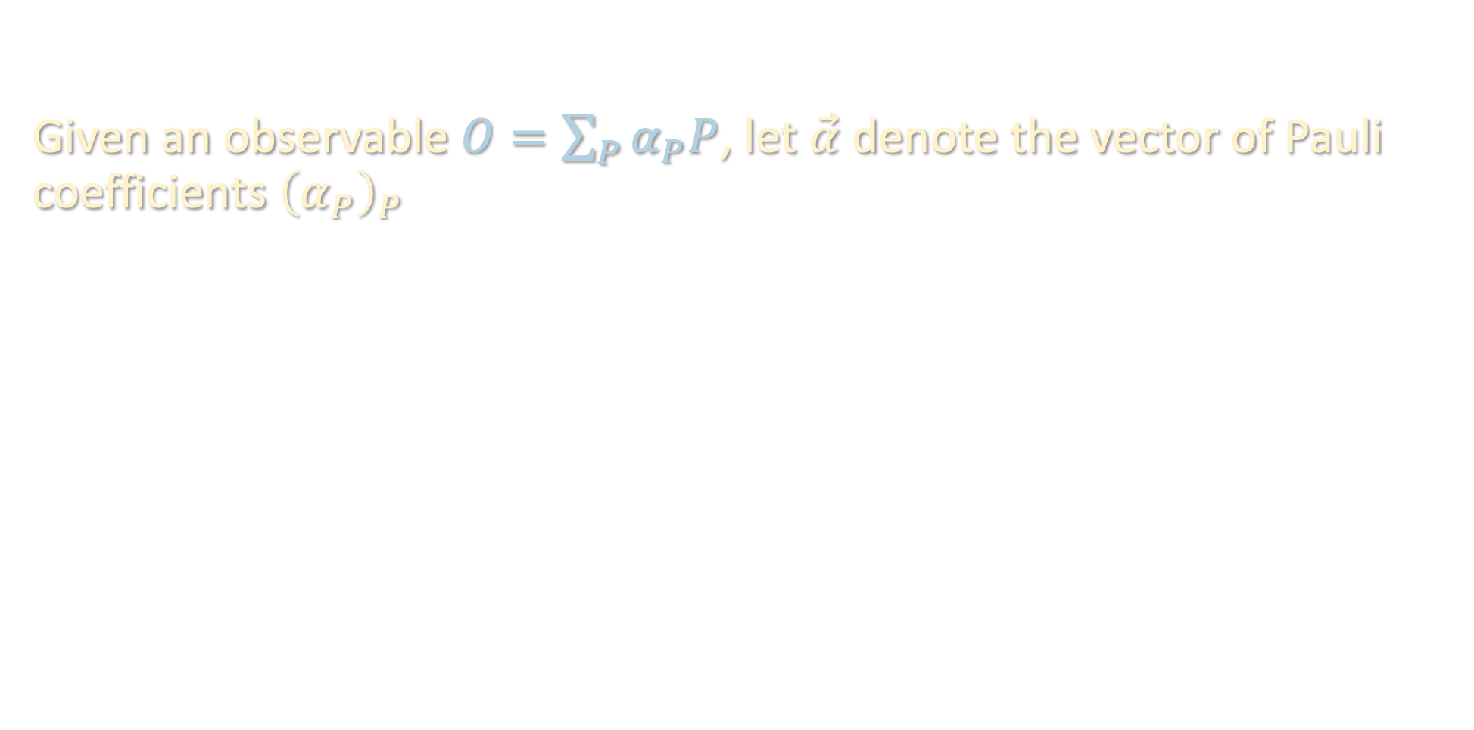


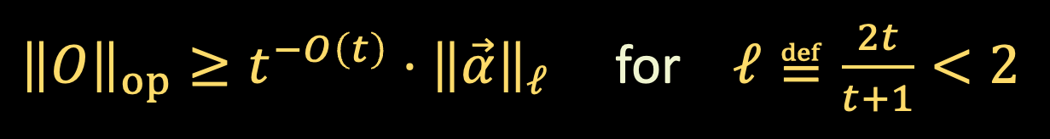

NORM INEQUALITIES
Given an observable $O=\sum_{P}{α_{P}P}$, let $\vec{α}$ denote the vector of Pauli coefficients ${\left(α_{P}\right)}_{P}$
Thm [Huang-C-Preskill ‘22]: If $O$ is $t$-local, then
${\left\|O\right\|}_{op}≥t^{−O\left(t\right)}⋅{\left\|\vec{α}\right\|}_{ℓ}$ for $ℓ≝\frac{2t}{t+1}<2$
${\left\|O\right\|}_{op}≥t^{−O\left(t\right)}⋅{\left\|\vec{α}\right\|}_{ℓ}$ for $ℓ≝\frac{2t}{t+1}<2$
Thm [Huang-C-Preskill ‘22]: If $O$ is $t$-local and degree-$d$, then
${\left\|O\right\|}_{op}≥t^{−O\left(t\right)}⋅{\left\|\vec{α}\right\|}_{ℓ}$ for $ℓ≝\frac{2t}{t+1}<2$
$${\left\|O\right\|}_{op}≥\frac{t^{−O\left(t\right)}}{\sqrt{d}}⋅{\left\|\vec{α}\right\|}_{1}$$
Improves* upon Hamiltonian optimization result of [Anshu-Gosset-Korol-Soleimanifar ‘21]

Slide 50
Setup
Warmup
Norm inequalities
Algorithm
Takeaways

Slide 51
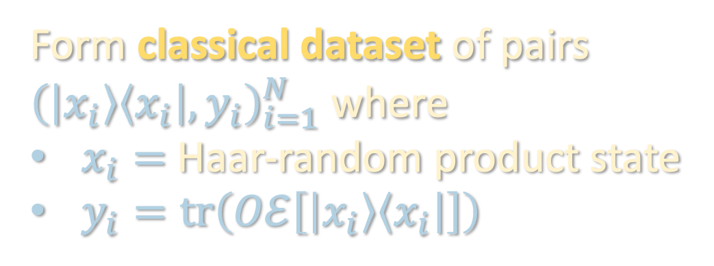


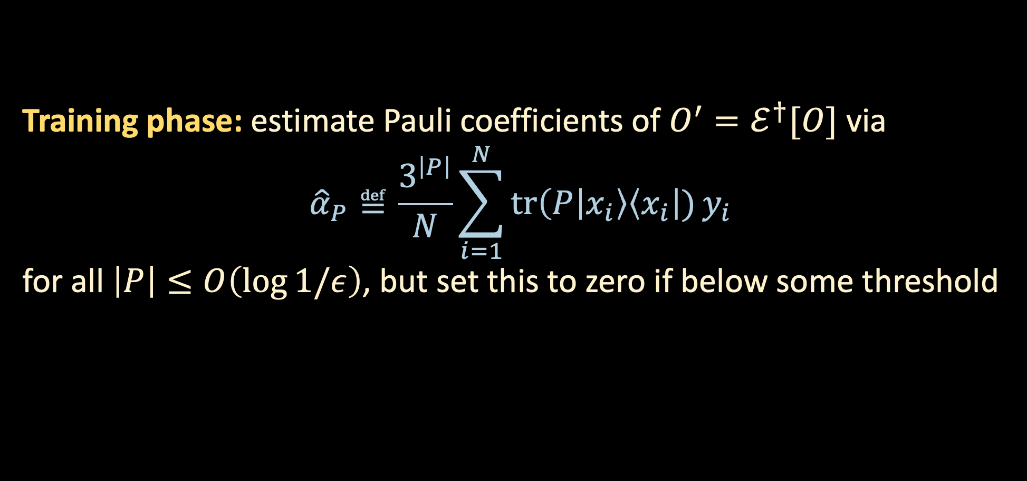
PUTTING EVERYTHING TOGETHER
$$O$$
Form classical dataset of pairs ${\left(\left|x_{i}\right\rangle \left\langle x_{i}\right|, y_{i}\right)}_{i=1}^{N}$ where
$x_{i}=$ Haar-random product state
$y_{i}=tr\left(Oℰ\left[\left|x_{i}\right\rangle \left\langle x_{i}\right|\right]\right)$
$$ℰ$$
Training phase: estimate Pauli coefficients of $O^{′}=ℰ^{†}[O]$ via
$${\hat{α}}_{P}≝\frac{3^{\left|P\right|}}{N}\sum_{i=1}^{N}{tr\left(P | x_{i}\right\rangle \left\langle x_{i}\right|)}y_{i}$$
for all $\left|P\right|≤O\left(\log{1/ε}\right)$, but set this to zero if below some threshold

Slide 52
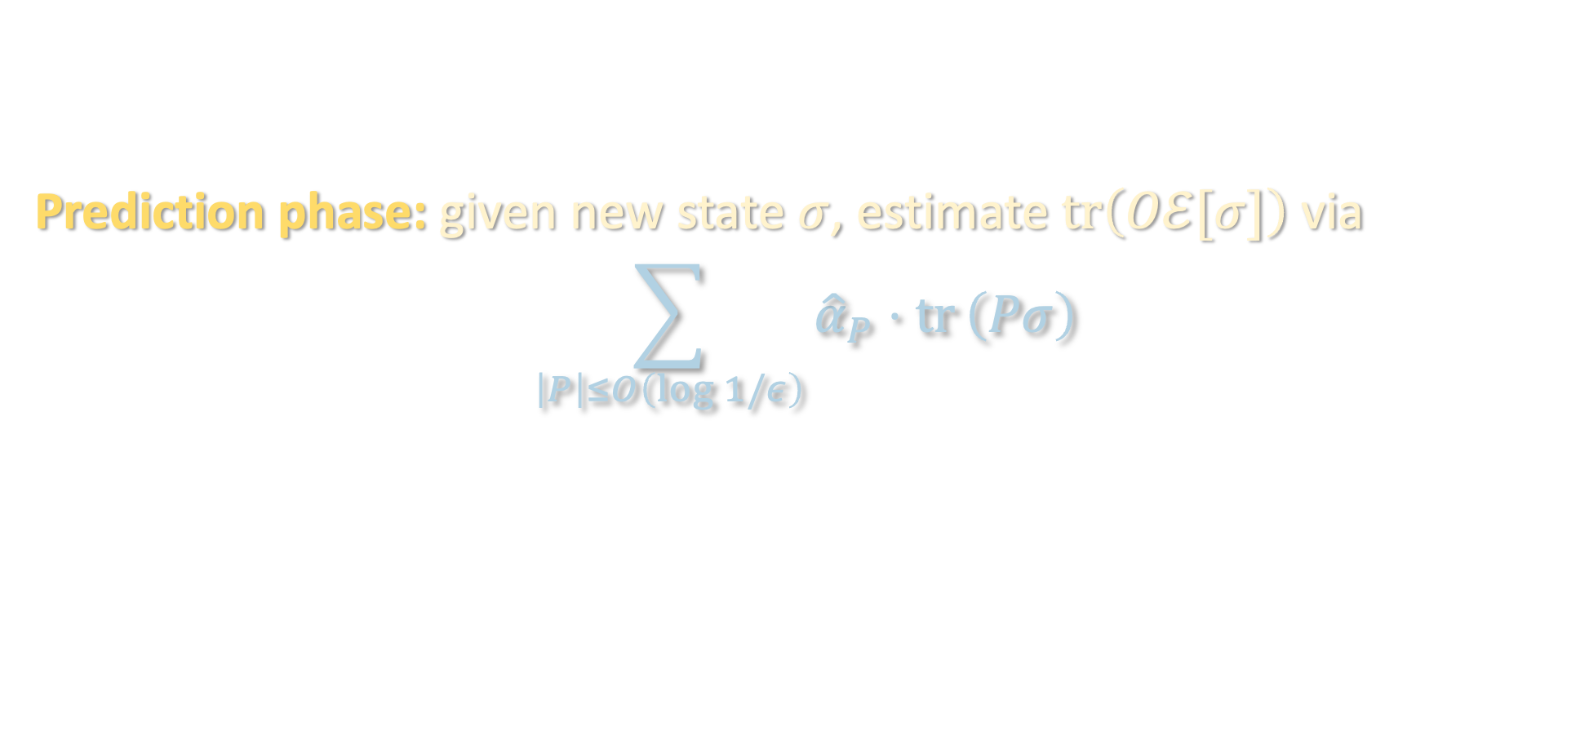
PUTTING EVERYTHING TOGETHER
$$O$$
Form classical dataset of pairs ${\left(\left|x_{i}\right\rangle \left\langle x_{i}\right|, y_{i}\right)}_{i=1}^{N}$ where
$x_{i}=$ Haar-random product state
$y_{i}=tr\left(Oℰ\left[\left|x_{i}\right\rangle \left\langle x_{i}\right|\right]\right)$
$$ℰ$$
Prediction phase: given new state $σ$, estimate $tr\left(Oℰ[σ]\right)$ via
$$\sum_{\left|P\right|≤O\left(\log{1/ε}\right)}{{\hat{α}}_{P}⋅tr}\left(Pσ\right)$$

Slide 53
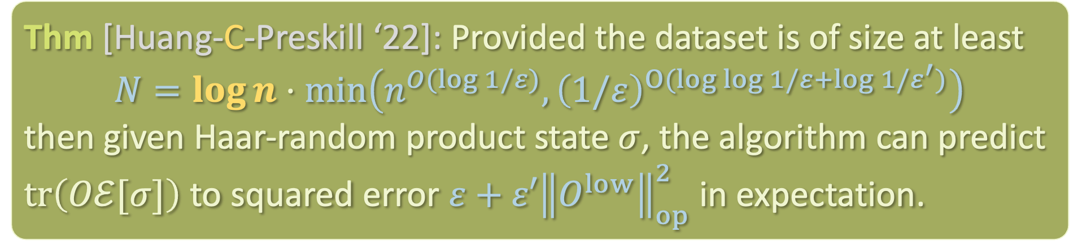
PUTTING EVERYTHING TOGETHER
$$O$$
Form classical dataset of pairs ${\left(\left|x_{i}\right\rangle \left\langle x_{i}\right|, y_{i}\right)}_{i=1}^{N}$ where
$x_{i}=$ Haar-random product state
$y_{i}=tr\left(Oℰ\left[\left|x_{i}\right\rangle \left\langle x_{i}\right|\right]\right)$
$$ℰ$$
Thm [Huang-C-Preskill ‘22]: Provided the dataset is of size at least
$$N=\log{n}⋅\min\left(n^{O(log{1/ε)}},{\left(1/ε\right)}^{O(log{\log{1/ε}+\log{1/ε^{′})}}}\right)$$
then given Haar-random product state $σ$, the algorithm can predict $tr\left(Oℰ[σ]\right)$ to squared error $ε+ε′{\left\|O^{low}\right\|}_{op}^{2}$ in expectation.

Slide 54


PUTTING EVERYTHING TOGETHER
Thm [Huang-C-Preskill ‘22]: Provided the dataset is of size at least
$$N=\log{n}⋅\min\left(n^{O(log{1/ε)}},{\left(1/ε\right)}^{O(log{\log{1/ε}+\log{1/ε^{′})}}}\right)$$
then given Haar-random product state $σ$, the algorithm can predict $tr\left(Oℰ[σ]\right)$ to squared error $ε+ε′{\left\|O^{low}\right\|}_{op}^{2}$ in expectation.
Algorithm is classical, except when we need to estimate $tr\left(Pσ\right)$’s during prediction phase, which can be done w/ classical shadows

Slide 55



EXTENSION 1: ESTIMATING ANY OBSERVABLE
$$O$$
$$ℰ$$
Original goal: Given observable $O$ and query access to unknown channel $ℰ$, learn the function $σ↦tr\left(O𝓔\left[σ\right]\right)$

Slide 56


EXTENSION 1: ESTIMATING ANY OBSERVABLE
$$?$$
$$ℰ$$
New goal: Given query access to unknown channel $ℰ$, learn the function $\left(O,σ\right)↦tr\left(O𝓔\left[σ\right]\right)$
i.e. we see $O$ after the training phase

Slide 57

EXTENSION 1: ESTIMATING ANY OBSERVABLE
$$?$$
Form classical dataset of pairs ${\left(\left|x_{i}\right\rangle \left\langle x_{i}\right|, y_{i}\right)}_{i=1}^{N}$ where
$x_{i}=$ Haar-random product state
$y_{i}=tr\left(Oℰ\left[\left|x_{i}\right\rangle \left\langle x_{i}\right|\right]\right)$
$$ℰ$$

Slide 58


EXTENSION 1: ESTIMATING ANY OBSERVABLE
$$O$$
Form classical dataset of pairs ${\left(\left|x_{i}\right\rangle \left\langle x_{i}\right|, y_{i}\right)}_{i=1}^{N}$ where
$x_{i}=$ Haar-random product state
$y_{i}=tr\left(O𝓔\left[\left|x_{i}\right\rangle \left\langle x_{i}\right|\right]\right)$
$$ℰ$$
Classical shadows framework [Huang-Kueng-Preskill ‘20] allows one to produce a classical ”summary” of an unknown state ($ℰ\left[\left|x\right\rangle \left\langle x\right|\right]$) which one can then use to estimate many observables
  Idea: use outcomes of measuring copies of the state in random bases to form unbiased estimator for the state

Slide 59


EXTENSION 1: ESTIMATING ANY OBSERVABLE
$$O$$
Form classical dataset of pairs ${\left(\left|x_{i}\right\rangle \left\langle x_{i}\right|, \left|y_{i}\right\rangle \left\langle y_{i}\right|\right)}_{i=1}^{N}$ where
$x_{i}=$ Haar-random product states
$y_{i}=$ send $x_{i}$ through $ℰ$, apply random Pauli measurement
$$ℰ$$
Training phase: estimate Pauli coefficients of $O^{′}=ℰ^{†}[O]$ via
$${\hat{α}}_{P}≝\frac{3^{\left|P\right|}}{N}\sum_{i=1}^{N}{tr\left(P | x_{i}\right\rangle \left\langle x_{i}\right|)}y_{i}$$

Slide 60


EXTENSION 1: ESTIMATING ANY OBSERVABLE
$$O$$
Form classical dataset of pairs ${\left(\left|x_{i}\right\rangle \left\langle x_{i}\right|, \left|y_{i}\right\rangle \left\langle y_{i}\right|\right)}_{i=1}^{N}$ where
$x_{i}=$ Haar-random product states
$y_{i}=$ send $x_{i}$ through $ℰ$, apply random Pauli measurement
$$ℰ$$
Training phase: estimate Pauli coefficients of $O^{′}=ℰ^{†}[O]$ via
$${\hat{α}}_{P}≝\frac{3^{\left|P\right|}}{N}\sum_{i=1}^{N}{tr\left(P | x_{i}\right\rangle \left\langle x_{i}\right|)}tr\left(O ⨂_{j=1}^{n}\left(3\left|y_{i,j}\right\rangle \left\langle y_{i,j}\right|−I\right)\right)$$
unbiased estimator for $tr\left(Oℰ\left[x_{i}⟩\left\langle x_{i}\right|\right]\right)$

Slide 61


EXTENSION 1: ESTIMATING ANY OBSERVABLE
Training phase: estimate Pauli coefficients of $O^{′}=ℰ^{†}[O]$ via
$${\hat{α}}_{P}≝\frac{3^{\left|P\right|}}{N}\sum_{i=1}^{N}{tr\left(P | x_{i}\right\rangle \left\langle x_{i}\right|)}tr\left(O ⨂_{j=1}^{n}\left(3\left|y_{i,j}\right\rangle \left\langle y_{i,j}\right|−I\right)\right)$$
Thm [Huang-Kueng-Preskill ‘20] + [Huang-C-Preskill ‘22]: If $O$ is $O\left(1\right)$-local and degree-$O\left(1\right)$, then the variance of this estimator is
$${\left\|O\right\|}_{shadow}^{2}≤O\left({\left\|\vec{α}\right\|}_{1}^{2}\right)≤O\left({\left\|O\right\|}_{op}^{2}\right)$$

Slide 62



EXTENSION 1: ESTIMATING ANY OBSERVABLE
$$?$$
$$ℰ$$
Thm [Huang-C-Preskill ‘22]: Provided the dataset is of size at least
$$N=\log\left(n\right)⋅\min\left(n^{O(log{1/ε)}},{\left(1/ε\right)}^{O(log{\log{1/ε}+\log{1/ε^{′})}}}\right)$$
then given random product state $σ$ and O(1)-degree/locality obs. $O$, can predict $tr\left(Oℰ[σ]\right)$ to sq. error $ε+ε^{′}{\left\|O^{low}\right\|}_{op}^{2}$in expectation.

Slide 63

EXTENSION 1: ESTIMATING ANY OBSERVABLE
$$O$$
Form classical dataset of pairs ${\left(\left|x_{i}\right\rangle \left\langle x_{i}\right|, \left|y_{i}\right\rangle \left\langle y_{i}\right|\right)}_{i=1}^{N}$ where
$x_{i}=$ Haar-random product states
$y_{i}=$ send $x_{i}$ through $ℰ$, apply random Pauli measurement
$$ℰ$$
Prediction phase: given new state $σ$, estimate $tr\left(ℰO[σ]\right)$ via
$$\sum_{\left|P\right|≤O\left(\log{1/ε}\right)}{{\hat{α}}_{P}⋅tr}\left(Pσ\right)$$

Slide 64

EXTENSION 1: ESTIMATING ANY OBSERVABLES
$$O$$
Form classical dataset of pairs ${\left(\left|x_{i}\right\rangle \left\langle x_{i}\right|, \left|y_{i}\right\rangle \left\langle y_{i}\right|\right)}_{i=1}^{N}$ where
$x_{i}=$ Haar-random product states
$y_{i}=$ send $x_{i}$ through $ℰ$, apply random Pauli measurement
$$ℰ$$
Thm [Huang-C-Preskill ‘22]: Provided the dataset is of size at least
$$N=\log{n}⋅\min\left(n^{O(log{1/ε)}},{\left(1/ε\right)}^{O(log{\log{1/ε}+\log{1/ε^{′})}}}\right)$$
then given Haar-random product state $σ$, the algorithm can predict $tr\left(Oℰ[σ]\right)$ to squared error $ε+ε′{\left\|O^{low}\right\|}_{op}^{2}$ in expectation.

Slide 65


EXTENSION 2: GENERAL INPUT DISTRIBUTIONS
The same algorithm works almost verbatim if $σ$ comes from any locally flat distribution
i.e. any distribution invariant under single-qubit Clifford gates
such distributions can consist of highly entangled states, yet our algorithm only trains on product states!
Thm [Huang-C-Preskill ‘22]: Given arbitrary $O=\sum_{P}{α_{P}P}$ and its degree-$t$ approximation $O^{low}$, if $D$ is locally flat, then
$$𝔼_{σ∼D}\left[{\left(tr\left(Oσ\right)−tr\left(O^{low}σ\right)\right)}^{2}\right]≤\sum_{\left|P\right|>t}{{\left(2/3\right)}^{\left|P\right|}}α_{P}^{2}$$

Slide 66
Setup
Warmup
Norm inequalities
Algorithm
Takeaways

Slide 67

TAKEAWAYS
We give an algorithm for predicting arbitrary quantum processes over a wide range of input distributions
Some surprises
  Analogous classical question is exponentially hard
  Only $\log{n}$ many queries to the process needed
  Algorithm is almost entirely classical (prediction phase requires RDM’s of the input state $σ$)
  Train/test data can differ dramatically: We only train on random product states but can accurately predict behavior of the process on highly entangled states

Slide 68

OPEN QUESTIONS
Beyond local flatness?
  Arbitrary “smoothed” distributions over $σ$
Improved time/sample complexity under additional assumptions on the channel and/or observable?
Improved quantum BH inequality?
  Classically, best-known constant is $\exp\left(O\left(\sqrt{t\log{t}}\right)\right)$
Beyond local, bounded-degree observables?

