Slide 1
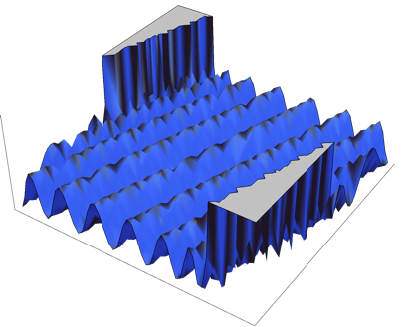
Learning Polynomials in Few Relevant Dimensions
Sitan Chen | Raghu Meka
MIT | UCLA

Slide 2
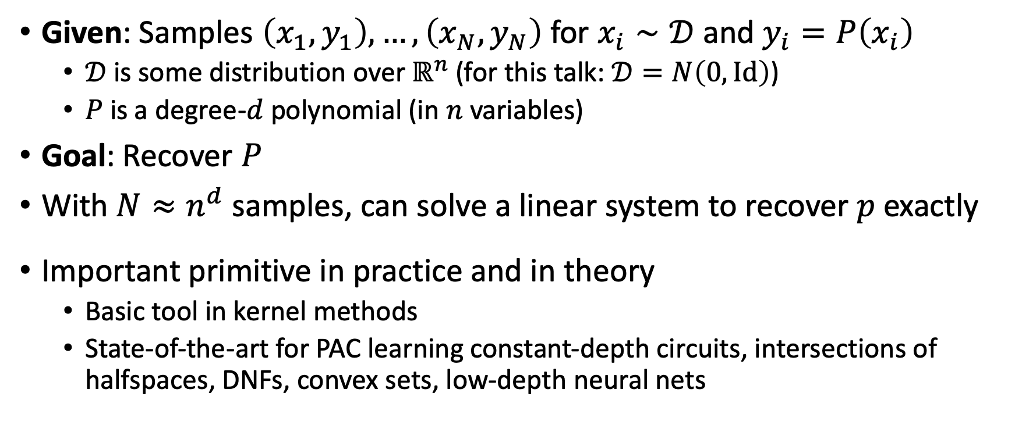
POLYNOMIAL REGRESSION
Given: Samples $\left(x_{1},y_{1}\right),…,\left(x_{N},y_{N}\right)$ for $x_{i}∼𝒟$ and $y_{i}=P\left(x_{i}\right)$
  $𝒟$ is some distribution over $ℝ^{n}$ (for this talk: $𝒟=N\left(0,Id\right)$)
  $P$ is a degree-$d$ polynomial (in $n$ variables)
Goal: Recover $P$
With $N≈n^{d}$ samples, can solve a linear system to recover $p$ exactly
Important primitive in practice and in theory
  Basic tool in kernel methods
  State-of-the-art for PAC learning constant-depth circuits, intersections of halfspaces, DNFs, convex sets, low-depth neural nets

Slide 3
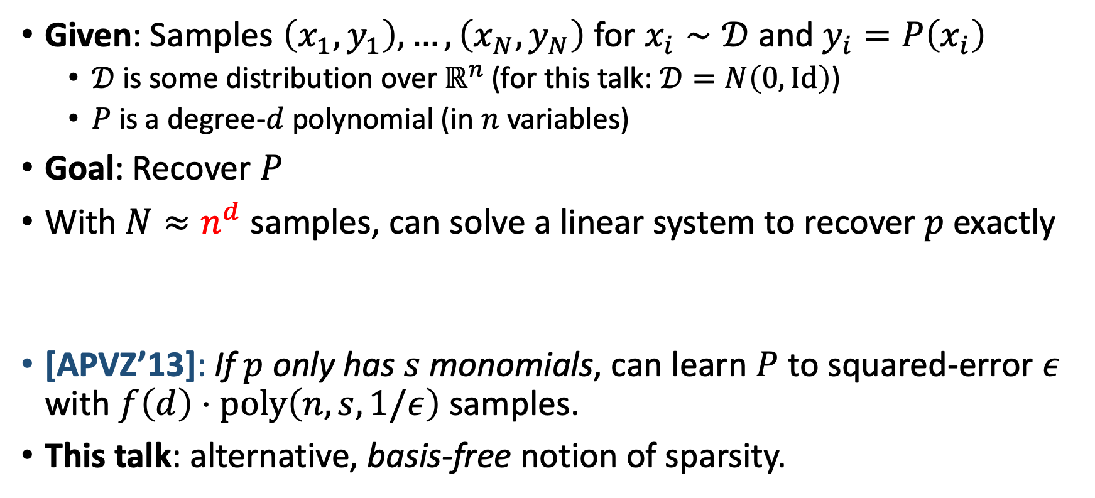
POLYNOMIAL REGRESSION
Given: Samples $\left(x_{1},y_{1}\right),…,\left(x_{N},y_{N}\right)$ for $x_{i}∼𝒟$ and $y_{i}=P\left(x_{i}\right)$
  $𝒟$ is some distribution over $ℝ^{n}$ (for this talk: $𝒟=N\left(0,Id\right)$)
  $P$ is a degree-$d$ polynomial (in $n$ variables)
Goal: Recover $P$
With $N≈n^{d}$ samples, can solve a linear system to recover $p$ exactly
[APVZ’13]: If $p$ only has $s$ monomials, can learn $P$ to squared-error $ε$ with $f\left(d\right)⋅poly\left(n,s,1/ε\right)$ samples.
This talk: alternative, basis-free notion of sparsity.
When can we hope to beat this $n^{d}$ scaling?

Slide 4
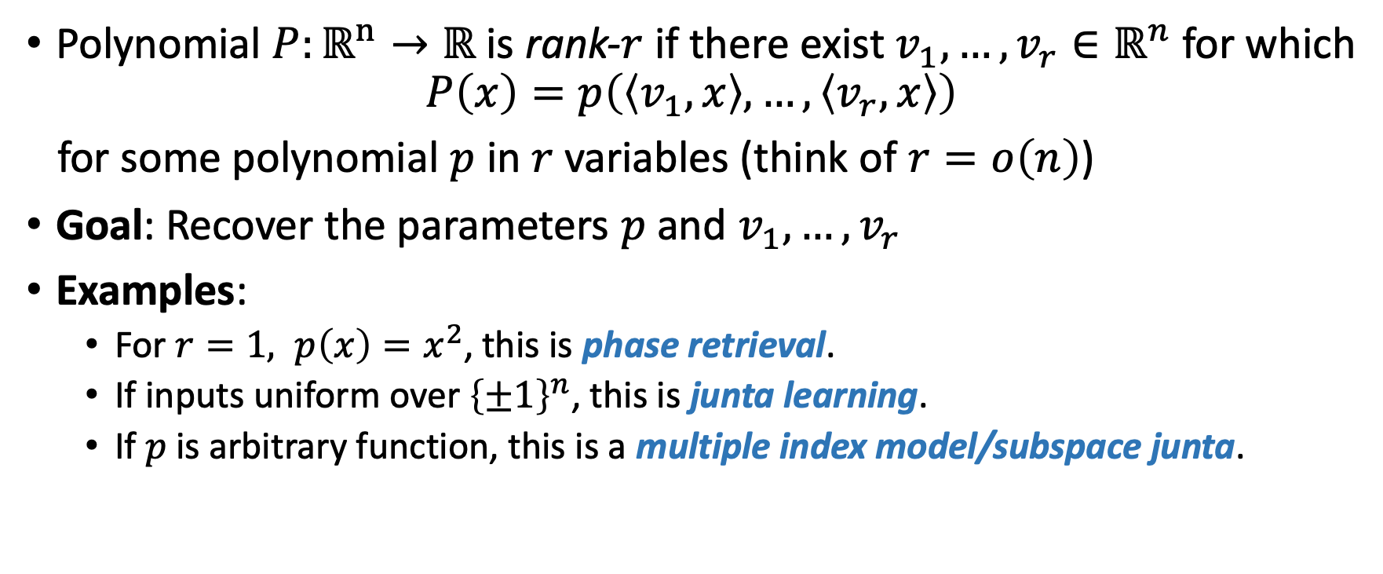
LOW-RANK POLYNOMIALS
Polynomial $P:ℝ^{n}→ℝ$ is rank-$r$ if there exist $v_{1},…,v_{r}∈ℝ^{n}$ for which
$$P\left(x\right)=p\left(\left\langle v_{1},x\right\rangle ,…,\left\langle v_{r},x\right\rangle \right)$$
for some polynomial $p$ in $r$ variables (think of $r=o\left(n\right)$)
Goal: Recover the parameters $p$ and $v_{1},…,v_{r}$
Examples:
  For $r=1, p\left(x\right)=x^{2}$, this is phase retrieval.
  If inputs uniform over ${\left\{±1\right\}}^{n}$, this is junta learning.
  If $p$ is arbitrary function, this is a multiple index model/subspace junta.

Slide 5
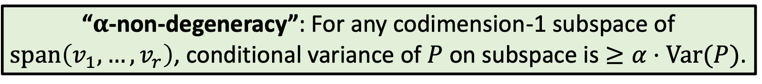
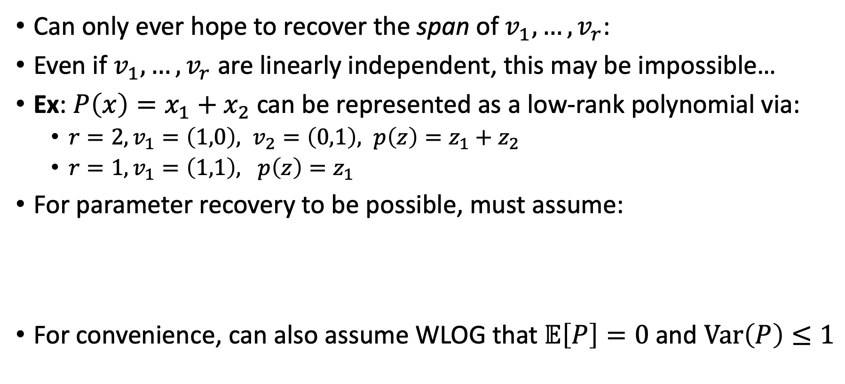
IDENTIFIABILITY ISSUES
Can only ever hope to recover the span of $v_{1},…,v_{r}$:
Even if $v_{1},…,v_{r}$ are linearly independent, this may be impossible…
Ex: $P\left(x\right)=x_{1}+x_{2}$ can be represented as a low-rank polynomial via:
  $r=2,v_{1}=\left(1,0\right), v_{2}=\left(0,1\right), p\left(z\right)=z_{1}+z_{2}$
  $r=1,v_{1}=\left(1,1\right), p\left(z\right)=z_{1}$
For parameter recovery to be possible, must assume:
For convenience, can also assume WLOG that $𝔼\left[P\right]=0$ and $Var\left(P\right)≤1$
“$α$-non-degeneracy”: For any codimension-1 subspace of $span\left(v_{1},…,v_{r}\right)$, conditional variance of $P$ on subspace is $≥α⋅Var(P)$.

Slide 6
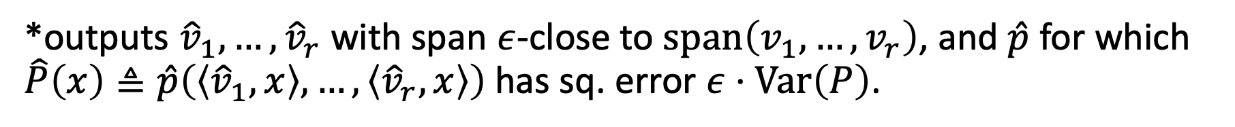
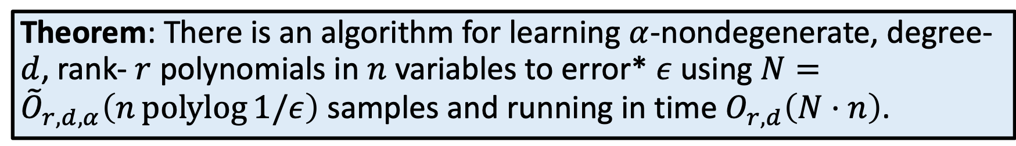
OUR RESULT
Theorem: There is an algorithm for learning $α$-nondegenerate, degree-$d$, rank- $r$ polynomials in $n$ variables to error* $ε$ using $N={\tilde{O}}_{r,d,α}\left(n\operatorname{polylog}{1/ε}\right)$ samples and running in time $O_{r,d}\left(N⋅n\right)$.
*outputs ${\hat{v}}_{1},…,{\hat{v}}_{r}$ with span $ε$-close to $span\left(v_{1},…,v_{r}\right)$, and $\hat{p}$ for which $\hat{P}\left(x\right)≜\hat{p}\left(\left\langle {\hat{v}}_{1},x\right\rangle ,…,\left\langle {\hat{v}}_{r},x\right\rangle \right)$ has sq. error $ε⋅Var\left(P\right)$.
Algorithm Outline:
Get a warm start- “Trimmed” PCA
Boost to arbitrary accuracy- Geodesic SGD w.r.t. squared loss

Slide 7
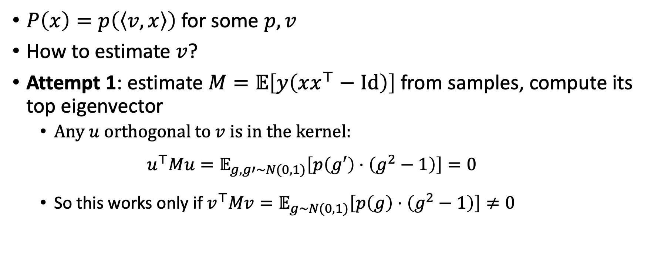

GETTING A WARM START ($r=1$)
$P\left(x\right)=p\left(\left\langle v,x\right\rangle \right)$ for some $p,v$
How to estimate $v$?
Attempt 1: estimate $M=𝔼\left[y\left(xx^{⊤}−Id\right)\right]$ from samples, compute its top eigenvector
  Any $u$ orthogonal to $v$ is in the kernel:
  $$u^{⊤}Mu=𝔼_{g,g′∼N(0,1)}\left[p\left(g′\right)⋅\left(g^{2}−1\right)\right]=0$$
  So this works only if $v^{⊤}Mv=𝔼_{g∼N(0,1)}\left[p\left(g\right)⋅\left(g^{2}−1\right)\right]≠0$

Slide 8
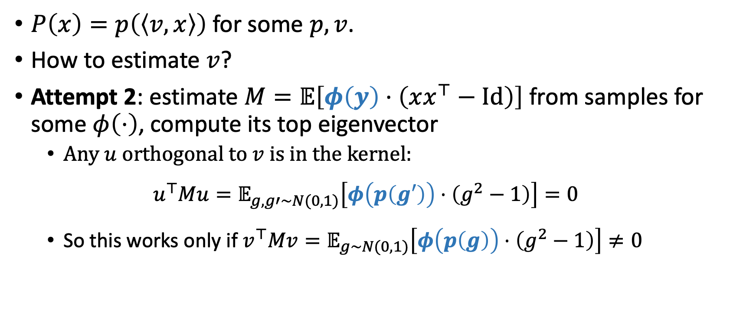

GETTING A WARM START ($r=1$)
$P\left(x\right)=p\left(\left\langle v,x\right\rangle \right)$ for some $p,v$.
How to estimate $v$?
Attempt 2: estimate $M=𝔼\left[φ\left(y\right)⋅\left(xx^{⊤}−Id\right)\right]$ from samples for some $φ\left(⋅\right)$, compute its top eigenvector
  Any $u$ orthogonal to $v$ is in the kernel:
  $$u^{⊤}Mu=𝔼_{g,g′∼N(0,1)}\left[φ\left(p\left(g′\right)\right)⋅\left(g^{2}−1\right)\right]=0$$
  So this works only if $v^{⊤}Mv=𝔼_{g∼N(0,1)}\left[φ\left(p\left(g\right)\right)⋅\left(g^{2}−1\right)\right]≠0$

Slide 9

GETTING A WARM START ($r=1$)
Want: $φ$ so that for all $p$, $𝔼_{g∼N(0,1)}\left[φ\left(p\left(g\right)\right)⋅\left(g^{2}−1\right)\right]≠0$
Idea: By compactness of the set of possible $p$’s, there is a $τ>0$ such that for all such $p$, if $\left|p\left(g\right)\right|>τ$, then $g^{2}>2$.

Slide 10
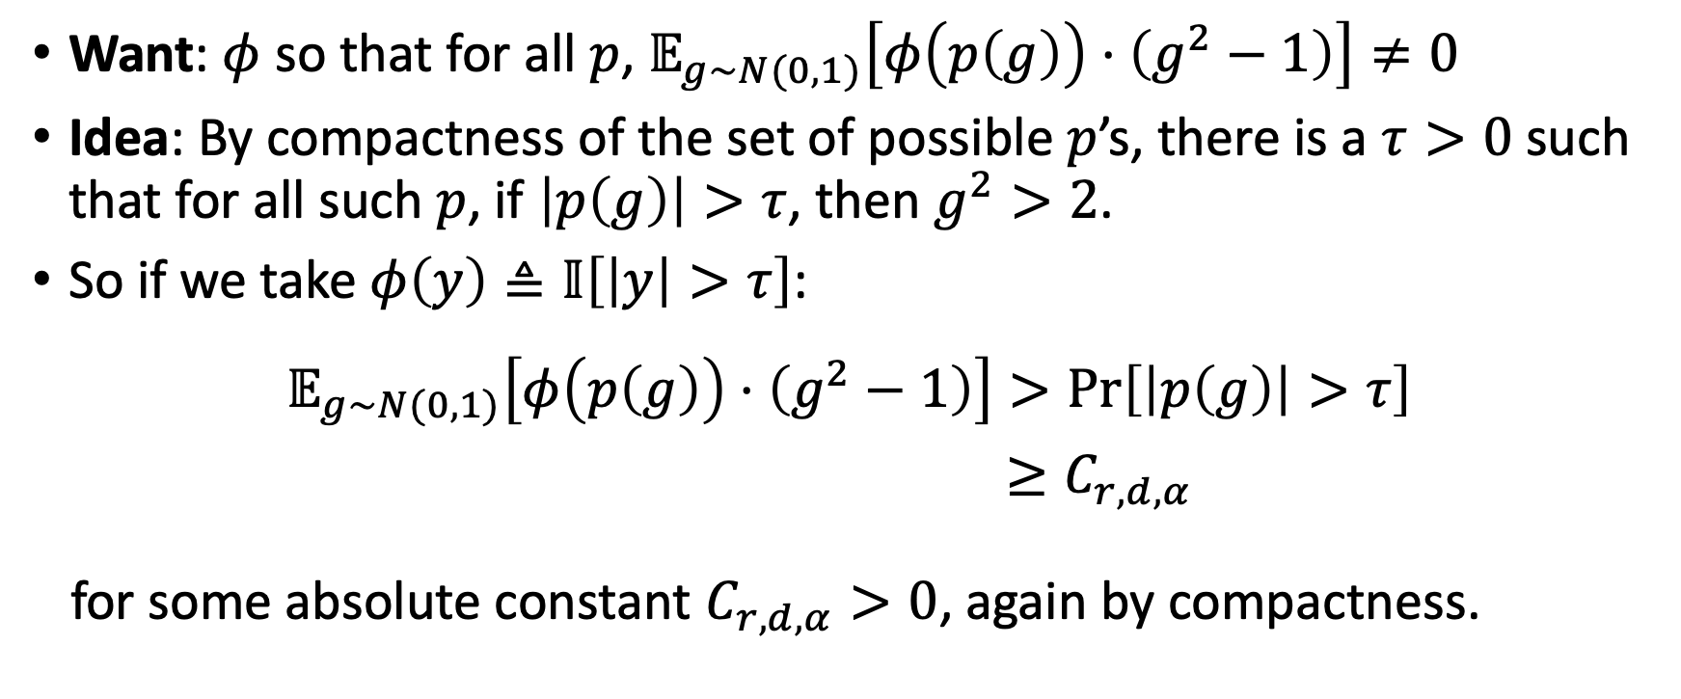
GETTING A WARM START ($r=1$)
Want: $φ$ so that for all $p$, $𝔼_{g∼N(0,1)}\left[φ\left(p\left(g\right)\right)⋅\left(g^{2}−1\right)\right]≠0$
Idea: By compactness of the set of possible $p$’s, there is a $τ>0$ such that for all such $p$, if $\left|p\left(g\right)\right|>τ$, then $g^{2}>2$.
So if we take $φ\left(y\right)≜𝕀\left[\left|y\right|>τ\right]$:
$$𝔼_{g∼N(0,1)}\left[φ\left(p\left(g\right)\right)⋅\left(g^{2}−1\right)\right]>\operatorname{Pr}\left[\left|p\left(g\right)\right|>τ\right]$$
$≥C_{r,d,α}$
for some absolute constant $C_{r,d,α}>0$, again by compactness.

Slide 11
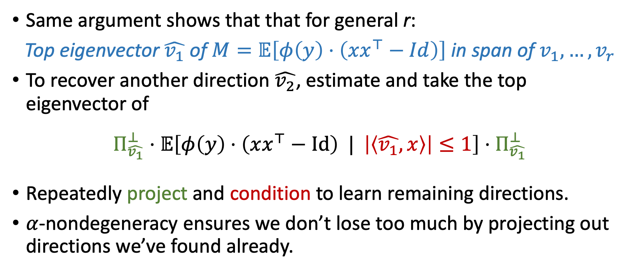

GETTING A WARM START (general $r$)
Same argument shows that that for general r:
Top eigenvector $\hat{v_{1}}$ of $M=𝔼\left[φ\left(y\right)⋅\left(xx^{⊤}−Id\right)\right]$ in span of $v_{1},…,v_{r}$
To recover another direction $\hat{v_{2}}$, estimate and take the top eigenvector of
$$Π_{\hat{v_{1}}}^{⊥}⋅𝔼\left[φ\left(y\right)⋅\left(xx^{⊤}−Id\right) | \left|\left\langle \hat{v_{1}},x\right\rangle \right|≤1\right]⋅Π_{\hat{v_{1}}}^{⊥}$$
Repeatedly project and condition to learn remaining directions.
$α$-nondegeneracy ensures we don’t lose too much by projecting out directions we’ve found already.

Slide 12
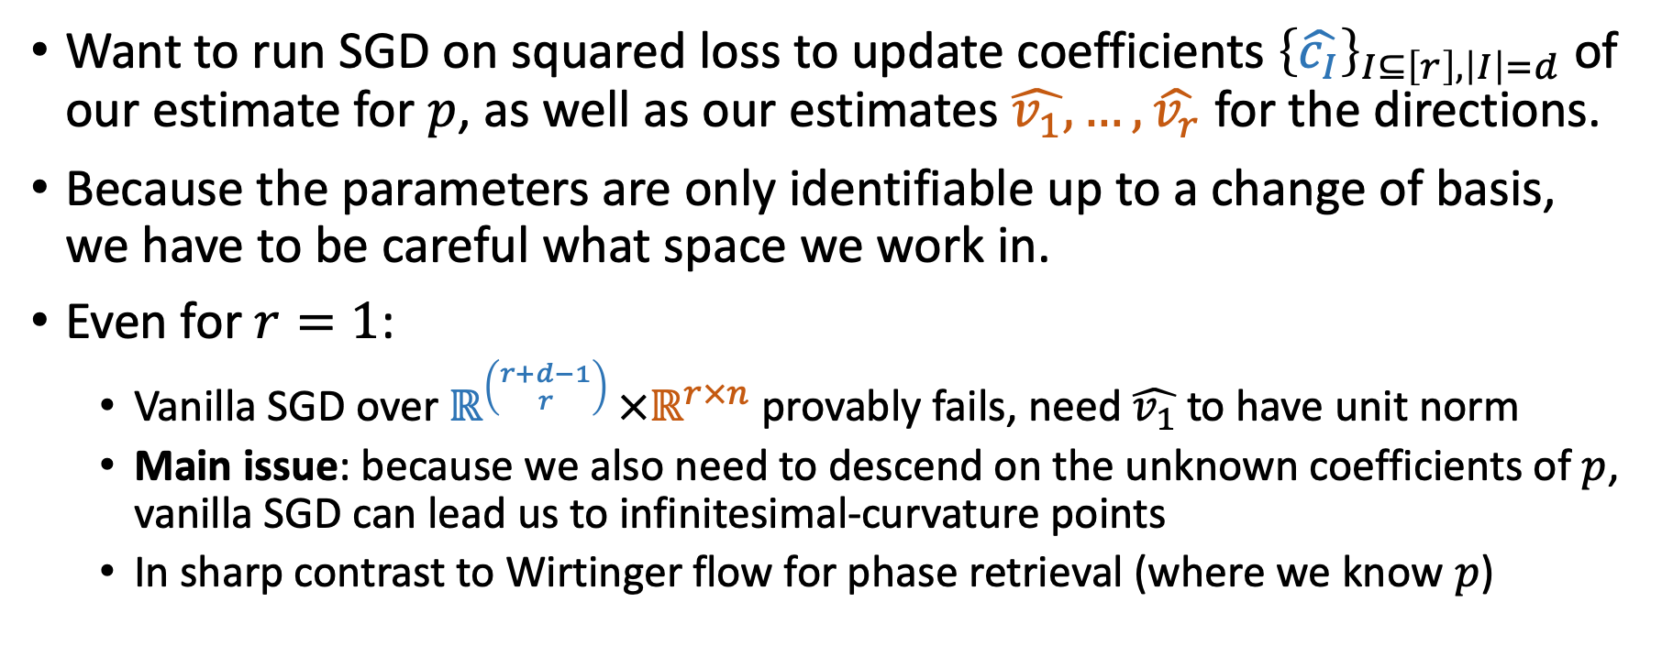
BOOSTING FROM A WARM START
Want to run SGD on squared loss to update coefficients ${\left\{\hat{c_{I}}\right\}}_{I⊆\left[r\right], \left|I\right|=d}$ of our estimate for $p$, as well as our estimates $\hat{v_{1}},…,\hat{v_{r}}$ for the directions.
Because the parameters are only identifiable up to a change of basis, we have to be careful what space we work in.
Even for $r=1$:
  Vanilla SGD over $ℝ^{\left({r+d−1 \atop r}\right) }×ℝ^{r×n}$ provably fails, need $\hat{v_{1}}$ to have unit norm
  Main issue: because we also need to descend on the unknown coefficients of $p$, vanilla SGD can lead us to infinitesimal-curvature points
  In sharp contrast to Wirtinger flow for phase retrieval (where we know $p$)

Slide 13


DESCENDING ON THE GRASSMANNIAN
In general, must maintain the invariant that:
$\hat{v_{1}},…,\hat{v_{r}}$ always form an orthonormal basis, i.e. represent a point on Grassmannian $G(n,r)$ of $r$-dimensional subspaces of $ℝ^{n}$
To maintain this: move iterates for $\hat{v_{1}},…,\hat{v_{r}}$along geodesics of $G\left(n,r\right)$
  Form stochastic gradient of squared loss at current iterate V
  Project the gradient onto tangent space at V
  Walk distance $η$ along the geodesic with
    Starting point: V
    Velocity: projected gradient
$$V$$

Slide 14
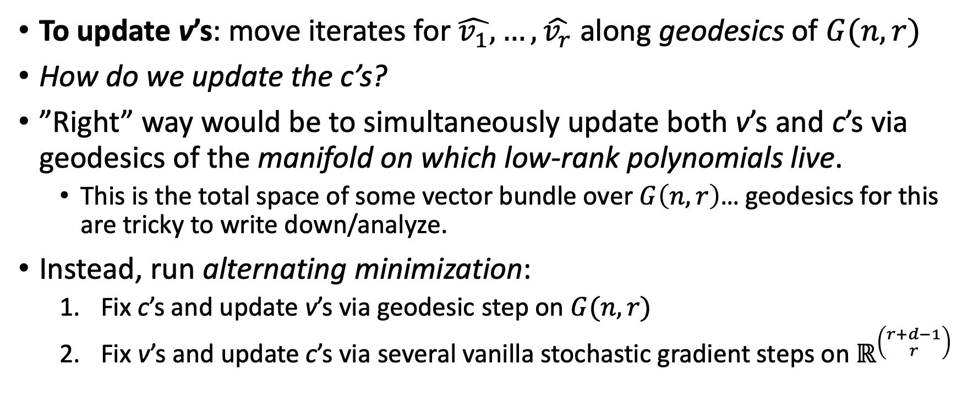
GEODESICS + ALTERNATING MINIMIZATION
To update v’s: move iterates for $\hat{v_{1}},…,\hat{v_{r}}$along geodesics of $G(n,r)$
How do we update the c’s?
”Right” way would be to simultaneously update both v’s and c’s via geodesics of the manifold on which low-rank polynomials live.
  This is the total space of some vector bundle over $G\left(n,r\right)$… geodesics for this are tricky to write down/analyze.
Instead, run alternating minimization:
  Fix c’s and update v’s via geodesic step on $G(n,r)$
  Fix v’s and update c’s via several vanilla stochastic gradient steps on $ℝ^{\left({r+d−1 \atop r}\right) }$

Slide 15
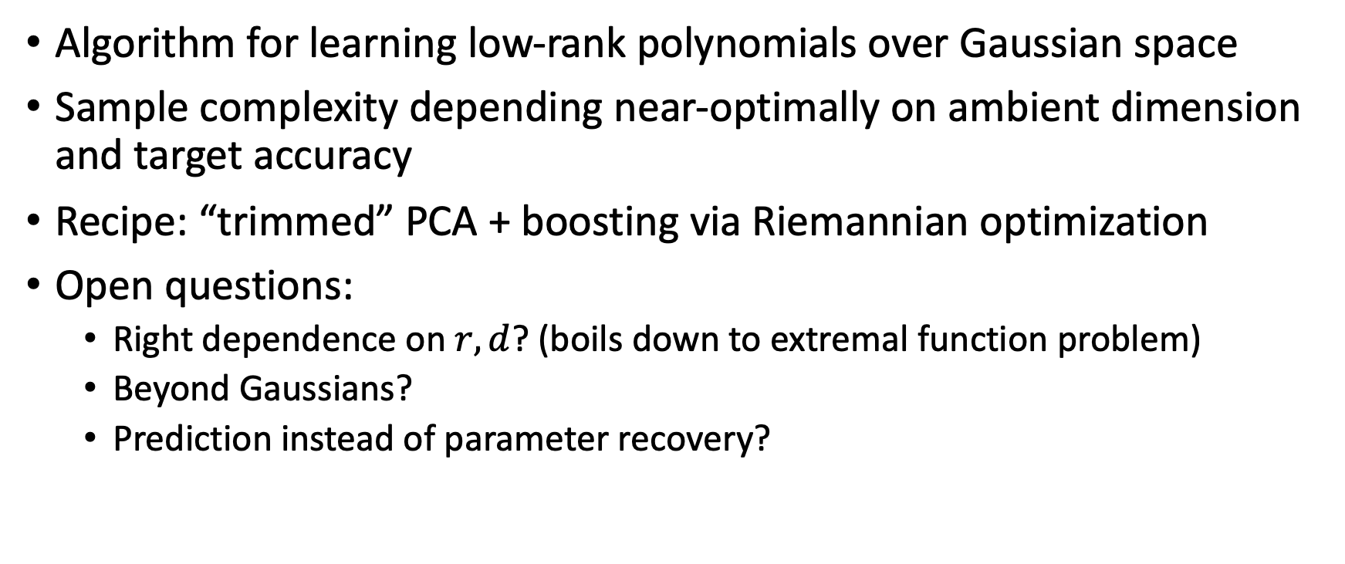
CONCLUSION
Algorithm for learning low-rank polynomials over Gaussian space
Sample complexity depending near-optimally on ambient dimension and target accuracy
Recipe: “trimmed” PCA + boosting via Riemannian optimization
Open questions:
  Right dependence on $r,d$? (boils down to extremal function problem)
  Beyond Gaussians?
  Prediction instead of parameter recovery?

Slide 16
Thanks!

