Slide 1
THE COMPLEXITY OF LEARNING GENERATIVE MODELS
SITAN CHEN UC BERKELEY
CCSI REUNION

Slide 2
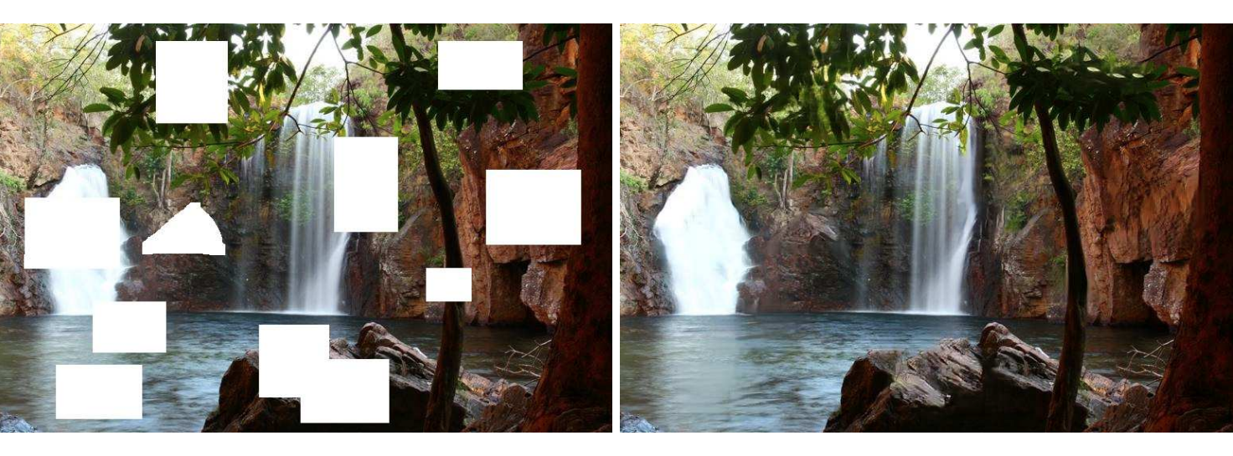
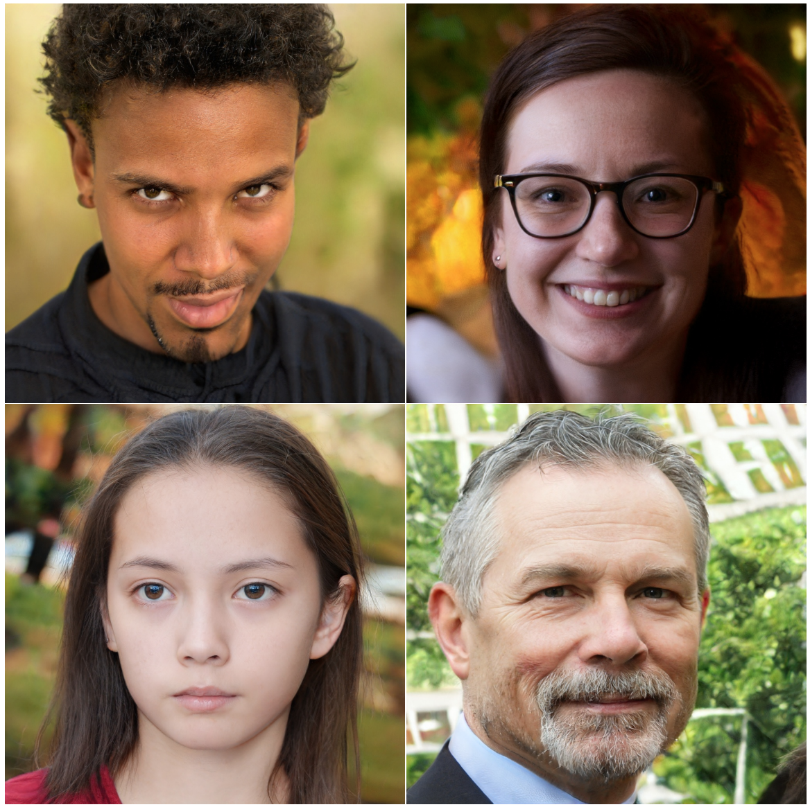
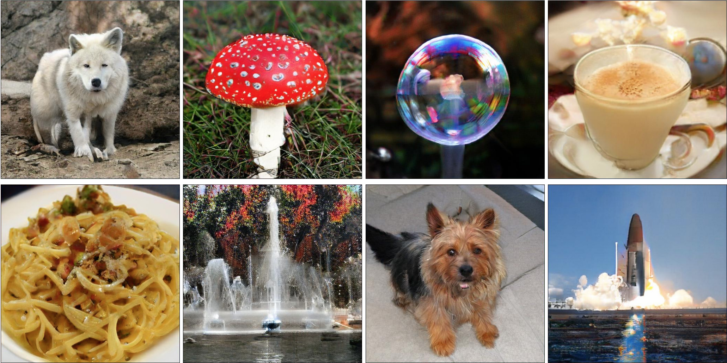
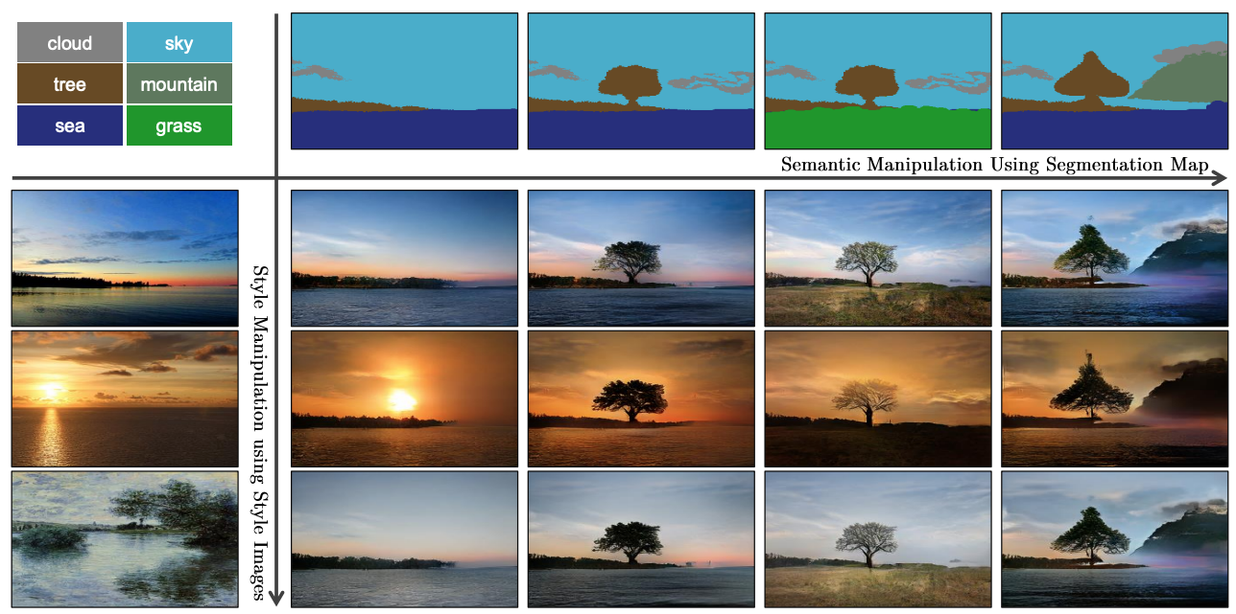
DEEP GENERATIVE MODELS
Powerful framework for modeling real-world, high-dimensional distributions
[Yu-Lin-Yang-Shen-Lu-Huang ‘18]
[Brock-Donahue-Simonyan ’18]
[Karras-Laine-Aittala-Hellsten-Lehtinen-Aila ’19]
[Park-Liu-Wang-Zhu ’19]

Slide 3



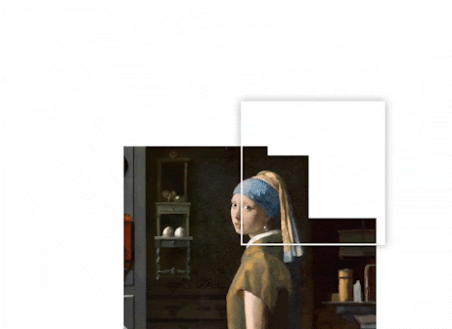


DEEP GENERATIVE MODELS
Powerful framework for modeling real-world, high-dimensional distributions
Idea: pushforwards of
simple distributions, e.g.
Gaussian, under neural networks are
highly expressive
(heuristically) easy to optimize over

Slide 4
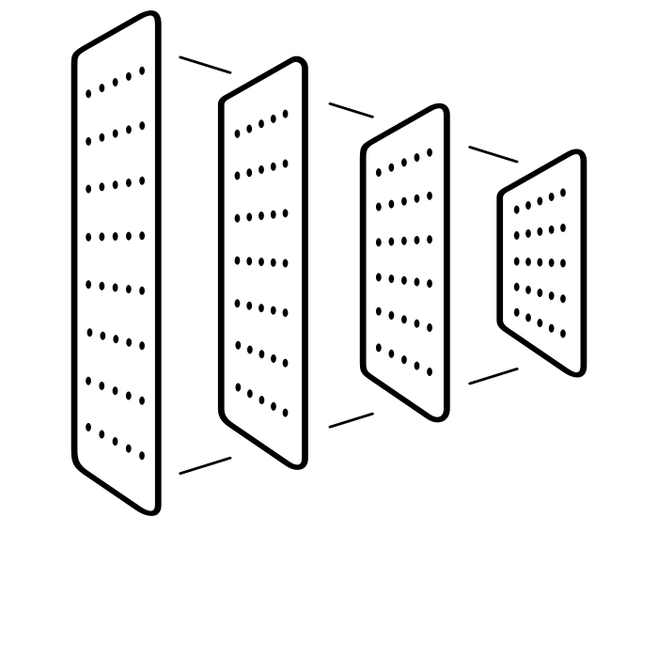
DEEP GENERATIVE MODELS
$$x$$
$F:ℝ^{r}→ℝ^{d}$: parametric function (e.g. a neural network)
Goal: given samples from some real-world distribution $D$, produce $F$ for which the pushforward $F(N\left(0,Id\right))$ $≈D$
To sample from $F\left(N\left(0,Id\right)\right)$:
Nature samples $g∼N(0,Id)$
We observe $x=F\left(g\right)$
$$g$$
$$F$$

Slide 5
DEEP GENERATIVE MODELS
$$x$$
$F:ℝ^{r}→ℝ^{d}$: parametric function (e.g. a neural network)
Goal: given samples from some real-world distribution $D$, produce $F$ for which the pushforward $F(N\left(0,Id\right))$ $≈D$
E.g., GANs try to do this by solving
$$g$$
$$\min_{F}{\max_{A}\left|𝔼_{x∼D}\left[A\left(x\right)\right] −𝔼_{x∼F(N\left(0,Id\right))}[A\left(x\right)]\right|}$$
$$F$$
“Discriminator”

Slide 6
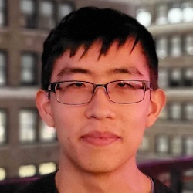
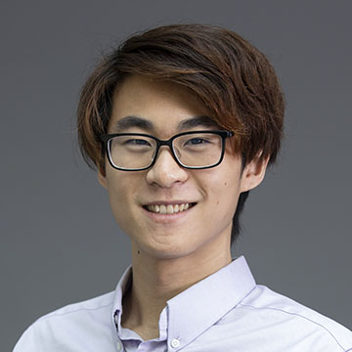
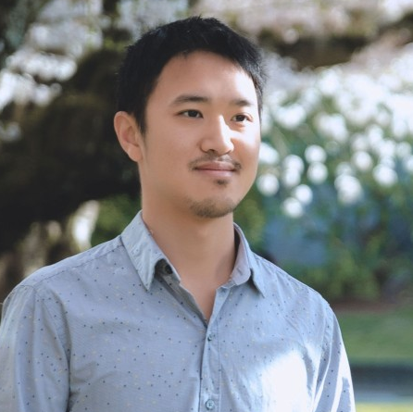
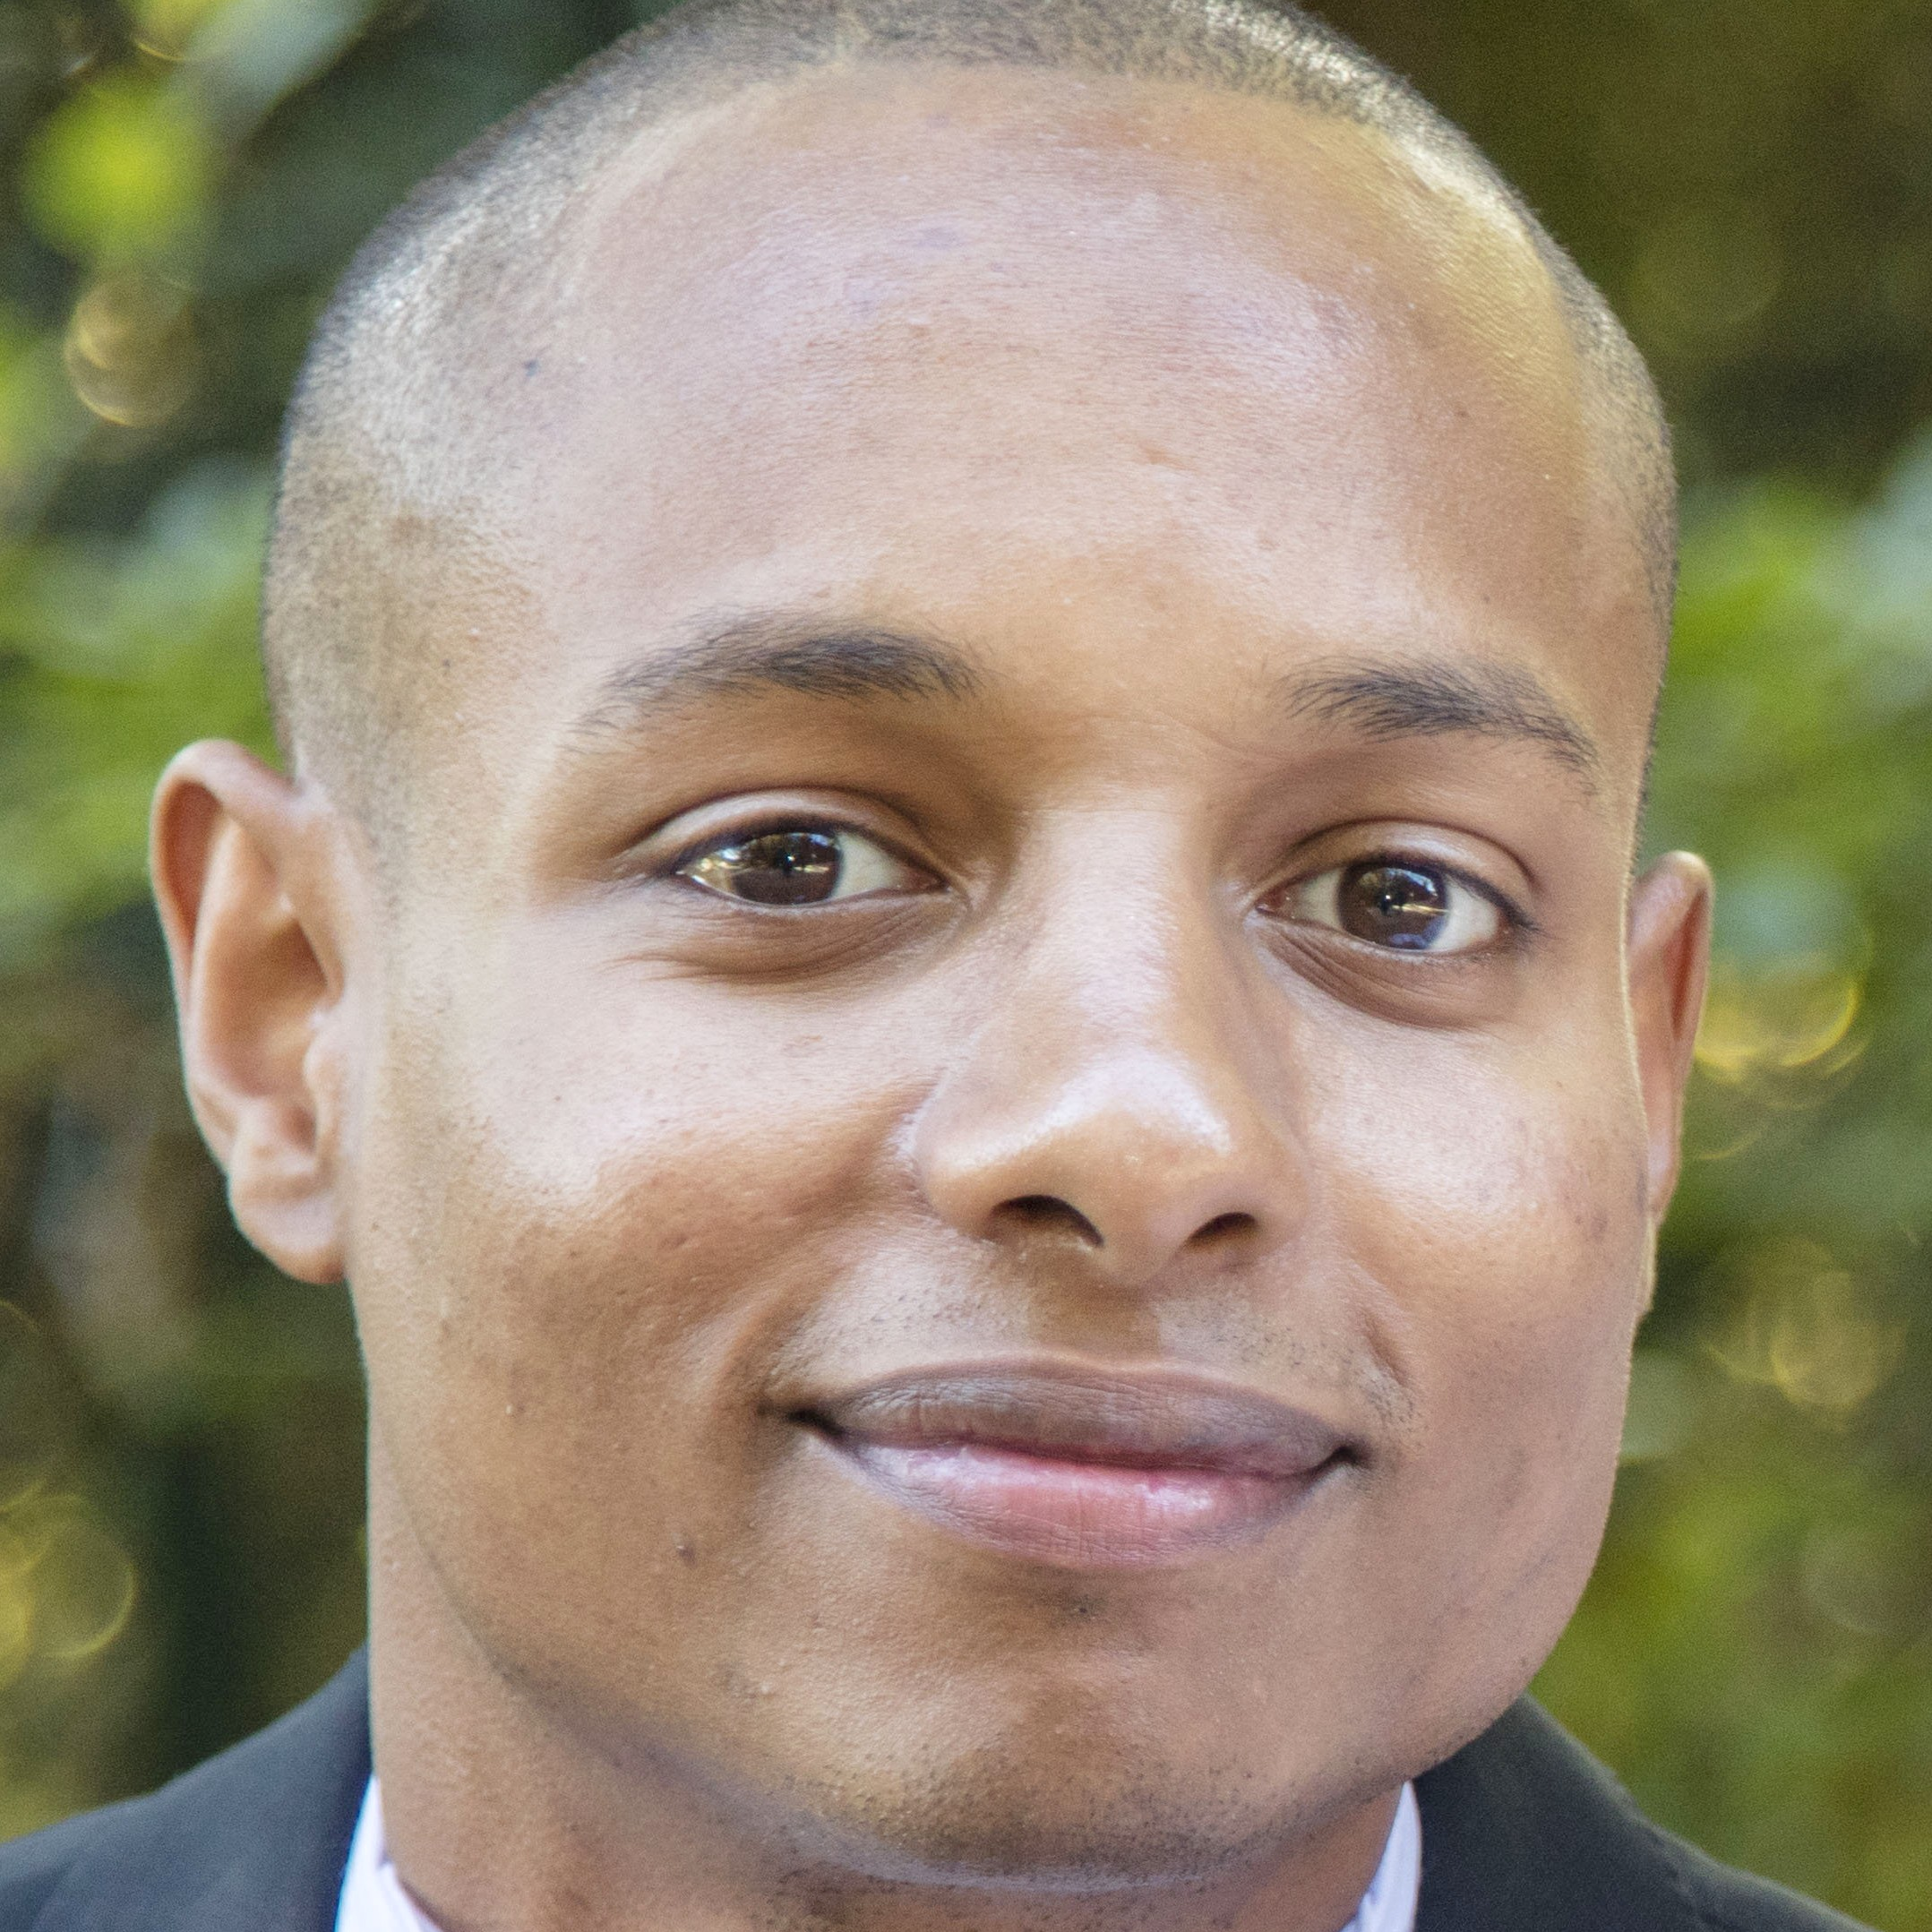
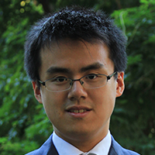
THIS TALK
Diffusion models: General reduction from distribution learning to a supervised learning task (“score estimation”)
  joint w/ Sinho Chewi, Jerry Li, Yuanzhi Li, Adil Salim, Anru Zhang: Sampling is as easy as learning the score: theory for diffusion models with minimal data assumptions.
SQ lower bound: Hardness for learning pushforwards of Gaussians
  joint w/ Jerry Li, Yuanzhi Li: Learning (very) simple generative models is hard.

Slide 7
DIFFUSION MODELS
Crash course
Prior work / our results
Proof sketch
SQ HARDNESS
Setup / prior work
Lower bound
TAKEAWAYS

Slide 8
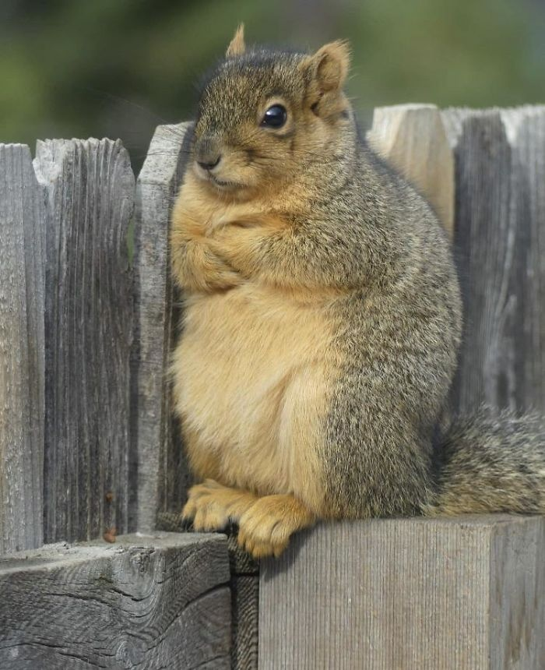
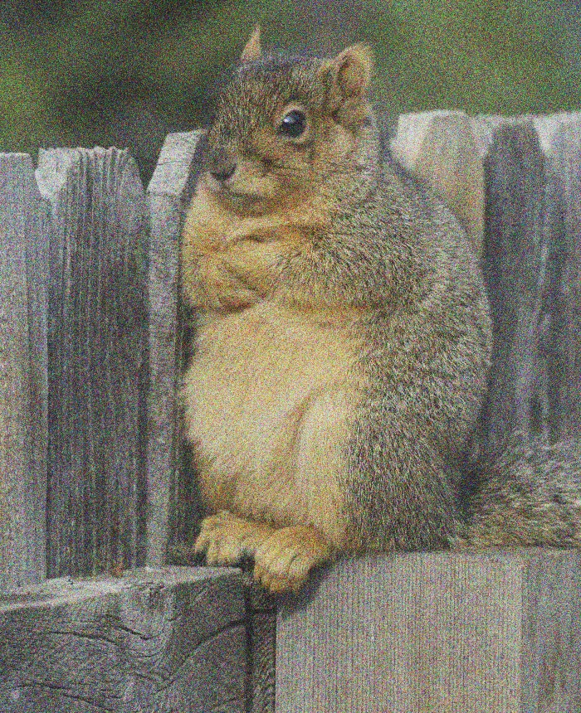
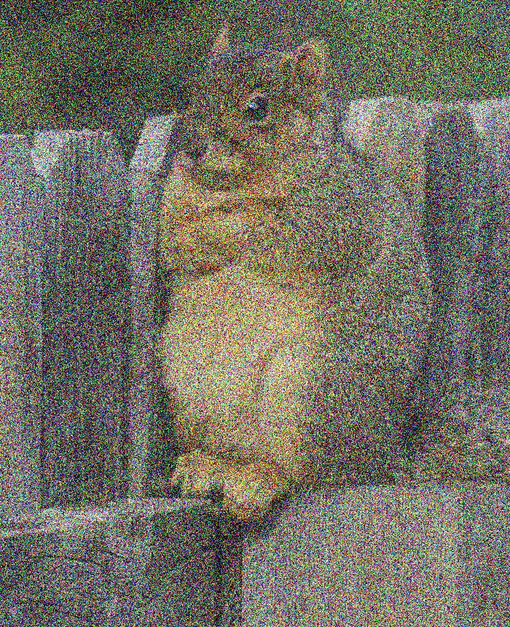
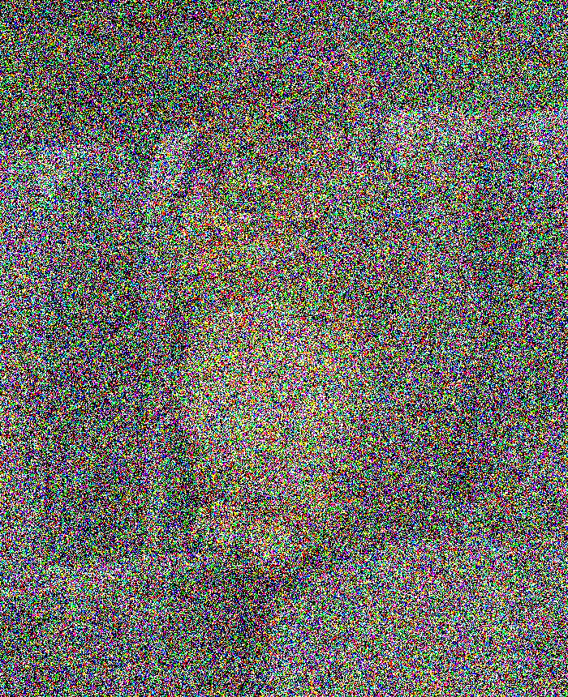

DIFFUSION MODELS
Forward process
$$t=0$$
$$t=∞$$
$$X_{t}=e^{−t}⋅X_{0}+\sqrt{1−e^{−2t}}⋅γ$$
$$dX_{t}=−X_{t}+\sqrt{2}dB_{t}$$
$X_{0}∼q$ (data distribution)
$$N\left(0,Id\right)$$

Slide 9
DIFFUSION MODELS
$$q_{0}=q$$
$$q_{t}$$
Forward process
$$t=0$$
$$t=∞$$
$$dX_{t}=−X_{t} dt+\sqrt{2} dB_{t}$$
$X_{0}∼q$ (data distribution)

Slide 10
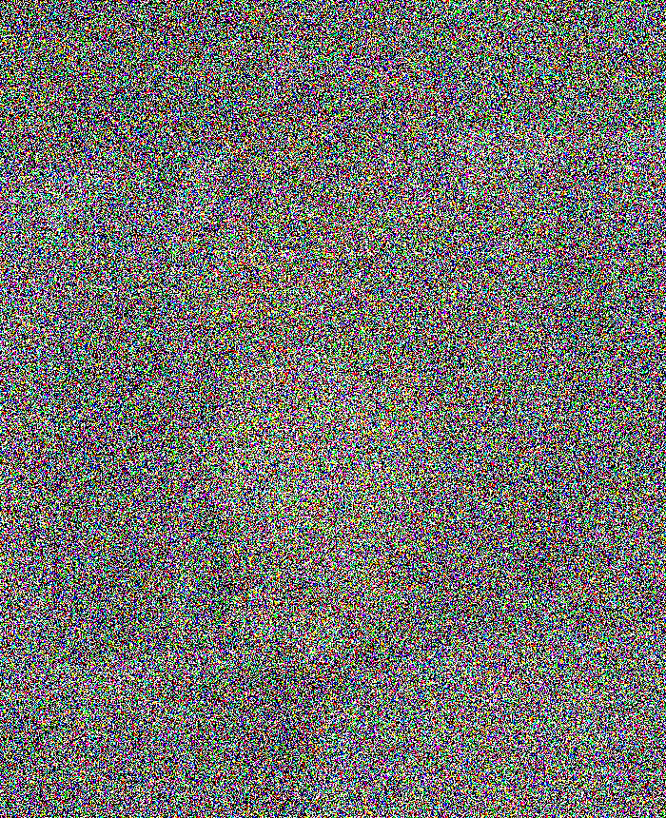
DIFFUSION MODELS
$$q_{0}=q$$
$$q_{t}$$
Forward process
$$t=0$$
$$t=T$$
$$dX_{t}=−X_{t} dt+\sqrt{2} dB_{t}$$
$X_{0}∼q$ (data distribution)
in practice, can only run for finite time

Slide 11
DIFFUSION MODELS
$$q_{T}$$
$$q_{T−t}$$
$$q_{0}=q$$
Reverse process
$$t=0$$
$$t=T$$
$$dX_{t}^{←}=\left\{X_{t}^{←}+2∇ ln q_{T−t}\left(X_{t}^{←}\right)\right\} dt+\sqrt{2} dB_{t}$$
$X_{0}^{←}∼q_{T}$ (forward process at time $T$)

Slide 12
DIFFUSION MODELS
Sources of error:
Initialize at Gaussian instead of $q_{T}$
To sample fresh images, run reverse process w/ Gaussian initialization
initialize at pure Gaussian
$$t=0$$
$$t=T$$
$$dX_{t}^{←}=\left\{X_{t}^{←}+2∇ ln q_{T−t}\left(X_{t}^{←}\right)\right\} dt+\sqrt{2} dB_{t}$$
$X_{0}^{←}∼q_{T}$ (forward process at time $T$)

Slide 13
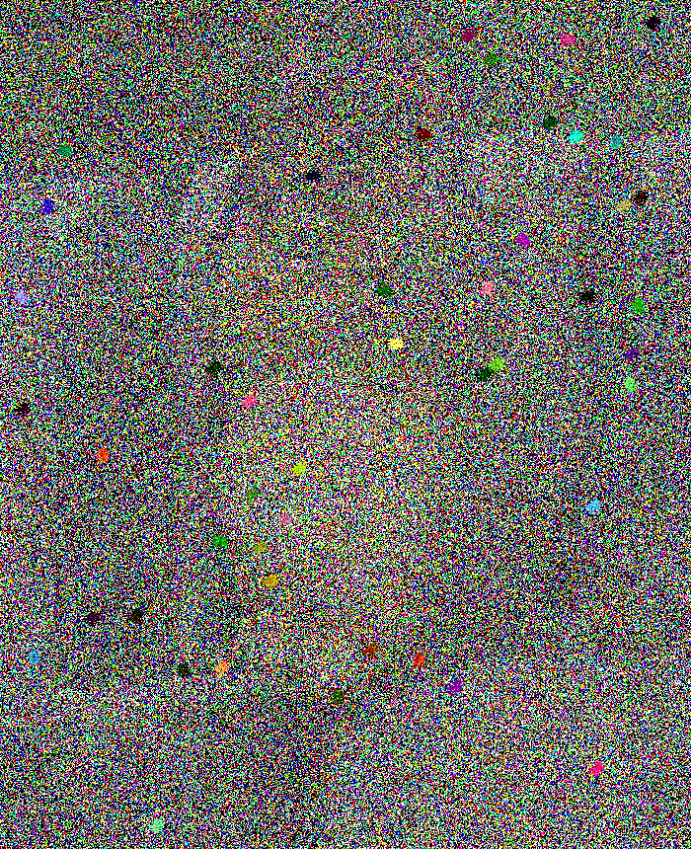
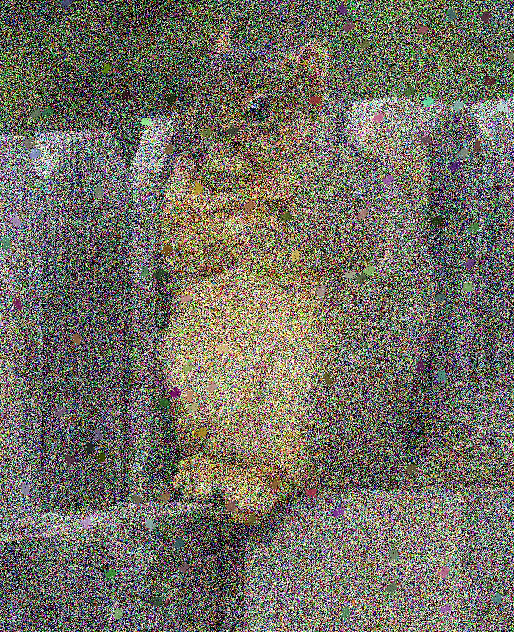
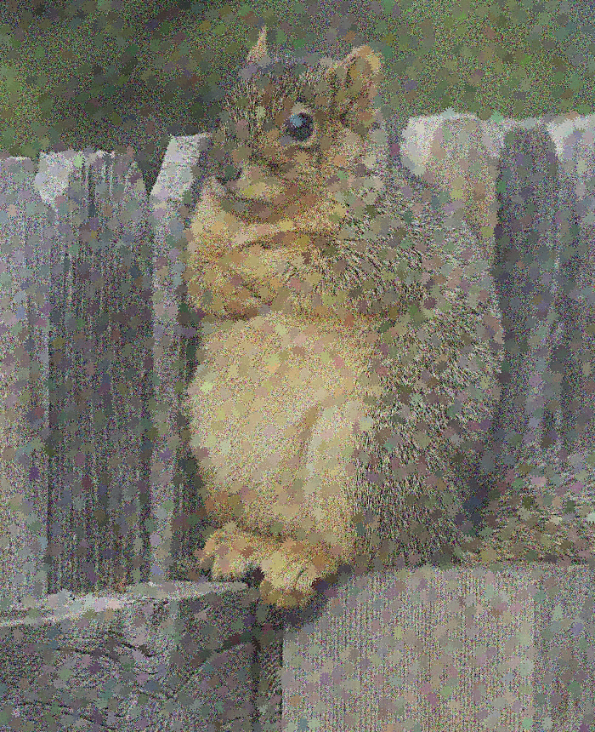
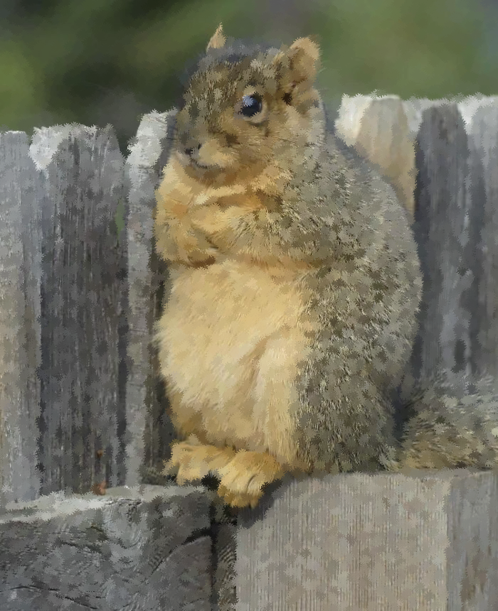
DIFFUSION MODELS
Sources of error:
Initialize at Gaussian instead of $q_{T}$
To sample fresh images, run reverse process w/ Gaussian initialization
initialize at pure Gaussian
$$t=0$$
$$t=T$$
$$dX_{t}^{←}=\left\{X_{t}^{←}+2∇ ln q_{T−t}\left(X_{t}^{←}\right)\right\} dt+\sqrt{2} dB_{t}$$
$X_{0}^{←}∼q_{T}$ (forward process at time $T$)

Slide 14

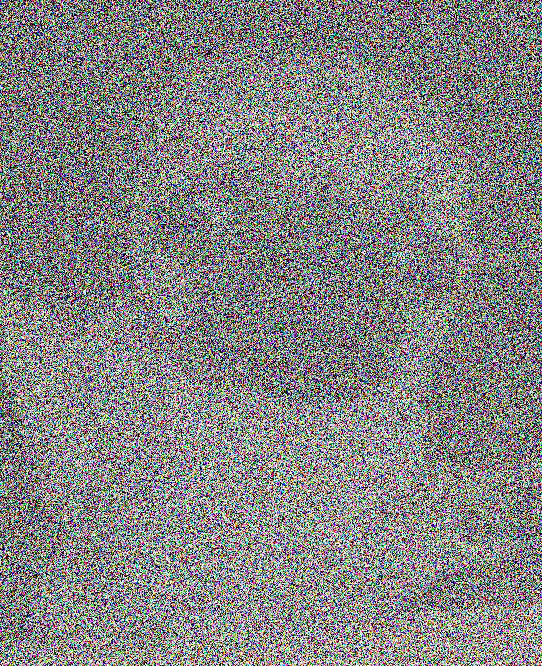
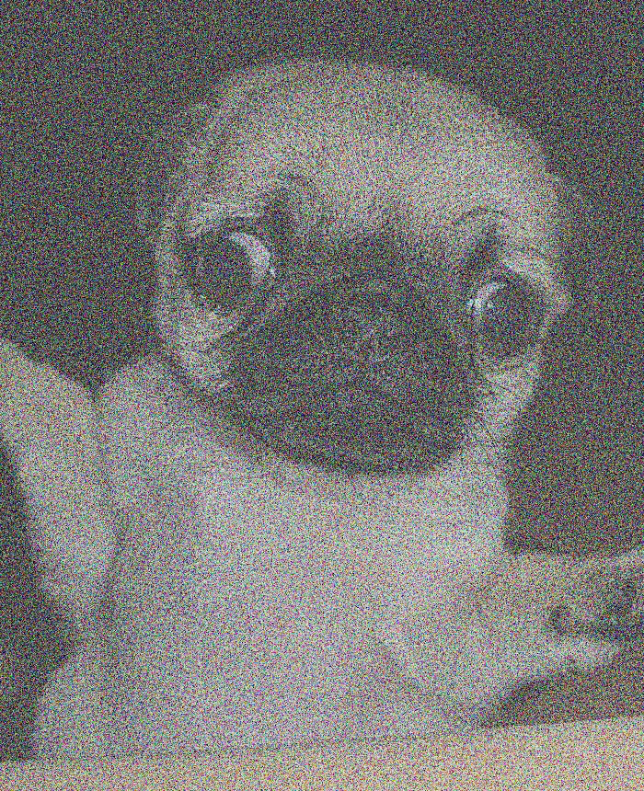
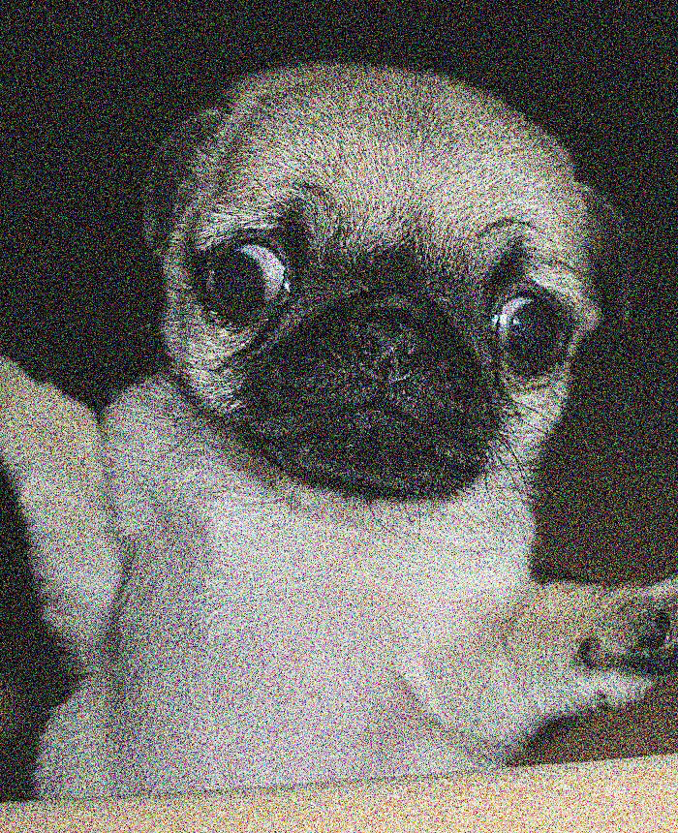
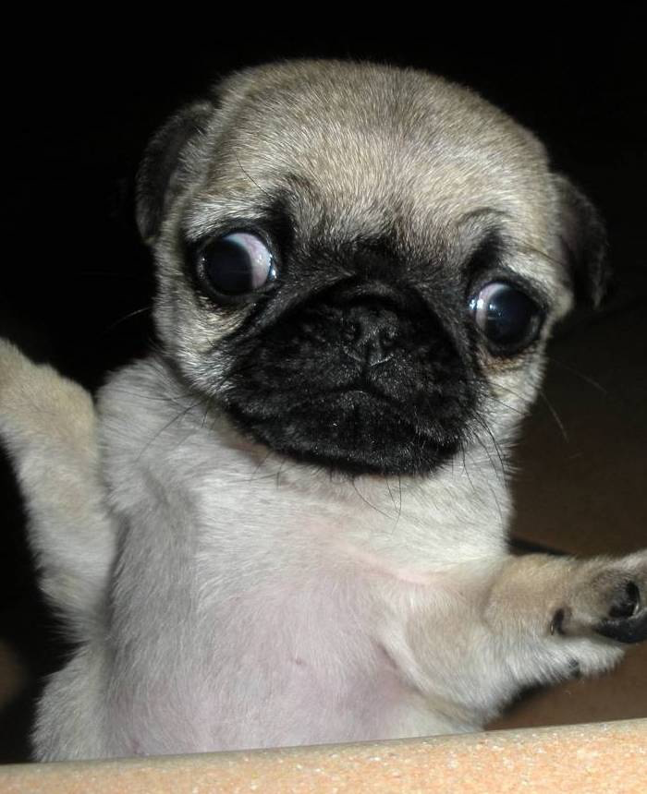
DIFFUSION MODELS
Sources of error:
Initialize at Gaussian instead of $q_{T}$
To sample fresh images, run reverse process w/ Gaussian initialization
initialize at pure Gaussian
$$t=0$$
$$t=T$$
$$dX_{t}^{←}=\left\{X_{t}^{←}+2∇ ln q_{T−t}\left(X_{t}^{←}\right)\right\} dt+\sqrt{2} dB_{t}$$
$X_{0}^{←}∼q_{T}$ (forward process at time $T$)

Slide 15
DIFFUSION MODELS
Sources of error:
Initialize at Gaussian instead of $q_{T}$
To sample fresh images, run reverse process w/ Gaussian initialization
initialize at pure Gaussian
$$t=0$$
$$t=T$$
“score function”
we don’t have access to this!
$$dX_{t}^{←}=\left\{X_{t}^{←}+2∇ ln q_{T−t}\left(X_{t}^{←}\right)\right\} dt+\sqrt{2} dB_{t}$$
$X_{0}^{←}∼q_{T}$ (forward process at time $T$)

Slide 16
SCORE MATCHING
Sources of error:
Initialize at Gaussian instead of $q_{T}$
Idea [Hyvarinen ‘05, Vincent ‘11, Song-Ermon ’19]:
reduce estimating the score function to a supervised learning task
$\min_{s}{𝔼_{q_{t}}{\left\|s\left(X_{t}\right)−∇\ln{q_{t}\left(X_{t}\right)}\right\|}^{2}}$

Slide 17
SCORE MATCHING
Sources of error:
Initialize at Gaussian instead of $q_{T}$
Idea [Hyvarinen ‘05, Vincent ‘11, Song-Ermon ’19]:
reduce estimating the score function to a supervised learning task
$\min_{s}{𝔼_{q_{t}}{\left\|s\left(X_{t}\right)\right\|}^{2}−2⋅\left\langle s\left(X_{t}\right),∇ ln q_{t}\left(X_{t}\right)\right\rangle +{\left\|∇\ln{q_{t}\left(X_{t}\right)}\right\|}^{2}}$

Slide 18
SCORE MATCHING
Sources of error:
Initialize at Gaussian instead of $q_{T}$
Idea [Hyvarinen ‘05, Vincent ‘11, Song-Ermon ’19]:
reduce estimating the score function to a supervised learning task
$\min_{s}{𝔼_{q_{t}}{\left\|s\left(X_{t}\right)\right\|}^{2}−2⋅⟨s\left(X_{t}\right),∇ ln q_{t}\left(X_{t}\right)⟩}$
$$∫\left\langle s,∇ ln q_{t}\right\rangle dq_{t}$$

Slide 19
SCORE MATCHING
Sources of error:
Initialize at Gaussian instead of $q_{T}$
Idea [Hyvarinen ‘05, Vincent ‘11, Song-Ermon ’19]:
reduce estimating the score function to a supervised learning task
$\min_{s}{𝔼_{q_{t}}{\left\|s\left(X_{t}\right)\right\|}^{2}−2⋅⟨s\left(X_{t}\right),∇ ln q_{t}\left(X_{t}\right)⟩}$
$$∫\left\langle s,∇ ln q_{t}\right\rangle dq_{t}$$ | $$=∫\left\langle s,∇q_{t}\right\rangle$$

Slide 20
SCORE MATCHING
Sources of error:
Initialize at Gaussian instead of $q_{T}$
Idea [Hyvarinen ‘05, Vincent ‘11, Song-Ermon ’19]:
reduce estimating the score function to a supervised learning task
$\min_{s}{𝔼_{q_{t}}{\left\|s\left(X_{t}\right)\right\|}^{2}−2⋅⟨s\left(X_{t}\right),∇ ln q_{t}\left(X_{t}\right)⟩}$
$$∫\left\langle s,∇ ln q_{t}\right\rangle dq_{t}$$ | $$=∫\left\langle s,∇q_{t}\right\rangle$$
integration by parts | $$=−∫\left(div s\right) dq_{t}$$

Slide 21
SCORE MATCHING
Sources of error:
Initialize at Gaussian instead of $q_{T}$
Idea [Hyvarinen ‘05, Vincent ‘11, Song-Ermon ’19]:
reduce estimating the score function to a supervised learning task
$\min_{s}{𝔼_{q_{t}}{\left\|s\left(X_{t}\right)\right\|}^{2}−2⋅⟨s\left(X_{t}\right),∇ ln q_{t}\left(X_{t}\right)⟩}$
$$∫\left\langle s,∇ ln q_{t}\right\rangle dq_{t}$$ | $$=∫\left\langle s,∇q_{t}\right\rangle$$
integration by parts | $$=−∫\left(div s\right) dq_{t}$$
 | $$=−∬\left(div s\right)(e^{−t} X_{0}+\sqrt{1−e^{−2t}} γ) dq\left(X_{0}\right)dγ$$

Slide 22
SCORE MATCHING
Sources of error:
Initialize at Gaussian instead of $q_{T}$
Idea [Hyvarinen ‘05, Vincent ‘11, Song-Ermon ’19]:
reduce estimating the score function to a supervised learning task
$\min_{s}{𝔼_{q_{t}}{\left\|s\left(X_{t}\right)\right\|}^{2}−2⋅⟨s\left(X_{t}\right),∇ ln q_{t}\left(X_{t}\right)⟩}$
$$∫\left\langle s,∇ ln q_{t}\right\rangle dq_{t}$$ | $$=∫\left\langle s,∇q_{t}\right\rangle$$
integration by parts | $$=−∫\left(div s\right) dq_{t}$$
 | $$=−∬\left(div s\right)(e^{−t} X_{0}+\sqrt{1−e^{−2t}} γ) dq\left(X_{0}\right)dγ$$
Stein’s lemma $\int{\left(div v\right)dγ}=\int{\left\langle γ,v\left(γ\right)\right\rangle dγ}$ | $$=$$
$−\frac{1}{\sqrt{1−e^{−2t}}}∫\left\langle γ,s\left(X_{t}\right)\right\rangle dq\left(X_{0}\right)dγ$

Slide 23
SCORE MATCHING
Sources of error:
Initialize at Gaussian instead of $q_{T}$
Idea [Hyvarinen ‘05, Vincent ‘11, Song-Ermon ’19]:
reduce estimating the score function to a supervised learning task
$\min_{s}{𝔼_{q_{t}}{\left\|s\left(X_{t}\right)\right\|}^{2}}−2⋅$
$− 2⋅⟨s\left(X_{t}\right),∇ ln q_{t}\left(X_{t}\right)⟩$
$$∫\left\langle s,∇ ln q_{t}\right\rangle dq_{t}$$ | $$=∫\left\langle s,∇q_{t}\right\rangle$$
integration by parts | $$=−∫\left(div s\right) dq_{t}$$
 | $$=−∬\left(div s\right)(e^{−t} X_{0}+\sqrt{1−e^{−2t}} γ) dq\left(X_{0}\right)dγ$$
Stein’s lemma $\int{\left(div v\right)dγ}=\int{\left\langle γ,v\left(γ\right)\right\rangle dγ}$ | $$=$$
$−\frac{1}{\sqrt{1−e^{−2t}}}𝔼_{q_{t}}\left\langle γ,s\left(X_{t}\right)\right\rangle$

Slide 24
SCORE MATCHING
Sources of error:
Initialize at Gaussian instead of $q_{T}$
Idea [Hyvarinen ‘05, Vincent ‘11, Song-Ermon ’19]:
reduce estimating the score function to a supervised learning task
$\min_{s}{𝔼_{q_{t}}{\left\|s\left(X_{t}\right)\right\|}^{2}}−2⋅$
$\left(−\frac{1}{\sqrt{1−e^{−2t}}}𝔼_{q_{t}}\left\langle γ,s\left(X_{t}\right)\right\rangle \right)$
$−\frac{1}{\sqrt{1−e^{−2t}}}𝔼_{q_{t}}\left\langle γ,s\left(X_{t}\right)\right\rangle$

Slide 25
SCORE MATCHING
Sources of error:
Initialize at Gaussian instead of $q_{T}$
Idea [Hyvarinen ‘05, Vincent ‘11, Song-Ermon ’19]:
reduce estimating the score function to a supervised learning task
$\min_{s}{𝔼_{q_{t}}{\left\|s\left(X_{t}\right)+\frac{1}{\sqrt{1−e^{−2t}}}γ\right\|}^{2}}$

Slide 26
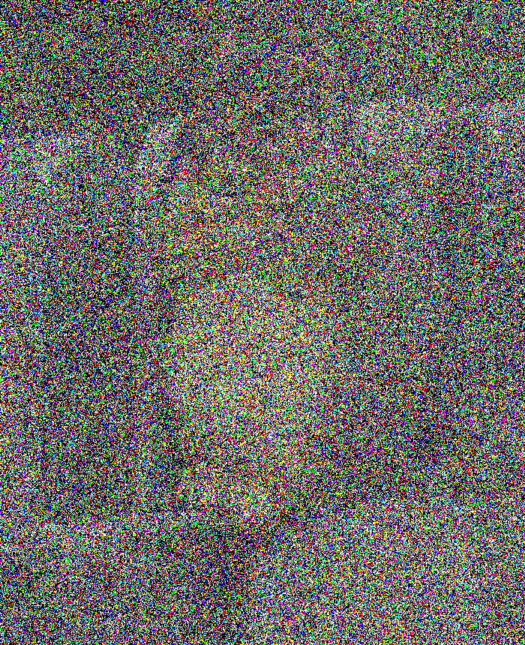
SCORE MATCHING
Sources of error:
Initialize at Gaussian instead of $q_{T}$
Idea [Hyvarinen ‘05, Vincent ‘11, Song-Ermon ’19]:
reduce estimating the score function to a supervised learning task
$\min_{s}{𝔼_{q_{t}}{\left\|s\left(X_{t}\right)−γ\right\|}^{2}}$
Interpretation: given noisy image $X_{t}$, predict noise $γ$ that was added
Fit neural net to
training examples
drawn from $q_{t}$:

Slide 27
SCORE MATCHING
Sources of error:
Initialize at Gaussian instead of $q_{T}$
Score estimation error
Still far from rigorously understanding why neural nets can solve such supervised tasks well... We will just take on faith that they can ☺
Assumption: For all $t$, score estimate $s_{t}\left(⋅\right)$ satisfies
$$𝔼_{q_{t}}\left[{\left\|s_{t}\left(X_{t}\right)−∇\ln{q_{t}\left(X_{t}\right)}\right\|}^{2}\right]≤ε_{sc}^{2}$$
Fit neural net to
training examples
drawn from $q_{t}$:

Slide 28
DIFFUSION MODELS
Sources of error:
Initialize at Gaussian instead of $q_{T}$
Score estimation error
Reverse process (in practice)
initialize at pure Gaussian
$$t=0$$
$$t=T$$
$$dX_{t}^{←}=\left\{X_{t}^{←}+2∇ ln q_{T−t}\left(X_{t}^{←}\right)\right\} dt+\sqrt{2} dB_{t}$$
$X_{0}^{←}∼q_{T}$ (forward process at time $T$)

Slide 29
DIFFUSION MODELS
Sources of error:
Initialize at Gaussian instead of $q_{T}$
Score estimation error
Reverse process (in practice)
initialize at pure Gaussian
$$t=0$$
$$t=T$$
can’t train infinitely many neural nets, need to discretize
$$dX_{t}^{←}=\left\{X_{t}^{←}+2s_{T−t}\left(X_{t}^{←}\right)\right\} dt+\sqrt{2} dB_{t}$$
$X_{0}^{←}∼q_{T}$ (forward process at time $T$)

Slide 30
DIFFUSION MODELS
Sources of error:
Initialize at Gaussian instead of $q_{T}$
Score estimation error
Reverse process (in practice)
initialize at pure Gaussian
$$t=h, 2h, 3h, …$$
$$t=0$$
$$t=T$$
can’t train infinitely many neural nets, need to discretize
$$dX_{t}^{←}=\left\{X_{t}^{←}+2s_{T−t}\left(X_{t}^{←}\right)\right\} dt+\sqrt{2} dB_{t}$$
$X_{0}^{←}∼q_{T}$ (forward process at time $T$)

Slide 31
DIFFUSION MODELS
Sources of error:
Initialize at Gaussian instead of $q_{T}$
Score estimation error
Discretization error
Reverse process (in practice)
initialize at pure Gaussian
$$t=h, 2h, 3h, …$$
$$t=0$$
$$t=T$$
$$dX_{t}^{←}=\left\{X_{t}^{←}+2s_{T−kh}\left(X_{kh}^{←}\right)\right\} dt+\sqrt{2} dB_{t}$$
$X_{0}^{←}∼q_{T}$ (forward process at time $T$)
Linear SDE, so can be implemented exactly
$$k=⌊t/h⌋$$

Slide 32
DIFFUSION MODELS
Crash course
Prior work / our results
Proof sketch
SQ HARDNESS
Setup / prior work
Lower bound
TAKEAWAYS

Slide 33
PRIOR WORK
Existing analyses [Block-Mroueh-Rahklin ‘20], [De Bortoli-Thornton-Heng-Doucet ‘21], [De Bortoli ‘22], [Lee-Lu-Tan ‘22], [Pidstrigach ‘22], [Liu-Mu-Ye-Liu ‘22] come with at least one of three limitations:
Exponential dependencies on problem parameters, e.g. dimension
Strong assumptions on $q$, e.g. log-Sobolev inequality
Strong assumptions on score estimate, e.g. pointwise accurate
Can we prove polynomial convergence of diffusion models under minimal assumptions on the data distribution and score estimate?

Slide 34
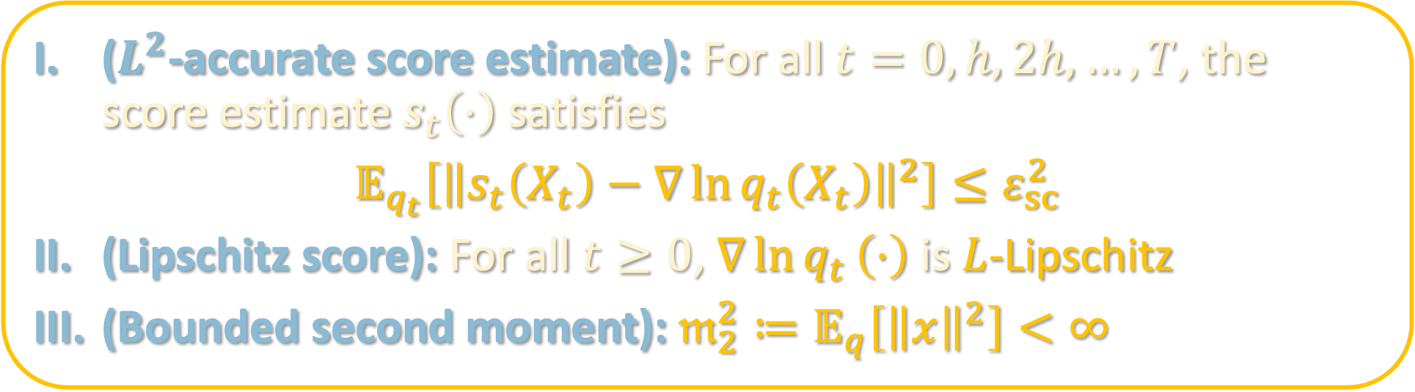
OUR ASSUMPTIONS
($L^{2}$-accurate score estimate): For all $t=0,h,2h,…,T$, the score estimate $s_{t}\left(⋅\right)$ satisfies
$$𝔼_{q_{t}}\left[{\left\|s_{t}\left(X_{t}\right)−∇\ln{q_{t}\left(X_{t}\right)}\right\|}^{2}\right]≤ε_{sc}^{2}$$
(Lipschitz score): For all $t≥0$, $∇\ln{q_{t}}\left(⋅\right)$ is $L$-Lipschitz
(Bounded second moment): $𝔪_{2}^{2}≔𝔼_{q}\left[{\left\|x\right\|}^{2}\right]<∞$
II is standard and necessary to get TV convergence
III is significantly weaker than what is needed in prior work

Slide 35
OUR RESULTS
Thm [C-Chewi-Li-Li-Salim-Zhang ‘22]: Under these assumptions, if $p_{T}$ is the law of the output of the algorithm after $N = T/h$ iterations with step size $h$,
$$TV\left(p_{T},q\right)≲\sqrt{KL(q|\left|γ\right)}⋅\exp\left(−T\right)+\left(L\sqrt{dh}+L𝖒_{2}h\right)\sqrt{T}+ε_{sc}\sqrt{T}$$
error from initializing at $γ$ instead of $q_{T}$
discretization error
score error
If $ε_{sc}≤\tilde{O}\left(ε\right)$, $KL(q|\left|γ\right)≤poly\left(d\right)$, and $𝔪_{2}≲d$,
then $N=\tilde{O}\left(L^{2}d/ε^{2}\right)$ iterations suffice to get $ε$-close in TV.
Matches SOTA discretization bounds for Langevin MCMC under LSI

Slide 36
OUR RESULTS
Cor [C-Chewi-Li-Li-Salim-Zhang ‘22]: If $q$ is an arbitrary distribution on $B(0,R)$, then diffusion models can sample from a distribution which is $ε_{TV}$-close in TV to a distribution which is $ε_{W_{2}}$-close in Wasserstein-2 to $q$ provided
$$N, ε_{sc}^{−1}≤poly\left(d,R,ε_{TV}^{−1},ε_{W_{2}}^{−1}\right)$$
Provided neural nets can do score matching, diffusion models can efficiently sample from arbitrarily non-log-concave distributions!
Concurrent work: [Lee-Lu-Tan ‘22b] arXiv:2209.12381
Follow-up work: [H. Chen-Lee-Lu ‘22] arxiv:2211.01916

Slide 37
DIFFUSION MODELS
Crash course
Prior work / our results
Proof sketch
SQ HARDNESS
Setup / prior work
Lower bound
TAKEAWAYS

Slide 38
CONTINUOUS-TIME ARGUMENT
$q$: data distribution
$q_{t}$: forward process at time $t$
$p_{t}$: reverse process at time $t$
$$q_{0}=q,p_{0}=γ, p_{T}=alg. output$$
Let’s momentarily ignore discretization and score estimation error
Forward process converges exponentially quickly to Gaussian
$$KL(q_{T}\left\|γ\right)≤\exp\left(−2T\right)KL(q_{0}‖γ)$$
Running reverse SDE starting from Gaussian vs. from $q_{T}$ cannot increase distance between them (data processing inequality)
$$KL\left(q\left\|p_{T}\right)=KL\left(reverse\left(q_{T}\right)‖reverse\left(γ\right)\right)≤KL\left(q_{T}\right\|γ\right)$$
Pinsker’s to get bound in TV

Slide 39
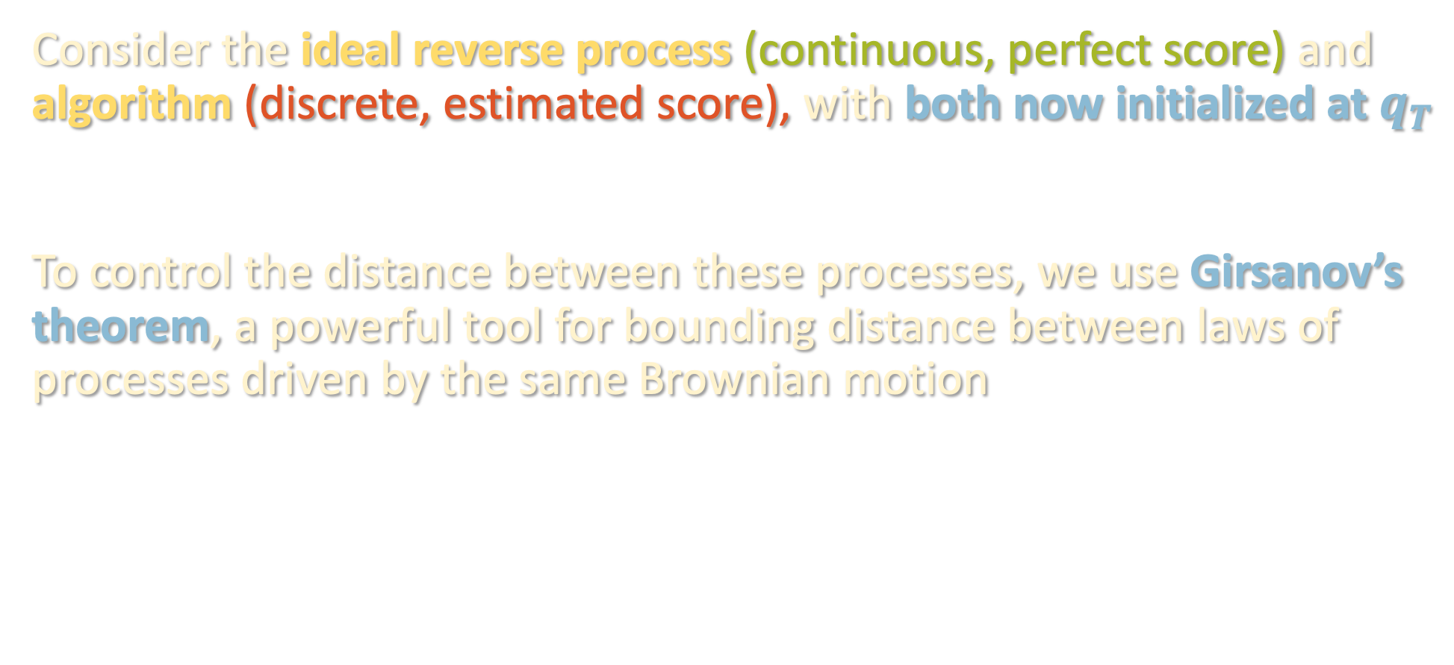
DISCRETIZATION ARGUMENT
$q$: data distribution
$q_{t}$: forward process at time $t$
$p_{t}$: reverse process at time $t$
$$q_{0}=q,p_{0}=γ, p_{T}=alg. output$$
Consider the ideal reverse process (continuous, perfect score) and algorithm (discrete, estimated score), with both now initialized at $q_{T}$
To control the distance between these processes, we use Girsanov’s theorem, a powerful tool for bounding distance between laws of processes driven by the same Brownian motion

Slide 40
DISCRETIZATION ARGUMENT
Consider the SDE’s
$$dX_{t}=b_{t} dt+\sqrt{2} dB_{t}$$
$$dX_{t}=b_{t}^{′} dt+\sqrt{2} dB_{t}$$
with the same initial distribution.
Let $Q_{T}, P_{T}$ denote the laws of the trajectories over time $T$,
i.e. as random variables in path space. Then*
$$\frac{dQ_{T}}{dP_{T}}=\exp\left(\frac{1}{\sqrt{2}}\int_{0}^{T}{\left(b_{t}−b_{t}^{′}\right) dB_{t}}−\frac{1}{4}\int_{0}^{T}{{\left\|b_{t}−b_{t}^{′}\right\|}^{2} dt}\right)$$
where $B_{t}$ is a standard Brownian motion w.r.t. $P_{T}$

Slide 41
DISCRETIZATION ARGUMENT
Consider the SDE’s
$$dX_{t}=\left\{X_{t}+2∇\ln{q_{T−t}\left(X_{t}\right)}\right\} dt+\sqrt{2} dB_{t}$$
$$dX_{t}=\left\{X_{t}+2s_{T−kh}\left(X_{kh}\right)\right\} dt+\sqrt{2} dB_{t}$$
both initialized at $q_{T}$.
Let $Q_{T}, P_{T}$ denote the laws of the trajectories over time $T$,
i.e. as random variables in path space. Then*
$$\frac{dQ_{T}}{dP_{T}}=\exp\left(\frac{1}{\sqrt{2}}\int_{0}^{T}{\left(b_{t}−b_{t}^{′}\right) dB_{t}}−\frac{1}{4}\int_{0}^{T}{{\left\|b_{t}−b_{t}^{′}\right\|}^{2} dt}\right)$$
where $B_{t}$ is a standard Brownian motion w.r.t. $P_{T}$

Slide 42
DISCRETIZATION ARGUMENT
Consider the SDE’s
$$dX_{t}=\left\{X_{t}+2∇\ln{q_{T−t}\left(X_{t}\right)}\right\} dt+\sqrt{2} dB_{t}$$
$$dX_{t}=\left\{X_{t}+2s_{T−kh}\left(X_{kh}\right)\right\} dt+\sqrt{2} dB_{t}$$
both initialized at $q_{T}$.
$$≥KL\left(ideal process‖algorithm\right)$$
Let $Q_{T}, P_{T}$ denote the laws of the trajectories over time $T$,
$KL(Q_{T}\left\|P_{T}\right)=𝔼_{Q_{T}}\left[\ln{\frac{dQ_{T}}{dP_{T}}}\right]$
$$=𝔼_{Q_{T}}\left[\sum_{k=0}^{T/h}{\int_{kh}^{(k+1)h}{{\left\|∇\ln{q_{T−t}(X_{t})}−s_{T−kh}\left(X_{k}\right)\right\|}^{2} dt }}\right]$$
$${\left\|∇\ln{q_{T−t}(X_{t})}−s_{T−kh}\left(X_{kh}\right)\right\|}^{2}$$

Slide 43
DISCRETIZATION ARGUMENT
Consider the SDE’s
$$dX_{t}=\left\{X_{t}+2∇\ln{q_{T−t}\left(X_{t}\right)}\right\} dt+\sqrt{2} dB_{t}$$
$$dX_{t}=\left\{X_{t}+2s_{T−kh}\left(X_{kh}\right)\right\} dt+\sqrt{2} dB_{t}$$
both initialized at $q_{T}$.
Let $Q_{T}, P_{T}$ denote the laws of their trajectories over time $T$. Then
$$\frac{dQ_{T}}{dP_{T}}=\exp\left(\sum_{k=0}^{T/h}{\int_{kh}^{(k+1)h}{{\left\|∇\ln{q_{T−t}(X_{t})}−s_{T−kh}\left(X_{kh}\right)\right\|}^{2} dt}}\right)$$

Slide 44
DISCRETIZATION ARGUMENT
$$\frac{dQ_{T}}{dP_{T}}=\exp\left(\sum_{k=0}^{T/h}{\int_{kh}^{(k+1)h}{{\left\|∇\ln{q_{T−t}(X_{t})}−s_{T−kh}\left(X_{kh}\right)\right\|}^{2} dt}}\right)$$
data processing inequality
$$KL\left(ideal process‖algorithm\right)≤KL(Q_{T}\left\|P_{T}\right)=𝔼_{Q_{T}}\left[\ln{\frac{dQ_{T}}{dP_{T}}}\right]$$
$$=𝔼_{Q_{T}}\left[\sum_{k=0}^{T/h}{\int_{kh}^{(k+1)h}{{\left\|∇\ln{q_{T−t}(X_{t})}−s_{T−kh}\left(X_{k}\right)\right\|}^{2} dt }}\right]$$
$${\left\|∇\ln{q_{T−t}(X_{t})}−s_{T−kh}\left(X_{kh}\right)\right\|}^{2}$$

Slide 45
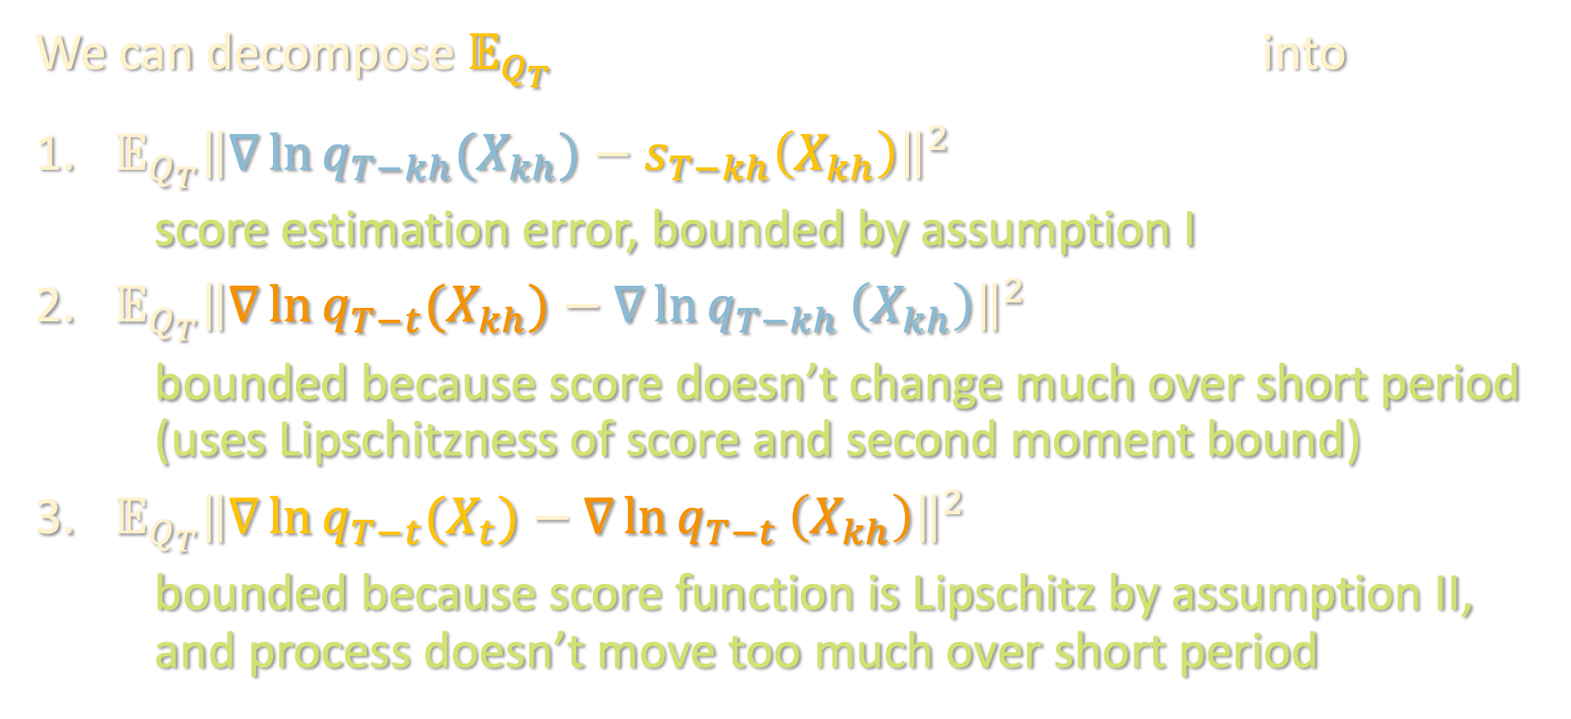
DISCRETIZATION ARGUMENT
$${\left\|∇\ln{q_{T−t}(X_{t})}−s_{T−kh}\left(X_{kh}\right)\right\|}^{2}$$
We can decompose $𝔼_{Q_{T}}$ into
${𝔼_{Q_{T}}\left\|∇\ln{q_{T−kh}(X_{kh})}−s_{T−kh}\left(X_{kh}\right)\right\|}^{2}$
score estimation error, bounded by assumption I
${𝔼_{Q_{T}}\left\|∇\ln{q_{T−t}(X_{kh})}−∇\ln{q_{T−kh}}\left(X_{kh}\right)\right\|}^{2}$
bounded because score doesn’t change much over short period (uses Lipschitzness of score and second moment bound)
${𝔼_{Q_{T}}\left\|∇\ln{q_{T−t}(X_{t})}−∇\ln{q_{T−t}}\left(X_{kh}\right)\right\|}^{2}$
bounded because score function is Lipschitz by assumption II, and process doesn’t move too much over short period

Slide 46
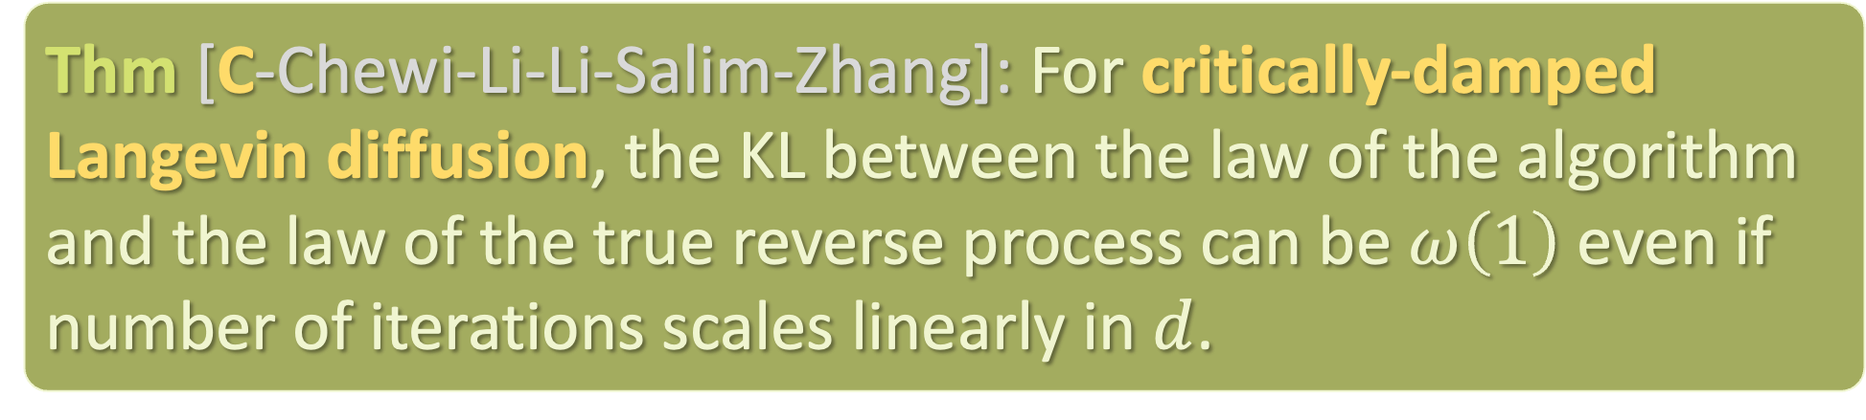
OPEN QUESTIONS
Interesting situations where score estimation is provably possible?
Acceleration via underdamped diffusion?
Thm [C-Chewi-Li-Li-Salim-Zhang]: For critically-damped Langevin diffusion, the KL between the law of the algorithm and the law of the true reverse process can be $ω\left(1\right)$ even if number of iterations scales linearly in $d$.

Slide 47
OPEN QUESTIONS
Interesting situations where score estimation is provably possible?
Acceleration via underdamped diffusion?
Other benefits of underdamping? e.g. better score error
Other reductions assuming strong supervised oracle?

Slide 48
DIFFUSION MODELS
Crash course
Prior work / our results
Proof sketch
SQ HARDNESS
Setup / prior work
Lower bound
TAKEAWAYS

Slide 49
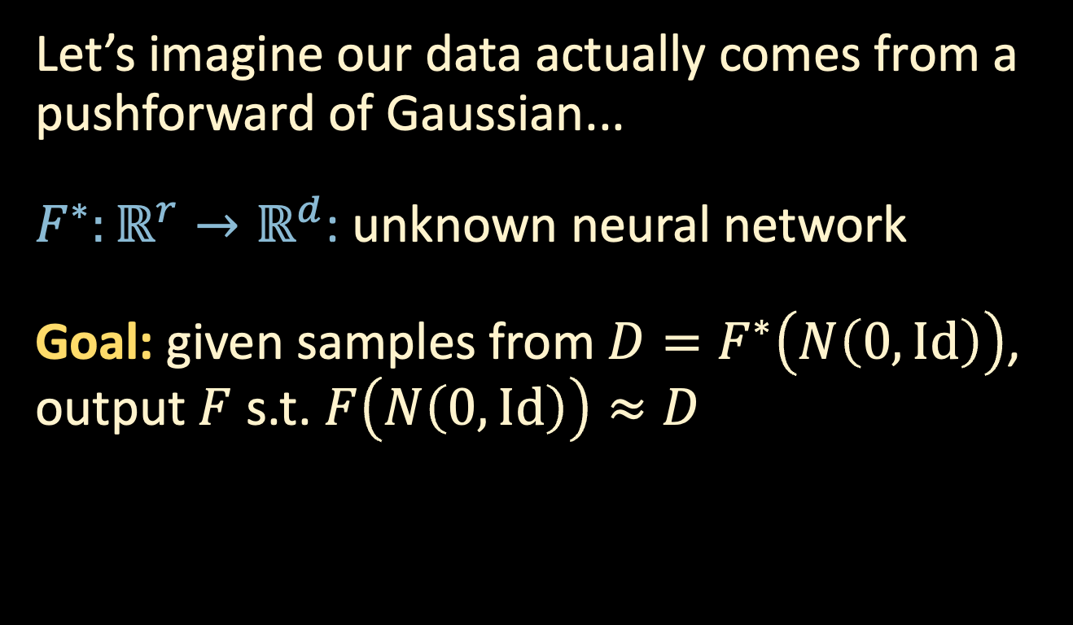
DEEP GENERATIVE MODELS
$$x$$
Let’s imagine our data actually comes from a pushforward of Gaussian...
$F^{∗}:ℝ^{r}→ℝ^{d}$: unknown neural network
Goal: given samples from $D=F^{∗}\left(N\left(0,Id\right)\right)$, output $F$ s.t. $F\left(N\left(0,Id\right)\right)≈D$
$$g$$
e.g. Wasserstein
$$F^{∗}$$

Slide 50

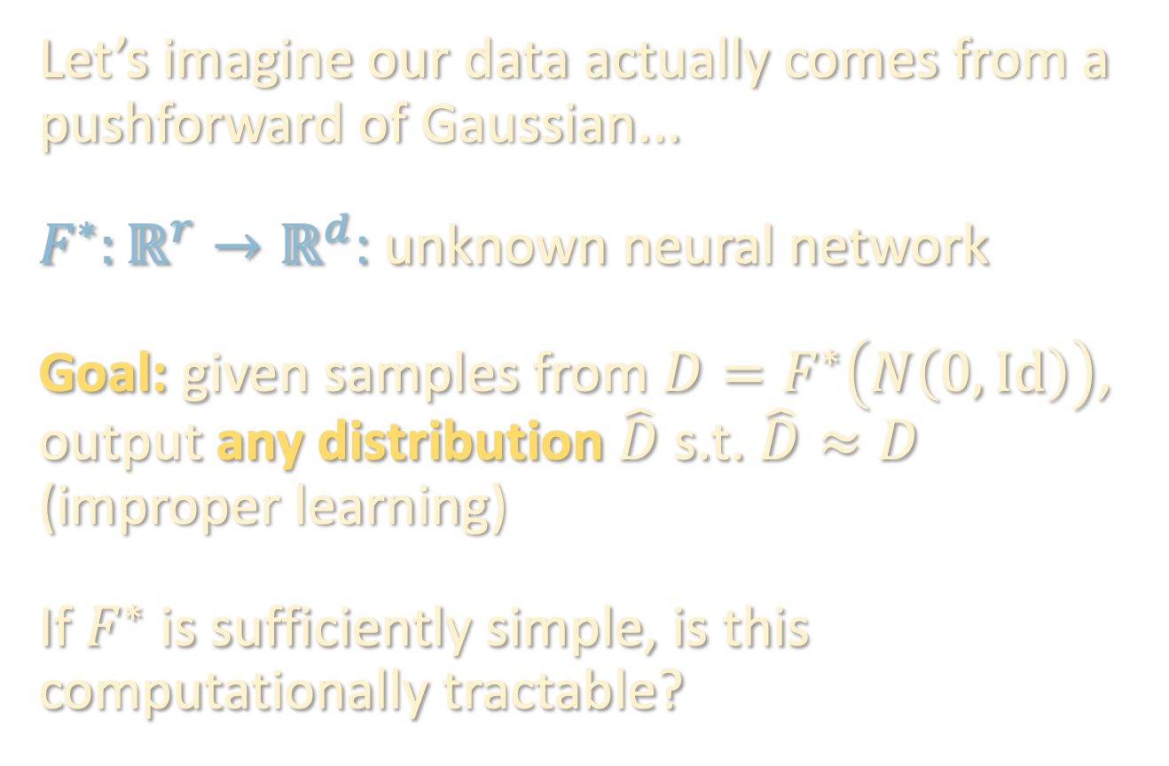


DEEP GENERATIVE MODELS
$$x$$
Let’s imagine our data actually comes from a pushforward of Gaussian...
$F^{∗}:ℝ^{r}→ℝ^{d}$: unknown neural network
Goal: given samples from $D=F^{∗}\left(N\left(0,Id\right)\right)$, output any distribution $\hat{D}$ s.t. $\hat{D}≈D$ (improper learning)
If $F^{∗}$ is sufficiently simple, is this computationally tractable?
$$g$$
$$F^{∗}$$

Slide 51
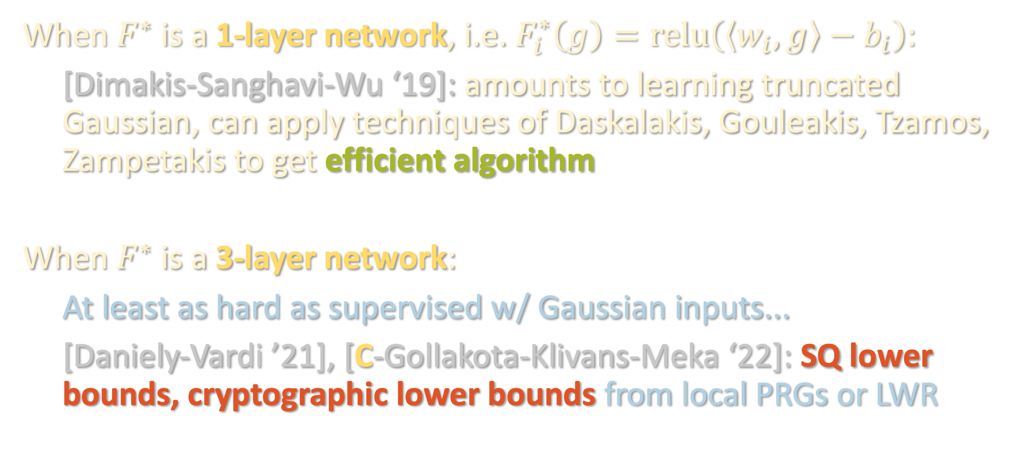
PRIOR WORK
When $F^{∗}$ is a 1-layer network, i.e. $F_{i}^{∗}\left(g\right)=relu\left(\left\langle w_{i},g\right\rangle −b_{i}\right)$:
[Dimakis-Sanghavi-Wu ‘19]: amounts to learning truncated Gaussian, can apply techniques of Daskalakis, Gouleakis, Tzamos, Zampetakis to get efficient algorithm
When $F^{∗}$ is a 3-layer network:
At least as hard as supervised w/ Gaussian inputs...
[Daniely-Vardi ’21], [C-Gollakota-Klivans-Meka ‘22]: SQ lower bounds, cryptographic lower bounds from local PRGs or LWR

Slide 52
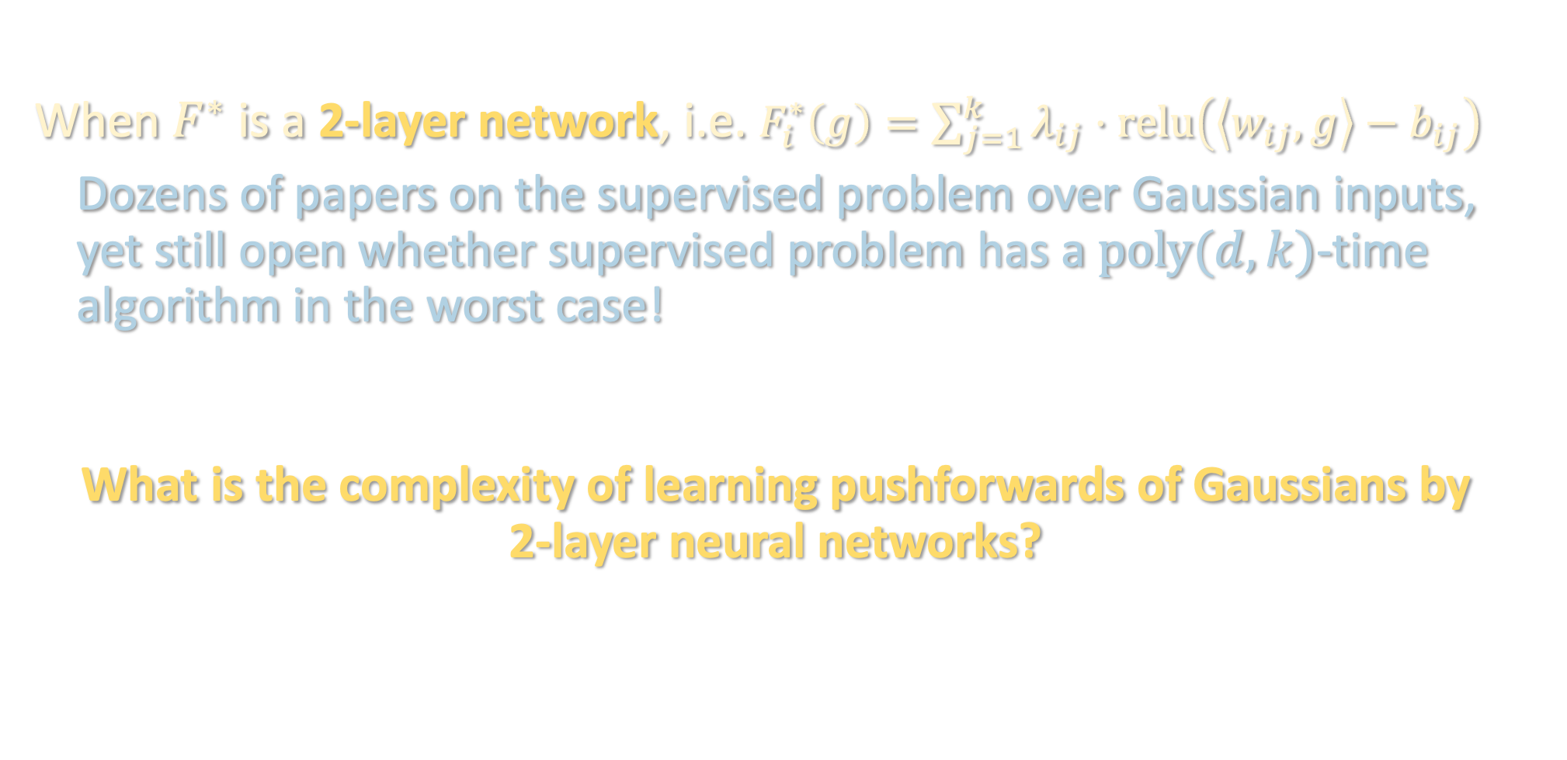
PRIOR WORK
When $F^{∗}$ is a 2-layer network, i.e. $F_{i}^{∗}\left(g\right)=\sum_{j=1}^{k}{λ_{ij}⋅relu\left(\left\langle w_{ij},g\right\rangle −b_{ij}\right)}$
Dozens of papers on the supervised problem over Gaussian inputs, yet still open whether supervised problem has a $poly(d,k)$-time algorithm in the worst case!
What is the complexity of learning pushforwards of Gaussians by 2-layer neural networks?

Slide 53
DIFFUSION MODELS
Crash course
Prior work / our results
Proof sketch
SQ HARDNESS
Setup / prior work
Lower bound
TAKEAWAYS

Slide 54
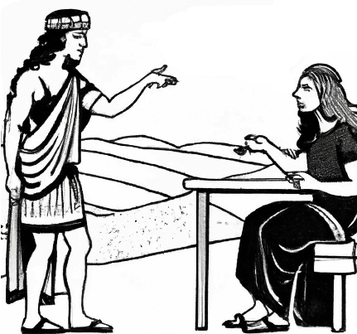

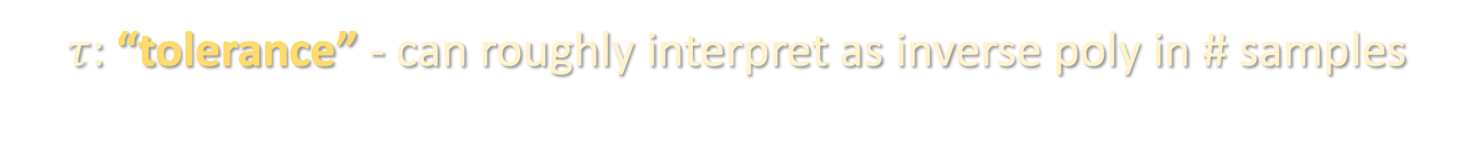

STATISTICAL QUERY (SQ) MODEL
$φ:ℝ^{d}→\left[−1,1\right]$ ?
$$𝔼\left[φ\left(x\right)\right]±τ$$
$τ$: “tolerance” - can roughly interpret as inverse poly in # samples

Slide 55
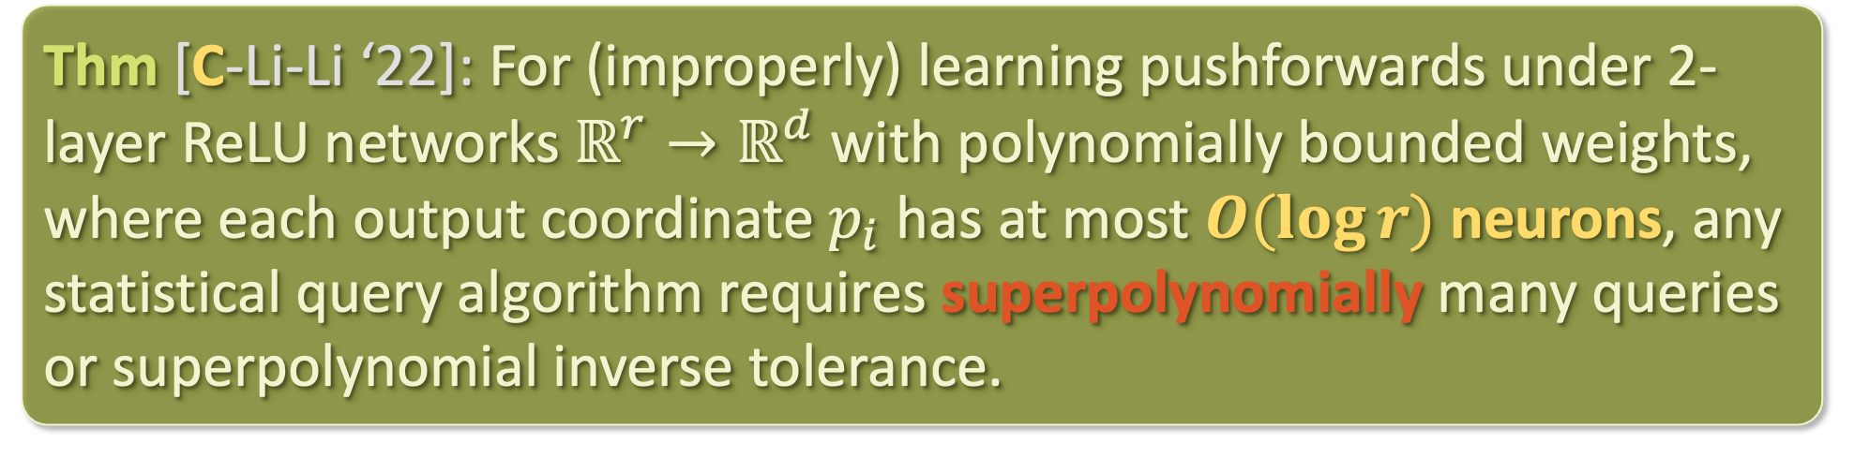
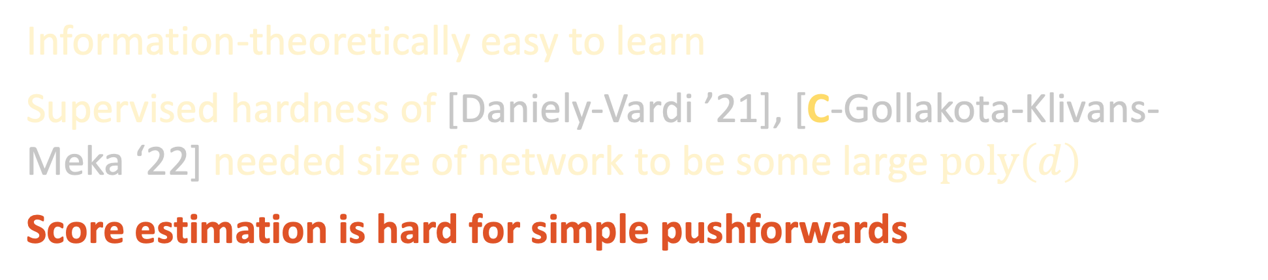
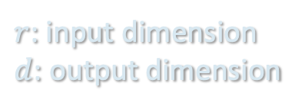
OUR RESULTS
$r$: input dimension
$d$: output dimension
Thm [C-Li-Li ‘22]: For (improperly) learning pushforwards under 2-layer ReLU networks $ℝ^{r}→ℝ^{d}$ with polynomially bounded weights, where each output coordinate $p_{i}$ has at most $O(\log{r})$ neurons, any statistical query algorithm requires superpolynomially many queries or superpolynomial inverse tolerance.
Information-theoretically easy to learn
Supervised hardness of [Daniely-Vardi ’21], [C-Gollakota-Klivans-Meka ‘22] needed size of network to be some large $poly\left(d\right)$
Score estimation is hard for simple pushforwards
Notes:
under any reasonable distance, e.g. TV or wasserstein

Slide 56
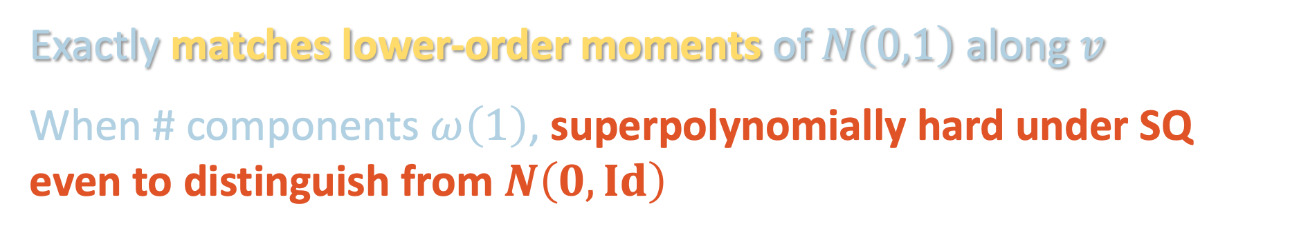
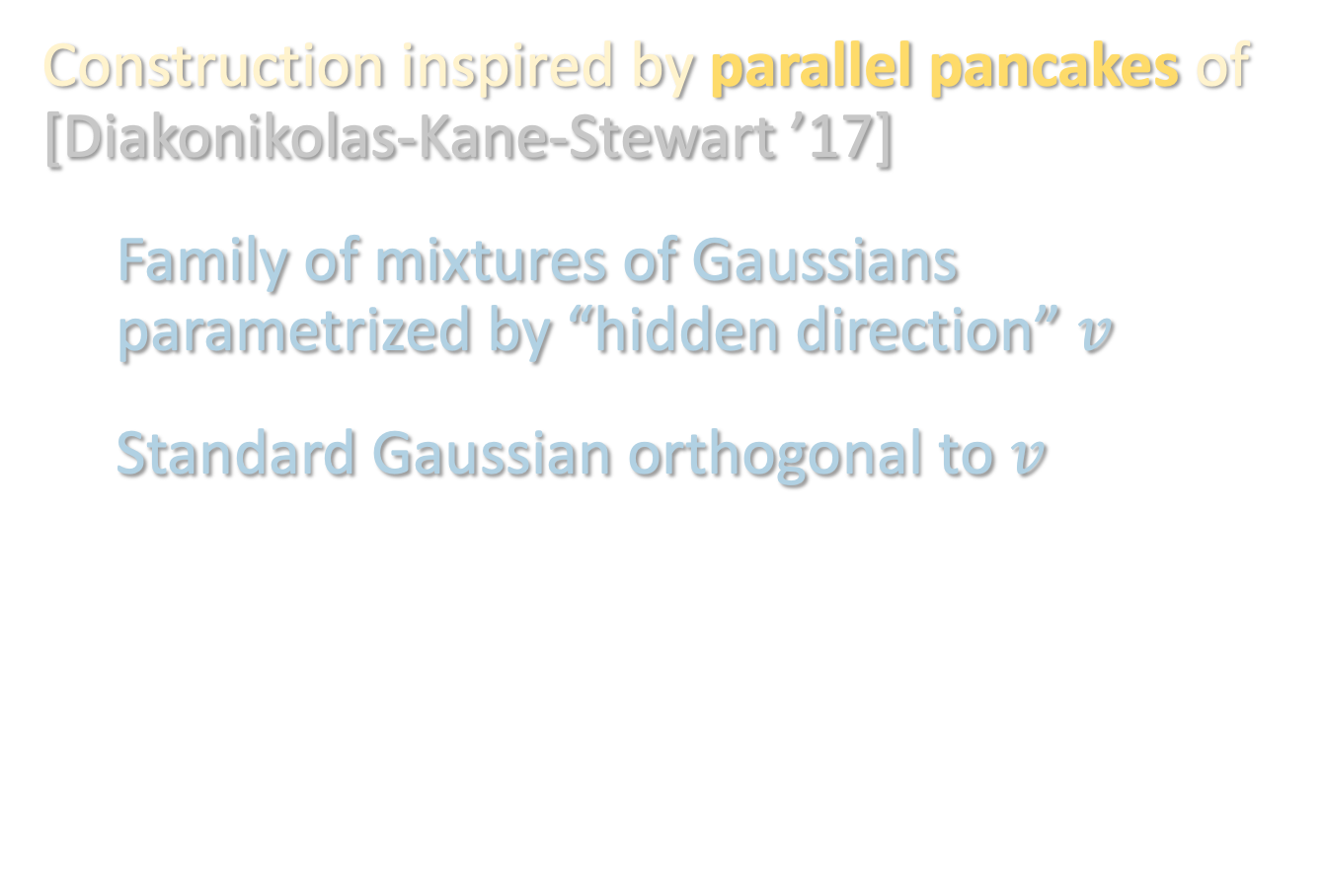
PROOF SKETCH
Construction inspired by parallel pancakes of [Diakonikolas-Kane-Stewart ’17]
Family of mixtures of Gaussians parametrized by “hidden direction” $v$
Standard Gaussian orthogonal to $v$
Exactly matches lower-order moments of $N\left(0,1\right)$ along $v$
When # components $ω\left(1\right)$, superpolynomially hard under SQ even to distinguish from $N\left(0,Id\right)$

Slide 57
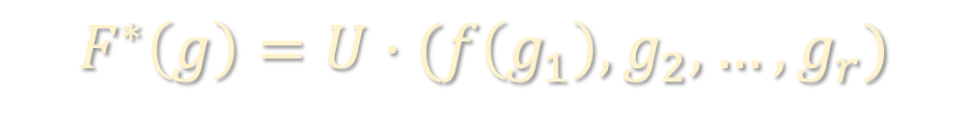

PROOF SKETCH
Key technical ingredient: construct 1D pushforward $D=f(N\left(0,1\right))$ which matches all low-order moments with $N\left(0,1\right)$
Can then construct a high-dimensional pushforward which is $D$ along $v$ and Gaussian along all directions orthogonal to $v$
$$F^{∗}\left(g\right)=U⋅(f\left(g_{1}\right),g_{2},…,g_{r})$$

Slide 58
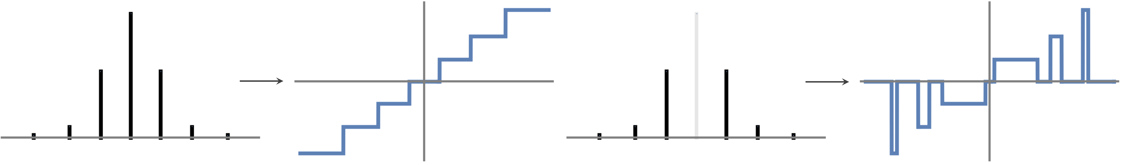

PROOF SKETCH
Key technical ingredient: construct 1D pushforward $D=f(N\left(0,1\right))$ which matches all low-order moments with $N\left(0,1\right)$
In 1D, 2-layer networks $≡$ piecewise linear functions
Main issue: the slopes are infinite... to implement this with a ReLU network, we’d need infinitely large weights! ☹

Slide 59
PROOF SKETCH
Key technical ingredient: construct 1D pushforward $D=f(N\left(0,1\right))$ which matches all low-order moments with $N\left(0,1\right)$
In 1D, 2-layer networks $≡$ piecewise linear functions
Main issue: the slopes are infinite... to implement this with a ReLU network, we’d need infinitely large weights! ☹

Slide 60
PROOF SKETCH
Key technical ingredient: construct 1D pushforward $D=f(N\left(0,1\right))$ which matches all low-order moments with $N\left(0,1\right)$
In 1D, 2-layer networks $≡$ piecewise linear functions
Main issue: the slopes are infinite... to implement this with a ReLU network, we’d need infinitely large weights! ☹

Slide 61
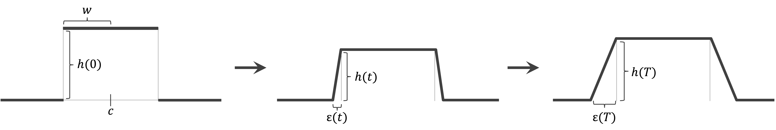
PROOF SKETCH
Idea: perturb the slopes of the function along a certain ODE
- maintains the moments of the pushforward
- gradually decreases weights needed to implement function
To ensure bases of the bumps don’t collide, can only run ODE for small amount of time, but enough to get poly-bounded slopes

Slide 62
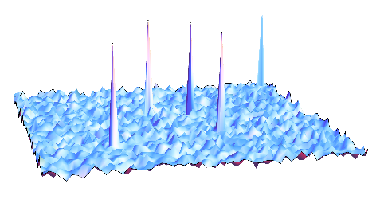
BEYOND THE WORST CASE
Hard examples are pathological and, upon random perturbation, become tractable
time
complexity

Slide 63
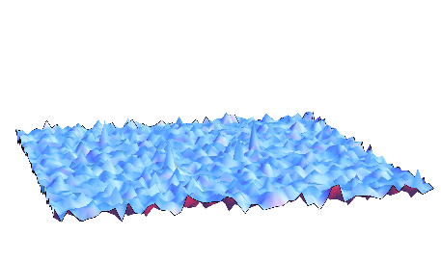
BEYOND THE WORST CASE
Hard examples are pathological and, upon random perturbation, become tractable
smoothed time
complexity

Slide 64

BEYOND THE WORST CASE
Hard examples are pathological and, upon random perturbation, become tractable
Can consider pushforwards by networks where every parameter has been randomly perturbed by $\sim 1/poly\left(r\right)$
smoothed time
complexity

Slide 65
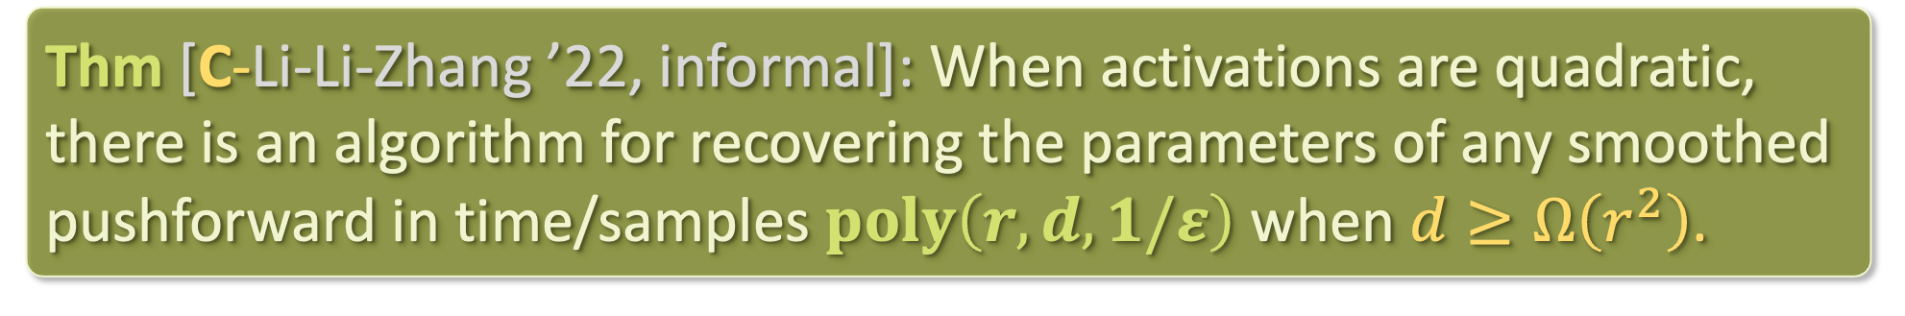
BEYOND THE WORST CASE
$r$: input dimension
$d$: output dimension
Thm [C-Li-Li-Zhang ’22, informal]: When activations are quadratic, there is an algorithm for recovering the parameters of any smoothed pushforward in time/samples $poly\left(r,d,1/ε\right)$ when $d≥Ω\left(r^{2}\right)$.
We also obtain efficient algorithms for higher degree activations
Algorithms based on sum-of-squares, method of moments, and connection to a noncommutative generalization of tensor decomposition

Slide 66
OPEN QUESTIONS
More practical algorithms?
Beyond polynomial activations?
Hardness for polynomial activations?
New notions of distribution learning?
e.g. learning in “computational” distance (“outcome indistinguishability”)

Slide 67
DIFFUSION MODELS
Crash course
Prior work / our results
Proof sketch
SQ HARDNESS
Setup / prior work
Lower bound
TAKEAWAYS

Slide 68
TAKEAWAYS
Pushforwards are a powerful way of modeling real-world distributions, but very little known w.r.t. provable guarantees for training/evaluating models
Perspectives from TCS/learning theory helpful for filling this gap
Pseudorandom generators, distribution learning theory, smoothed analysis, method of moments / tensor methods, convex programming hierarchies, discretization analysis for log-concave sampling
By building on these ideas, we proved
Diffusion models are completely principled assuming accurate score estimation
Lower bounds + smoothed upper bounds for certain simple pushforwards
Lots of open questions!

Slide 69
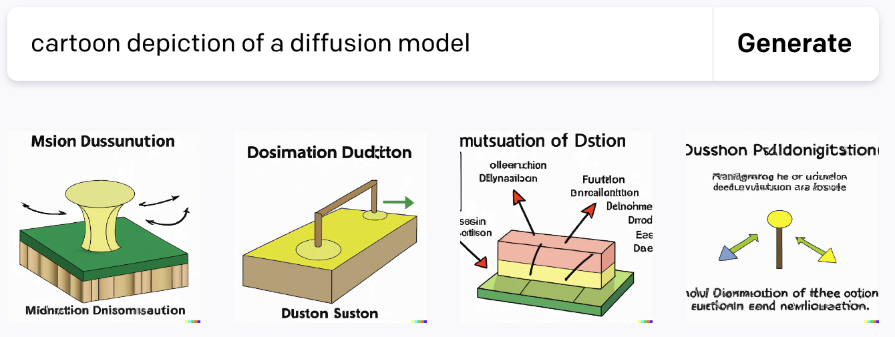
TAKEAWAYS
Pushforwards are a powerful way of modeling real-world distributions, but very little known w.r.t. provable guarantees for training/evaluating models
Perspectives from TCS/learning theory helpful for filling this gap
Pseudorandom generators, distribution learning theory, smoothed analysis, method of moments / tensor methods, convex programming hierarchies, discretization analysis for log-concave sampling
By building on these ideas, we proved
Diffusion models are completely principled
assuming accurate score estimation
Lower bounds + smoothed upper bounds for certain simple pushforwards
Lots of open questions!

