Slide 1
THE COMPLEXITY OF NISQ
SITAN CHEN UC BERKELEY | JORDAN COTLER HARVARD | HSIN-YUAN HUANG CALTECH | JERRY LI MSR

Slide 2
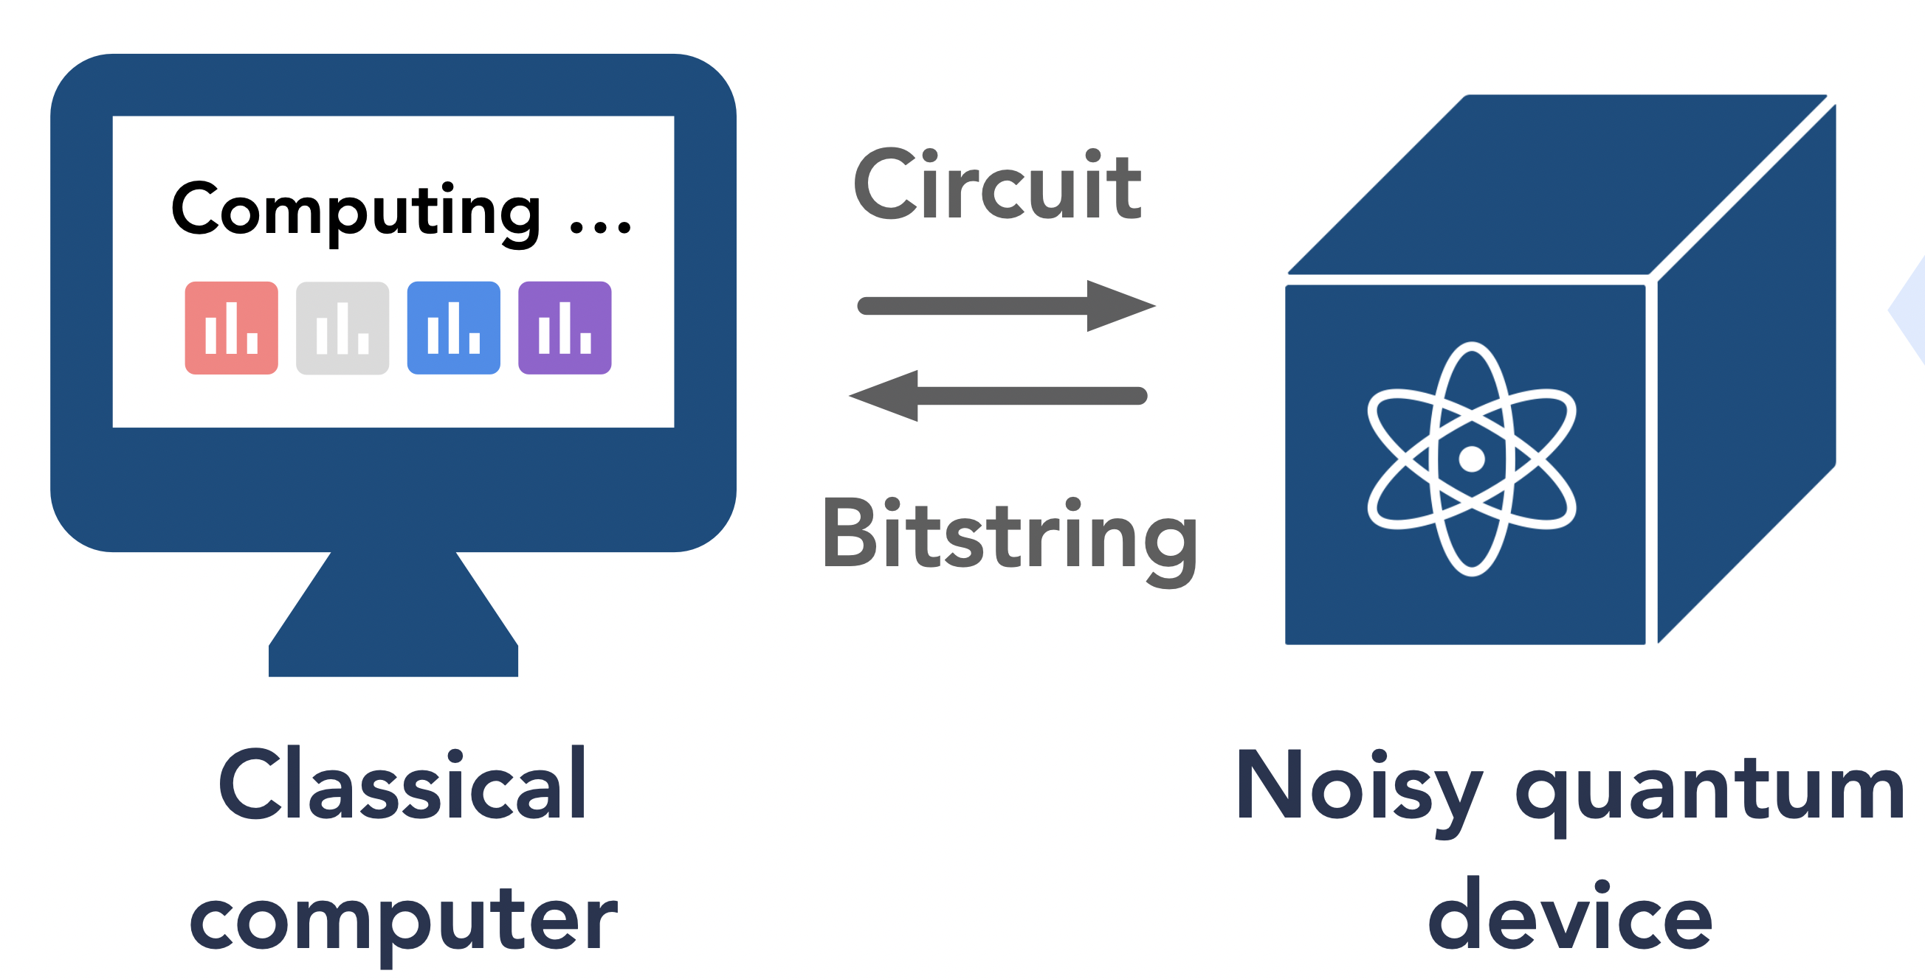
NEAR-TERM QUANTUM DEVICES
Still quite far from fault-tolerant quantum computing
In the meantime, proliferation of noisy quantum devices
Superconducting qubits
Trapped ions
Electron spins in silicon
Other solid-state systems
Photonics
Rydberg atoms
Algorithms in the noisy intermediate-scale quantum (NISQ) era based on hybrid quantum-classical computation
Notes:
We're still many years and engineering breakthroughs away from implementing fault-tolerant quantum computing, and in the meantime there's been a lot of excitement around the various platforms for noisy quantum computation that are currently available in the NISQ era.

Slide 3
NEAR-TERM QUANTUM DEVICES
Plethora of near-term algorithms:
VQE
QAOA
quantum-enhanced kernel methods
quantum neural networks
fermionic QC QMC
......
with applications in quantum chemistry, ML, combinatorial optimization, linear system solving, experimental data analysis
What is the inherent computational power
of the class of all NISQ algorithms?
BQP
NISQ
BPP

Slide 4
DEFINITION DESIDERATA
Should capture limitations common to vast majority of existing devices
Can execute noisy quantum logic gates
All qubits must be prepared at the start --- no fresh ancilla in middle of computation
Device has fixed # qubits that all accrue entropy during computation
Noisy measurement at the end --- no intermediate partial measurements
Difficult to isolate qubits to measure without decohering remaining qubits
Removing any one of these already allows nontrivial fault tolerance

Slide 5




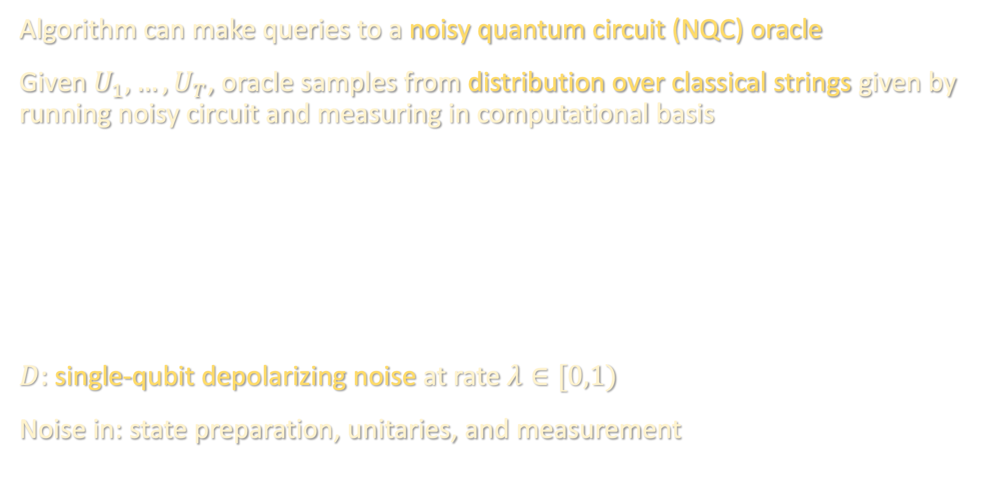

























THE NISQ COMPLEXITY CLASS
Algorithm can make queries to a noisy quantum circuit (NQC) oracle
Given $U_{1},…, U_{T}$, oracle samples from distribution over classical strings given by running noisy circuit and measuring in computational basis
$D$: single-qubit depolarizing noise at rate $λ∈[0,1)$
Noise in: state preparation, unitaries, and measurement
$$\left|0\right\rangle$$
$$D$$
$$U_{1}$$
$$D$$
$${ U}_{2}$$
$$D$$
$${ U}_{3}$$
$$D$$
$${ U}_{T}$$
$$D$$
$$\left|0\right\rangle$$
$$D$$
$$D$$
$$D$$
$$D$$
$$D$$
$$⋯$$
$$\left|0\right\rangle$$
$$D$$
$$D$$
$$D$$
$$D$$
$$D$$
$$\left|0\right\rangle$$
$$D$$
$$D$$
$$D$$
$$D$$
$$D$$
Notes:
note that we choose a particular noise channel simply because it’s the canonical one, but our upper bounds hold for arbitrary local noise

Slide 6
H
T
H
T
T
T
T
H
H
T
H
H
T
H
H
H
H
H
T
T

Slide 7
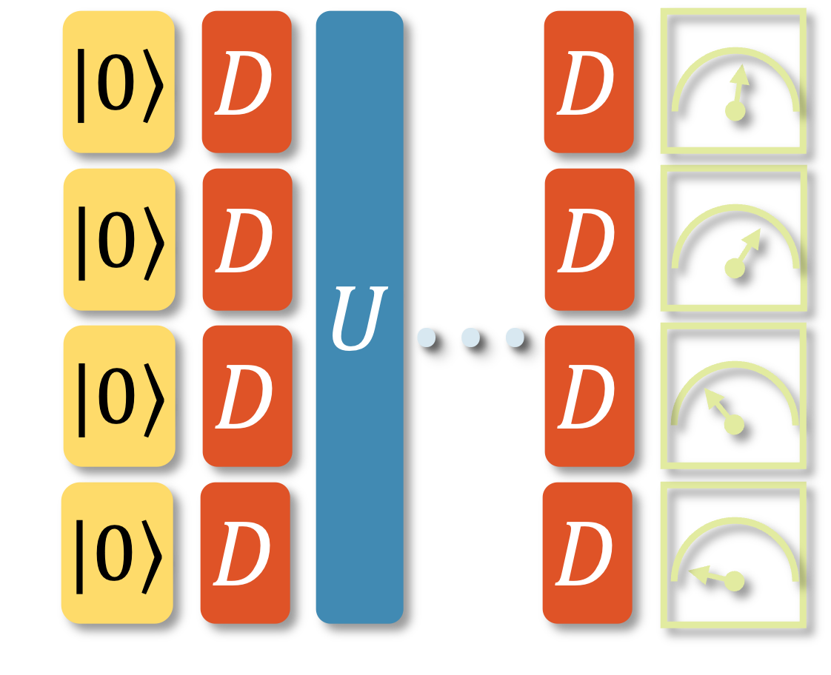
















THE NISQ COMPLEXITY CLASS
NISQ algorithm: probabilistic TM that can make arbitrary queries to NQC oracle
Runtime measured by
[classical runtime of TM]
+
[time spent on NQC oracle queries]
......
......
$$⋯$$
......
NISQ: classical languages accepted by a poly-time NISQ algorithm w.h.p.
$$\left|0\right\rangle$$
$$D$$
$$U$$
$$D$$
Each query $\left(U_{1},…,U_{T}\right)$ to NQC
oracle takes time $O\left(T⋅\#qubits\right)$
$$\left|0\right\rangle$$
$$D$$
$$D$$
$$⋯$$
$$\left|0\right\rangle$$
$$D$$
$$D$$
$$\left|0\right\rangle$$
$$D$$
$$D$$

Slide 8
FAULT-TOLERANT QUANTUM COMPUTING
Q: Why isn’t this just BQP by the threshold theorem?
A: We do not allow intermediate measurements or initializing fresh ancilla in the middle of the circuit, which is needed in all known fault-tolerant schemes
Key bottleneck for NISQ devices is not the width / # qubits available, it’s the inability to pump out entropy
Notes:
8:30

Slide 9
BERNSTEIN-VAZIRANI
GROVER SEARCH
BPP vs NISQ vs BQP
SHADOW TOMOGRAPHY
OPEN PROBLEMS/TAKEAWAYS

Slide 10

BERNSTEIN-VAZIRANI
$$\left|x\right\rangle \left|y\right\rangle ↦\left|x\right\rangle \left|y⊕(s⋅x mod 2)\right\rangle$$
Thm [C-Cotler-Huang-Li ‘22]: For $0≤λ<1/24$, there is a NISQ algorithm that solves the Bernstein-Vazirani problem with probability $1−δ$ in $O\left(\log\left(n/δ\right)\right)$ oracle queries.
For this task, NISQ exhibits exponential advantage in query complexity over classical algorithms
Algorithm just minor variant of original Bernstein-Vazirani algorithm

Slide 11


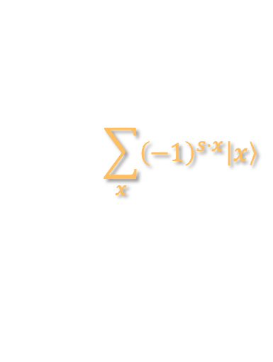


BERNSTEIN-VAZIRANI
$$\sum_{x}{{\left(−1\right)}^{s⋅x}\left|x\right\rangle }$$
$$1$$
$$n$$
$$anc$$
$$trace out$$

Slide 12















BERNSTEIN-VAZIRANI
$$1$$
$$2$$
$$3$$
$$4$$
$$1$$
$$local$$
$$noise$$
$$local$$
$$noise$$
$$local$$
$$noise$$
$$local$$
$$noise$$
$$n$$
$$local$$
$$noise$$
$$local$$
$$noise$$
$$local$$
$$noise$$
$$local$$
$$noise$$
$$anc$$
$$local$$
$$noise$$
$$local$$
$$noise$$
$$trace out$$
Suppose ancilla qubit not corrupted

Slide 13
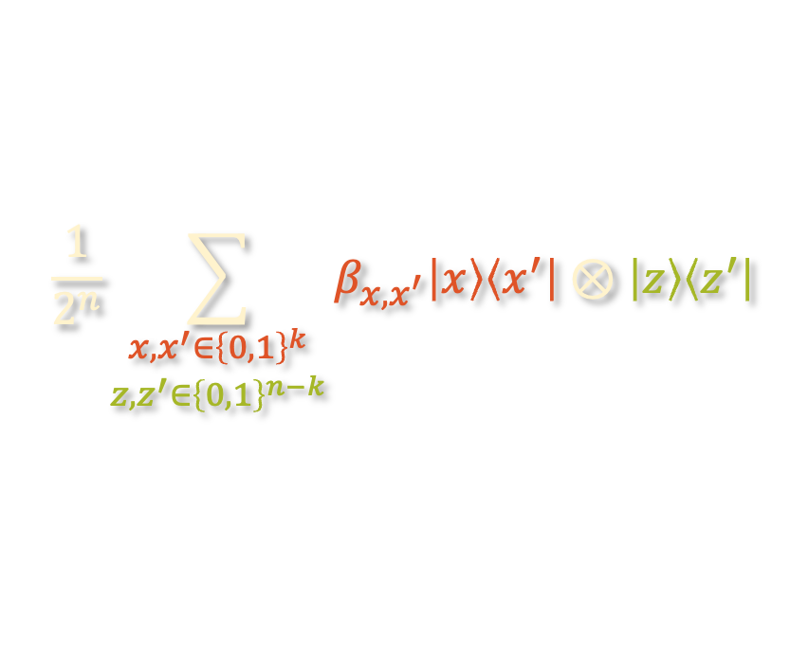




BERNSTEIN-VAZIRANI
$$1$$
$$2$$
$$3$$
$$4$$
$k$ qubits corrupted
$$1$$
$$local$$
$$noise$$
$$local$$
$$noise$$
$$local$$
$$noise$$
$$local$$
$$noise$$
$n−k$ qubits uncorrupted
$$n$$
$$local$$
$$noise$$
$$local$$
$$noise$$
$$local$$
$$noise$$
$$local$$
$$noise$$
$$anc$$
$$local$$
$$noise$$
$$local$$
$$noise$$
$$trace out$$
$$\frac{1}{2^{n}}\sum_{\begin{aligned}x,x^{′}∈{\left\{0,1\right\}}^{k} \\ {z,z}^{′}∈{\left\{0,1\right\}}^{n−k}\end{aligned}}{β_{x,x^{′}}\left|x\right\rangle \left\langle x^{′}\right|⊗\left|z\right\rangle \left\langle z^{′}\right|}$$

Slide 14
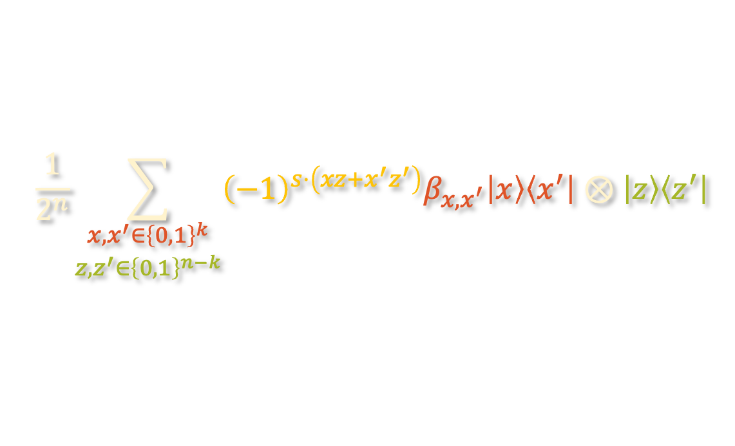
BERNSTEIN-VAZIRANI
$$1$$
$$2$$
$$3$$
$$4$$
$k$ qubits corrupted
$$1$$
$$local$$
$$noise$$
$$local$$
$$noise$$
$$local$$
$$noise$$
$$local$$
$$noise$$
$n−k$ qubits uncorrupted
$$n$$
$$local$$
$$noise$$
$$local$$
$$noise$$
$$local$$
$$noise$$
$$local$$
$$noise$$
$$anc$$
$$local$$
$$noise$$
$$local$$
$$noise$$
$$trace out$$
$$\frac{1}{2^{n}}\sum_{\begin{aligned}x,x^{′}∈{\left\{0,1\right\}}^{k} \\ z,z^{′}∈{\left\{0,1\right\}}^{n−k}\end{aligned}}{{\left(−1\right)}^{s⋅\left(xz+x^{′}z^{′}\right)}β_{x,x^{′}}\left|x\right\rangle \left\langle x^{′}\right|⊗\left|z\right\rangle \left\langle z^{′}\right|}$$

Slide 15




BERNSTEIN-VAZIRANI
$$1$$
$$2$$
$$3$$
$$4$$
$k$ qubits corrupted
$$1$$
$$local$$
$$noise$$
$$local$$
$$noise$$
$$local$$
$$noise$$
$$local$$
$$noise$$
$n−k$ qubits uncorrupted
$$n$$
$$local$$
$$noise$$
$$local$$
$$noise$$
$$local$$
$$noise$$
$$local$$
$$noise$$
$$anc$$
$$local$$
$$noise$$
$$local$$
$$noise$$
$$trace out$$
$$\frac{1}{2^{n}}\sum_{\begin{aligned}x,x^{′}∈{\left\{0,1\right\}}^{k} \\ z,z^{′}∈{\left\{0,1\right\}}^{n−k}\end{aligned}}{{\left(−1\right)}^{s⋅\left(xz+x^{′}z^{′}\right)}β_{x,x^{′}}\left|x\right\rangle \left\langle x^{′}\right|⊗\left|z\right\rangle \left\langle z^{′}\right|}$$

Slide 16
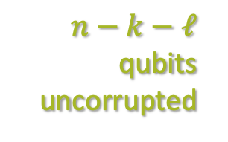
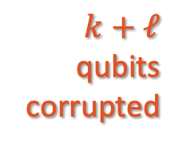


BERNSTEIN-VAZIRANI
$$1$$
$$2$$
$$3$$
$$4$$
$k+ℓ$ qubits corrupted
$$1$$
$$local$$
$$noise$$
$$local$$
$$noise$$
$$local$$
$$noise$$
$$local$$
$$noise$$
$n−k−ℓ$ qubits uncorrupted
$$n$$
$$local$$
$$noise$$
$$local$$
$$noise$$
$$local$$
$$noise$$
$$local$$
$$noise$$
$$anc$$
$$local$$
$$noise$$
$$local$$
$$noise$$
$$trace out$$
$$\frac{1}{2^{n}}\sum_{\begin{aligned}x,x^{′}∈{\left\{0,1\right\}}^{k} \\ z,z^{′}∈{\left\{0,1\right\}}^{n−k}\end{aligned}}{{\left(−1\right)}^{s⋅\left(xz+x^{′}z^{′}\right)}β_{x,x^{′}}\left|x\right\rangle \left\langle x^{′}\right|⊗\left|z\right\rangle \left\langle z^{′}\right|}$$

Slide 17
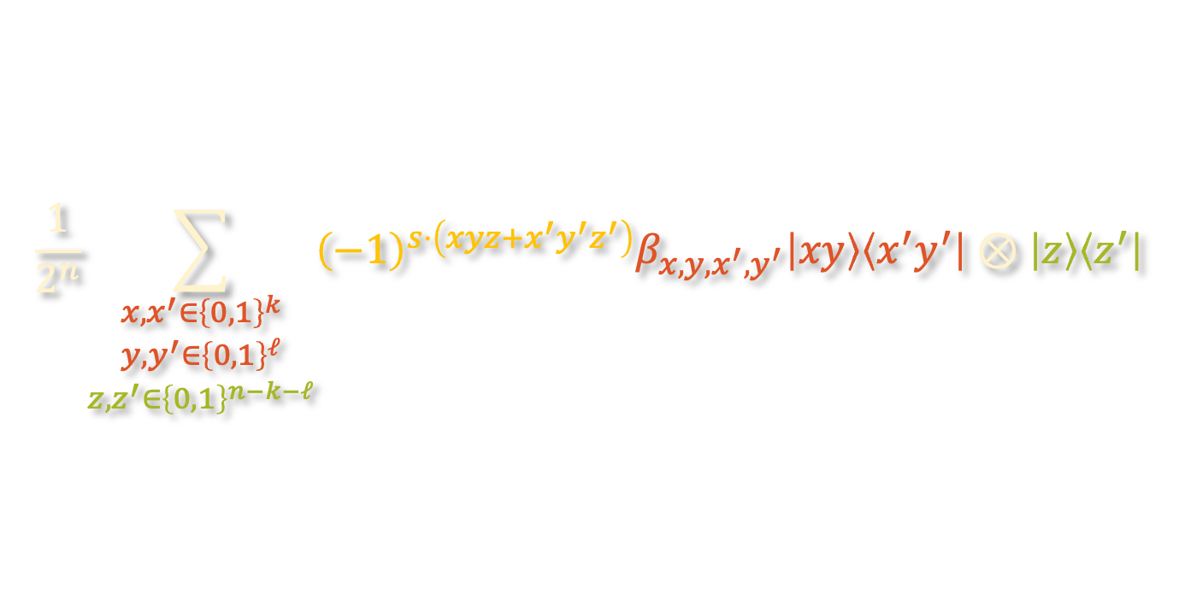
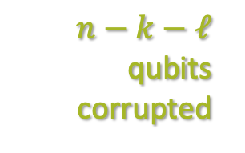
BERNSTEIN-VAZIRANI
$$1$$
$$2$$
$$3$$
$$4$$
$k+ℓ$ qubits corrupted
$$1$$
$$local$$
$$noise$$
$$local$$
$$noise$$
$$local$$
$$noise$$
$$local$$
$$noise$$
$n−k−ℓ$ qubits uncorrupted
$$n$$
$$local$$
$$noise$$
$$local$$
$$noise$$
$$local$$
$$noise$$
$$local$$
$$noise$$
$$anc$$
$$local$$
$$noise$$
$$local$$
$$noise$$
$$trace out$$
$$\frac{1}{2^{n}}\sum_{\begin{aligned}x,x^{′}∈{\left\{0,1\right\}}^{k} \\ y,y^{′}∈{\left\{0,1\right\}}^{ℓ} \\ z,z^{′}∈{\left\{0,1\right\}}^{n−k−ℓ}\end{aligned}}{{\left(−1\right)}^{s⋅\left(xyz+x^{′}y^{′}z^{′}\right)}β_{x,y,x^{′},y^{′}}\left|xy\right\rangle \left\langle x^{′}y^{′}\right|⊗\left|z\right\rangle \left\langle z^{′}\right|}$$

Slide 18



BERNSTEIN-VAZIRANI
$$1$$
$$2$$
$$3$$
$$4$$
$k+ℓ$ qubits corrupted
$$1$$
$$local$$
$$noise$$
$$local$$
$$noise$$
$$local$$
$$noise$$
$$local$$
$$noise$$
$n−k−ℓ$ qubits uncorrupted
$$n$$
$$local$$
$$noise$$
$$local$$
$$noise$$
$$local$$
$$noise$$
$$local$$
$$noise$$
$$anc$$
$$local$$
$$noise$$
$$local$$
$$noise$$
$$trace out$$
$$\frac{1}{2^{n−k−ℓ}}\sum_{z,z^{′}∈{\left\{0,1\right\}}^{n−k−ℓ}}{{\left(−1\right)}^{s_{good}⋅\left(z+z^{′}\right)}\left|z\right\rangle \left\langle z^{′}\right|}$$

Slide 19

BERNSTEIN-VAZIRANI
$$1$$
$$2$$
$$3$$
$$4$$
$k+ℓ$ qubits corrupted
$$1$$
$$local$$
$$noise$$
$$local$$
$$noise$$
$$local$$
$$noise$$
$$local$$
$$noise$$
$n−k−ℓ$ qubits uncorrupted
$$n$$
$$local$$
$$noise$$
$$local$$
$$noise$$
$$local$$
$$noise$$
$$local$$
$$noise$$
$$anc$$
$$local$$
$$noise$$
$$local$$
$$noise$$
$$trace out$$
$$\left|s_{good}\right\rangle \left\langle s_{good}\right|$$

Slide 20
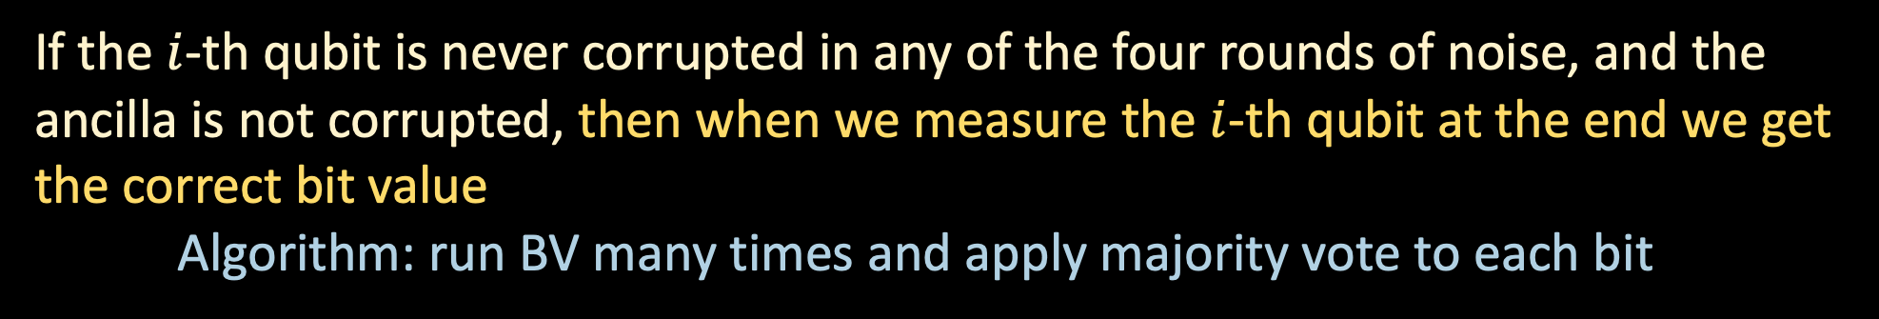

BERNSTEIN-VAZIRANI
$$1$$
$$2$$
$$3$$
$$4$$
$k+ℓ$ qubits corrupted
$$1$$
$$local$$
$$noise$$
$$local$$
$$noise$$
$$local$$
$$noise$$
$$local$$
$$noise$$
$n−k−ℓ$ qubits uncorrupted
$$n$$
$$local$$
$$noise$$
$$local$$
$$noise$$
$$local$$
$$noise$$
$$local$$
$$noise$$
$$anc$$
$$local$$
$$noise$$
$$local$$
$$noise$$
$$trace out$$
If the $i$-th qubit is never corrupted in any of the four rounds of noise, and the ancilla is not corrupted, then when we measure the $i$-th qubit at the end we get the correct bit value
Algorithm: run BV many times and apply majority vote to each bit
--- happens with probability ${\left(1 −λ\right)}^{6}$

Slide 21


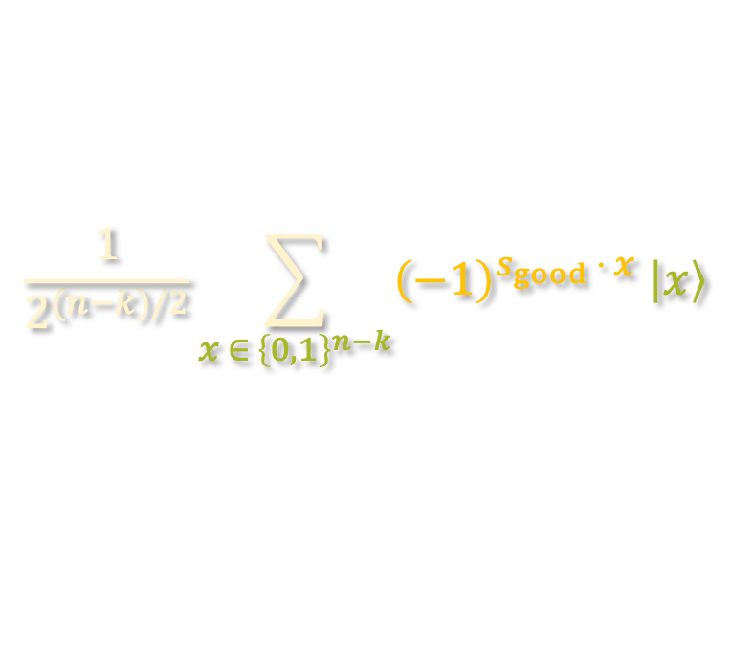
BERNSTEIN-VAZIRANI
$$1$$
$$2$$
$$3$$
$$4$$
$k$ qubits corrupted
$$1$$
$$local$$
$$noise$$
$$local$$
$$noise$$
$$local$$
$$noise$$
$$local$$
$$noise$$
$n−k$ qubits uncorrupted
$$n$$
$$local$$
$$noise$$
$$local$$
$$noise$$
$$local$$
$$noise$$
$$local$$
$$noise$$
$$anc$$
$$local$$
$$noise$$
$$local$$
$$noise$$
$$trace out$$
$$\frac{1}{2^{(n−k)/2}}\sum_{x ∈ {\left\{0,1\right\}}^{n−k}}{{\left(−1\right)}^{s_{good} ⋅ x} \left|x\right\rangle }$$

Slide 22
BERNSTEIN-VAZIRANI
$$1$$
$$2$$
$$3$$
$$4$$
$k$ qubits corrupted
$$1$$
$$local$$
$$noise$$
$$local$$
$$noise$$
$$local$$
$$noise$$
$$local$$
$$noise$$
$n−k$ qubits uncorrupted
$$n$$
$$local$$
$$noise$$
$$local$$
$$noise$$
$$local$$
$$noise$$
$$local$$
$$noise$$
$$anc$$
$$local$$
$$noise$$
$$local$$
$$noise$$
$$trace out$$
$$\left|s_{good}\right\rangle \left\langle s_{good}\right|$$

Slide 23
BERNSTEIN-VAZIRANI
$$1$$
$$2$$
$$3$$
$$4$$
$k$ qubits corrupted
$$1$$
$$local$$
$$noise$$
$$local$$
$$noise$$
$$local$$
$$noise$$
$$local$$
$$noise$$
$n−k$ qubits uncorrupted
$$n$$
$$local$$
$$noise$$
$$local$$
$$noise$$
$$local$$
$$noise$$
$$local$$
$$noise$$
$$anc$$
$$local$$
$$noise$$
$$local$$
$$noise$$
$$trace out$$
If the $i$-th qubit is never corrupted in any of the four rounds of noise, and the ancilla is not corrupted, then when we measure the $i$-th qubit at the end we get the correct bit value
Algorithm: run BV many times and apply majority vote to each bit
--- happens with probability ${\left(1 −λ\right)}^{6}$

Slide 24
BERNSTEIN-VAZIRANI
GROVER SEARCH
BPP vs NISQ vs BQP
SHADOW TOMOGRAPHY
OPEN PROBLEMS/TAKEAWAYS

Slide 25
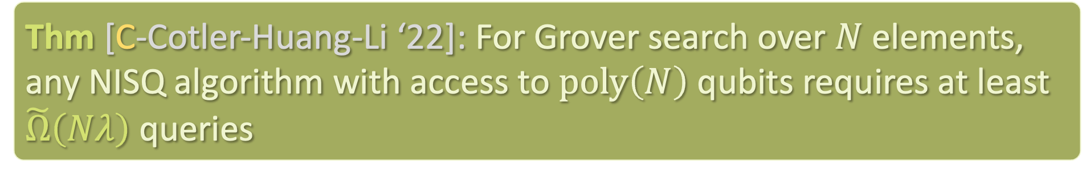
GROVER SEARCH
$$\left|i\right\rangle ↦{\left(−1\right)}^{1\left[i=i^{∗}\right]} \left|i\right\rangle$$
Thm [C-Cotler-Huang-Li ‘22]: For Grover search over $N$ elements, any NISQ algorithm with access to $poly\left(N\right)$ qubits requires at least $\tilde{Ω}\left(Nλ\right)$ queries
With constant noise rate, no speedup in NISQ (up to log factors)

Slide 26
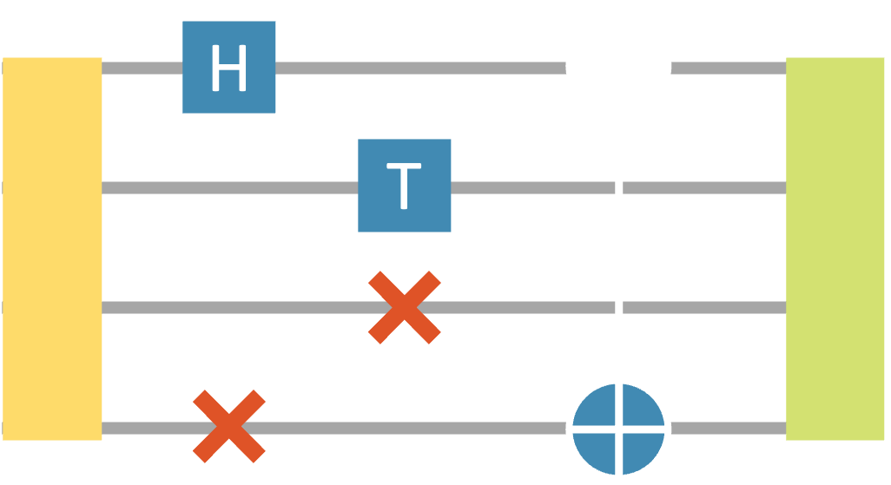
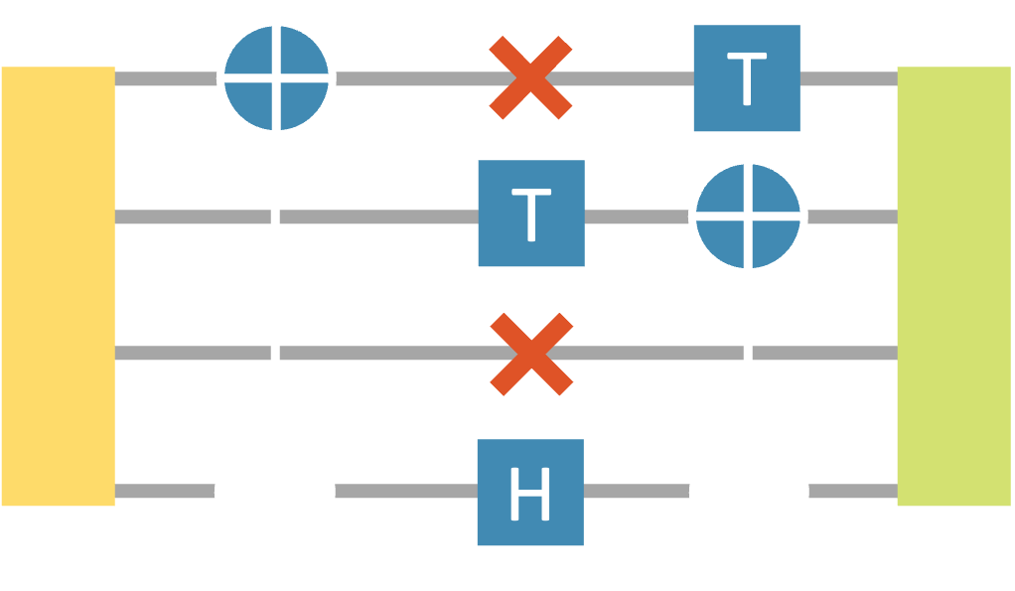
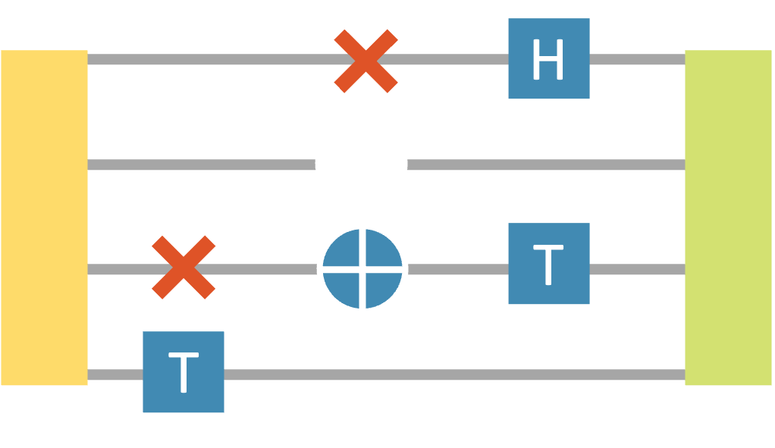
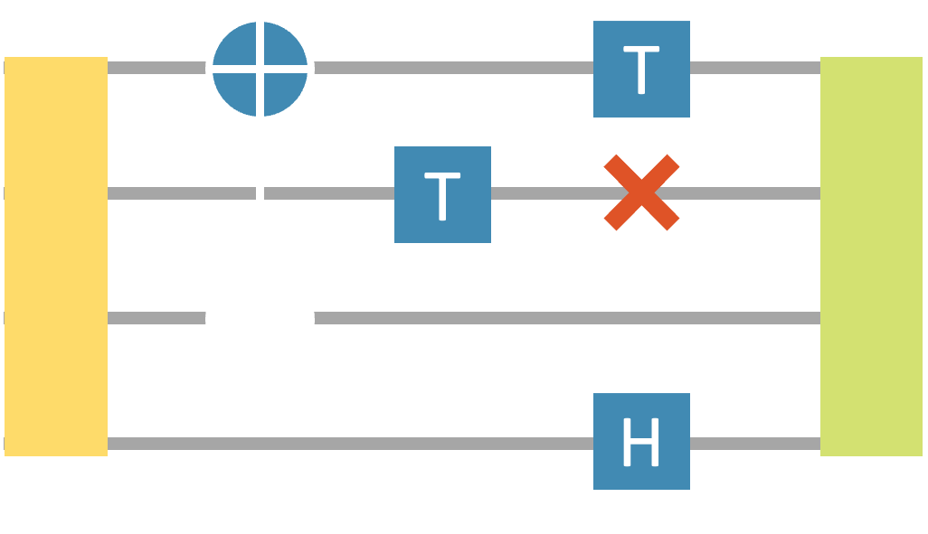
GROVER SEARCH – LEARNING TREE FORMALISM

Slide 27
GROVER SEARCH – LEARNING TREE FORMALISM

Slide 28
GROVER SEARCH – LEARNING TREE FORMALISM

Slide 29
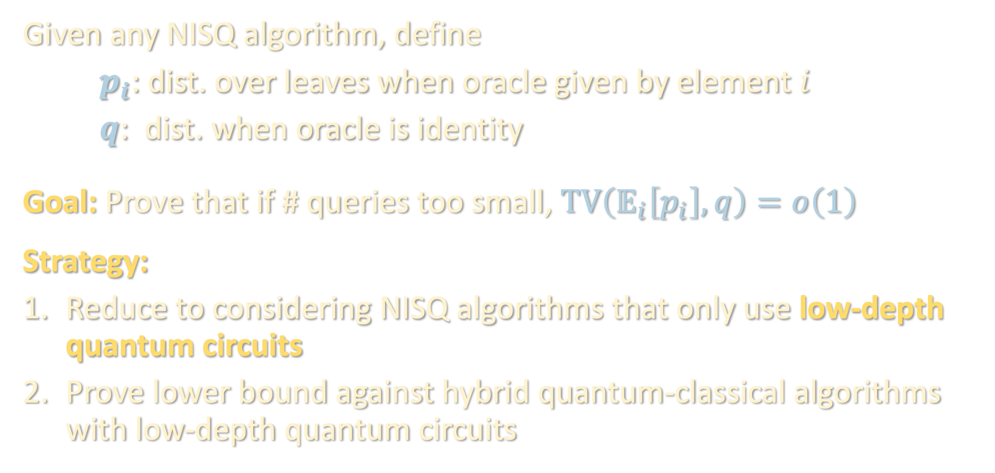
GROVER SEARCH – LEARNING TREE FORMALISM
Given any NISQ algorithm, define
$p_{i}$: dist. over leaves when oracle given by element $i$
$q$: dist. when oracle is identity
Goal: Prove that if # queries too small, $TV\left(𝔼_{i}\left[p_{i}\right],q\right)=o\left(1\right)$
Strategy:
Reduce to considering NISQ algorithms that only use low-depth quantum circuits
Prove lower bound against hybrid quantum-classical algorithms with low-depth quantum circuits

Slide 30
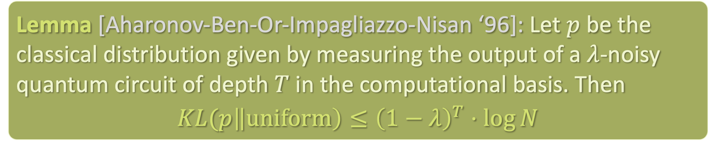

GROVER SEARCH – REDUCTION TO LOW-DEPTH
Can assume all NQC queries are low-depth:
Given any successful NISQ algorithm, can replace results of all NQC oracle calls of depth >> $λ^{−1}\log{N}$ with uniformly random strings.
Distribution over leaves is negligibly affected in statistical distance
Lemma [Aharonov-Ben-Or-Impagliazzo-Nisan ‘96]: Let $p$ be the classical distribution given by measuring the output of a $λ$-noisy quantum circuit of depth $T$ in the computational basis. Then
$$KL(p\left\|uniform\right)≤{\left(1−λ\right)}^{T}⋅\log{N}$$

Slide 31

GROVER SEARCH – LOWER BOUND FOR LOW-DEPTH
To bound TV, suffices to show that the likelihood ratio
$$\frac{𝔼_{i}\left[p_{i}\left(x_{1},…,x_{T}\right)\right]}{q\left(x_{1},…,x_{T}\right)}$$
is close to 1 w.h.p. over leaves $∼q$.

Slide 32

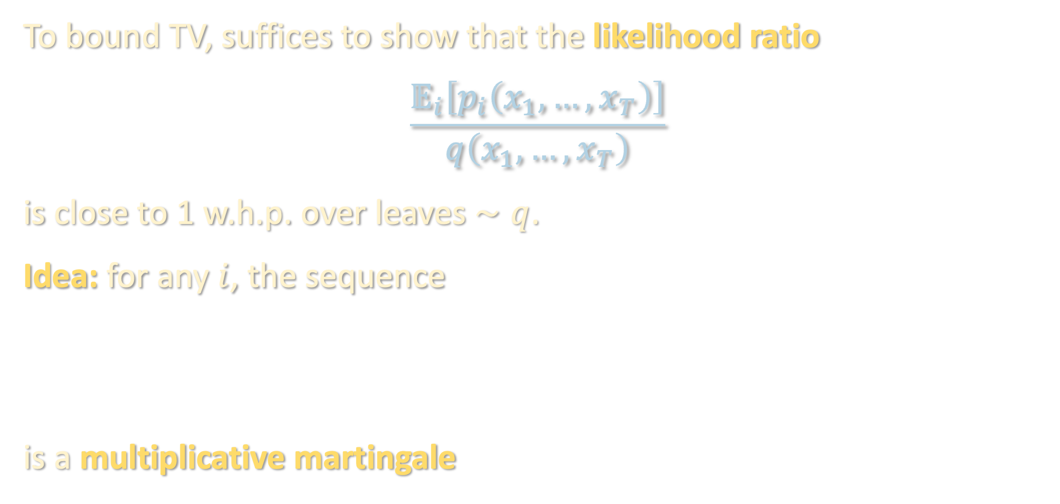
GROVER SEARCH – LOWER BOUND FOR LOW-DEPTH
To bound TV, suffices to show that the likelihood ratio
$$\frac{𝔼_{i}\left[p_{i}\left(x_{1},…,x_{T}\right)\right]}{q\left(x_{1},…,x_{T}\right)}$$
is close to 1 w.h.p. over leaves $∼q$.
Idea: for any $i$, the sequence
is a multiplicative martingale
$${\left\{\frac{p_{i}\left(x_{1},…,x_{s}\right)}{q\left(x_{1},…,x_{s}\right)}\right\}}_{s=1,…,T}$$

Slide 33

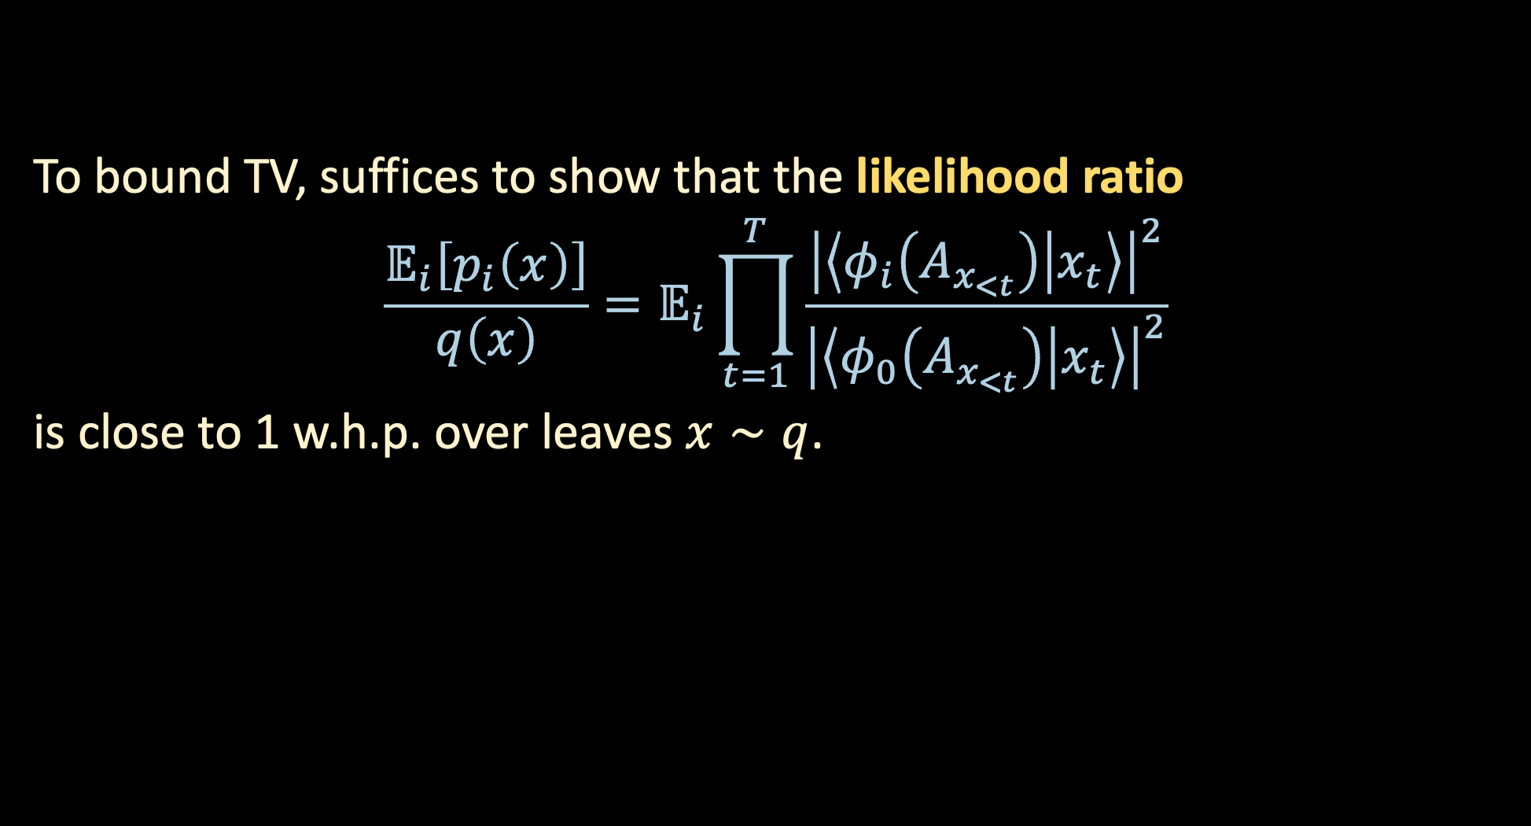
GROVER SEARCH – LOWER BOUND FOR LOW-DEPTH
To bound TV, suffices to show that the likelihood ratio
$$\frac{𝔼_{i}\left[p_{i}\left(x\right)\right]}{q\left(x\right)}=𝔼_{i}\prod_{t=1}^{T}{\frac{{\left|\left\langle φ_{i}\left(A_{x_{<t}}\right) | x_{t}\right\rangle \right|}^{2}}{{\left|\left\langle φ_{0}\left(A_{x_{<t}}\right) | x_{t}\right\rangle \right|}^{2}}}$$
is close to 1 w.h.p. over leaves $x∼q$.
Upon seeing $x_{1},…,x_{t−1}$, the NISQ algorithm runs noisy quantum circuit $A_{x_{<t}}$ with calls to $i$-th Grover oracle, resulting in output state $φ_{i}\left(A_{x_{<t}}\right)$

Slide 34

GROVER SEARCH – LOWER BOUND FOR LOW-DEPTH
To bound TV, suffices to show that the likelihood ratio
$$\frac{𝔼_{i}\left[p_{i}\left(x\right)\right]}{q\left(x\right)}=𝔼_{i}\prod_{t=1}^{T}{\frac{{\left|\left\langle φ_{i}\left(A_{x_{<t}}\right) | x_{t}\right\rangle \right|}^{2}}{{\left|\left\langle φ_{0}\left(A_{x_{<t}}\right) | x_{t}\right\rangle \right|}^{2}}}$$
is close to 1 w.h.p. over leaves $x∼q$.
Upon seeing $x_{1},…,x_{t−1}$, the NISQ algorithm runs noisy quantum circuit $A_{x_{<t}}$ with calls to the identity oracle, resulting in output state $φ_{0}\left(A_{x_{<t}}\right)$

Slide 35
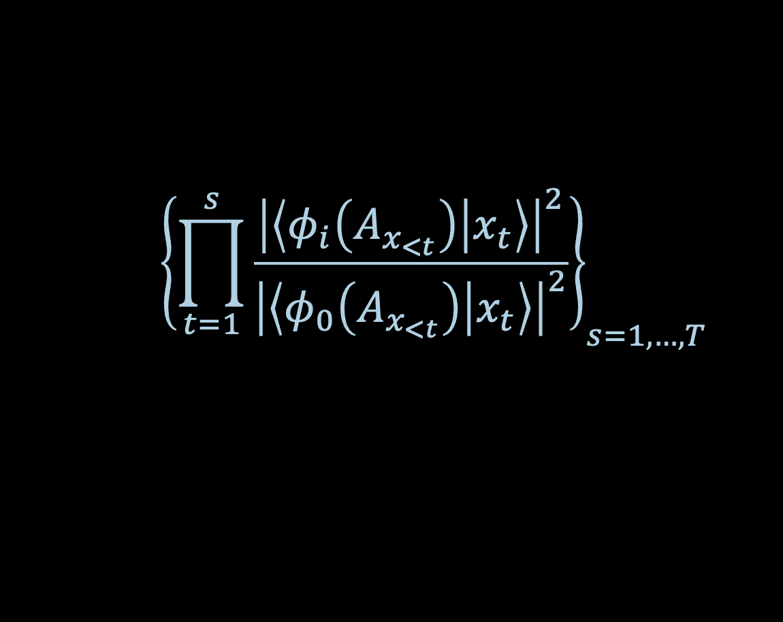
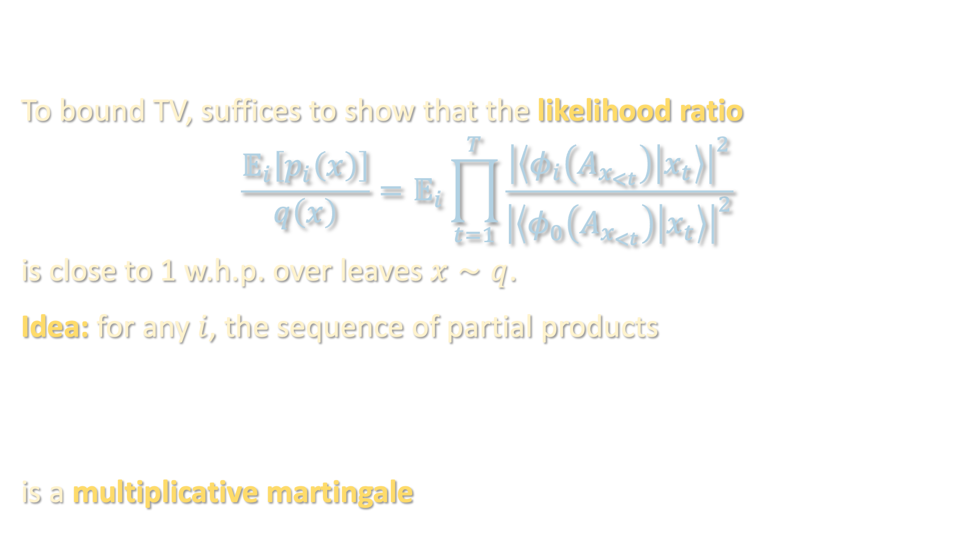
GROVER SEARCH – LOWER BOUND FOR LOW-DEPTH
To bound TV, suffices to show that the likelihood ratio
$$\frac{𝔼_{i}\left[p_{i}\left(x\right)\right]}{q\left(x\right)}=𝔼_{i}\prod_{t=1}^{T}{\frac{{\left|\left\langle φ_{i}\left(A_{x_{<t}}\right) | x_{t}\right\rangle \right|}^{2}}{{\left|\left\langle φ_{0}\left(A_{x_{<t}}\right) | x_{t}\right\rangle \right|}^{2}}}$$
is close to 1 w.h.p. over leaves $x∼q$.
Idea: for any $i$, the sequence of partial products
is a multiplicative martingale
$${\left\{\prod_{t=1}^{s}{\frac{{\left|\left\langle φ_{i}\left(A_{x_{<t}}\right) | x_{t}\right\rangle \right|}^{2}}{{\left|\left\langle φ_{0}\left(A_{x_{<t}}\right) | x_{t}\right\rangle \right|}^{2}}}\right\}}_{s=1,…,T}$$

Slide 36
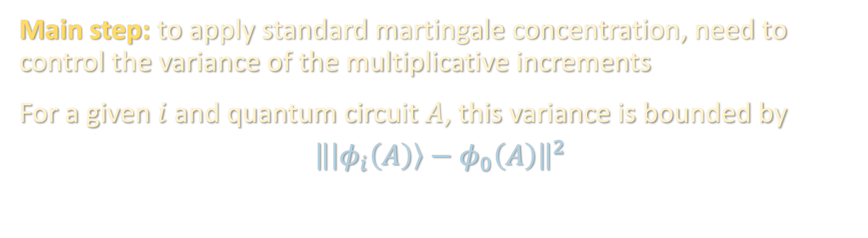
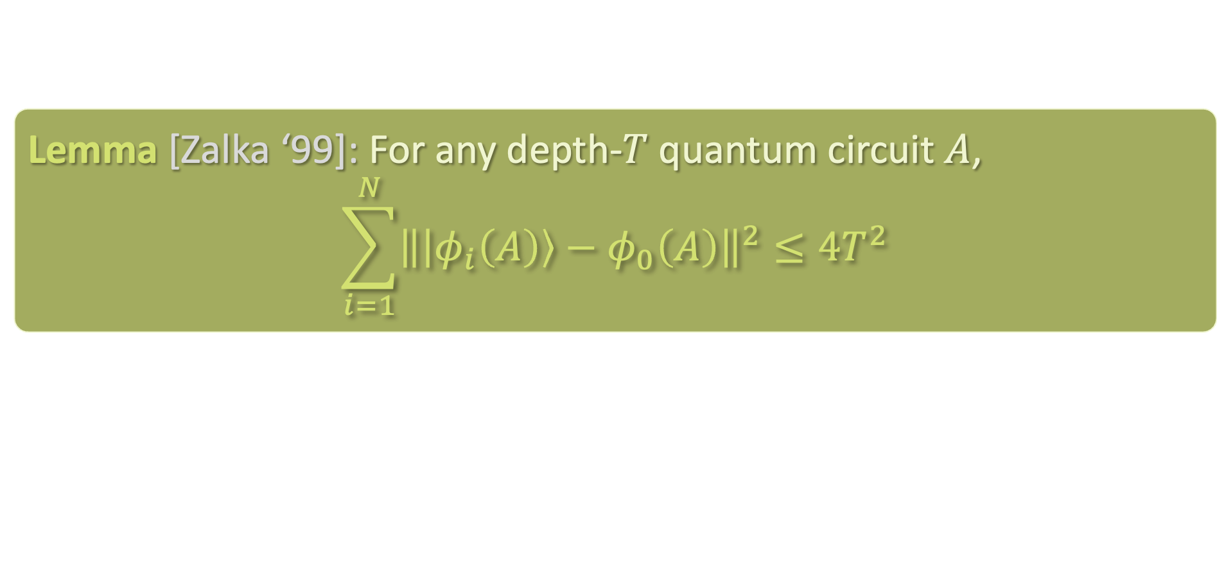
GROVER SEARCH – LOWER BOUND FOR LOW-DEPTH
Main step: to apply standard martingale concentration, need to control the variance of the multiplicative increments
For a given $i$ and quantum circuit $A$, this variance is bounded by
$${\left\|\left|φ_{i}\left(A\right)\right\rangle −φ_{0}\left(A\right)\right\|}^{2}$$
Lemma [Zalka ‘99]: For any depth-$T$ quantum circuit $A$,
$$\sum_{i=1}^{N}{{\left\|\left|φ_{i}\left(A\right)\right\rangle −φ_{0}\left(A\right)\right\|}^{2}}≤4T^{2}$$

Slide 37
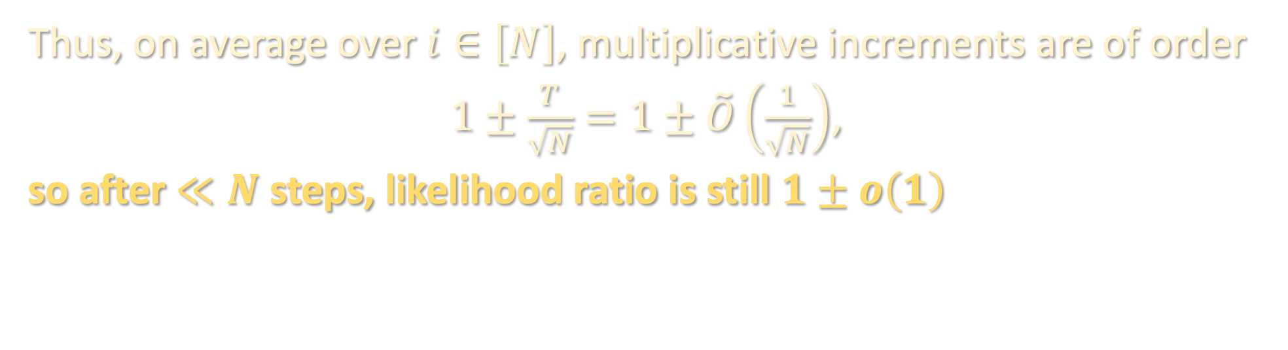
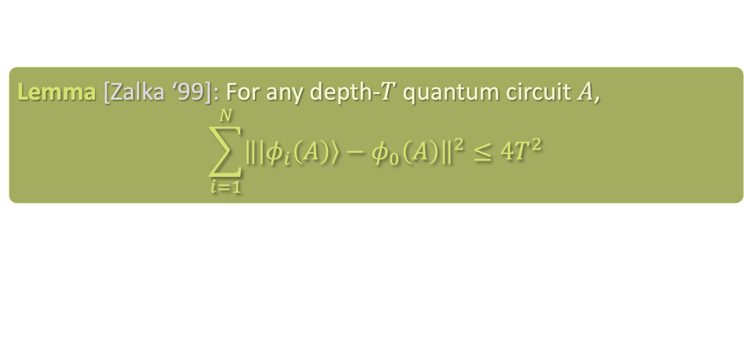
GROVER SEARCH – LOWER BOUND FOR LOW-DEPTH
Lemma [Zalka ‘99]: For any depth-$T$ quantum circuit $A$,
$$\sum_{i=1}^{N}{{\left\|\left|φ_{i}\left(A\right)\right\rangle −φ_{0}\left(A\right)\right\|}^{2}}≤4T^{2}$$
Thus, on average over $i∈\left[N\right]$, multiplicative increments are of order
$1±\frac{T}{\sqrt{N}}=1±\tilde{O}\left(\frac{1}{\sqrt{N}}\right)$,
so after $≪N$ steps, likelihood ratio is still $1±o\left(1\right)$

Slide 38
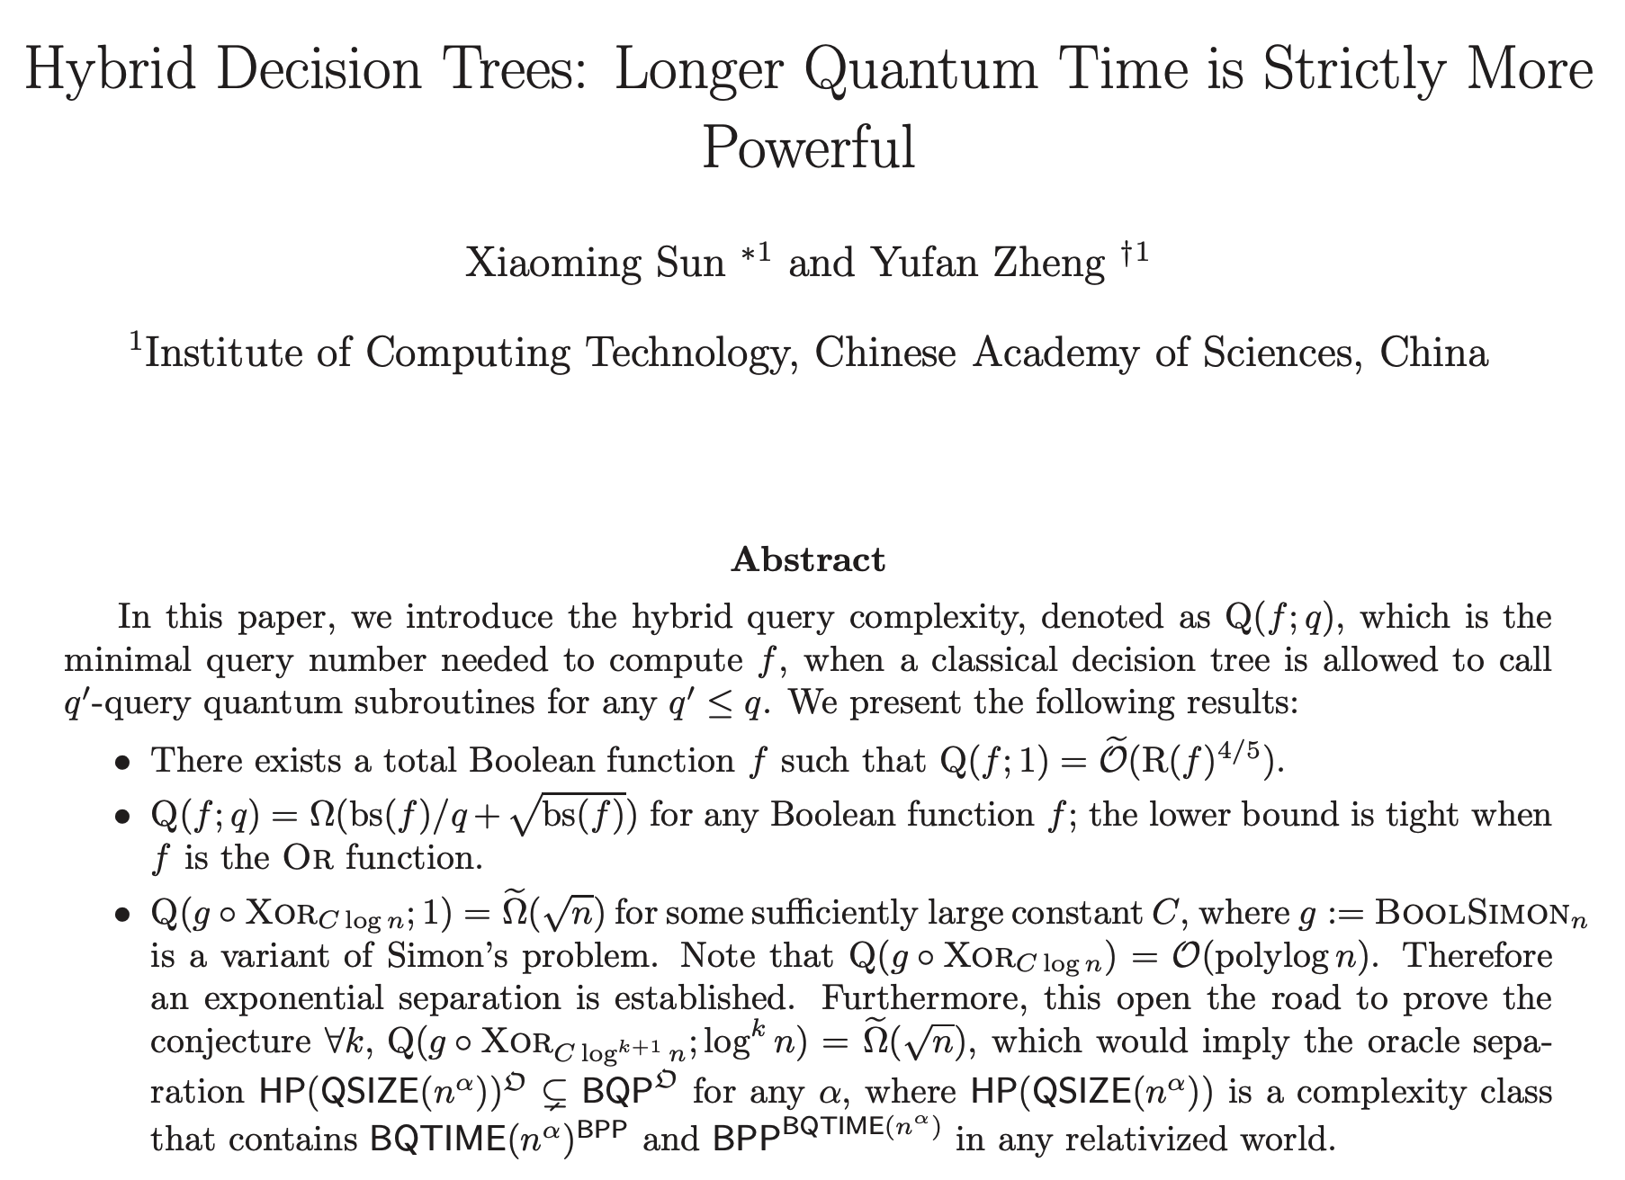
GROVER SEARCH – LOWER BOUND FOR LOW-DEPTH
Sun-Zheng ‘19 proved a similar negative result for hybrid quantum-classical with bounded-depth quantum computation using a very different set of tools, e.g. adversary method

Slide 39
BERNSTEIN-VAZIRANI
GROVER SEARCH
BPP vs NISQ vs BQP
SHADOW TOMOGRAPHY
OPEN PROBLEMS/TAKEAWAYS

Slide 40
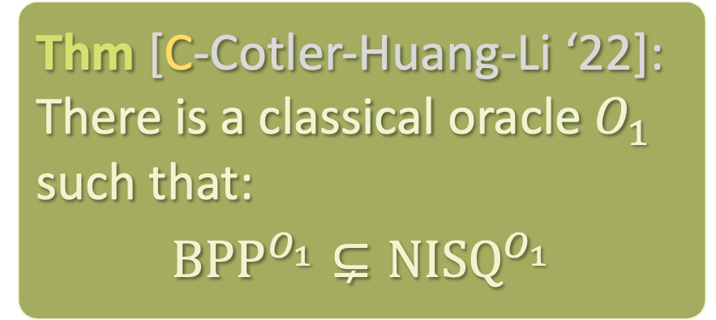

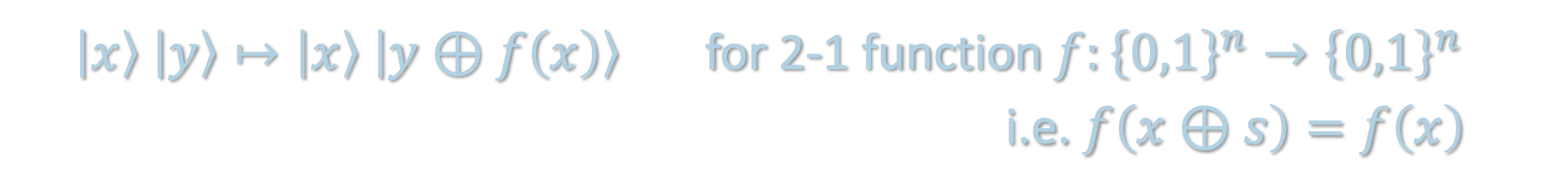

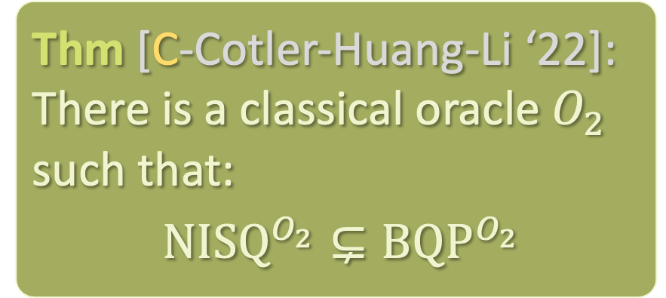
BPP vs NISQ vs BQP
$\left|x\right\rangle \left|y\right\rangle ↦\left|x\right\rangle \left|y⊕f\left(x\right)\right\rangle$ for 2-1 function $f:{\left\{0,1\right\}}^{n}→{\left\{0,1\right\}}^{n}$
i.e. $f\left(x⊕s\right)=f\left(x\right)$
Thm [C-Cotler-Huang-Li ‘22]: There is a classical oracle $O_{1}$ such that:
$${BPP}^{O_{1}}⊊{NISQ}^{O_{1}}$$
Thm [C-Cotler-Huang-Li ‘22]: There is a classical oracle $O_{2}$ such that:
${NISQ}^{O_{2}}⊊{BQP}^{O_{2}}$
$O_{1}$: robustified version of Simon’s oracle
$O_{2}$: non-robust version of Simon’s oracle

Slide 41
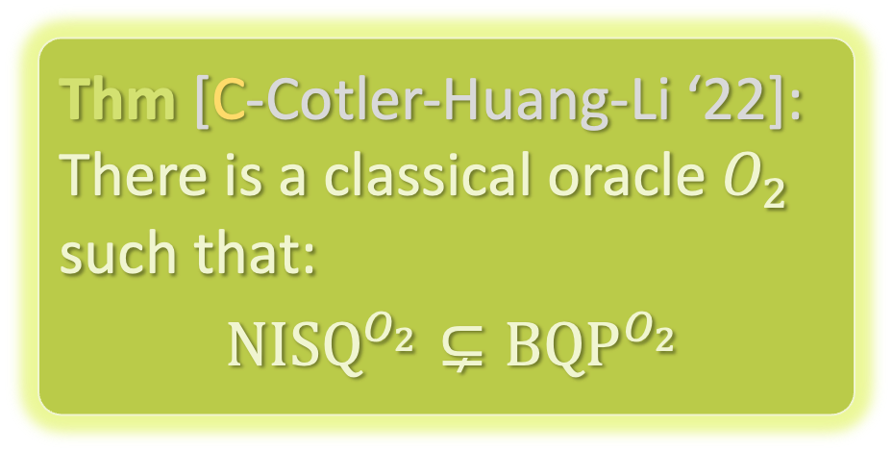
NISQ vs BQP
$\left|x\right\rangle \left|y\right\rangle ↦\left|x\right\rangle \left|y⊕f\left(x\right)\right\rangle$ for 2-1 function $f:{\left\{0,1\right\}}^{n}→{\left\{0,1\right\}}^{n}$
i.e. $f\left(x⊕s\right)=f\left(x\right)$
Thm [C-Cotler-Huang-Li ‘22]: There is a classical oracle $O_{1}$ such that:
$${BPP}^{O_{1}}⊊{NISQ}^{O_{1}}$$
Thm [C-Cotler-Huang-Li ‘22]: There is a classical oracle $O_{2}$ such that:
${NISQ}^{O_{2}}⊊{BQP}^{O_{2}}$
$O_{1}$: robustified version of Simon’s oracle
$O_{2}$: non-robust version of Simon’s oracle

Slide 42
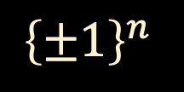
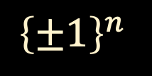
NISQ vs BQP
Lifted Simon’s function:
$${\left\{±1\right\}}^{n}$$
$${\left\{±1\right\}}^{n}$$

Slide 43


NISQ vs BQP
Lifted Simon’s function:
$${\left\{±1\right\}}^{2n}$$
$${\left\{±1\right\}}^{n}$$
$$\vec{0}$$

Slide 44
NISQ vs BQP
Lifted Simon’s function:
$${\left\{±1\right\}}^{2n}$$
$${\left\{±1\right\}}^{n}$$
$$\vec{0}$$
An “interesting” input remains “interesting” after being corrupted by noise with exponentially small probability

Slide 45




NISQ vs BQP
Lifted Simon’s function:
$${\left\{±1\right\}}^{2n}$$
$${\left\{±1\right\}}^{n}$$
This construction can be viewed as the base case of the recursive “shuffling Simon’s problem” due to [Chia-Chung-Lai ‘20], which can be used to prove NISQ $≠BPP^{{QNC}_{0}}$
$$\vec{0}$$

Slide 46
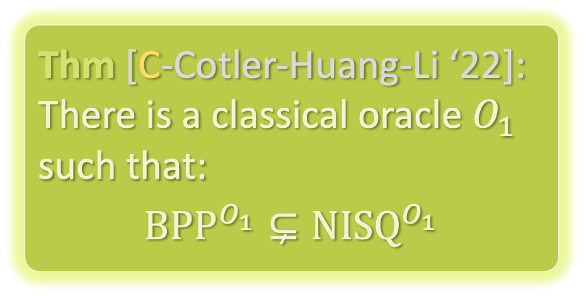
BPP vs NISQ
$\left|x\right\rangle \left|y\right\rangle ↦\left|x\right\rangle \left|y⊕f\left(x\right)\right\rangle$ for 2-1 function $f:{\left\{0,1\right\}}^{n}→{\left\{0,1\right\}}^{n}$
i.e. $f\left(x⊕s\right)=f\left(x\right)$
Thm [C-Cotler-Huang-Li ‘22]: There is a classical oracle $O_{1}$ such that:
$${BPP}^{O_{1}}⊊{NISQ}^{O_{1}}$$
Thm [C-Cotler-Huang-Li ‘22]: There is a classical oracle $O_{2}$ such that:
${NISQ}^{O_{2}}⊊{BQP}^{O_{2}}$
$O_{1}$: robustified version of Simon’s oracle
$O_{2}$: non-robust version of Simon’s oracle

Slide 47






BPP vs NISQ
$$\left|0\right\rangle$$
$$\left|0\right\rangle$$
$$\left|0\right\rangle$$
$$trace out$$
$$\left|0\right\rangle$$
$$trace out$$

Slide 48

BPP vs NISQ
$$\left|0\right\rangle$$
$$\left|0\right\rangle$$
$$\left|0\right\rangle$$
$$trace out$$
Robustly
Hadamard + measure
$$\left|0\right\rangle$$
$$trace out$$
Robustly prepare ${\left|+\right\rangle }^{⊗n}⊗{\left|0\right\rangle }^{⊗n}$
Robustify the oracle

Slide 49



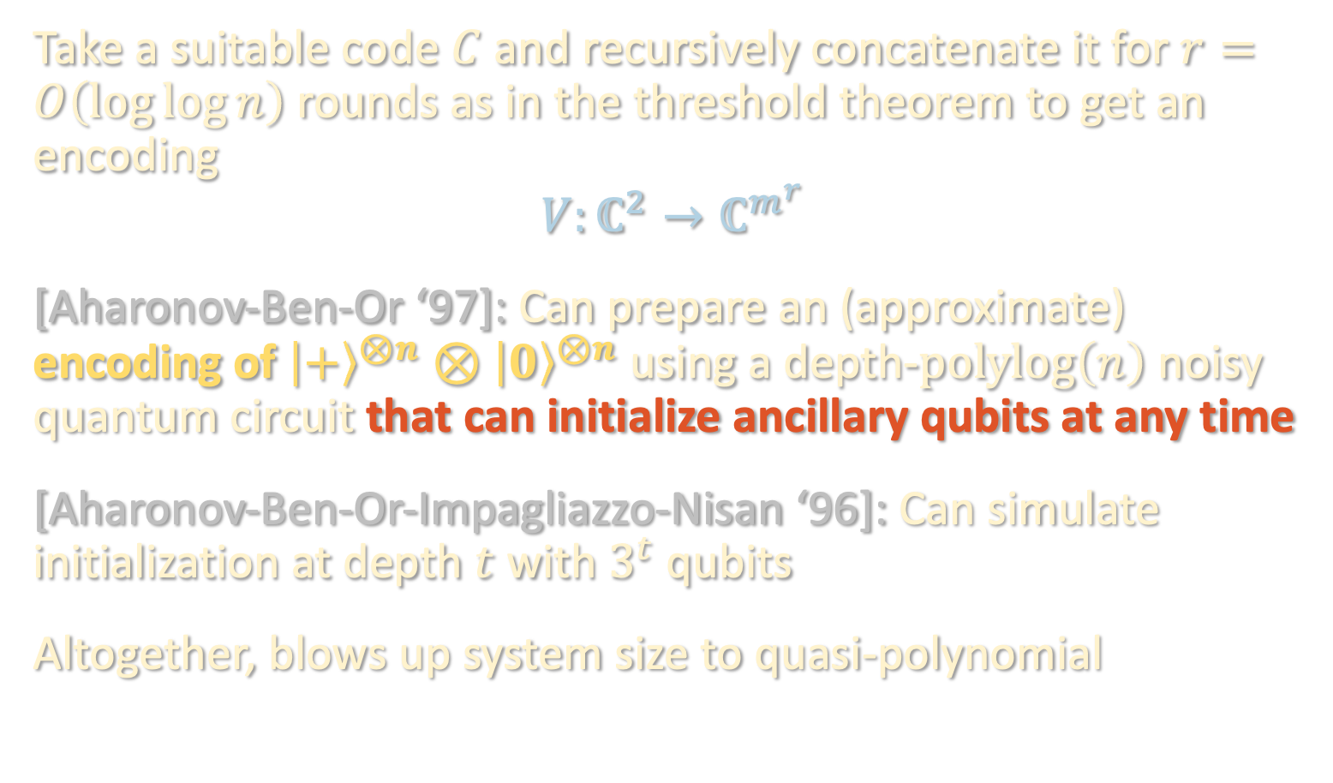


BPP vs NISQ
Take a suitable code $C$ and recursively concatenate it for $r=O\left(\log{\log{n}}\right)$ rounds as in the threshold theorem to get an encoding
$$V:ℂ^{2}→ℂ^{m^{r}}$$
[Aharonov-Ben-Or ‘97]: Can prepare an (approximate) encoding of ${\left|+\right\rangle }^{⊗n}⊗{\left|0\right\rangle }^{⊗n}$ using a depth-$polylog\left(n\right)$ noisy quantum circuit that can initialize ancillary qubits at any time
[Aharonov-Ben-Or-Impagliazzo-Nisan ‘96]: Can simulate initialization at depth $t$ with $3^{t}$ qubits
Altogether, blows up system size to quasi-polynomial
$$\left|0\right\rangle$$
$$\left|0\right\rangle$$
$$\left|0\right\rangle$$
$$\left|0\right\rangle$$
Robustly prepare ${\left|+\right\rangle }^{⊗n}⊗{\left|0\right\rangle }^{⊗n}$
Notes:
the noiseless circuit is low-depth, so we can robustly implement it with polylog blowup

Slide 50
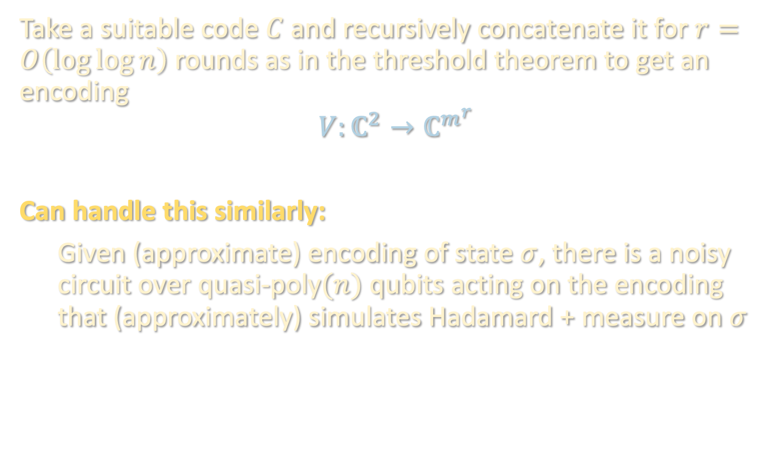
BPP vs NISQ
Take a suitable code $C$ and recursively concatenate it for $r=O\left(\log{\log{n}}\right)$ rounds as in the threshold theorem to get an encoding
$$V:ℂ^{2}→ℂ^{m^{r}}$$
Can handle this similarly:
Given (approximate) encoding of state $σ$, there is a noisy circuit over quasi-poly$(n)$ qubits acting on the encoding that (approximately) simulates Hadamard + measure on $σ$
Robustly Hadamard + measure
Notes:
the noiseless circuit is low-depth, so we can robustly implement it with polylog blowup

Slide 51
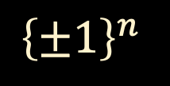


BPP vs NISQ
Encoding blows input size from $n$ to $m^{r}n$
$${\left\{±1\right\}}^{n}$$
$${\left\{±1\right\}}^{n}$$
Robustify the oracle
Notes:
the noiseless circuit is low-depth, so we can robustly implement it with polylog blowup

Slide 52

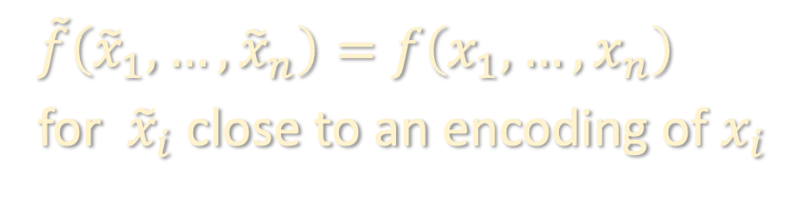



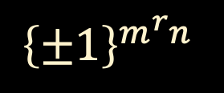


BPP vs NISQ
Encoding blows input size from $n$ to $m^{r}n$
$${\left\{±1\right\}}^{m^{r}n}$$
$${\left\{±1\right\}}^{n}$$
$$⋮$$
$$⋮$$
$$⋮$$
$$⋮$$
$$⋮$$
$$⋮$$
Robustify the oracle
$\tilde{f}\left({\tilde{x}}_{1},…,{\tilde{x}}_{n}\right)=f\left(x_{1},…,x_{n}\right)$
for ${\tilde{x}}_{i}$ close to an encoding of $x_{i}$
Notes:
the noiseless circuit is low-depth, so we can robustly implement it with polylog blowup

Slide 53
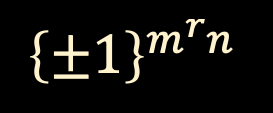
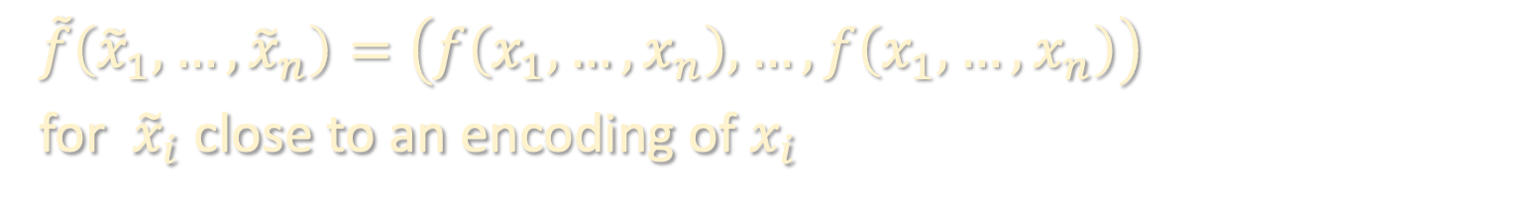
BPP vs NISQ
Encoding blows input size from $n$ to $m^{r}n$
$${\left\{±1\right\}}^{m^{r}n}$$
$${\left\{±1\right\}}^{m^{r}n}$$
$$⋮$$
$$⋮$$
$$⋮$$
$$⋮$$
$$⋮$$
$$⋮$$
Robustify the oracle
$$\tilde{f}\left({\tilde{x}}_{1},…,{\tilde{x}}_{n}\right)=\left(f\left(x_{1},…,x_{n}\right),…,f\left(x_{1},…,x_{n}\right)\right)$$
for ${\tilde{x}}_{i}$ close to an encoding of $x_{i}$
Notes:
the noiseless circuit is low-depth, so we can robustly implement it with polylog blowup

Slide 54
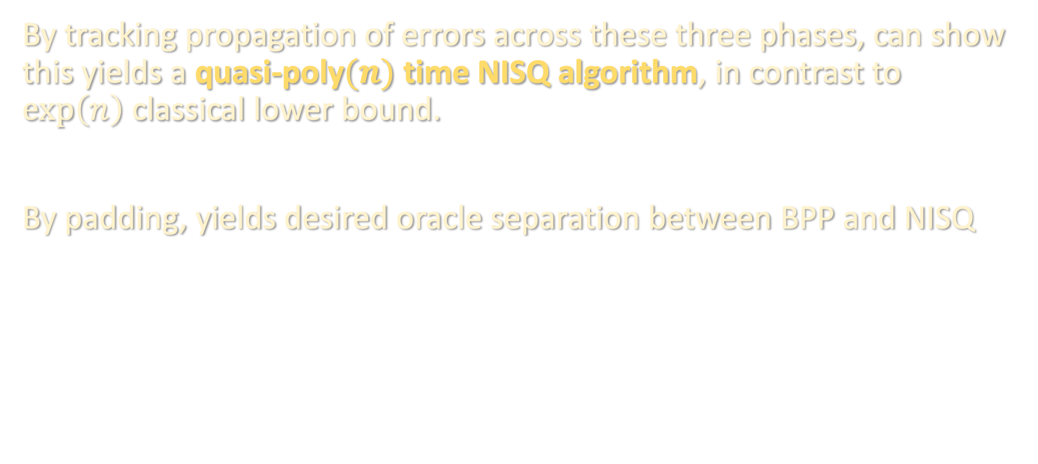
BPP vs NISQ
By tracking propagation of errors across these three phases, can show this yields a quasi-poly$(n)$ time NISQ algorithm, in contrast to $\exp\left(n\right)$ classical lower bound.
By padding, yields desired oracle separation between BPP and NISQ
Notes:
the noiseless circuit is low-depth, so we can robustly implement it with polylog blowup

Slide 55
BERNSTEIN-VAZIRANI
GROVER SEARCH
BPP vs NISQ vs BQP
SHADOW TOMOGRAPHY
OPEN PROBLEMS/TAKEAWAYS

Slide 56


SHADOW TOMOGRAPHY
Thm [C-Cotler-Huang-Li ‘22]: Any NISQ algorithm requires at least $Ω\left({\left(1 −λ\right)}^{−n}\right)$ copies of $ρ$ to learn $\left|Tr\left(Pρ\right)\right|$ for all Pauli observables $P$ up to constant additive error
In contrast, at most $O(n)$ copies are needed for BQP
[Huang-Flammia-Preskill ‘22]: NISQ upper bound of $O\left({\left(1 −λ\right)}^{−n}\right)$ copies even for more challenging noise models

Slide 57



SHADOW TOMOGRAPHY
Thm [C-Cotler-Huang-Li ‘22]: Any NISQ algorithm requires at least $Ω\left({\left(1 −λ\right)}^{−n}\right)$ copies of $ρ$ to learn $\left|Tr\left(Pρ\right)\right|$ for all Pauli observables $P$ up to constant additive error
In contrast, at most $O(n)$ copies are needed for BQP
[Huang-Flammia-Preskill ‘22]: NISQ upper bound of $O\left({\left(1 −λ\right)}^{−n}\right)$ copies even for more challenging noise models
[Huang et al. ’21]: Practical advantage for intermediate $n$

Slide 58
BERNSTEIN-VAZIRANI
GROVER SEARCH
BPP vs NISQ vs BQP
SHADOW TOMOGRAPHY
OPEN PROBLEMS/TAKEAWAYS

Slide 59
OPEN QUESTIONS TAKEAWAYS
Thanks!
More natural oracles?
NISQ lower bd for (vanilla) Simon’s?
Single oracle that simultaneously separates all three classes?
Separate BPP and NISQ relative to a random oracle? (conj: not possible)
Incorporating spatial constraints?
Hierarchy between NISQ and BQP?
What can NISQ + modest amount of partial measurement / intermediate ancilla do?
Other NISQ speedups beyond BV?
Unique opportunity to define complexity class directly motivated by contemporary engineering constraints
NISQ class offers mathematical framework for reasoning about noisy quantum advantage
Oracle separations suggesting NISQ is intermediate between BPP and BQP
Gave NISQ upper/lower bds for well-studied problems: Grover search, BV, shadow tomography

Slide 60
TAKEAWAYS
NISQ era provides unique opportunity to define complexity class directly motivated by contemporary engineering constraints
Abstracting NISQ computation into a complexity class offers mathematical framework for reasoning about noisy quantum advantage
Used tools from query complexity to give oracle separations suggesting that NISQ is intermediate between BPP and BQP
Gave NISQ speedups and slowdowns for three well-studied problems: Grover search, Bernstein-Vazirani, shadow tomography

