Slide 1
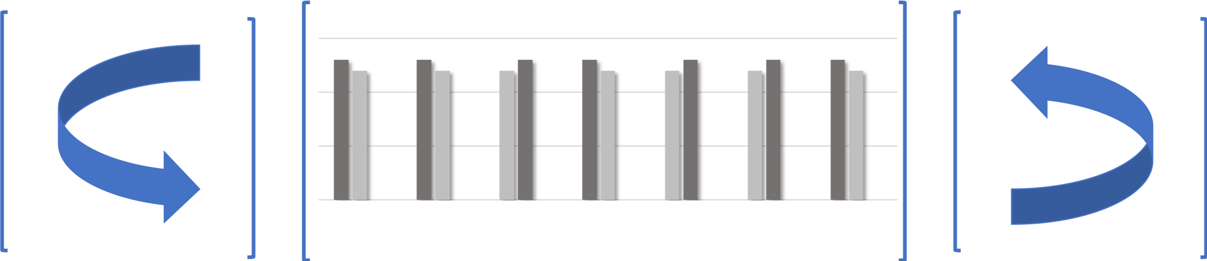
Entanglement is Necessary for Optimal Quantum Property Testing
Sébastien Bubeck | Sitan Chen | Jerry Li
MSR | MIT | MSR

Slide 2
OUTLINE
Crash Course on Quantum Property Testing
Prior Work + Our Results
Lower Bound Construction
Chain Rule Calculation
Open Questions

Slide 3
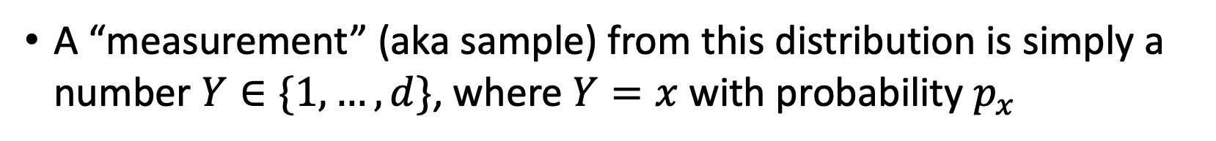
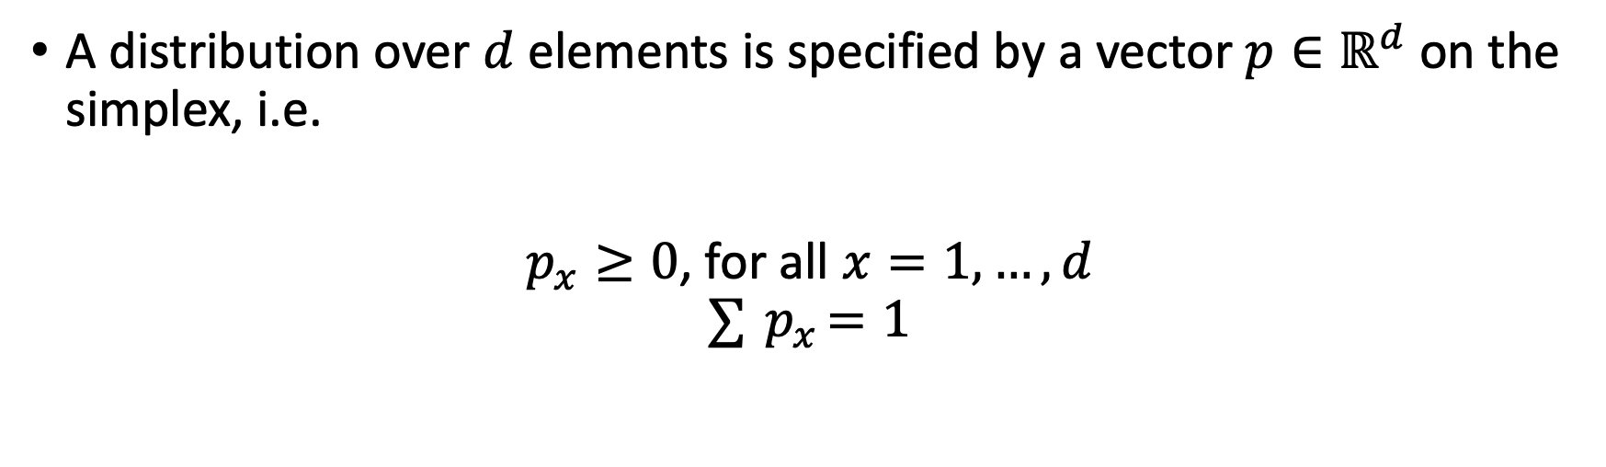
CLASSICAL DISTRIBUTIONS
A distribution over $d$ elements is specified by a vector $p∈ℝ^{d}$ on the simplex, i.e.
$p_{x}≥0$, for all $x=1, …, d$
$$∑{ p}_{x}=1$$
A “measurement” (aka sample) from this distribution is simply a number $Y∈\{1, …, d\}$, where $Y=x$ with probability $p_{x}$

Slide 4
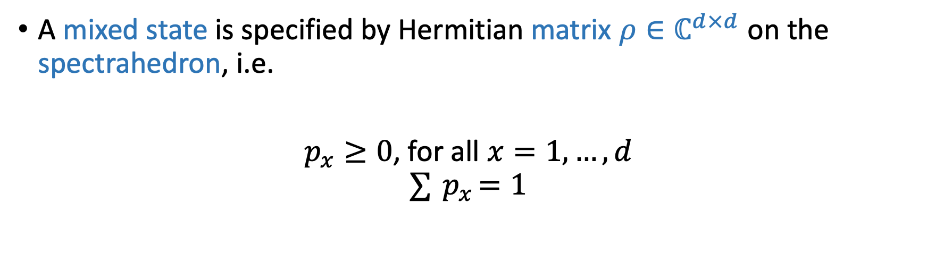
QUANTUM “DISTRIBUTIONS”
A mixed state is specified by Hermitian matrix $ρ∈ℂ^{d×d}$ on the spectrahedron, i.e.
$p_{x}≥0$, for all $x=1, …, d$
$$∑{ p}_{x}=1$$
A “measurement” (aka sample) from this distribution is simply a number $Y∈\{1, …, d\}$, where $Y=x$ with probability $p_{x}$

Slide 5
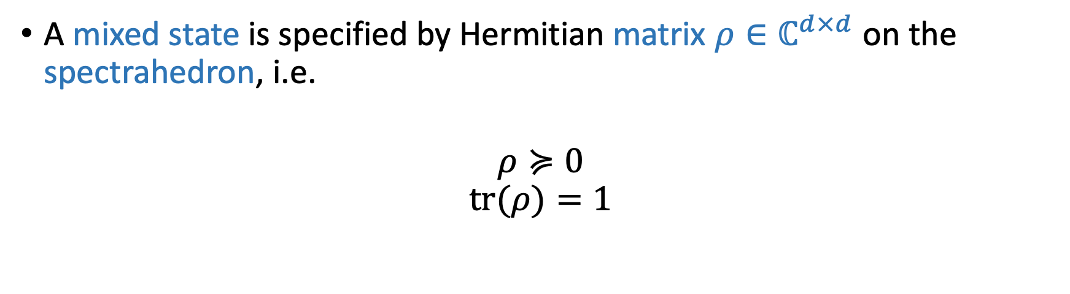
QUANTUM “DISTRIBUTIONS”
A mixed state is specified by Hermitian matrix $ρ∈ℂ^{d×d}$ on the spectrahedron, i.e.
$$ρ≽0$$
$$tr(ρ)=1$$
A “measurement” (aka sample) from this distribution is simply a number $Y∈\{1, …, d\}$, where $Y=x$ with probability $p_{x}$

Slide 6

QUANTUM “DISTRIBUTIONS”
A mixed state is specified by Hermitian matrix $ρ∈ℂ^{d×d}$ on the spectrahedron, i.e.
$$ρ≽0$$
$$tr(ρ)=1$$
Measuring a quantum distribution is a tad more complicated…

Slide 7
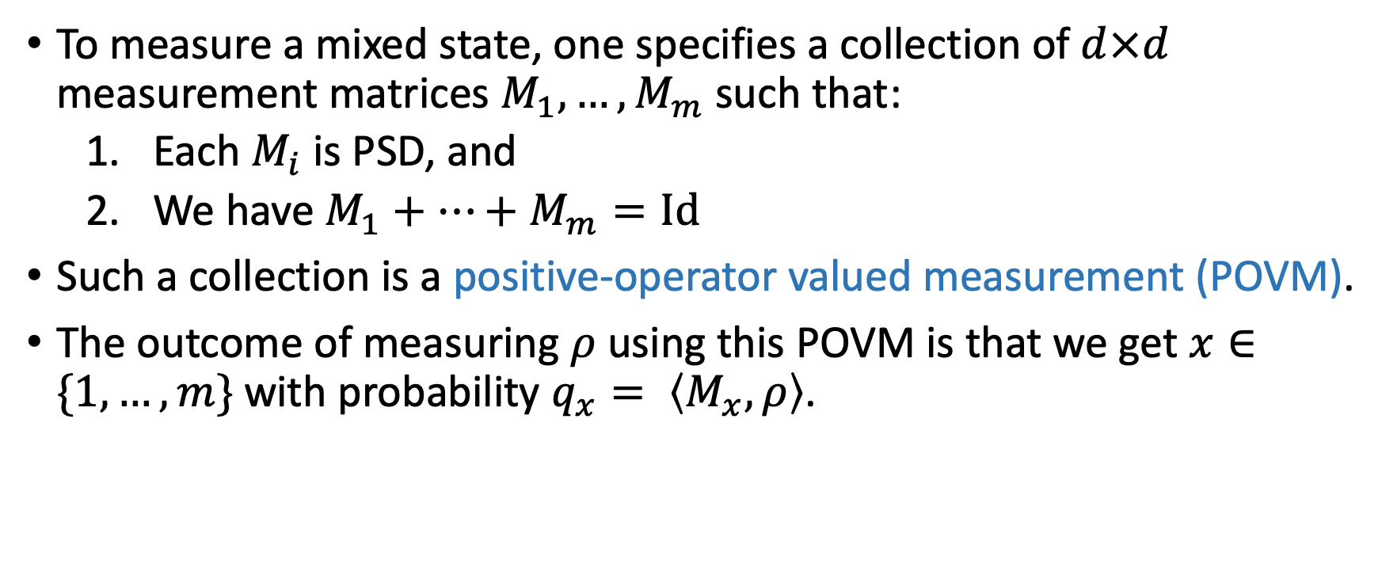
MEASURING MIXED STATES
To measure a mixed state, one specifies a collection of $d×d$ measurement matrices $M_{1},…,M_{m}$ such that:
  Each $M_{i}$ is PSD, and
  We have $M_{1}+…+M_{m}=Id$
Such a collection is a positive-operator valued measurement (POVM).
The outcome of measuring $ρ$ using this POVM is that we get $x∈\{1, …, m\}$ with probability $q_{x}= \left\langle M_{x},ρ\right\rangle$.

Slide 8
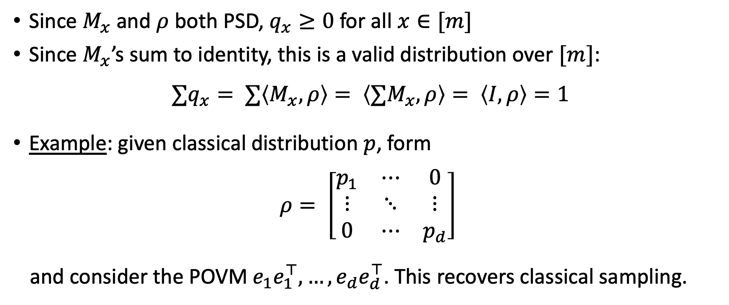
MEASURING MIXED STATES
Since $M_{x}$ and $ρ$ both PSD, $q_{x}≥0$ for all $x∈[m]$
Since $M_{x}$’s sum to identity, this is a valid distribution over $[m]$:
$$∑q_{x}= ∑\left\langle M_{x}, ρ\right\rangle = \left\langle ∑M_{x}, ρ\right\rangle = \left\langle I, ρ\right\rangle =1$$
Example: given classical distribution $p$, form
$$ρ= \left[\begin{matrix}p_{1} & ⋯ & 0 \\ ⋮ & ⋱ & ⋮ \\ 0 & ⋯ & p_{d}\end{matrix}\right]$$
and consider the POVM $e_{1}e_{1}^{⊤}, …,e_{d}e_{d}^{⊤}$. This recovers classical sampling.

Slide 9
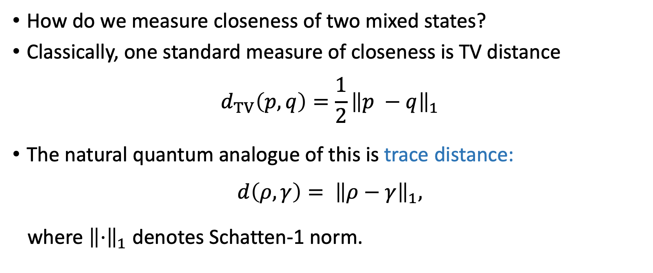
MEASURING CLOSENESS
How do we measure closeness of two mixed states?
Classically, one standard measure of closeness is TV distance
$$d_{TV}\left(p, q\right)=\frac{1}{2}{\left\|p −q\right\|}_{1}$$
The natural quantum analogue of this is trace distance:
$$d\left(ρ,γ\right)= {\left\|ρ−γ\right\|}_{1},$$
where ${\left\|⋅\right\|}_{1}$ denotes Schatten-1 norm.

Slide 10
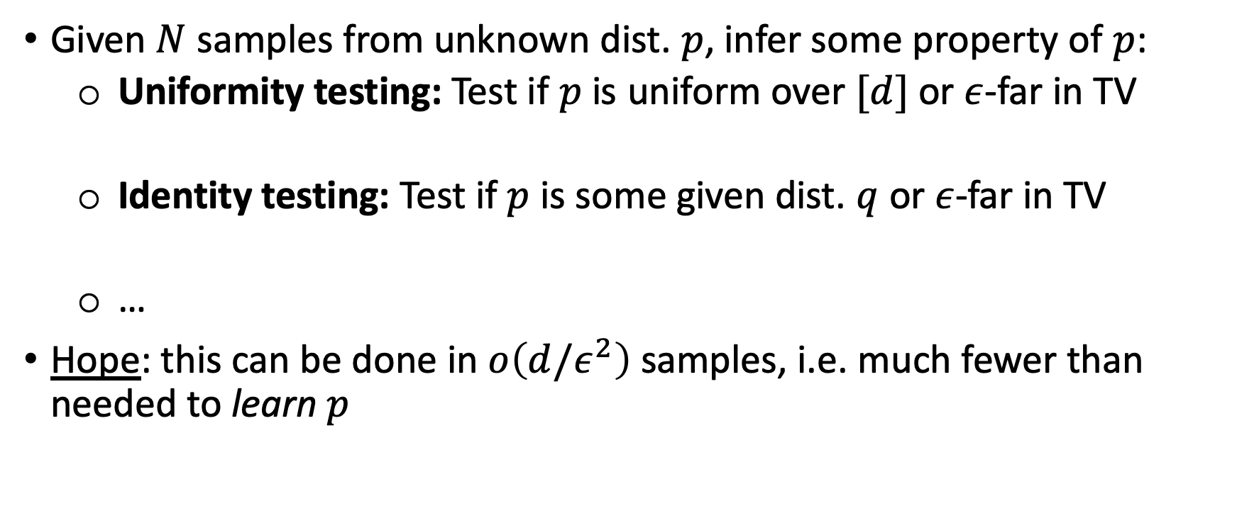
CLASSICAL DISTRIBUTION TESTING
Given $N$ samples from unknown dist. $p$, infer some property of $p$:
  Uniformity testing: Test if $p$ is uniform over $[d]$ or $ε$-far in TV
  Identity testing: Test if $p$ is some given dist. $q$ or $ε$-far in TV
  …
Hope: this can be done in $o\left(d/ε^{2}\right)$ samples, i.e. much fewer than needed to learn $p$

Slide 11
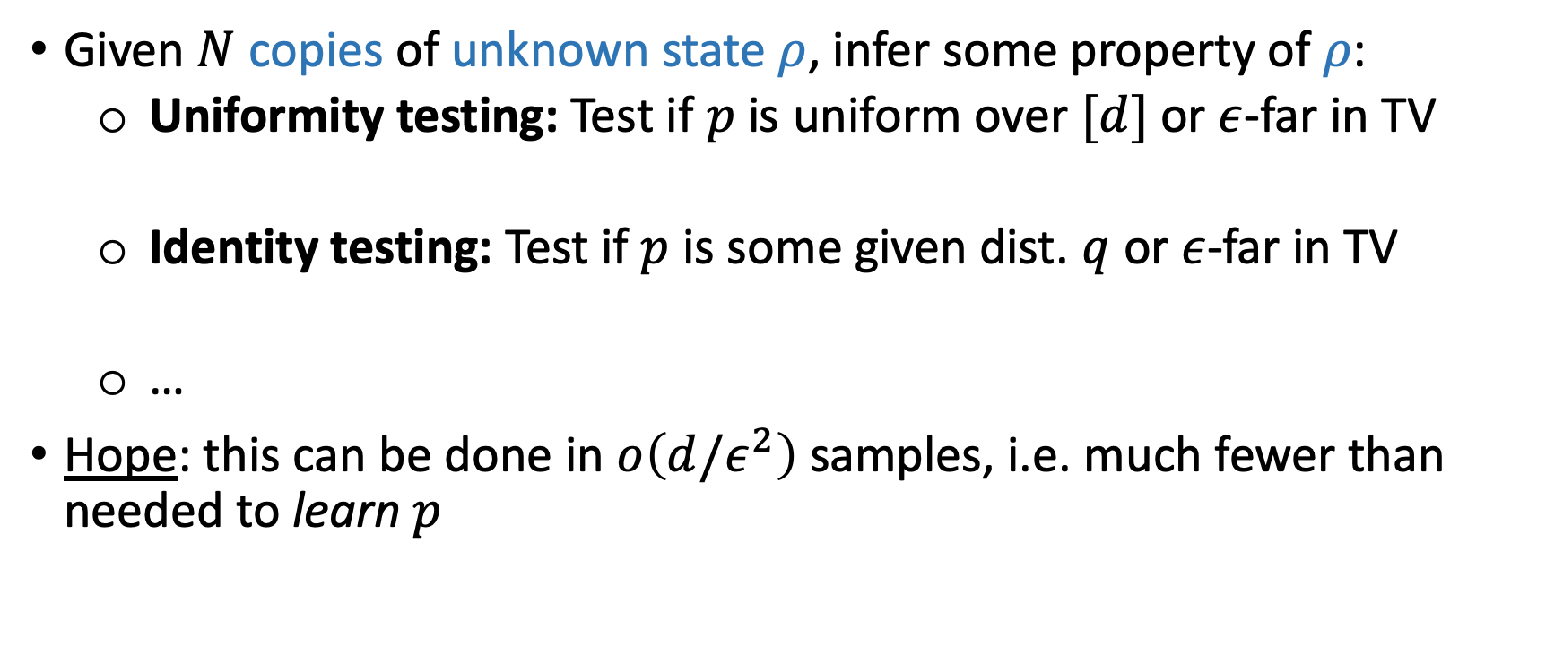
QUANTUM DISTRIBUTION TESTING
Given $N$ copies of unknown state $ρ$, infer some property of $ρ$:
  Uniformity testing: Test if $p$ is uniform over $[d]$ or $ε$-far in TV
  Identity testing: Test if $p$ is some given dist. $q$ or $ε$-far in TV
  …
Hope: this can be done in $o\left(d/ε^{2}\right)$ samples, i.e. much fewer than needed to learn $p$

Slide 12
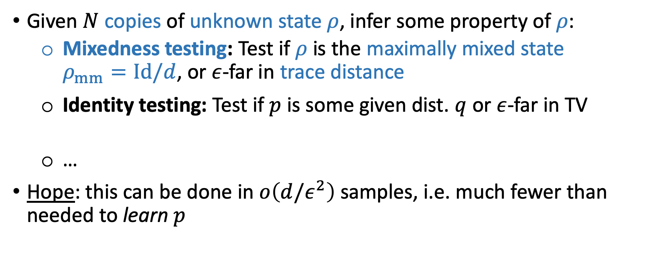
QUANTUM DISTRIBUTION TESTING
Given $N$ copies of unknown state $ρ$, infer some property of $ρ$:
  Mixedness testing: Test if $ρ$ is the maximally mixed state $ρ_{mm}=Id/d$, or $ε$-far in trace distance
  Identity testing: Test if $p$ is some given dist. $q$ or $ε$-far in TV
  …
Hope: this can be done in $o\left(d/ε^{2}\right)$ samples, i.e. much fewer than needed to learn $p$

Slide 13
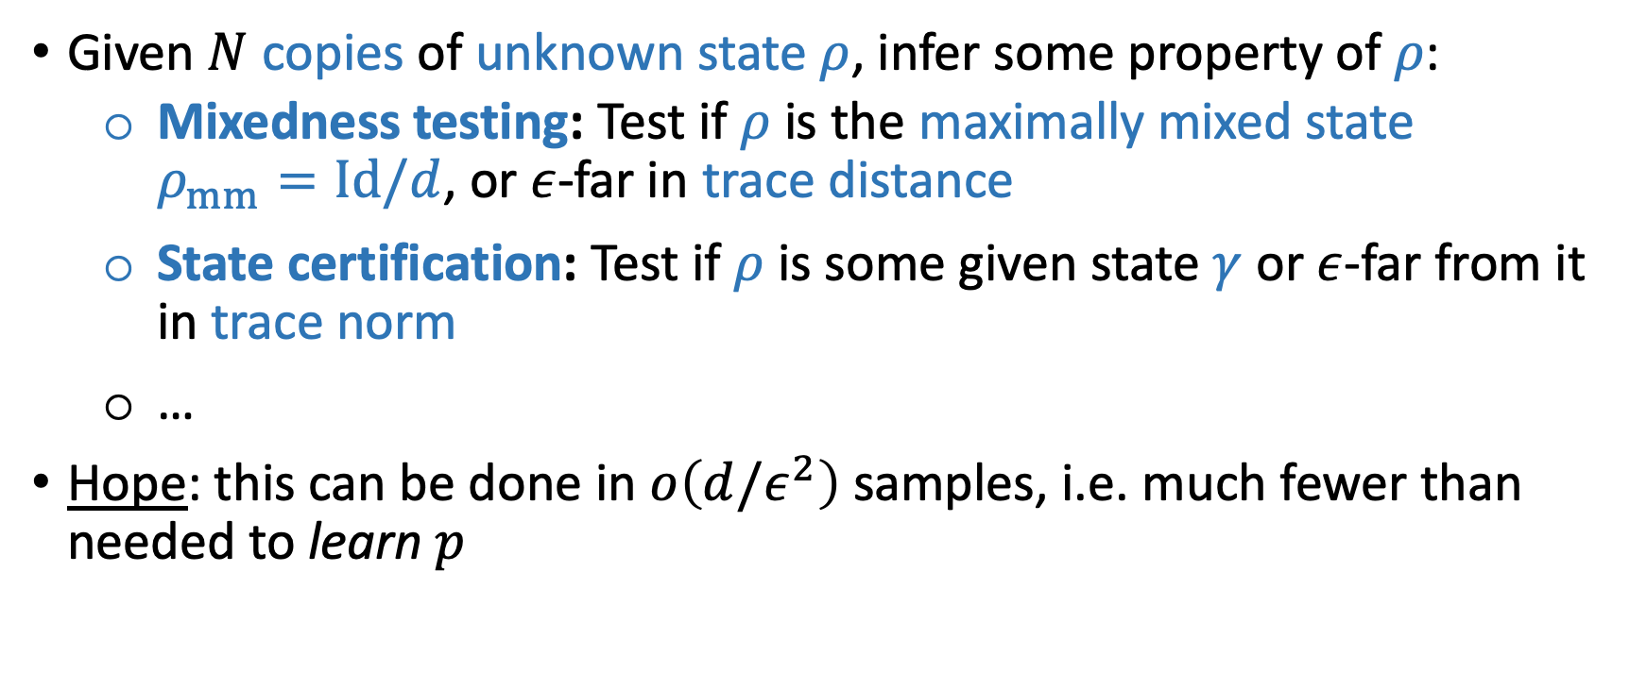
QUANTUM DISTRIBUTION TESTING
Given $N$ copies of unknown state $ρ$, infer some property of $ρ$:
  Mixedness testing: Test if $ρ$ is the maximally mixed state $ρ_{mm}=Id/d$, or $ε$-far in trace distance
  State certification: Test if$ρ$ is some given state $γ$ or $ε$-far from it in trace norm
  …
Hope: this can be done in $o\left(d/ε^{2}\right)$ samples, i.e. much fewer than needed to learn $p$

Slide 14
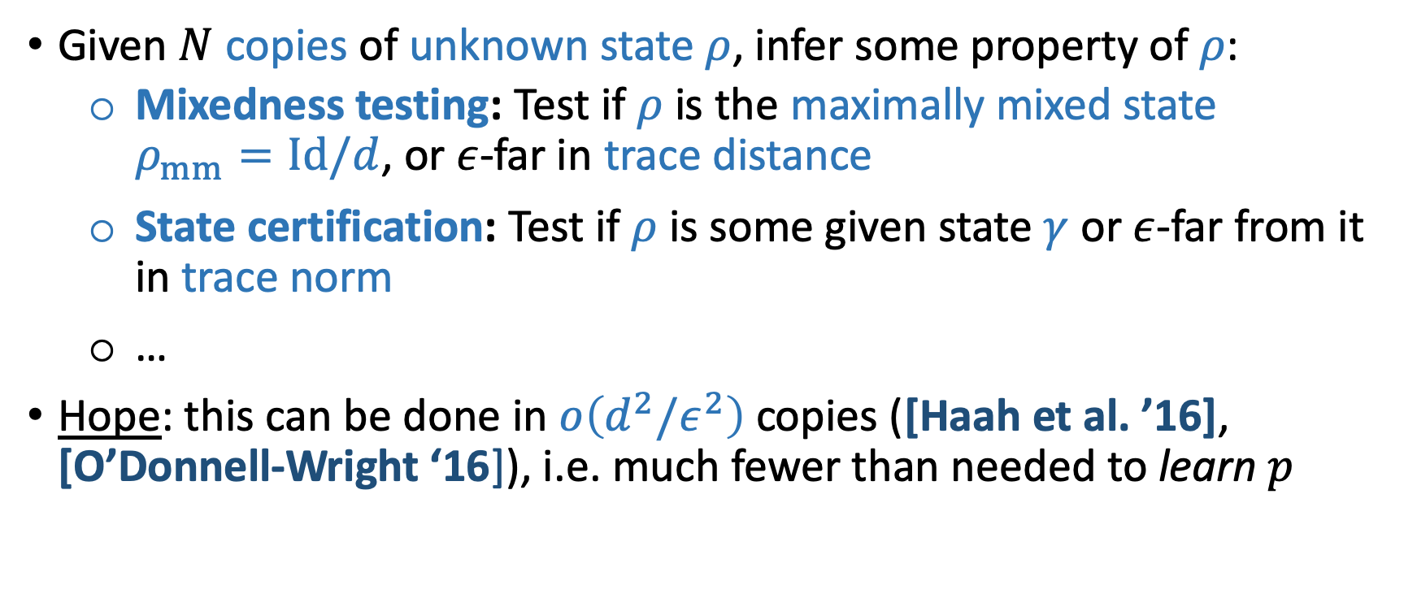
QUANTUM DISTRIBUTION TESTING
Given $N$ copies of unknown state $ρ$, infer some property of $ρ$:
  Mixedness testing: Test if $ρ$ is the maximally mixed state $ρ_{mm}=Id/d$, or $ε$-far in trace distance
  State certification: Test if$ρ$ is some given state $γ$ or $ε$-far from it in trace norm
  …
Hope: this can be done in $o\left(d^{2}/ε^{2}\right)$ copies ([Haah et al. ’16], [O’Donnell-Wright ‘16]), i.e. much fewer than needed to learn $p$

Slide 15
WHY DO WE CARE?
Natural non-commutative analogue of distribution testing.
Practically, lets us certify whether quantum states prepared in experimental setups satisfy the properties we want them to
Image credit: Forest Stearns, Google AI Quantum Artist in Residence

Slide 16
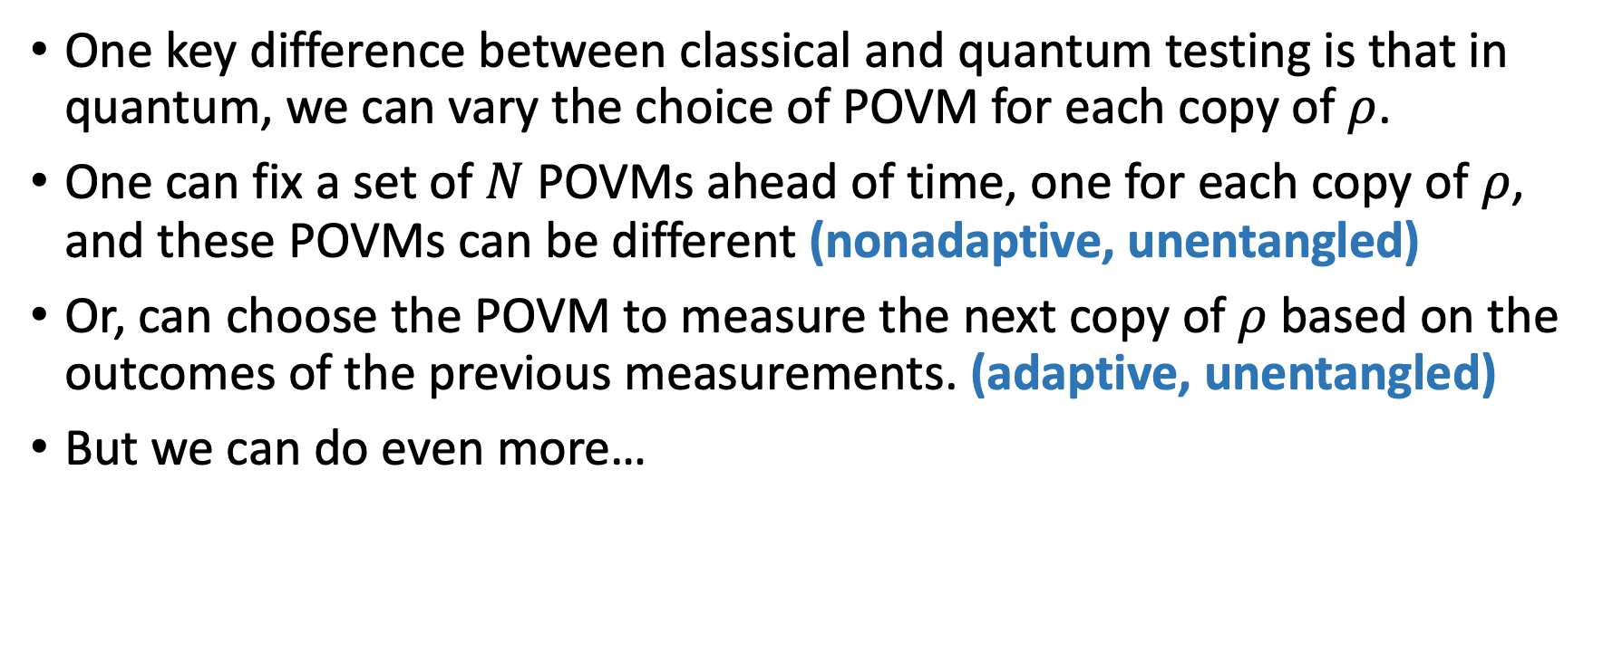
ADAPTIVE MEASUREMENTS
One key difference between classical and quantum testing is that in quantum, we can vary the choice of POVM for each copy of $ρ$.
One can fix a set of $N$ POVMs ahead of time, one for each copy of $ρ$, and these POVMs can be different (nonadaptive, unentangled)
Or, can choose the POVM to measure the next copy of $ρ$ based on the outcomes of the previous measurements. (adaptive, unentangled)
But we can do even more…

Slide 17
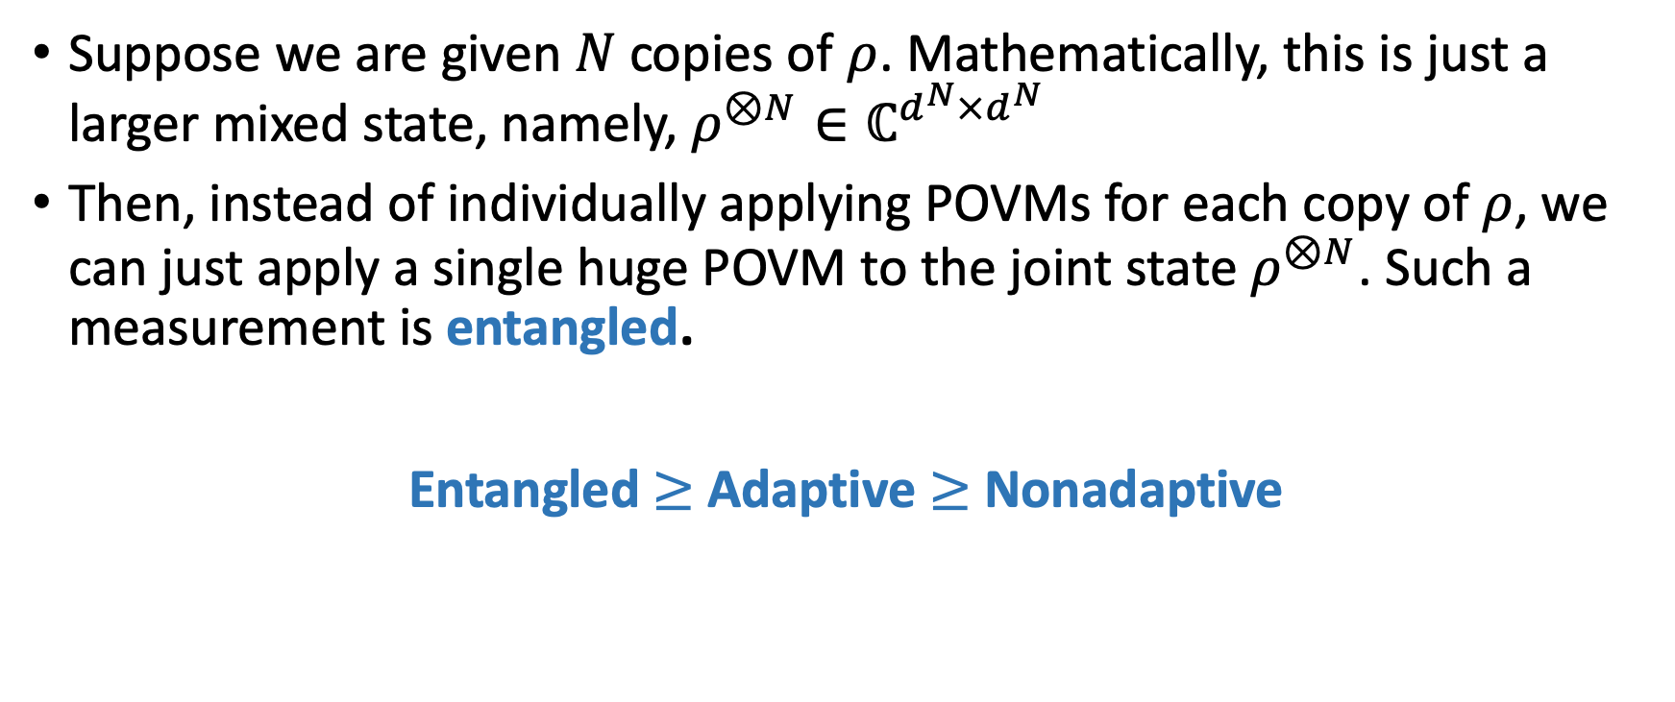
ENTANGLED MEASUREMENTS
Suppose we are given $N$ copies of $ρ$. Mathematically, this is just a larger mixed state, namely, $ρ^{⊗N}∈ℂ^{d^{N}×d^{N}}$
Then, instead of individually applying POVMs for each copy of $ρ$, we can just apply a single huge POVM to the joint state $ρ^{⊗N}$. Such a measurement is entangled.
Entangled $≥$ Adaptive $≥$ Nonadaptive
Can we show separations between these families of measurements?

Slide 18
OUTLINE
Crash Course on Quantum Property Testing
Prior Work + Our Results
Lower Bound Construction
Chain Rule Calculation
Open Questions

Slide 19
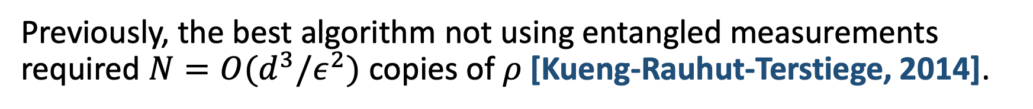
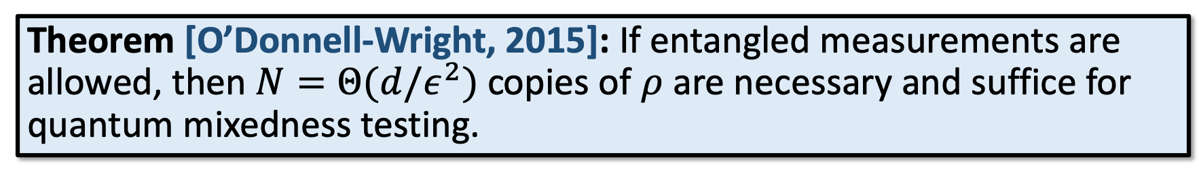
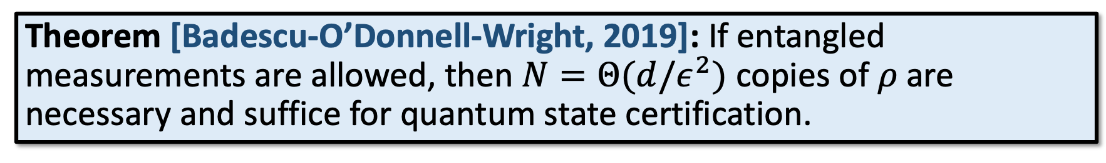
POWER OF ENTANGLEMENT
Theorem [O’Donnell-Wright, 2015]: If entangled measurements are allowed, then $N=Θ(d/ε^{2})$ copies of $ρ$ are necessary and suffice for quantum mixedness testing.
Theorem [Badescu-O’Donnell-Wright, 2019]: If entangled measurements are allowed, then $N=Θ(d/ε^{2})$ copies of $ρ$ are necessary and suffice for quantum state certification.
Previously, the best algorithm not using entangled measurements required $N=O(d^{3}/ε^{2})$ copies of $ρ$ [Kueng-Rauhut-Terstiege, 2014].

Slide 20

COST OF ENTANGLEMENT
Entangled measurements require simultaneously maintaining $N$ copies of $ρ$, i.e. huge quantum memory overhead.
Unentangled measurements can be performed in a streaming fashion, only require 1 copy of $ρ$ at a time to be prepared. Much closer to what we can currently achieve in practice.
Is entanglement necessary for optimal quantum property testing?

Slide 21
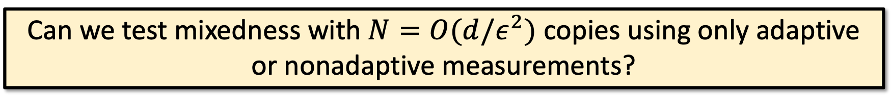
COST OF ENTANGLEMENT
Entangled measurements require simultaneously maintaining $N$ copies of $ρ$, i.e. huge quantum memory overhead.
Unentangled measurements can be performed in a streaming fashion, only require 1 copy of $ρ$ at a time to be prepared. Much closer to what we can currently achieve in practice.
Can we test mixedness with $N=O(d/ε^{2})$ copies using only adaptive or nonadaptive measurements?
Answer (this work): No! ☹

Slide 22
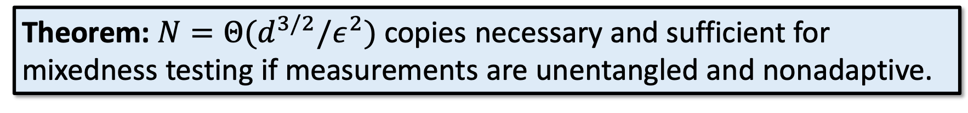
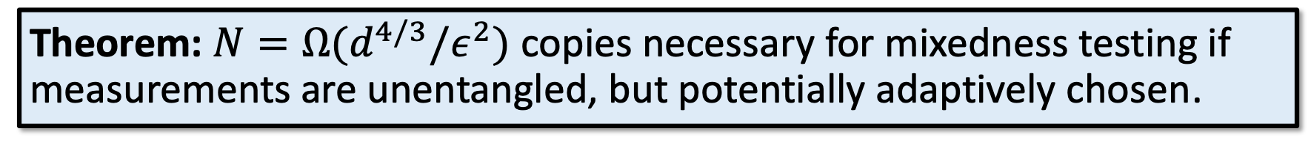
OUR RESULTS
Theorem: $N=Θ(d^{3/2}/ε^{2})$ copies necessary and sufficient for mixedness testing if measurements are unentangled and nonadaptive.
Theorem: $N=Ω(d^{4/3}/ε^{2})$ copies necessary for mixedness testing if measurements are unentangled, but potentially adaptively chosen.
Resolves a question of [Wright’16].
Since mixedness testing is special case of state certification, lower bound also applies to state certification.
First separation between entangled and general adaptive measurements to date, for any quantum testing or learning problem.

Slide 23
OUTLINE
Crash Course on Quantum Property Testing
Prior Work + Our Results
Lower Bound Construction
Chain Rule Calculation
Open Questions

Slide 24
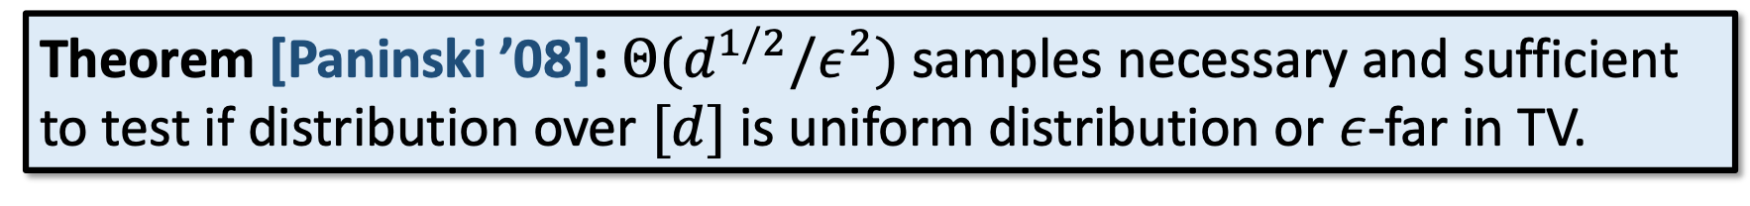
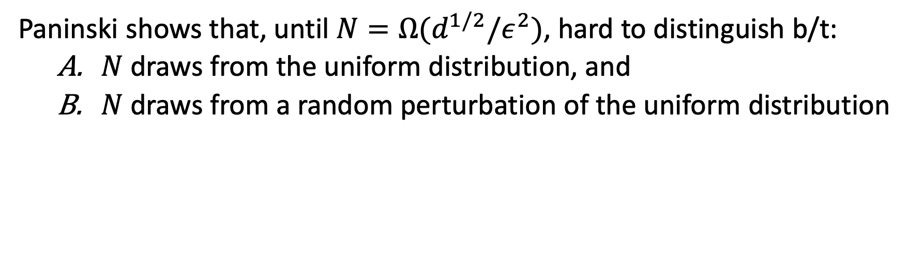
PANINSKI’S LOWER BOUND
Theorem [Paninski ’08]: $Θ(d^{1/2}/ε^{2})$ samples necessary and sufficient to test if distribution over $[d]$ is uniform distribution or $ε$-far in TV.
Paninski shows that, until $N=Ω(d^{1/2}/ε^{2})$, hard to distinguish b/t:
  $N$ draws from the uniform distribution, and
  $N$ draws from a random perturbation of the uniform distribution

Slide 25

PANINSKI’S LOWER BOUND
Formally, assume $d$ is even. For every $z∈{\left\{−1,1\right\}}^{d/2}$, define dist. $p_{z}$:
$$p_{z}\left(x\right)=\frac{1}{d}+{\left(−1\right)}^{x}⋅\frac{ε}{d}⋅z_{\left\lceil x/2\right\rceil }$$
+1 | +1 | -1 | +1 | -1 | -1 | +1

Slide 26
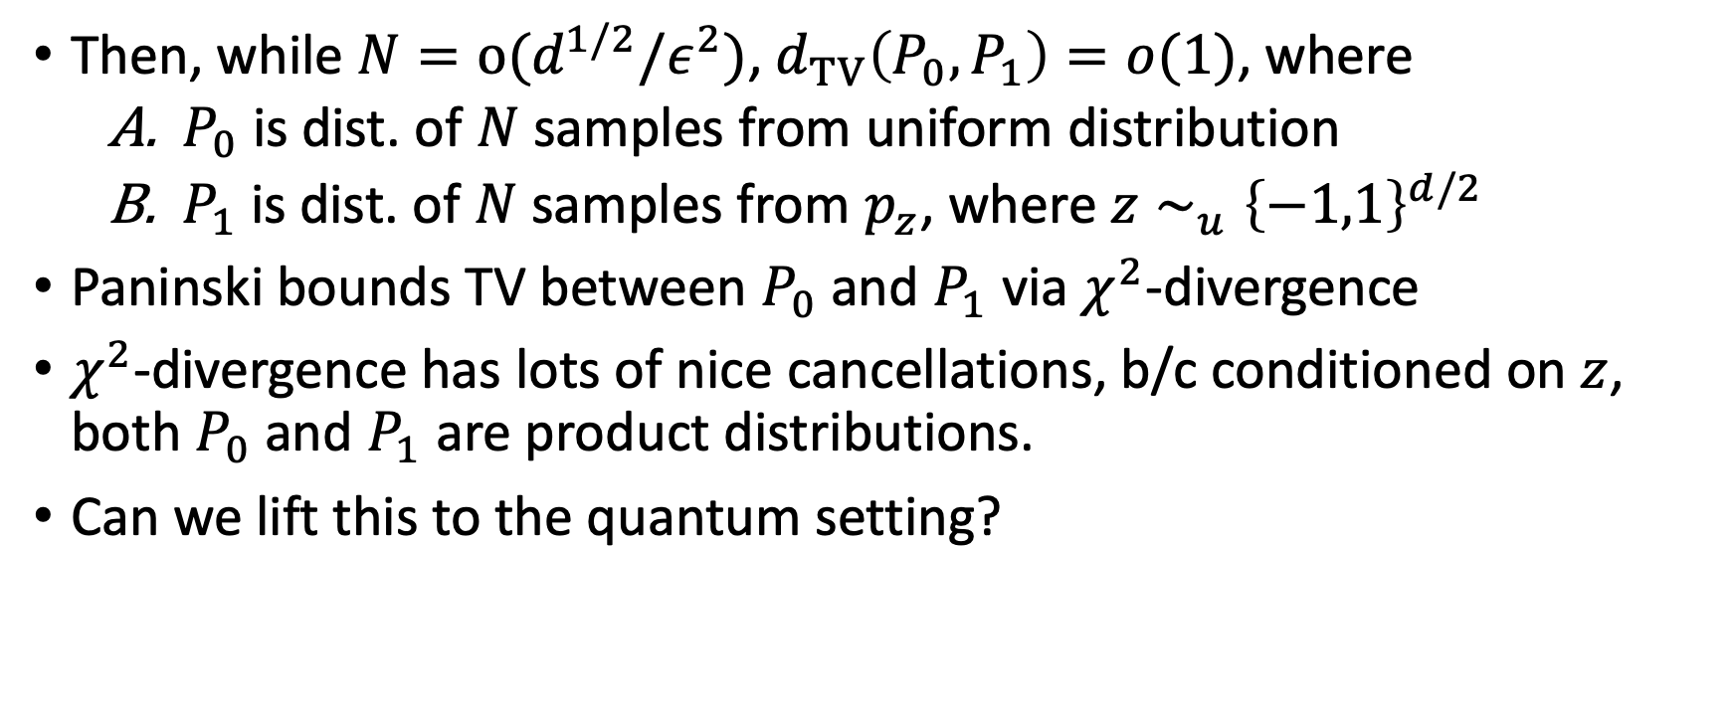
PANINSKI’S LOWER BOUND
Then, while $N=o(d^{1/2}/ε^{2})$, $d_{TV}\left(P_{0},P_{1}\right)=o(1)$, where
  $P_{0}$ is dist. of $N$ samples from uniform distribution
  $P_{1}$is dist. of $N$ samples from $p_{z}$, where $z∼_{u}{\left\{−1,1\right\}}^{d/2}$
Paninski bounds TV between $P_{0}$ and $P_{1}$ via $χ^{2}$-divergence
$χ^{2}$-divergence has lots of nice cancellations, b/c conditioned on $z$, both $P_{0}$ and $P_{1}$ are product distributions.
Can we lift this to the quantum setting?

Slide 27





LIFTING PANINSKI’S BOUND
Natural “quantum Paninski” instance:
  Take a $p_{z}$ and embed it onto the diagonal of a mixed state.
  Rotate that mixed state by a Haar-random unitary matrix $U$.
$$ρ_{U}=$$
$$U$$
$$diag(p_{z})$$
$$U^{∗}$$

Slide 28
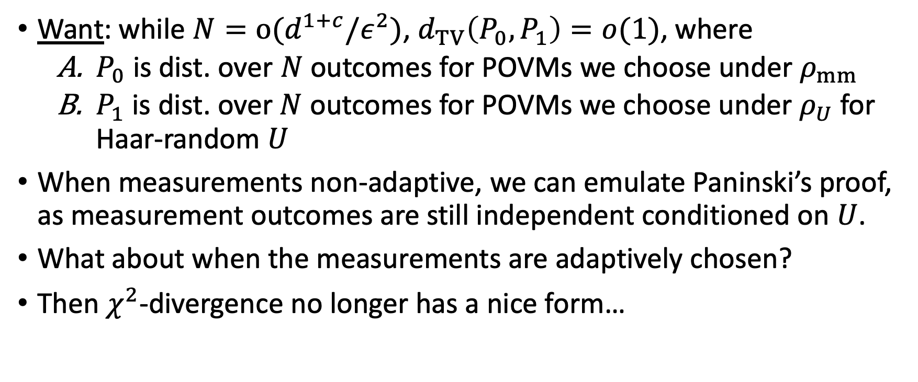
LIFTING PANINSKI’S BOUND
Want: while $N=o(d^{1+c}/ε^{2})$, $d_{TV}\left(P_{0},P_{1}\right)=o(1)$, where
  $P_{0}$ is dist. over $N$ outcomes for POVMs we choose under $ρ_{mm}$
  $P_{1}$ is dist. over $N$ outcomes for POVMs we choose under $ρ_{U}$ for Haar-random $U$
When measurements non-adaptive, we can emulate Paninski’s proof, as measurement outcomes are still independent conditioned on $U$.
What about when the measurements are adaptively chosen?
Then $χ^{2}$-divergence no longer has a nice form…
Idea: Use chain rule to upper bound $KL\left(P_{1}||P_{0}\right)$

Slide 29
OUTLINE
Crash Course on Quantum Property Testing
Prior Work + Our Results
Lower Bound Construction
Chain Rule Calculation
Open Questions

Slide 30
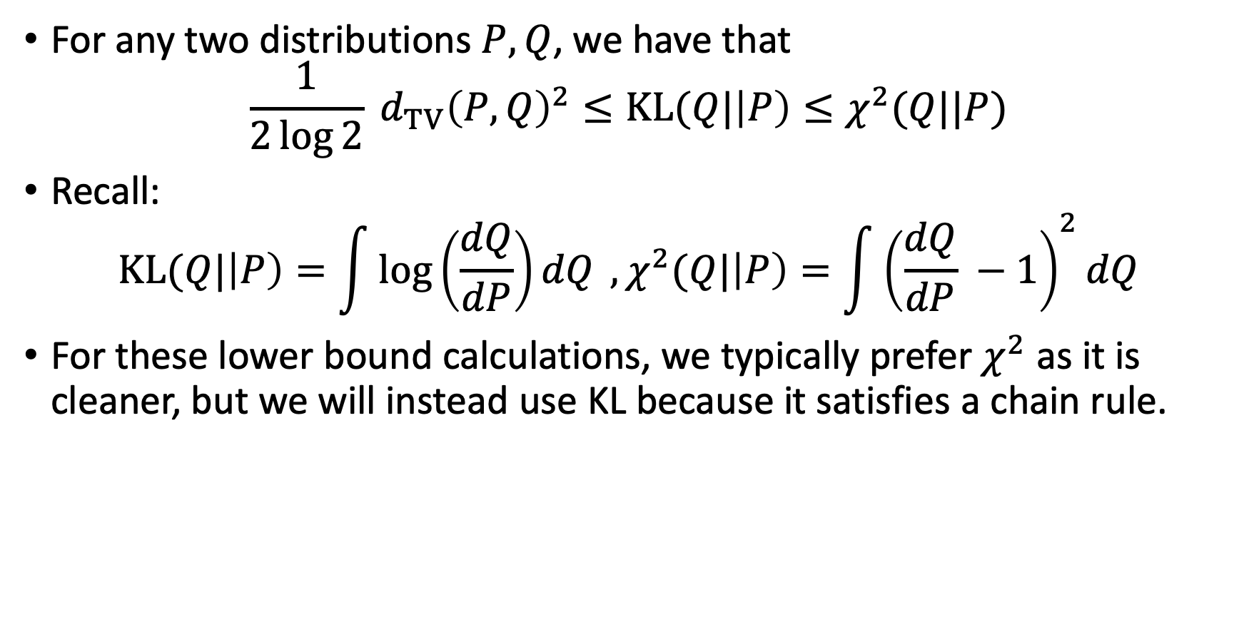
GOING THROUGH KL
For any two distributions $P, Q$, we have that
$$\frac{1}{2\log{2}} d_{TV}{\left(P, Q\right)}^{2}≤KL(Q|\left|P\right)≤χ^{2}(Q||P)$$
Recall:
$$KL(Q|\left|P\right)=\int{\log\left(\frac{dQ}{dP}\right)dQ }, χ^{2}(Q|\left|P\right)=\int{{\left(\frac{dQ}{dP} −1\right)}^{2}dQ}$$
For these lower bound calculations, we typically prefer $χ^{2}$ as it is cleaner, but we will instead use KL because it satisfies a chain rule.

Slide 31
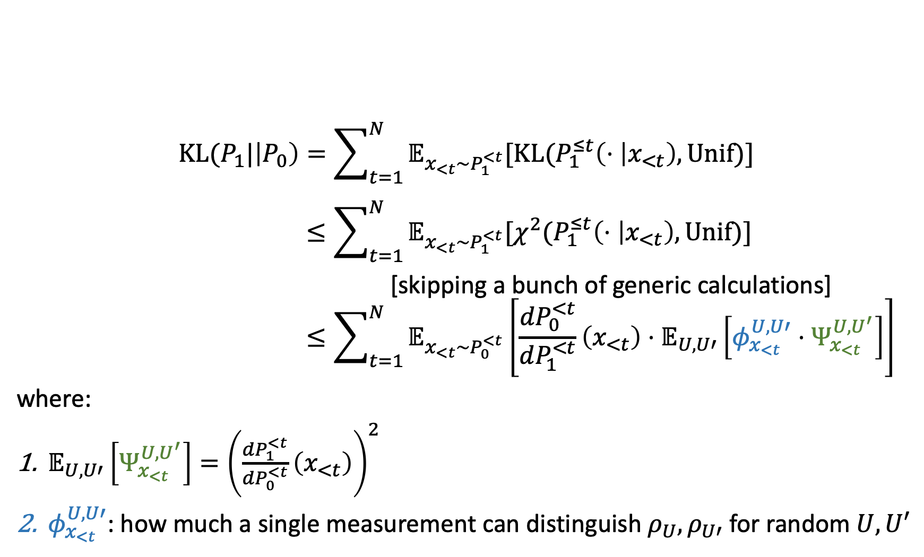
STEP 1: CHAIN RULE
$$KL(P_{1}|\left|P_{0}\right)=\sum_{t=1}^{N}{𝔼_{x_{<t}∼P_{1}^{<t}}[KL(P_{1}^{≤t}\left(⋅ | x_{<t}\right), Unif)]}$$
$$≤\sum_{t=1}^{N}{𝔼_{x_{<t}∼P_{1}^{<t}}[χ^{2}(P_{1}^{≤t}\left(⋅ | x_{<t}\right),Unif)]}$$
[skipping a bunch of generic calculations]
$$≤\sum_{t=1}^{N}{𝔼_{x_{<t}∼P_{0}^{<t}}\left[\frac{{dP}_{0}^{<t}}{dP_{1}^{<t}}\left(x_{<t}\right)⋅𝔼_{U,U′}\left[φ_{x_{<t}}^{U,U′}⋅Ψ_{x_{<t} }^{U,U^{′}}\right]\right]}$$
where:
$𝔼_{U,U′}\left[Ψ_{x_{<t} }^{U,U^{′}}\right]={\left(\frac{{dP}_{1}^{<t}}{dP_{0}^{<t}}\left(x_{<t}\right)\right)}^{2}$
$φ_{x_{<t}}^{U,U′}$: how much a single measurement can distinguish $ρ_{U}, ρ_{U′}$ for random $U,U′$

Slide 32
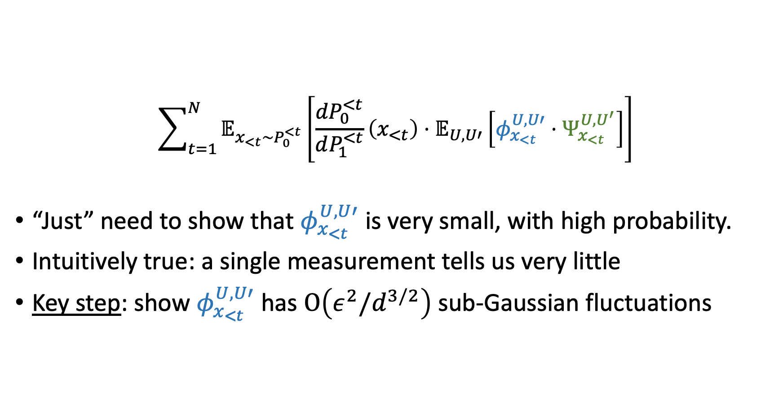
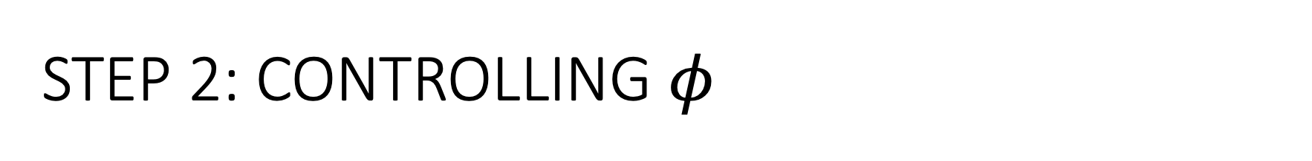
STEP 2: CONTROLLING $φ$
$$\sum_{t=1}^{N}{𝔼_{x_{<t}∼P_{0}^{<t}}\left[\frac{{dP}_{0}^{<t}}{dP_{1}^{<t}}\left(x_{<t}\right)⋅𝔼_{U,U′}\left[φ_{x_{<t}}^{U,U′}⋅Ψ_{x_{<t} }^{U,U^{′}}\right]\right]}$$
“Just” need to show that $φ_{x_{<t}}^{U,U′}$ is very small, with high probability.
Intuitively true: a single measurement tells us very little
Key step: show $φ_{x_{<t}}^{U,U′}$ has $O\left(ε^{2}/d^{3/2}\right)$ sub-Gaussian fluctuations

Slide 33
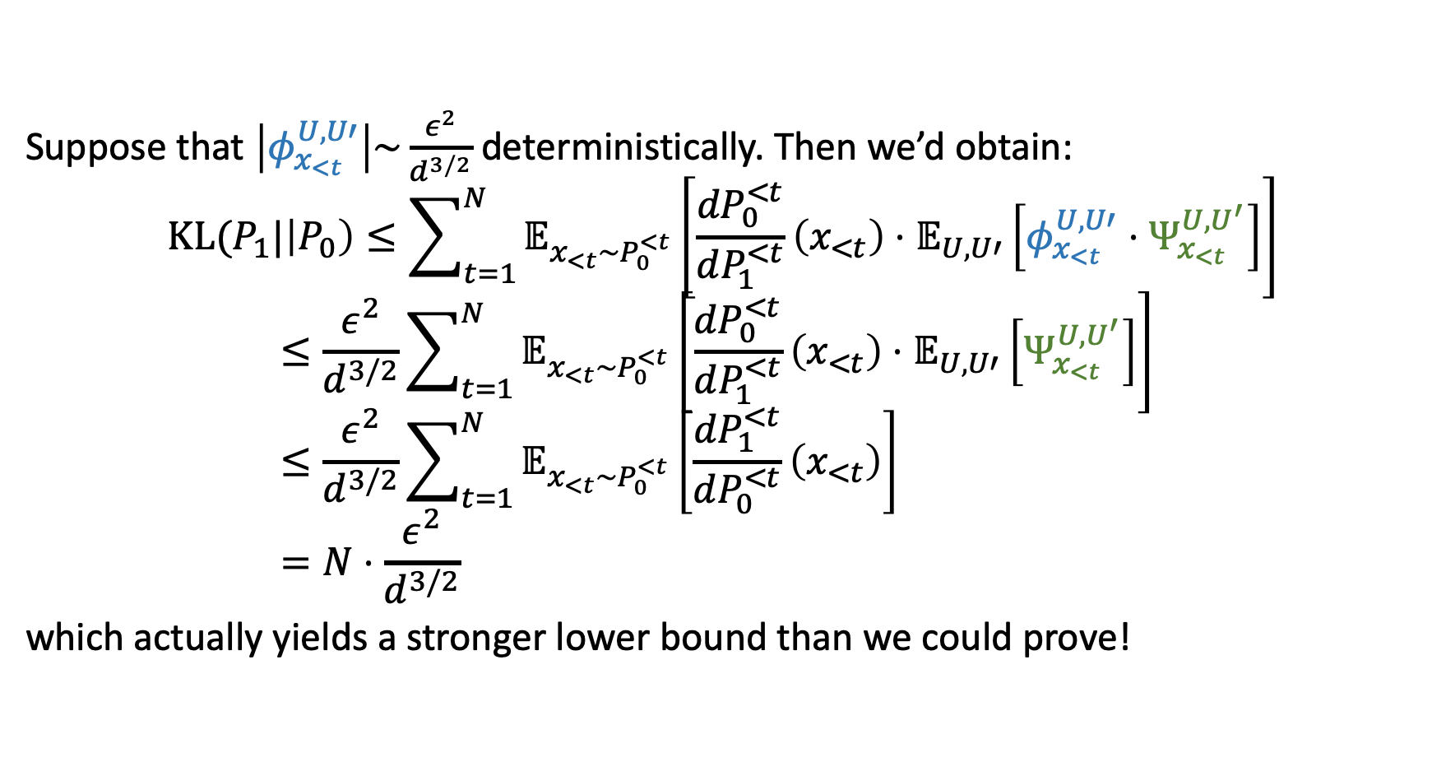
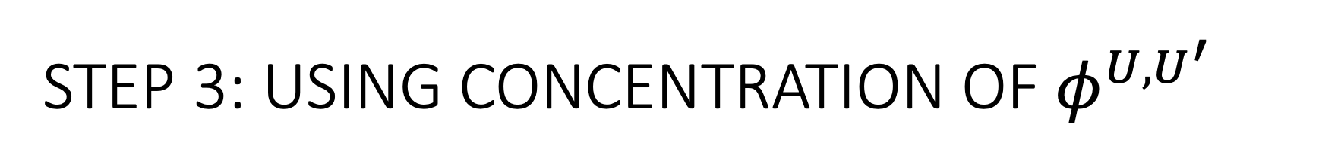
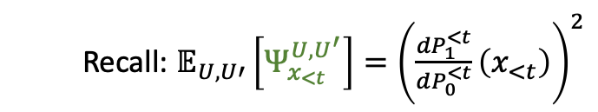
STEP 3: USING CONCENTRATION OF $φ^{U,U^{′}}$
Suppose that $\left|φ_{x_{<t}}^{U,U′}\right|\sim \frac{ε^{2}}{d^{3/2}}$ deterministically. Then we’d obtain:
$$KL(P_{1}|\left|P_{0}\right)≤\sum_{t=1}^{N}{𝔼_{x_{<t}∼P_{0}^{<t}}\left[\frac{{dP}_{0}^{<t}}{dP_{1}^{<t}}\left(x_{<t}\right)⋅𝔼_{U,U′}\left[φ_{x_{<t}}^{U,U′}⋅Ψ_{x_{<t} }^{U,U^{′}}\right]\right]}$$
$$≤\frac{ε^{2}}{d^{3/2}}\sum_{t=1}^{N}{𝔼_{x_{<t}∼P_{0}^{<t}}\left[\frac{{dP}_{0}^{<t}}{dP_{1}^{<t}}\left(x_{<t}\right)⋅𝔼_{U,U′}\left[Ψ_{x_{<t} }^{U,U^{′}}\right]\right]}$$
$$≤\frac{ε^{2}}{d^{3/2}}\sum_{t=1}^{N}{𝔼_{x_{<t}∼P_{0}^{<t}}\left[\frac{{dP}_{1}^{<t}}{dP_{0}^{<t}}\left(x_{<t}\right)\right]}$$
$$=N⋅\frac{ε^{2}}{d^{3/2}}$$
which actually yields a stronger lower bound than we could prove!
Recall: $𝔼_{U,U′}\left[Ψ_{x_{<t} }^{U,U^{′}}\right]={\left(\frac{{dP}_{1}^{<t}}{dP_{0}^{<t}}\left(x_{<t}\right)\right)}^{2}$

Slide 34
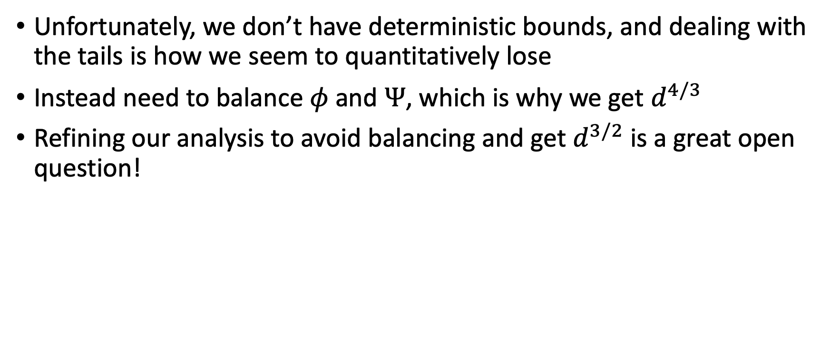
STEP 4: BALANCING
Unfortunately, we don’t have deterministic bounds, and dealing with the tails is how we seem to quantitatively lose
Instead need to balance $φ$ and $Ψ$, which is why we get $d^{4/3}$
Refining our analysis to avoid balancing and get $d^{3/2}$ is a great open question!

Slide 35
OUTLINE
Crash Course on Quantum Property Testing
Prior Work + Our Results
Lower Bound Construction
Chain Rule Calculation
Open Questions

Slide 36
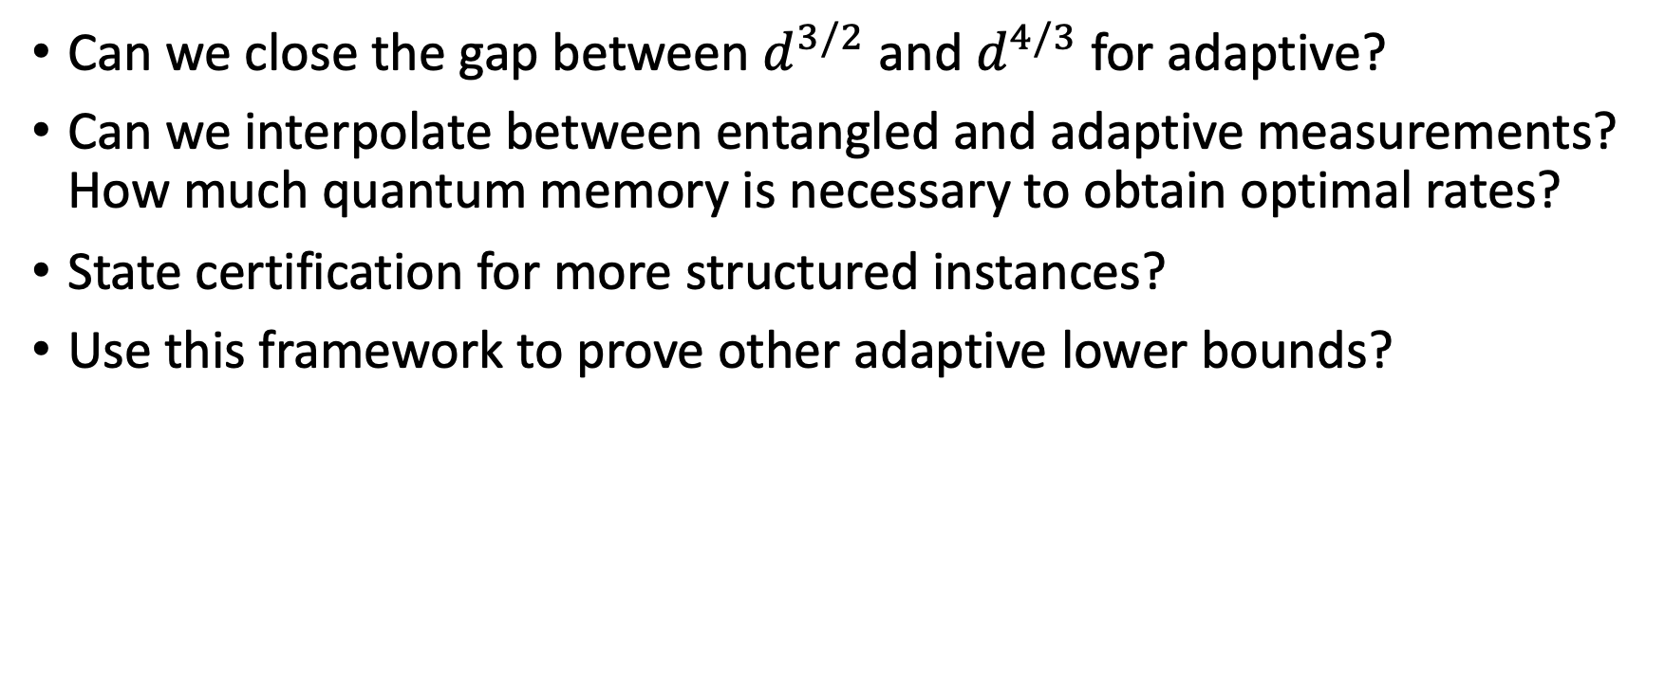
OPEN QUESTIONS
Can we close the gap between $d^{3/2}$ and $d^{4/3}$ for adaptive?
Can we interpolate between entangled and adaptive measurements? How much quantum memory is necessary to obtain optimal rates?
State certification for more structured instances?
Use this framework to prove other adaptive lower bounds?

Slide 37
Thanks!

