Slide 1
PROVABLY LEARNING A MULTI-HEAD ATTENTION LAYER
SITAN CHEN HARVARD
BASED ON JOINT WORK W/ YUANZHI LI (CMU / MSR)

Slide 2
TRANSFORMERS
Architecture behind state-of-the-art approaches to NLP and vision
Wildly successful in practice, poorly understood in theory
This talk: clean sandbox where we can hope to rigorously study learnability of these functions, first provable learnability results
Comes in wake of ~10 yrs of theoretical work on learning feedforward architectures (for which many mysteries still remain!)
Outlook: theory for learning transformers could shape out very differently!

Slide 3
Preliminaries and setup
Prior work and our results
Algorithm outline
Proof sketch

Slide 4
SINGLE-HEAD ATTENTION
Given:
input sequence $X∈ℝ^{k×d}$ (sequence of $k$ tokens in $ℝ^{d}$),
attention matrix $Θ∈ℝ^{d×d}$
projection matrix $W∈ℝ^{d×d}$
$$F\left(X\right)=softmax\left(XΘX^{⊤}\right)XW$$
The
quick
brown
fox
jumps
over
the
lazy
dog
The
quick
brown
fox
jumps
over
the
lazy
dog
(applied row-wise)
$i$-th row of $F\left(X\right)$:
$$($$
$$)$$
$$softmax$$
$${\left\langle X_{i},X_{1}\right\rangle }_{Θ}$$ | $${\left\langle X_{i},X_{2}\right\rangle }_{Θ}$$ | $${\left\langle X_{i},X_{3}\right\rangle }_{Θ}$$ | $$⋯$$ | $${\left\langle X_{i},X_{k}\right\rangle }_{Θ}$$
$$XW$$

Slide 5
MULTI-HEAD ATTENTION
Given:
input sequence $X∈ℝ^{k×d}$ (sequence of $k$ tokens in $ℝ^{d}$),
attention matrices $Θ_{1},…,Θ_{m}∈ℝ^{d×d}$
projection matrices $W_{1},…,W_{m}∈ℝ^{d×d}$
$$F\left(X\right)=\sum_{i=1}^{m}{softmax\left(XΘ_{i}X^{⊤}\right)XW_{i}}$$

Slide 6
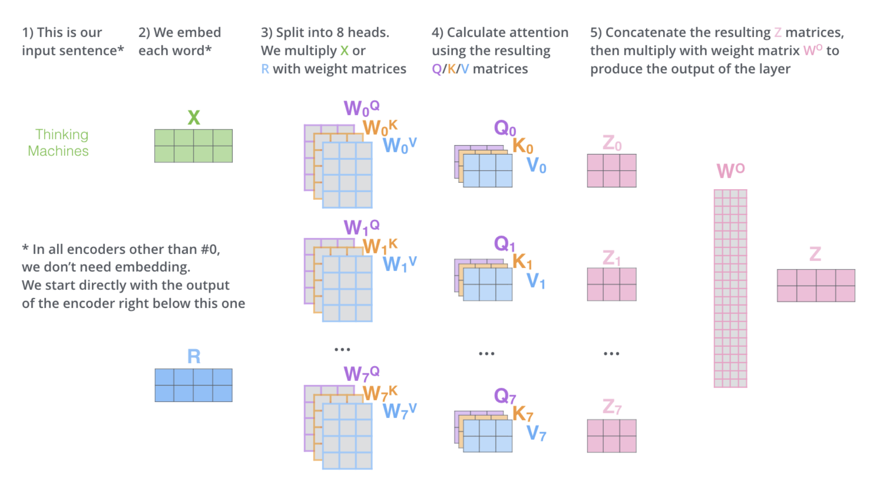
MULTI-HEAD ATTENTION
Generalizes what is typically used in practice:
$$F\left(X\right)=concat\left(softmax\left(XW_{1}^{Q}{\left(W_{1}^{K}\right)}^{⊤}X^{T}\right)XW_{1}^{V},…,softmax\left(XW_{m}^{Q}{\left(W_{m}^{K}\right)}^{⊤}X^{T}\right)XW_{m}^{V}\right)W^{O}$$
from “The Illustrated Transformer”

Slide 7
A SANDBOX
Prior theory for transformers:
Representational power [Dehghani et al. ’18], [Yun et al. ’20], [Bhattamishra-Ahuja-Goyal ’20], ………..
Sample compl. [Wei-Chen-Ma ’21], [Edelman-Goel-Kakade-Zhang ‘22]
Dynamical systems / neural ODE [Geshkokvski-Letrouit-Polyanskiy-Rigollet ‘23a, ‘23b]
Training a single attention head for simple synthetic tasks [Jelassi-Sander-Li ’22], [Li-Wang-Liu-Chen ’23], [Oymak-Rawat-Soltanolkotabi-Thrampoulidis ‘23], [Tian-Wang-Chen-Du ‘23], [Li-Li-Risteski ‘23]
Training a linearized multi-head attention layer [Fu-Guo-Bai-Mei ‘23], [Deora-Ghaderi-Taheri-Thrampoulidis ‘23]

Slide 8
A SANDBOX
Today: Can we efficiently learn if all we assume is
The data comes from a “nice” distribution
It can be perfectly labeled by a multi-head attention layer?
Unlike prior settings, not even clear if we have any provable algorithm, let alone an end-to-end analysis of gradient descent

Slide 9
REALIZABLE PAC LEARNING
$$F\left(X\right)=\sum_{i=1}^{m}{softmax\left(XΘ_{i}X^{⊤}\right)XW_{i}}$$
Input: sequence-to-sequence pairs
$$\left(X_{1},Y_{1}\right),…,\left(X_{N}, Y_{N}\right)$$
where $X_{i}∼𝒟$, $Y_{i}=F\left(X_{i}\right)$
Output: multi-head attention layer $\hat{F}$ such that w.h.p. over randomness of the samples and algorithm,
$$𝔼_{𝒟} {\left\|F\left(X\right)−\hat{F}\left(X\right)\right\|}_{F}^{2}≤ε$$
Real-world tokens are discrete. As a (highly stylized) proxy, we consider
$𝒟=Unif\left({\left\{−1,1\right\}}^{k×d}\right)$
but can also handle $𝒟=N\left(0,Id\right)$ (analysis there is strictly easier for us)

Slide 10
Preliminaries and setup
Prior work and our results
Algorithm outline
Proof sketch

Slide 11
PRIOR WORK ON FEED-FORWARD NETWORKS
Long line of work on PAC learning feed-forward networks (mostly focusing on one-hidden-layer networks)
$$f\left(x\right)=\sum_{i=1}^{m}{λ_{i}σ\left(\left\langle w_{i},x\right\rangle \right)}$$
Almost exclusively considers input distribution given by $N\left(0,Id\right)$
State of the art:
[C-Narayanan ‘23]: ${poly\left(d,1/ε\right)}^{O\left(m^{2}\right)}$-time proper learner
[Diakonikolas-Kane ‘23]: ${poly\left(d,1/ε\right)}^{O\left(m\right)}$-time improper learner
[C-Klivans-Meka ‘21]: $poly\left(d\right)⋅exp(poly\left(size,Lipschitzness, 1/ε\right))$-time proper learner for deep networks

Slide 12
PRIOR WORK ON FEED-FORWARD NETWORKS
These all exploit some subset of the following features specific to feedforward networks + Gaussianity assumption
$f(x)$ only depends on a low-dimensional projection of $x$, namely to the span of $w_{1},…,w_{m}$ --- “multi-index model”
Projections of $N\left(0,Id\right)$ to orthogonal subspaces are independent --- product + rotation invariance
for any $g$, $ker\left(𝔼\left[g\left(y\right)⋅\left(xx^{⊤}−Id\right)\right]\right)$ contains all “irrelevant directions”
Joint distribution over $\left(x,f\left(x\right)\right)$ has useful moment structure
e.g. exists tensor-valued polynomial $S_{ℓ}$ s.t. $𝔼\left[f\left(x\right)⋅S_{ℓ}\left(x\right)\right]=\sum_{i=1}^{m}{λ_{i}w_{i}^{⊗ℓ}}$
multi-index model
product + rotation invariance
useful moment structure

Slide 13
PRIOR WORK ON FEED-FORWARD NETWORKS
What about for $F\left(X\right)=\sum_{i=1}^{m}{softmax\left(XΘ_{i}X^{⊤}\right)XW_{i}}$ ?
--- $F\left(X\right)$ does not only depend on low-dim projection
--- specific to Gaussian distribution
--- $𝔼\left[…softmax\left(XΘX^{⊤}\right)…\right]=$???
What are the structural properties of multi-head attention that enable efficient learning?
multi-index model
product + rotation invariance
useful moment structure

Slide 14
OUR RESULTS
$m$: # heads
$k$: # tokens
$$F\left(X\right)=\sum_{i=1}^{m}{softmax\left(XΘ_{i}X^{⊤}\right)XW_{i}}$$
We only consider small $m$ (at most logarithmic in $d$), and $m≲k≪d$
To our knowledge, no such result was known even for $m=1$
Thm [C-Li ‘24]: There is a $d^{O\left(m^{3}\right)}$-time algorithm for PAC learning “nice” multi-head attention layers over uniformly random Boolean examples to error $d^{−Ω\left(m\right)}$.
Thm [C-Li ‘24]: For general multi-head attention layers, even for $k=2$:
[SQ lower bound]: Any statistical query alg. requires $d^{Ω\left(m\right)}$ queries/inv. tolerance
[Crypto lower bound]: Assuming LWE variant, cannot be done in $poly\left(d,m,k\right)$ time

Slide 15
FINE PRINT
$m$: # heads
$k$: # tokens
$$F\left(X\right)=\sum_{i=1}^{m}{softmax\left(XΘ_{i}X^{⊤}\right)XW_{i}}$$
We only consider small $m$ (at most logarithmic in $d$), and $m≲k≪d$
Attention matrices: for all $a,b∈\left[m\right]$,
Incoherence: $\left|\left\langle Θ_{a},Θ_{b}\right\rangle \right|≤\frac{1}{poly\left(m,log\left(d\right)\right)}{\left\|Θ_{a}\right\|}_{F}⋅{\left\|Θ_{b}\right\|}_{F}$
Stable rank not too small: $r≔{\left\|Θ_{a}\right\|}_{F}^{2}/{\left\|Θ_{a}\right\|}_{op}^{2}≥poly\left(k,m,log\left(d\right)\right)$
Diagonals not too heavy: $Tr\left(Θ_{a}\right)≲\sqrt{\log{k}}⋅{\left\|Θ_{a}\right\|}_{F}$
Columns not too heavy: ${\left\|{\left(Θ_{a}\right)}_{:,i}\right\|}_{2}≤d^{−c}{\left\|Θ_{a}\right\|}_{F}$
Non-arithmetic: entries are somewhat far from any lattice
Norms comparable + bounded: ${\left\|Θ_{a}\right\|}_{F}^{2}≍{\left\|Θ_{b}\right\|}_{F}^{2}∈\left[polylog\left(d\right),d^{O\left(m\right)}\right]$
removing these would require new ideas
so that diagonal entries of softmax don’t behave differently from off-diagonals
for handling quirks of
Boolean input distribution
(e.g. lack of anti-concentration)
can probably handle more diverse norms with (a lot) more work

Slide 16
FINE PRINT
$m$: # heads
$k$: # tokens
$$F\left(X\right)=\sum_{i=1}^{m}{softmax\left(XΘ_{i}X^{⊤}\right)XW_{i}}$$
We only consider small $m$ (at most logarithmic in $d$), and $m≲k≪d$
Projection matrices: for all $a,b∈\left[m\right]$,
Incoherence: $\left|\left\langle W_{a},W_{b}\right\rangle \right|≲\frac{1}{m}{\left\|W_{a}\right\|}_{F}⋅{\left\|W_{b}\right\|}_{F}$
Stable rank not too small: ${\left\|W_{a}\right\|}_{F}^{2}≥poly\left(k,m,log\left(d\right)\right)⋅{\left\|W_{a}\right\|}_{op}^{2}$
Norms not too different: ${\left\|W_{a}\right\|}_{F}^{2}≲r{\left\|W_{b}\right\|}_{F}^{2}$, where $r$ is stable rank of $Θ$’s
much milder than for $Θ$’s, but removing would still require new ideas
much milder than for $Θ$’s, can probably remove with more work

Slide 17
Preliminaries and setup
Prior work and our results
Algorithm outline
Proof sketch

Slide 18
ALGORITHM OUTLINE
$$F\left(X\right)=\sum_{i=1}^{m}{softmax\left(XΘ_{i}X^{⊤}\right)XW_{i}}$$
Crudely estimate $\sum_{i}{W_{i}}$
Crudely estimate affine hull $K$of $Θ_{i}$’s:
$K≔\left\{\sum_{i}{c_{i}Θ_{i}}: \sum_{i}{c_{i}=1}\right\}$
Refine estimate for $\sum_{i}{W_{i}}$
Refine estimate for $K$
Estimate $span\left(Θ_{1},…,Θ_{m}\right)$
Epsilon-net over $span\left(Θ_{1},…,Θ_{m}\right)$ to learn $F$

Slide 19
ALGORITHM OUTLINE
$$F\left(X\right)=\sum_{i=1}^{m}{softmax\left(XΘ_{i}X^{⊤}\right)XW_{i}}$$
Crudely estimate $\sum_{i}{W_{i}}$
Crudely estimate affine hull $K$of $Θ_{i}$’s:
$K≔\left\{\sum_{i}{c_{i}Θ_{i}}: \sum_{i}{c_{i}=1}\right\}$
Refine estimate for $\sum_{i}{W_{i}}$
Refine estimate for $K$
Estimate $span\left(Θ_{1},…,Θ_{m}\right)$
Epsilon-net over $span\left(Θ_{1},…,Θ_{m}\right)$ to learn $F$
hardest part of the analysis

Slide 20
ALGORITHM OUTLINE
$$F\left(X\right)=\sum_{i=1}^{m}{softmax\left(XΘ_{i}X^{⊤}\right)XW_{i}}$$
Crudely estimate $\sum_{i}{W_{i}}$
Crudely estimate affine hull $K$of $Θ_{i}$’s:
$K≔\left\{\sum_{i}{c_{i}Θ_{i}}: \sum_{i}{c_{i}=1}\right\}$
Refine estimate for $\sum_{i}{W_{i}}$
Refine estimate for $K$
Estimate $span\left(Θ_{1},…,Θ_{m}\right)$
Epsilon-net over $span\left(Θ_{1},…,Θ_{m}\right)$ to learn $F$
hardest part of the analysis

Slide 21
Preliminaries and setup
Prior work and our results
Algorithm outline
Proof sketch

Slide 22
ESTIMATING $\sum_{i}{W_{i}}$
$$F\left(X\right)=\sum_{i=1}^{m}{softmax\left(XΘ_{i}X^{⊤}\right)XW_{i}}$$
Lemma: If we train a single attention head $softmax\left(XΘX^{⊤}\right)XW$ with $Θ$ initialized to $0_{d×d}$ with a single step of gradient descent on $W$ w.r.t
$ℓ\left(W\right)≔𝔼 {\left\|Y−softmax\left(XΘX^{⊤}\right)XW\right\|}_{F}^{2}$,
then the resulting $\hat{W}$ is $1/poly\left(r\right)$-close in Frobenius norm to $\sum_{i}{W_{i}}$
More succinctly,
$\frac{1}{k}𝔼\left[X^{⊤}1_{k×k}Y\right]≈\sum_{i}{W_{i}}$
Recall $Y=\sum_{i=1}^{m}{softmax\left(XΘ_{i}X^{⊤}\right)XW_{i}}$, so by linearity suffices to show
$$\frac{1}{k}𝔼\left[X^{⊤}1_{k×k} softmax\left(XΘ_{i}X^{⊤}\right)XW_{i}\right]≈W_{i}$$

Slide 23
ESTIMATING $\sum_{i}{W_{i}}$
$$F\left(X\right)=\sum_{i=1}^{m}{softmax\left(XΘ_{i}X^{⊤}\right)XW_{i}}$$
Lemma: If we train a single attention head $softmax\left(XΘX^{⊤}\right)XW$ with $Θ$ initialized to $0_{d×d}$ with a single step of gradient descent on $W$ w.r.t
$ℓ\left(W\right)≔𝔼 {\left\|Y−softmax\left(XΘX^{⊤}\right)XW\right\|}_{F}^{2}$,
then the resulting $\hat{W}$ is $1/poly\left(r\right)$-close in Frobenius norm to $\sum_{i}{W_{i}}$
More succinctly,
$\frac{1}{k}𝔼\left[X^{⊤}1_{k×k}Y\right]≈\sum_{i}{W_{i}}$
Recall $Y=\sum_{i=1}^{m}{softmax\left(XΘ_{i}X^{⊤}\right)XW_{i}}$, so by linearity suffices to show
$$\frac{1}{k}𝔼\left[X^{⊤}1_{k×k} softmax\left(XΘ_{i}X^{⊤}\right)X\right]≈Id_{d}$$

Slide 24
ESTIMATING $\sum_{i}{W_{i}}$
$$F\left(X\right)=\sum_{i=1}^{m}{softmax\left(XΘ_{i}X^{⊤}\right)XW_{i}}$$
$$\frac{1}{k}𝔼\left[X^{⊤}1_{k×k} softmax\left(XΘ_{i}X^{⊤}\right)X\right]≈Id_{d}$$
Intuition: if the inner softmax concentrated tightly around its expectation $Δ≔𝔼\left[softmax\left(XΘ_{i}X^{⊤}\right)\right]$, then the above would be
$$≈\frac{1}{k}𝔼\left[X^{⊤}1_{k×k} Δ X\right]$$
$$=Id_{d}⋅\frac{1}{k}Tr\left(1_{k×k} Δ\right)$$
$$=Id_{d}$$

Slide 25
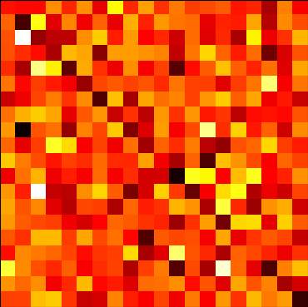
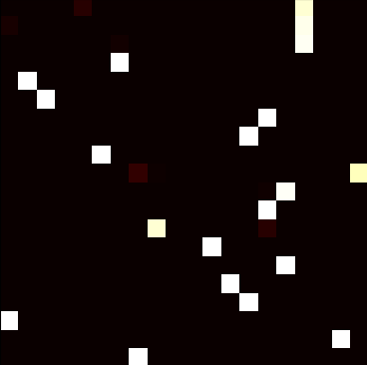
ESTIMATING $\sum_{i}{W_{i}}$
$$F\left(X\right)=\sum_{i=1}^{m}{softmax\left(XΘ_{i}X^{⊤}\right)XW_{i}}$$
Unfortunately, we don’t in general have such good concentration…
Example: $Θ∼N{\left(0,0.01\right)}^{200×200}$
Instead, we argue that, conditioned on the Hamming weight of fixed substrings of $X$, conditional expectation of softmax concentrates
expectation
reality

Slide 26
ALGORITHM OUTLINE
$$F\left(X\right)=\sum_{i=1}^{m}{softmax\left(XΘ_{i}X^{⊤}\right)XW_{i}}$$
Crudely estimate $\sum_{i}{W_{i}}$
Crudely estimate affine hull $K$of $Θ_{i}$’s:
$K≔\left\{\sum_{i}{c_{i}Θ_{i}}: \sum_{i}{c_{i}=1}\right\}$
Refine estimate for $\sum_{i}{W_{i}}$
Refine estimate for $K$
Estimate $span\left(Θ_{1},…,Θ_{m}\right)$
Epsilon-net over $span\left(Θ_{1},…,Θ_{m}\right)$ to learn $F$
hardest part of the analysis

Slide 27
ALGORITHM OUTLINE
$$F\left(X\right)=\sum_{i=1}^{m}{softmax\left(XΘ_{i}X^{⊤}\right)XW_{i}}$$
Crudely estimate $\sum_{i}{W_{i}}$
Crudely estimate affine hull $K$of $Θ_{i}$’s:
$K≔\left\{\sum_{i}{c_{i}Θ_{i}}: \sum_{i}{c_{i}=1}\right\}$
Refine estimate for $\sum_{i}{W_{i}}$
Refine estimate for $K$
Estimate $span\left(Θ_{1},…,Θ_{m}\right)$
Epsilon-net over $span\left(Θ_{1},…,Θ_{m}\right)$ to learn $F$
hardest part of the analysis

Slide 28
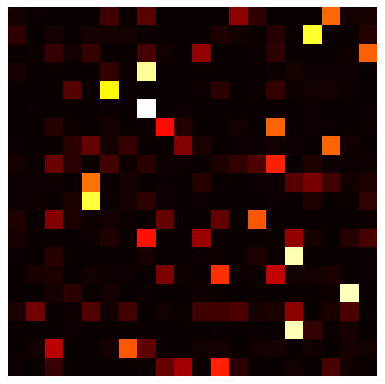
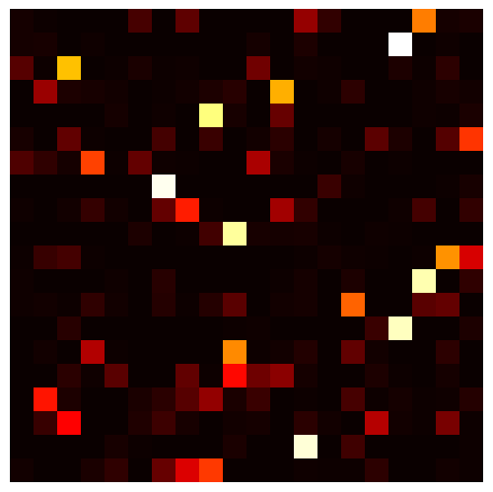
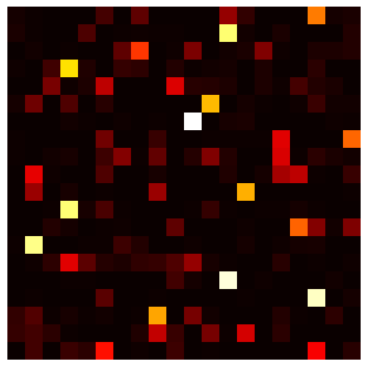
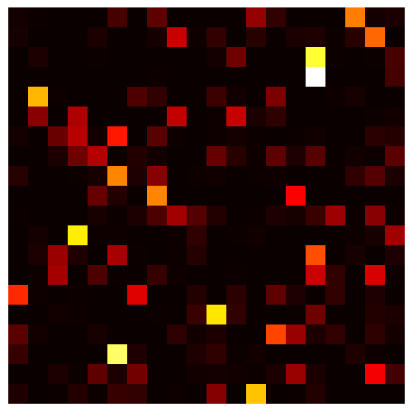
SCULPTING THE AFFINE HULL
$$F\left(X\right)=\sum_{i=1}^{m}{softmax\left(XΘ_{i}X^{⊤}\right)XW_{i}}$$
Let $\hat{W}$ denote our crude estimate for $\sum_{i}{W_{i}}$
Suppose in every head, first token attended to other tokens in same way
$$Y_{1,:}=\sum_{i}{softmax\left(X_{1,:}Θ_{i}X^{⊤}\right)XW_{i}}=v^{⊤}X\sum_{i}{W_{i}}≈v^{⊤}X\hat{W}$$
then $Y_{1,:}≈$ linear combination of $k$ rows of $X\hat{W}$
Approx. converse holds, letting us detect/certify when this happens
$$v$$

Slide 29
SCULPTING THE AFFINE HULL
$$F\left(X\right)=\sum_{i=1}^{m}{softmax\left(XΘ_{i}X^{⊤}\right)XW_{i}}$$
Let $\hat{W}$ denote our crude estimate for $\sum_{i}{W_{i}}$
Suppose in every head, first token attended to other tokens in same way
If $softmax\left(X_{1,:}ΘX^{⊤}\right)=v$, then for every $i,j∈[k]$,
$${\left(X_{1,:}ΘX^{⊤}\right)}_{i}−{\left(X_{1,:}ΘX^{⊤}\right)}_{j}=\ln\left(v_{i}/v_{j}\right)$$
This yields an affine constraint on every attention matrix $Θ$
$$v$$

Slide 30
SCULPTING THE AFFINE HULL
$$F\left(X\right)=\sum_{i=1}^{m}{softmax\left(XΘ_{i}X^{⊤}\right)XW_{i}}$$
So if we saw many examples $\left(X,Y\right)$ for which the first row of every attention pattern is the same across heads:
We can detect every time this happens, yields affine constraint on $Θ_{i}$’s
With enough such examples, can solve to obtain the affine hull of $Θ_{i}$’s
Why are the set of possible affine constraints obtainable in this fashion sufficiently diverse that we can learn the affine hull?
Technically can only certify when first rows are approximately equal… approximation error dictated by how accurate $\hat{W}$ was
How long do we have to wait before seeing enough such examples?

Slide 31
APPROXIMATION ERRORS: ISSUE #1
Suppose we wanted to learn the affine hull to “error” $ε$
need to certify all first rows of attention patterns are $poly\left(ε\right)$-close
this happens with probability $≈ε^{Θ\left(m\right)}$ over Gaussian examples
traditional CLT-based estimates have error $1/\sqrt{d}$
for Boolean examples, this bottlenecks us at $ε≈d^{−Θ\left(1/m\right)}$ even if we have exact access to $\sum_{i}{W_{i}}$…
Must use a suitable local CLT to avoid the $1/\sqrt{d}$ bottleneck (this is where non-arithmetic assumption comes in)

Slide 32
APPROXIMATION ERRORS: ISSUE #2
Recall that we only have $\sum_{i}{W_{i}}$ up to error $1/poly\left(r\right)$
→ bottlenecks our error in estimating the affine hull at $1/poly\left(r\right)$
Issue: Even if $r=d$, the exponent in this polynomial is not large enough
Given membership query access to a convex body in $ℝ^{D}$ which is $δ$-pointwise-close to the affine hull for $δ≫1/\sqrt{D}$, unclear how to estimate the span of the affine hull, even when the span is just 1-dimensional…
To refine $δ$, we first obtain a crude estimate of the affine hull, then use it to refine our estimate for $\sum_{i}{W_{i}}$, then return to this step

Slide 33
ALGORITHM OUTLINE
Crudely estimate $\sum_{i}{W_{i}}$
Crudely estimate affine hull $K$of $Θ_{i}$’s:
$K≔\left\{\sum_{i}{c_{i}Θ_{i}}: \sum_{i}{c_{i}=1}\right\}$
Refine estimate for $\sum_{i}{W_{i}}$
Refine estimate for $K$
Estimate $span\left(Θ_{1},…,Θ_{m}\right)$
Epsilon-net over $span\left(Θ_{1},…,Θ_{m}\right)$ to learn $F$
hardest part of the analysis

Slide 34
ALGORITHM OUTLINE
Crudely estimate $\sum_{i}{W_{i}}$
Crudely estimate affine hull $K$of $Θ_{i}$’s:
$K≔\left\{\sum_{i}{c_{i}Θ_{i}}: \sum_{i}{c_{i}=1}\right\}$
Refine estimate for $\sum_{i}{W_{i}}$
Refine estimate for $K$
Estimate $span\left(Θ_{1},…,Θ_{m}\right)$
Epsilon-net over $span\left(Θ_{1},…,Θ_{m}\right)$ to learn $F$
hardest part of the analysis

Slide 35
USING A CRUDE AFFINE HULL ESTIMATE
Say we have a $1/poly\left(r\right)$-accurate estimate $\hat{K}$ of the affine hull
Idea:
Use a representative point $\hat{Θ}$ in $\hat{K}$ as a proxy for the actual attention heads ($\hat{Θ}≈\frac{1}{k}\sum_{i}{Θ_{i}}$)
Wait for an example $X$ which induces a very “high-margin” (i.e. nearly 1-sparse) attention pattern in some row of $softmax\left(X\hat{Θ}X^{⊤}\right)$
Conditioned on this pattern being high-margin, the patterns for the actual attention heads must also be high-margin

Slide 36
USING A CRUDE AFFINE HULL ESTIMATE
Say we have a $1/poly\left(r\right)$-accurate estimate $\hat{K}$ of the affine hull
Idea:
Even though $\hat{Θ}$ is only $1/poly\left(r\right)$-close to $Θ_{i}$’s, the pattern it induces will be very close to the ones induced by the actual attention heads
(e.g. $\left(100,2\right)$ and $(100000,1)$ are far, but their softmaxes are $≈e^{−98}$-close)
Can use $X$ and this pattern to read off (very accurate) approximate linear constraint on $\sum_{i}{W_{i}}$
Repeat until we can solve for a very accurate estimate for $\sum_{i}{W_{i}}$

Slide 37
TAKEAWAYS
Realizable PAC learning as a clean sandbox for probing the learnability of transformers
Unlike in the traditional feed-forward setting, our target functions are not multi-index models, and we go beyond Gaussian inputs
Techniques do not use rotation invariance or delicate structure of the moments, only concentration and anti-concentration
Need to make many “niceness” assumptions on the target function, interesting open question which ones can be removed
Can the theories for learning feed-forward networks and for learning multi-head attention be “composed”?

Slide 38
TAKEAWAYS
Thanks!
Realizable PAC learning as a clean sandbox for probing the learnability of transformers
Unlike in the traditional feed-forward setting, our target functions are not multi-index models, and we actually go beyond Gaussian inputs
Techniques do not use rotation invariance or delicate structure of the moments, only concentration and anti-concentration
Need to make many “niceness” assumptions on the target function, interesting open question which ones can be removed
Can the theories for learning feed-forward networks and for learning multi-head attention be “composed”?
Generation by a 21M parameter transformer with only one attention layer, from [Eldan-Li ‘23]

